Slide 1
Theoretical Feedforward/Feedback
Jitter Reduction
Jack Roberts
FONT Meeting 10/4/15

Slide 2

“100% Gain” Feedforward/back
“Bare” downstrem phase
(or bunch 2 position)
Corrected downstrem phase
(or bunch 2 position)
“Bare” upstream phase
(or bunch 1 position)
Jitter
Upstream-downstream phase correlation
(or bunch1-bunch2 position correlation)

Slide 3
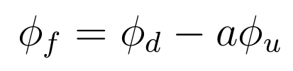
Optimal Gain Feedforward/back
Optimal feedforward/feedback with gain a:

Slide 4
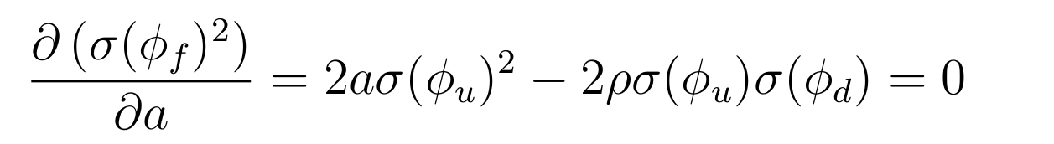
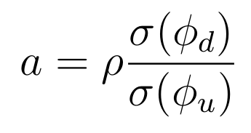
Optimal Gain Feedforward/back
Differentiate to find optimal value of a:

Slide 5
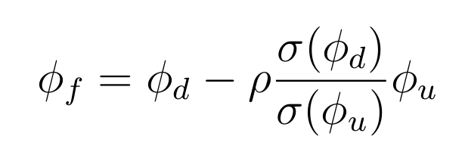
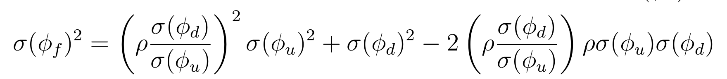

Optimal Gain Feedforward/back
DOWNSTREAM PHASE / BUNCH 2 JITTER
WITH OPTIMAL GAIN

Slide 6
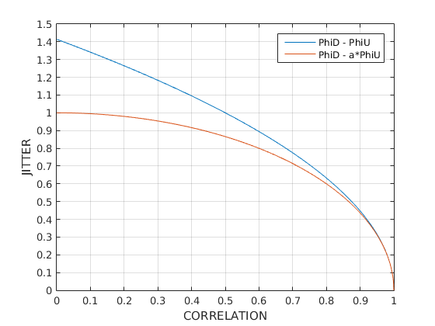
100% Gain vs. Optimal Gain
Jitter can be reduced for correlations below 50%.

Slide 7
Prediction compared to Feedforward Results
Best results last year: 2 degrees downstream jitter reduce to 1.4 degrees with 50% correlation.
Equation predicts that 70% correlation is required to reduce the jitter by 30%...
Correction was larger than theoretical limit?

