Slide 1
Testing the first Mainz SMD-HBU
Sascha Krause
Johannes Gutenberg-Universität Mainz
CALICE Collaboration Meeting, MPP Munich
Sep. 10, 2015
Norman Bhatti, Volker Büscher, Julien Caudron, Phi Chau, Reinhold Degele, Karl-Heinz Geib, Yong Liu, Lucia Masetti, Anna Rosmanitz, Ulrich Schäfer, Stefan Tapprogge, Rainer Wanke

Slide 2
Testing the first Mainz SMD-HBU
Outline:
Measurements performed in Mainz
  Obtaining Pedestal and Gain Values
    Comparison to Gain Values at DESY April Testbeam
  Measurement of Muons in Cosmic Ray Test Stand
    Determination of MIP Response
Measurements performed at DESY April Testbeam
  MIP reponse analysis steps
  Investigating in understanding long tail
  Estimation of MIP Response
    Comparison
Conclusion

Slide 3
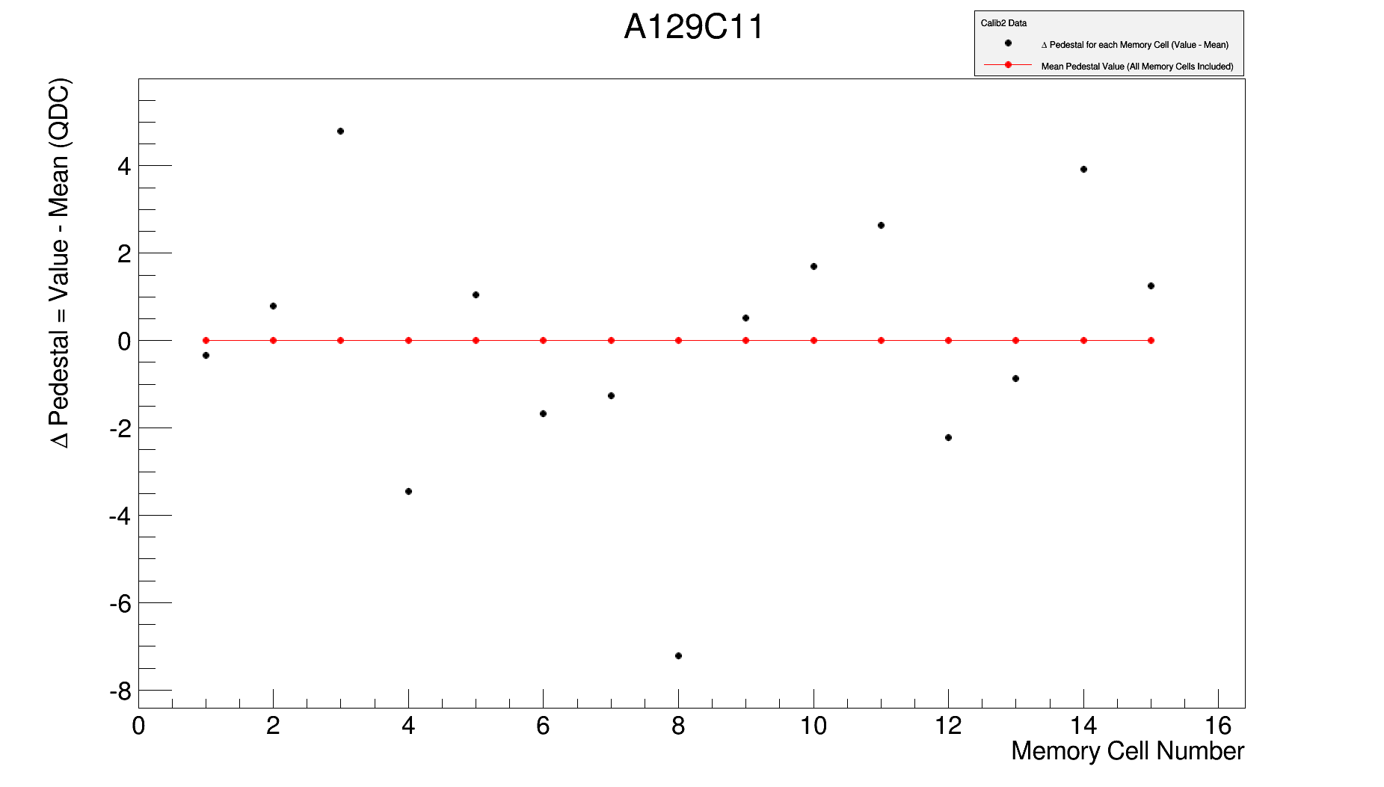
Obtaining Pedestal Values (Example: A129C11)
Reminder:
If a channel on the HBU is hit by a particle, the created electrical charge is stored into a memory cell. For each channel we have in total 16 memory cells (0 – 15). Since DESY April Testbeam only Forcetrigger events are stored in memory cell 0. This cell information is neglected and 15 Pedestal Values per Channel remain.
Obtaining Pedestal Values:
1000 cycles of Pedestal information
HBU operated in external trigger mode.
15 Pedestal values per channel.
Comparison of Pedestal Values:
Difference of Pedestal values for each memory cell from a mean Pedestal value.
Difference between memory cell 3 and 8: 12 ADC tics
Gain is roughly 22 ADC tics/p.e.
Difference corresponds to ~ 0.5 p.e.
By subtracting the pedestal value corresponding to the memory cells separately, one can equalize the memory cells.
memory cell 3
(ADC)
difference : ~ 12 ADC tics
memory cell 8

Slide 4
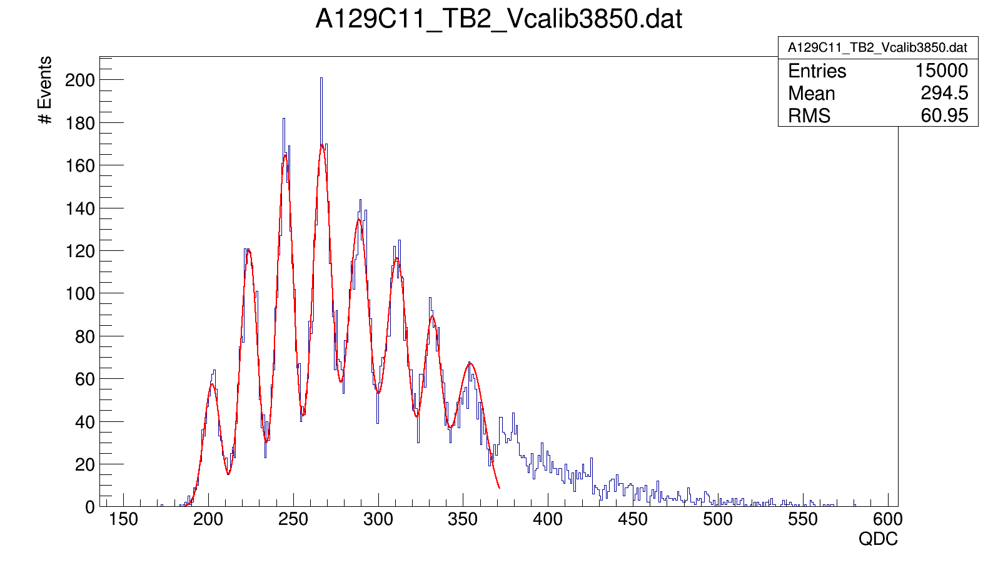
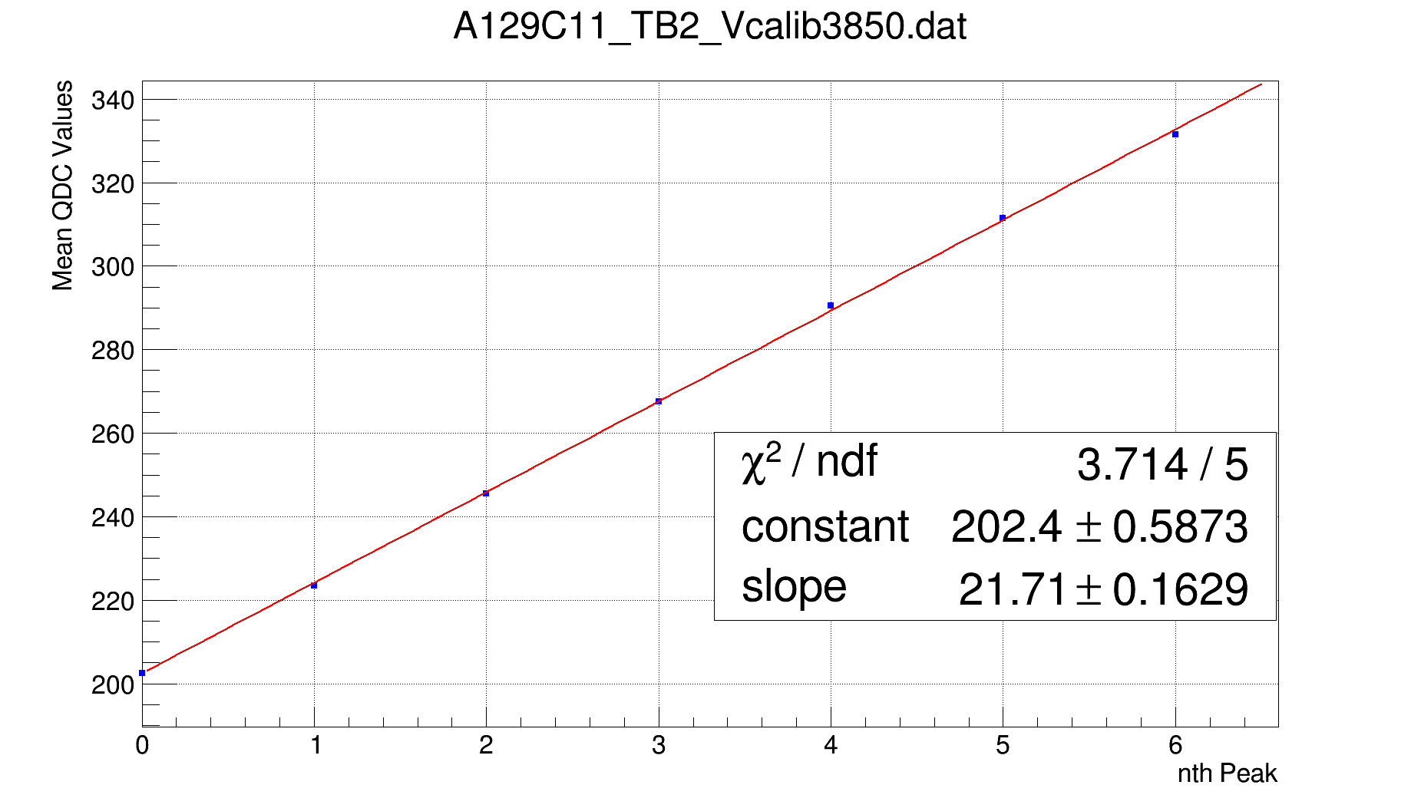
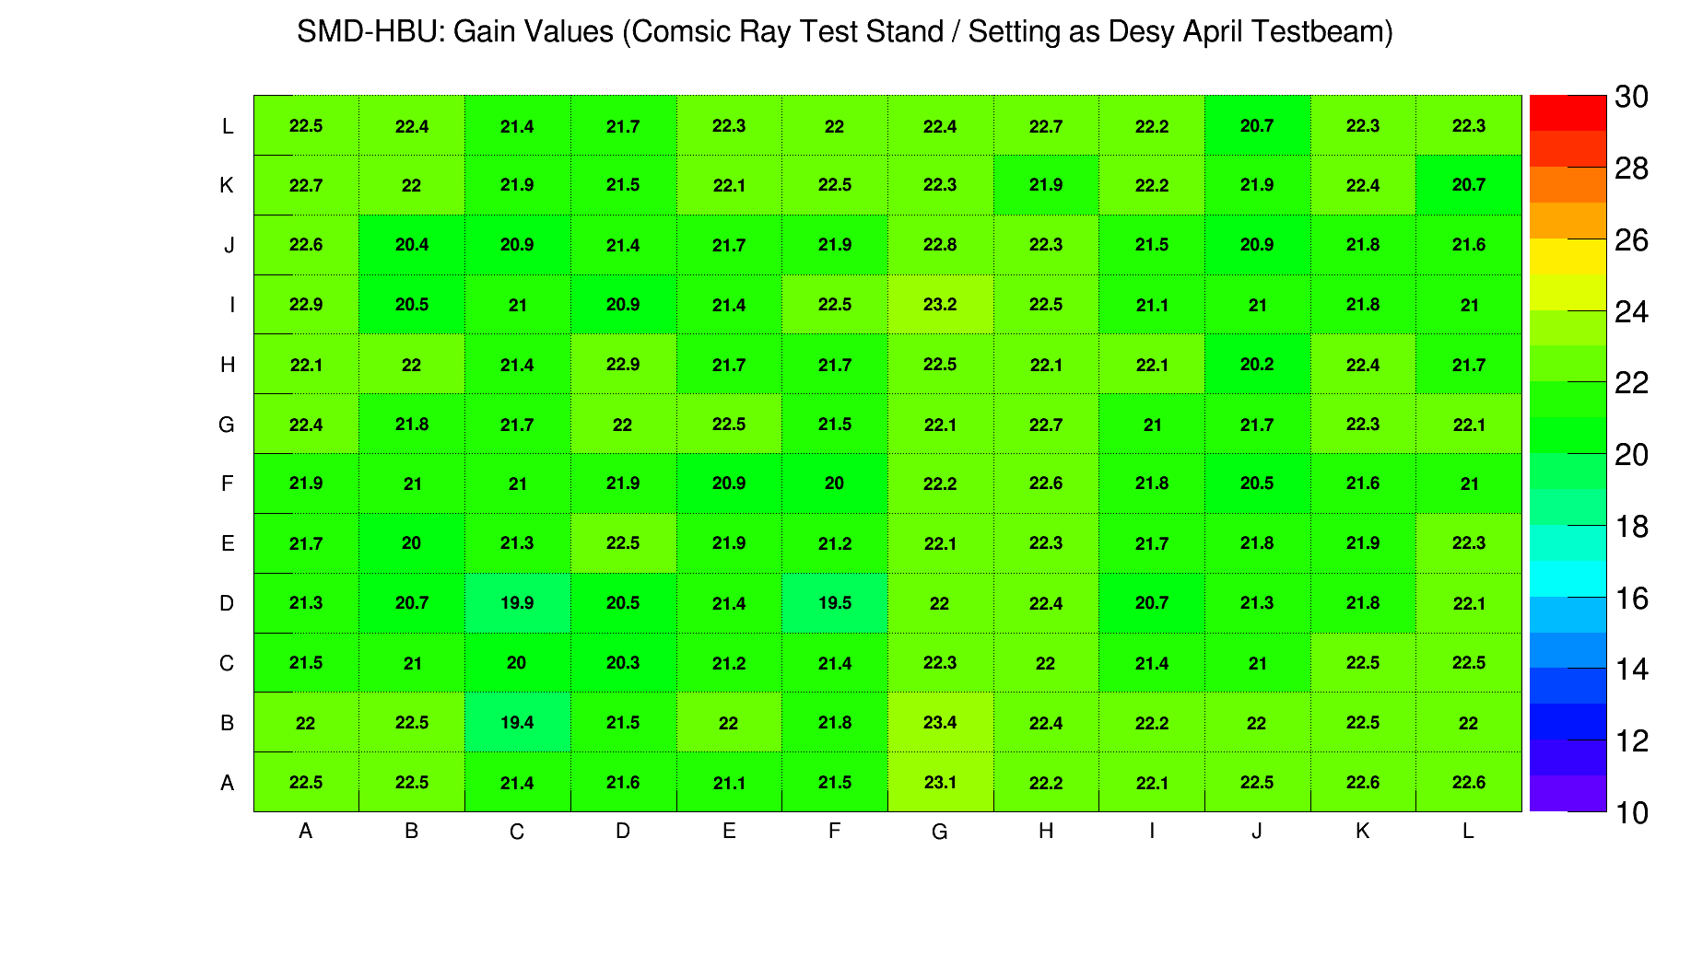
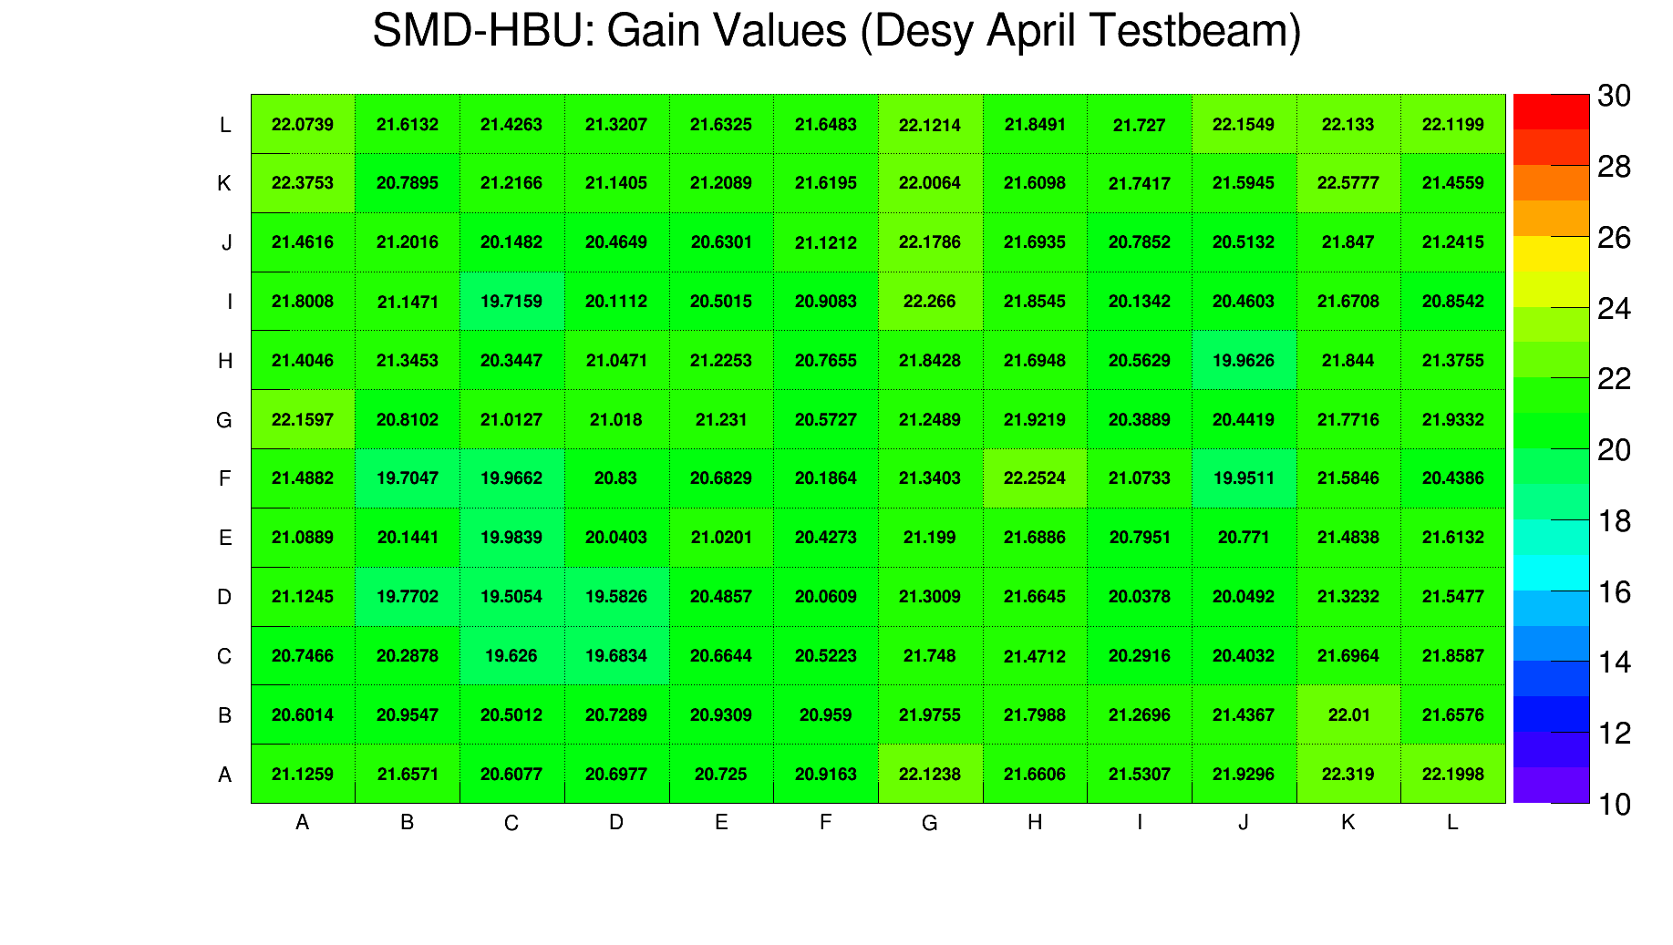
Obtaining Gain Values (Example: A129C11)
Procedure:
Plot Single Photon Spectrum (SPS)
Find peaks in spectrum and get distance between neighboring peaks. (ROOT Peakfinder)
As long as Peak to Peak distance is within a certain range → Store Peak position
Apply linear fit to stored Peak positions → Obtain Gain.
Additional: Use information from ROOT Peakfinder to fit a sum of Gaussian Distributions to the spectrum.
ADC
Mean ADC Values
Both maps verify good uniformity of Mainz SMD-HBU
Gain Values obtained at Desy April Testbeam
A129C11

Slide 5
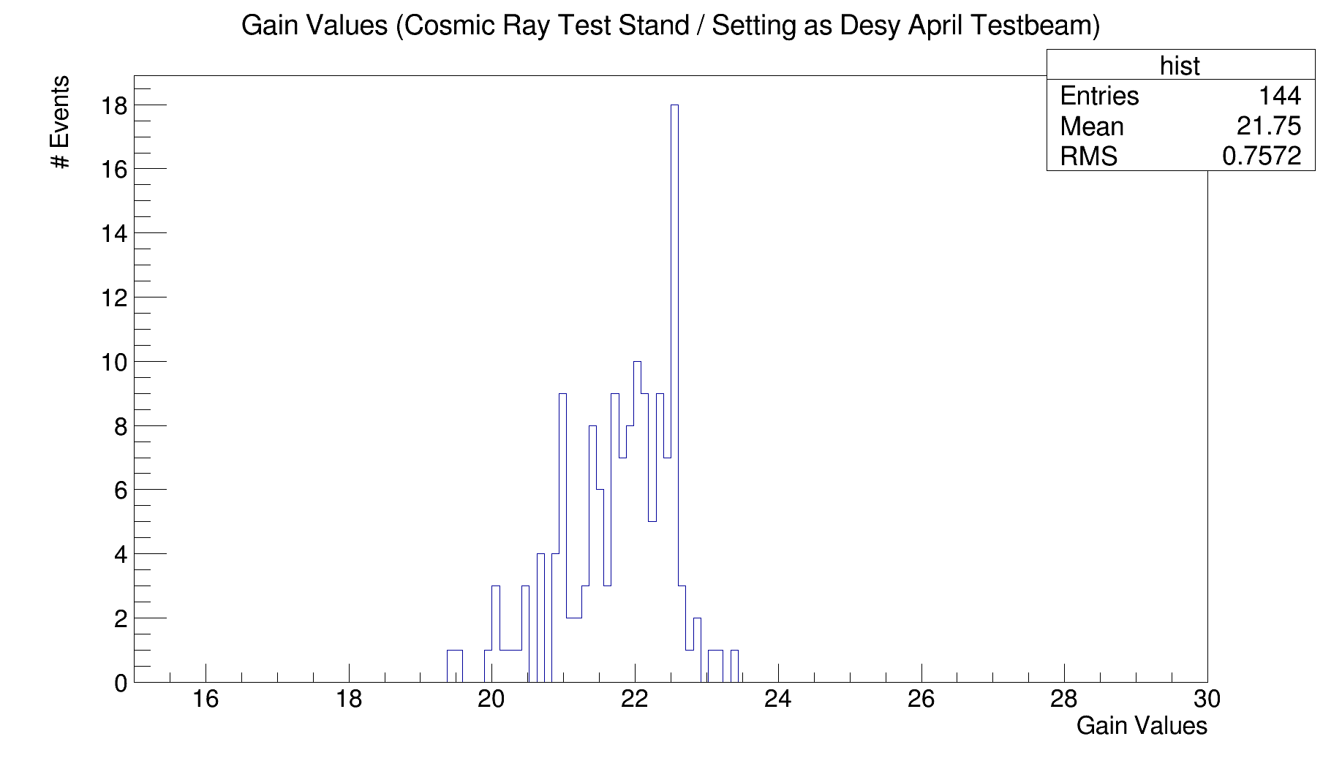
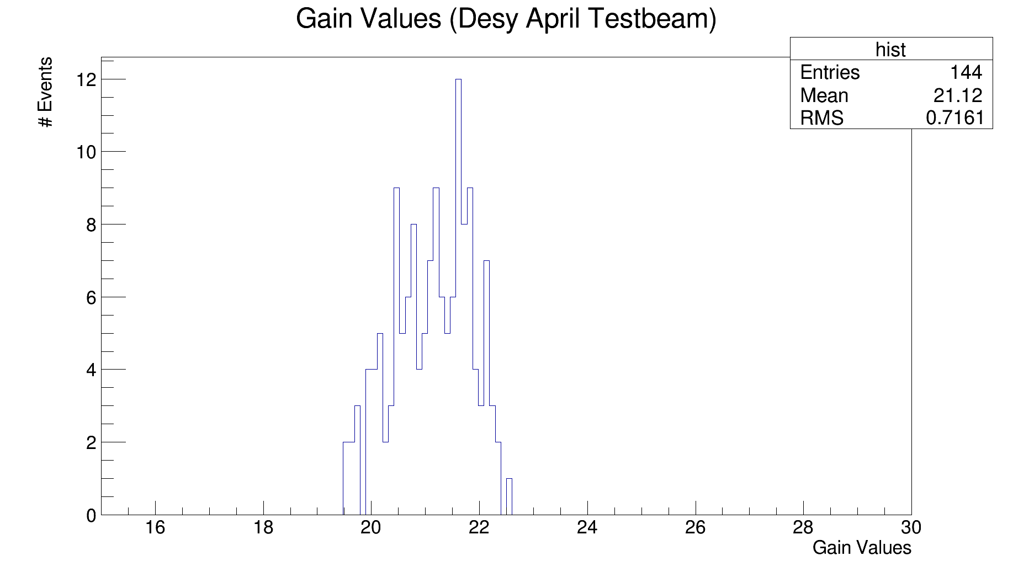
Compare Gain Values obtained at Cosmic Ray Test Stand & Desy April Testbeam
Gain Values obtained in Mainz are slightly higher than the ones obtained in the Desy April Testbeam.
A possible cause for this difference might be the different temperature present in the Cosmic Ray Test Stand and the Desy April Testbeam.
~ 22
Cosmic Ray Test Stand
Sensor | Average Temp. [°C]
T1 | 26.95
T2 | 26.02
T3 | 25.48
T4 | 25.17
T5 | 25.30
T6 | 25.12
Temperature difference between Cosmic Ray Test Stand and Desy April Testbeam possible

Slide 6
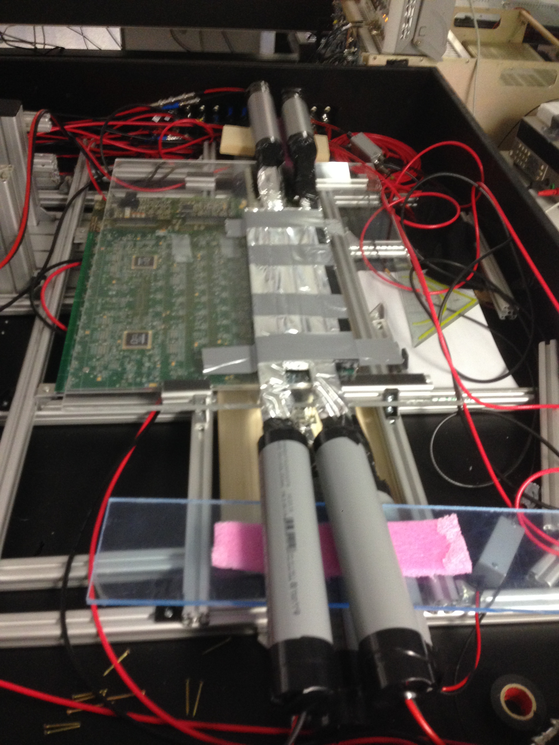
Measurement in Cosmic Ray Teststand
Experimental Setup:
1.2 cm Trigger Scintillator
0.8 cm Plexiglas
6.8 cm
8.8 cm
~ 0.4 cm SMD - HBU
1.2 cm Trigger Scintillator
1.8 cm Wooden Panel
SMD - HBU
For the measurement 4 trigger scintillator strips were used on top as well as on the bottom.
3 different configuration were needed to cover the whole SMD-HBU.
Several data acquisition runs were performed for each configuration. Information was combined later on. In total we measured:
Config 1 → 1.625.000 Cycles
Config 2 → 1.310.000 Cycles
Config 3 → 1.595.000 Cycles
Config 1
Config 2
Config 3

Slide 7
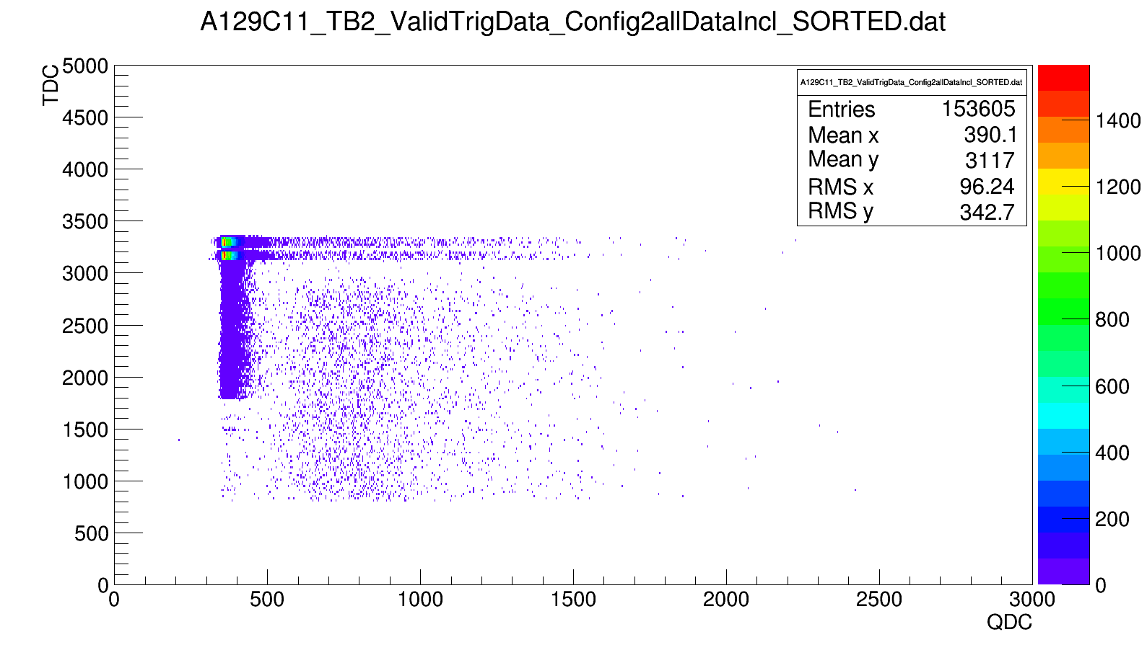
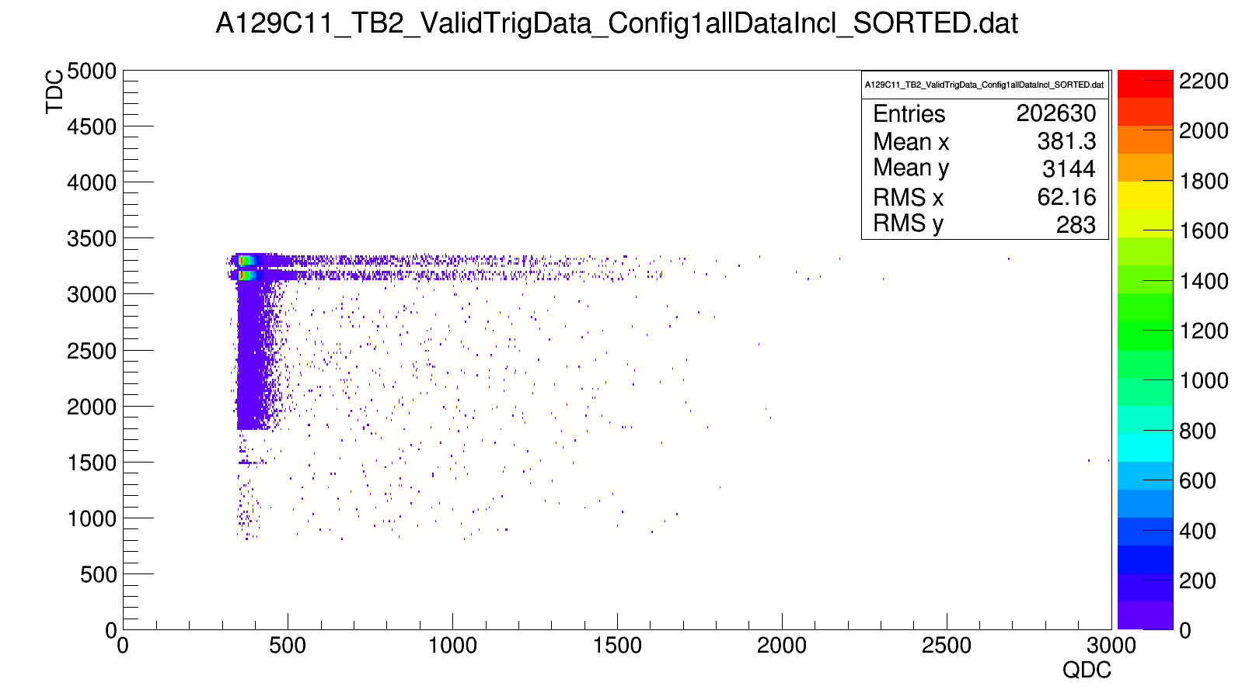
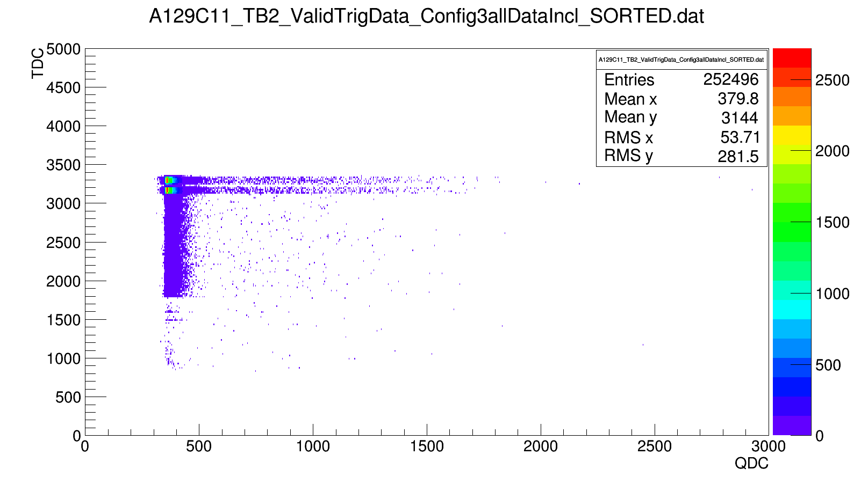
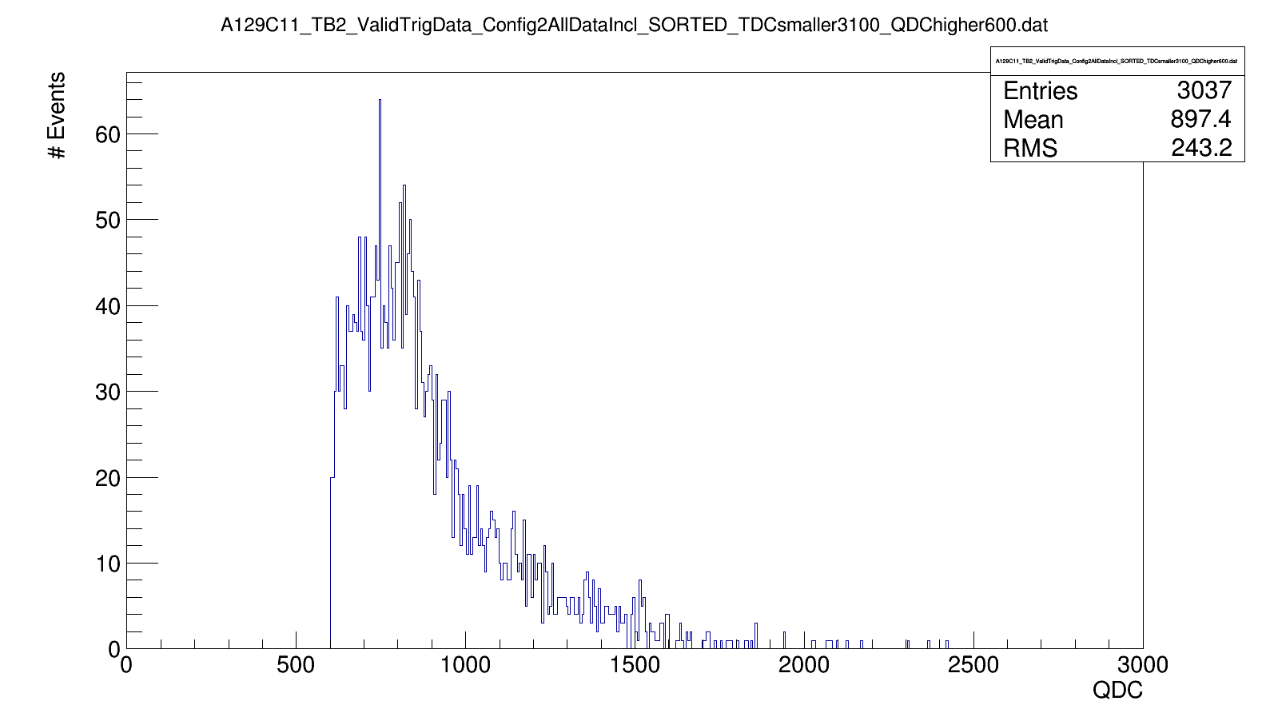
Measurement in Cosmic Ray Teststand
Config 2 (A129C11 triggered)
Config 1: A129C11 not triggered
TDC cut mandatory to resolve Mip events
TDC ~ 3100
ADC
Mip-Entries expected, only if channel was triggered
ADC ~ 600
Config 3: A129C11 not triggered
ADC
Histogram for channel A129C11 with:
TDC < 3100
ADC > 600
Note:
requiring ADC > 600 is enough to separate Mip-events from DCR events for all channels.
ADC
ADC

Slide 8
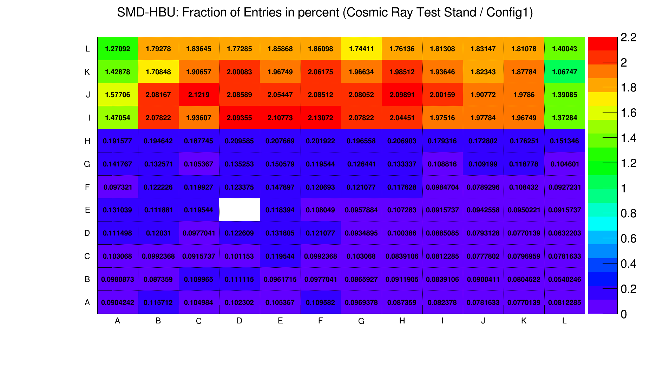
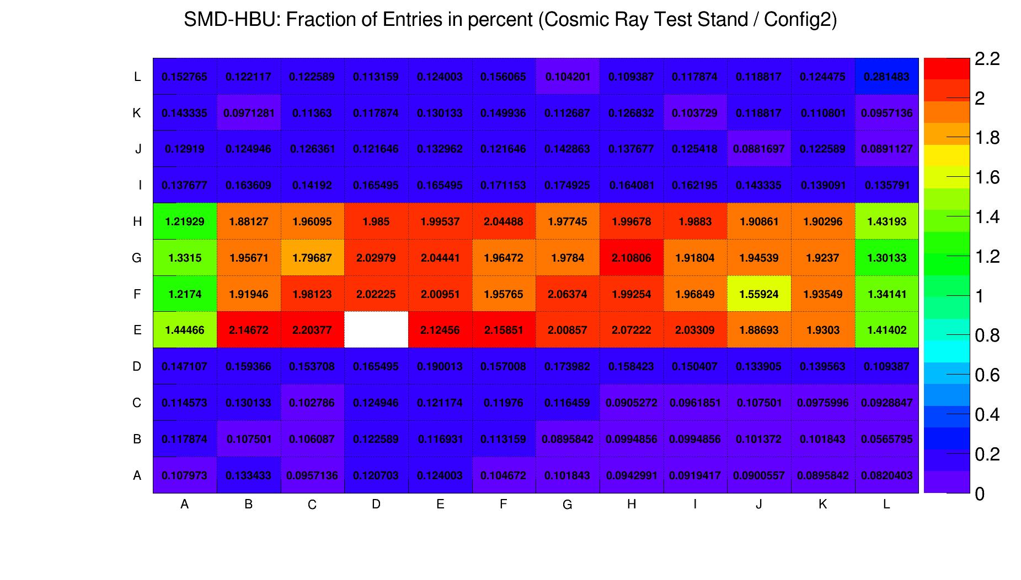
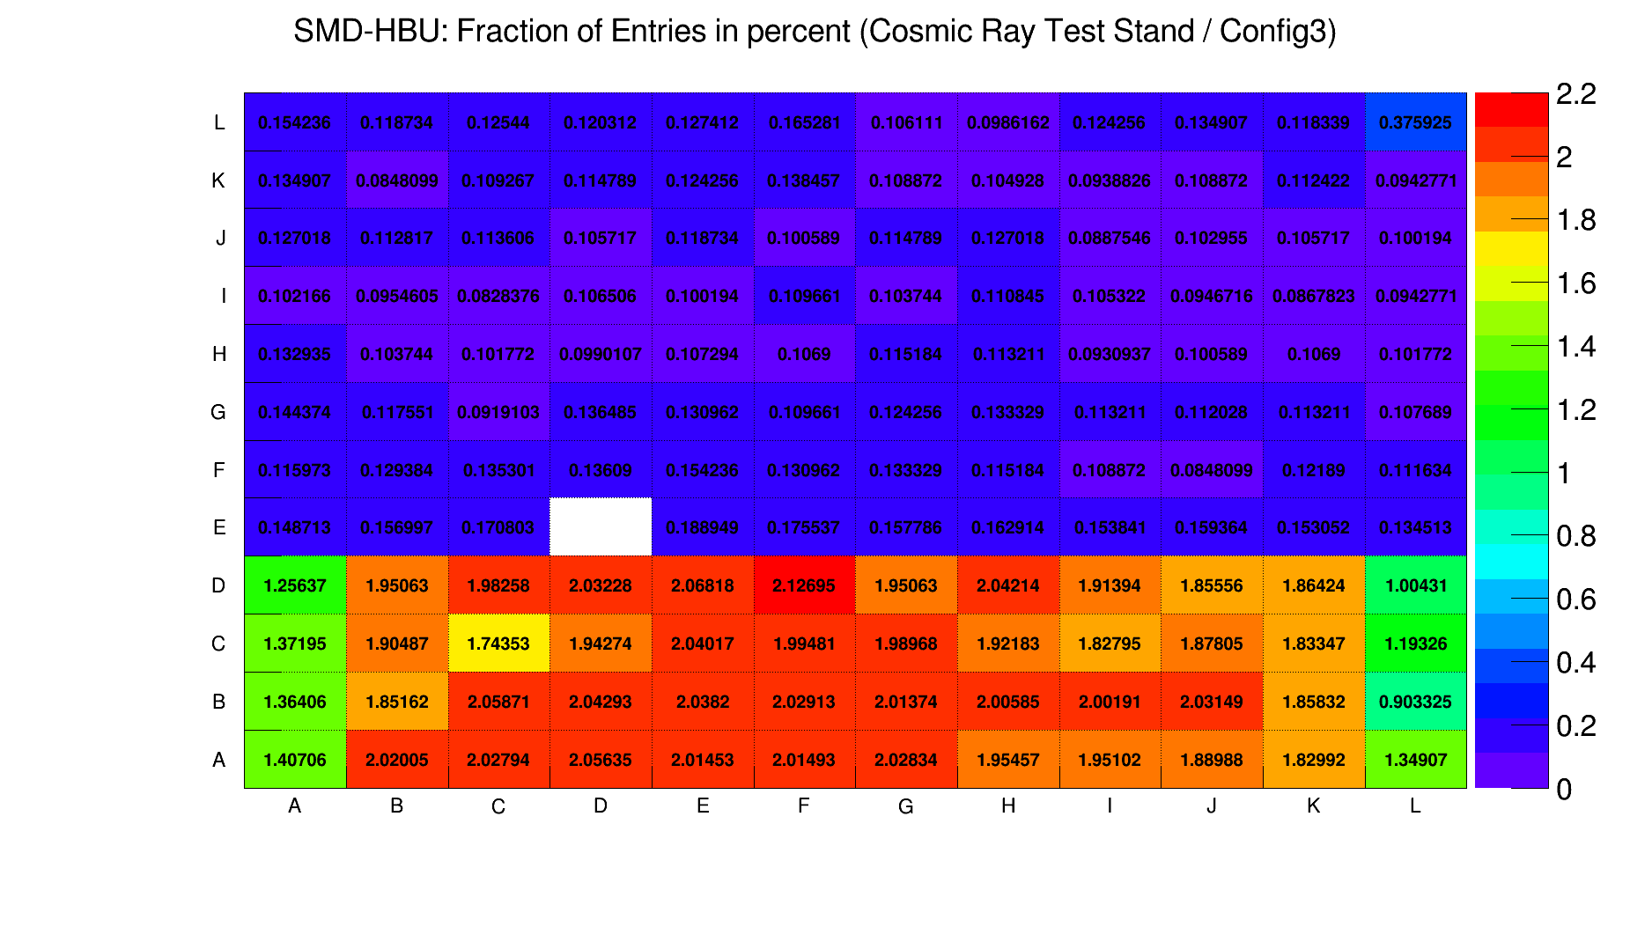
Measured MIP events in Cosmic Ray Teststand
To resolve the MIP events a cut with ADC > 600 and a ASIC dependend TDC cut was applied to the measured data.
Entries as fraction of the total entries in percent.
ASIC dependent TDC cut:
A129 → TDC < 3100
A130 → TDC < 3200
A131 → TDC < 2700
A132 → TDC < 3150
Total entries with ADC > 600 & TDC cut:
Config 1 → 260.992 entries on whole HBU
Config 2 → 212.091 entries on whole HBU
Config 3 → 253.508 entries on whole HBU
Note:
white spot on map: A132C26 (broken channel)
Less entries measured on the left and right edge of the SMD-HBU for each configuration due to the geometrical acceptance angle.
Geometrical Acceptance:
Trigger Scintillator
SMD-HBU
Trigger Scintillator

Slide 9
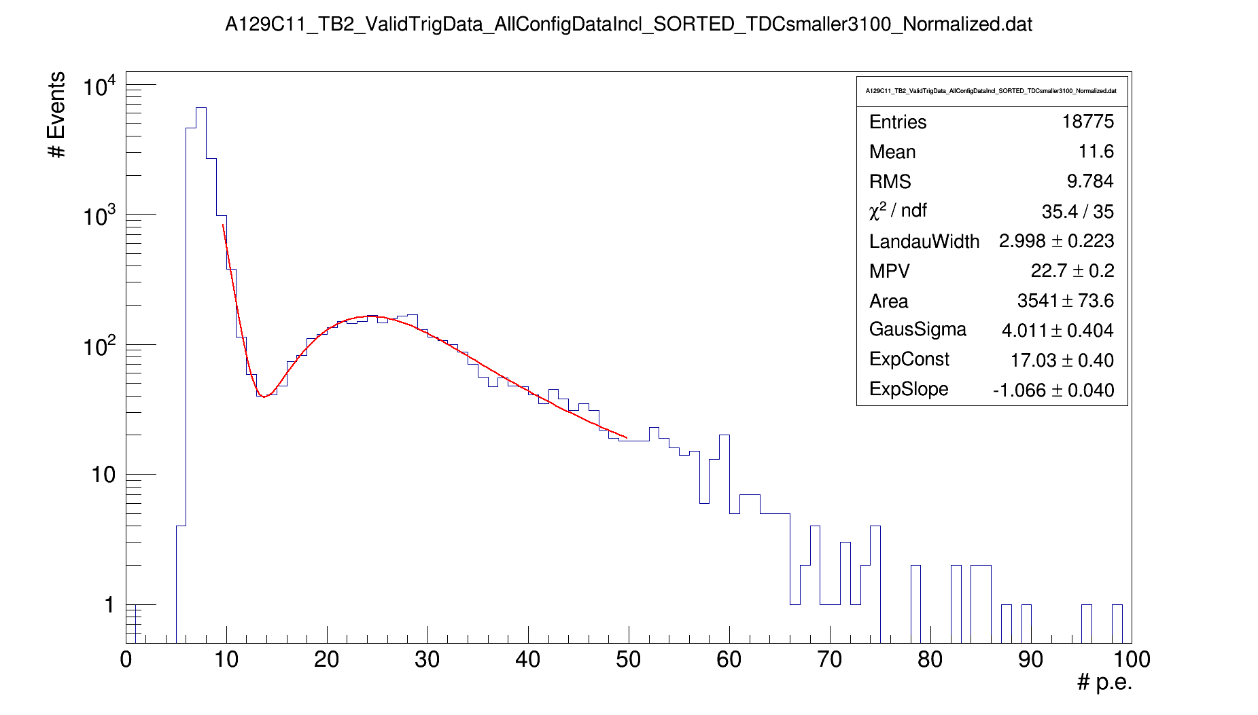
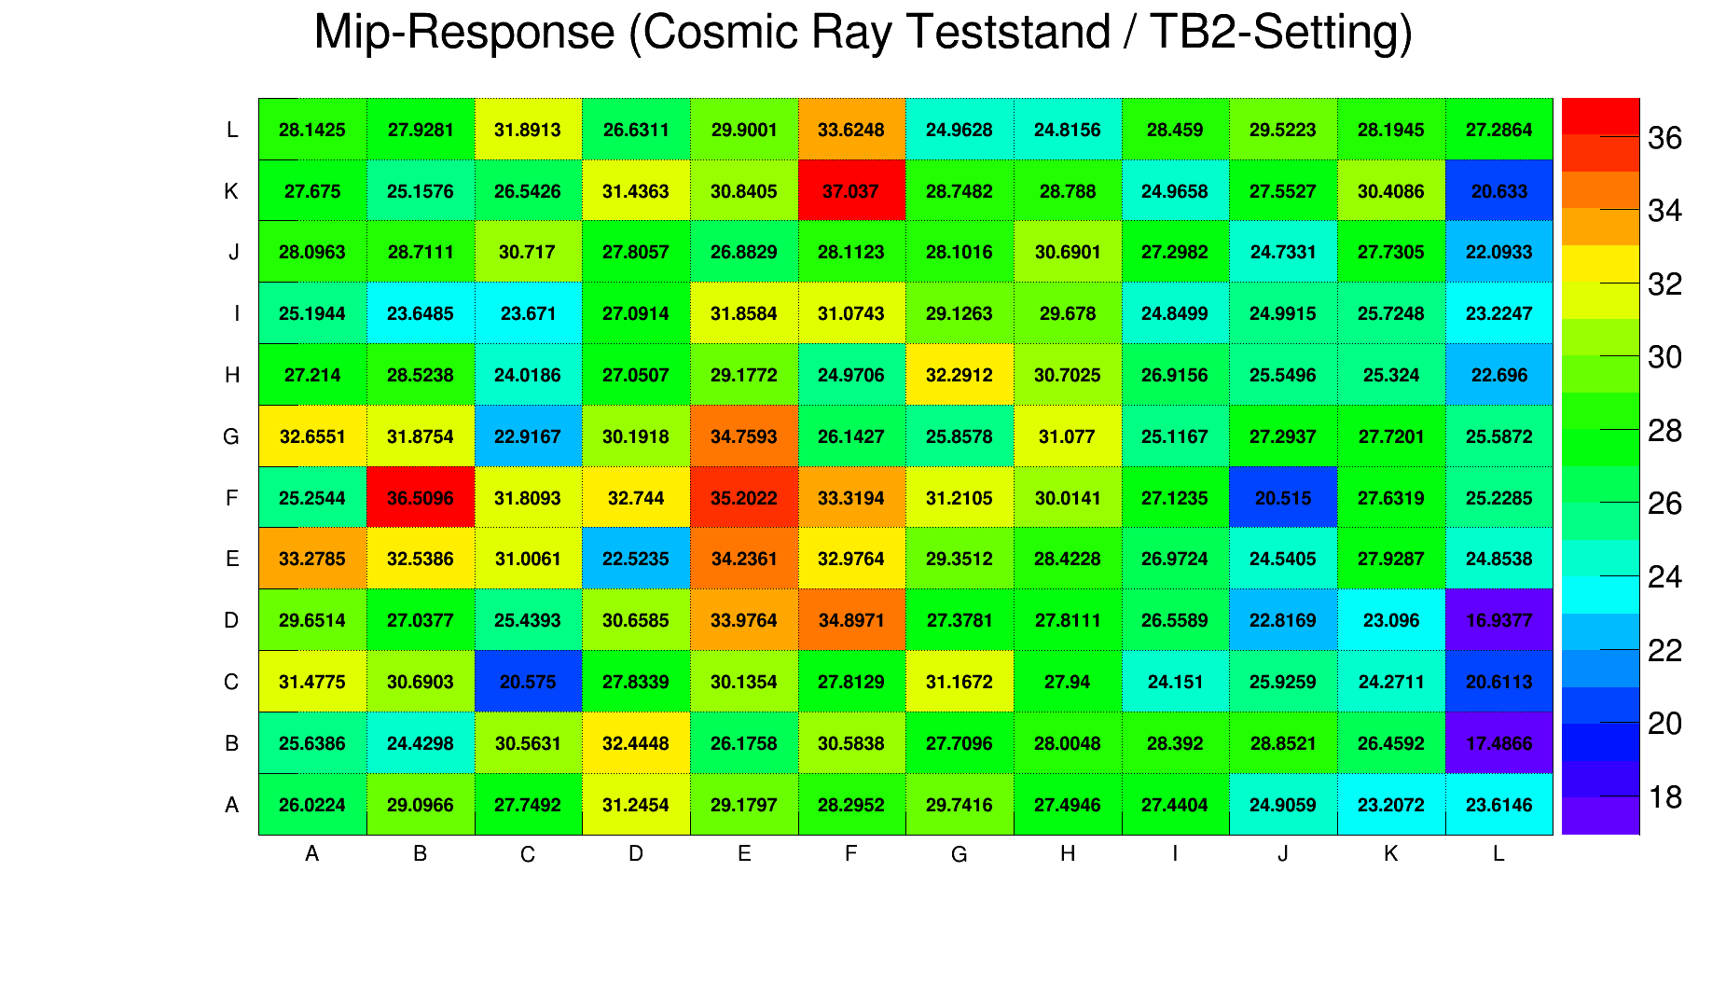
Determination of MIP response (Example A129C11)
Procedure:
Data with (ASIC dependend) TDC cut is plotted
Spectra is fitted with the sum of an exponential (two parameters) and a Landau-Gaussian convoluted function.
MIP response equals the MPV of the Landau-Gaussian convoluted distribution
T6
T4
Possible reason for lower MIP response on the right edge of the map: Temperature ?
Sensor | Average Temp. [°C]
T1 | 30.44
T2 | 29.96
T3 | 27.70
T4 | 27.55
T5 | 27.87
T6 | 26.82
T5
T3
Power CALIB DIF
T1
T2

Slide 10
Measurement at DESY April Testbeam (Airstack)
MIP response analysis steps
Reconstruction from raw data into ROOT data using pedestal subtraction
Find channel number of Beam Position (maximum energy deposited in one Run)
Add all energies in all cycles to histograms, where IJ(K) position = IJ of Beam
Convert from ADC to p.e. -> ADC/gain
Applying selections
Landau-Gaussian fit
J
K=Layer
I
How it looks like after step 3:
MIP
peak
Layer 1
Layer 2
Layer 3
Layer 4
Layer 5
Mainz SMD
DAQ
Shower
Multiple MIPs
…?
Gap due to high &
low gain switching
Large tail ?

Slide 11
Measurement at DESY Testbeam (April)
Applying Selections
Large tail
Many entries for higher Energies than MIP-Energy in late layers (4 & 5), maybe due to shower production?
Need for explanation and correction/selection
First Step: Checking Neighbors
Neighbor definition:
N1
Large tail?
N4
Beam
Position
N2
N3

Slide 12
Measurement at DESY Testbeam (April)
Checking Neighbors
Within MIP Peak: 20pe < E < 40pe
Higher than MIP: 40pe < E < 200pe
~71%
~61%
N1
N4
Beam
Position
N2
~31%
~24%
N3
~4%
~7%
All neighbor energy hits, if there was a hit at beam position:
Looks like there are events with more than one MIP
Next step: Check TDC differences

Slide 13
Measurement at DESY Testbeam (April)
N1
Checking Neighbors:
TDC Difference (tdc_n - tdc_mip) for neighbor n=1 to 4
N4
Beam
Position
N2
N3
Layer 5
Neighbor 1
Layer 5
Neighbor 2
quantified
Δtdc ≈ 1µs
Layer 5
Neighbor 3
Layer 5
Neighbor 4
The time difference Δtdc equals the DESY II revolution frequency of 1 MHz
Sometimes more than one electron is shot at the detector within the open time window

Slide 14
Measurement at DESY Testbeam (April)
Selections to reduce shower / multiple events
Track finder in all layers: min 1 .. 4 hits in line in beam position
Reducing maximum allowed number of hits per event
Number of Events left
Number of Events left
min 1 hit in
beam position
min 2 hits in
beam position
Results:
Without selections, ratio between #MIP/#all is ≈ 48%
Including selections, the ratio can be increased up to 90% while statistics decrease
Chosen selection:
  min. 4 hits in line
  ~71% #Mip/#all
  acceptable statistics
Ratio #MIP / #all
Ratio #MIP / #all
Number of Events left
Number of Events left
min 3 hits in
beam position
min 4 hits in
beam position
Ratio #MIP / #all
Ratio #MIP / #all
Chosen selection

Slide 15
Measurement at DESY Testbeam (April)
Selections to reduce shower / multiple events
Track finder in all layers: min 1 .. 4 hits in line in beam position
Reducing maximum allowed number of hits per event
no selection
Results:
Long tail can be significantly reduced by applying event selections
Hint for shower generation
Nearly no effect on most probable value of Landau-Gaussian (≈ MIP Response)
Selection:
min. 4 hits in line
max 50 Hits/ Event

Slide 16
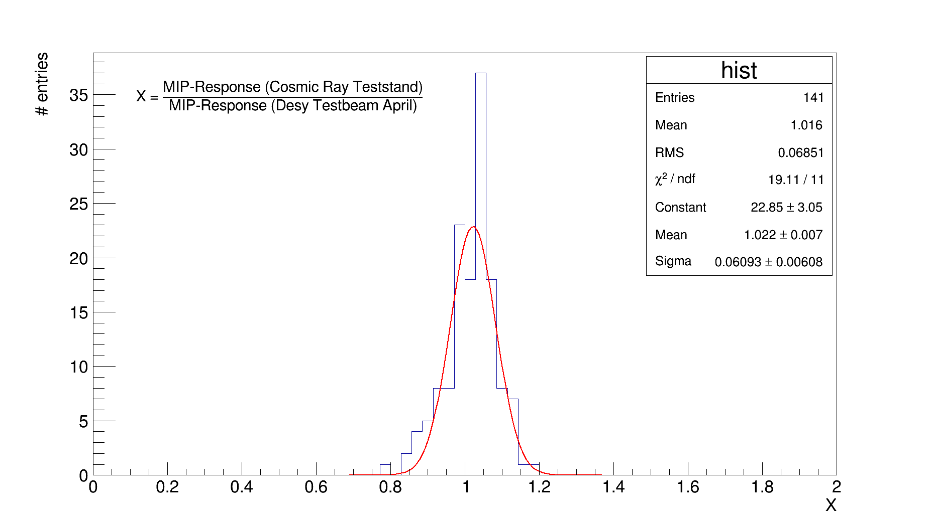
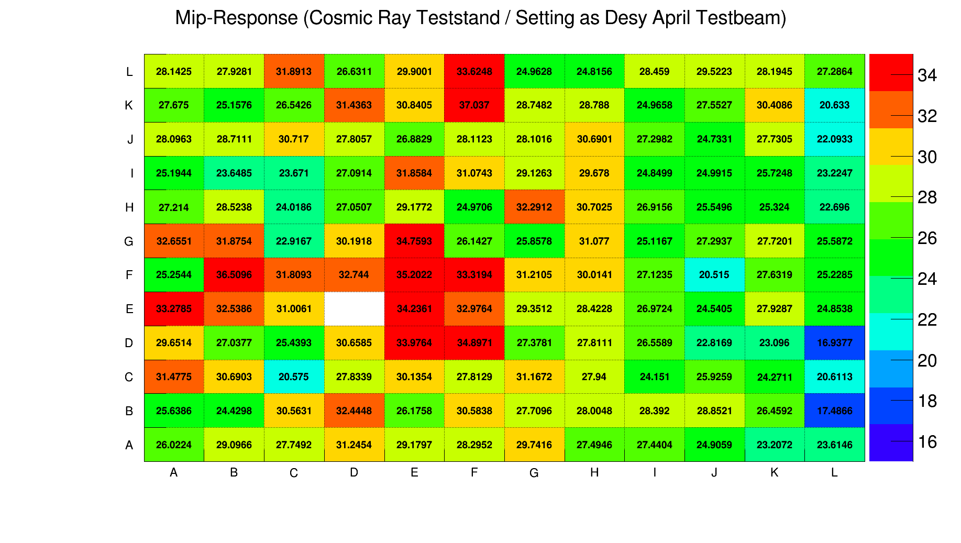
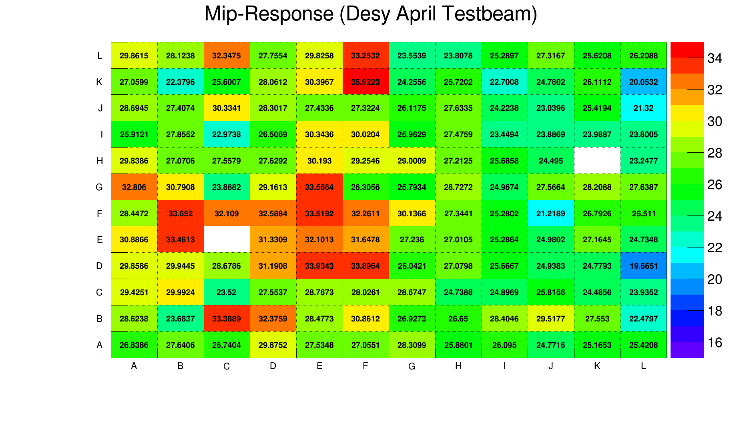
Comparison Mip Response: Cosmic Ray Test Stand & Desy April Testbeam
Measurement of Mip-Response in both cases:
Identical settings (Preamplifier, Bias-Voltage, …)
Mip-Response equals the MPV of the Landau-Gaussian convoluted distribution.
Difference in temperature possible and acceptance angle slightly different.

Slide 17
Conclusion
Cosmic Ray Test Stand:
  allows to measure Pedestal, Gain and MIP response which equal the results of the DESY April Testbeam
  SMD-HBU shows a good uniformity in gain
DESY April TB:
  Neighbor TDC differences show: Sometimes more than one electron is shot at the detector within the open time window
    Should belong to a different event
  Selections like trackfinders reduce large tail in ADC-Spectrum but don’t have large influence on MIP response analysis

Slide 18
Thank you!

Slide 19
Backup

Slide 20
Measurement at DESY Testbeam (April)
N1
Checking Neighbors
Beam
Position
N4
N2
Within MIP Peak: 20pe < E < 40pe
Higher than MIP: 40pe < E < 200pe
N3
~71%
~61%
~31%
~24%
~7%
~4%
All neighbor energy hits:
Energy of…
-1 Hit at beam position without neighbor hit
0 Hit at beam position with neighbor hit
1 1 out of 4 neighbors hit
2 2 out of 4 neighbors hits
3….4….
Looks like there are events with more than one MIP
Next step: Check TDC differences

Slide 21
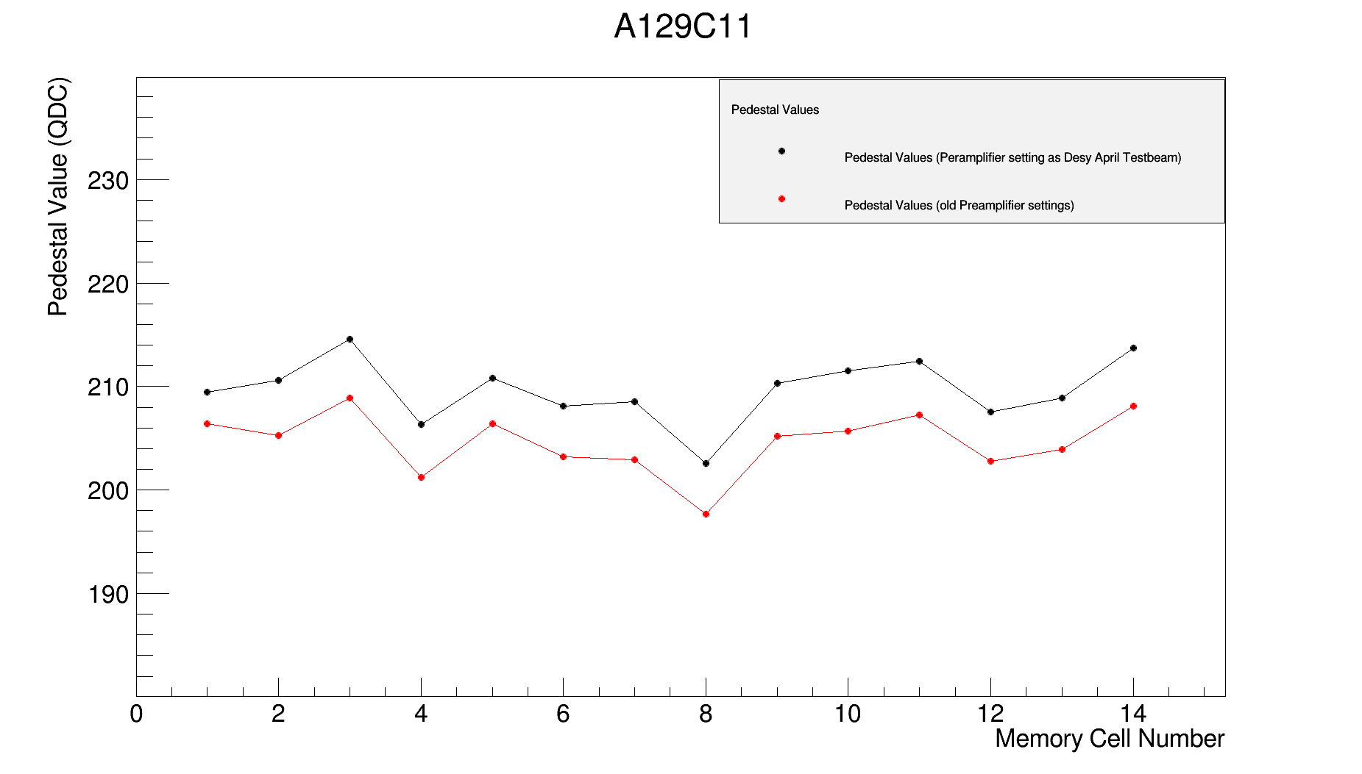
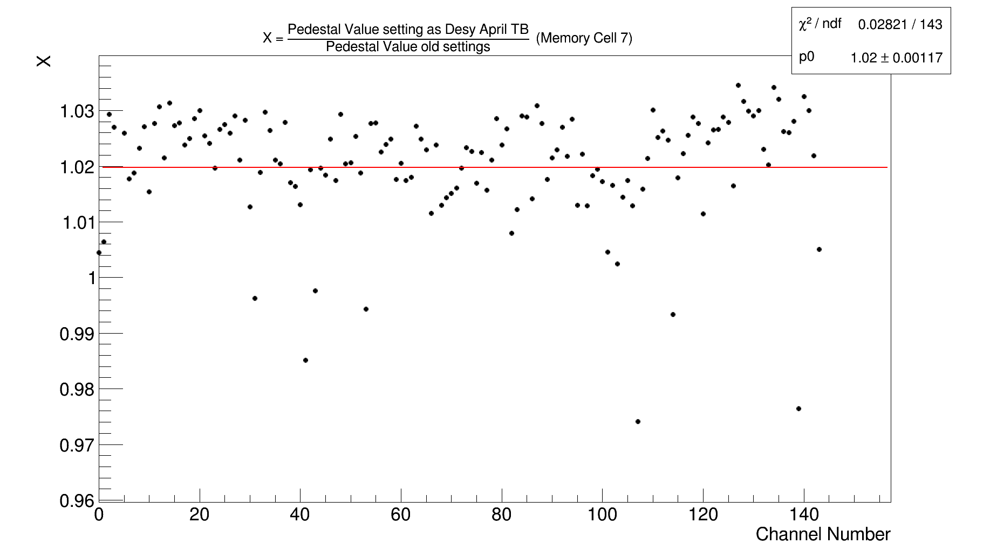
Influence of Preamplifier settings on Pedestal values for each memory cell
Black curve: Pedestal values obtained with preamplifier settings as in the Desy April Testbeam.
Red curve: Pedestal values obtained with „old“ preamplifier settings.
(ADC)
Differences in Pedestal due to change in Preamplifier settings.
Response to the Preampliefier changes is different for each channel.
For almost all channels: black curve is above the red curve.
Ratio between Pedestal values obtained with the same preamplifier setting as in the Desy April Testbeam and Pedestal values obtained with „old“ settings for for memory cell 7.
Red line: linear fit with parameter p0 = 1.02 → 2% difference
X = 1 (no changes in Pedestal)

Slide 22
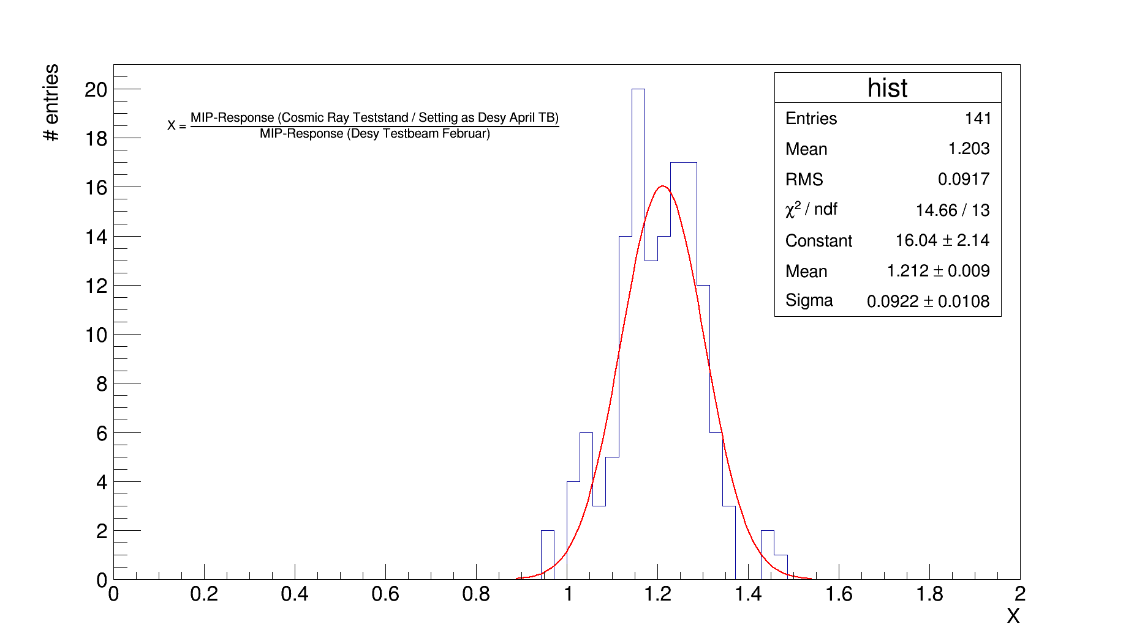
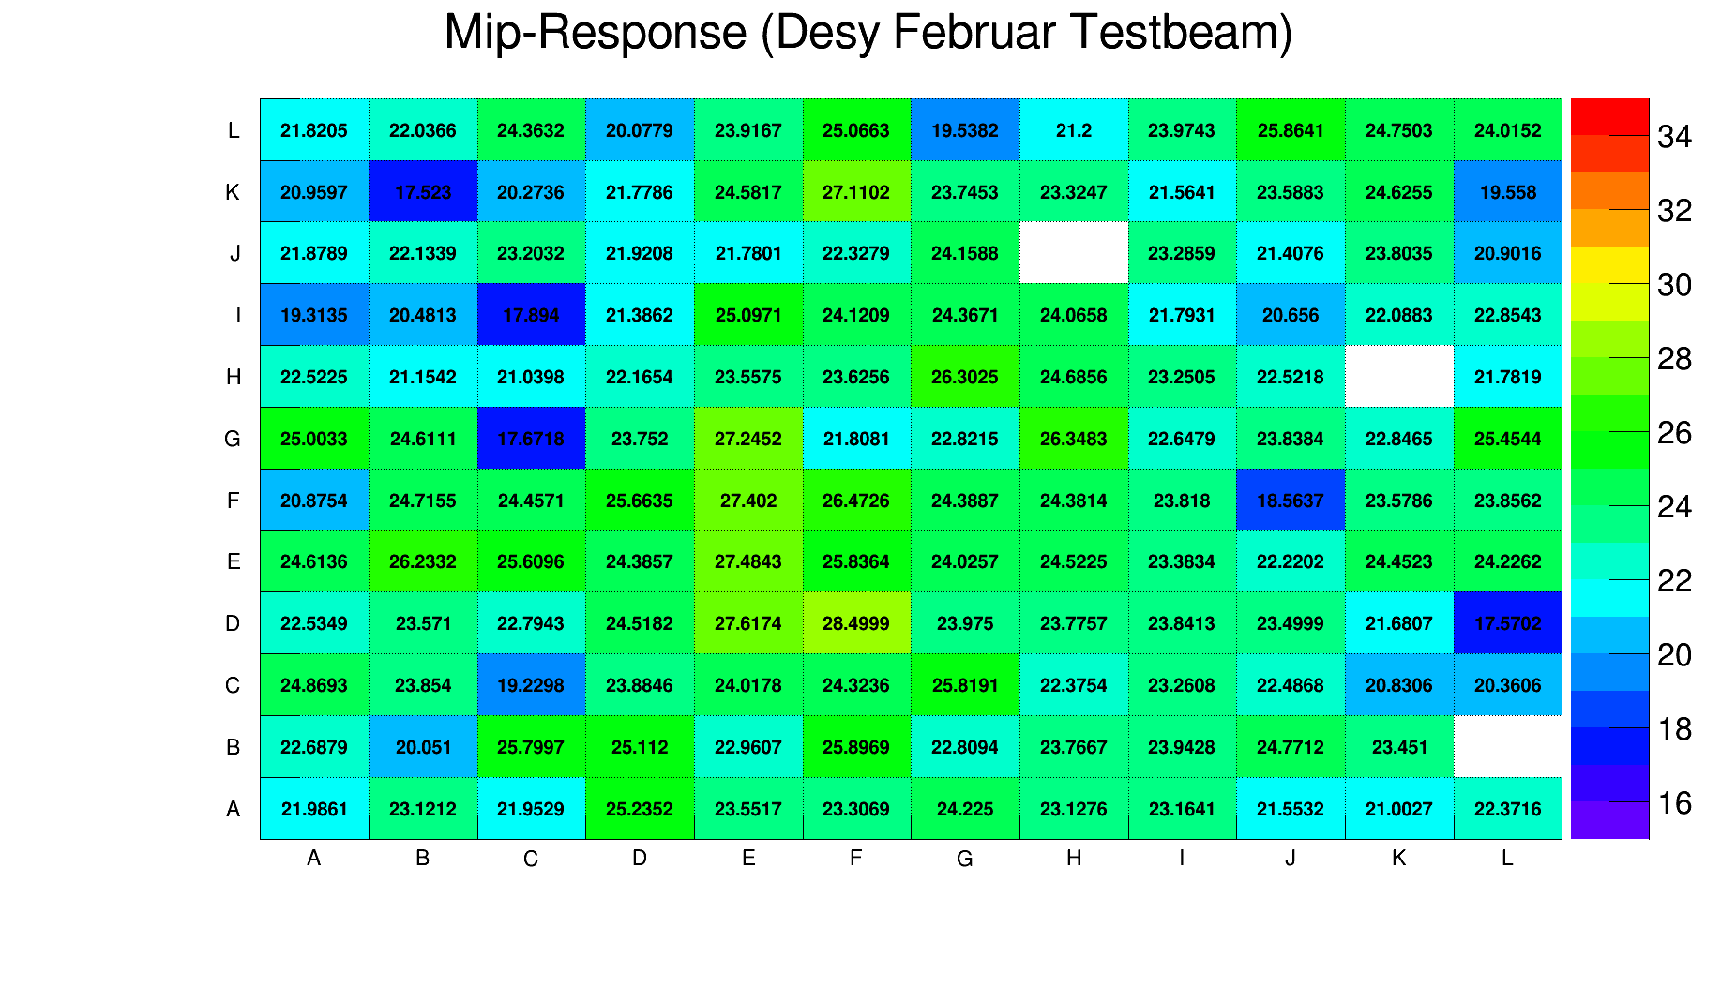
Comparison Mip Response: Cosmic Ray Test Stand & Desy Februar Testbeam
Measurement of Mip-Response in both cases:
Different settings (Preamplifier, Bias-Voltage, …)
Mip-Response equals the MPV of a Landau-Gaussian convoluted distribution (Cosmic Ray Test Stand)
Mip-Response equals the MPV of Landau distribution (Desy Februar Testbeam)
Difference in temperature possible and acceptance angle slightly different.

Slide 23
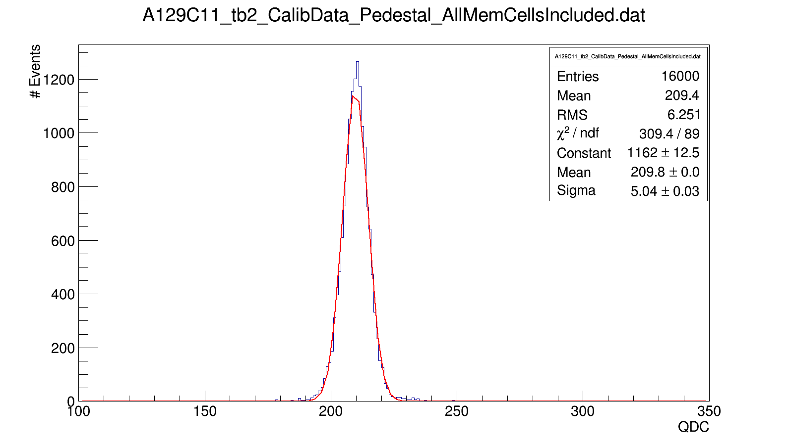
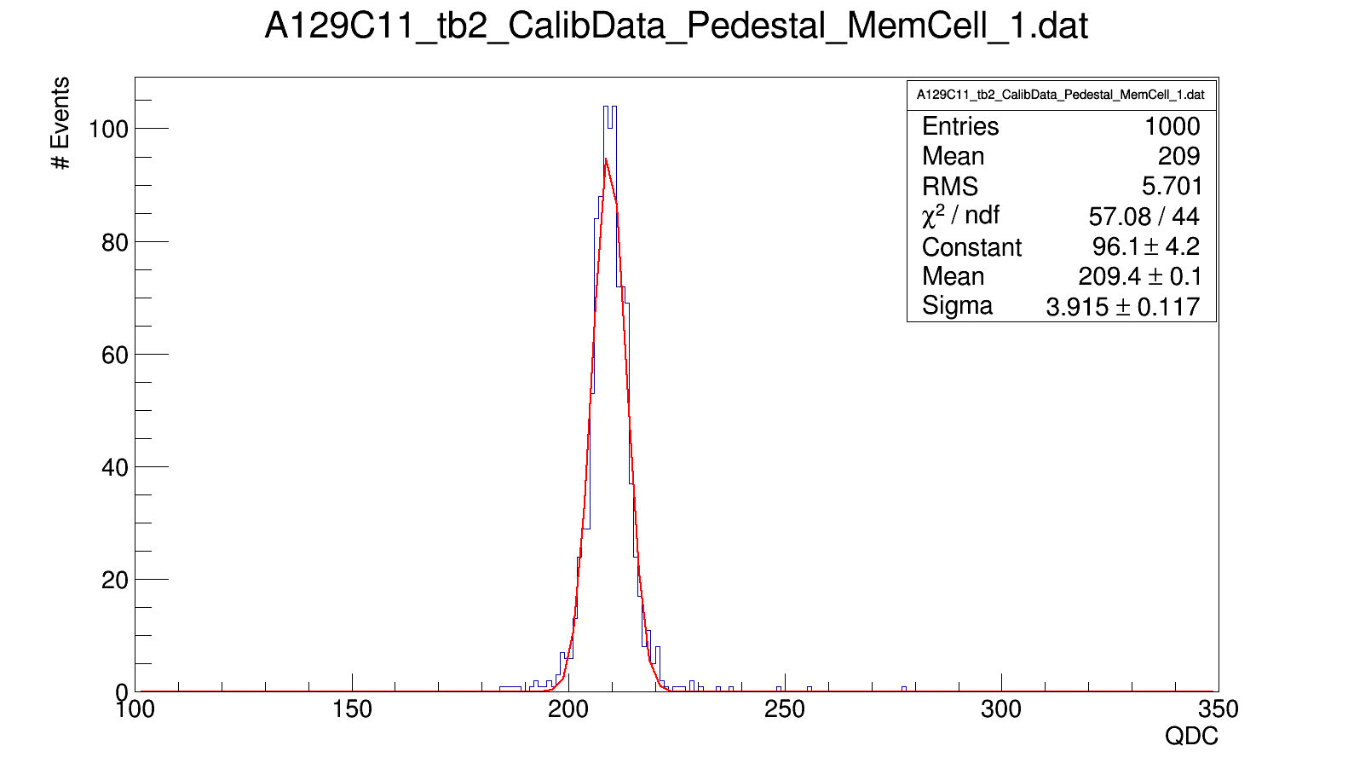
Determination of Pedestal (Example: A129C11)

Slide 24
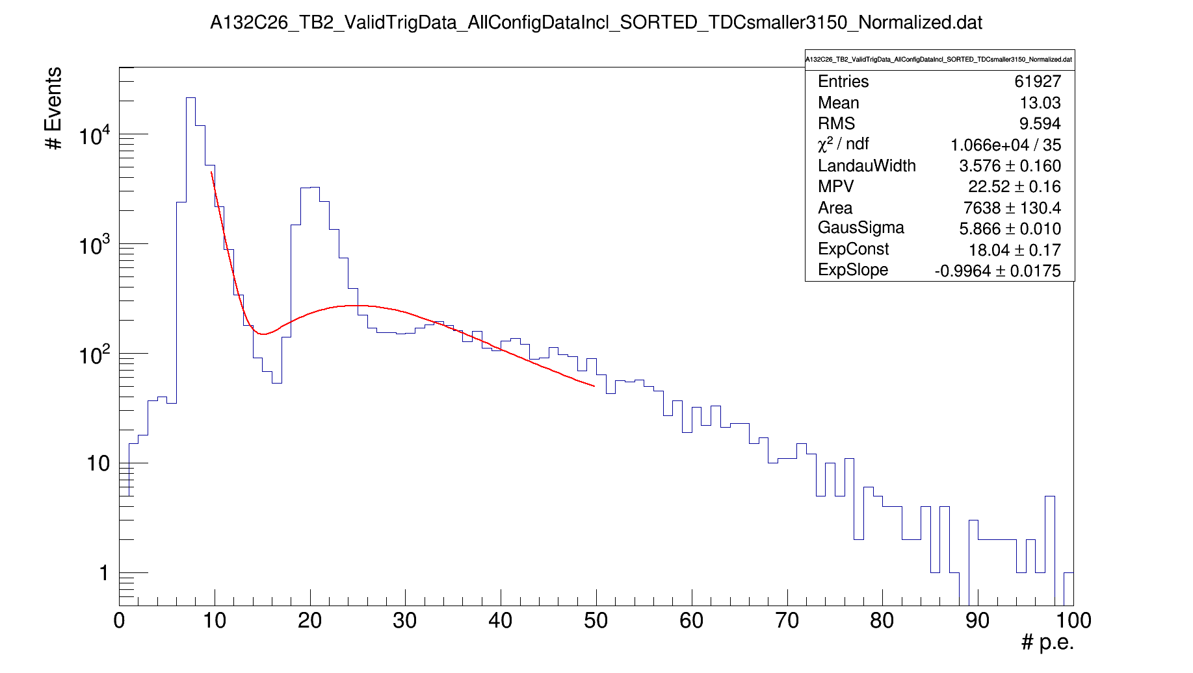
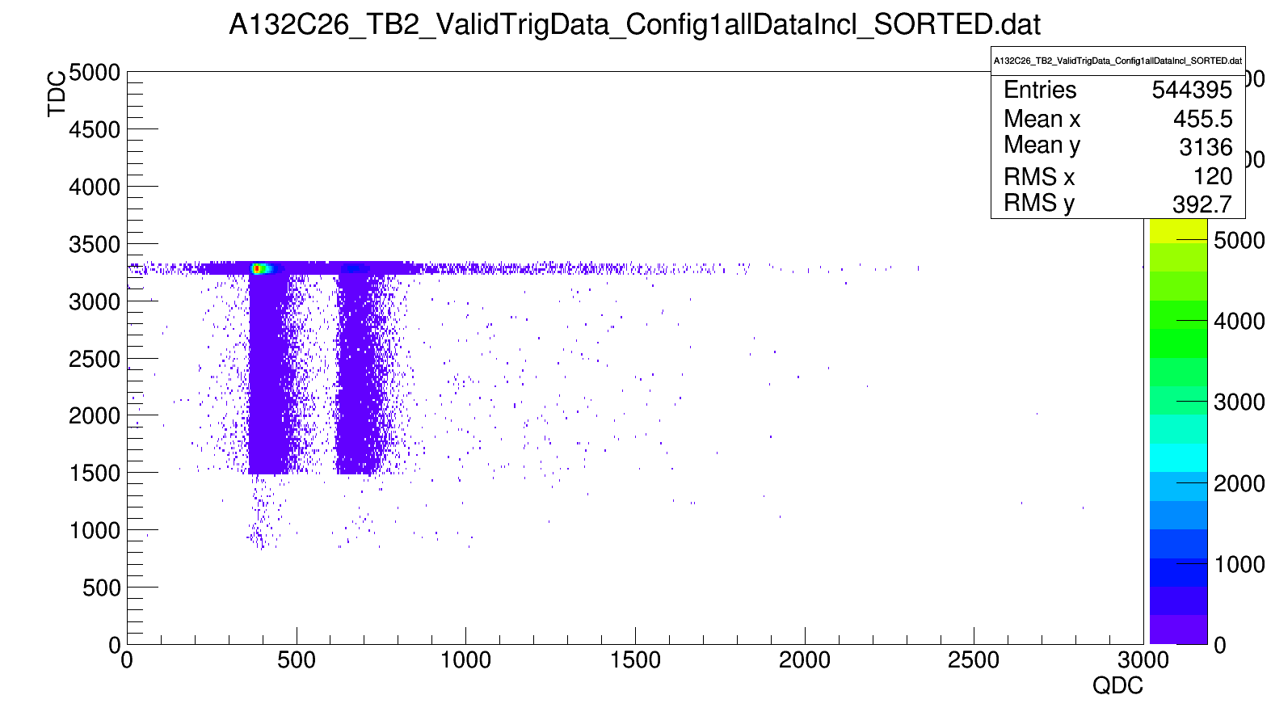
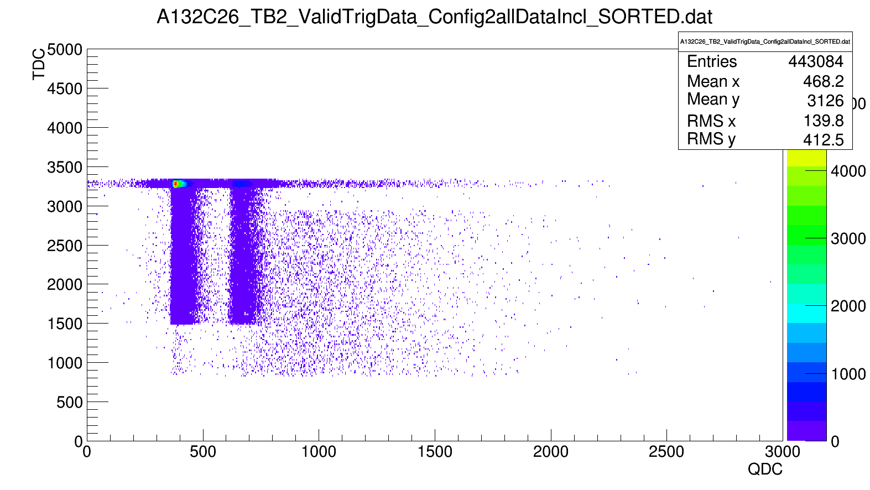

A132C26 (broken channel)

Slide 25
TDC Diff and Energy for Neighbor 1 to 4

Slide 26
Energy spectrum for Abs(TDC_diff)<100
TDC_diff neighbor1 vs TDC_diff neighbor 2
TDC_diff neighbor1 vs TDC_diff neighbor 2/3/4

Slide 27
Energy spectrum for Abs(TDC_diff)<100
Neighbor 1:
Neighbor 2:

Slide 28
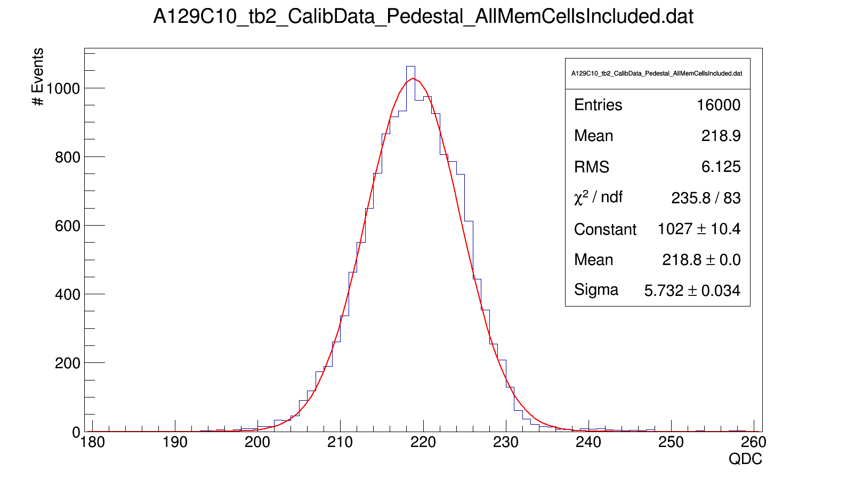
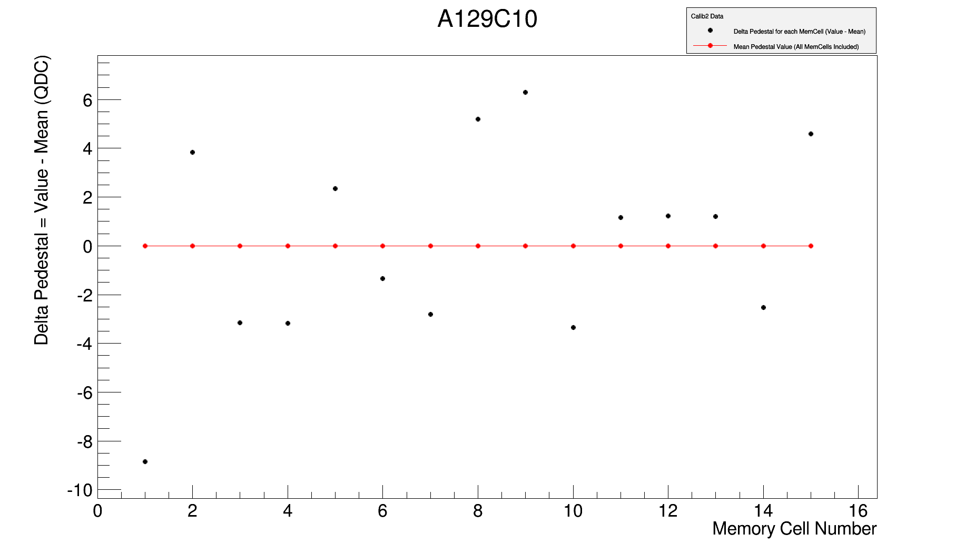
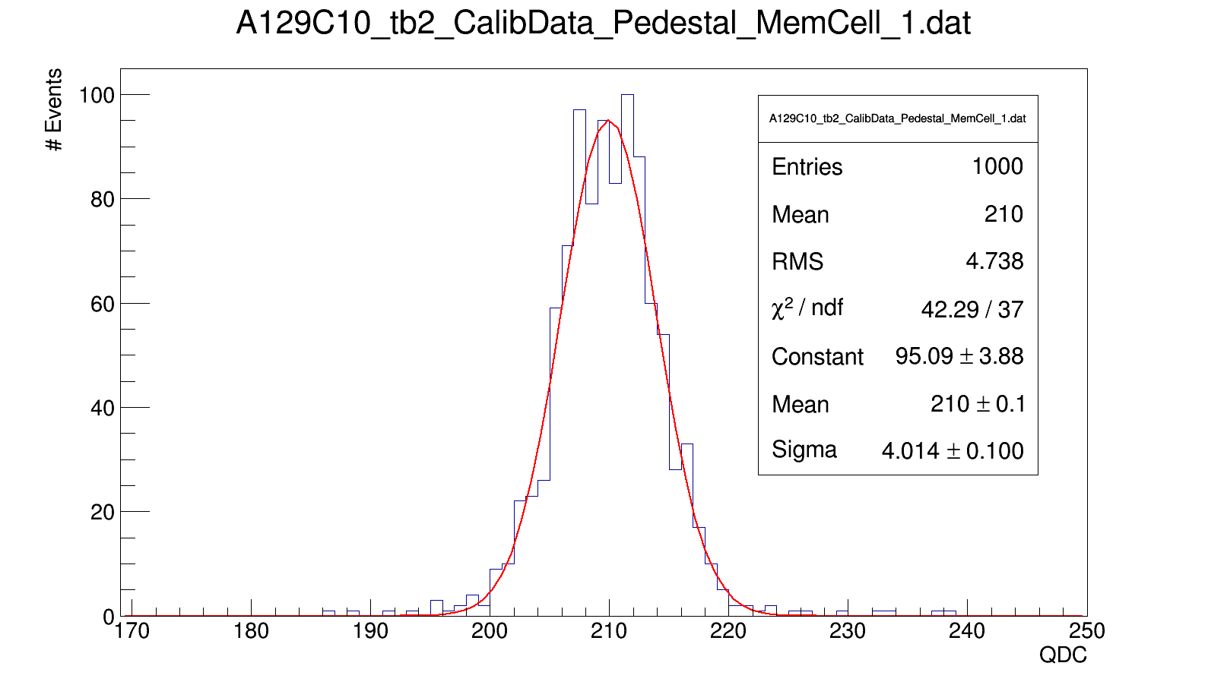
Obtaining Pedestal Values (Example: A129C10)
Reminder: each channel has 16 memory cells
Aquisition of Pedestal data in Forcetrigger mode (1000 cycles)
For each cycle all MemCells are filled with information (therefore 16000 entries)
Since Desy April Testbeam: Only Forcetrigger events are stored in MemCell 0 . → No Pedestal information is needed for MemCell 0 .
Pedestal information is obtained for every MemCell (1 -15). → 15 Pedestal values for each channel

Slide 29
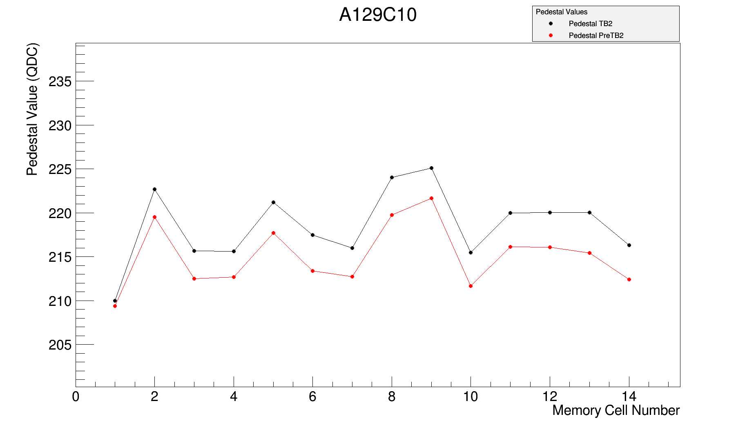
Comparison of Pedestal (Example: A129C10)
Notation:
TB2 (black dots) → setting as in April Desy Testbeam (Forcetrigger events stored in MemCell 0)
PreTB2 (red dots) → old settings (Forcetrigger events stored in MemCell n+1 , n = # MemCells filled)
For comparison: (Associate MemCells with PreTB2 and TB2 setting.)
TB2 (MemCell) | 1 | 2 | 3 | 4 | 5 | 6 | 7 | 8 | 9 | 10 | 11 | 12 | 13 | 14
PreTB2 (MemCell) | 13 | 12 | 11 | 10 | 9 | 8 | 7 | 6 | 5 | 4 | 3 | 2 | 1 | 0
Differences in Pedestal due to change in Preamplifier settings.
Response to Preamplifier changes is different for each channel.
For almost all channels: Pedestal with TB2 settings is higher than with PreTB2 settings.

Slide 30
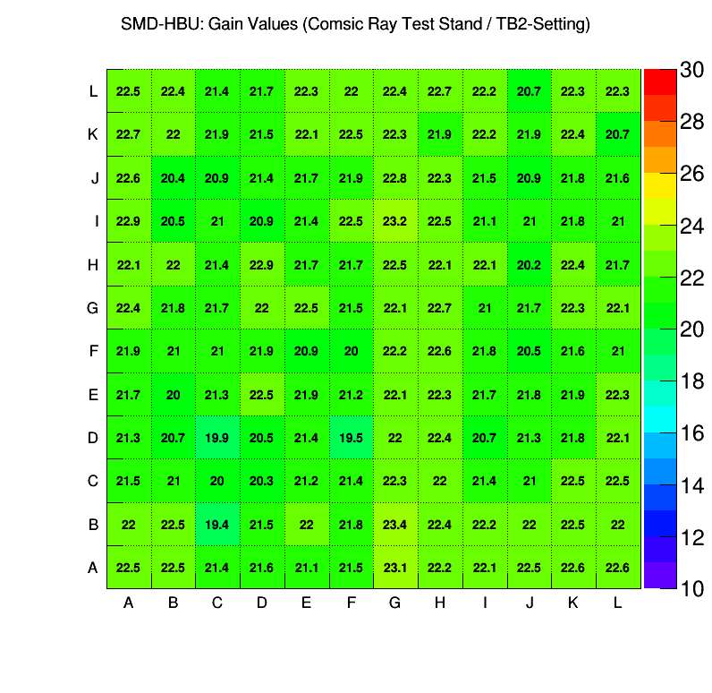
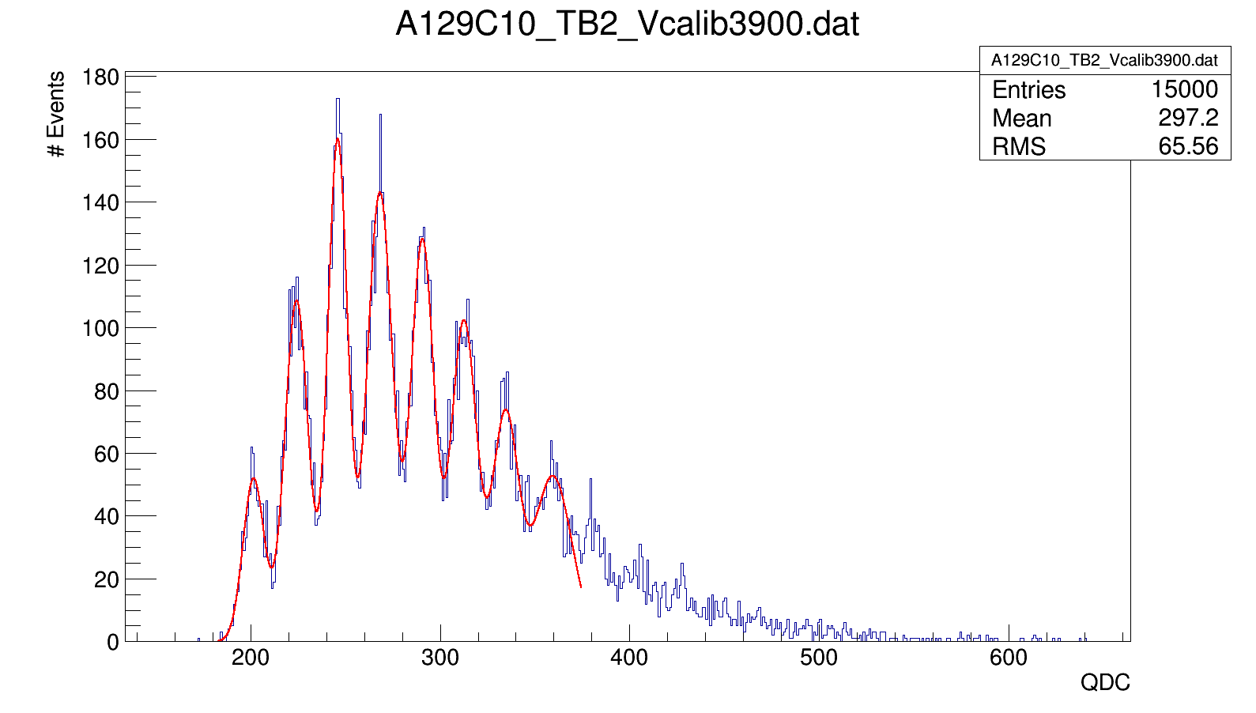
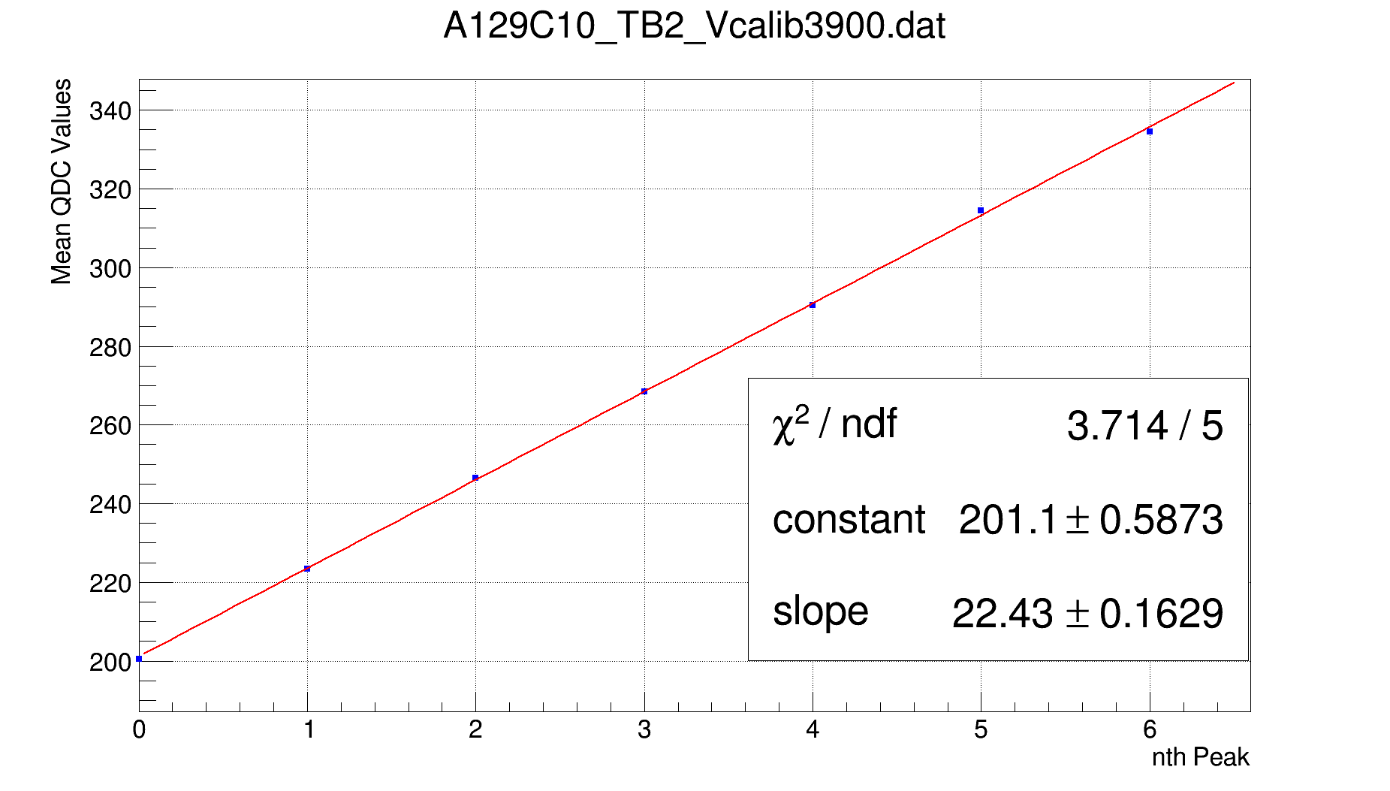
Obtaining Gain Values (Example: A129C10)
Plot Single Photon Spectrum (SPS)
Find peaks in spectrum and get distance between neighboring peaks. (ROOT Peakfinder)
As long as Peak to Peak distance is within a certain range → Store Peak position. (Abort storage as soon as distance is out of range)
Linear Fit to stored Peak positions → Obtain Gain.
Additional: Use information from ROOT Peakfinder to fit a sum of Gaussian Distributions to the spectrum.

Slide 31
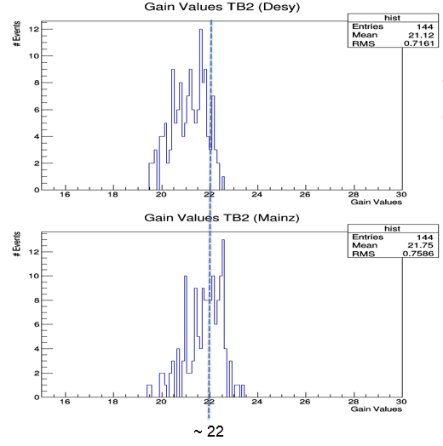
Gain Values: Mainz Cosmic Ray Teststand vs. Desy TB April
Gain Values obtained in Mainz are slightly higher than the ones obtained in the Desy April Testbeam.
Due to temperature ?
Habe gestern, die Roh-SPS-Daten ~ 160 GB vom Desy April Testbeam bekommen (TB2) und werte diese im Moment aus.
Hoffe, dass ich bis kommenden Montag die Resultate habe.

Slide 32
Measurement in Cosmic Ray Teststand
Experimental Setup:
1.2 cm Trigger Scintillator
0.8 cm Plexiglas
6.8 cm
8.8 cm
~ 0.4 cm SMD - HBU
1.2 cm Trigger Scintillator
1.8 cm Wooden Panel
SMD - HBU
For the measurement 4 trigger scintillator strips were used on top as well as on the bottom.
3 different configuration were needed to cover the whole SMD-HBU.
Several data acquisition runs were performed for each configuration. Information was combined later on. In total we measured:
Config 1 → 1.625.000 Cycles
Config 2 → 1.310.000 Cycles
Config 3 → 1.595.000 Cycles
Config 1
Config 2
Config 3

Slide 33
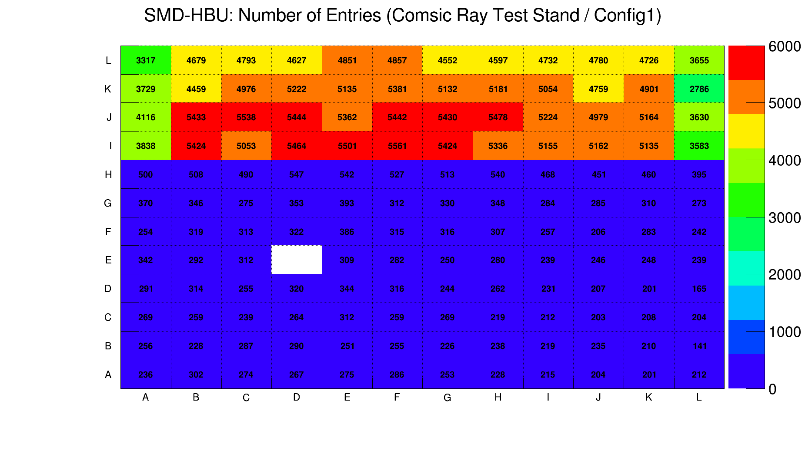
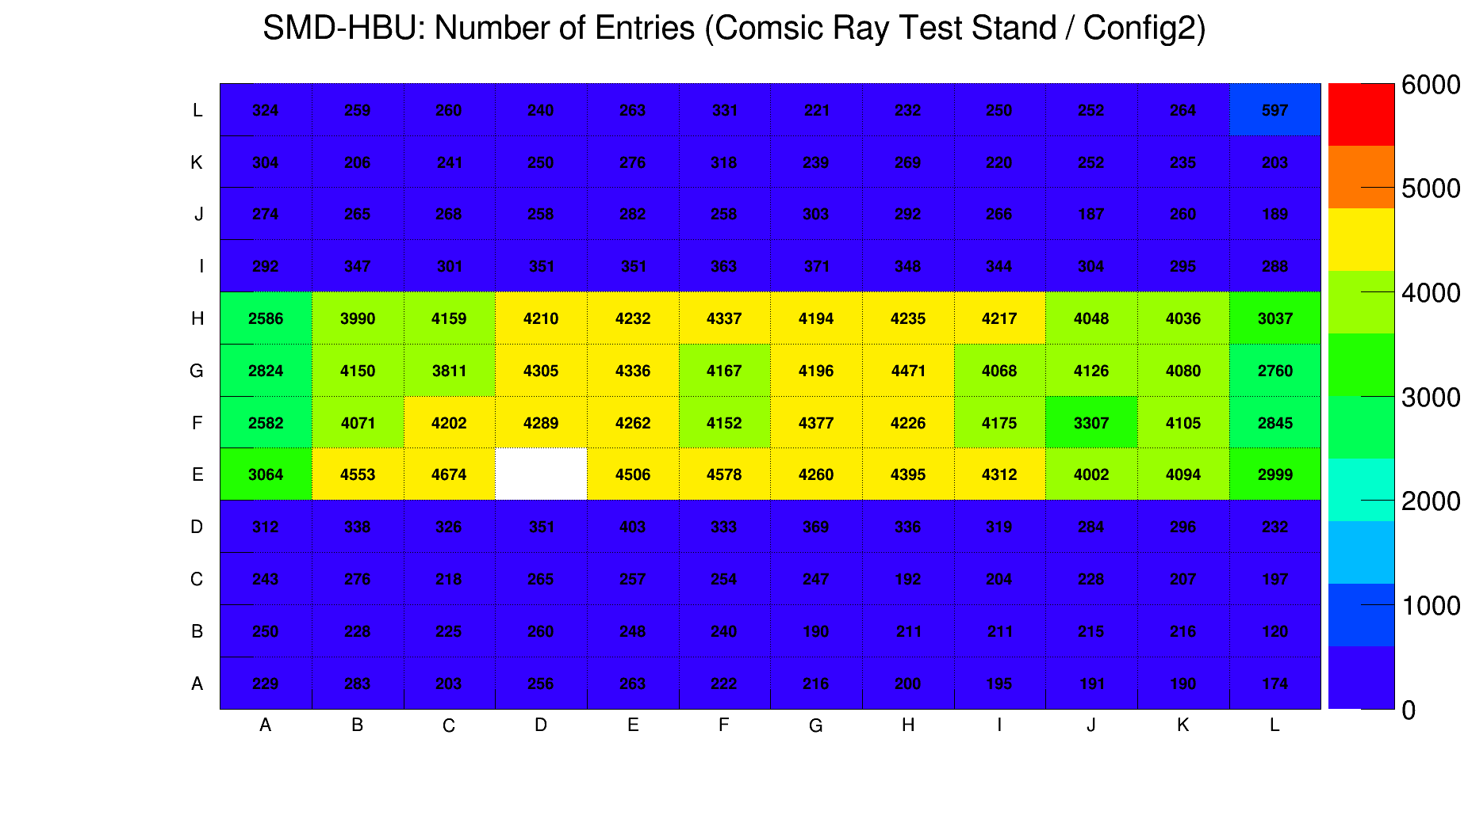
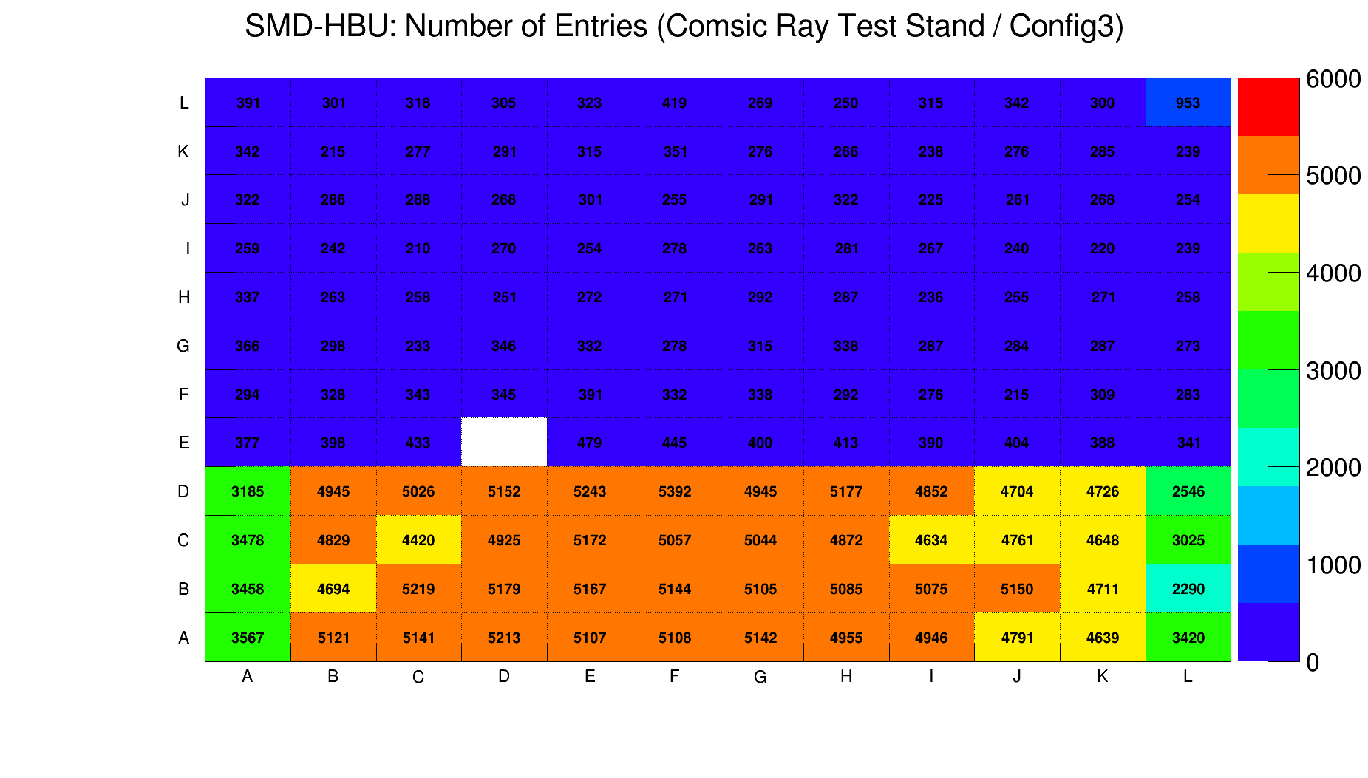
Measurement in Cosmic Ray Teststand
The maps show measured entries for the whole SMD-HBU using the three different configurations. Furthermore a ADC cut (ADC > 600) as well as a TDC cut (ASIC dependent, see next slide) were performed. All measured data for each configuration was included.
White spot → A132C26 is the broken channel.
Less entries for all channels measured in configuration 2 due to the lower data acquisition time (see slide before). Also ADC cut has a channel dependend influence on the number of entries.
Less entries measured on the left and right edge of the SMD-HBU for each configuration due to the geometrical acceptance angle.
Geometrical Acceptance:
Trigger Scintillator
SMD-HBU
Trigger Scintillator

Slide 34
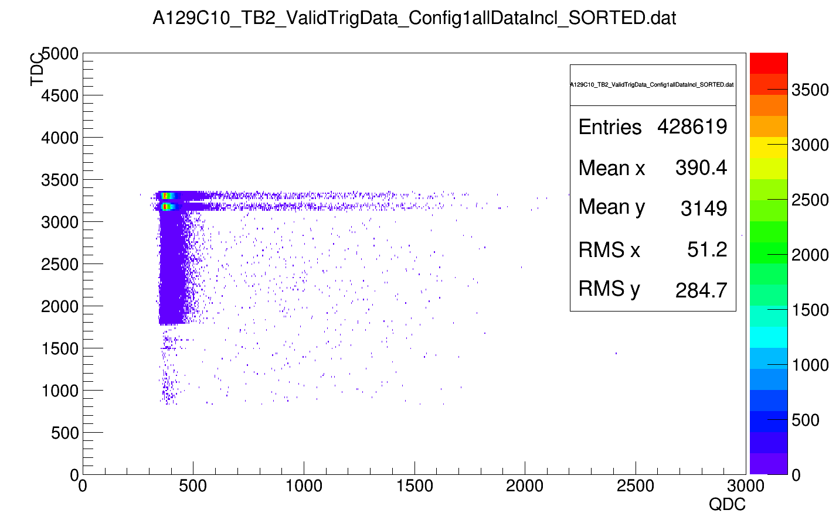
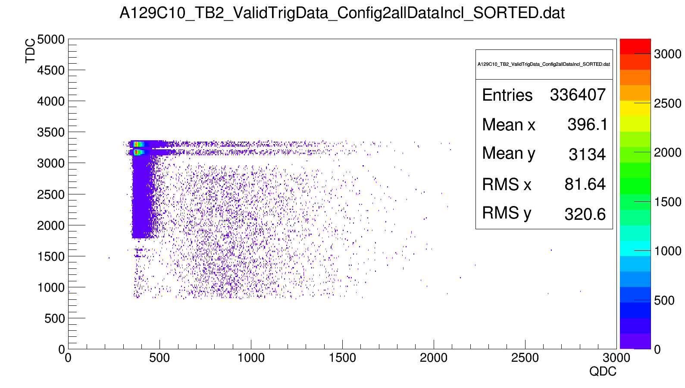
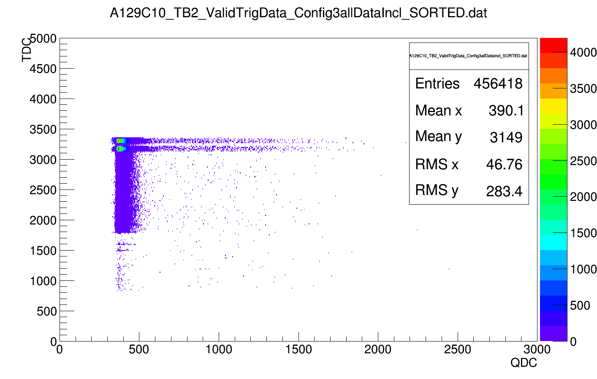
Measurement in Cosmic Ray Teststand (Example: A129C10)
Config 1 (not triggered)
Config 2 (triggered)
TDC ~ 3100
Config 3 (not triggered)
ADC ~ 600
A ADC cut is not needed and therefore not applied to obtain the Mip-Response.
A TDC cut is needed in order to resolve the Mip events. One should notice that the applied TDC cut depends on the ASIC.
A129 → TDC < 3100
A130 → TDC < 3200
A131 → TDC < 2700
A132 → TDC < 3150

Slide 35
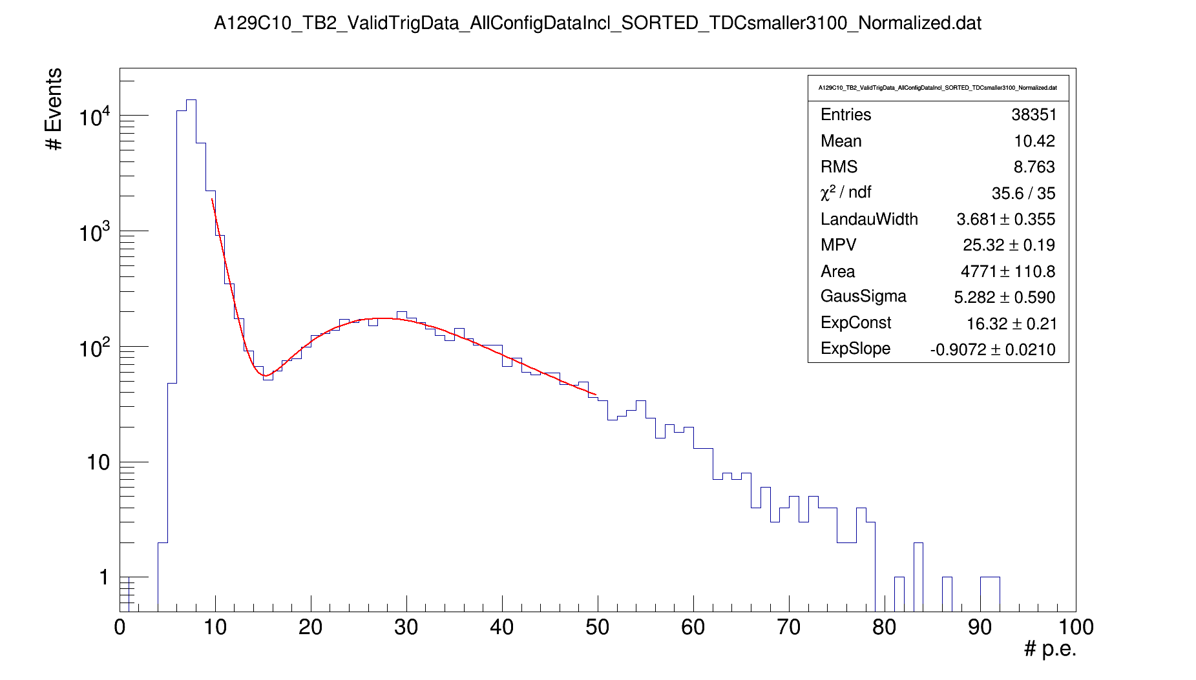
Determination of MIP-Response (Example A129C10)
Data with TDC cut is plotted
Spectra is fitted with the sum of an exponential (two parameters) and a Landau-Gaussian convoluted function.
Mip-Response equals the MPV of the Landau-Gaussian convoluted distribution
DIF
Reasons for lower Mip-Response on the right edge of the Map:
Due to geometrical acceptance angle.
Due to temperature, because Power board produces heat.
(Muss noch die Temperatur überprüfen, brauch dafür aber Information, wo auf dem Board sich die Temp-Sensoren: T1-T6 befinden.)
CALIB
POWER

Slide 36
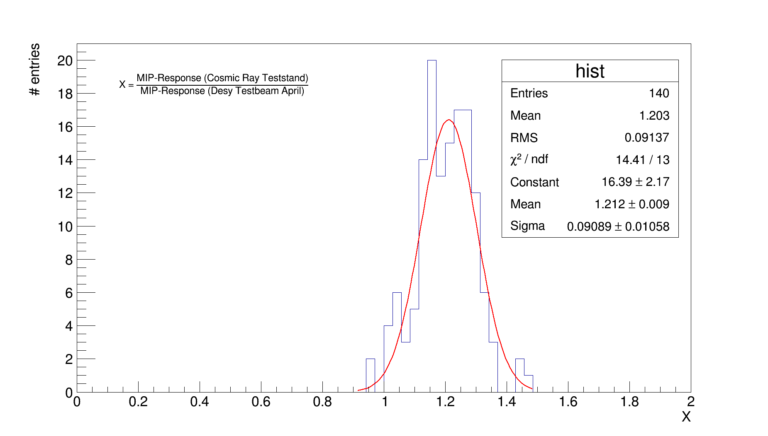
Comparison with Testbeam data
Mip-Response in Cosmic Ray Test Stand is higher than in the Desy April Testbeam
Reasons:
Acceptance angle. Since the electron beam at Desy hits each channel perpendicular, whereas in the Cosmic Ray Test Stand a wider range of angles is accepted.
(Auswirkung muss noch rechnerich bestimmt werden)
Sascha wollte noch die April Testbeamdaten mit einem LandauGaus fitten, sodass sich das obige spektrum noch verbessern kann. Mehr dazu am Montag.

