Slide 1
Bunch charge measurement
N. Blaskovic
N. Blaskovic

Slide 2
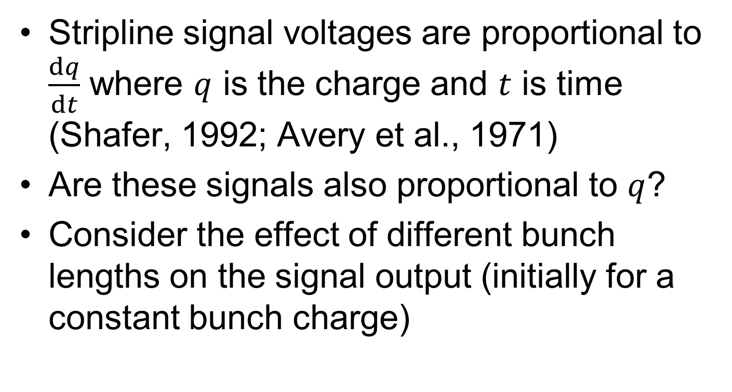
Introduction
Stripline signal voltages are proportional to $\frac{dq}{dt}$ where $q$ is the charge and $t$ is time
(Shafer, 1992; Avery et al., 1971)
Are these signals also proportional to $q$?
Consider the effect of different bunch lengths on the signal output (initially for a constant bunch charge)
N. Blaskovic

Slide 3
Effect of bunch length
raw stripline signal
processed Σ_{I}
?
shorter bunch
longer bunch
N. Blaskovic

Slide 4
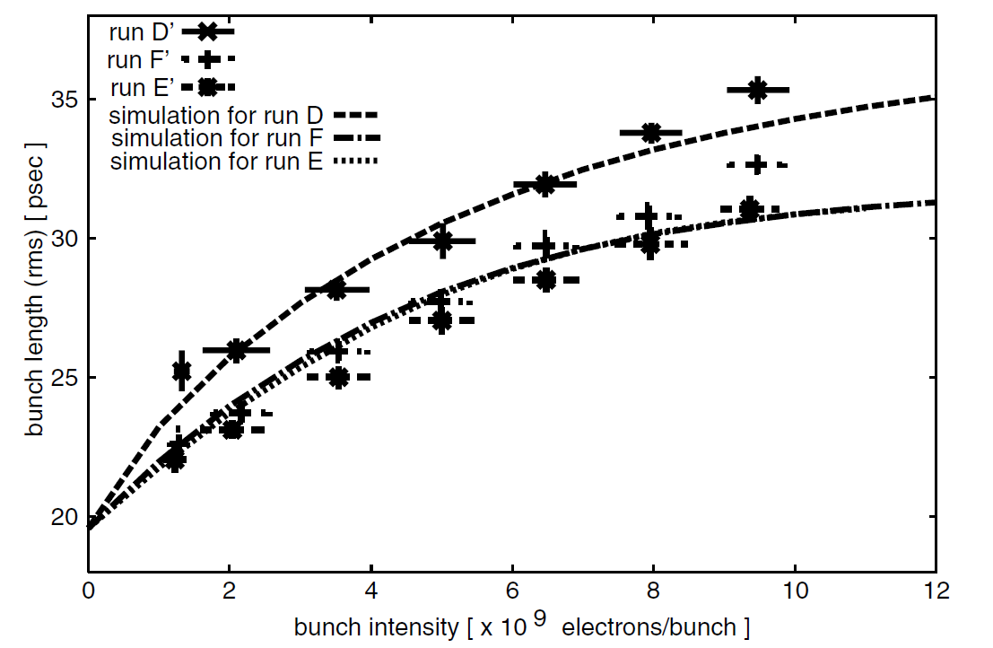
Bunch length vs. bunch charge
Honda et al., 2004
N. Blaskovic

Slide 5
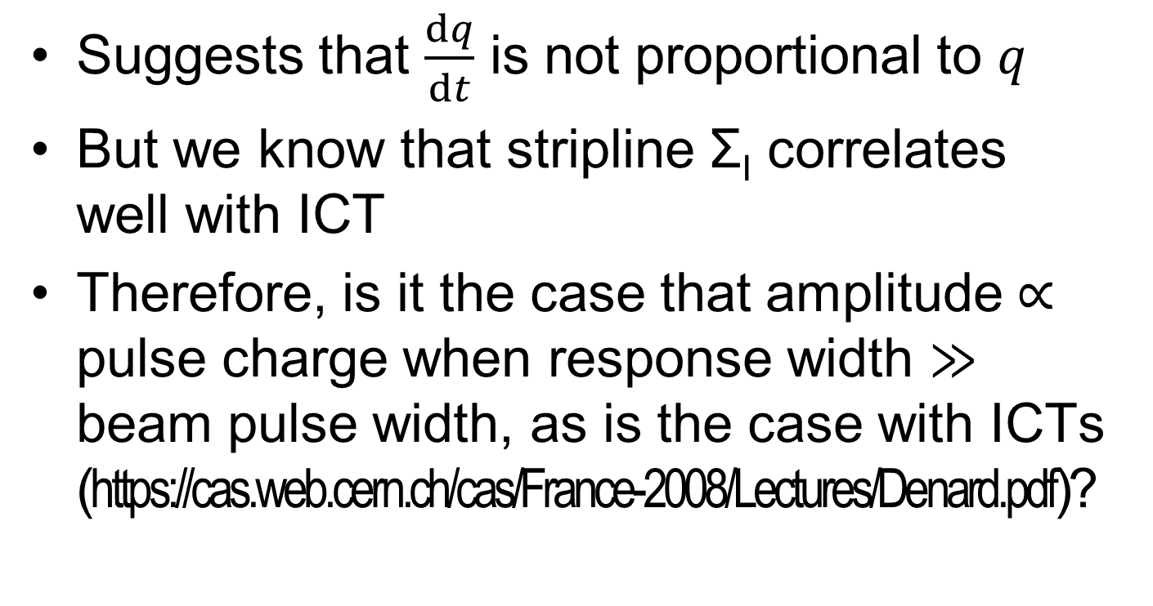
Stripline signals
Suggests that $\frac{dq}{dt}$ is not proportional to $q$
But we know that stripline Σ_{I} correlates well with ICT
Therefore, is it the case that amplitude $∝$ pulse charge when response width $≫$ beam pulse width, as is the case with ICTs (https://cas.web.cern.ch/cas/France-2008/Lectures/Denard.pdf)?
N. Blaskovic

Slide 6
Appendix
Scatter plots between stripline Σ_{I}, IP reference diode and ICT
N. Blaskovic

Slide 7
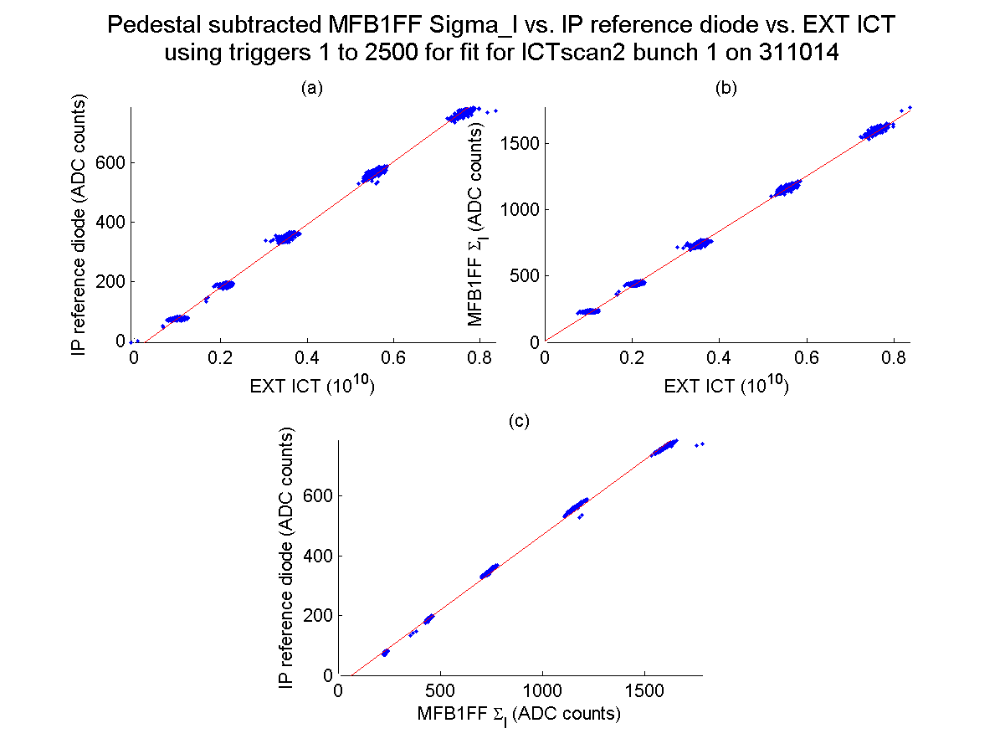
N. Blaskovic

Slide 8
Appendix
Calibration constant versus
variable attenuator setting
and bunch charge
N. Blaskovic

Slide 9
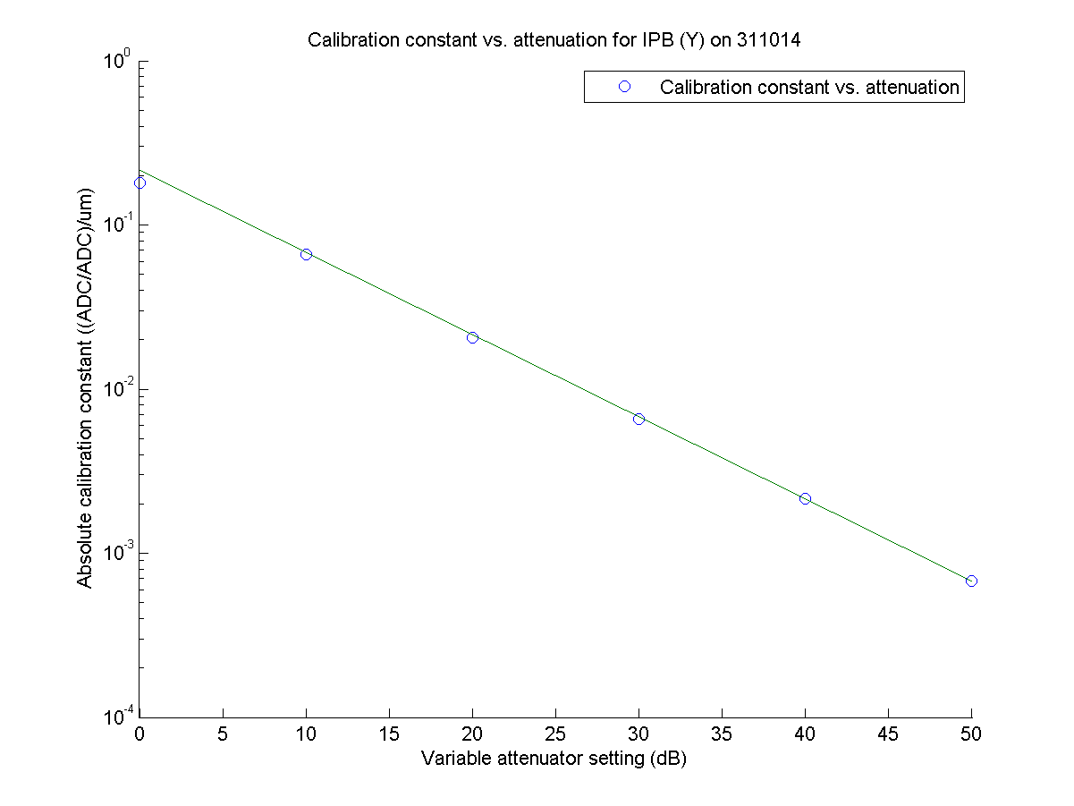
N. Blaskovic

Slide 10
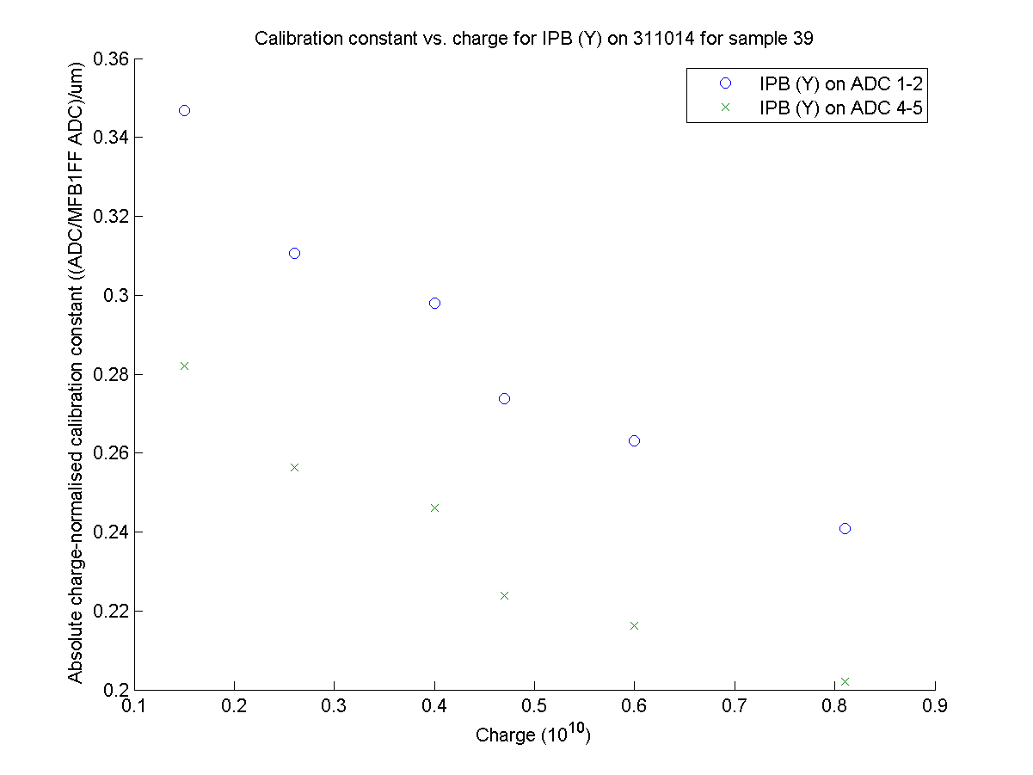
N. Blaskovic

Slide 11
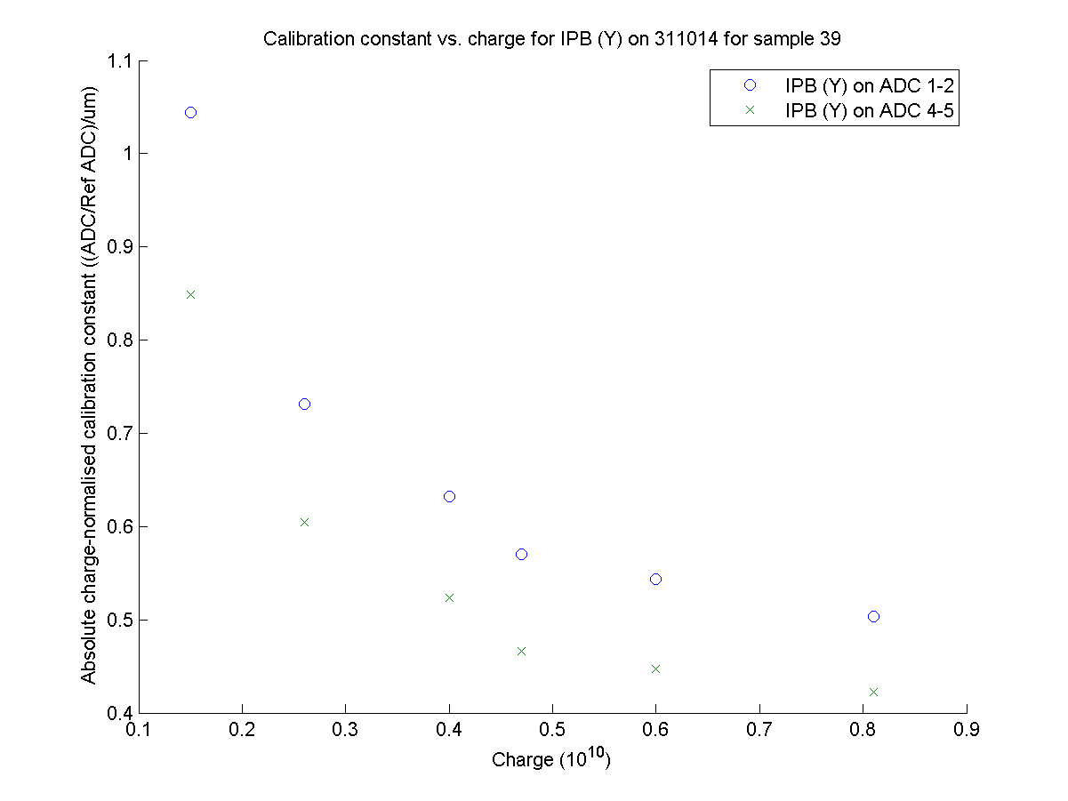
N. Blaskovic

