Slide 1
Japanese Planning for FY2015
Akira Yamamoto
To be reported to ILC-TB, 2015-4-28

Slide 2
Japanese Planning for FY2015
Month | 4 | 5 | 6 | 7 | 8 | 9 | 10 | 11 | 12 | 1 | 2 | 3
CFS Geol. Survey TOT develop.
ATF (see next p.) FF beam-size Stability
SRF Cavity STF2 Input-coupler Tuner Cryogenics
e+ source
Meetings Int’l Domestic Comm. survey | ALCW |  | AEC | CFS-CR mtg. |  |  |  | LCWS
Surface survery, and boring at the new IP region
Tunnel Optimization Tool to be developed, by ARUP-CERN-KEK
beam
beam
beam
beam
(beam)
9-cell cavity, 1-cell cavity research
RF wave guide purchase, and assembled with CM1
New, plug-compatible coupler to be test at KEK in coop. with CERN
Watch the progress of LCLS-II, lever-arm tuner development, and hopefully consider CR
Cryogenics system design to be updated and go to Change Req.
Demonstrate a full-scale mechanical model with a ”conventional technology”, within 2 years.
MEXT ILC Academic Expert Committee to be completed by
Commissioned survey for the ILC technology and project plan

Slide 3
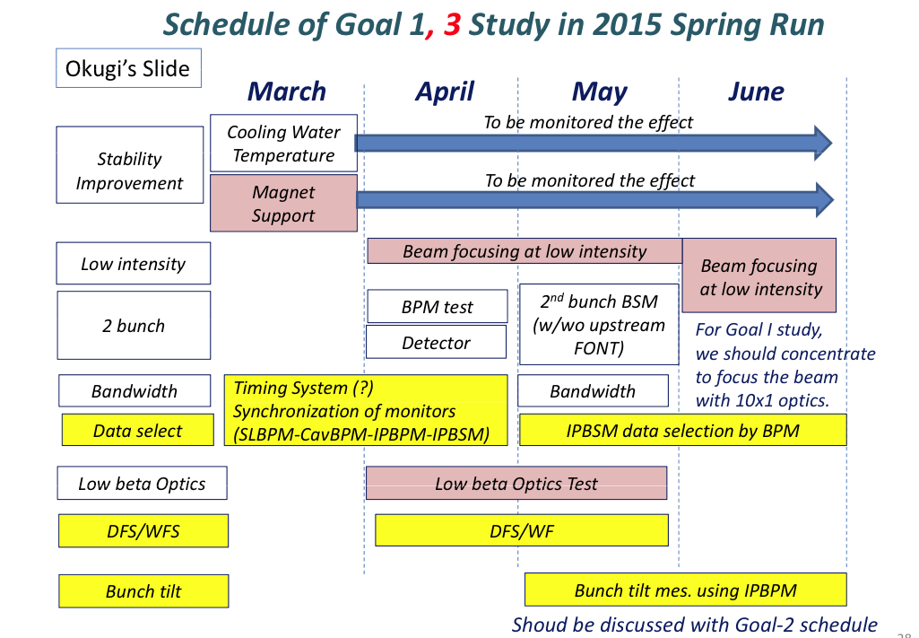
Short term schedule: ATF2

