Slide 1
Summary of SRF WG @ALCW2015
H. Hayano

Slide 2
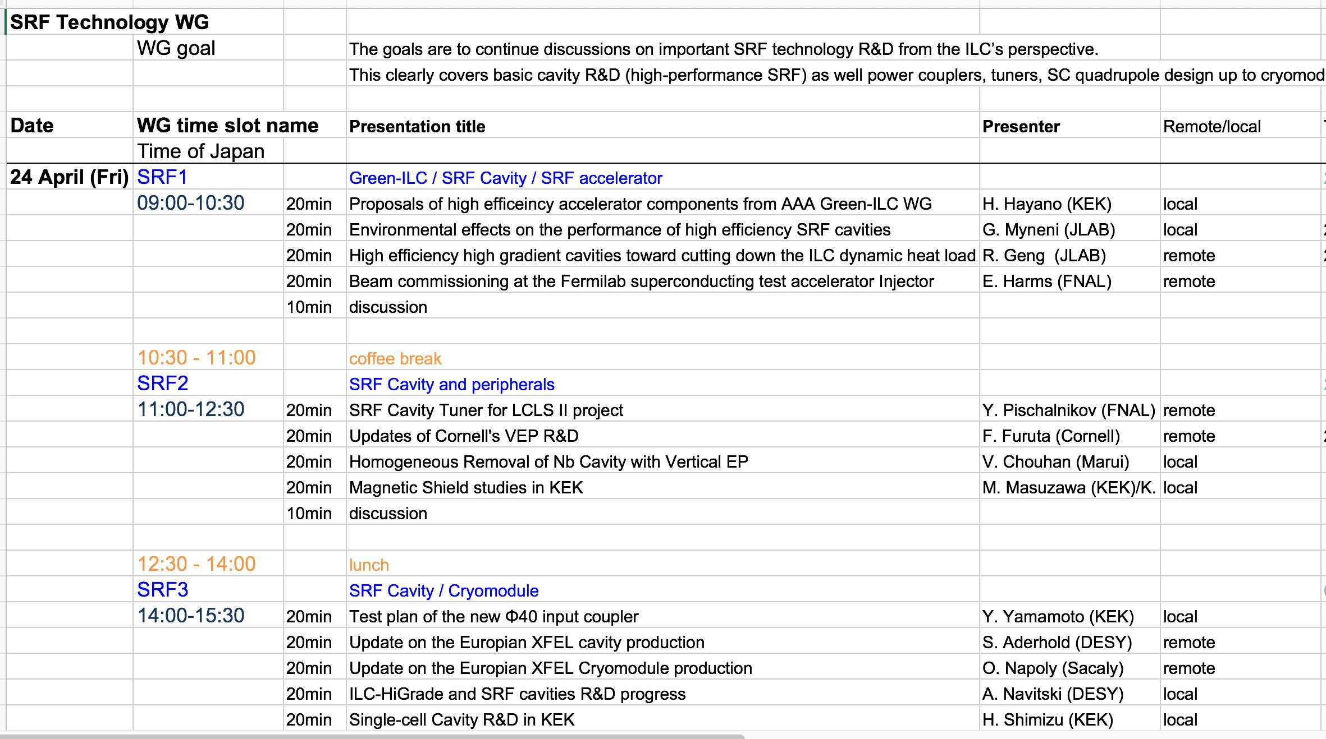
13 talks (7: at present, 6: remote)

Slide 3
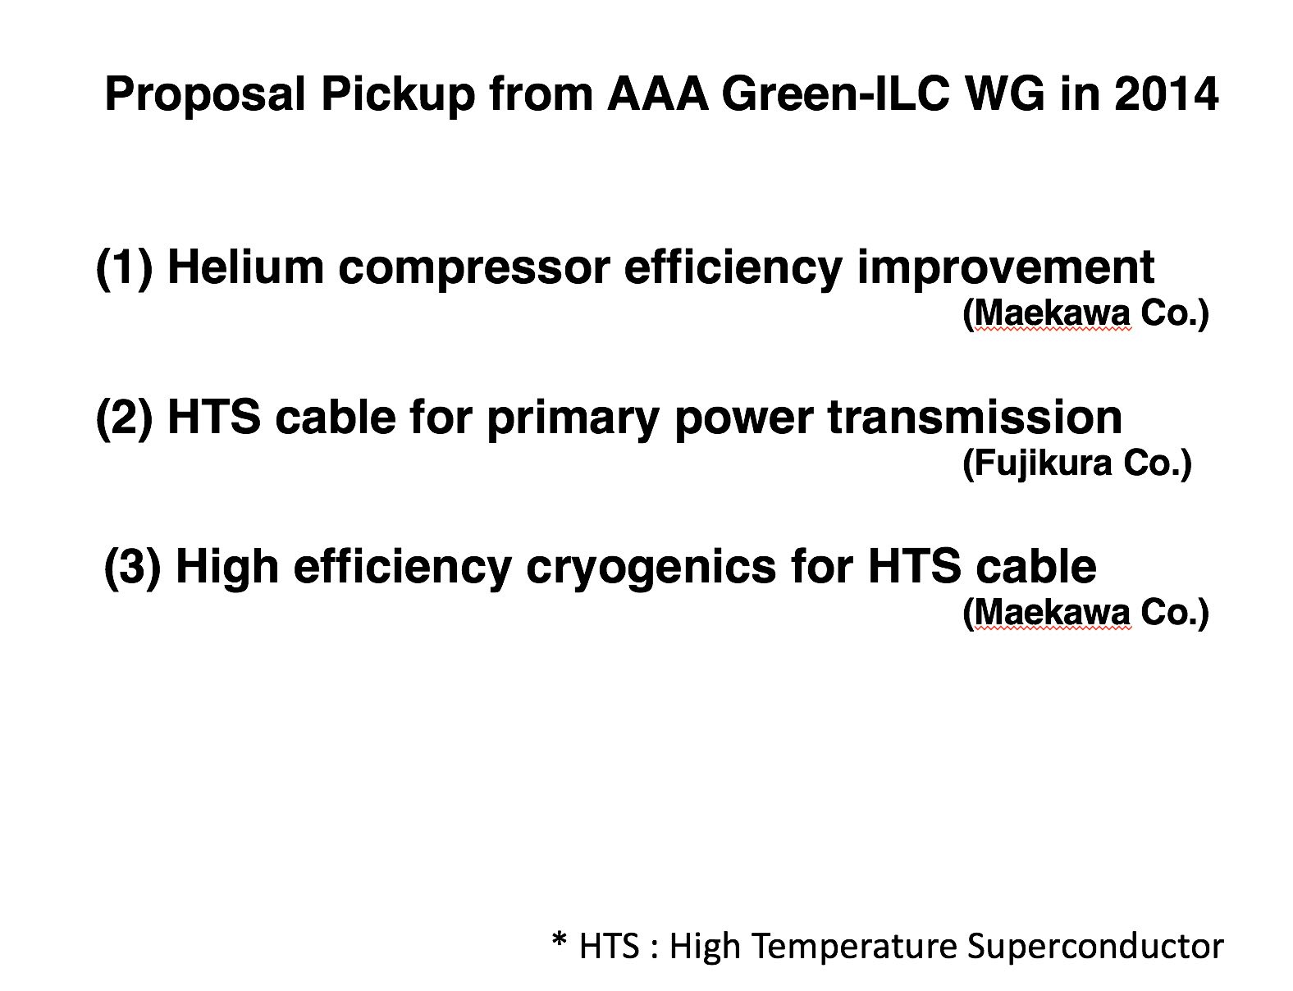
H. Hayano: Green-ILC updates

Slide 4
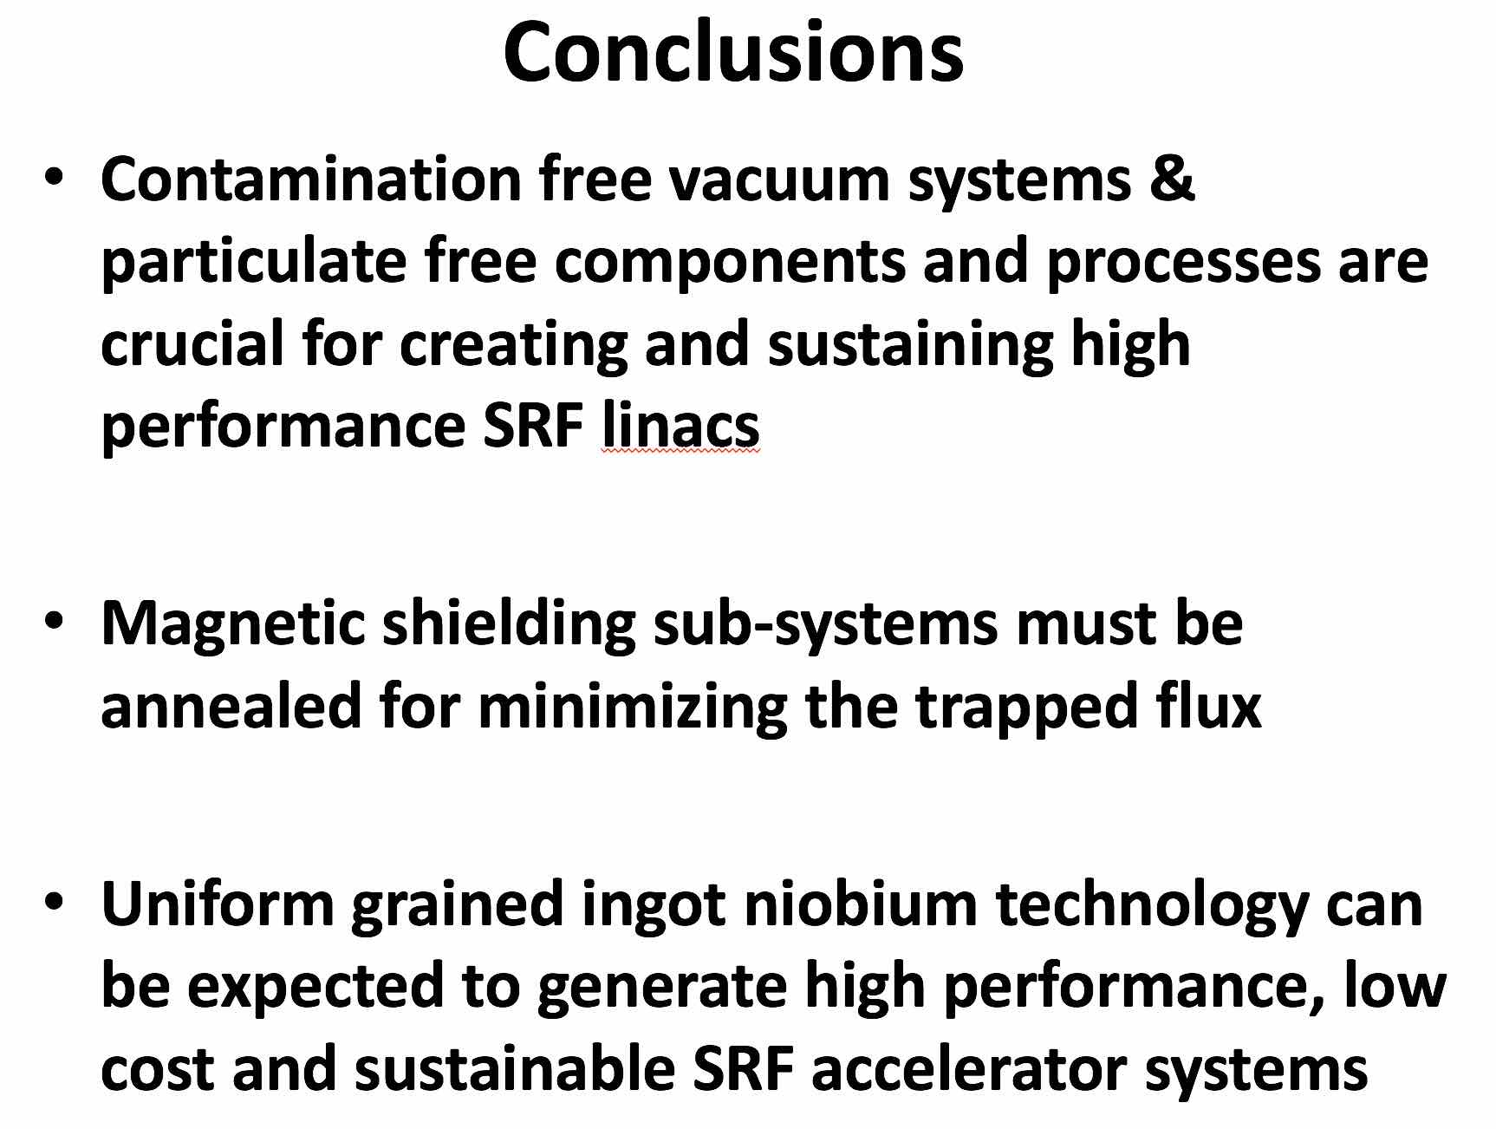
G. Myneni: Environmental effects

Slide 5
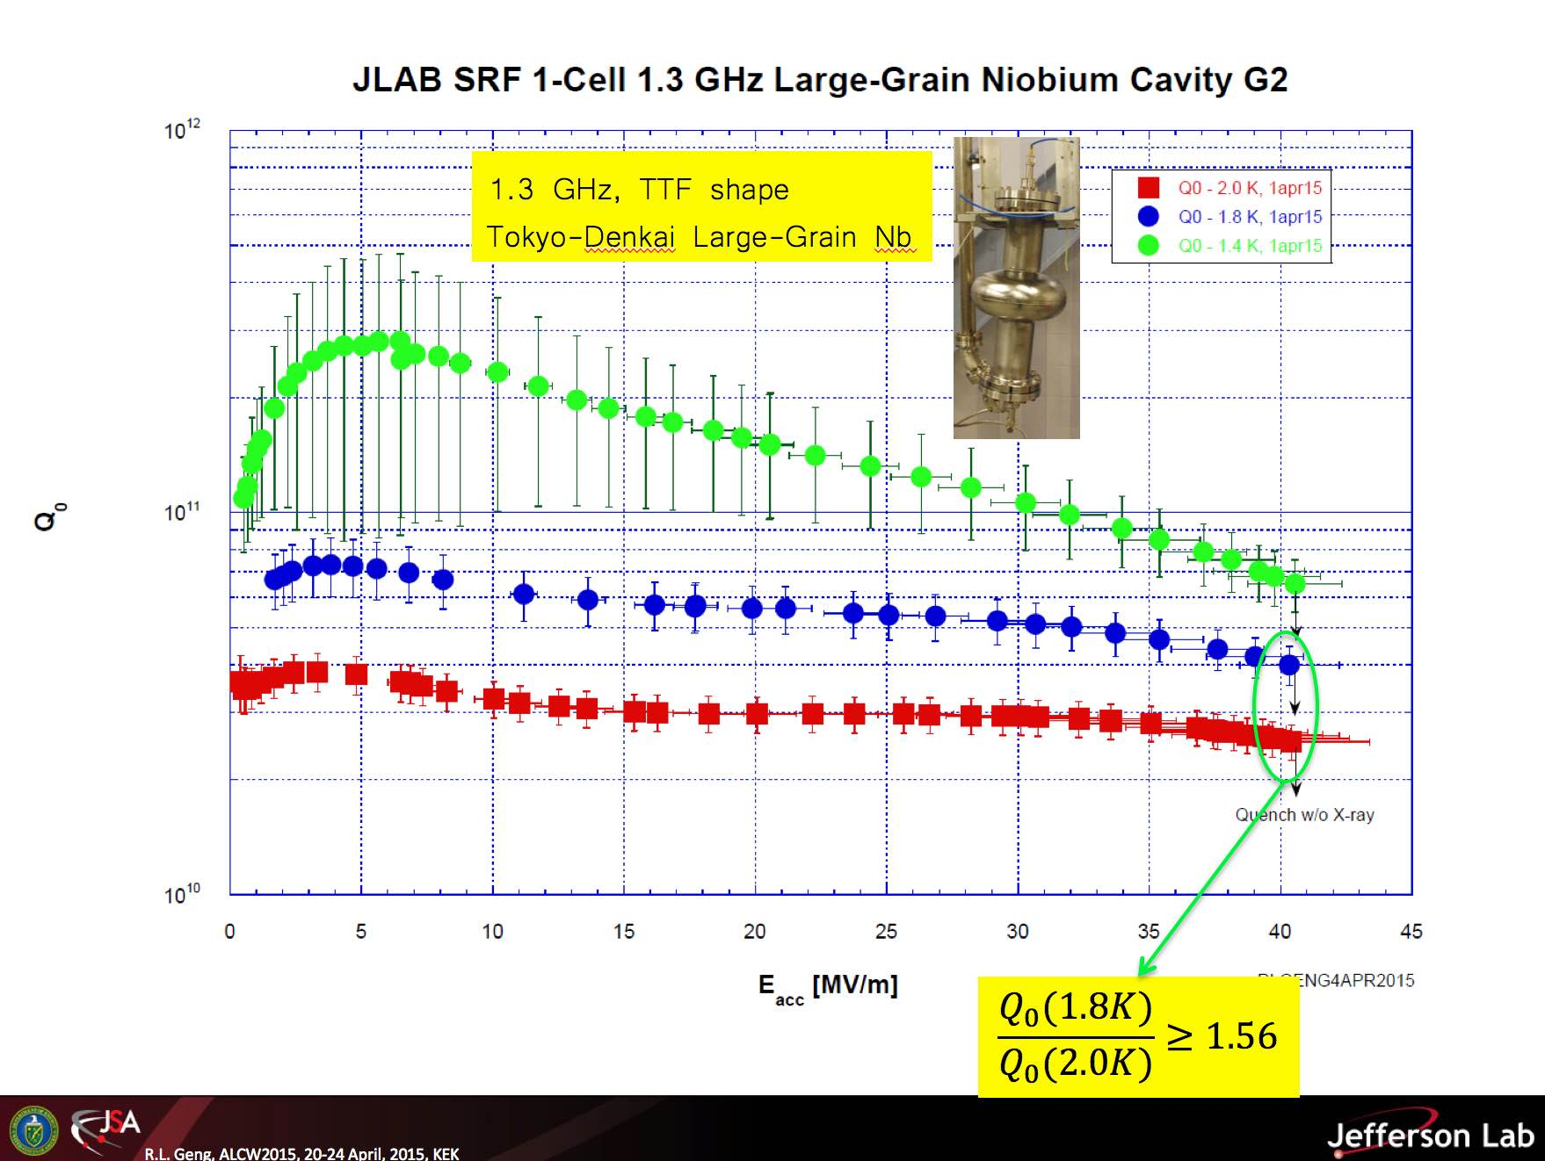
R. Geng : High efficiency HG cavity
1.4K result

Slide 6
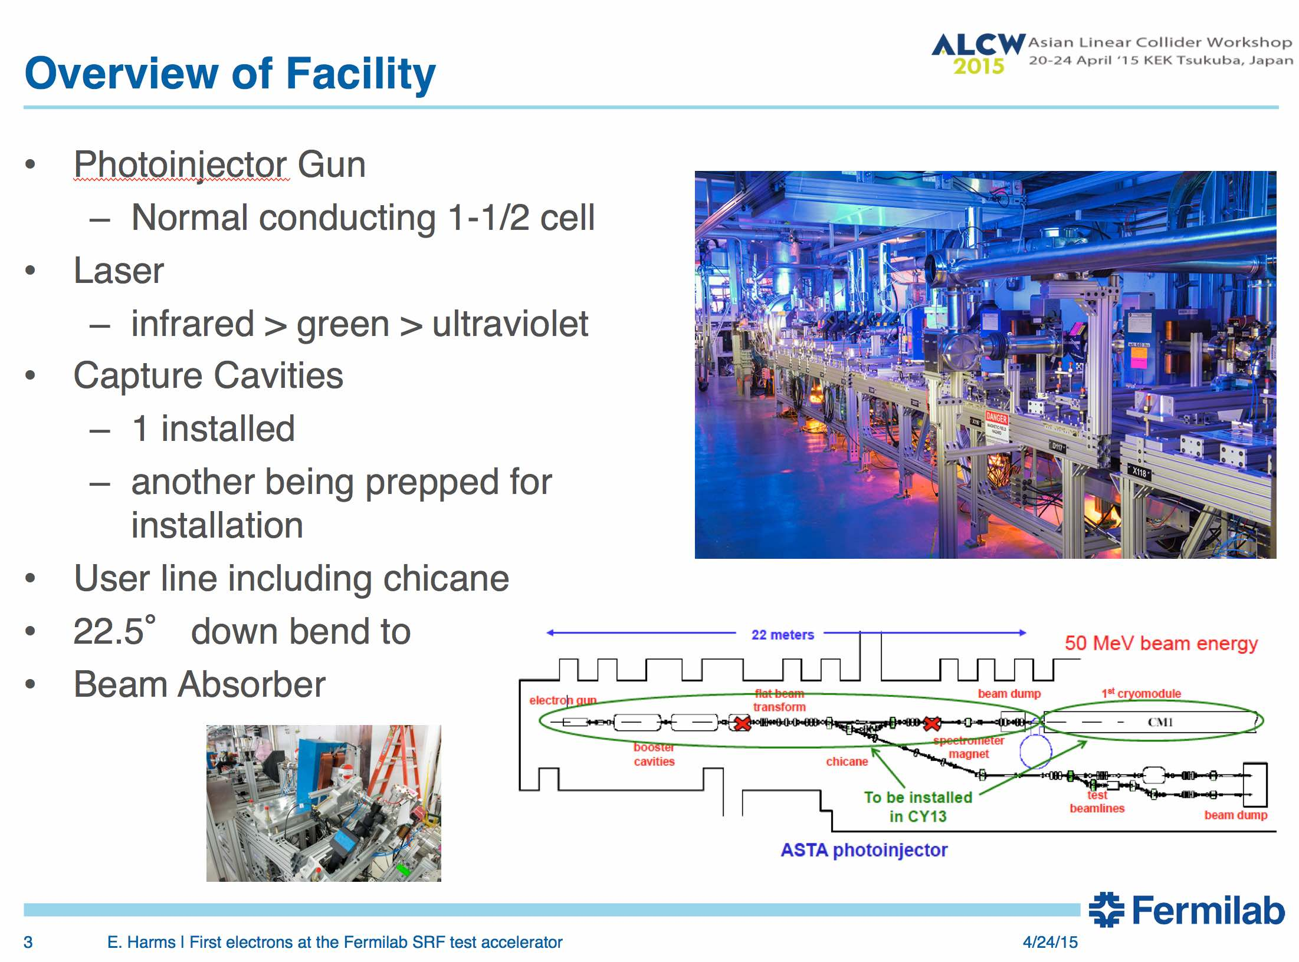
E. Harms: ASTA Injector commissioning

Slide 7
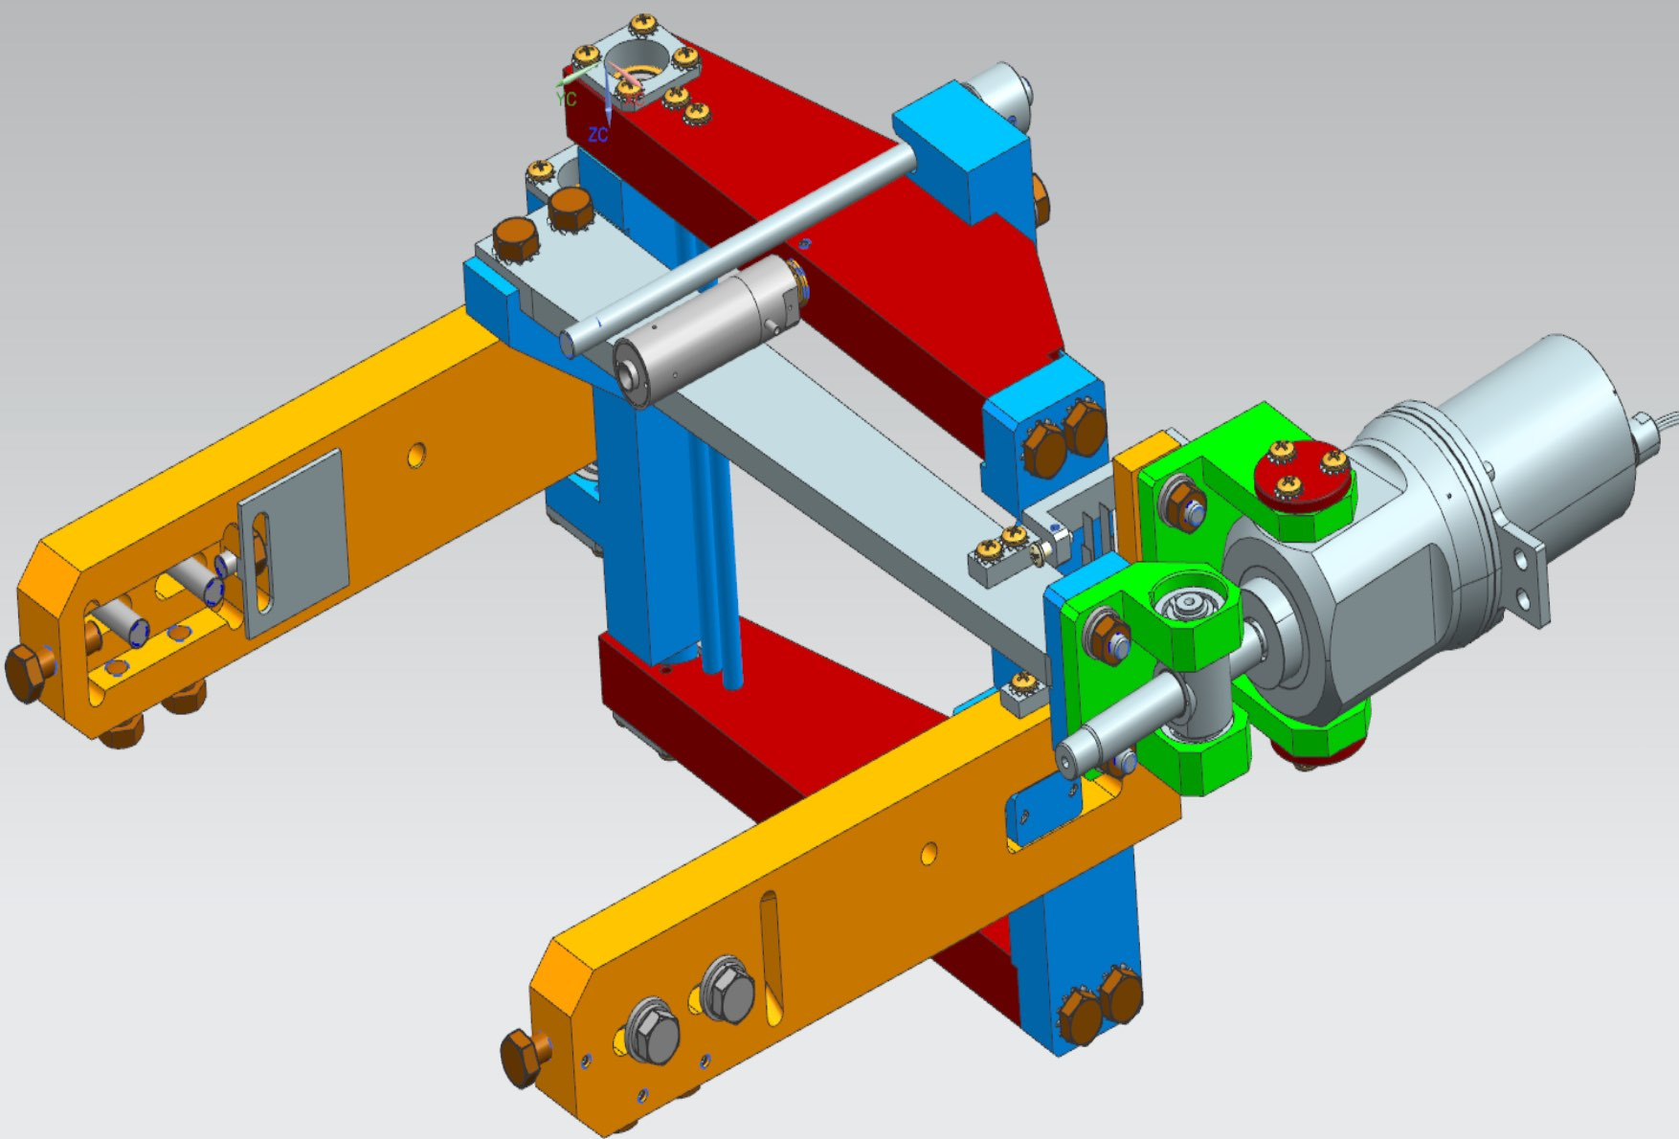
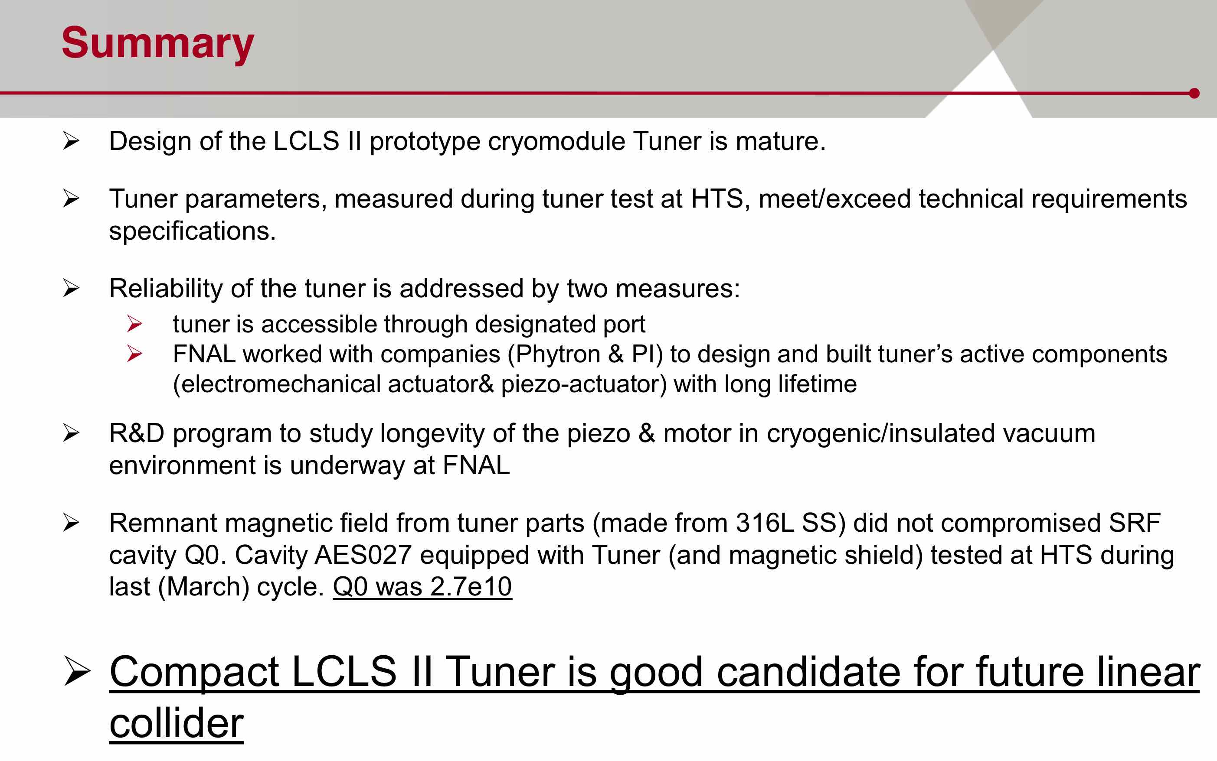
Y. Pischalnikov: LCLS II tuner
Tuner Version2

Slide 8
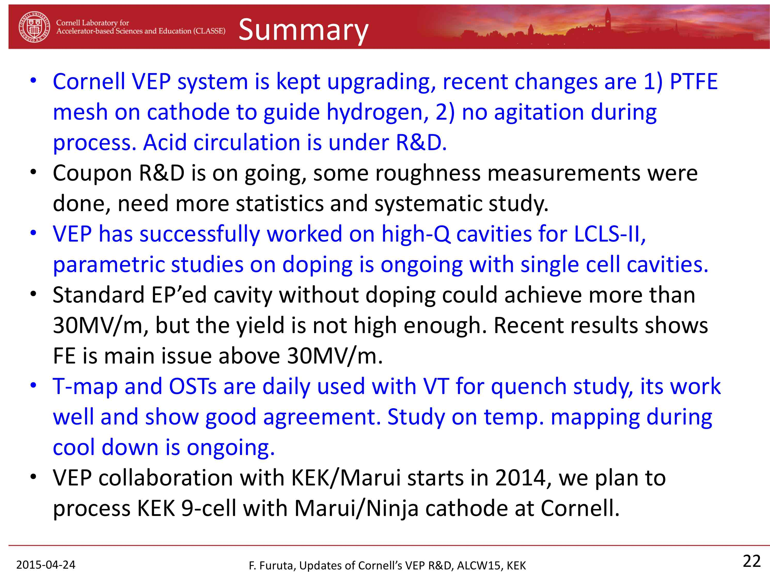
F. Furuta: Cornell VEP status

Slide 9
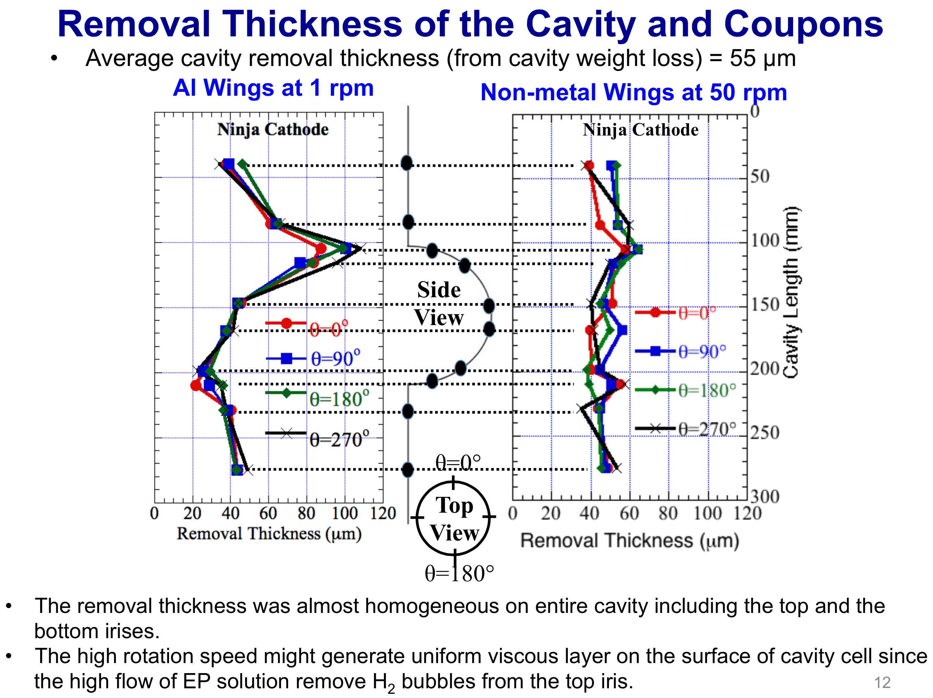
V. Chouhan: KEK-Marui VEP development

Slide 10
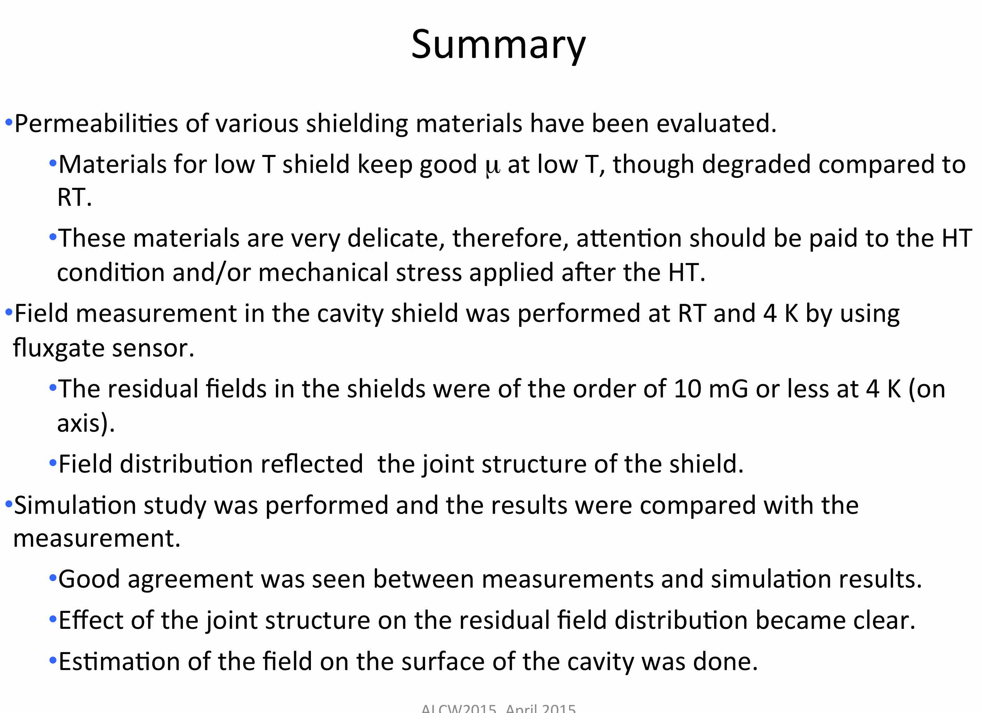
M. Masuzawa: Magnetic shield study

Slide 11
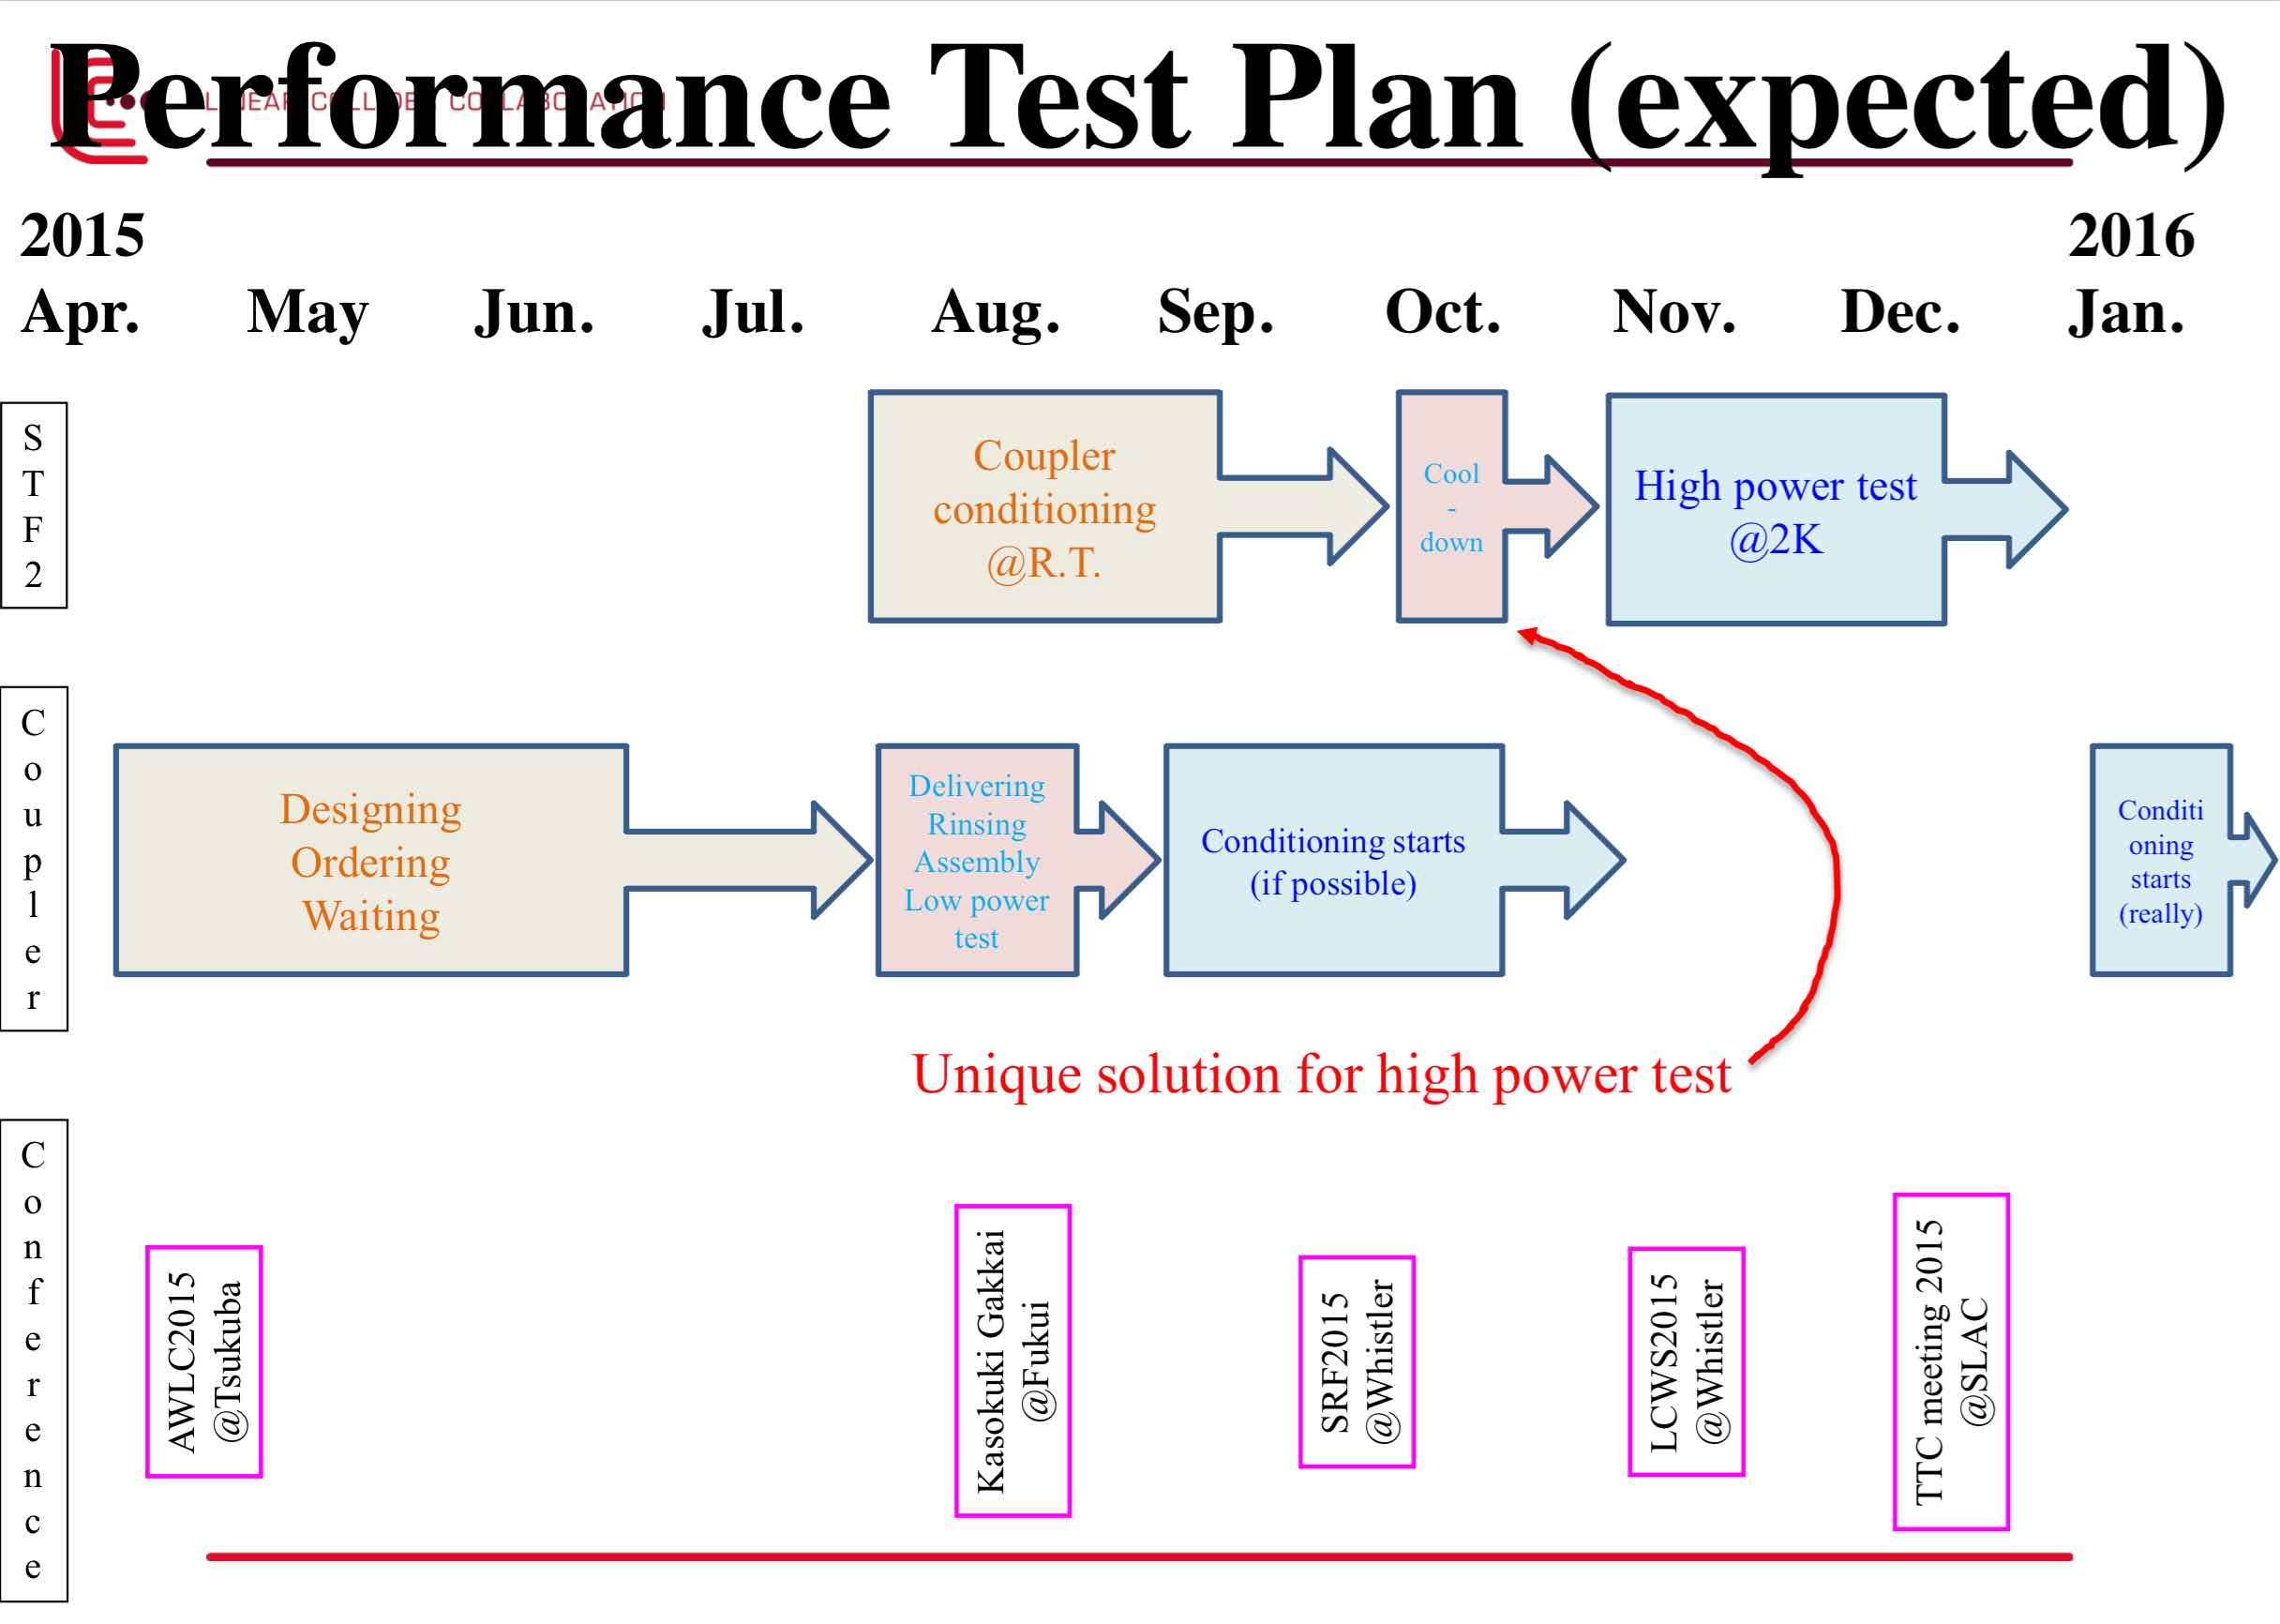
Y. Yamamoto: Φ40 KEK coupler test plan

Slide 12
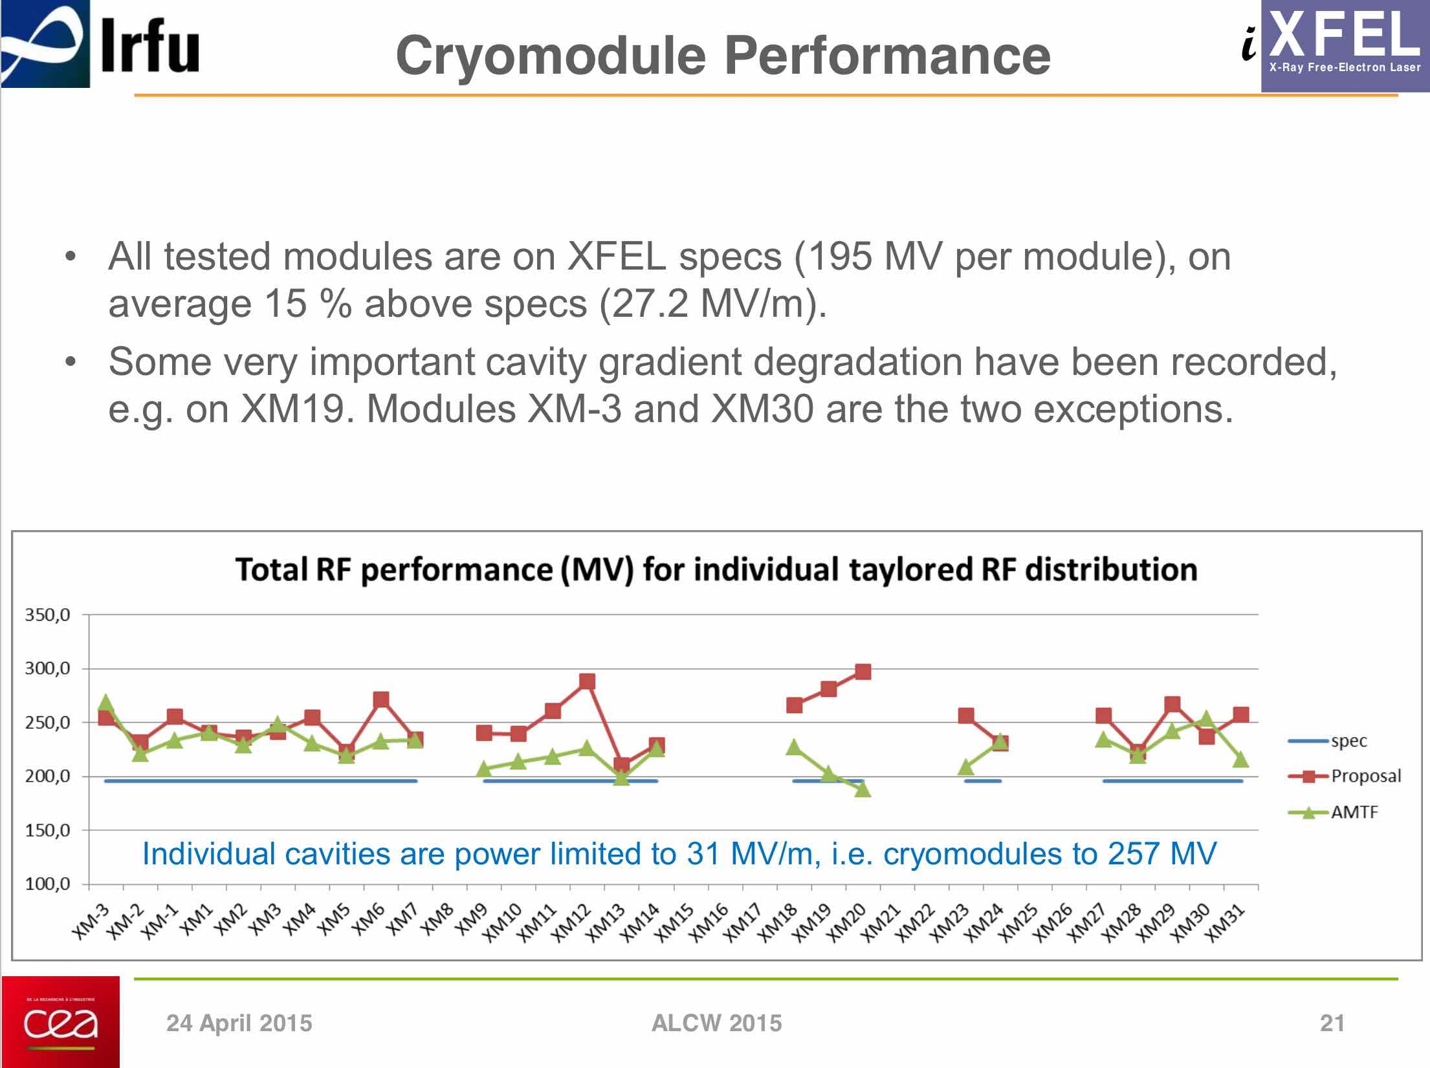
O. Napoly: XFEL Cryomodule production status

Slide 13
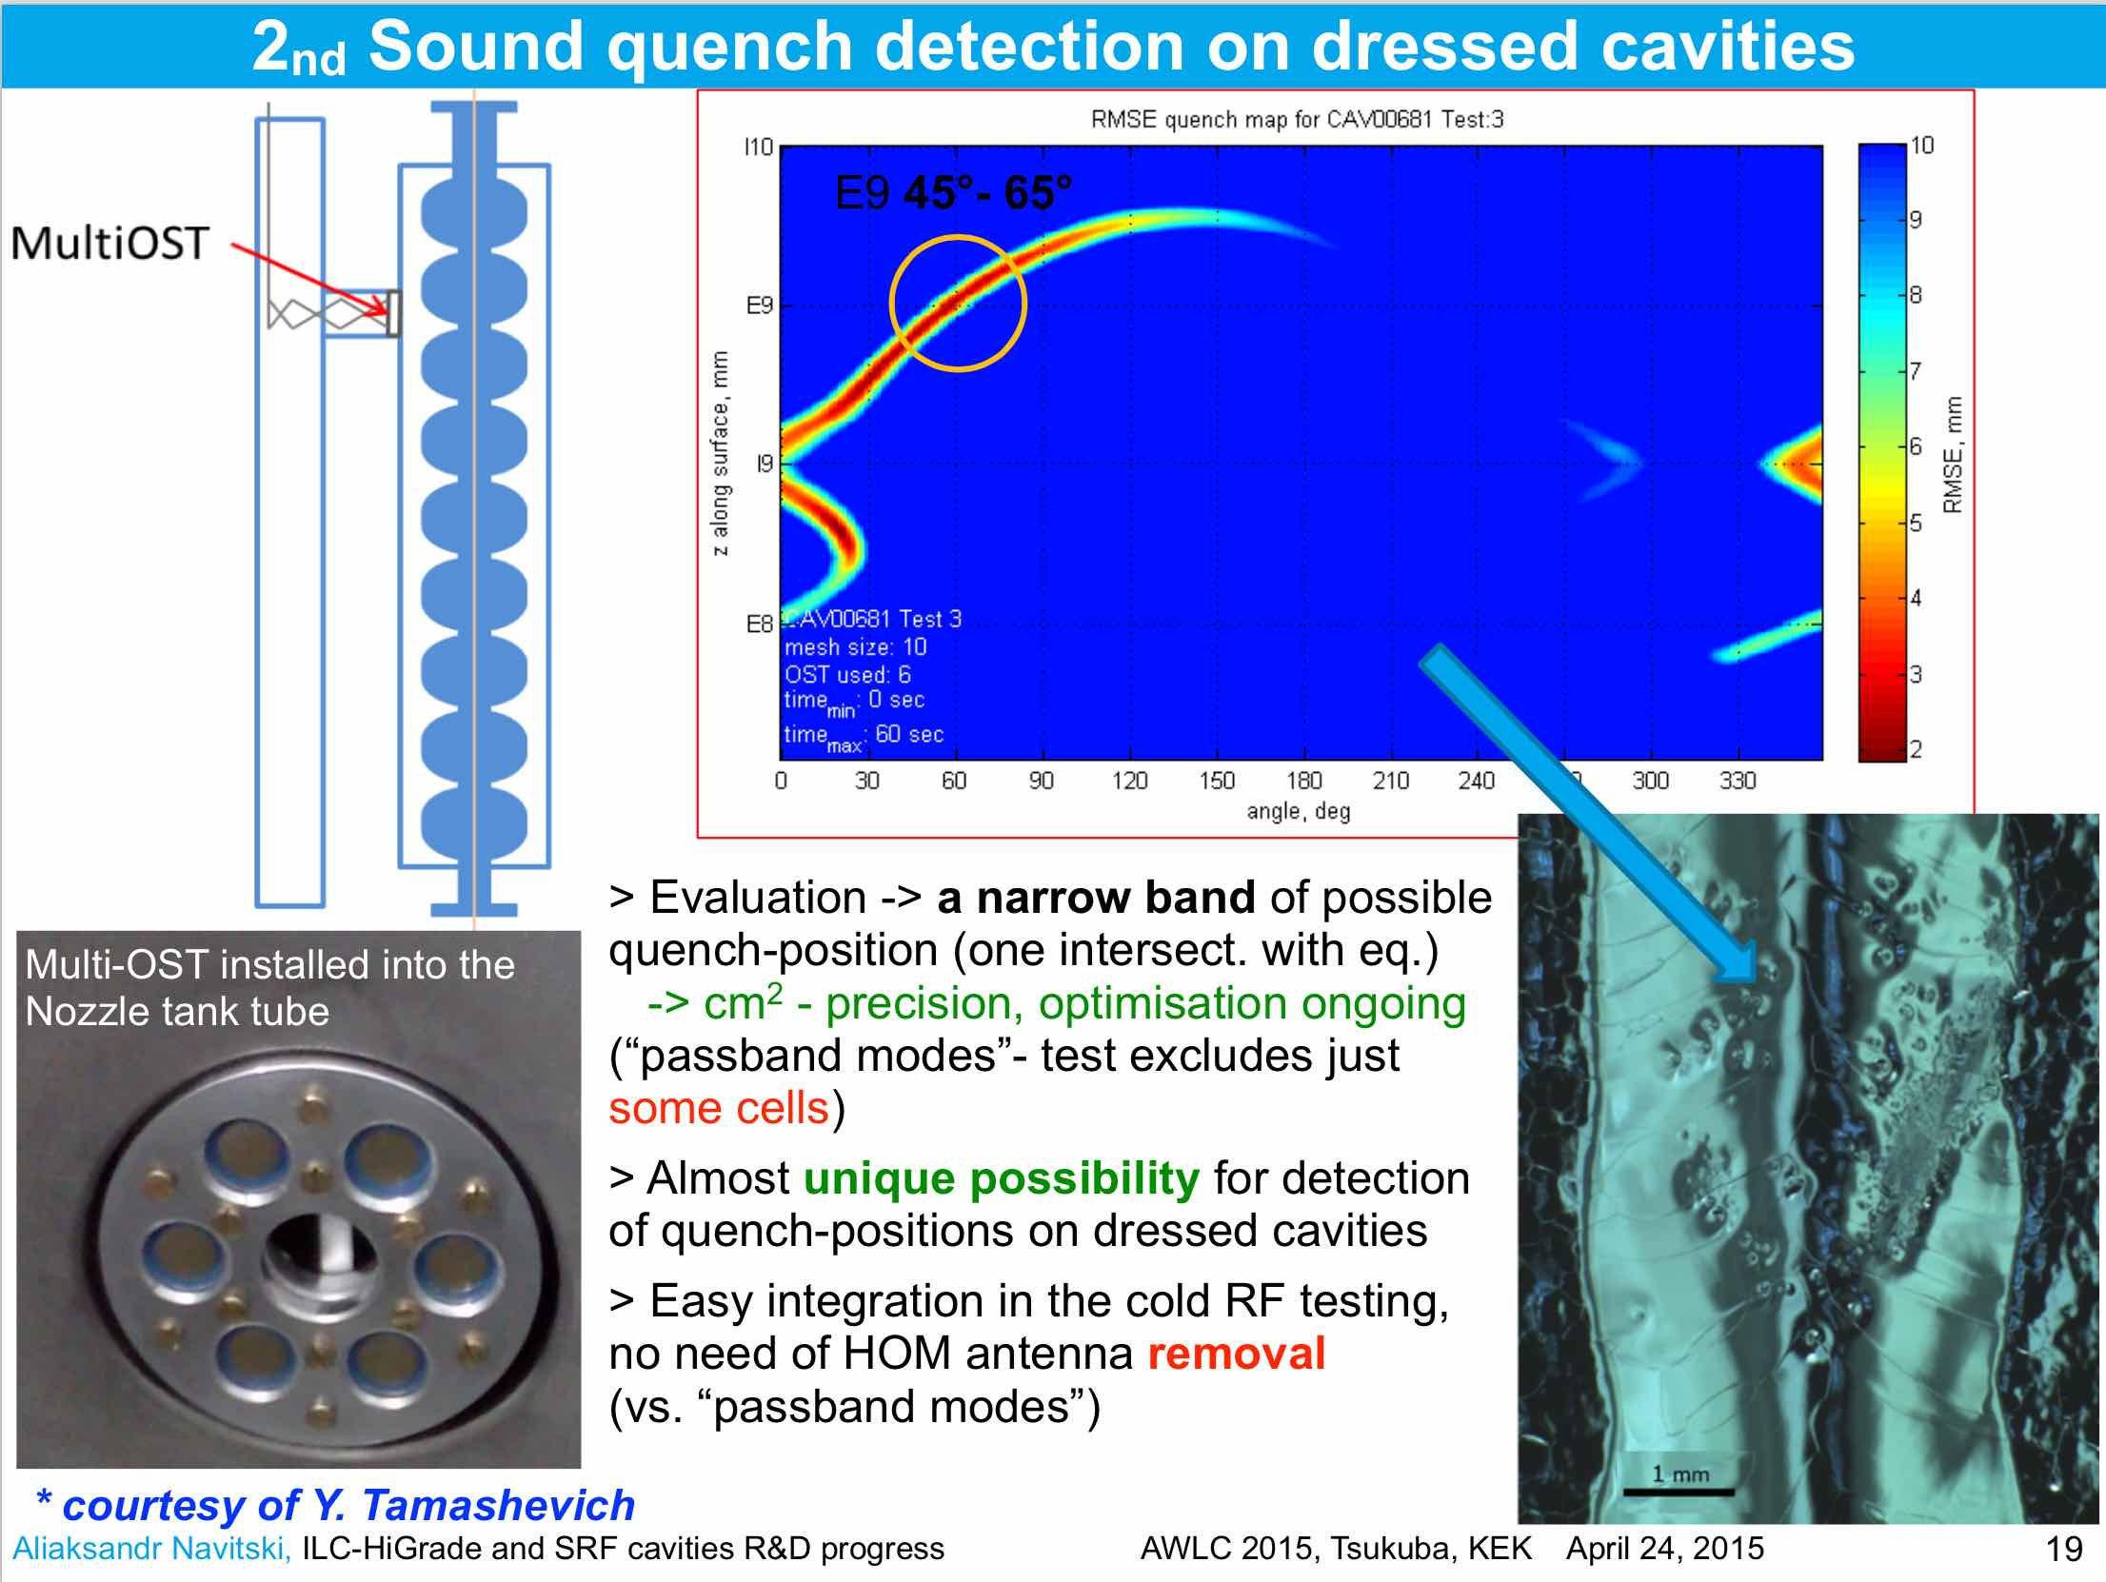
A. Navitski: ILC HiGrade cavity R&D

Slide 14
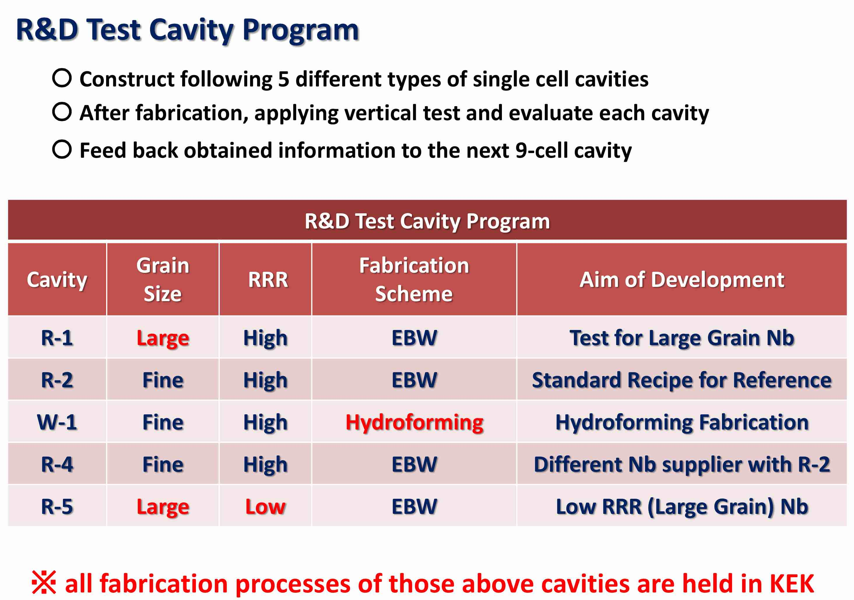
H. Shimizu: KEK single-cell cavity R&D

Slide 15
End
(Sebastian’s presentation file is not uploaded)

