Slide 1
calibrations
IPBPM FILTER TESTS
Siwon Jang
Hoyeong Jeong
Glenn Christian
Talitha Bromwich

Slide 2
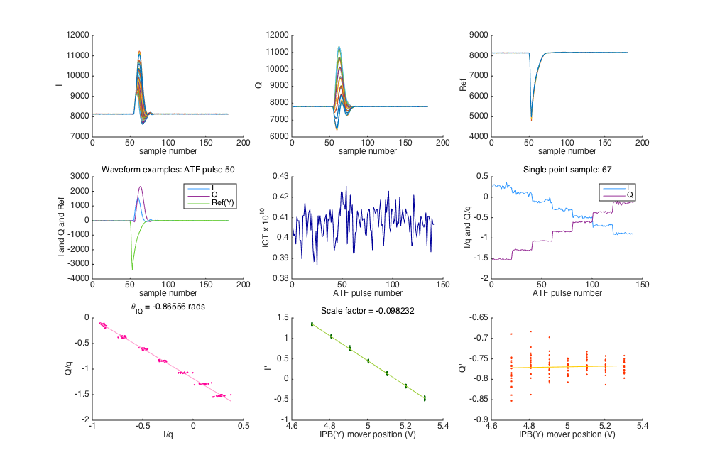
Finding single sample point
Remove pedestals
Find location of max in each pulse
for the I signal.
Find mode sample location of the maximum.
+ 5, so after the peak. Use same sample for I and Q across all pulses.
Find Ref charge peak in the same way. Use this sample number for charge normalisation across all pulses.
Following Michael Davis thesis, 2014

Slide 3
Calibration calculations
Plot I/q vs Q/q for all pulses
Calculate I' (charge normalised)
Calculate Q' (charge normalised)
Plot I' vs mover voltage
Mover μm/V calibration to change to correct units
Plot Q' vs mover voltage
Following Young-Im Kim thesis, 2012

Slide 4

IPB_to_elec_A_with_BPF_split_before_2nd_stage_0dB_cal

Slide 5
Calibration comparisons
Comparison of calibrations with and without 714 MHz BPF
Nominal optics, beam waist (minimum y jitter of 141 nm) centered on IPB.
SIS digitiser gathering data
ICT ~ 4 x 10¹⁰
3.5 dB power splitter to IPBY, sending two signals to the channels for
A and B on the second stage electronics.
714 MHz +/- 10 BPF added.
Plot the change in calibration constants for both cases choosing different single point sample numbers for the calibration.

Slide 6
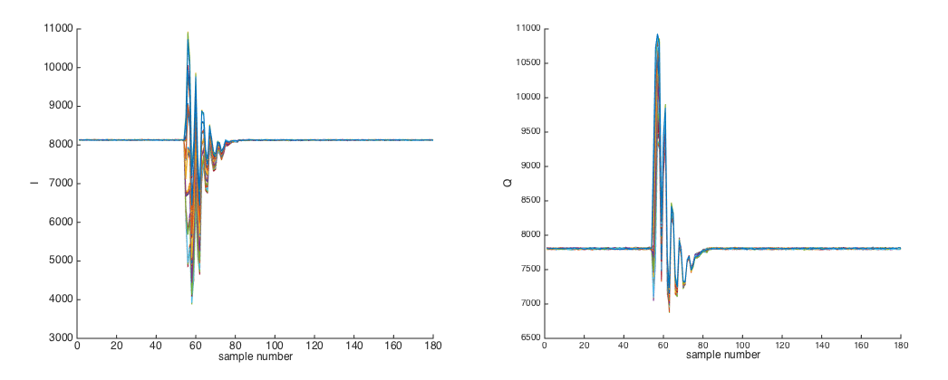
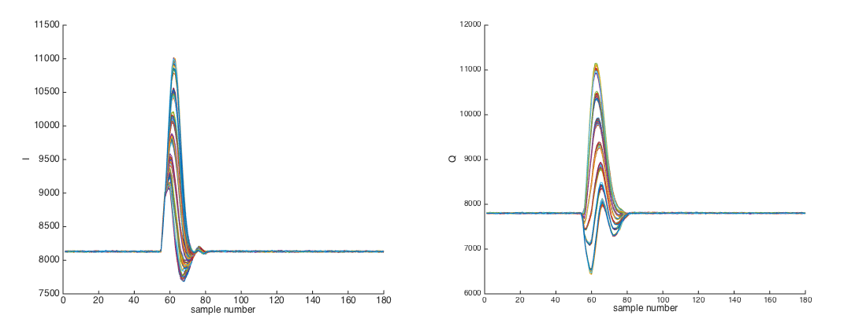
Calibration comparisons
I and Q signals
No filter
I and Q signals
714+/- 10 MHz
filter before 2nd
stage electronics

Slide 7
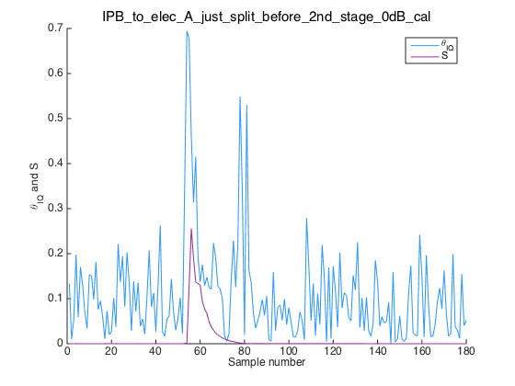
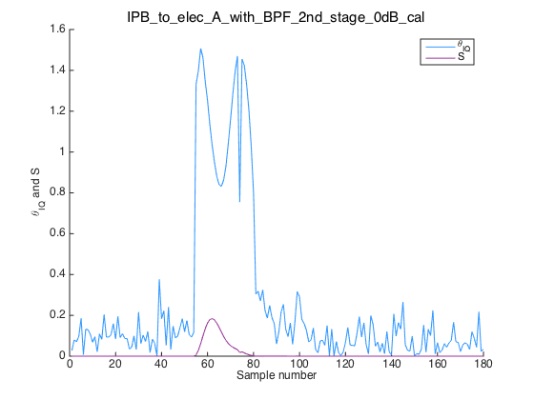
Calibration comparisons
Plots of the change in calibration constants for both cases choosing different single point sample numbers for the calibration from 0 to 180.
No filter
Filter

