Slide 1
Occupancy Study
George Courcoubetis

Slide 2
Goal
Produce the occupancy distribution for FCAL channels for a single train

Slide 3
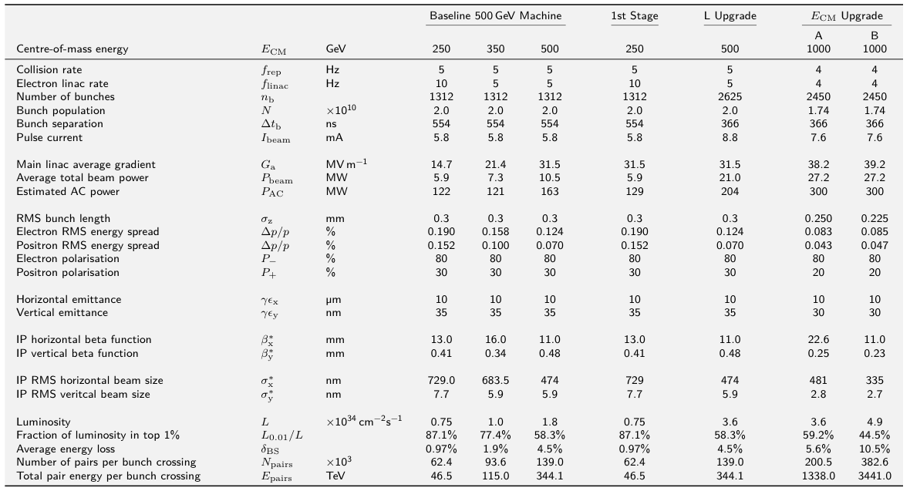
ILC Design Table

Slide 4
Derivation of Luminosity
The train luminosity with a 5hz collision rate is given by:

Slide 5
Processes Included
Pair backgrounds
γγ->hadrons
Bhabha’s
32 lower cross section processes
Criterion: Included processes with expected event number 0.1 per train

Slide 6
Method
Used Norman Graf's Calorimeter Occupancy Driver to extract event number cell ID and position per hit for FCAL
Printed the information for each hit in a text file
One text file per process
A python script was written to input the text files and output train occupancy results

Slide 7
Method
For each physical process in the study, the expected number of events per train was calculated
The number of events included was randomly selected according to the Poisson distribution based on the expected number
The information from each event was combined to calculate the hits per detector cell

Slide 8
Treatment of polarization
The polarization of the beam was assumed to be 80% for electrons 30% for positrons
Processes had 1(γγ) , 2 (e±γ or bhabha), or 4 (mostly e+e-) polarization states
We assumed equal luminosity of each polarization state

Slide 9
Question about bhabhas
There are two kinds of bhabha files
-80e-|+30e+ and +80e-|-30e+
What about -80e-|-30e+ and +80e-|+30e+?
Even if cross section is 0 for e-L/e+L and e-R/e+R the event rate should not be 0 since the polarization is not 100%
For now we have ignored the -80e-|-30e+ and +80e-|+30e+ polarizations and assumed 100% of the luminosity is in -80e-|+30e+ and +80e-|-30e+

Slide 10
Limitations
Available pair background events are 1024, only enough for 39% of a single train
True division between the polarization states is not known

Slide 11
Calculation of expected event numbers
Pair background: 1 per bunch crossing, 2625 events (but only 39% of a single train available)
γγ->hadrons: 1.2 per bunch crossing, 2625*1.2=3150 events
The bhabha sample has a total Luminosity of hence .
Total number of Bhabha events is 100,334 hence 2006.68 is the expected event number per train.
Bhabhas depend on polarization, since assumed a 50-50 polarization ~1003 events were included for each beam polarization

Slide 12

Estimation of number of cells
Assumed FCAL is an annulus shaped detector
Found the hits with the greatest and lowest registered radius in the FCAL, r=1295mm & r=197mm, and the number of layers, n= 62.
Used the cell geometry, 3.5x3.5 mm per cell
Notes:
Say why you need it?

Slide 13
Output
Histograms of number of hits per cell (occupancy) vs. number of cells, both exclusive and integrated over above a given frequency
Text file with numerical display of results

Slide 14
Single train: Results in printed form
Channel occupancy 0 24289956 percent 0.934229076923
Channel occupancy 1 1404692 percent 0.0540266153846
Channel occupancy 2 235374 percent 0.00905284615385
Channel occupancy 3 52012 percent 0.00200046153846
Channel occupancy 4 13609 percent 0.00052342307692
Channel occupancy 5 3346 percent 0.00012869230769
Channel occupancy 6 790 percent 3.03846153846e-05
Channel occupancy 7 179 percent 6.88461538462e-06
Channel occupancy 8 34 percent 1.30769230769e-06
Channel occupancy 9 7 percent 2.69230769231e-07
Channel occupancy 10 1 percent 3.84615384615e-08

Slide 15
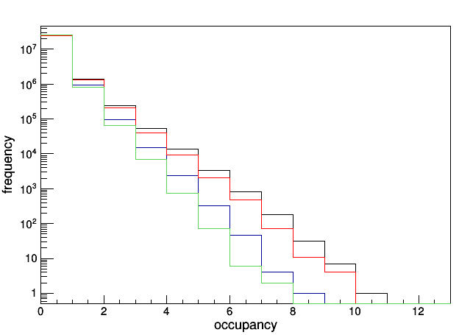
Green = Bhabhas+gammagamma to hadrons red = all except pairs blue = everything except lowcrossection black = everything = Bhabhas + gamma gamma + pair + low-cross section
Insight on the contribution of each process
Notes:
Add title component breakdown put fir

Slide 16
Not that “Low cross section”
Under the title of low cross section, there are two processes with high cross sections
Two fermion production via electron positron annihilation (ids: 39068, 39069, 39070 and 39071) have a total event number of ~2006 per train.
Down and anti-down quark production via two photon interaction (ids: 37577 709 events,37578 ~1100 events, 37579 ~1100 events, 37580 ~1648 events) has a total number of ~4550.

Slide 17
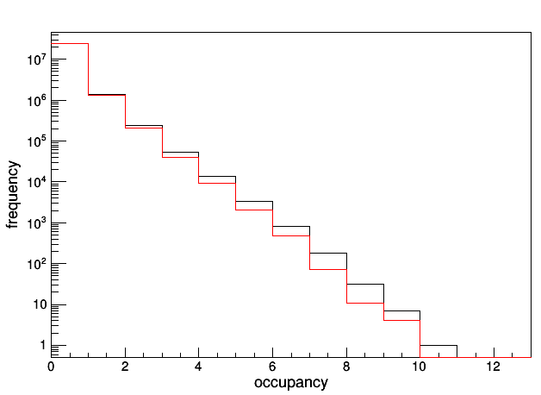
Occupancy contribution of pairs
Black=everything
Red=everything-pairs

Slide 18
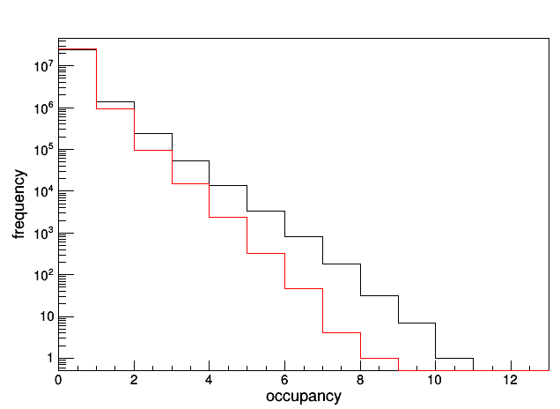
Occupancy contribution of low cross section processes
Black=everything
Red=everything-low cross section

Slide 19
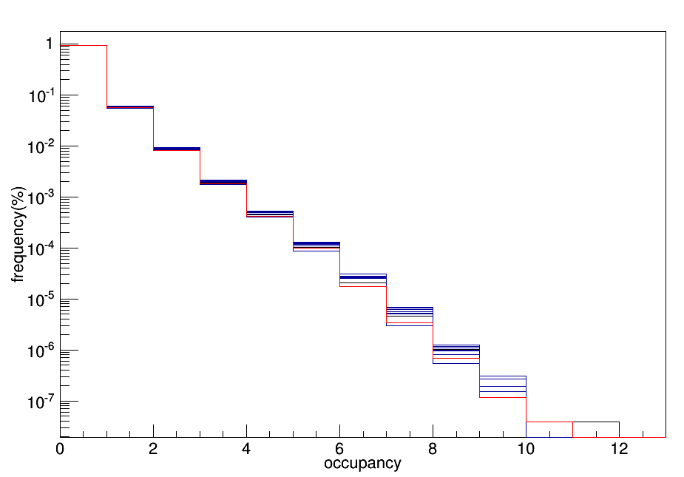
All processes, ten distinct trains in terms of prevalence in percent

Slide 20
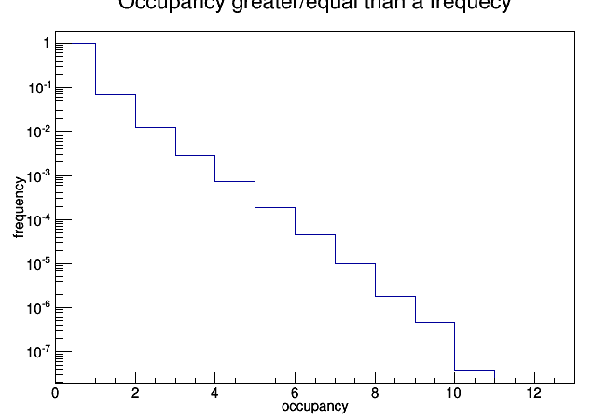
Integrated occupancy
Total missed hits:

Slide 21
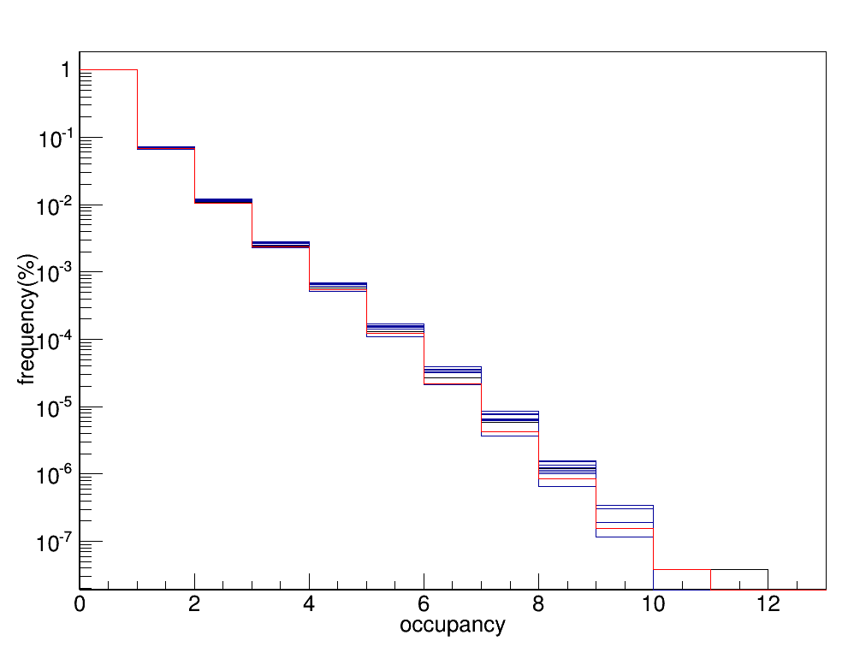
Integrated occupancy, ten distinct trains

Slide 22
Additional Plans
Acquire more pairs
Refine treatment of polarizations, especially bhabhas
Study occupancy by layer
Radial occupancy study
Share the tools for further studies

Slide 23
Calculation of expected event numbers
For the lower crossection processes
Where σ is crossection, P is number of polarisation states
P is 1,2 or 4 since it depends on the polarization state of the electrons and positrons.
1 for processes involving photons , 2 for processes involving one positron (or electron) and a photon and 4 for processes involving an electron and a positron

