Slide 1
CALIBRATIONS
INTEGRATION WINDOWS
3BPM RESOLUTION

Slide 2
Updates on cuts and fitting
Calibration
Cut to remove empty samples.
Cut to ADC saturation range.
Pedestal removal (as before)
Bin data in mover steps.
3 sigma cut on the reference and ICT within bins.
Find mean and σ of I and Q in each bin. Fit to Q vs I plot using a least-squares analysis with uncertainty in y ^{[1]}. Then use the results of this analysis for a least squares analysis with uncertainty in x and y ^{[2]} to find θ_{IQ}.
Cut to remove stuck mover positions.
Find mean and σ of I' and Q' in each bin. Fit to I' vs mover position plot using least squares analysis with uncertainty in y to find scale factor k.
Position calculation
Cut to remove empty samples.
Cut to ADC saturation range.
Pedestal removal.
3 sigma cut on the reference and ICT. (No cut on I or Q??)
Calculate position (as before)
[1] D. Sivia & J. Skilling, Data Analysis: A Bayesian Tutorial, Oxford University Press, 2nd edition, 2006, p65
[2] J. H. Williamson, Least-squares fitting of a straight line, Can. J. Phys. 46 (1968) 1845-1847.

Slide 3
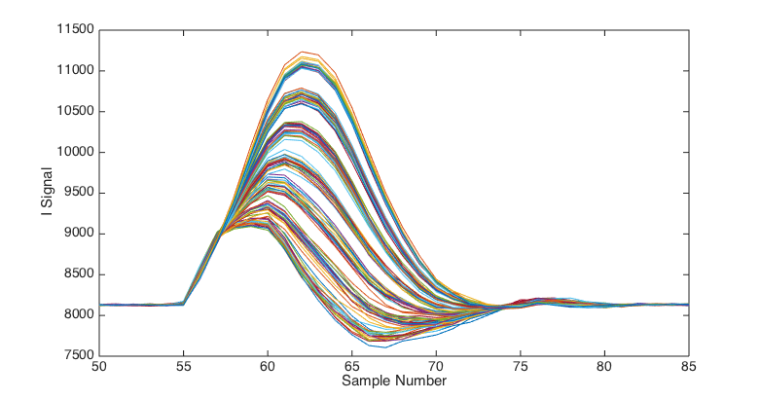
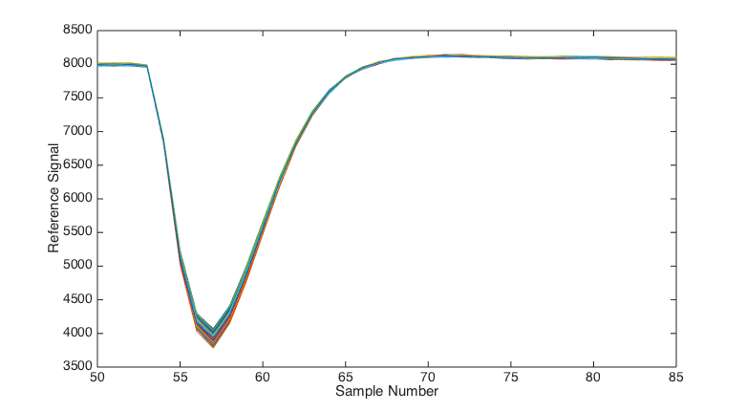
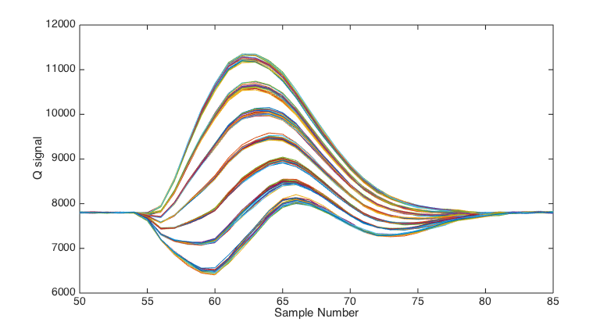
Changing integration window
Data file from 2-on-1 resolution study, 714 MHz BPF on second stage. A electronics.
Pulse starts after sample number 55.
Peak between 59 and 64.
Try changing the integration calibration window across the pulse.

Slide 4
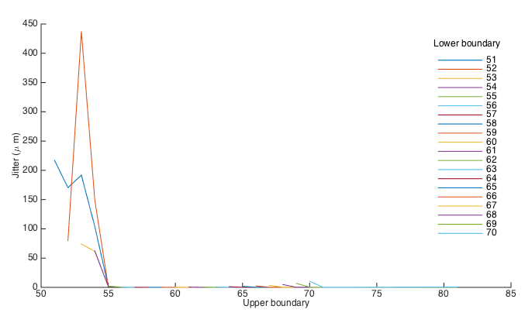
Changing integration window

Slide 5
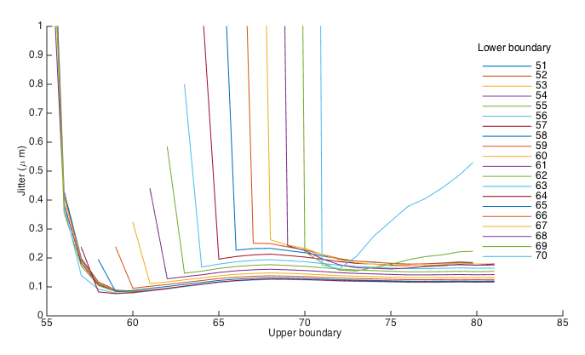
Changing integration window

Slide 6
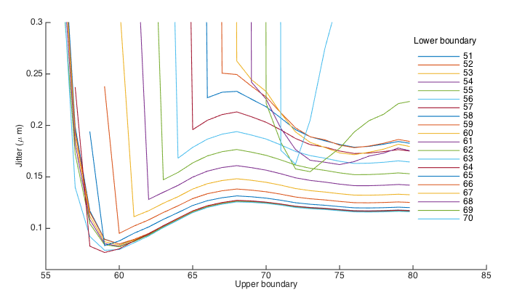
Changing integration window
Smallest jitter measured with integration from 57 to 59

Slide 7
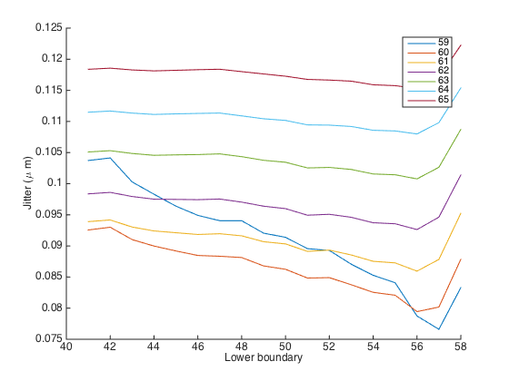
Changing integration window
Fixed upper boundary inside pulse. Extended lower boundary.

Slide 8
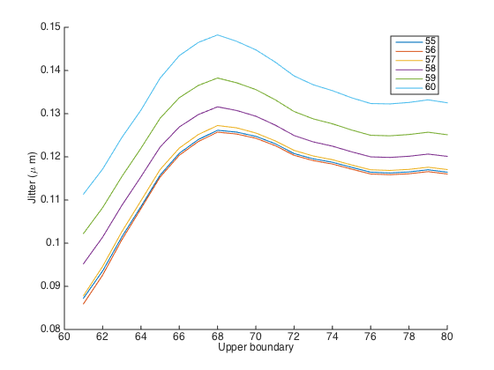
Changing integration window
Fixed lower boundaries within pulse. Extending the upper boundary.

Slide 9
3BPM calibration constants
Data taken by Siwon Jang and Hoyeong Jeong. 714 ± 10 MHz BPF installed to X and Y-ports of 2nd stage electronics.
Charge ~ 0.4 x 10¹⁰.
High beta optics.
Test of calibration factors by comparison with ATF results. Integration from 41 to 81.
IPBPM | θ_{IQ} | ATF θ_{IQ} | k_{IQ} | ATF k_{IQ}
AY | -0.141 ± 0.010 | -0.140 ± 0.001 | 0.1939 ± 0.0093 | -0.1902 ± 0.0032
BY | -0.361 ± 0.019 | -0.376 ± 0.008 | 0.1754 ± 0.0055 | -0.1732 ± 0.0020
CY | -0.507 ± 0.018 | -0.499 ± 0.011 | -0.1886 ± 0.0032 | -0.1848 ± 0.0014
AX | -0.201 ± 0.010 | -0.200 ± 0.002 | -0.0495 ± 0.0015 | 0.0571 ± 0.0007
BX | -0.193 ± 0.007 | -0.179 ± 0.003 | -0.0121 ± 0.0001 | 0.0119 ± 0.0001
CX | -0.243 ± 0.006 | -0.238 ± 0.002 | 0.0179 ± 0.0002 | 0.0180 ± 0.0001

Slide 10
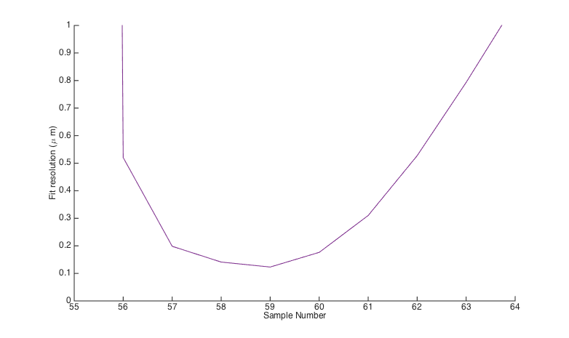
3BPM Single Point
resol_1_BPF_10dB_X_0dB_Y_4.9V_4.42V Smallest fitting resolution on BPM A 0.123 ± 0.005 μm with single point at 59.

Slide 11
3BPM Integration
resol_1_BPF_10dB_X_0dB_Y_4.9V_4.42V Integration from 41 to 81 compared to optimal window.
Integration | BPM | Mean position | Jitter | Resolution (geometric) | Resolution (fitting)
41 to 81 | AY | 5.568 ± 0.032 | 0.558 ± 0.023 | 0.165 ± 0.007 | 0.137 ± 0.006
 | BY | -1.033 ± 0.021 | 0.366 ± 0.015 |  | 0.132 ± 0.005
 | CY | 0.523 ± 0.019 | 0.331 ± 0.014 |  | 0.298 ± 0.012
58 to 61 Geometric minimised | AY | 3.458 ± 0.032 | 0.561 ± 0.023 | 0.153 ± 0.006 | 0.063 ± 0.003
 | BY | -2.560 ± 0.020 | 0.337 ± 0.014 |  | 0.062 ± 0.003
 | CY | 8.943 ± 0.017 | 0.294 ± 0.012 |  | 0.087 ± 0.004
57 to 60 Fitting minimised in AY | AY | 3.152 ± 0.033 | 0.564 ± 0.023 | 0.156 ± 0.006 | 0.050 ± 0.002
 | BY | -2.681 ± 0.019 | 0.336 ± 0.014 |  | 0.050 ± 0.002
 | CY | 10.287 ± 0.017 | 0.293 ± 0.012 |  | 0.062 ± 0.003

Slide 12
3BPM Integration
resol_1_BPF_10dB_X_0dB_Y_4.9V_4.62V Integration from 41 to 81 compared to optimal window.
Integration | BPM | Mean position | Jitter | Resolution (geometric) | Resolution (fitting)
41 to 81 | AY | 3.860 +/- 0.034 | 0.582 +/- 0.024 | 0.145 +/- 0.006 | 0.127 +/- 0.005
 | BY | -2.228 +/- 0.020 | 0.351 +/- 0.014 | 0.145 +/- 0.006 | 0.120 +/- 0.005
 | CY | -0.141 +/- 0.015 | 0.255 +/- 0.010 | 0.145 +/- 0.006 | 0.210 +/- 0.009
58 to 60 Geometric minimised | AY | 1.900 +/- 0.033 | 0.581 +/- 0.024 | 0.127 +/- 0.005 | 0.040 +/- 0.002
 | BY | -3.627 +/- 0.019 | 0.326 +/- 0.013 | 0.127 +/- 0.005 | 0.040 +/- 0.002
 | CY | 8.708 +/- 0.013 | 0.219 +/- 0.009 | 0.127 +/- 0.005 | 0.053 +/- 0.002
57 to 60 Fitting minimised in AY | AY | 1.711 +/- 0.034 | 0.583 +/- 0.024 | 0.127 +/- 0.005 | 0.039 +/- 0.002
 | BY | -3.695 +/- 0.019 | 0.328 +/- 0.013 | 0.127 +/- 0.005 | 0.039 +/- 0.002
 | CY | 9.229 +/- 0.013 | 0.220 +/- 0.009 | 0.127 +/- 0.005 | 0.051 +/- 0.002

