Slide 1
Summary of LumiCal APV test and TAU status.
FCAL HWG
26.5.2015

Slide 2
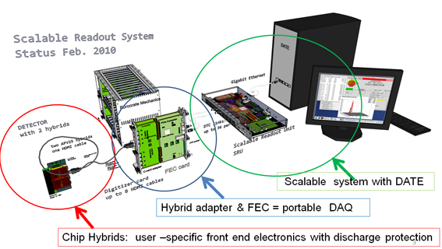
SRS system .
SRS system (from RD51) is a general-purpose chip link interface for a common, portable readout backend allowing to connect a variety of frontend chips connected to the same readout backend.

Slide 3
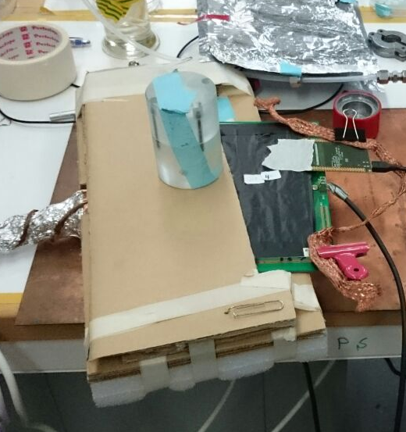
We had a test with the SRS system were we connected APV25 chip to LumiCAl sensors.
APV chip.
Ru 106 source.
LumiCal sensor.
Scintillator box.
Stand.

Slide 4
We measured data from LumiCal sensor connected to modified APV chip (DC coupled - no capacitors) in the SRS system.
Measurements were done with Ru106 source and the upper scintilator in a trigger box (D = 3 cm).
we change the configure APV chip file to set the inverting bit in the mode register to "on" (0x19 original -> 0x39).
run 92 - pedestal run needed by the daq system.
run 93 - first physics run source on tag "6" on bottom area of sector L2 (~pad 10-20) 15k events 1 of 5 with signal.
run 94 - random trigger for pedestal and noise.
run 95 - physics run source on upper part of sector L2 (pad ~45).
run 98 - regular APV chip (AS coupled with capacitors) short physics run (3k events).
run 99 - random trigger for pedestal and noise.

Slide 5
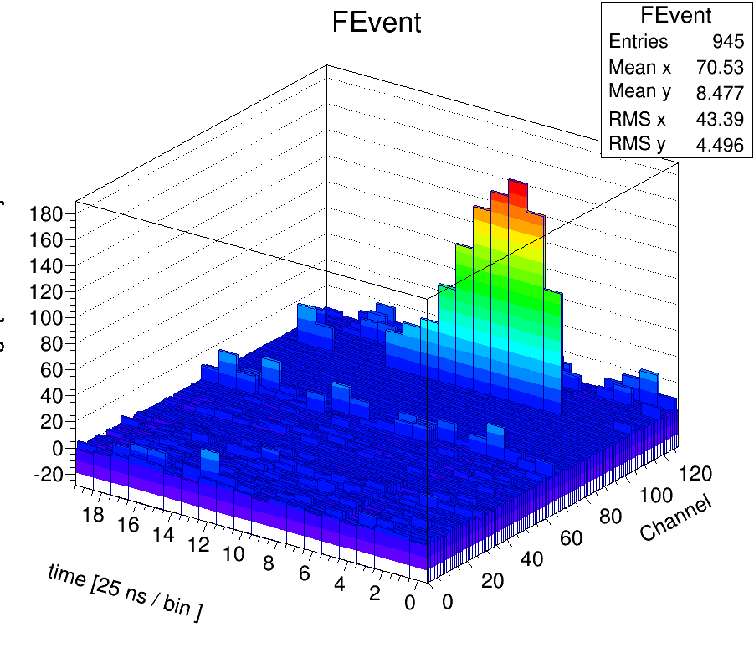
1 signal

Slide 6
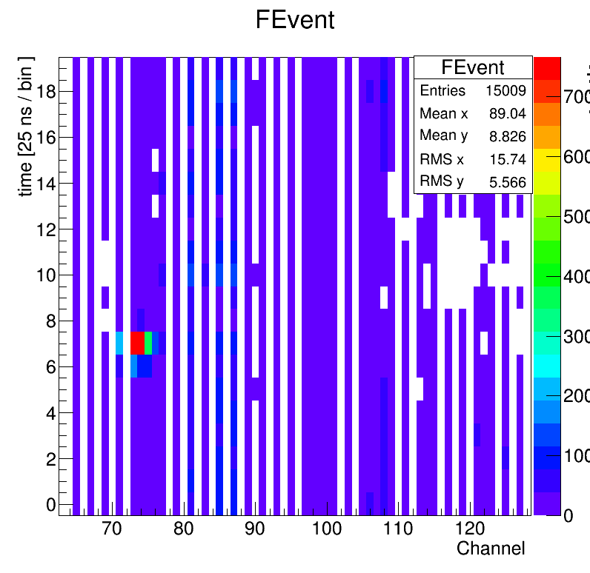
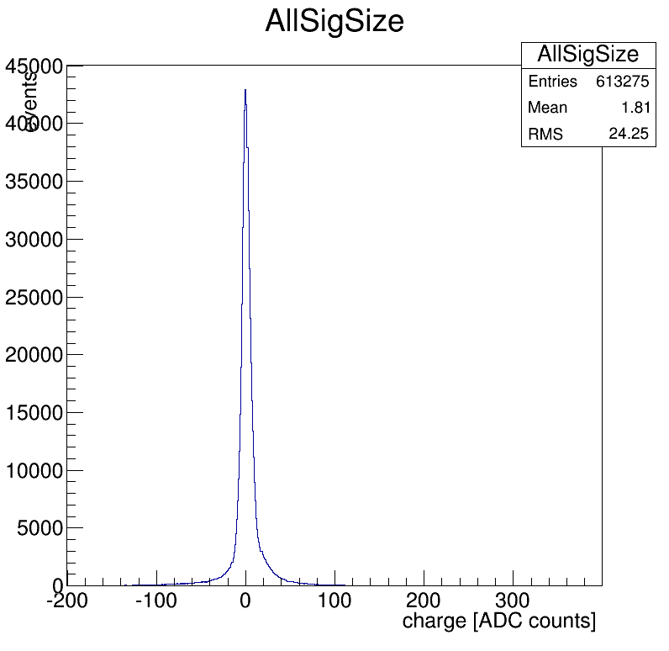
Run 93 (1)

Slide 7
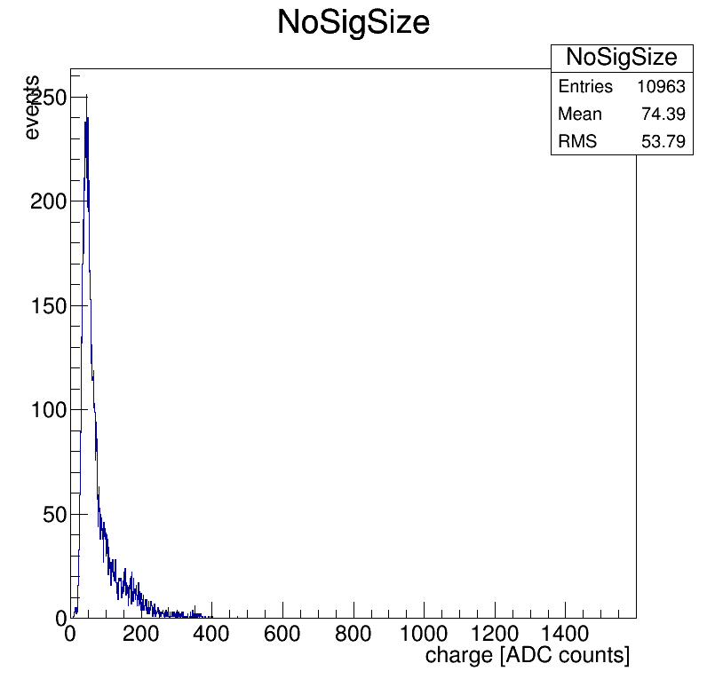
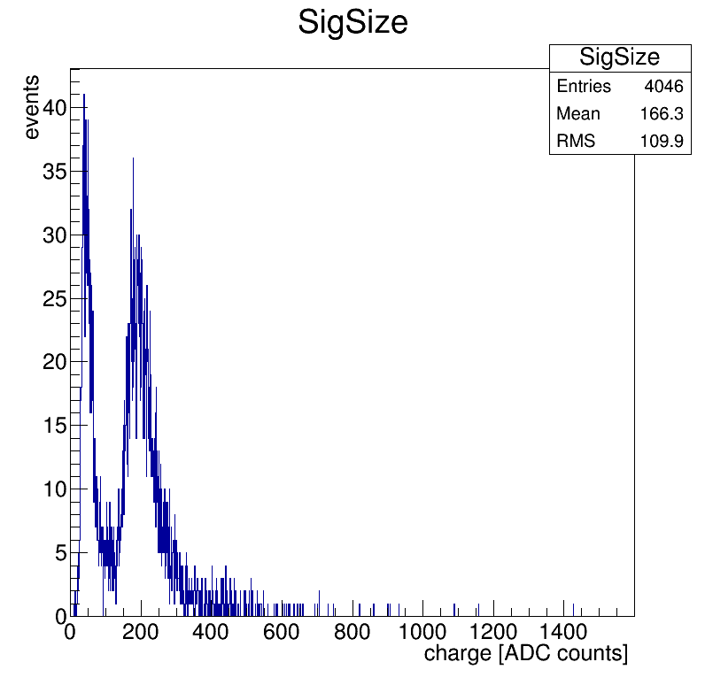
Run 93 (2)

Slide 8
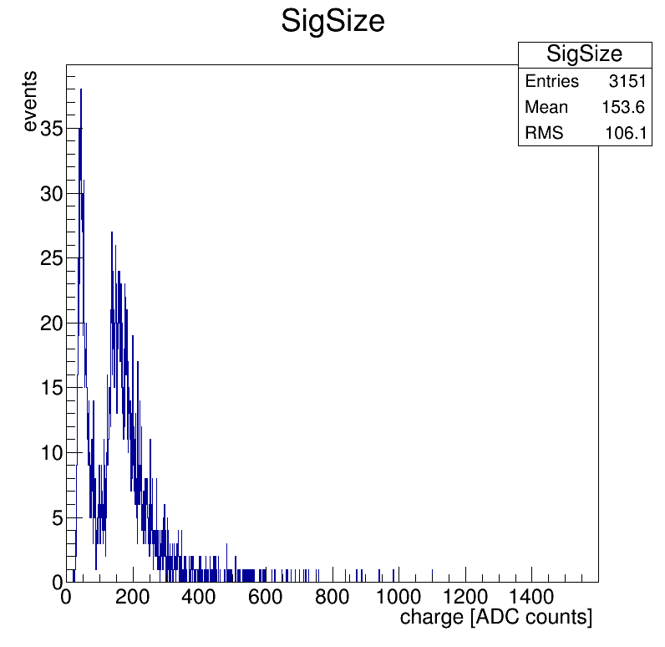
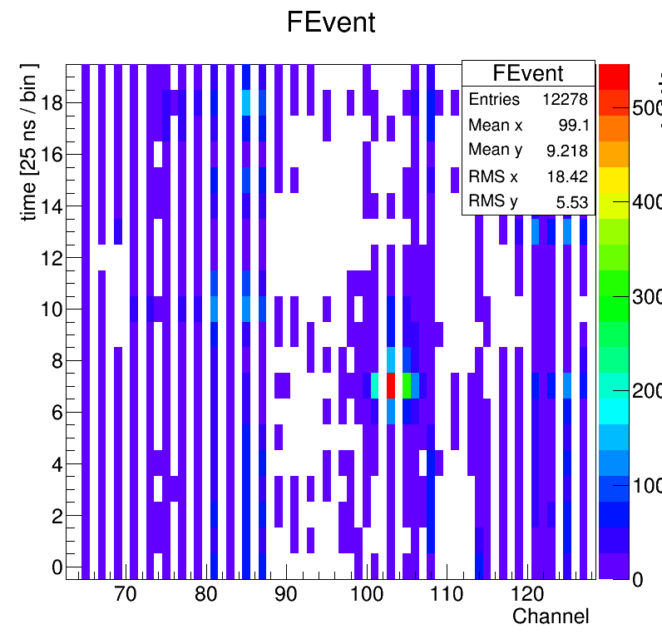
Run 95

Slide 9
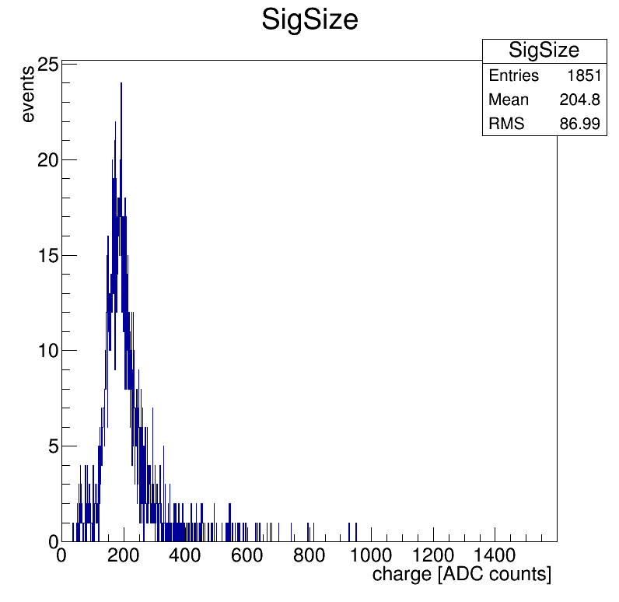
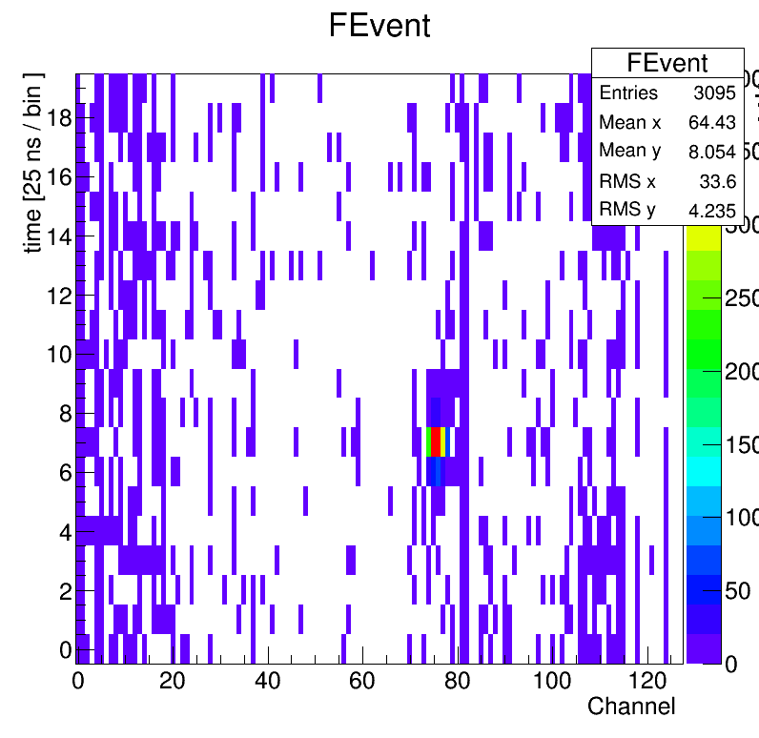
Run 98

Slide 10
Summary
Test was successful!
APV has a limit on signal size of 8 MIP.
It is good for use in the lab (1 mip is needed).
not for test beam?
SRS system is working for VMM2.

