Slide 1
CALIBRATIONS
3BPM RESOLUTION

Slide 2
3BPM Single Point (59), 0dB(y), 10dB(x), Y with BPF
Cedrat(2.8V, 4.75 (-0.03,0.055,-3.5)), PI(3V, 4.5 (0.05,0.05,0.05))
File | BPM | Mean position | Jitter | Resolution (geometric) | Resolution (fitting)
resol_1_BPF_10dB_X_0dB_Y_4.9V_4.62V | AY | -1.128 +/- 0.033 | 0.564 +/- 0.023 | 0.049 +/- 0.002 | 0.046 +/- 0.002
 | BY | 4.228 +/- 0.019 | 0.334 +/- 0.014 | 0.049 +/- 0.002 | 0.046 +/- 0.002
 | CY | 9.308 +/- 0.012 | 0.207 +/- 0.008 | 0.049 +/- 0.002 | 0.060 +/- 0.002
resol_2_BPF_10dB_X_0dB_Y_4.9V_4.62V | AY | -2.093 +/- 0.035 | 0.604 +/- 0.025 | 0.050 +/- 0.002 | 0.047 +/- 0.002
 | BY | 3.673 +/- 0.020 | 0.341 +/- 0.014 | 0.050 +/- 0.002 | 0.047 +/- 0.002
 | CY | 9.307 +/- 0.013 | 0.221 +/- 0.009 | 0.050 +/- 0.002 | 0.064 +/- 0.003
resol_3_BPF_10dB_X_0dB_Y_4.8V_4.62V | AY | -3.963 +/- 0.033 | 0.579 +/- 0.024 | 0.063 +/- 0.003 | 0.060 +/- 0.002
 | BY | 1.320 +/- 0.019 | 0.336 +/- 0.014 | 0.063 +/- 0.003 | 0.060 +/- 0.002
 | CY | 9.503 +/- 0.013 | 0.230 +/- 0.009 | 0.063 +/- 0.003 | 0.073 +/- 0.003
resol_4_BPF_10dB_X_0dB_Y_4.8V_4.62V | AY | -2.399 +/- 0.033 | 0.579 +/- 0.024 | 0.054 +/- 0.002 | 0.051 +/- 0.002
 | BY | 2.244 +/- 0.019 | 0.324 +/- 0.013 | 0.054 +/- 0.002 | 0.051 +/- 0.002
 | CY | 9.555 +/- 0.016 | 0.276 +/- 0.011 | 0.054 +/- 0.002 | 0.069 +/- 0.003

Slide 3
3BPM Single Point (59), 0dB(y), 10dB(x), X with BPF
Cedrat(2.8V, 4.75 (-0.03,0.055,-3.5)), PI(3V, 4.5 (0.05,0.05,0.05))
File | BPM | Mean position | Jitter | Resolution (geometric) | Resolution (fitting)
resol_1_BPF_10dB_X_0dB_Y_4.9V_4.62V | AY | -49.775 +/- 0.114 | 1.982 +/- 0.081 | 0.654 +/- 0.027 | 0.683 +/- 0.028
 | BY | -10.376 +/- 0.093 | 1.609 +/- 0.066 | 0.654 +/- 0.027 | 0.654 +/- 0.027
 | CY | 14.374 +/- 0.077 | 1.335 +/- 0.054 | 0.654 +/- 0.027 | 0.933 +/- 0.038
resol_2_BPF_10dB_X_0dB_Y_4.9V_4.62V | AY | -49.162 +/- 0.113 | 1.963 +/- 0.080 | 0.670 +/- 0.027 | 0.700 +/- 0.029
 | BY | -9.682 +/- 0.085 | 1.467 +/- 0.060 | 0.670 +/- 0.027 | 0.677 +/- 0.028
 | CY | 15.602 +/- 0.070 | 1.216 +/- 0.050 | 0.670 +/- 0.027 | 0.858 +/- 0.035
resol_3_BPF_10dB_X_0dB_Y_4.8V_4.62V | AY | -48.574 +/- 0.098 | 1.705 +/- 0.070 | 0.695 +/- 0.028 | 0.756 +/- 0.031
 | BY | -9.665 +/- 0.075 | 1.293 +/- 0.053 | 0.695 +/- 0.028 | 0.719 +/- 0.029
 | CY | 16.122 +/- 0.072 | 1.253 +/- 0.051 | 0.695 +/- 0.028 | 0.969 +/- 0.040
resol_4_BPF_10dB_X_0dB_Y_4.8V_4.62V | AY | -49.132 +/- 0.110 | 1.906 +/- 0.078 | 0.693 +/- 0.028 | 0.729 +/- 0.030
 | BY | -10.044 +/- 0.091 | 1.580 +/- 0.065 | 0.693 +/- 0.028 | 0.695 +/- 0.028
 | CY | 16.398 +/- 0.079 | 1.369 +/- 0.056 | 0.693 +/- 0.028 | 0.958 +/- 0.039

Slide 4
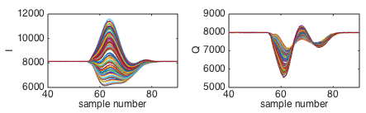
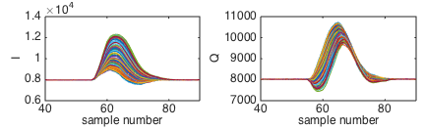
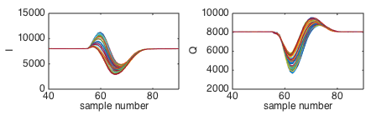
3BPM Integration window changes
IPA_Y_0dB_BPF_cal, IPB_Y_0dB_BPF_cal, IPC_Y_0dB_BPF_cal
A
Pulse starts 56.
Ends 82.
B
C

Slide 5
3BPM Integration window changes
resol_1_BPF_10dB_X_0dB_Y_4.9V_4.62V
File | BPM | Mean position | Jitter | Resolution (geometric) | Resolution (fitting)
Singe Sample 59 (optimal) | AY | -1.128 +/- 0.033 | 0.564 +/- 0.023 | 0.049 +/- 0.002 | 0.046 +/- 0.002
 | BY | 4.228 +/- 0.019 | 0.334 +/- 0.014 |  | 0.046 +/- 0.002
 | CY | 9.308 +/- 0.012 | 0.207 +/- 0.008 |  | 0.060 +/- 0.002
Integration 58 to 59 (optimal) | AY | -0.793 +/- 0.032 | 0.563 +/- 0.023 | 0.045 +/- 0.002 | 0.043 +/- 0.002
 | BY | 4.263 +/- 0.019 | 0.334 +/- 0.014 |  | 0.043 +/- 0.002
 | CY | 9.972 +/- 0.012 | 0.208 +/- 0.008 |  | 0.054 +/- 0.002
Integration 41 to 81 | AY | -3.044 +/- 0.032 | 0.561 +/- 0.023 | 0.145 +/- 0.006 | 0.134 +/- 0.005
 | BY | 2.846 +/- 0.021 | 0.366 +/- 0.015 |  | 0.128 +/- 0.005
 | CY | -0.107 +/- 0.015 | 0.258 +/- 0.011 |  | 0.229 +/- 0.009
Integration 58 to 67 | AY | -1.605 +/- 0.032 | 0.559 +/- 0.023 | 0.161 +/- 0.007 | 0.150 +/- 0.006
 | BY | 3.642 +/- 0.021 | 0.362 +/- 0.015 |  | 0.140 +/- 0.006
 | CY | 3.615 +/- 0.015 | 0.259 +/- 0.011 |  | 0.226 +/- 0.009
Integration 54 to 63 | AY | -0.989 +/- 0.032 | 0.563 +/- 0.023 | 0.101 +/- 0.004 | 0.099 +/- 0.004
 | BY | 4.111 +/- 0.020 | 0.343 +/- 0.014 |  | 0.097 +/- 0.004
 | CY | 7.148 +/- 0.013 | 0.233 +/- 0.010 |  | 0.191 +/- 0.008

Slide 6
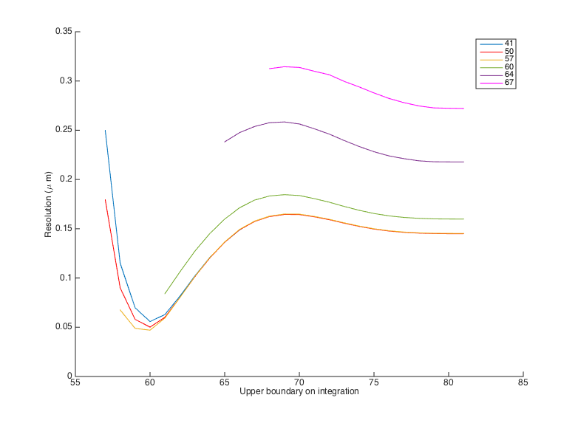
3BPM integration window – geometric resolution
resol_1_BPF_10dB_X_0dB_Y_4.9V_4.62V
Resolution is best when the upper boundary is around 60 and when the lower boundary is inside the start of the pulse.

Slide 7
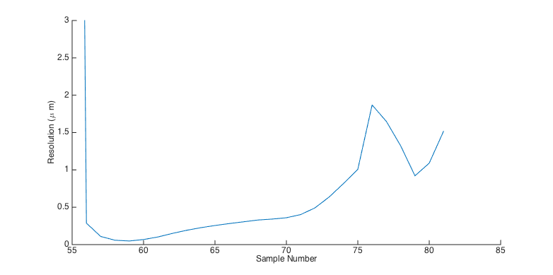
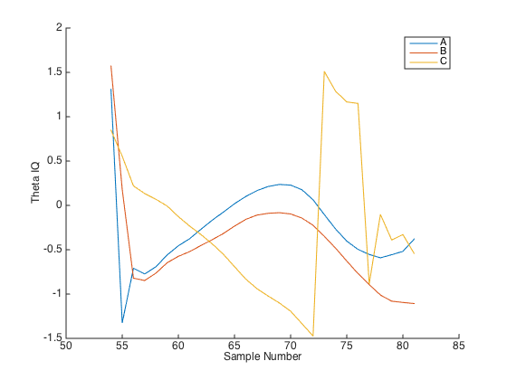
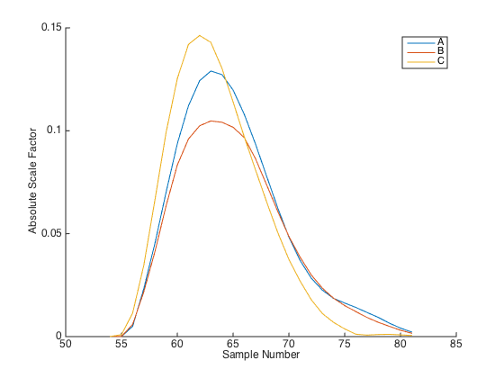
3BPM single sample
resol_1_BPF_10dB_X_0dB_Y_4.9V_4.62V

Slide 8
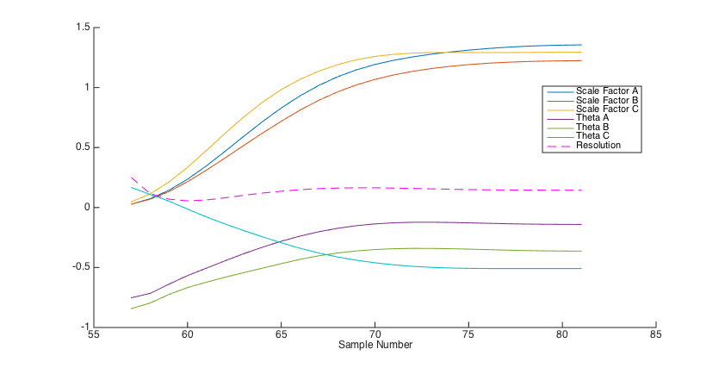
3BPM integration – fixed lower boundary 41
resol_1_BPF_10dB_X_0dB_Y_4.9V_4.62V

