Slide 1
Phase Monitor Measurements April 2015
Jack Roberts

Slide 2
Overview
Took measurements in April with the phase monitors to try to understand why we have poor resolution (design 0.2 degrees, measured 0.8 degrees).
Swapped phase monitors between the different sets of electronics and phase shifters between the different sets of electronics.

Slide 3
Calibrations
I took a calibration (vary phase shifter through 360 degrees, calculate degrees per volt output) with the specific electronics setup before every measurement.
Possibly a few interesting features in the calibrations to look at as well but just jitter/resolution measurements shown here.

Slide 4
Moving monitors between electronics
Observation: Noise stays with mixer not with phase monitor.

Slide 5
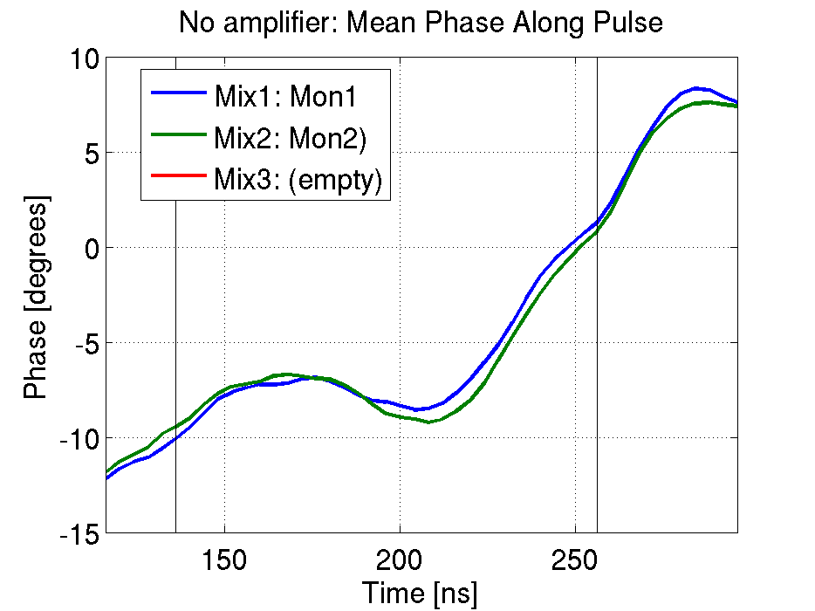
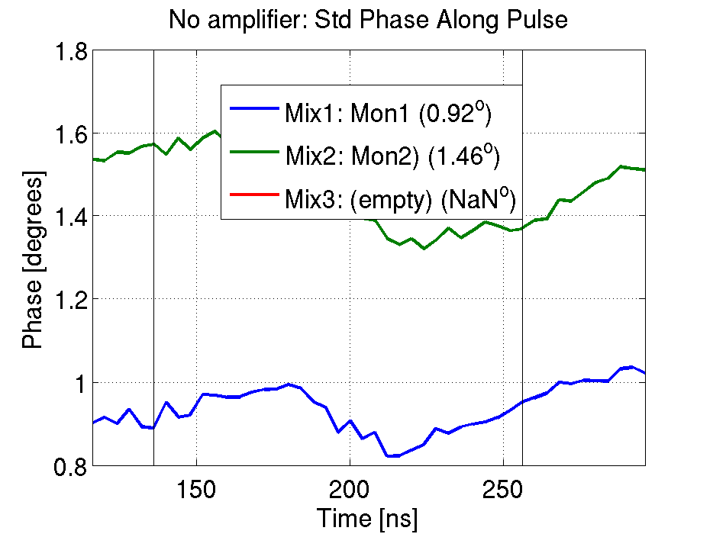
Mix1 Mon1 and Mix2 Mon2

Slide 6
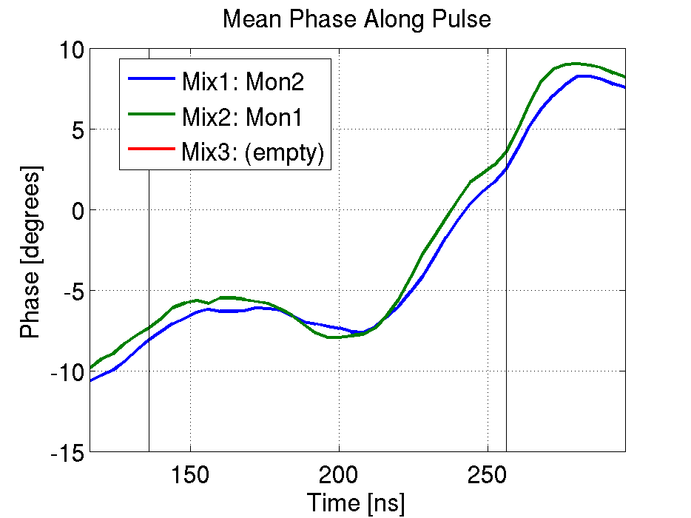
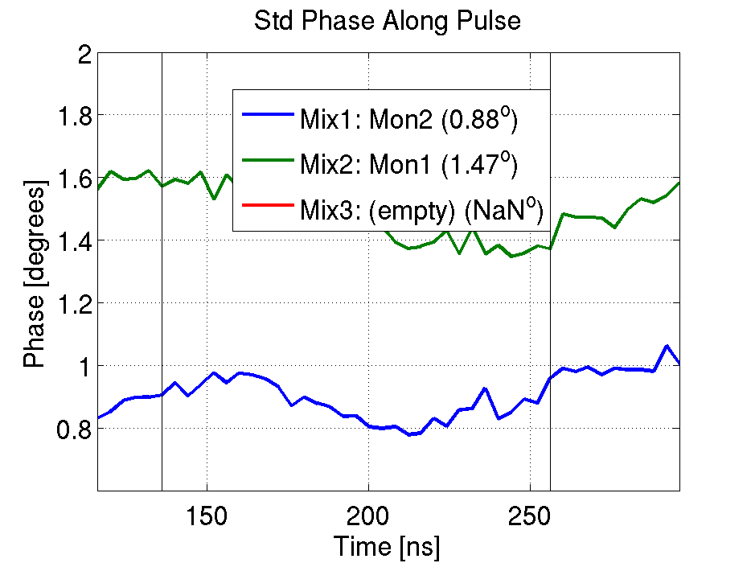
Mix1 Mon2 and Mix2 Mon1

Slide 7
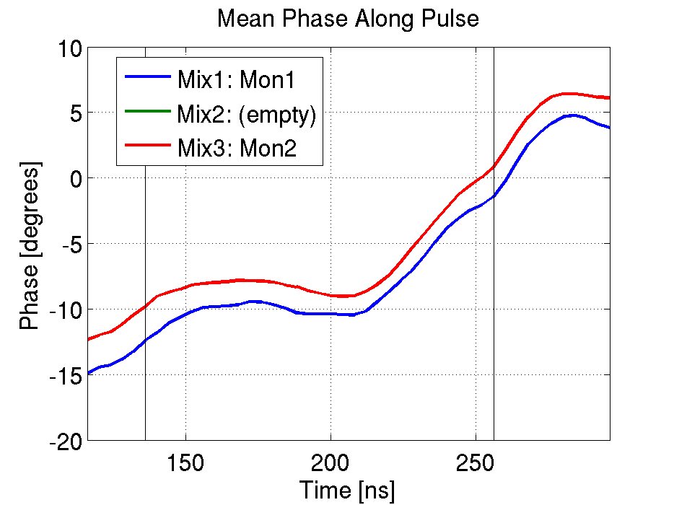
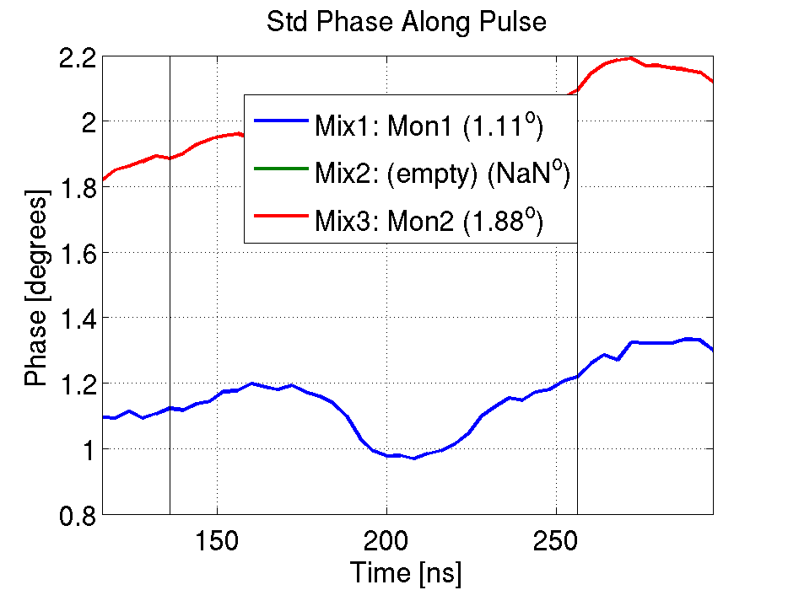
Mix1 Mon1 and Mix3 Mon2

Slide 8
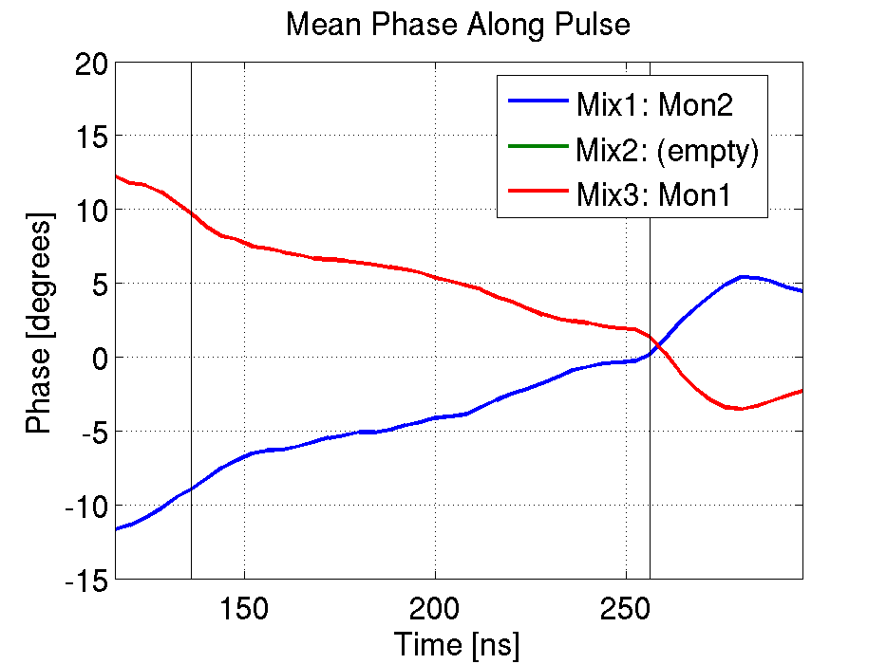
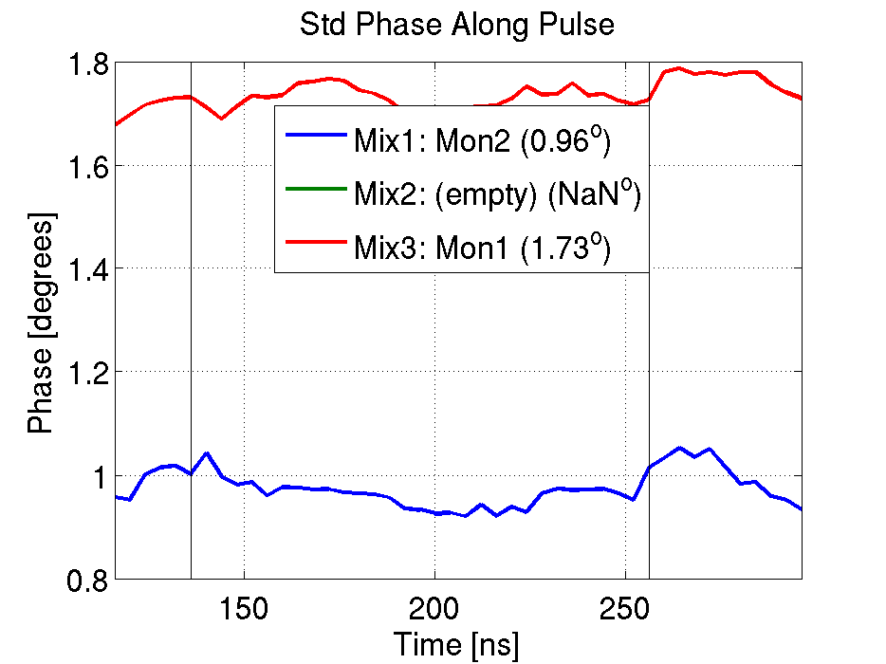
Mix1 Mon2 and Mix3 Mon1

Slide 9
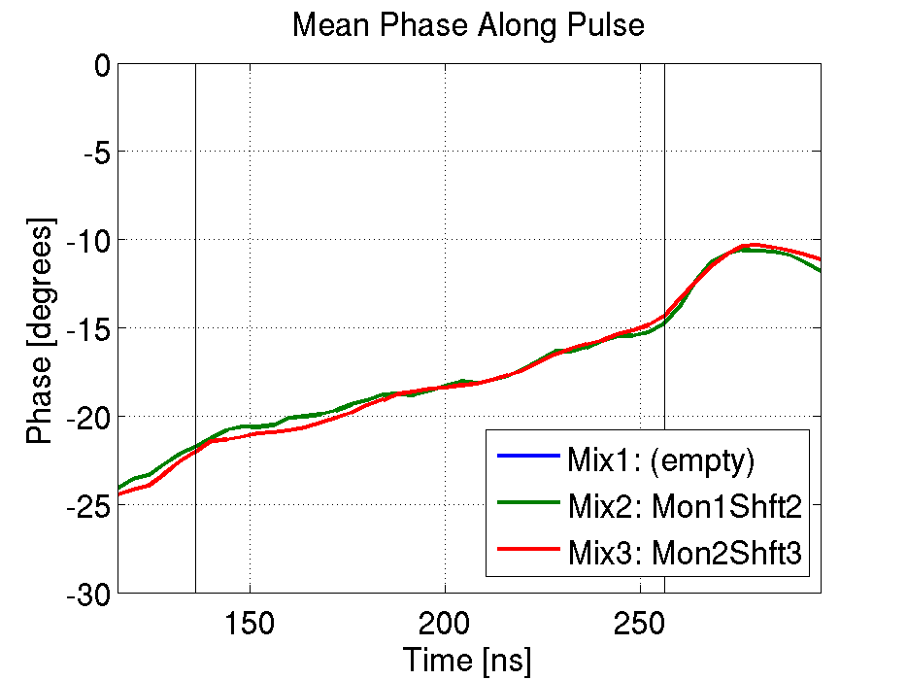
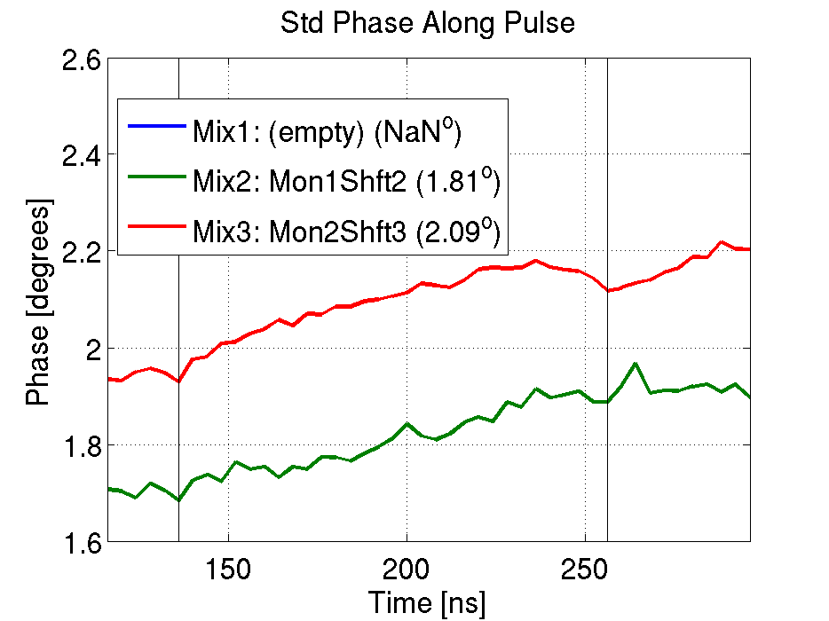
Mix2Mon1 and Mix3Mon2

Slide 10
Moving phase shifters between electronics
Observation: Noise stays with phase shifter not with mixer.

Slide 11
Mix1Mon1Shft1 and Mix2Mon2Shft2

Slide 12
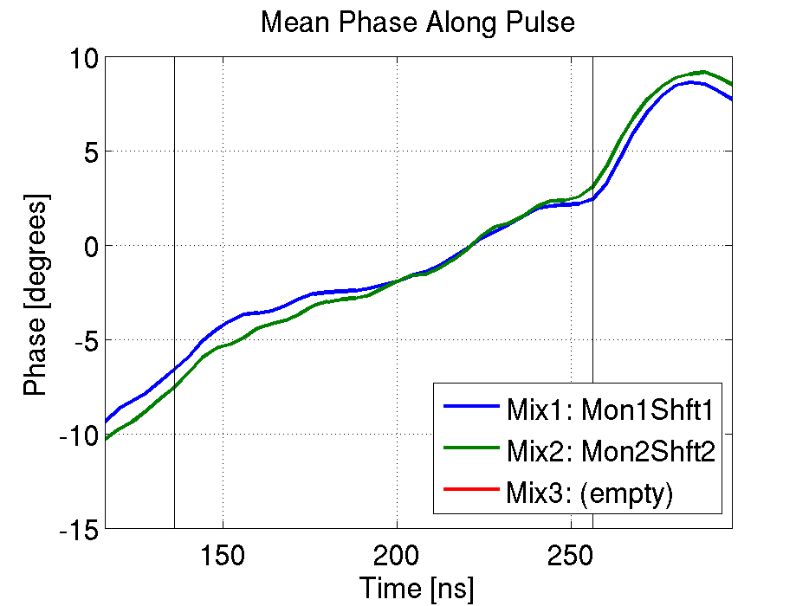
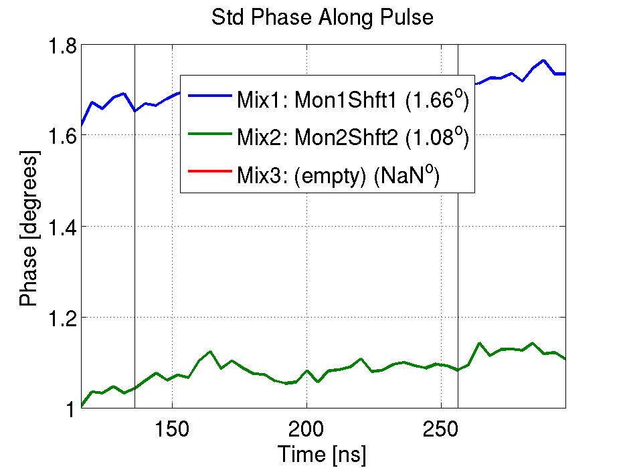
Mix1Mon1Shft2 and Mix2Mon2Shft1
Legend is wrong! (should be Mix1Mon1Shft2 and Mix2Mon2Shft1)

Slide 13
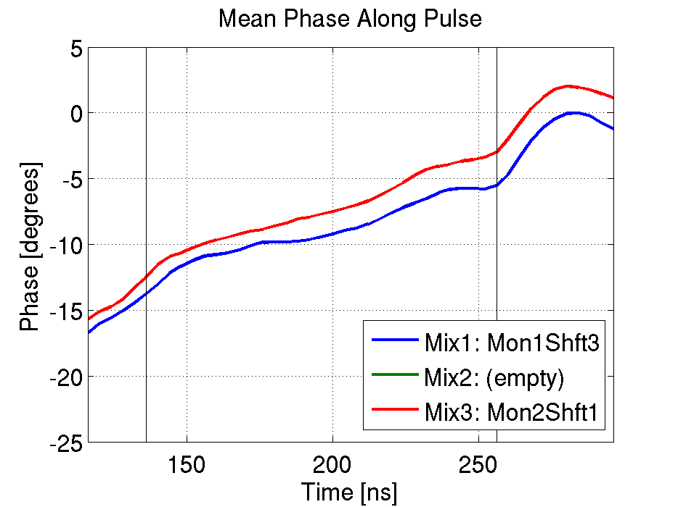
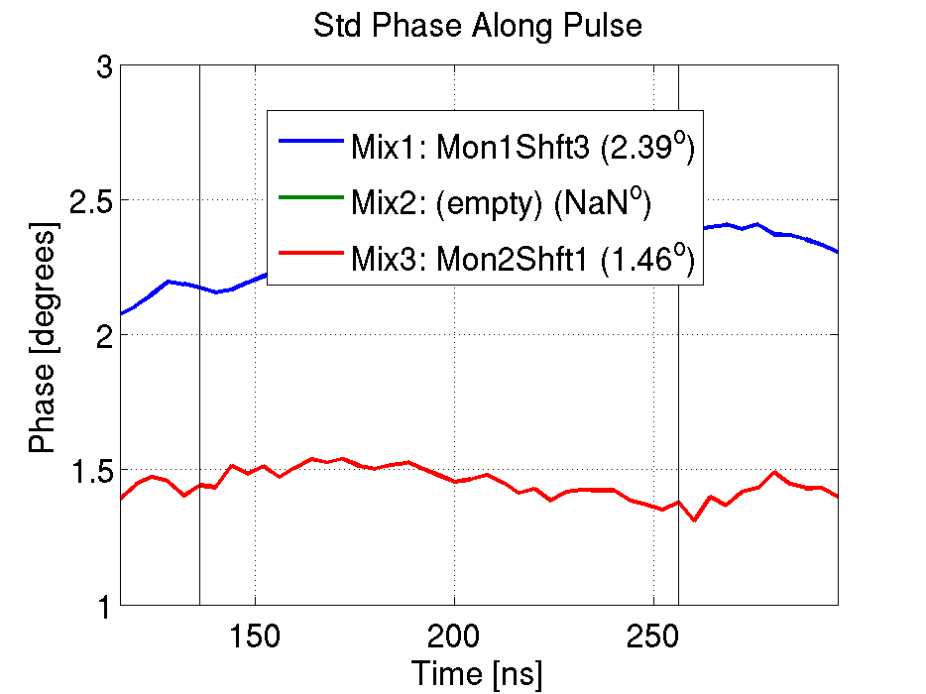
Mix1Mon1Shft3 and Mix3Mon2Shft1

Slide 14
Summary Table
Data Set | Monitor A | Mixer A | Shifter A | Monitor B | Mixer B | Shifter B | Jitter A (deg) | Jitter B (deg) | Jitter Ratio A/B | Resolution (deg) | Correlation | Gradient
20150421_0951 | 1 | 1 | 1 | 2 | 2 | 2 | 0.92 | 1.46 | 0.63 | 0.71 | 0.81 | 1.22
20150421_1401 | 2 | 1 | 1 | 1 | 2 | 2 | 0.88 | 1.47 | 0.60 | 0.74 | 0.82 | 1.32
20150421_1501 | 2 | 1 | 1 | 1 | 2 | 2 | 1.87 | 2.32 | 0.81 | 0.73 | 0.92 | 1.09
20150421_1534 | 1 | 1 | 1 | 2 | 3 | 2 | 1.11 | 1.88 | 0.59 | 0.96 | 0.81 | 1.24
20150421_1637 | 2 | 1 | 1 | 1 | 3 | 2 | 0.96 | 1.73 | 0.55 | 1.71 | 0.77 | 1.22
20150421_1722 | 1 | 1 | 2 | 2 | 2 | 1 | 1.41 | 0.99 | 1.42 | 0.63 | 0.86 | 0.61
20150422_1023 | 1 | 1 | 2 | 2 | 2 | 1 | 1.6 | 1.07 | 1.50 | 0.84 | 0.75 | 0.52
20150422_1031 | 1 | 1 | 2 | 2 | 2 | 1 | 1.66 | 1.08 | 1.54 | 0.89 | 0.72 | 0.51
20150422_1323 | 1 | 1 | 3 | 2 | 3 | 1 | 2.39 | 1.46 | 1.64 | 1.11 | 0.87 | 0.58
20150422_1331 | 1 | 1 | 3 | 2 | 3 | 1 | 2.09 | 1.17 | 1.79 | 1.08 | 0.77 | 0.48
20150422_1513 | 1 | 2 | 2 | 2 | 3 | 3 | 1.81 | 2.09 | 0.87 | 0.53 | 0.95 | 1.08
20150422_1551 | 1 | 1 | 1 | 2 | 2 | 2 | 1.27 | 1.76 | 0.72 | 0.77 | 0.86 | 1.12

Slide 15
Amplifier to SiS Digitisers
SiS Digitisers (3320): 12 bit, 250 MHz, +/- 2.5 V
Phase monitor signals typically ~ +/- 500 mV
0.2 degrees ~= 1 count.
End last year moved to using an amplifier to reduce effect of ADC noise on the resolution.
This improved the resolution last year (from memory from ~0.7 degrees to ~0.4 degrees).
Took data with and without the amplifier in April this year as well.
Noticed no improvement in resolution with the amplifier.
Oscillation in the baseline noise seen for one of the amplifier outputs: ~10mV at ~4MHz.
The baseline jitter from this channel increases by a larger factor than the amplification factor.
The baseline jitter from the well functioning channel is not increased.

