Slide 1
Results from April Data Analysis: R56 scan and Feedforward runs
Jack Roberts
FONT Meeting 12/6/15

Slide 2
Contents of April Data
Phase monitor studies: Comparison between sets of electronics, remote vs. mechanical phase shifters.
R56 in TL1: Second attempt varying R56 in TL1 to minimise downstream phase jitter.
Feedforward runs: Several feedforward attempts when we saw better correlation / lower jitter.
(more to show but not today)
IN THIS PRESENTATION

Slide 3
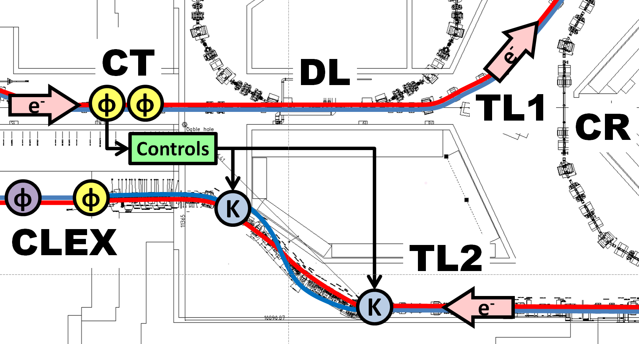
CTF3 Phase Feedforward Layout
UPSTREAM
MON1
MON2
TL1
R56 = 0
DOWNSTREAM
MON3
TL2
R56 = -0.2

Slide 4
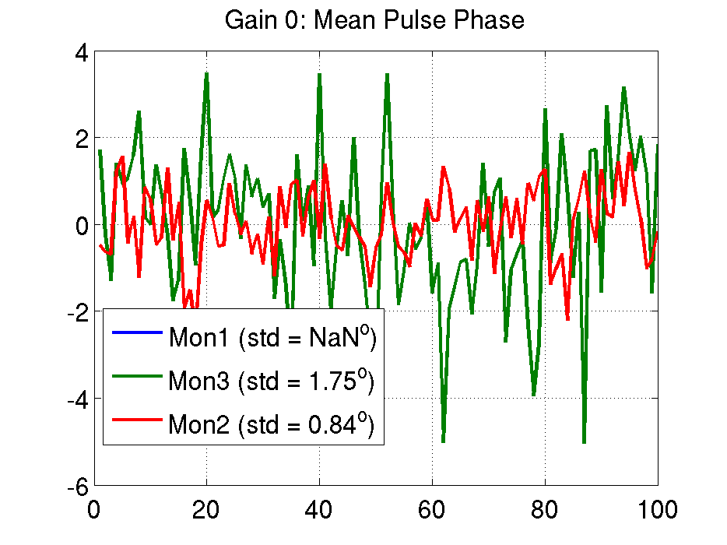
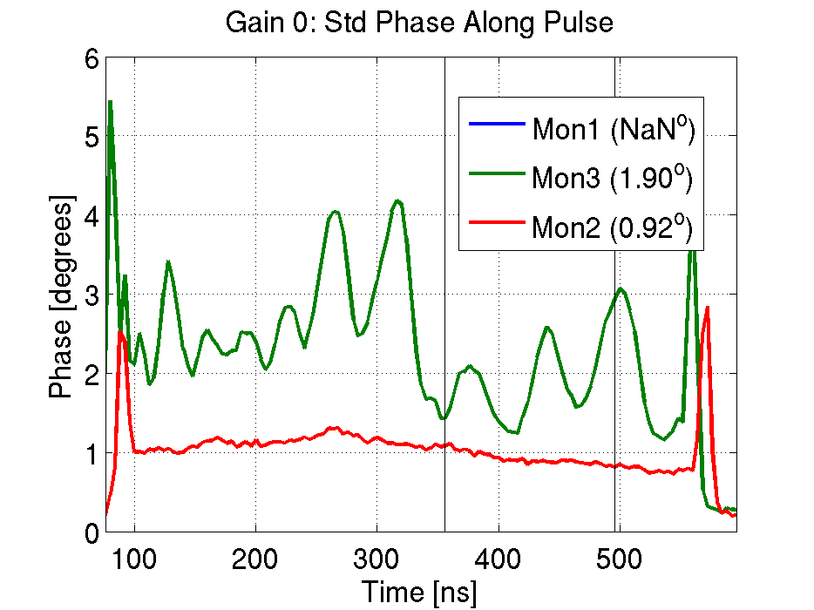
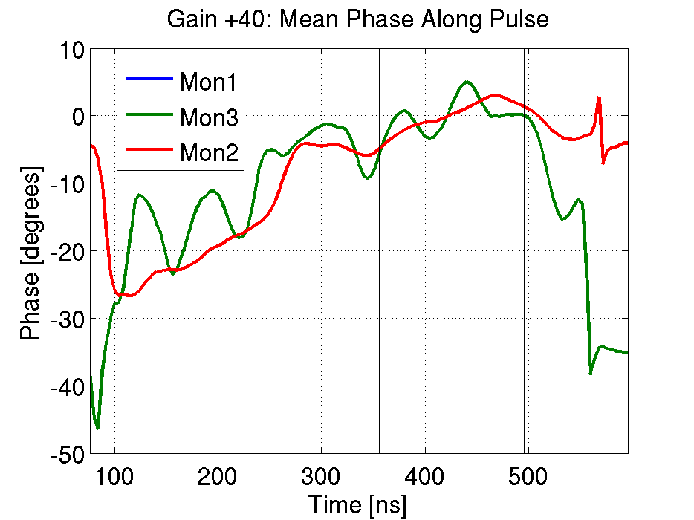
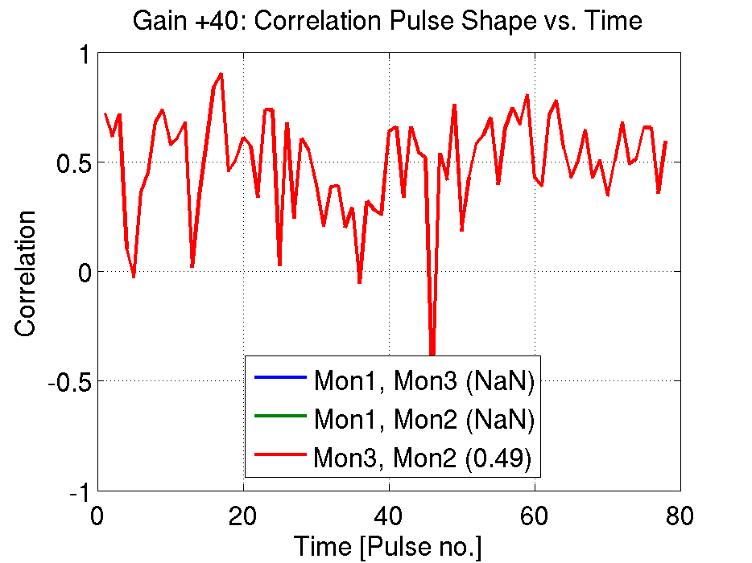
Different Correlation/Jitter Calculations
In each trigger (0.8 Hz): one beam pulse (up to 1.2 us long), acquire 500 samples (4ns/sample) from each monitor
Pulse Mean
Take the mean pulse phase for each trigger:
Jitter in pulse mean for each monitor.
Correlation between pulse means.
Lowest downstream jitter 2014: ~1.4 degrees
Per Sample
Take the phase at each sample in each trigger:
Jitter for each sample no. for each monitor.
Correlation vs. sample no. along the pulse.
Lowest downstream jitter 2014: ~1.7 degrees (mean sample jitter).
Pulse Shape
In one trigger, correlate the phase at each sample no. between monitors.
One correlation per trigger.
Correlation in pulse shape vs. trigger.
Phase [degrees]
Time [Pulse no.]

Slide 5
R56 in TL1
R56: Transfer matrix coefficient relating energy and phase:
Non-zero R56 means energy jitter is transformed in to phase jitter.
For phase feedforward, R56 between upstream and downstream monitors should be zero.
Optics could not be found with non-zero R56 in the correction chicane (TL2).
To reduce energy component in the downstream phase we introduce positive R56 in TL1 to compensate for negative R56 in TL2.
From the model expect R56 ~= 0.3m in TL1 to be optimal.
Caveat: Before switching to the mechanical shifter downstream, which changed the observed correlations etc.

Slide 6
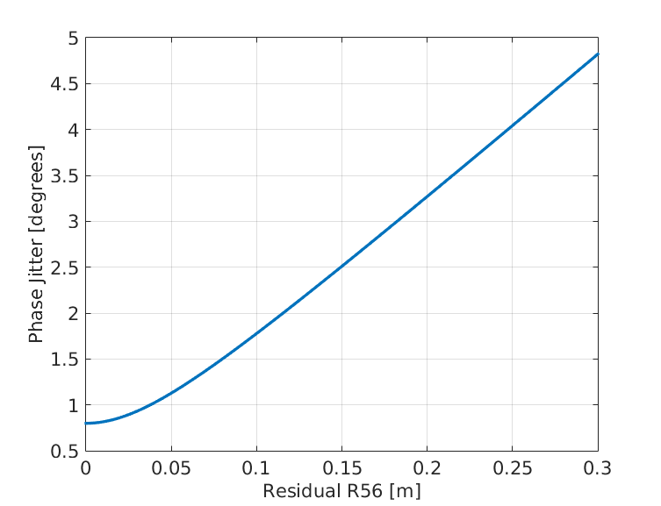
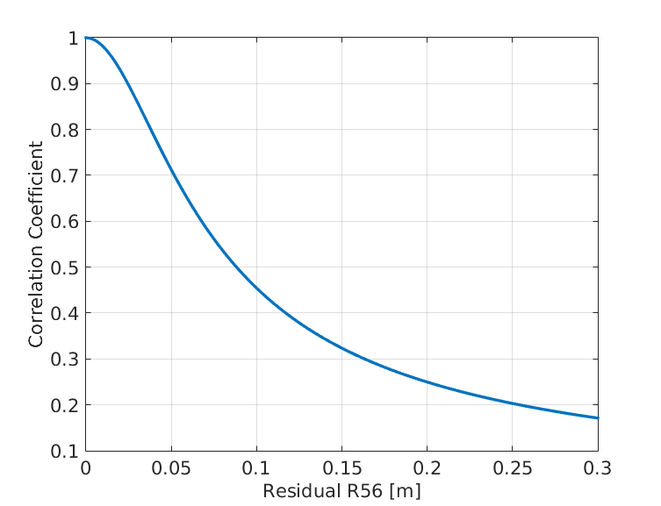
Simulations
Downstream Phase Jitter vs. Residual R56
Upstream-Downstream Correlation vs. Residual R56
R56 needs to be controlled at the 5cm level to achieve 0.2 degrees downstream jitter with the feedforward system.

Slide 7
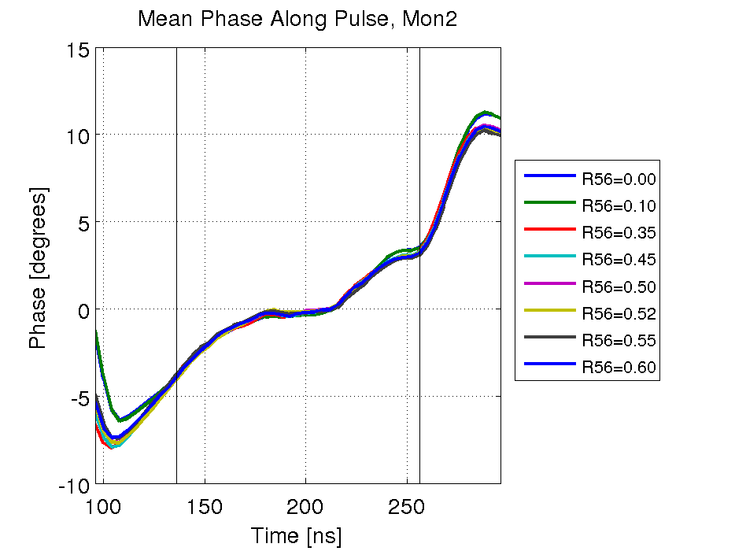
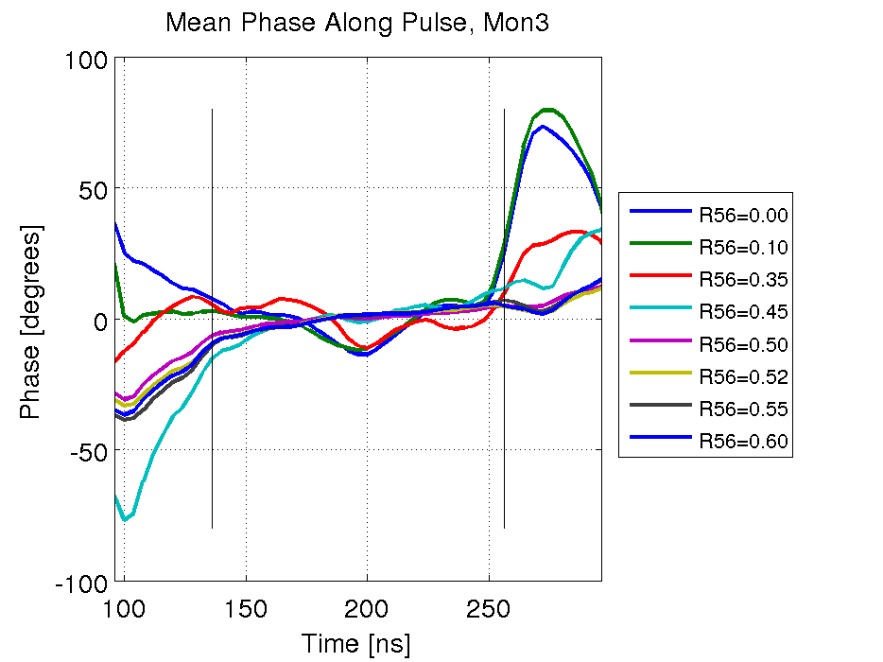
Mean Pulse Phase for Different R56
Downstream phase: cluster with R56>=0.5 have much flatter phase.

Slide 8
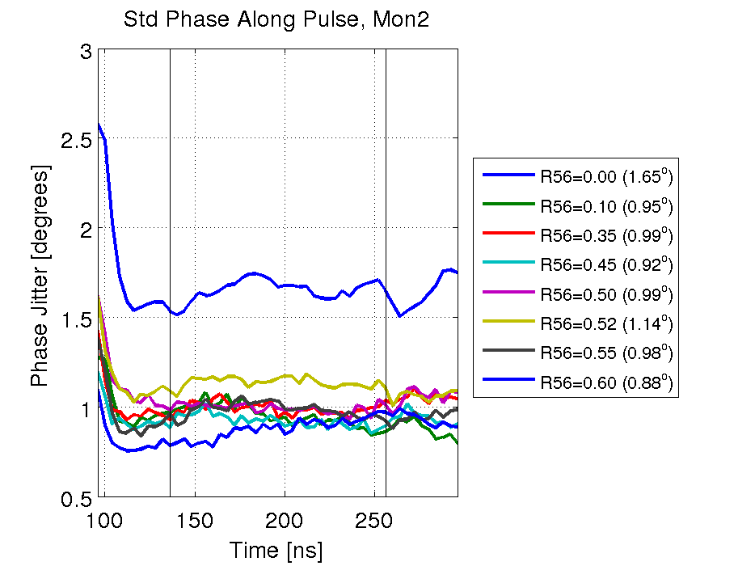
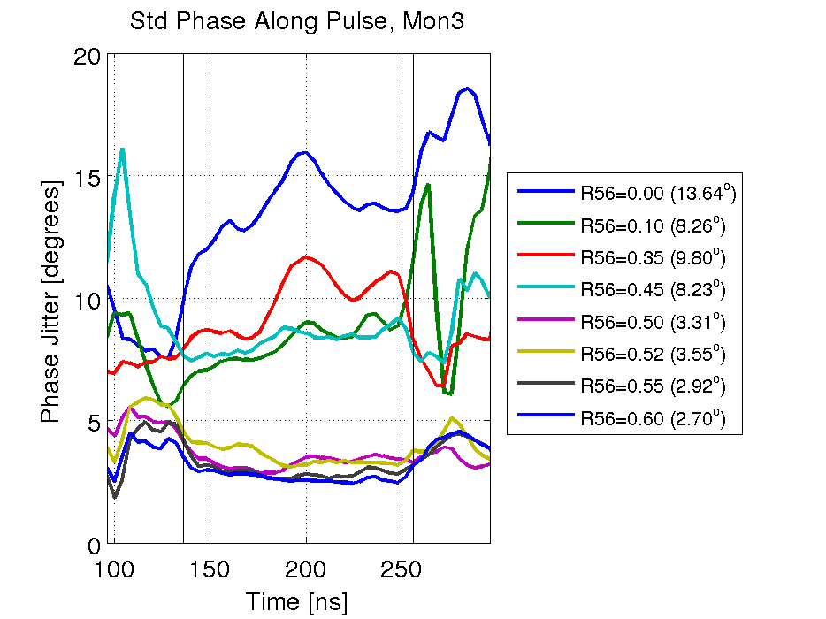
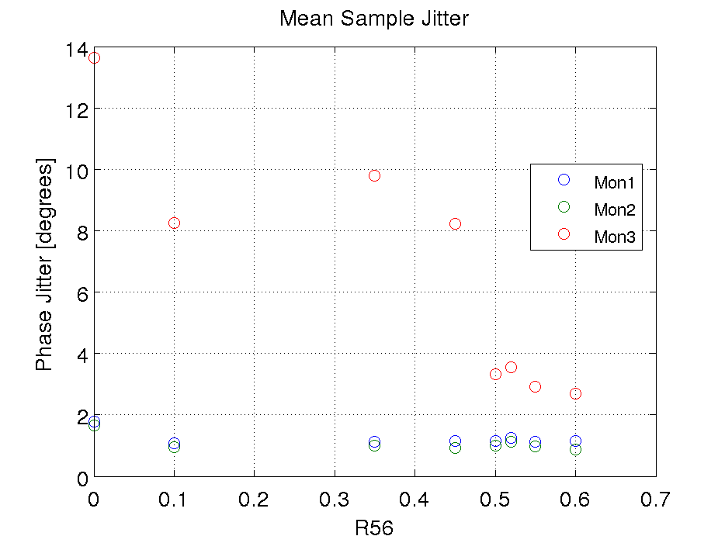
Phase Jitter for Different R56
Upstream jitter unusually high in R56=0 data set.
Cluster of low jitter points with R56 >= 0.50.
Small variation because they’re close to the optimal point?
OR – something else changed during this time?

Slide 9
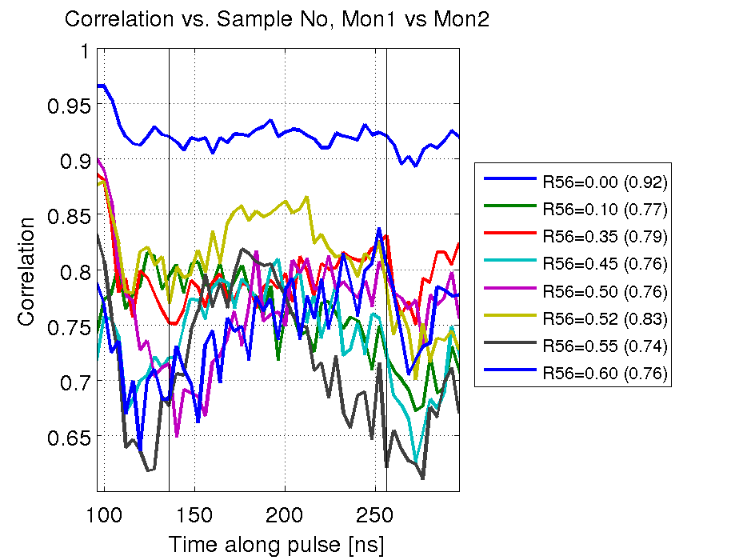
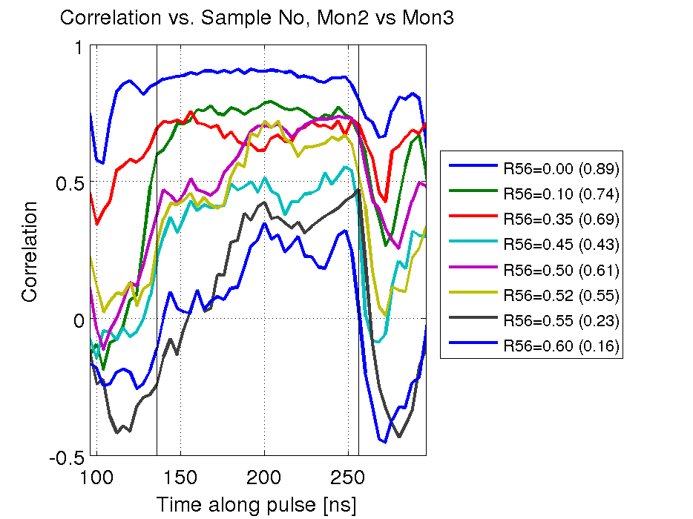
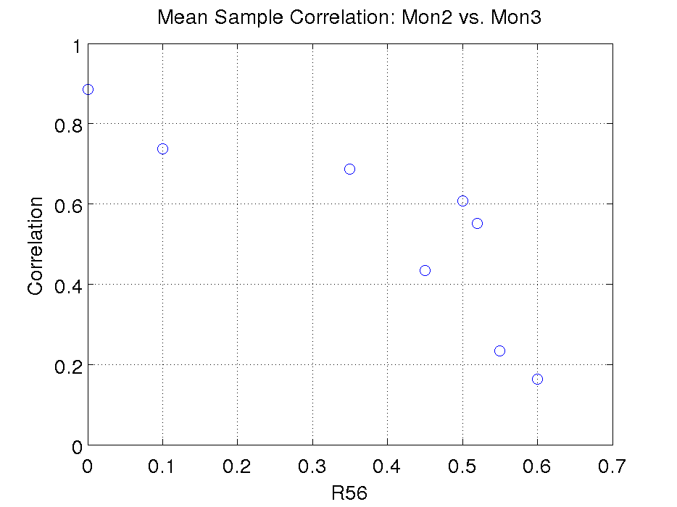
Phase Correlation for Different R56
Correlation between upstream monitors is poor in general (except R56=0 data set).
Upstream-Downstream correlation decreases with increasing R56.
Smaller phase jitter with larger R56… but not convinced that is the whole explanation.

Slide 10
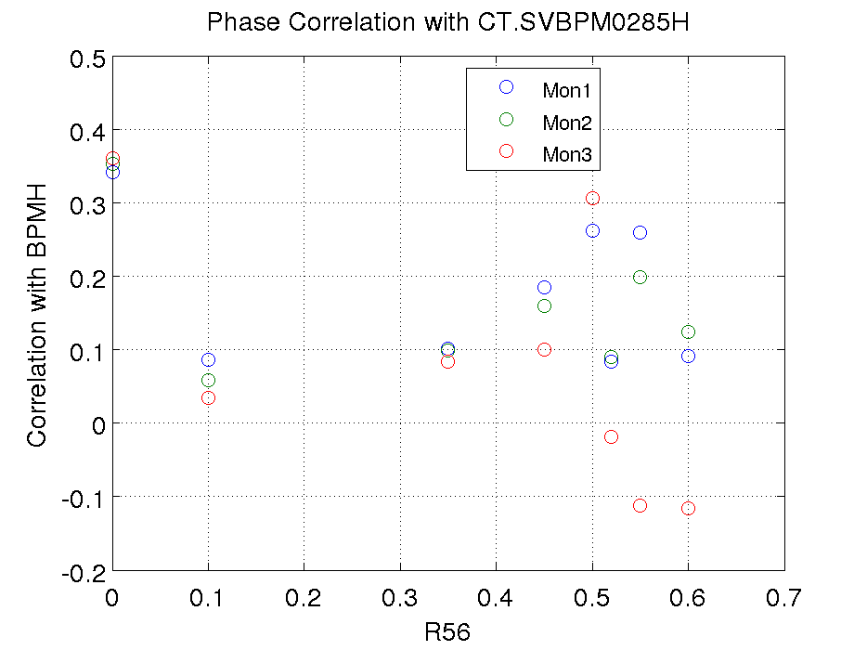
BPM Correlation for Different R56
Correlation with the dispersive BPM position (i.e. energy) is lower than seen last year (as much as 70%).
Negative correlation between energy and downstream phase for R56 > 0.50 points.
Ideal for feedforward would be to have the same phase correlation with energy both upstream and downstream (i.e. ideal downstream correlation may not be zero).

Slide 11
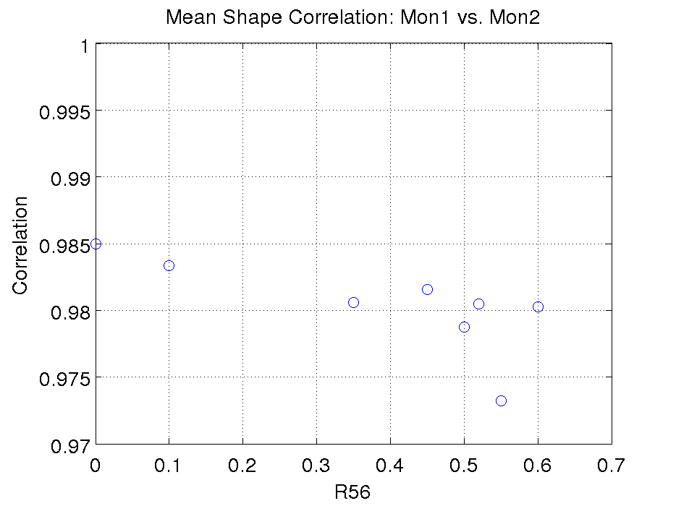
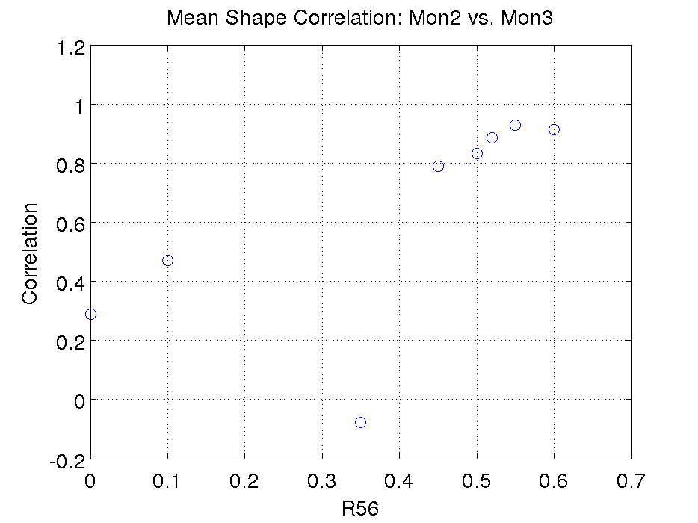
Pulse Shape Correlation Different R56
Agreement in shape between upstream monitors always >0.97.
Cluster with high upstream-downstream correlation with R56>=0.45.
Correlation reduced to below 50% in following feedforward runs (with mechanical shifter).

Slide 12
Feedforward Attempts
Feedforward runs on two days (both after R56 optimisation attempt):
29th April:
With remote phase shifter downstream.
Typically around 2.5 degrees phase jitter.
Fairly good correlations (>60%).
30th April:
With mechanical shifter downstream.
Typically around 2.0 degrees phase jitter.
Generally lower correlations (40-50%).

Slide 13
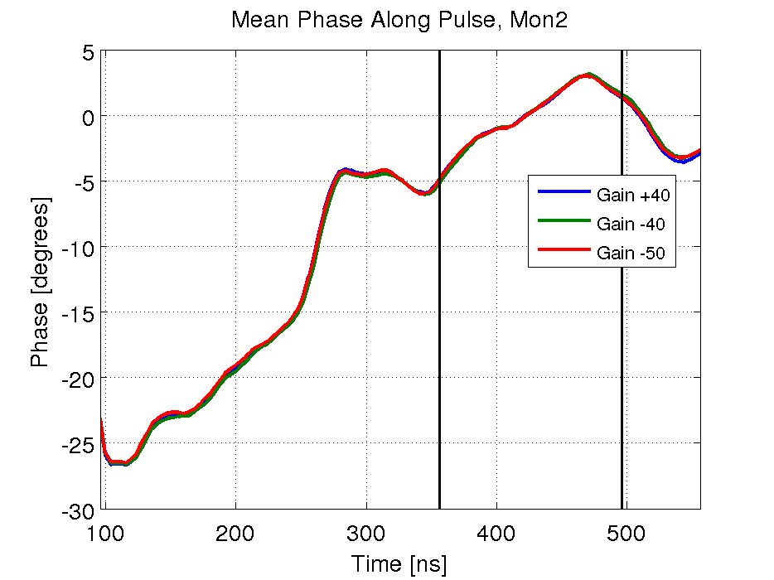
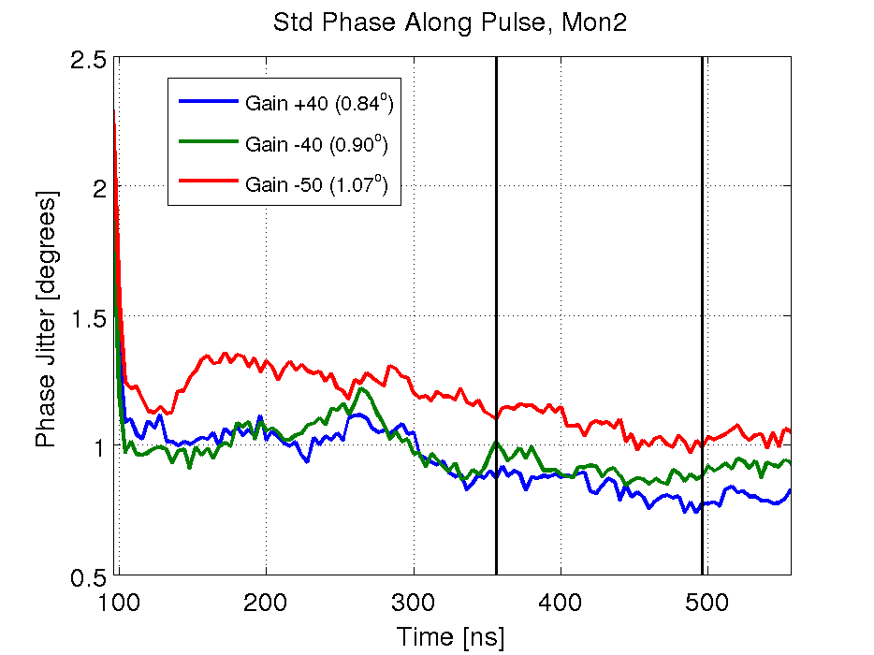
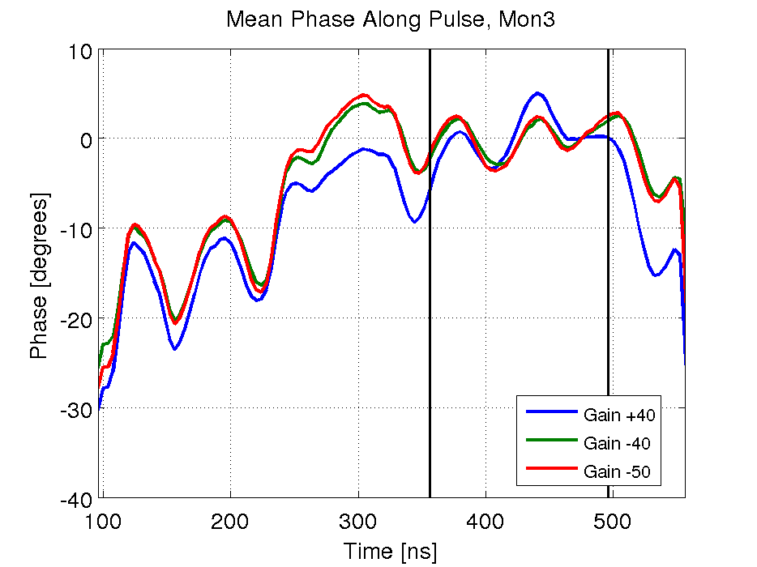
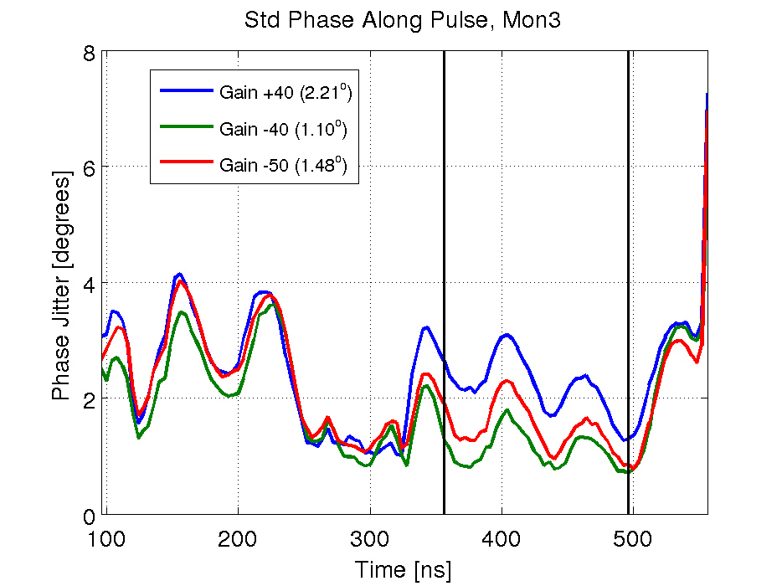
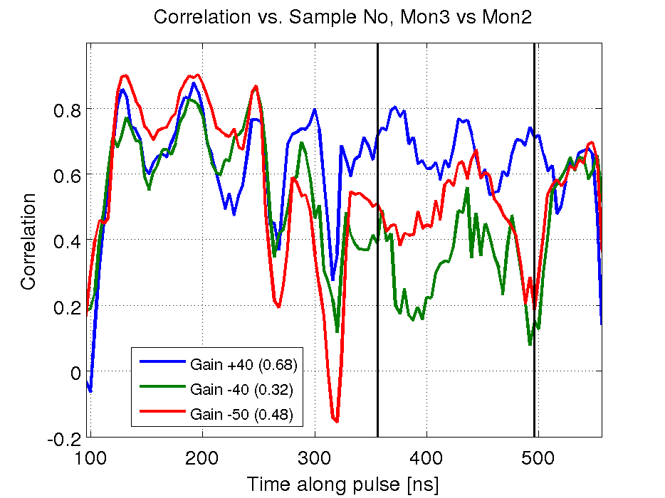
Feedforward Run: 30th April, 18:03
Mean downstream phase appears slightly flatter for negative gain data sets.
Downstream phase jitter of 1.1 degrees with gain -40 is the lowest we’ve ever seen.
Higher correlation and downstream jitter with gain -50 (but note higher upstream jitter as well).

Slide 14
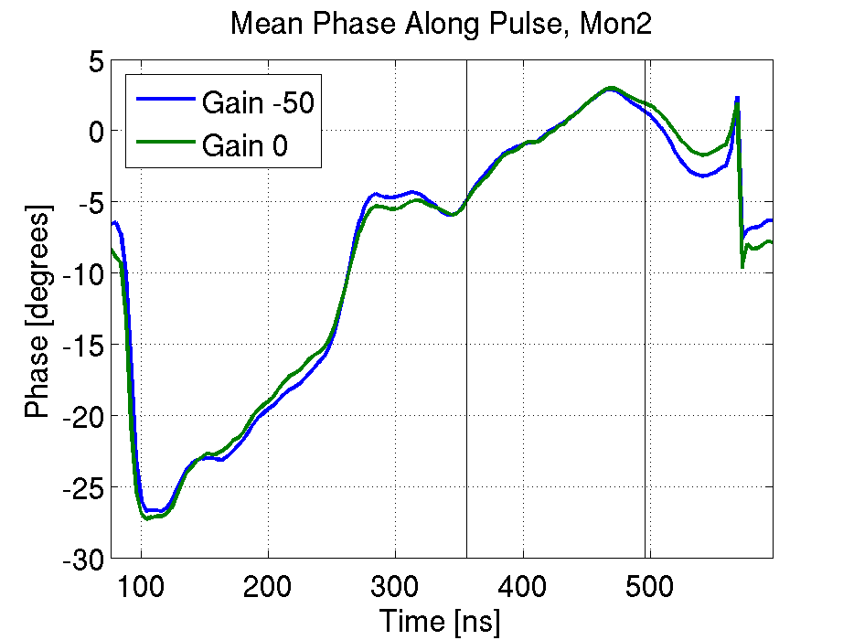
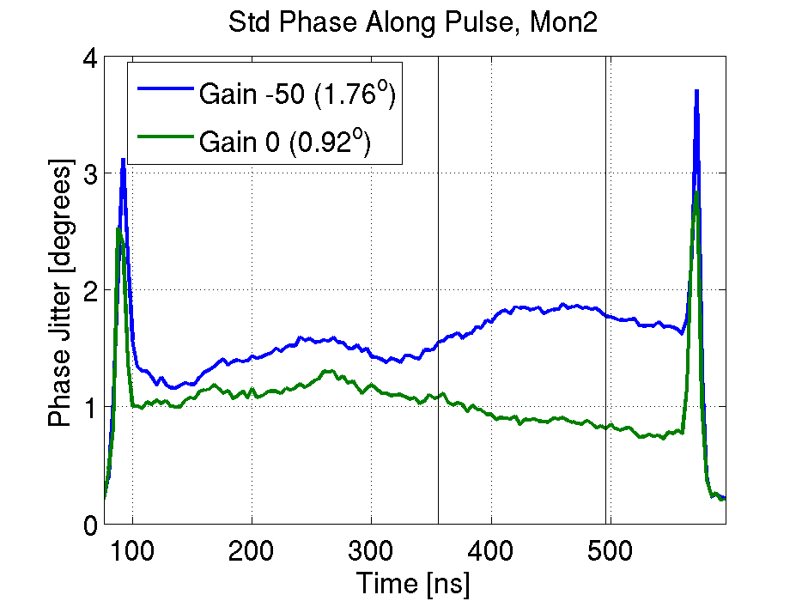
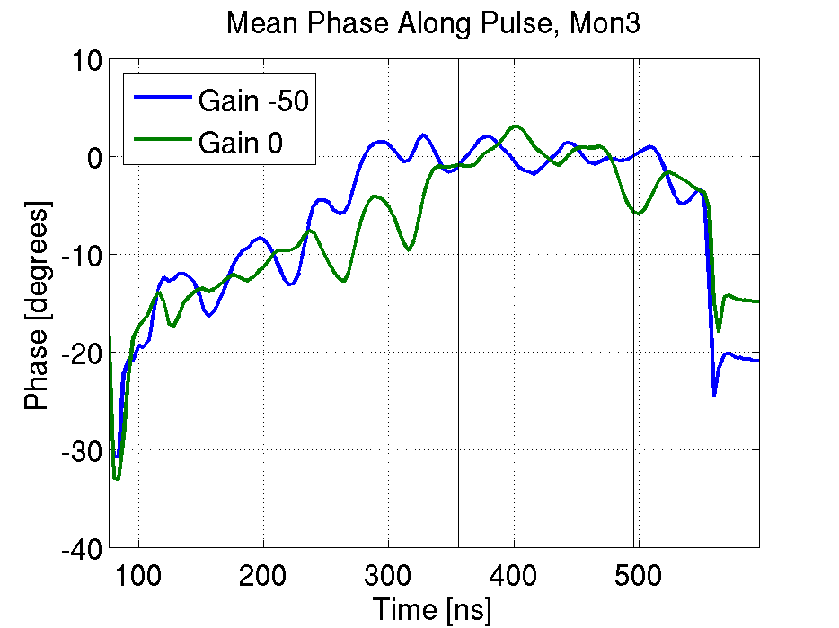
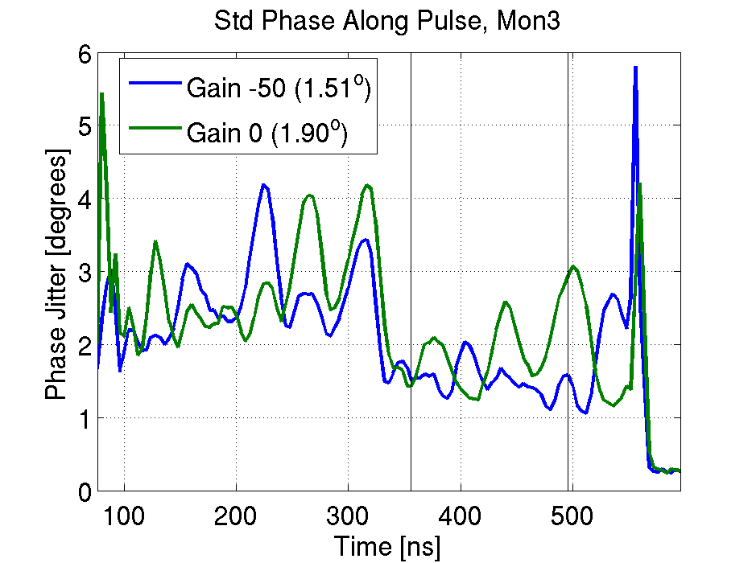
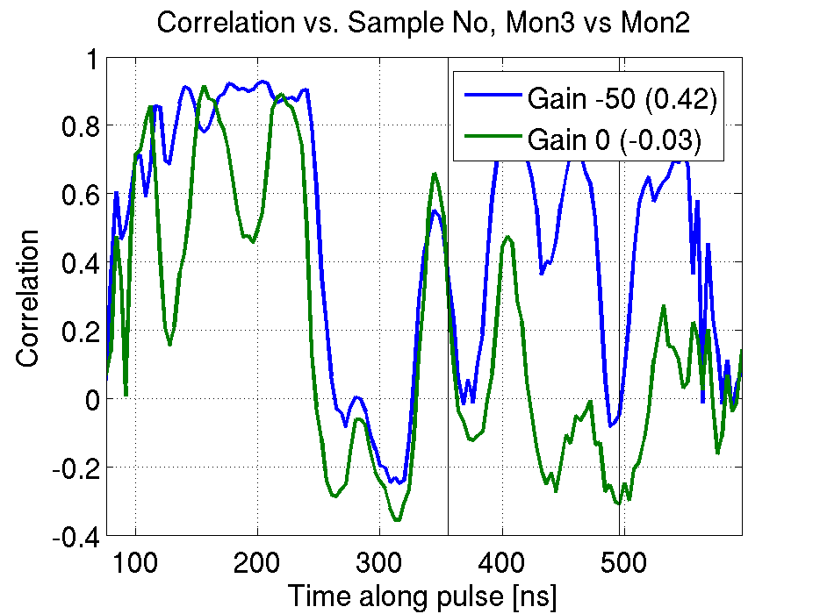
Feedforward Run: 30th April, 18:27
Unusually high upstream phase jitter in gain 0 data.
Downstream jitter lower than upstream jitter with gain -50.
Only a small difference between downstream gain -50 jitter (not so different outside correction region).
~No upstream-downstream phase correlation in gain 0 data set.

