Slide 1
Effect of Mechanical Phase Shifters
Jack Roberts
FONT Meeting 19/6/15

Slide 2
Overview
I showed a few weeks ago that:
  Swapping the phase monitors between different sets of electronics didn’t change the measured jitter/resolution.
  Swapping the LO chain (phase shifter etc.) between the different mixers did change the measured jitter/resolution.
The remote phase shifters are the (believed) cause of the different performance from each set of electronics.
  A few plots showing results with a mechanical shifter here.

Slide 3
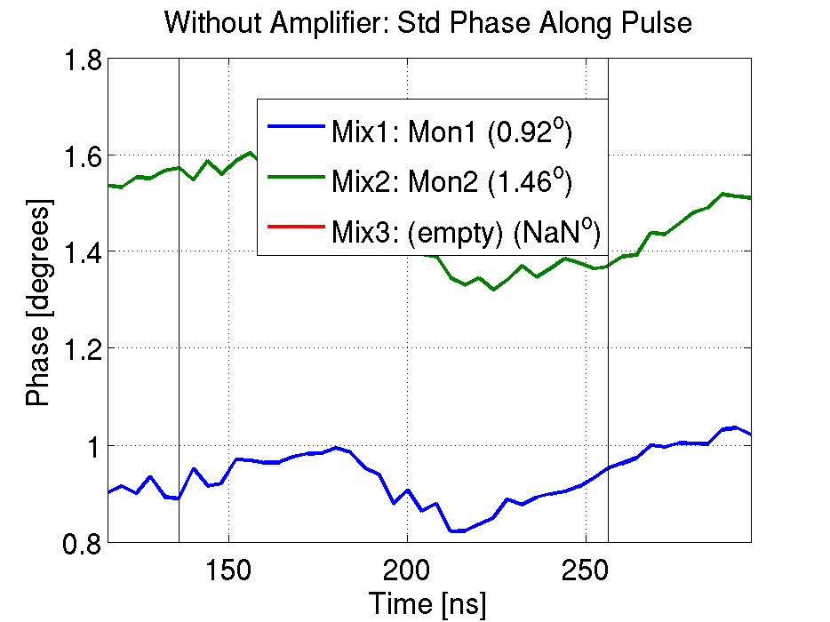
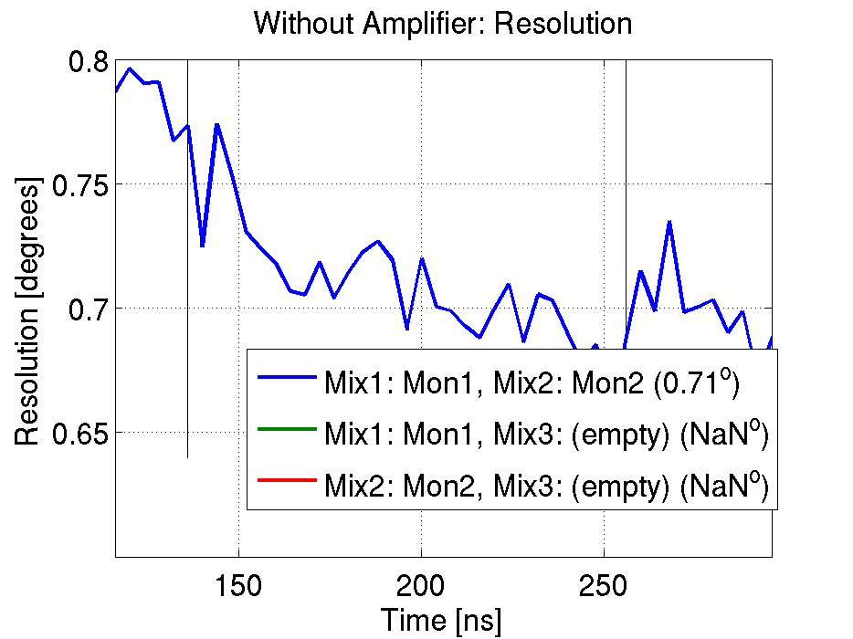
All Remote Phase Shifters
0.7 degrees resolution, jitter ratio: 1.6

Slide 4
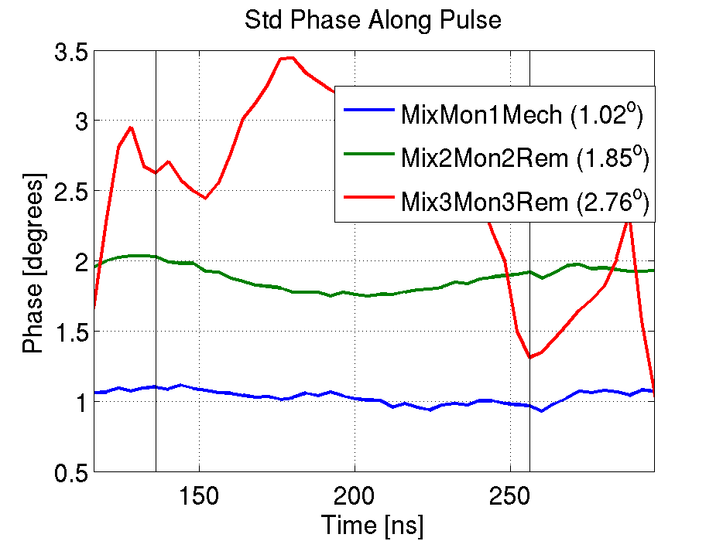
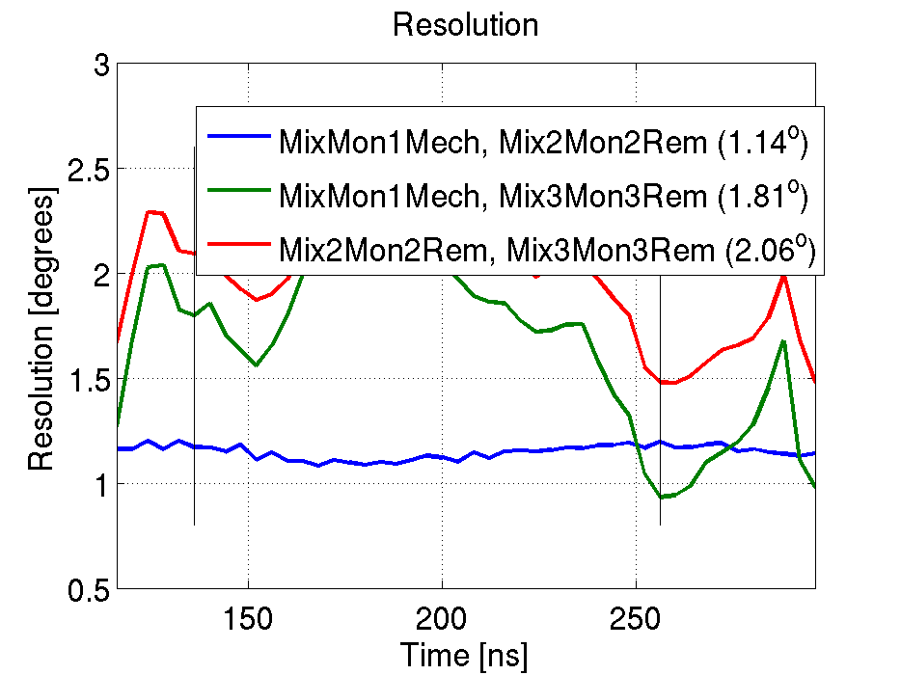
Mechanical Shifter on Mon1 (Mixer 1)
1.1 degrees resolution, jitter ratio: 1.8

Slide 5
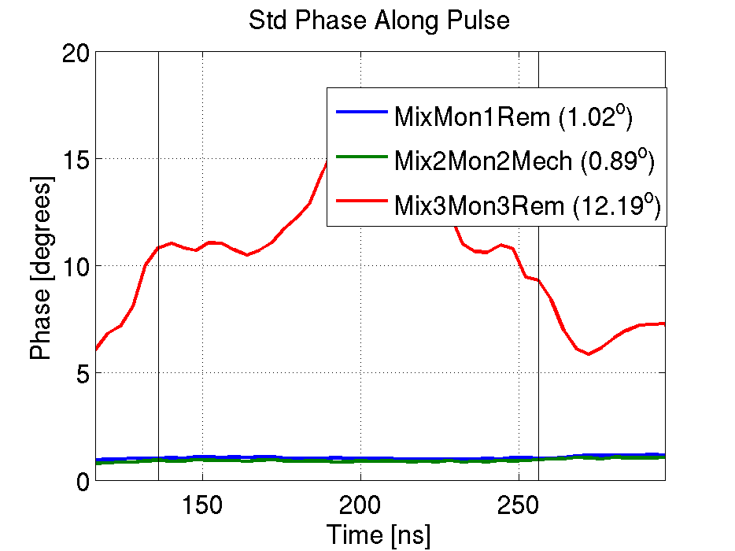
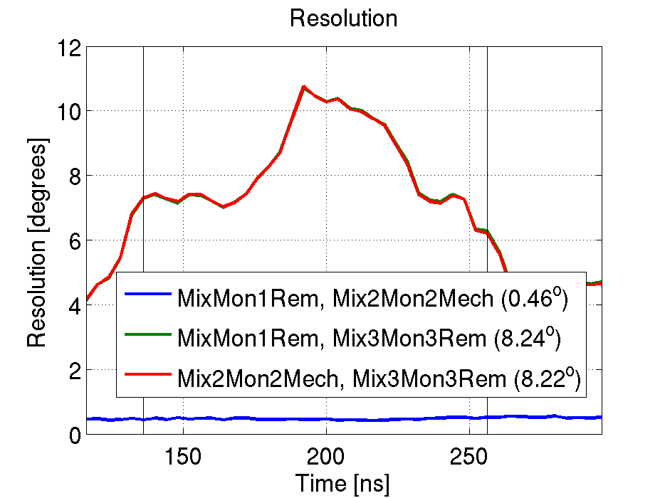
Mechanical Shifter on Mon2 (Mixer 2)
0.5 degrees resolution, jitter ratio: 0.9

Slide 6
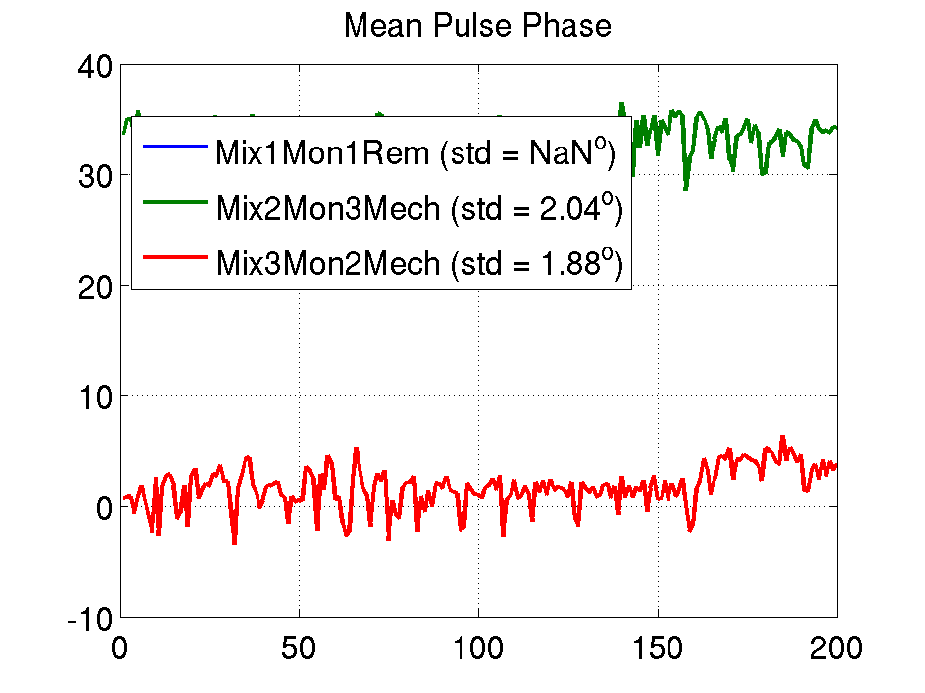
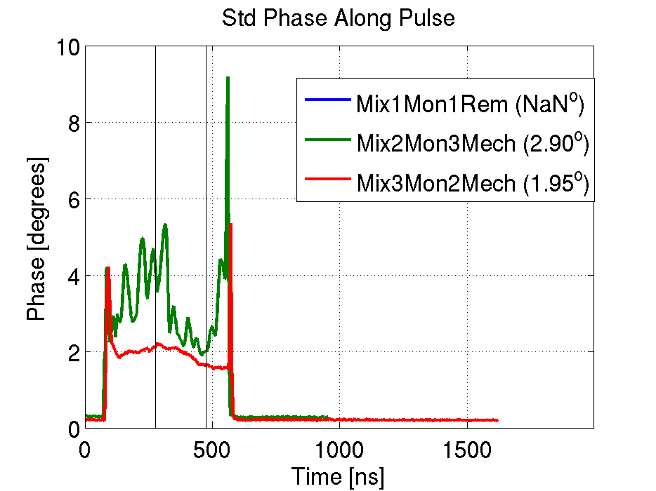
Mechanical Shifter on Mon2 (Mix3) and Mon3 (Mix2)
Similar upstream and downstream jitter (at least in one part of the pulse).

Slide 7
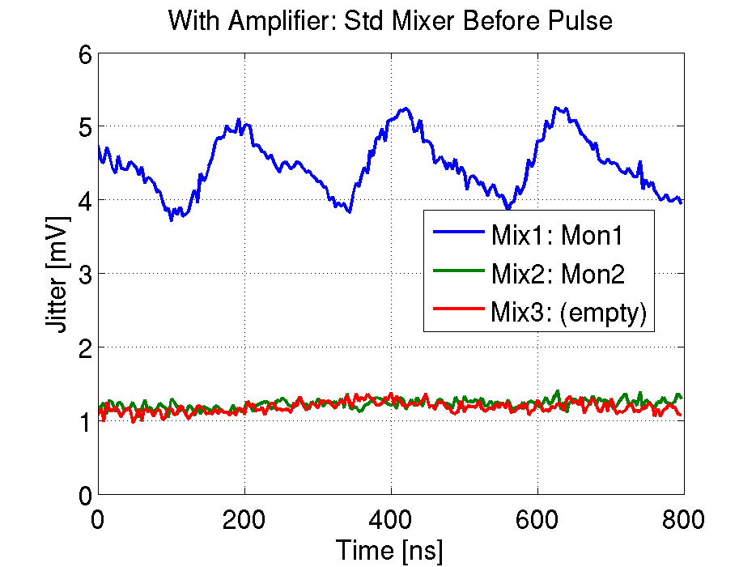
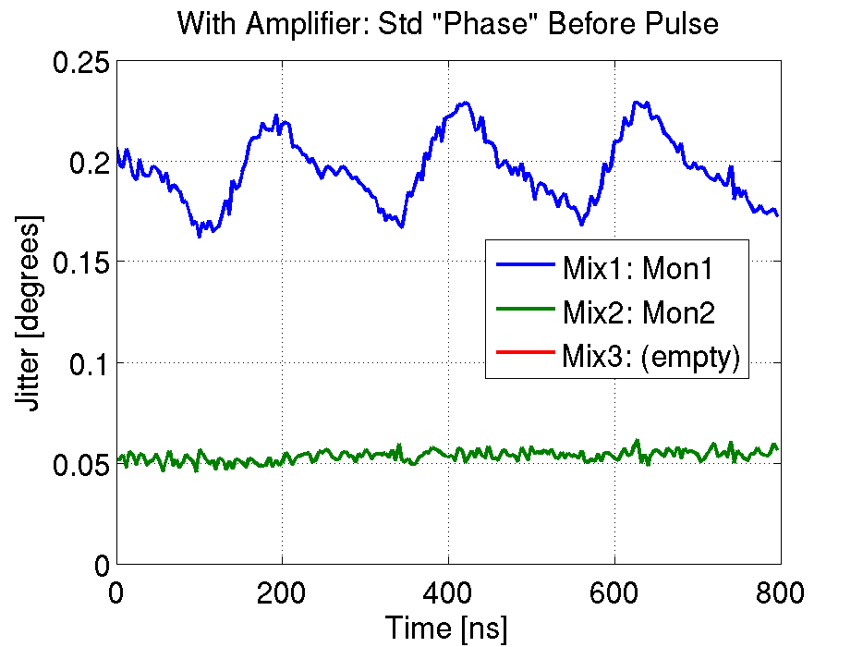
Amplifier to SiS Digitisers
Mix1 and Mix2 signals amplified.
Mix1: noisy channel.
Mix2: baseline noise not increased compared to Mix3 (i.e. limited by ADC noise)

Slide 8
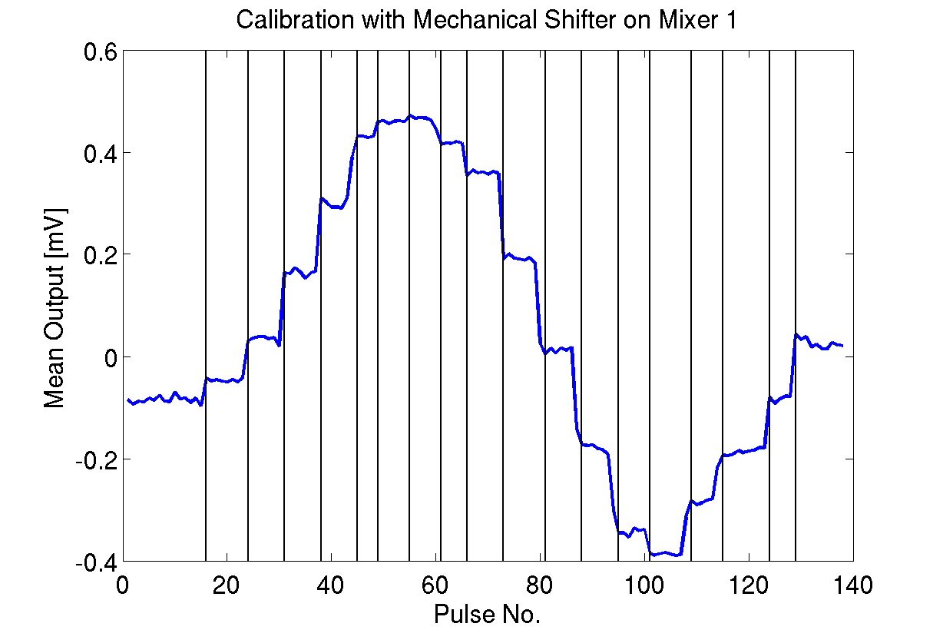
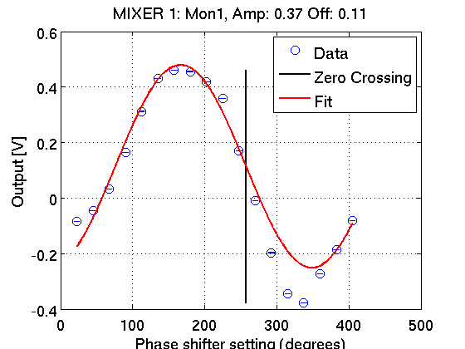
Manual Calibration
Sine fit: Amplitude 0.37 V, Offset 0.11 V
Min max fit: Amplitude 0.42 V, Offset 0.04 V

