Slide 1
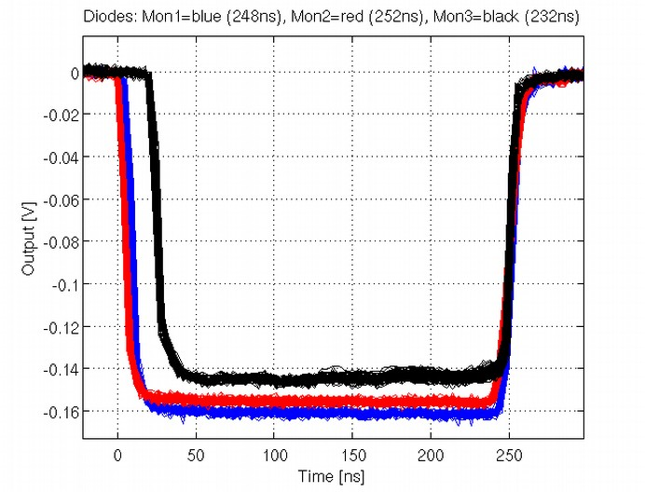
Different pulse length upstream and downstream (also BPMs).
Lose transient at start of pulse (~20ns).
Alignment of output from different devices.
Should align to the end of the pulse.
How?
Output 5 stds above noise.
Cross correlation combined with gradient of slope.

