Slide 1
ATF june summary
Neven & Talitha

Slide 2
June Shifts
9/6 Tues Swing
10/6 Wed Swing (IPBSM)
12/6 Fri Day
16/6 Tues Swing
18/6 Thur Owl (Siwon’s shift)
18/6 Thur Day (IPBSM)
19/6 Fri Day

Slide 3
9/6 Tues Swing
Tightened and checked all connections on 1st and 2nd stage.
Note: no longer a 150 MHz BPF or amplifier before reference enters the limiter – this explains why no longer need for delay cables.
Checked dipole/ref phase with and without 714 MHz BPF on
2nd stage – needs 2m delay cable without BPF.
Movers not working - re-launched IP BPM mover system.
Bug in ATF IPBPM data-saving code – fixed later in week by ATF engineers.

Slide 4
10/6 Wed Swing (IPBSM)
Set up upstream feedback in 2-bunch mode using P1, P2 and P3 and FONT5 board #1.
Unable to kick beam – problem isolated to ZPULs.

Slide 5
12/6 Friday Day
High-beta (100x1000) optics.
Charge 0.7 x 10¹⁰
3 BPM resolution studies without 714 MHz BPF in X and Y.
3 BPM resolution studies with 714 MHz BPF in X and Y.
Discontinuities in mover calibrations – particularly in IPC - saturating? – need to analyze further to see if this data can be useful.

Slide 6
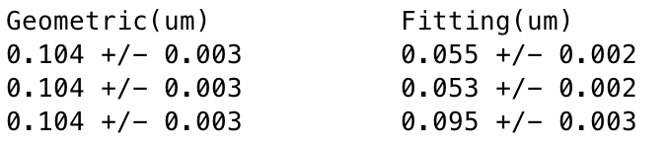
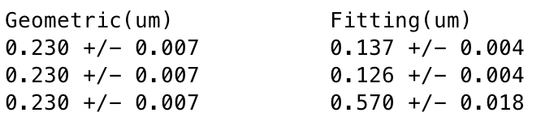
3BPM resolution – no BPF
High-beta (100x1000) optics.
Charge 0.7 x 10¹⁰
Integration 55 to 62
3BPM resolution – 714 MHz BPF
High-beta (100x1000) optics.
Charge 0.7 x 10¹⁰
Integration 55 to 62

Slide 7
12/6 Tues Swing
Nominal optics
Charge 0.3 x 10¹⁰
Re-calibrate IPC with 714 MHz BPF in X and Y – linear behaviour observed at lower charge.
Install C-band BPFs on between hybrid and variable attenuator inside tunnel on dipole and reference cavities.
Reference not limited properly. Remove C-band BPFs from references.

Slide 8
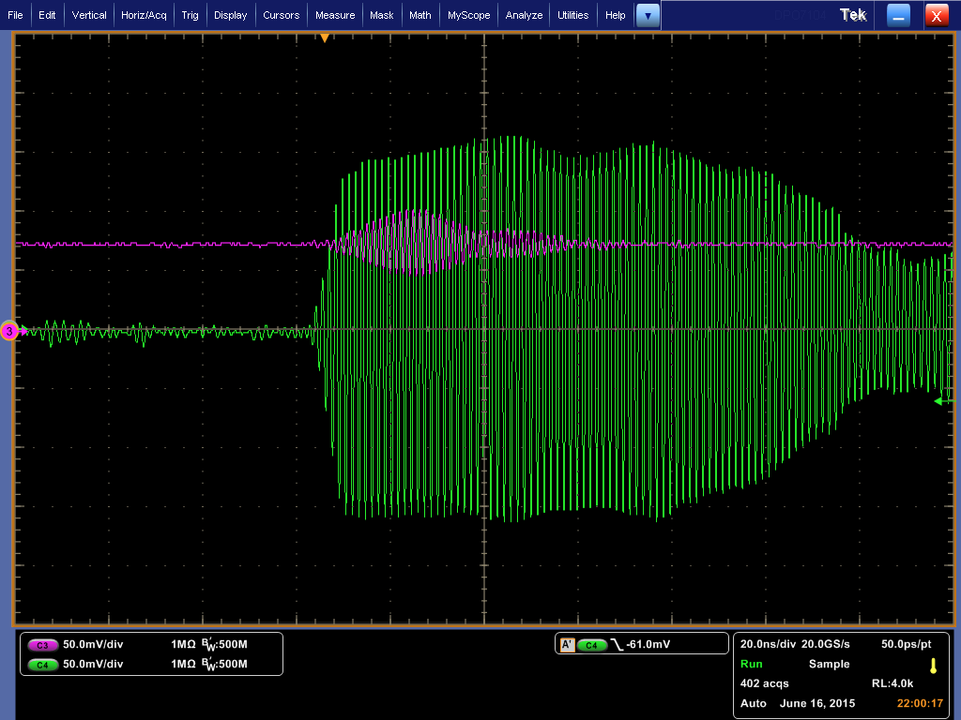
C-band BPF on the reference
Not limited properly.
BPFs subsequently removed from the reference.

Slide 9
18/6 Thurs Owl (Siwon’s Shift)
Nominal optics. Charge 0.5 x 10¹⁰.
Calibration matching in X and Y.
18/6 Thurs Day (IPBSM)
Set up upstream feedback in 2-bunch mode using P1, P2 and P3 and FONT5 board #1. ZPULs replaced with ATF pre-amplifier.
Poor bunch-to-bunch position correlation.

Slide 10
19/6 Fri Day
High-beta (100x1000) optics.
Charge 0.3 x 10¹⁰ and 0.6 x 10¹⁰.
3 BPM resolution studies with C-band BPF in X and Y at different attenuations.

Slide 11
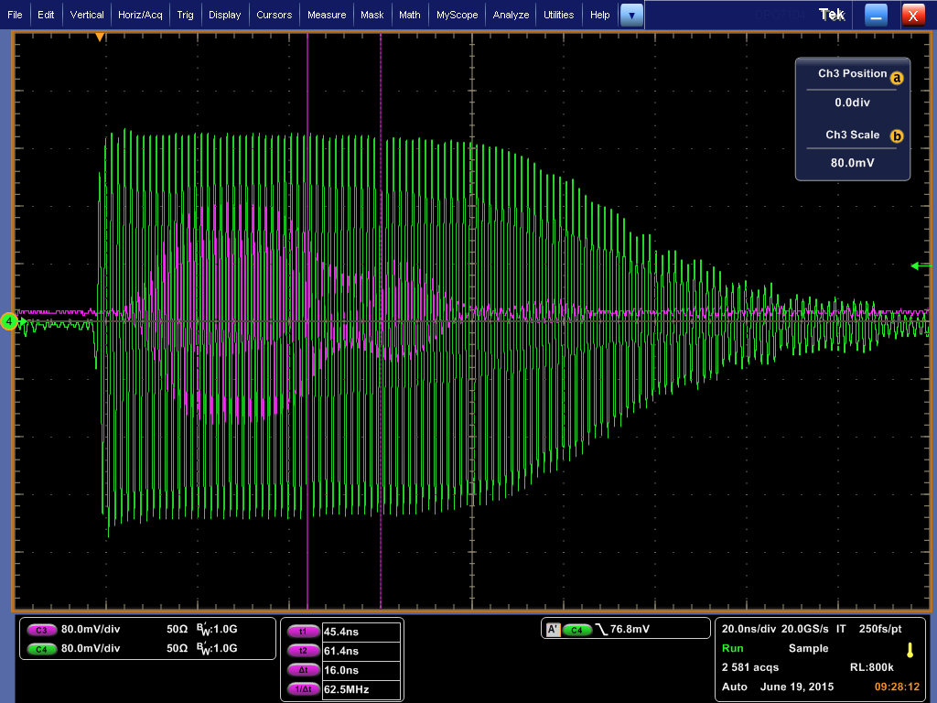
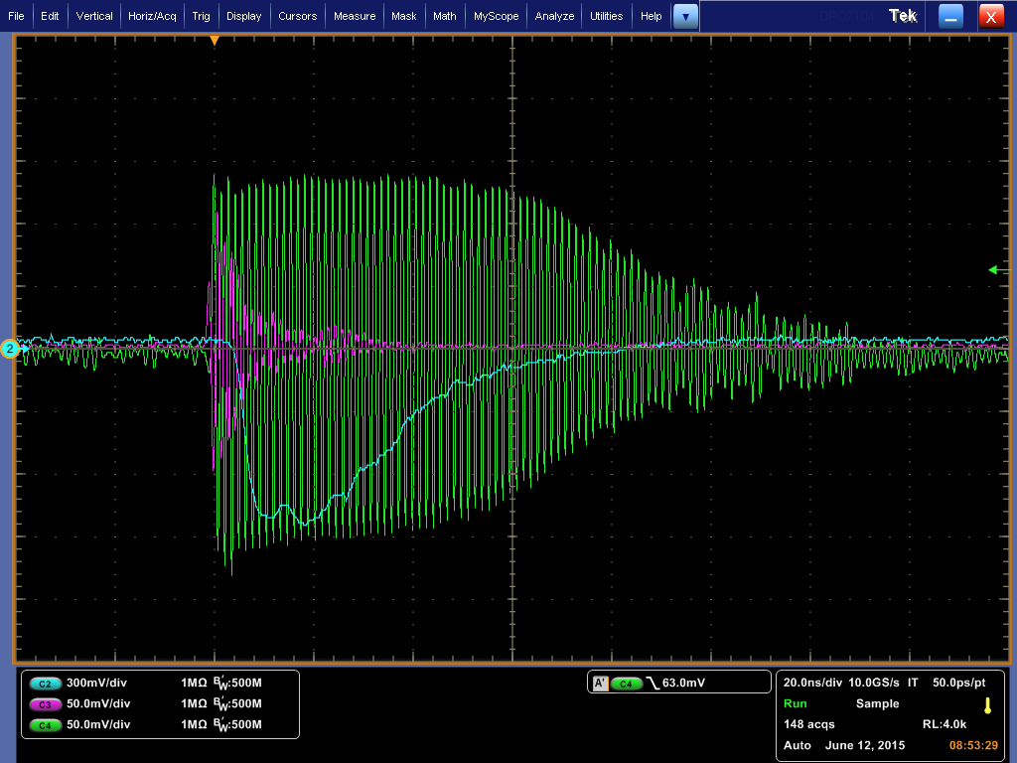
No BPF – 2m delay cables
Signals out of 2nd stage going into detector.
IPC(X)
Ref(X)

Slide 12
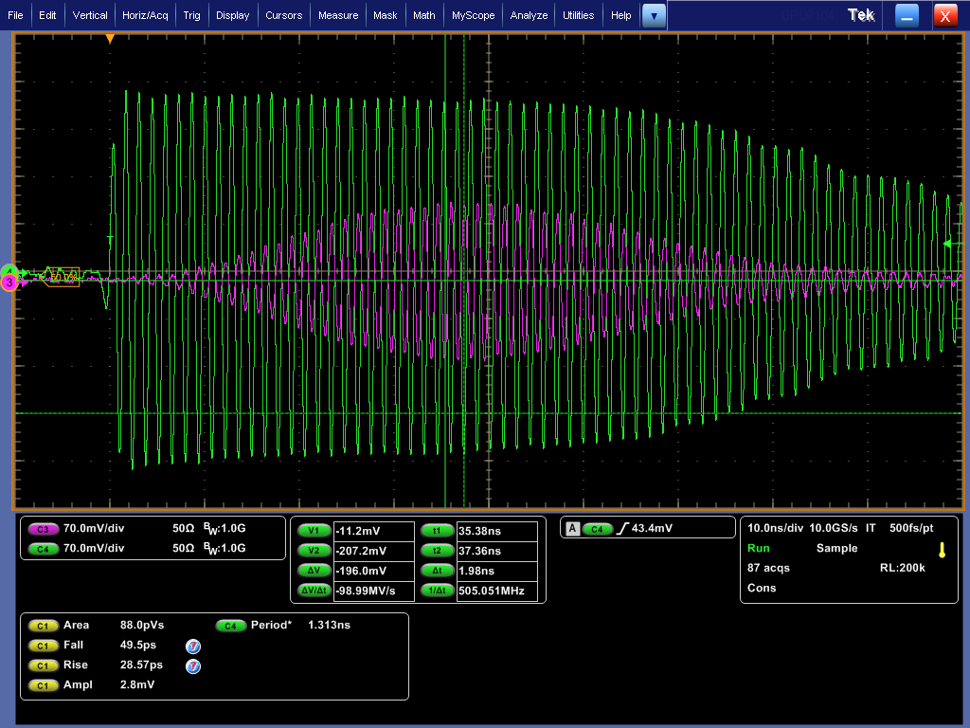
714 MHz BPF on 2nd stage
Signals out of 2nd stage going into detector.
IPC(X)
Ref(X)

Slide 13
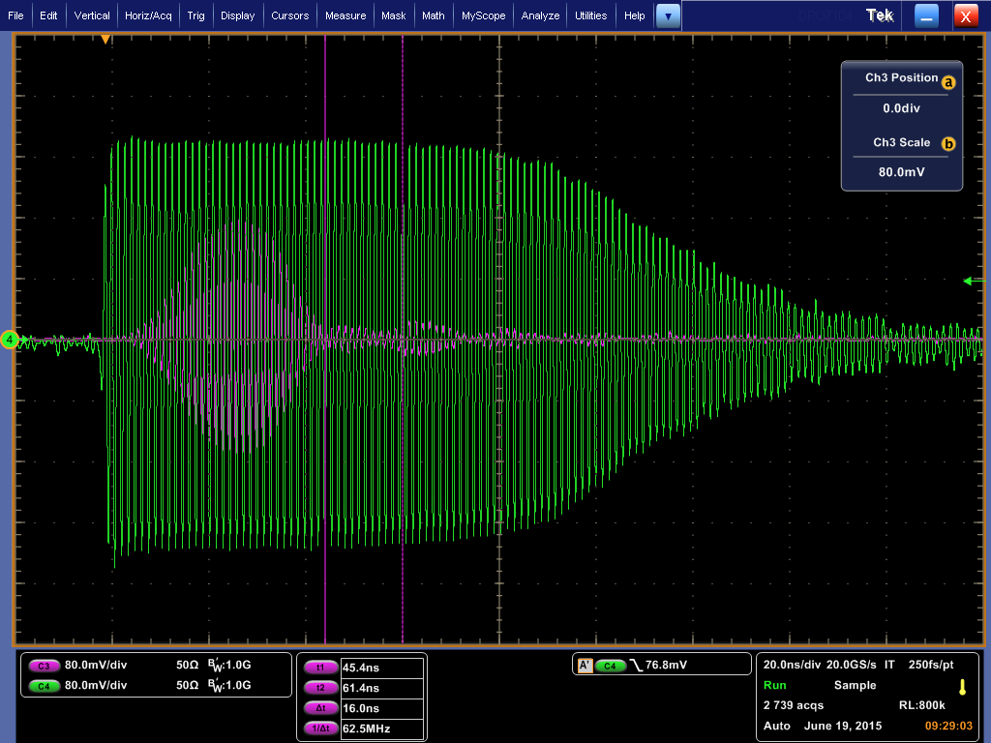
C-band BPF before 1st stage
Signals out of 2nd stage going into detector.
IPC(X)
Ref(X)

Slide 14
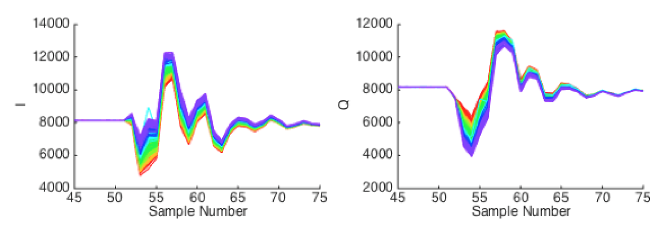
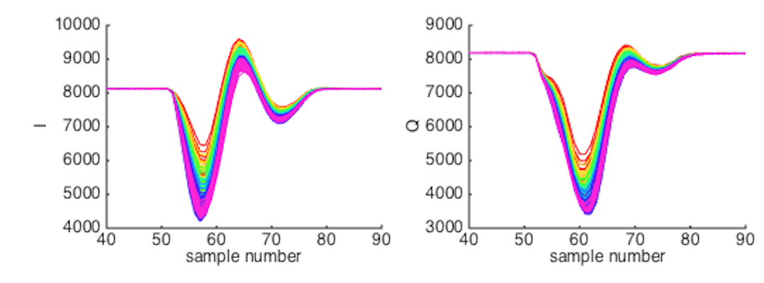
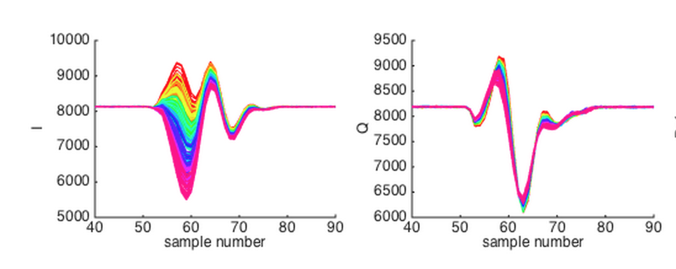
IPA(Y)
No BPF
0dB
0.7 x 10¹⁰
714 MHz BPF on 2nd stage
0dB
0.7 x 10¹⁰
C-band filter before 1st stage
0dB
0.3 x 10¹⁰

Slide 15
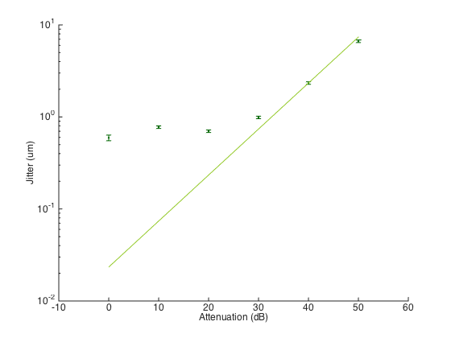
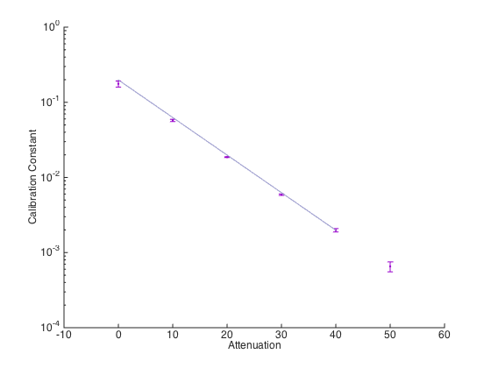
Jitter vs Attenuation IPA(Y)
C-band BPF before 1st stage
0.3 x 10¹⁰

Slide 16
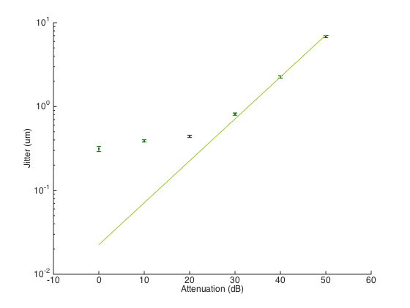
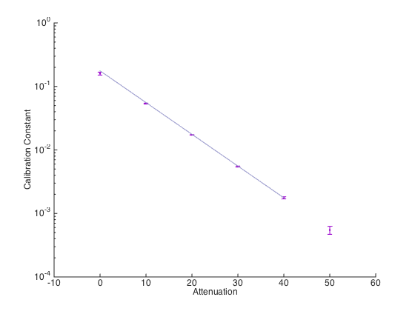
Jitter vs Attenuation IPB(Y)
C-band BPF before 1st stage
0.3 x 10¹⁰

Slide 17
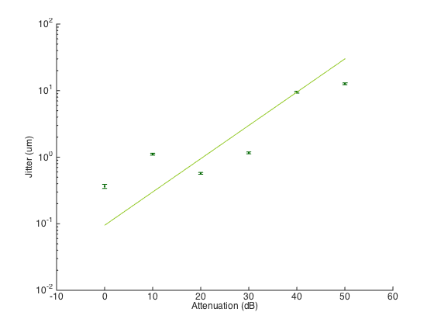
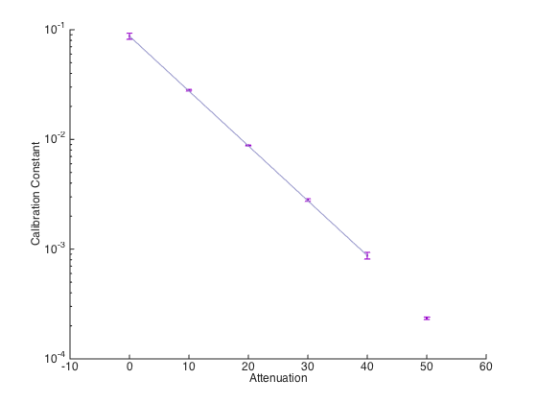
Jitter vs Attenuation IPC(Y)
C-band BPF before 1st stage
0.3 x 10¹⁰

Slide 18
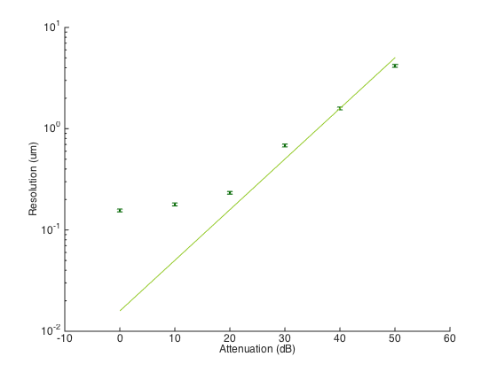
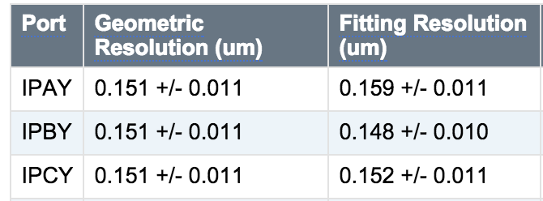
Resolution vs Attenuation in Y
C-band BPF before 1st stage
0.3 x 10¹⁰
Results for 0dB

