Slide 1
ADIJ (ADI in Japan)
K. Yokoya
Technical Board Meeting, Jun.30. 2015

Slide 2
ADI-J (ADI of Japan)
Responsibility of Japanese team
  Expected to take more leadership
Lack of human resources in the international team of LCC
  Human resources are relatively abundant in Japan
Need closer relation between International and Japanese team
  In addition to LCB, LCC, TB, CRB, etc.
Communication among groups
  Right now Japanese members are attending international meetings individually

Slide 3
Activities
Range
  CFS, lattice, positron, BDS, etc
  SRF issues not included directly
Regular meeting
  Every Monday 13:45-14:30 (actually, 2-3 times a month like the regular meeting of LC Office)
Topics
  Technical issues & design issues
  Report to each other on what is happening in each group
  Status of change requests
  Think what is missing
  Requests to the international ADI team
  Requests from the international ADI team
Regular report in monthly ADI meeting
  From KEK LC Office (First report on Jun.4)
  From ADI-J

Slide 5
Members
No rigorous border
  Core members should attend every time
Core members
Akira Yamamoto LCC, LC office
Masao KURIKI, sources
Tsunehiko OMORI sources
Nobuhiro Terunuma TB, CRB
Shigeru Kuroda RTML
Kiyoshi Kubo Main linac
Toshiyuki Okugi BDS
Toshiaki Tauchi MDI
Tomoyuki Sanuki Site
Masanobu Miyahara CFS
Toshiya Sanami Radiation safety
Kaoru Yokoya ADI
Hitoshi Hayano SRF
Shinichiro Michizono RF, division head

Slide 6
Meetings
Jun.22
  Introduction of the groups
Jun.29
  Positron status by T.Omori
Jul.6
  CFS by M.Miyahara
No meetings on Jul.13 and Jul.20 due to confliction with other meetings

Slide 7
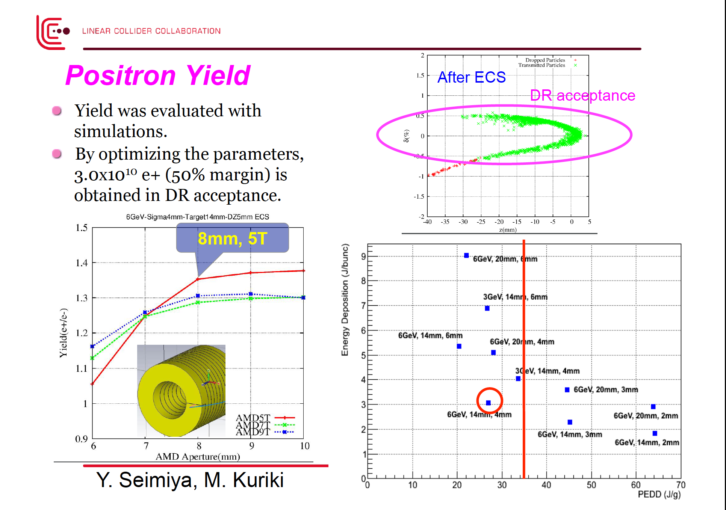
2nd meeting on Jun.29. Summary report by Omori.
Notes:
7

Slide 8
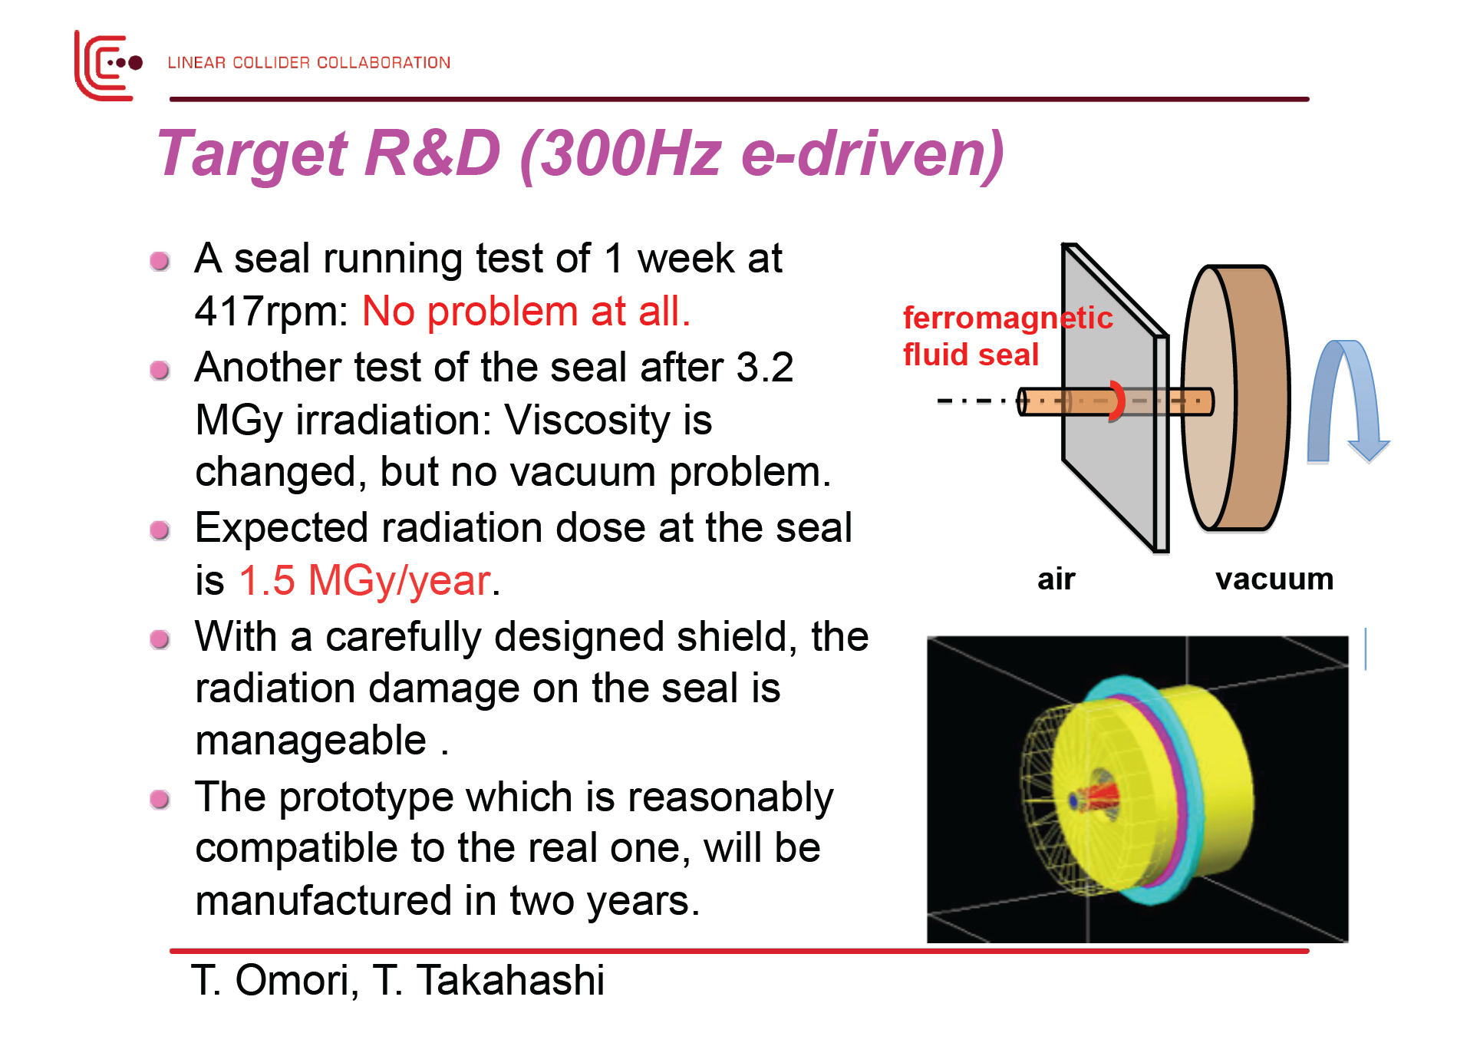
4.7
Notes:
8

Slide 9
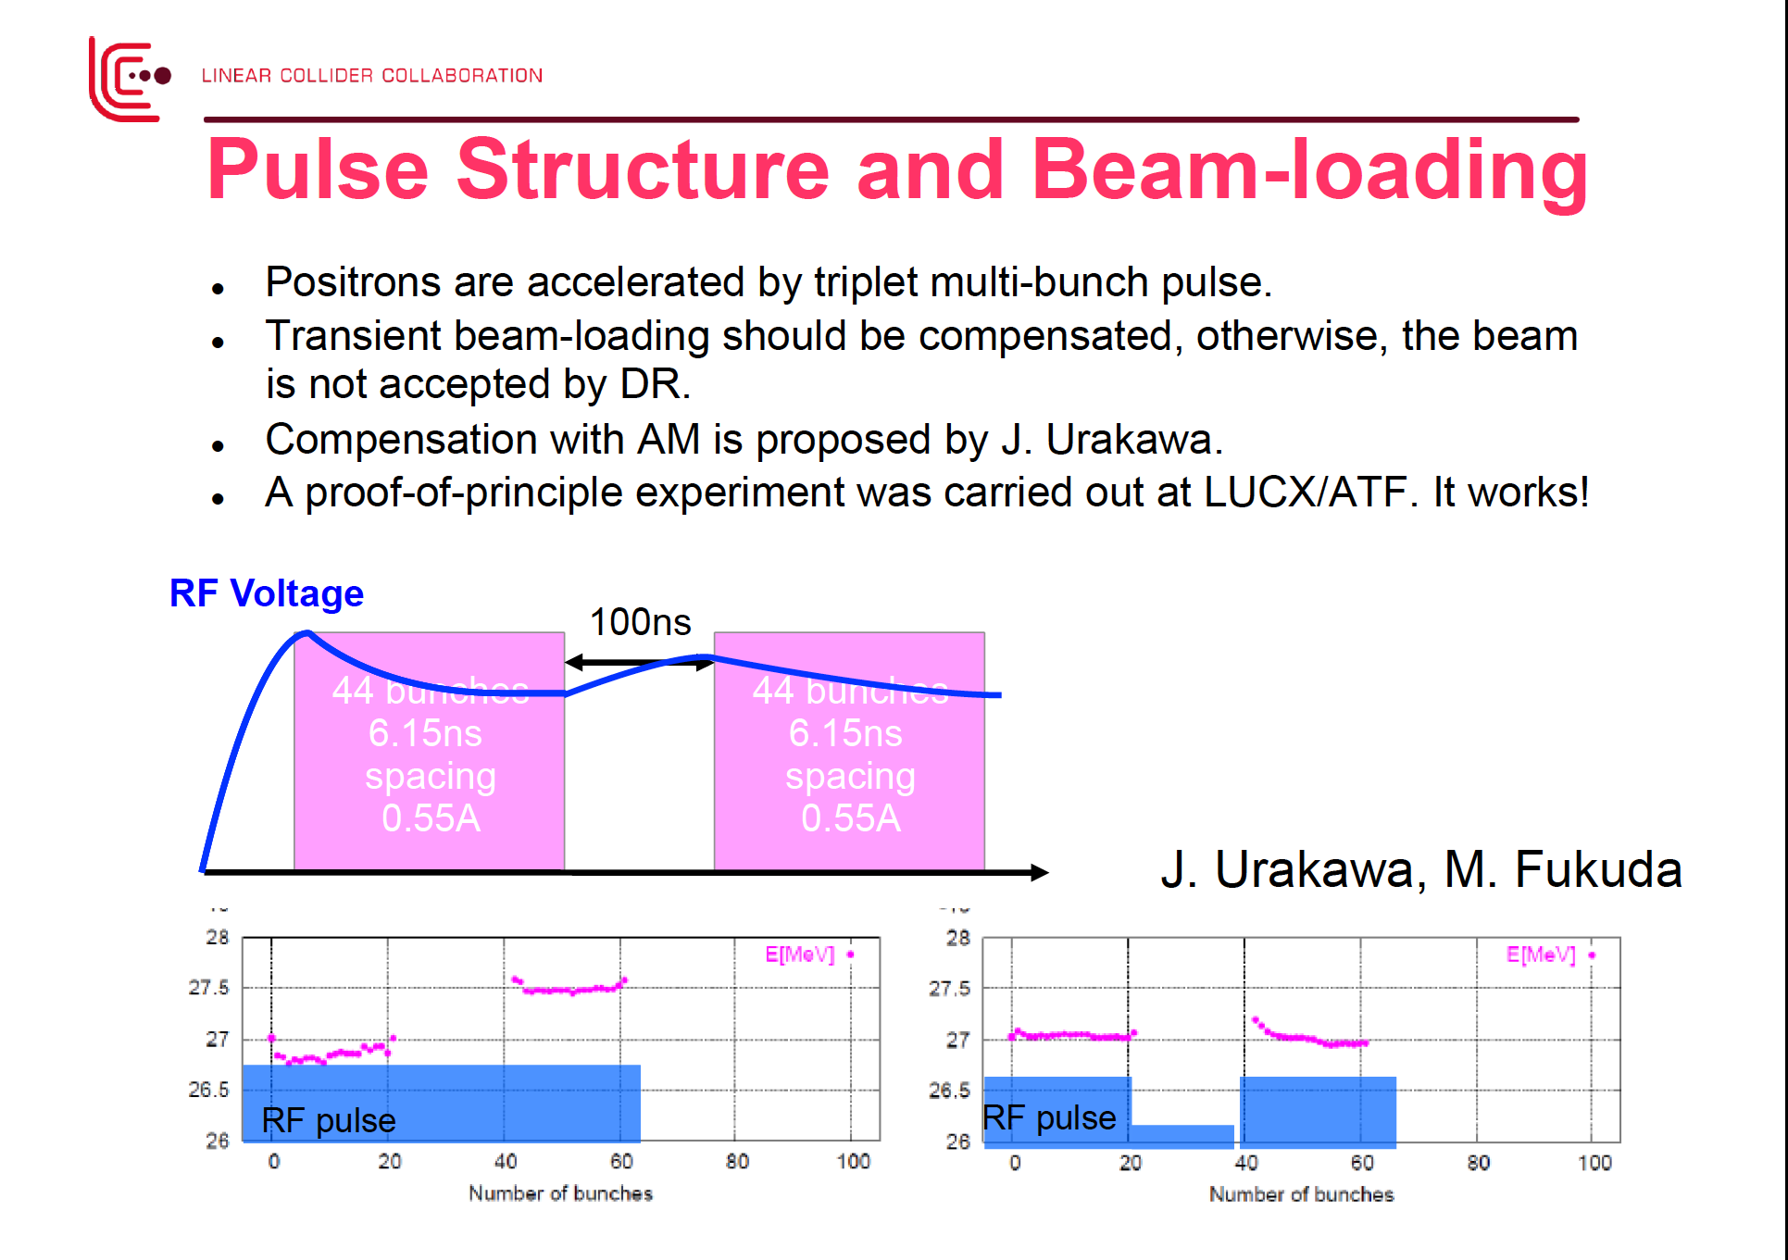
Notes:
9

Slide 10
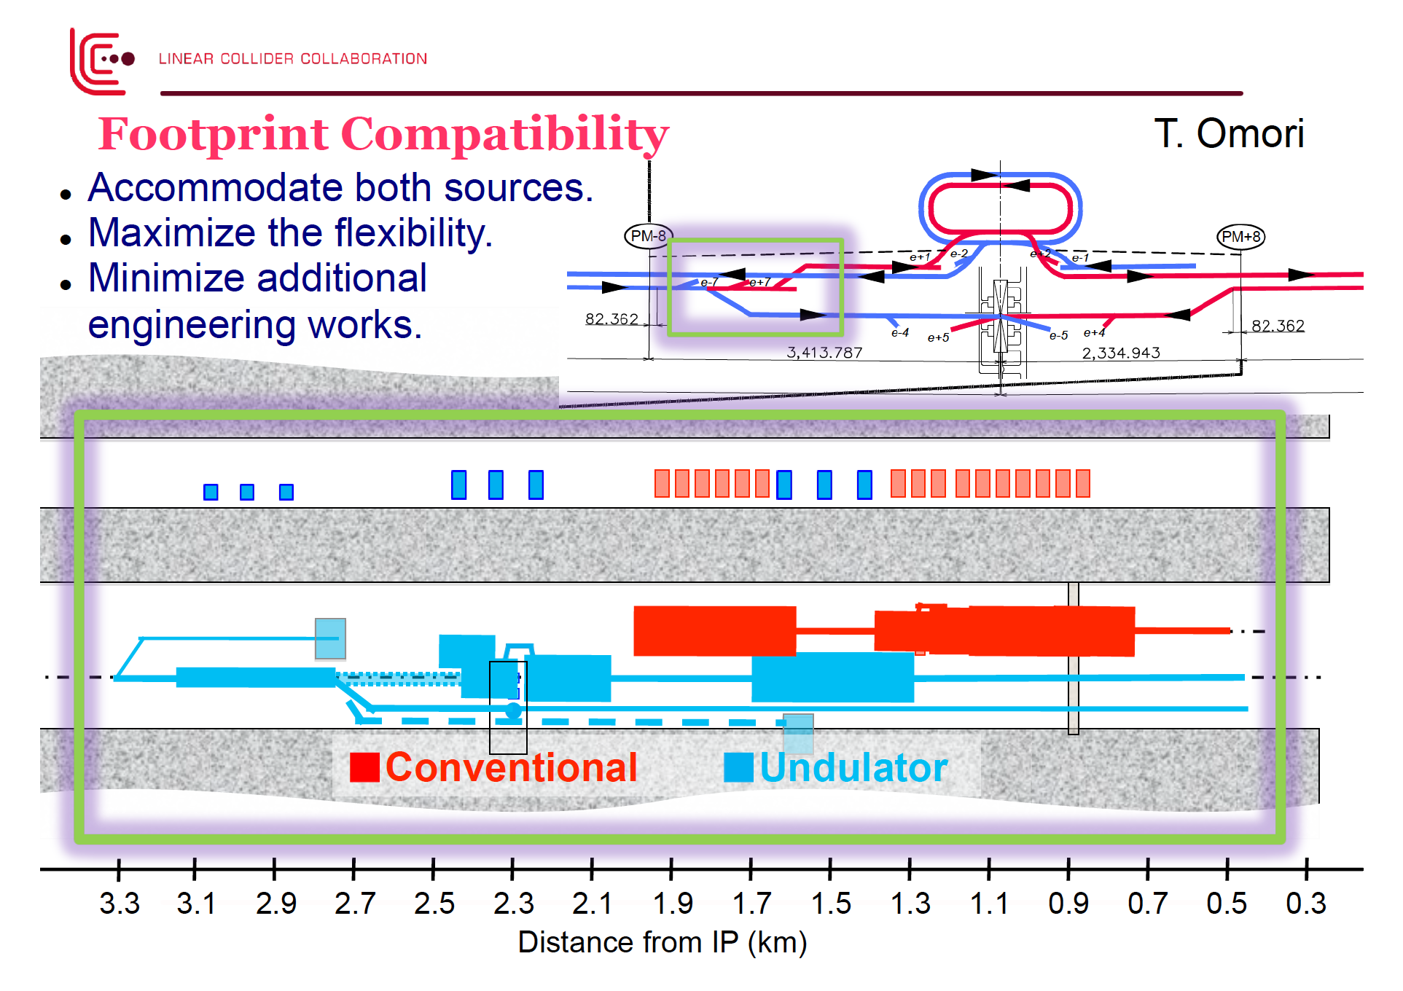
Notes:
10

Slide 11
Who are Working? ~ 20 people
Incomplete list
Simulation: Seimiya¹⁾
Target: T.Omori, T.Takahashi¹⁾, P.Sievers⁴⁾, M.Yamanaka, RIGAKU⁵⁾, J.Gao²⁾, S.Jin²⁾
Flux concentrator: P.Martyshkin³⁾, T.Kamitani, G.Pei²⁾, X.Sun²⁾, M.Akemoto
Linac: S.Fukuda, S.Michizono, J.Urakawa
CFS: M.Miyahara
General: M.Kuriki, T.Okugi, K.Yokoya
1) Hiroshima Univ. 2) IHEP 3) BINP 4) CERN 5) company, others are KEK
Groups are actually overlapping

Slide 12
Preparing a Detailed Report on e-Driven Source
System design of e-driven source
  Simulation
  Electron driver linac (S-band NC)
  Target
  Flux concentrator
  Capture section (L-band)
  Booster linac (L-band + S-band)
  Energy compressor
  Tunnel, Radiation safety (coupled with general BDS tunnel design)
  Cost
Least advanced is the booster linac
  Drives the design of the tunnel
Timeline: end of September (well before the November workshop at Whistler)
Possible change request in ~October
  Compatible tunnel design for undulator plus e-driven sources
This work is also needed for the response to Nomura survey

