Slide 1
Resolution Measurements with Two Mechanical Phase Shifters
Jack Roberts

Slide 2
Status
Last 2 days:
Mechanical shifters connected to all 3 sets of electronics.
Calibrations/resolution measurements with the upstream monitors.
Beam has been setup to downstream monitor.
Hopefully this afternoon:
Performance measurements of the downstream monitor.
Some phase propagation studies.
Lucy and Murtaza (summer students) arrived on Monday and are settling in well.
Lucy will work with Davide on continuing the phase space tomography work started by Alex last year.
Murtaza will work with me on phase feedforward: Simulations of expected/achieved phase jitter reduction, helping any data taking over the next couple of months.

Slide 3
SiS Digitisers: Amplifier
Amplifier used to better match range of SiS digitiser ADCs.
Saw no improvement in resolution using it in April due to one noisy channel.
Tried again on Wednesday, being 100% sure to terminate all unused channels etc.
No longer see the noisy channel.
NB: Some channels terminated by connecting to FONT5 board (which was off). Maybe there is some effect if FONT5 board turned on?

Slide 4
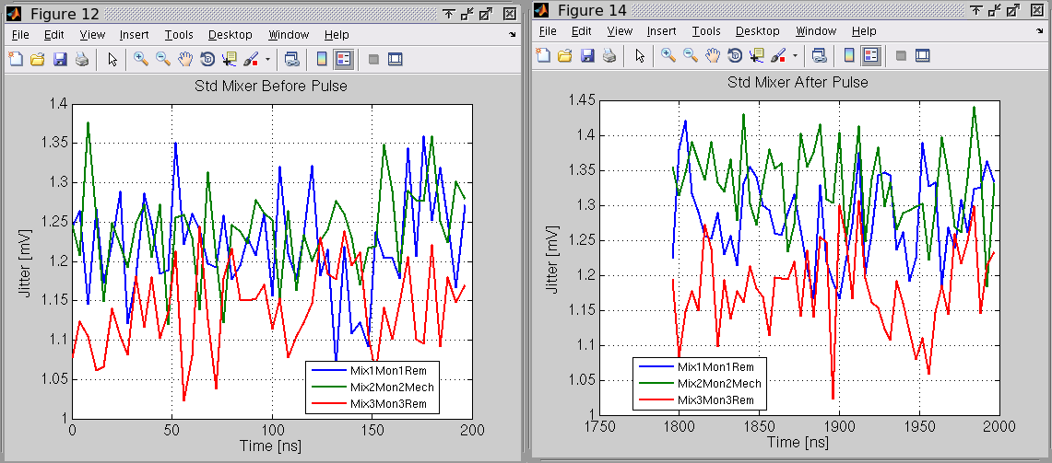
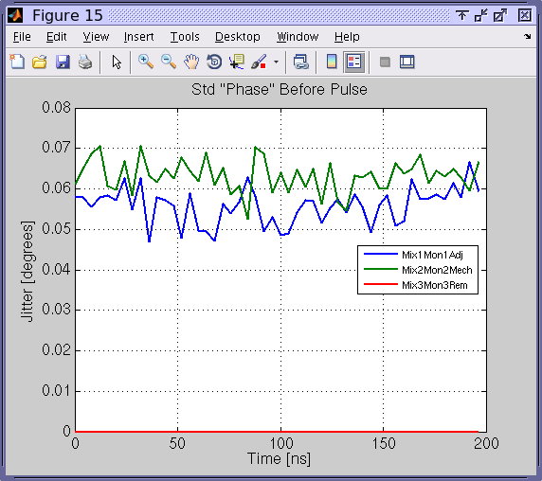
SiS Digitisers: Amplifier (July)

Slide 5
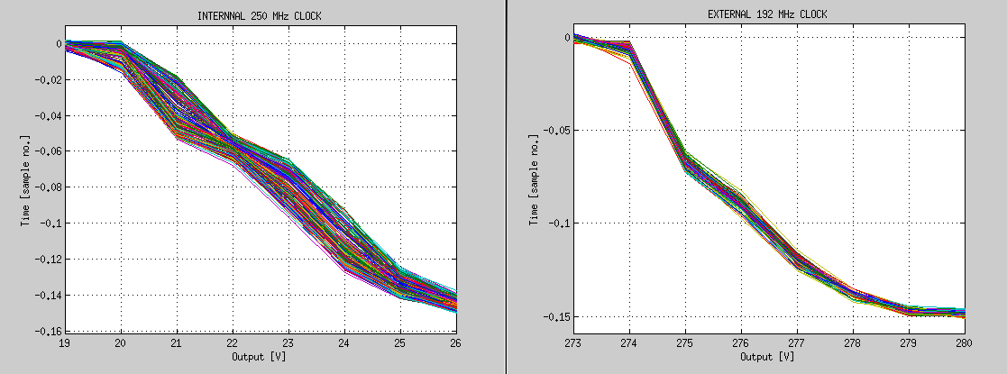
SiS Digitisers: Clock
SiS digitisers have been using an internal 250 MHz clock up until now.
As this is not locked to the beam, it created a pulse to pulse jitter of up to ~3 samples.
They have now been configured to use an external 192 MHz clock locked to CTF timings.
Should we consider using this for the FONT5 board as well?
INTERNAL
250 MHz
CLOCK
EXTERNAL
192 MHz
CLOCK

Slide 6
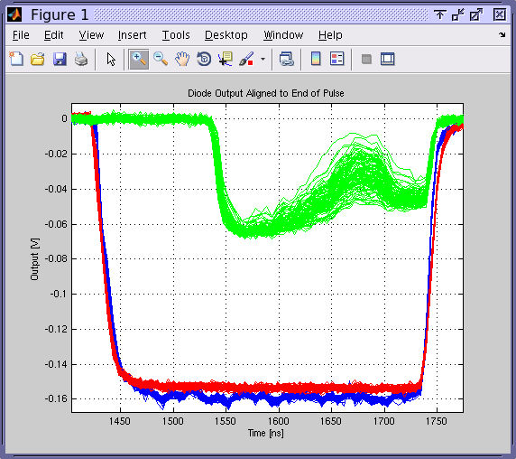
Up/Downstream Pulse Length Difference
Bypassing Frascati chicane.
Difference is ~109 ns.
Verified that lost part of the pulse is off-energy transient at the beginning.

Slide 7
Resolution with Mechanical Shifters
Don’t have a delivery date for the 3 new mechanical shifters yet.
We currently have two (borrowed) mechanical shifters:
One for which 3 GHz is within design specifications.
One which is only rated down to 3.5 GHz.
This may or may not be the one used in April!
I connected these to the 2 upstream monitors for resolution measurements.
Eventually replaced 3.5GHz shifter with one of the phase adjusters from Oxford.
Also replaced remote shifter on Mon3 (downstream) with a phase adjuster.

Slide 8
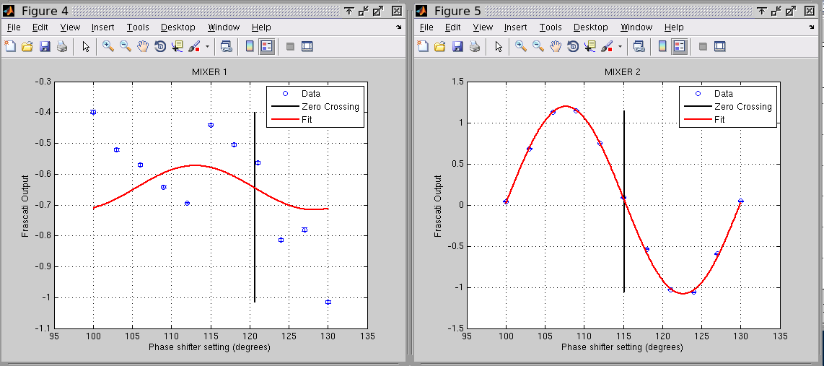
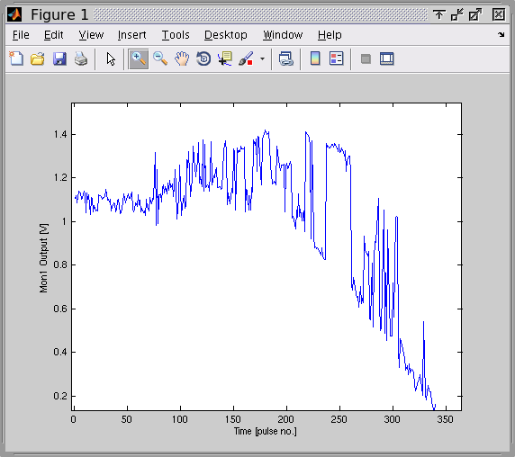
3.5 GHz Mechanical Shifter
Shifter varied through 4 x 360 degrees.
360 degrees calibration attempt
Many discontinuities, doesn’t resemble desired response at a ll.

Slide 9
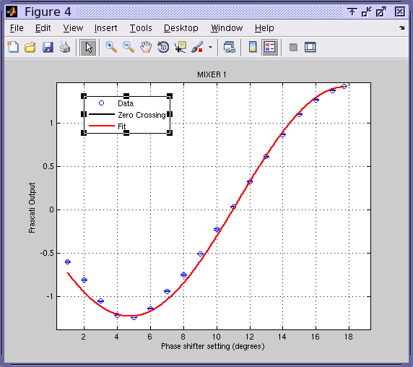
3 GHz Mechanical Shifter and Phase Adjuster

Slide 10
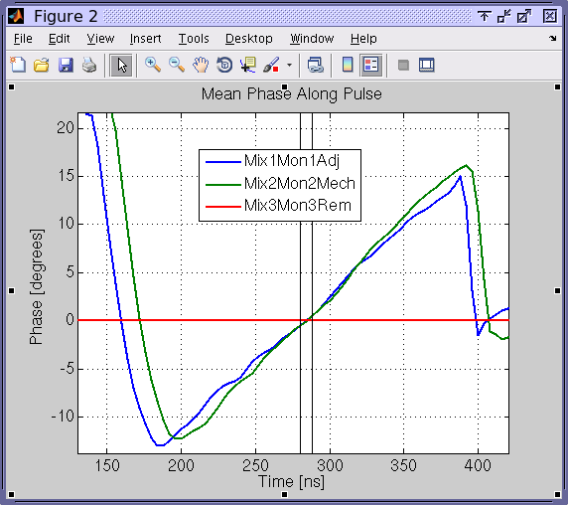
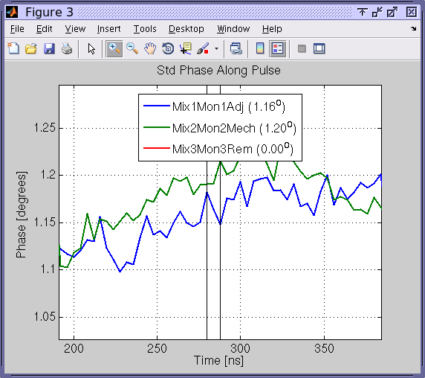
Mean Phase/Jitter Along the Pulse
1.2 degrees phase jitter, some signs that Mon2 measurement still slightly noisier (clearer in other datasets).

Slide 11
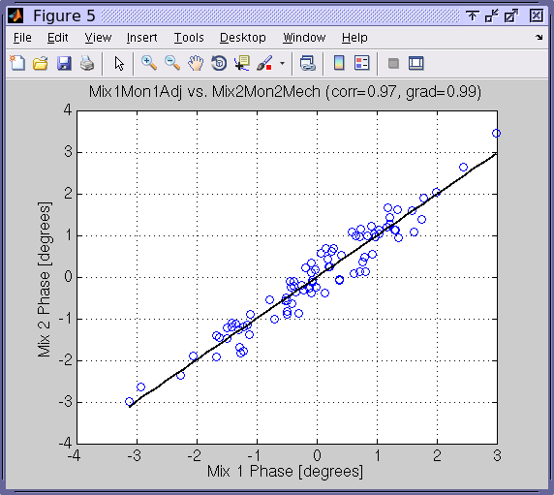
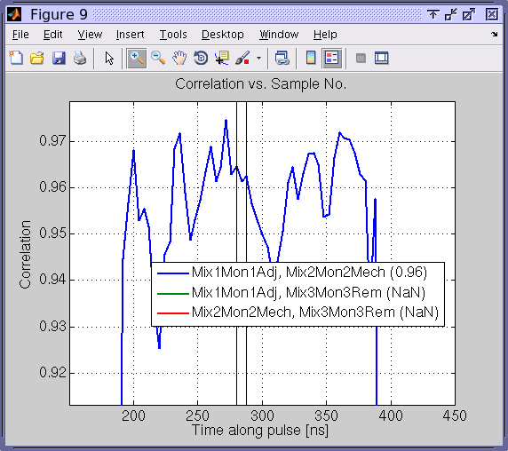
Correlations

Slide 12
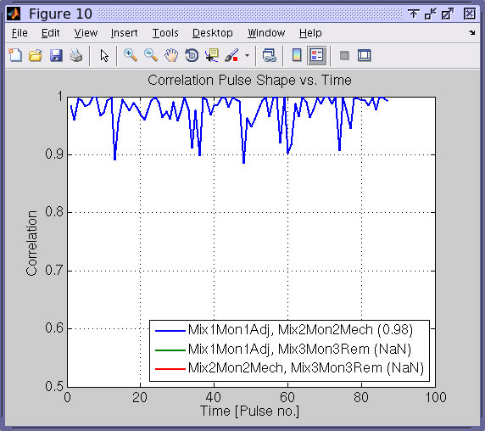
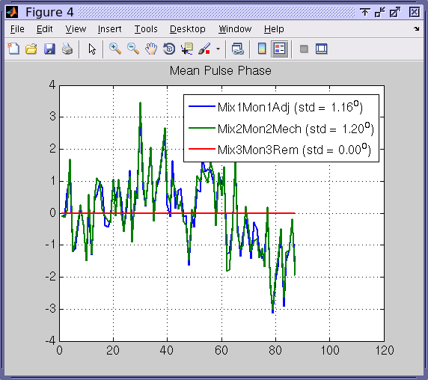
Shape Correlation / Mean Phase

Slide 13
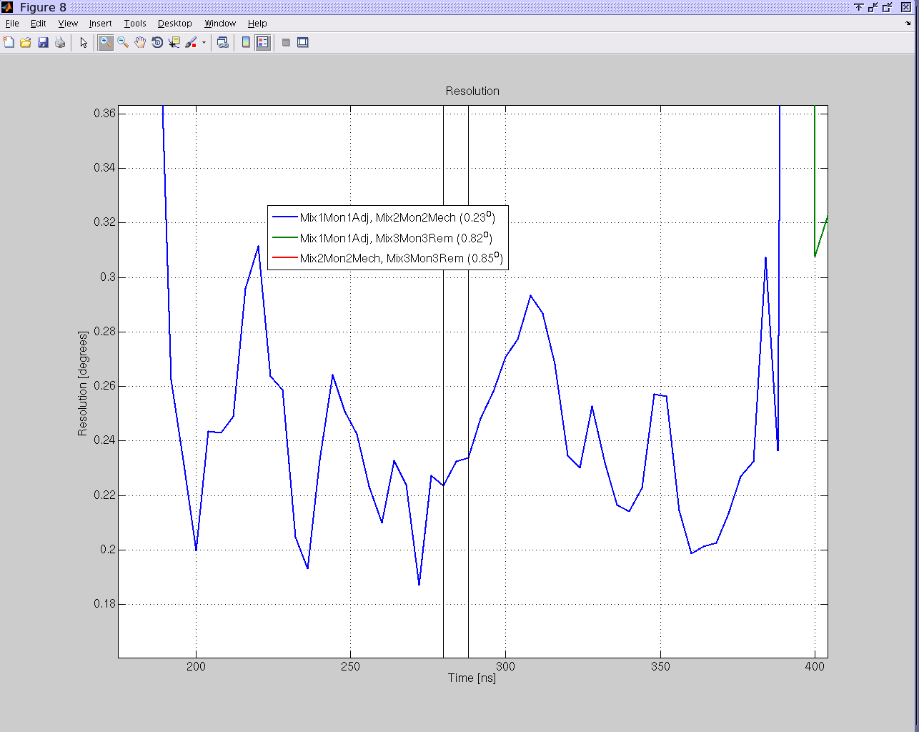
Last but not least… Resolution!
~0.25 degrees resolution ☺
Some scope to improve it a bit further, e.g. additional amplification/use FONT5 board, improved calibrations…
0.3º
0.2º

Slide 14
BACKUP

Slide 15
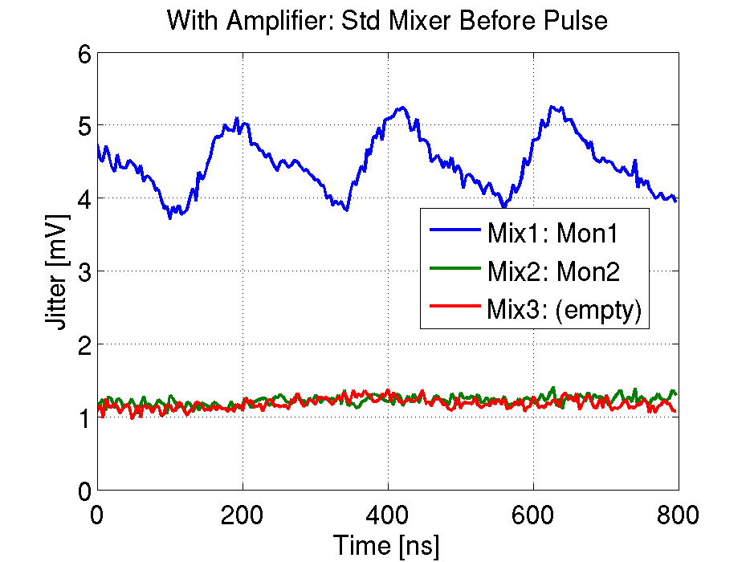
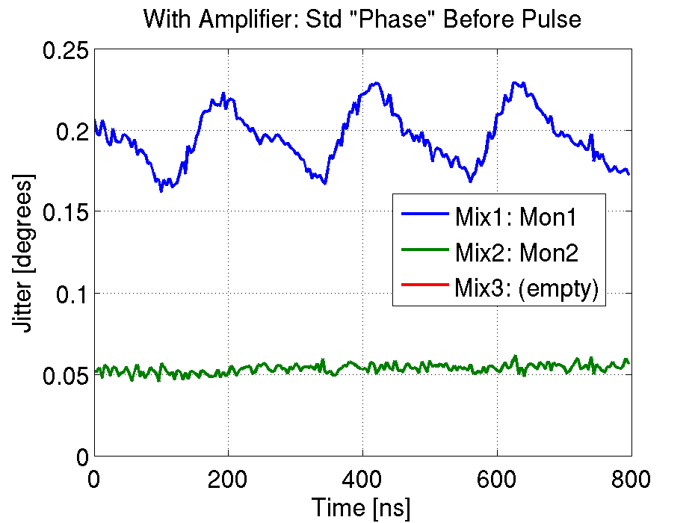
SiS Digitisers: Amplifier (April)
Mix1 and Mix2 signals amplified.
Mix1: noisy channel.
Mix2: baseline noise not increased compared to Mix3 (i.e. limited by ADC noise)

Slide 16
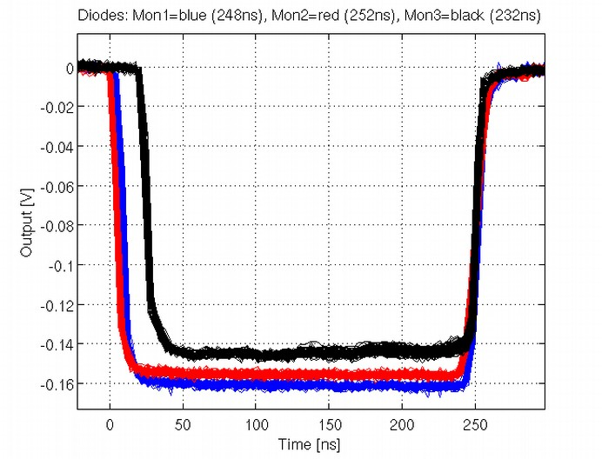
Up/Downstream Pulse Length Difference
Using Frascati chicane.
Different pulse length upstream and downstream (also BPMs).
Lose transient at start of pulse (~20ns).

