Slide 1
Waveforms with and without BPFs
N. Blaskovic
N. Blaskovic

Slide 2
Contents
Waveforms and their Fourier transforms:
Without BPF (12 June)
With 714 MHz BPF on dipole signal (12 June)
With C-band BPF on dipole signal (19 June)
N. Blaskovic

Slide 3
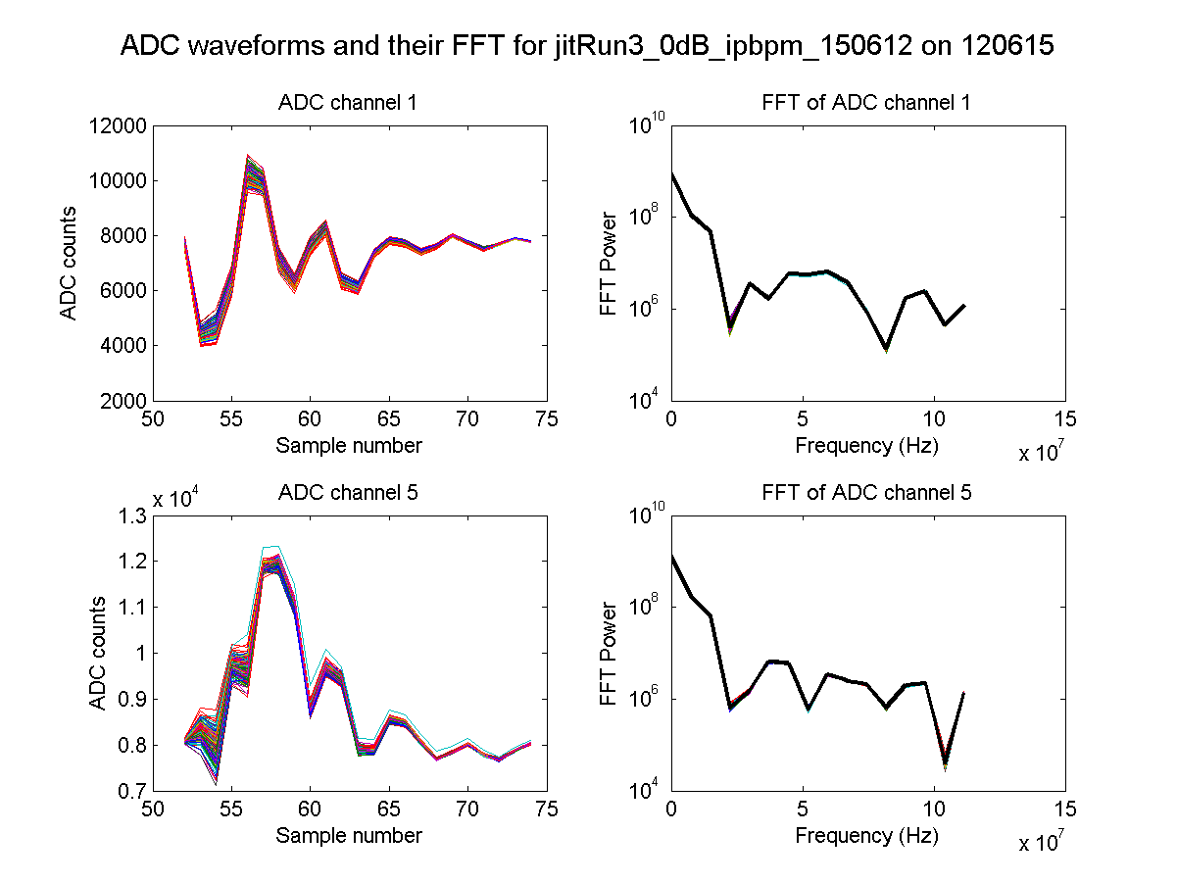
no BPF
IPA I
IPA Q
N. Blaskovic

Slide 4
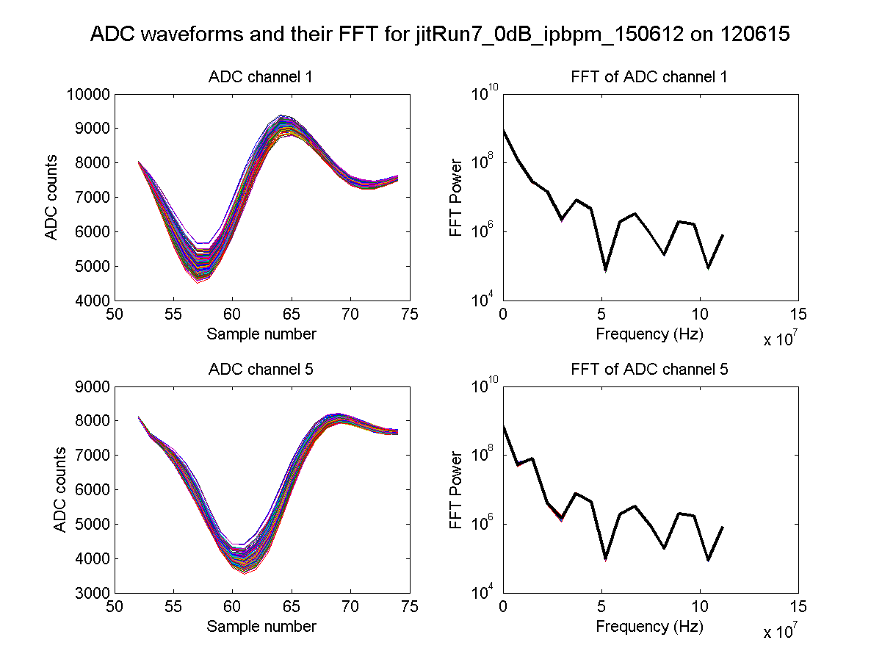
714 MHz BPF
IPA I
IPA Q
N. Blaskovic

Slide 5
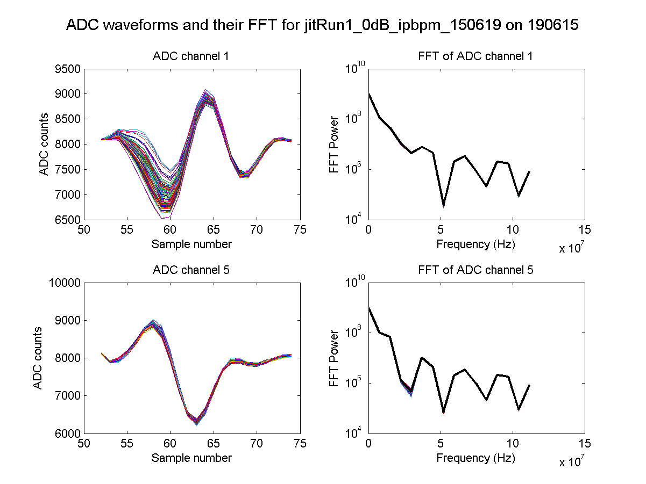
C-band BPF
IPA I
IPA Q
N. Blaskovic

Slide 6
Appendix
Waveforms and their Fourier transforms for IPB and IPC
N. Blaskovic

Slide 7
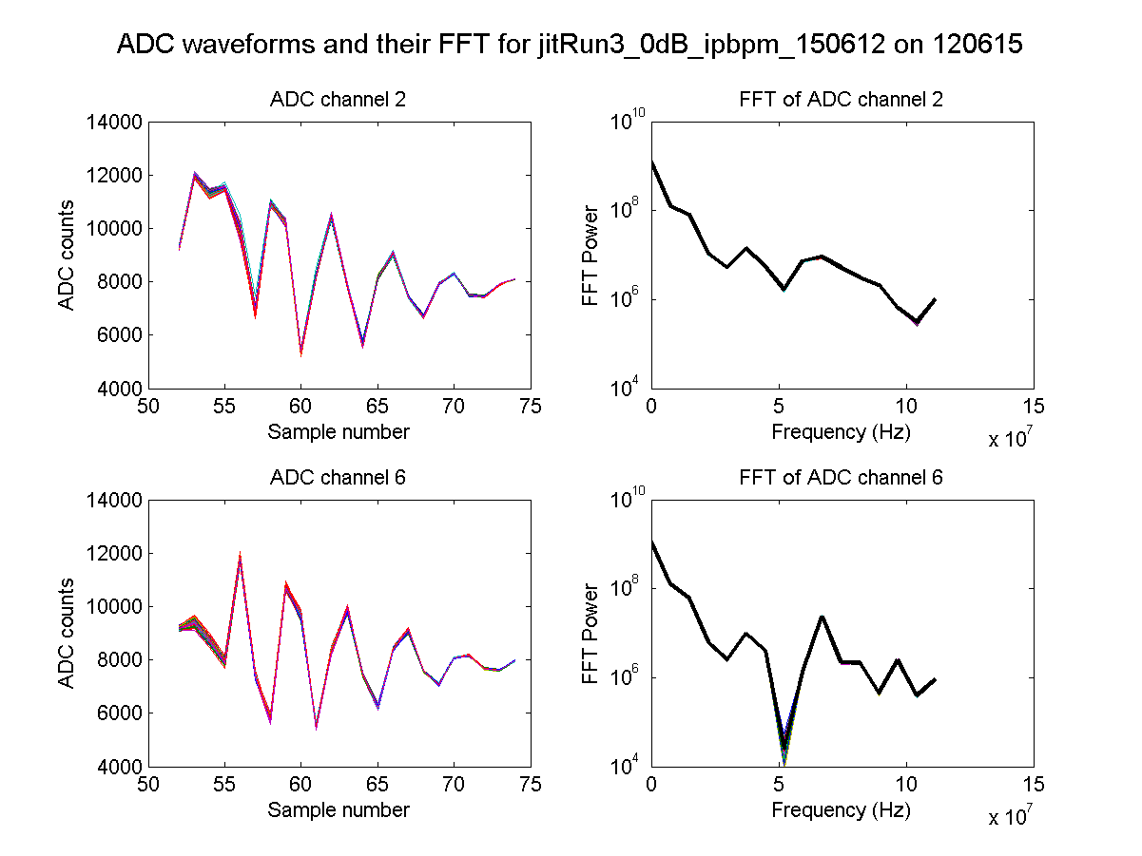
no BPF
IPB I
IPB Q
N. Blaskovic

Slide 8
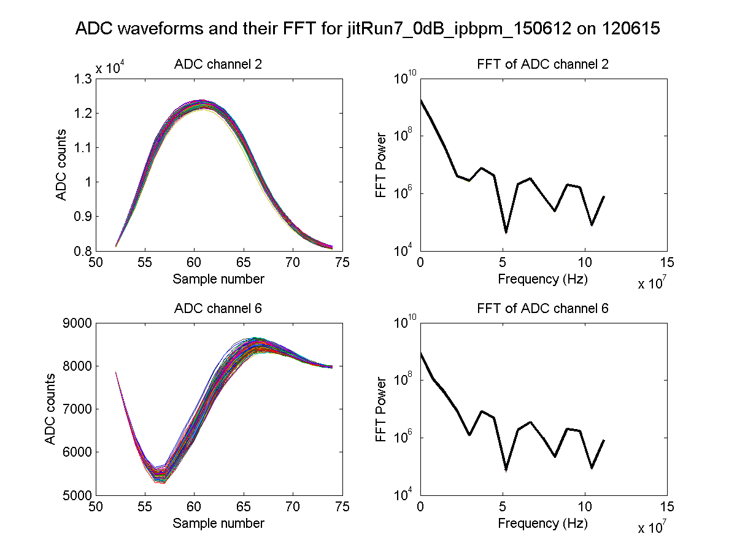
714 MHz BPF
IPB I
IPB Q
N. Blaskovic

Slide 9
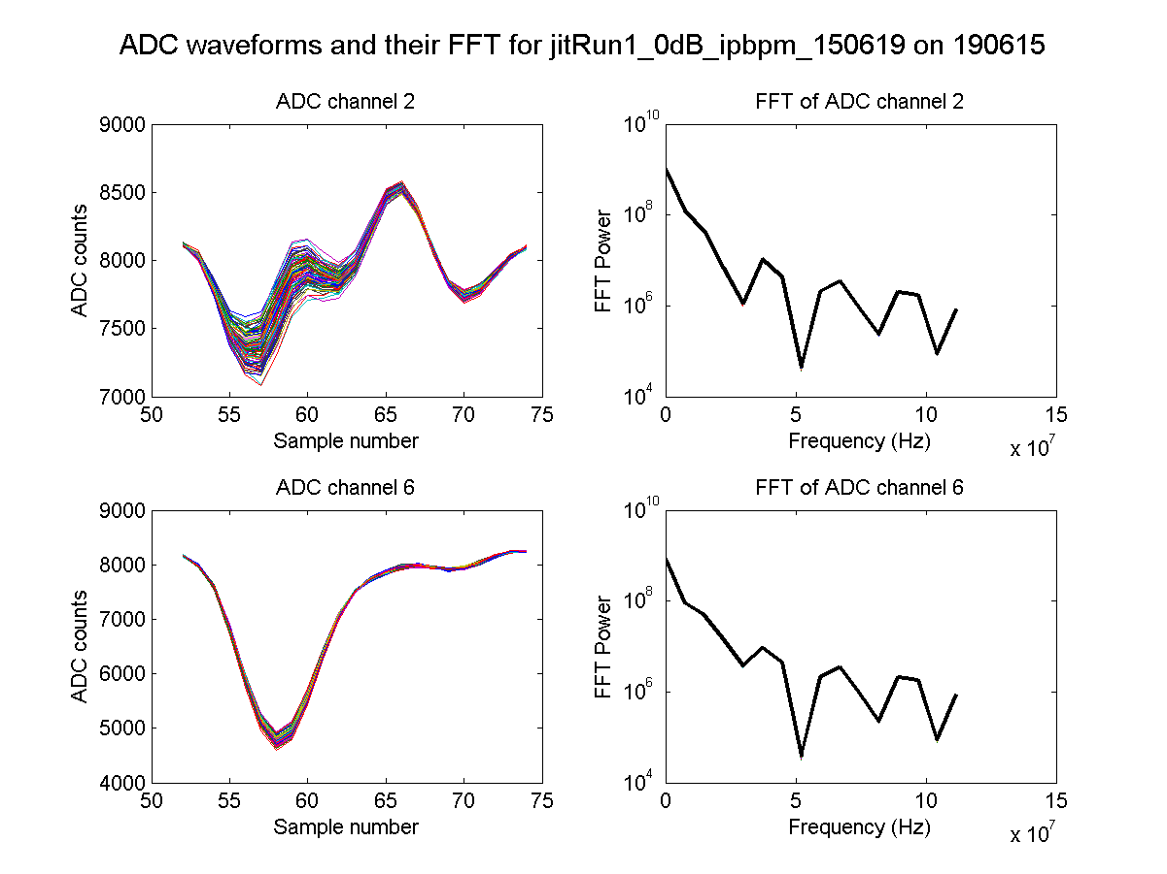
C-band BPF
IPB I
IPB Q
N. Blaskovic

Slide 10
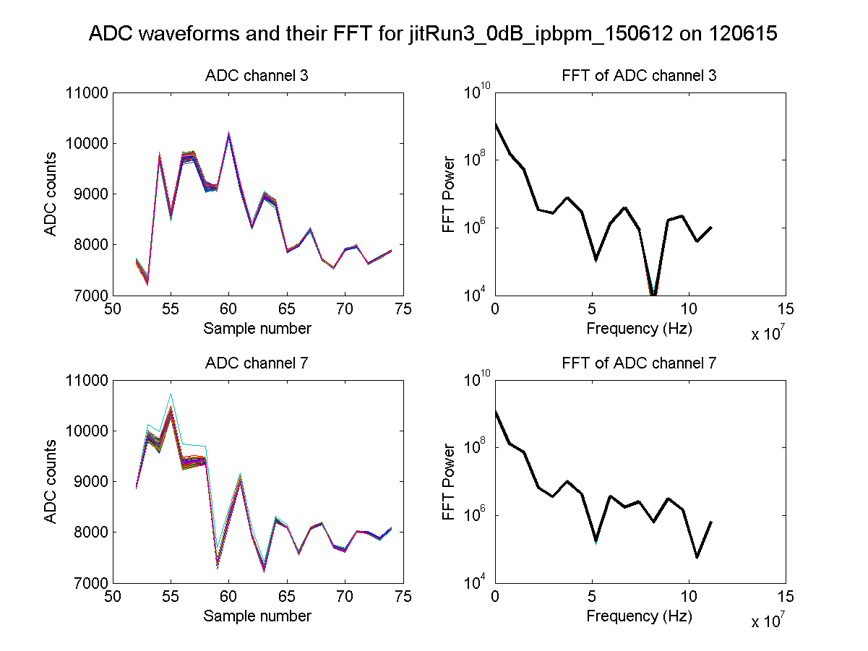
no BPF
IPC I
IPC Q
N. Blaskovic

Slide 11
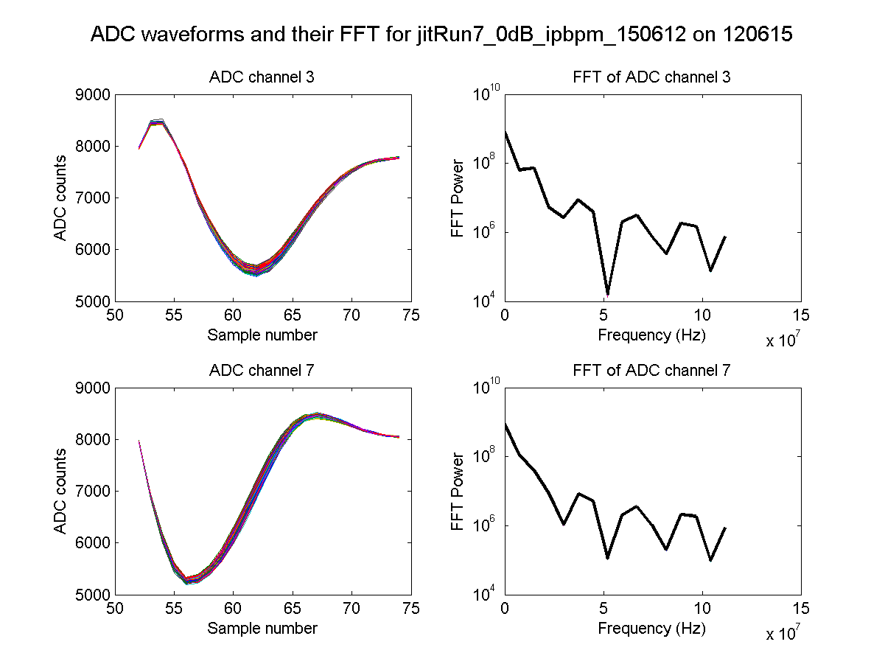
714 MHz BPF
IPC I
IPC Q
N. Blaskovic

Slide 12
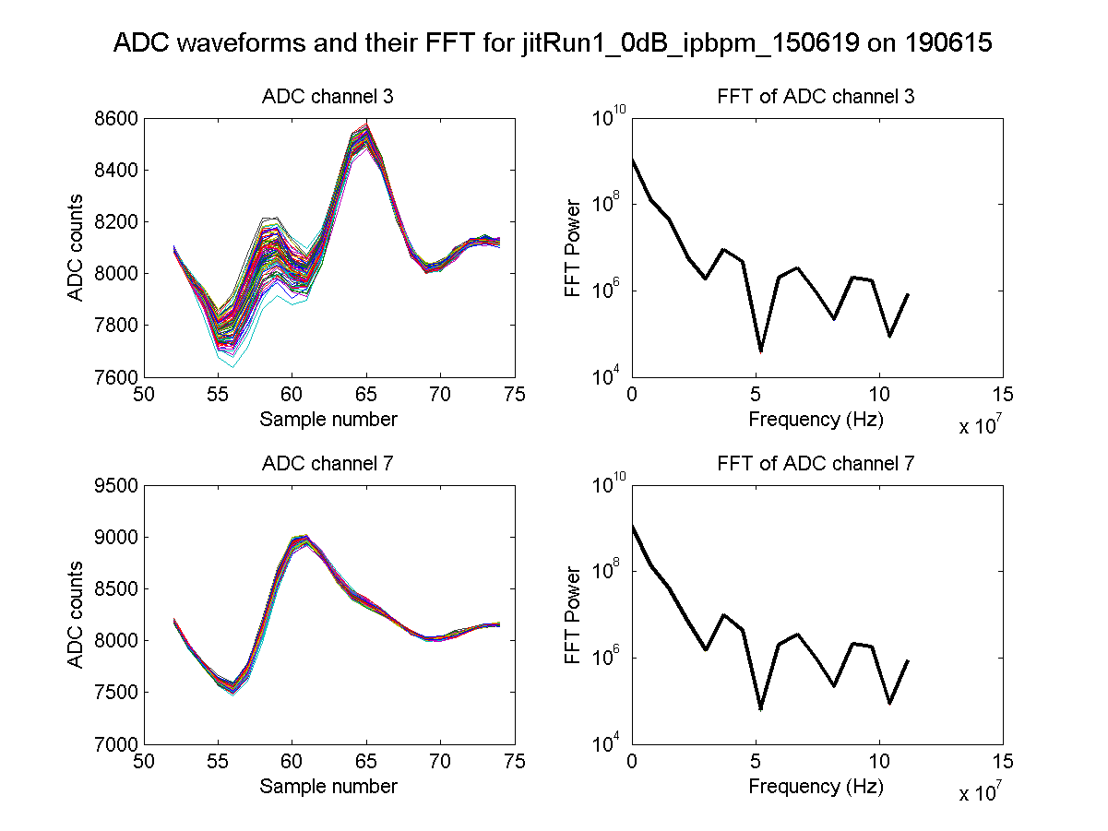
C-band BPF
IPC I
IPC Q
N. Blaskovic

