Slide 1
Summary of Shifts Fri 3rd PM – Weds 8th
Jack Roberts

Slide 2
Summary
Friday PM
R56 scan in TL1 over a wide range.
Monday
Issue with interlock system delayed beam until late afternoon.
Recovered beam conditions of Friday
Tuesday
AM: Calibrations, then magnet issue which again delayed beam until late afternoon.
PM/evening: Further R56 optimisation attempts, feedforward runs.
Wednesday
AM: Shifted pulse to create flatter phase sag.
PM/evening: Some checks in gallery, more feedforward runs, R56 studies

Slide 3
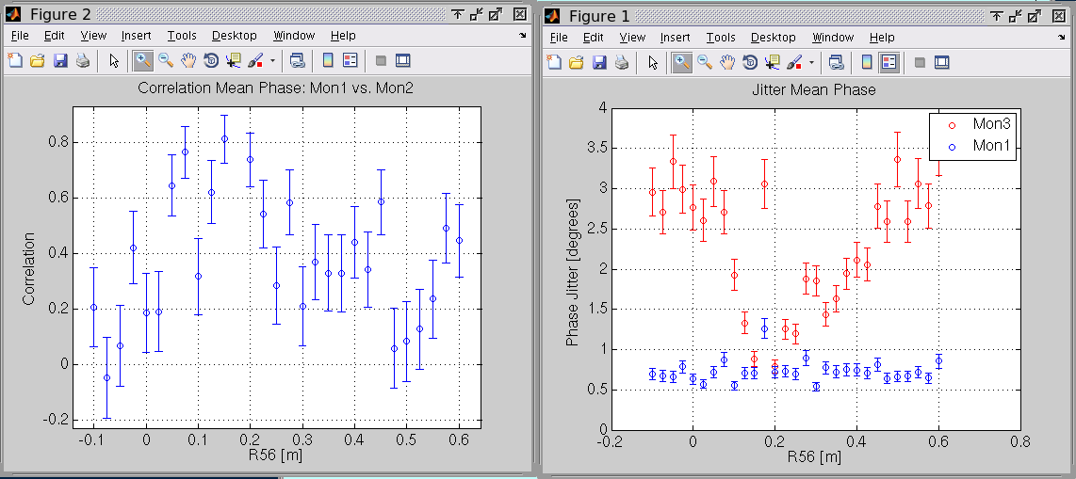
Friday: R56 Scan in TL1

Slide 4
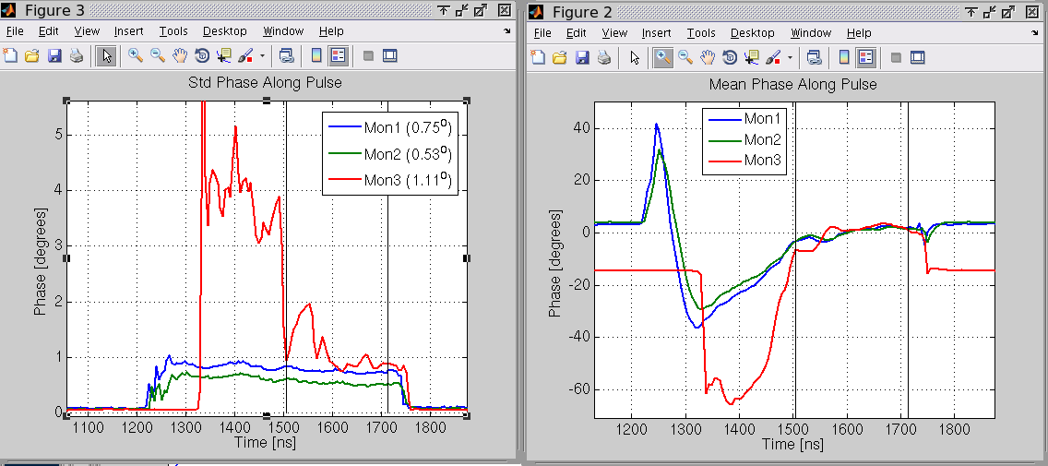
Friday: R56 = +0.2m
Good second half of pulse but bad first half
…different optimal R56 for different energies.

Slide 5
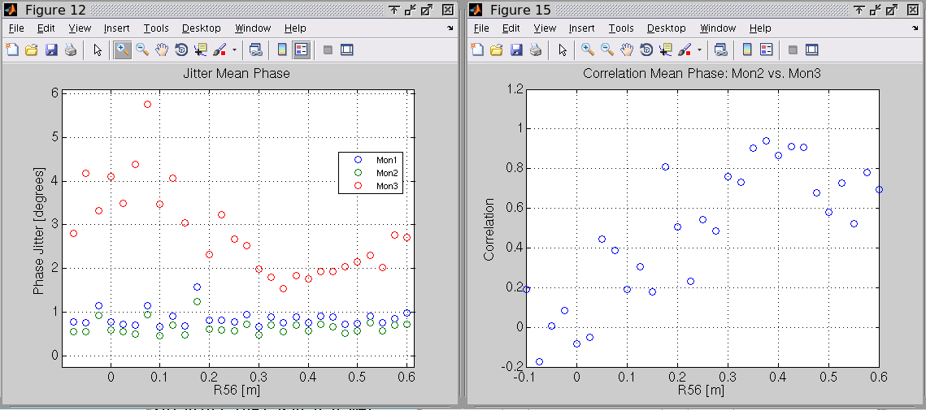
Friday: R56 Scan – optimising to 1st half of pulse

Slide 6
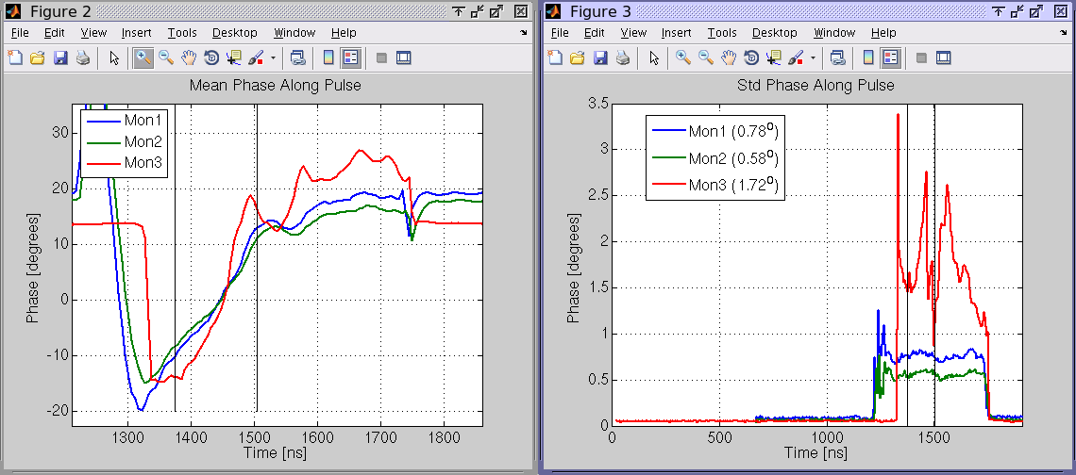
Friday: R56 Scan, R56=0.35m

Slide 7
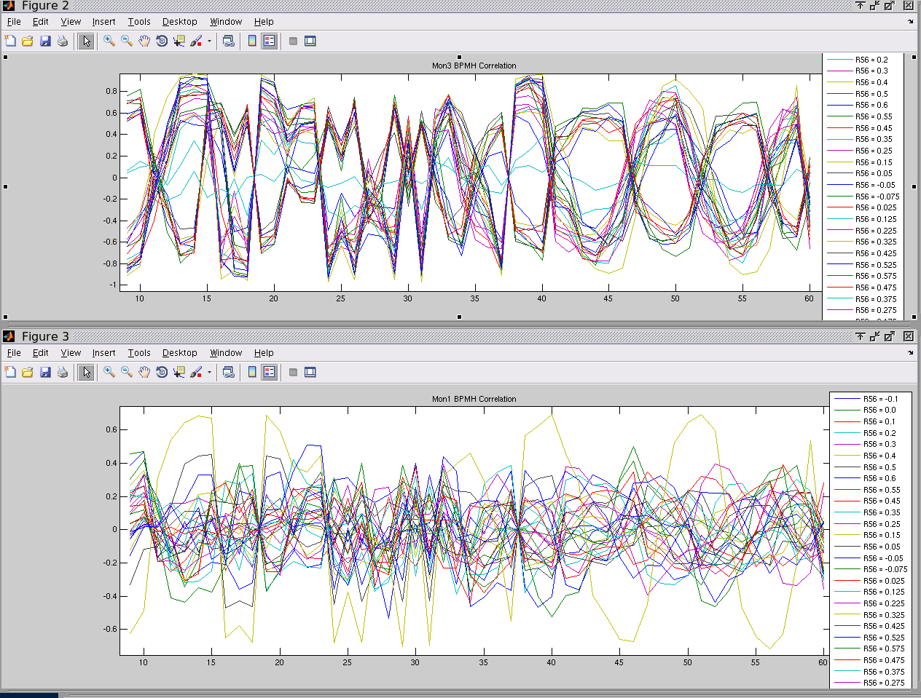
Friday: Correlation with BPM H pos (energy) vs. R56
DOWNSTREAM

Slide 8
Friday: Correlation with BPM H pos (energy) vs. R56
UPSTREAM

Slide 9
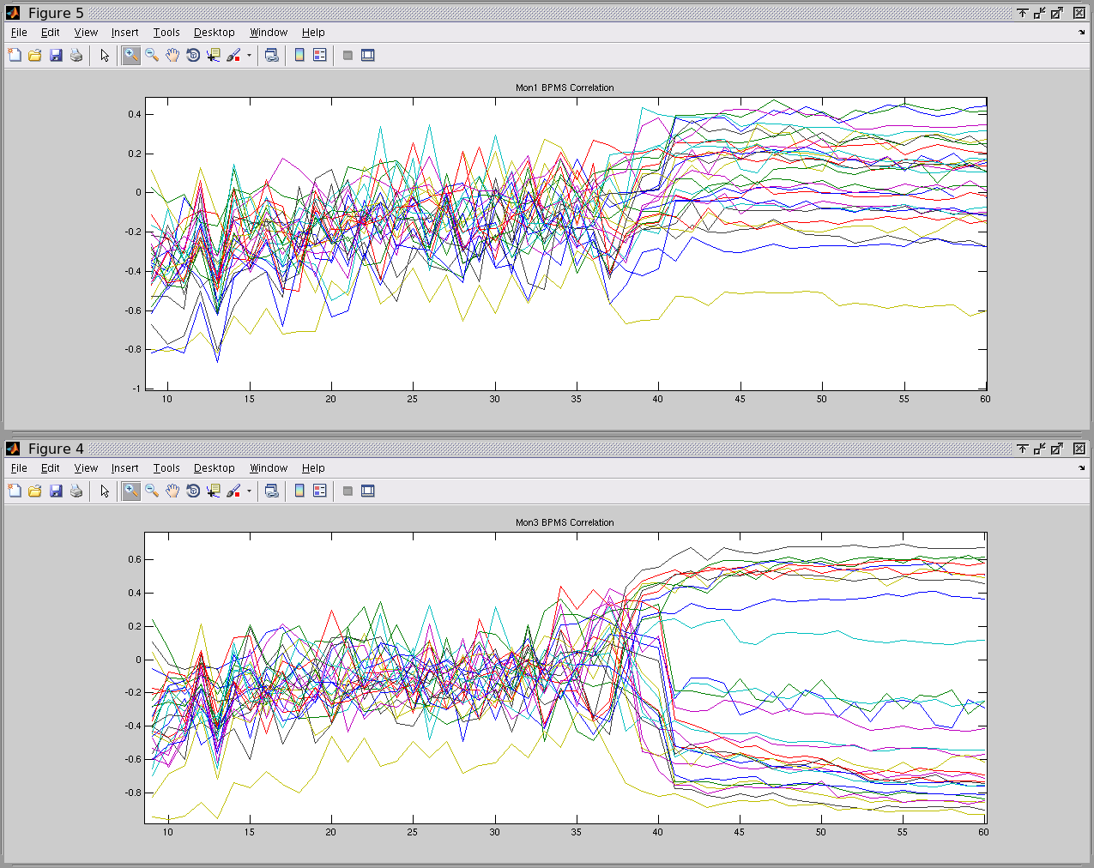
Friday: Correlation with BPM S (transmission) vs. R56
DOWNSTREAM

Slide 10
Friday: Correlation with BPM S (transmission) vs. R56
UPSTREAM

Slide 11
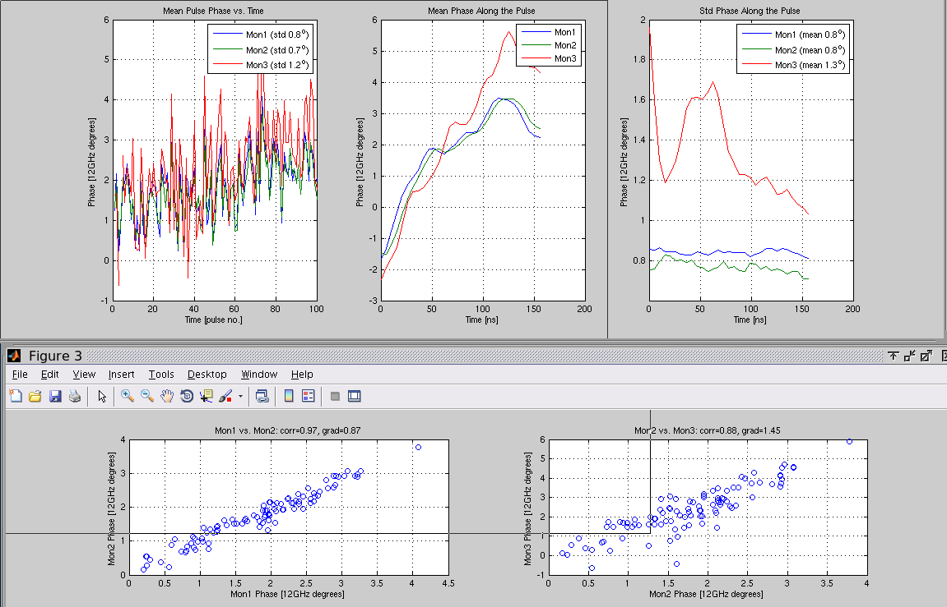
Tuesday: R56=0.05m in TL1
Optimal point changed from Friday, and seemed to switch between two states, ~0.05m and ~0.2m

Slide 12
Tuesday: R56=0.05m in TL1

Slide 13
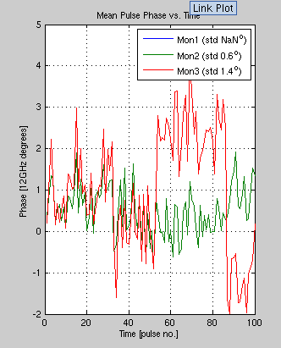
Tuesday: Constant Kicks

Slide 14
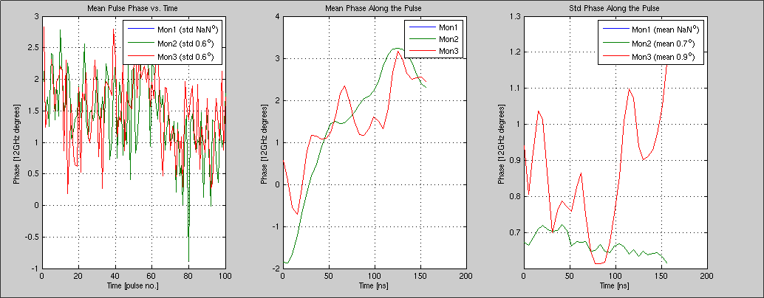
Tuesday: FF Gain +63

Slide 15
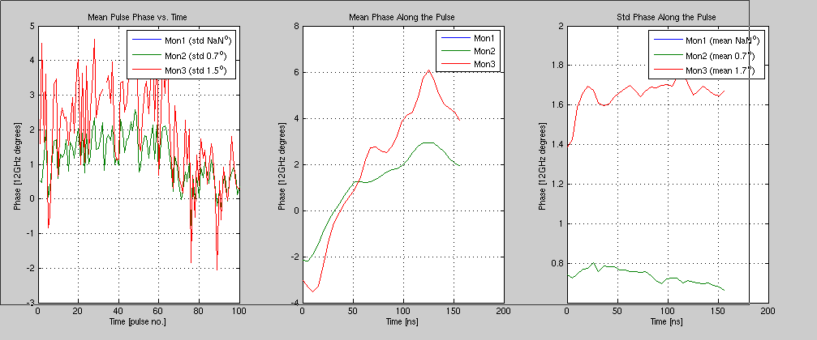
Tuesday: FF Gain -63

Slide 16
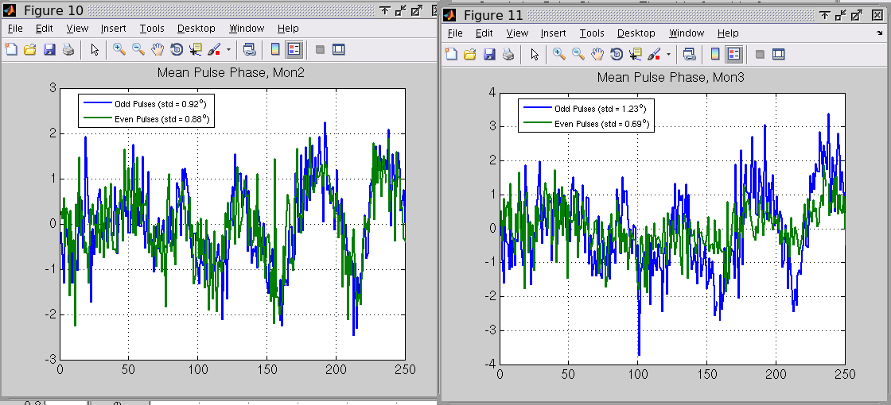
Tuesday: Interleaved Data, Gain +63 (Even = FF On)
Mean phase jitter reduced from 1.2 degrees to 0.7 degrees downstream.

Slide 17
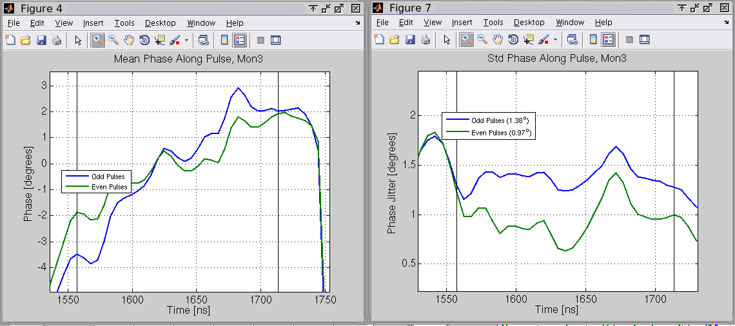
Tuesday: Interleaved Data, Gain +63 (Even = FF On)

Slide 18
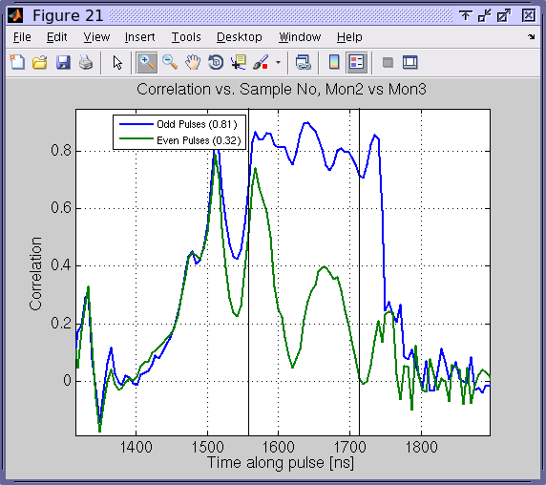
Tuesday: Interleaved Data, Gain +63 (Even = FF On)

Slide 19
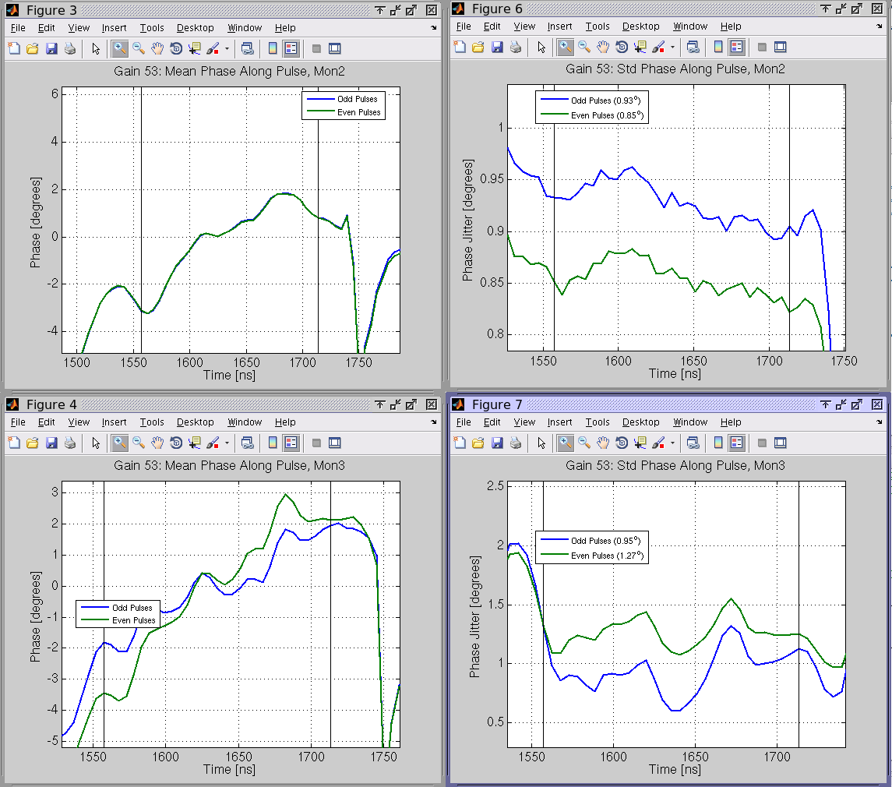
Tuesday: Interleaved Data, Gain +53 (Odd= FF On)

Slide 20
Tuesday: Interleaved Data, Gain +53 (Odd= FF On)

Slide 21
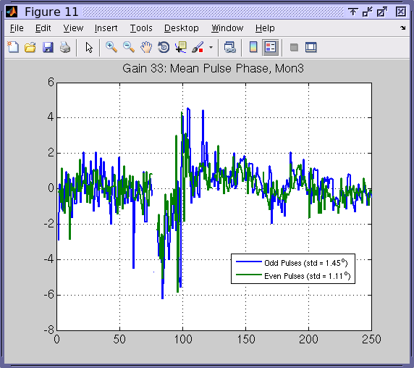
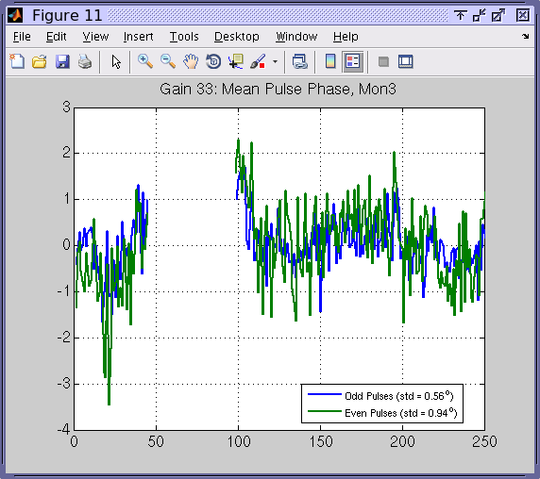
Tuesday: Interleaved Data
GAIN 33
GAIN 43
0.94 degrees reduced to 0.56 degrees.
1.45 degrees reduced to 1.11 degrees.

Slide 22
Wednesday
Moved beam ~200ns later to get flatter phase sag – took most of morning to set up (losses caused by energy difference?)
Best R56 flipped between 0.2 m and 0.05m during day.
Was saturating the amplifier so went to double check max DAC counts to output.
Feedforward runs: Gain scan, plus similar results to Tuesday.
Tried some online R56 optimisation, didn’t really work so needs more thought.

Slide 23
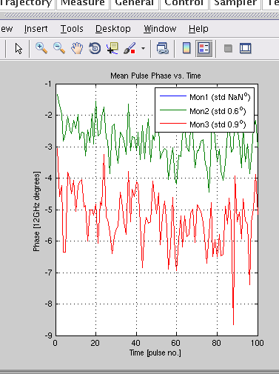
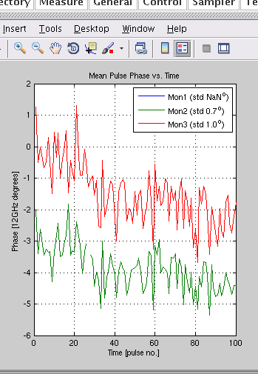
Wednesday: Saturating amplifier
Min/Max gain just caused mean phase shift, no jitter improvement.

Slide 24
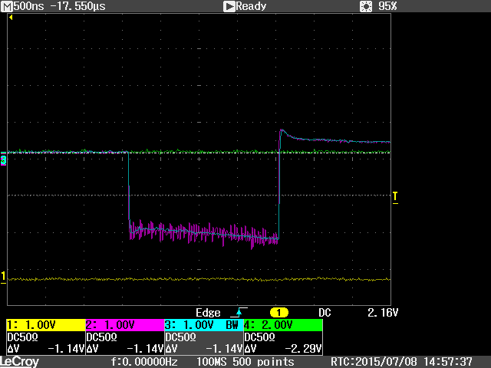
Wednesday: Verifying signal level to amplifier
1000 DAC counts = 2V to amplifier.

