Slide 1
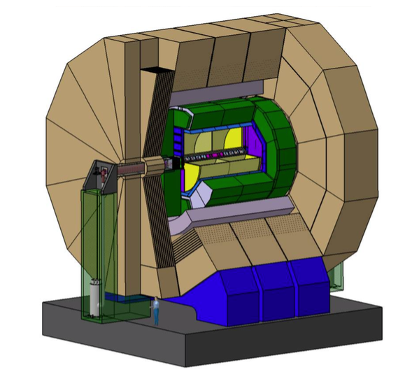

Ideas on TPC Assembly
Volker Prahl,
Thomas Schörner-Sadenius
Paris, 8/9 October 2015

Slide 2
Outline
Some basic considerations
Horizontal / vertical TPC assembly (in the AH?)
A first shot at the various possible TPC project plans
TPC insertion in the DH

Slide 3
Some basic assumptions – all to be argued
No (long) transport of full TPC, field cage or fully equipped end-plates → need to assemble TPC at IP campus
Our assumption here: TPC assembly in the AH. Compatible with Yasuhiro’s overall plan assuming realistic TPC time scales?
Then space in AH necessary
Do it in research office building? But then where full TPC system test (gas!)?
No TPC assembly in DH.
No TPC assembly in DH – sufficient space and possibility to work in parallel with yoke construction, but probably bad timeslot?
Current scenario therefore:
  Horizontal or vertical assembly in AH hall (exact position tbd)
  Space requirement: 100 m² (probably 60 m² enough, but some contingency), plus storage space (for modules) and test area for modules
  Field cage delivered in one or two big pieces and assembled in AH
  Necessity to create grey-room / ISO7 characteristics around TPC assembly place

Slide 4
Location in AH (from Yasuhiro’s yoke assembly plan)
TPC Assembly
horizontal - long
Questions:
Grey-room quality after delivery of field cage and mounted end-plates?
Position of large door?
Obsolete after yesterday’s discussion?
Door position?

Slide 5
Location in AH (from Yasuhiro’s yoke assembly plan)
TPC Assembly
horizontal - long
Obsolete after yesterday’s discussion?
Possible TPC assembly area
approx. 25×8 m²
(half the length also ok,
greyroom / ISO7 needed)

Slide 6
Vertical procedure in a few steps
Field-cage in cradle
Endplate frame

Slide 7
Vertical procedure in a few steps

Slide 8
Vertical procedure in a few steps

Slide 9
Vertical procedure in a few steps

Slide 10
Vertical procedure in a few steps

Slide 11
Vertical procedure in a few steps

Slide 12
Vertical procedure in a few steps
Then
Cleaning of field cage
Construction of grey/clean room around TPC field cage (ISO 7)
Equipping of end-plates with tested modules using robot (petal-like structures in
EP quadrant holes).
System test (in AH)

Slide 13
Horizontal procedure in a few steps
Note: – Greyroom / ISO7 with stable T and FFUs needed from start.
– Access to greyroom through sliding gate with air lock
– Assumption that field cage self-supporting and first EP equipment
Trolley with self-supporting
thorn (load 100 kg, sideview)
Platforms for inner vessel
and field cage: (re)movable
Width
min. 6 m
Length min. 12 m

Slide 14
Horizontal procedure in a few steps
End-plate structures on trolleys and beginning of end-plate equipping (R); supporting star on inner-vessel platform

Slide 15
Horizontal procedure in a few steps
Field-cage assembly

Slide 16
Horizontal procedure in a few steps
Marriage of field-cage and end-plate R

Slide 17
Horizontal procedure in a few steps
Set-up of inner vessel with cathode (“sail”)

Slide 18
Horizontal procedure in a few steps
Marriage of inner vessel with cathode and field cage

Slide 19
Horizontal procedure in a few steps
Marriage of inner vessel with cathode and field cage
Alternative: First fixing of inner vessel in field cage,
then installation / spanning of cathode.

Slide 20
Horizontal procedure in a few steps
Marriage of inner vessel with cathode and field cage.
Fixing the supporting “star” supporting the inner vessel and the sail

Slide 21
Horizontal procedure in a few steps
Removing inner-vessel platform and finalisation of end-plate L

Slide 22
Horizontal procedure in a few steps
Inserting end-plate L: approaching the field cage …

Slide 23
Horizontal procedure in a few steps
Inserting end-plate L: approaching the field cage, supporting the inner vessel and removing the supporting star, …

Slide 24
Horizontal procedure in a few steps
Inserting end-plate L: approaching the field cage, supporting the inner vessel + removing the supporting star, pushing in end-plate L

Slide 25
Horizontal procedure in a few steps
Ready

Slide 26
Alternative horizontal procedure
Assumptions: Similar as before, but …
EP equipment at the end with robot
Question of overall time planning (end-plate equipment the most time-consuming item

Slide 27
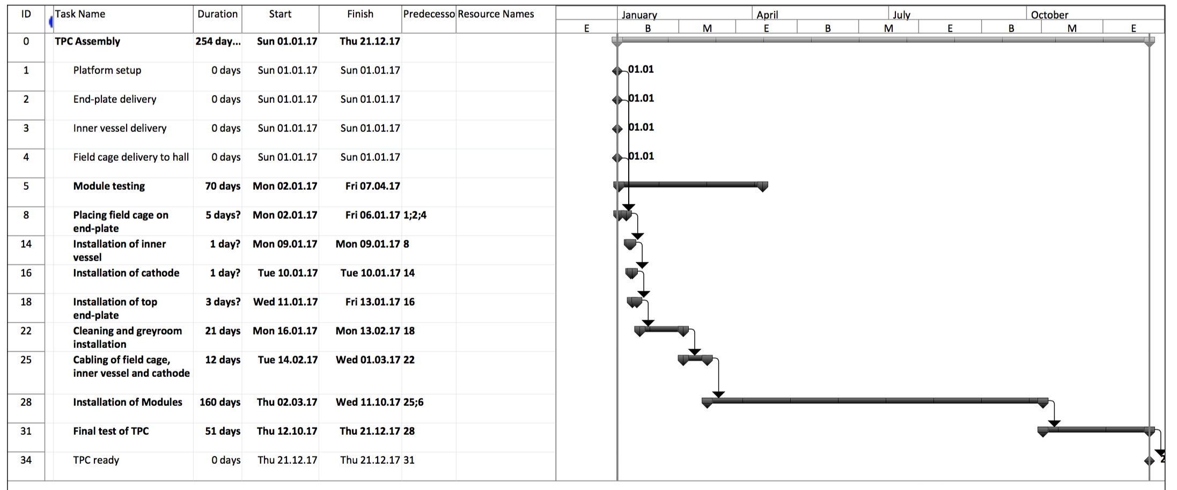
Vertical procedure – time estimate

Slide 28
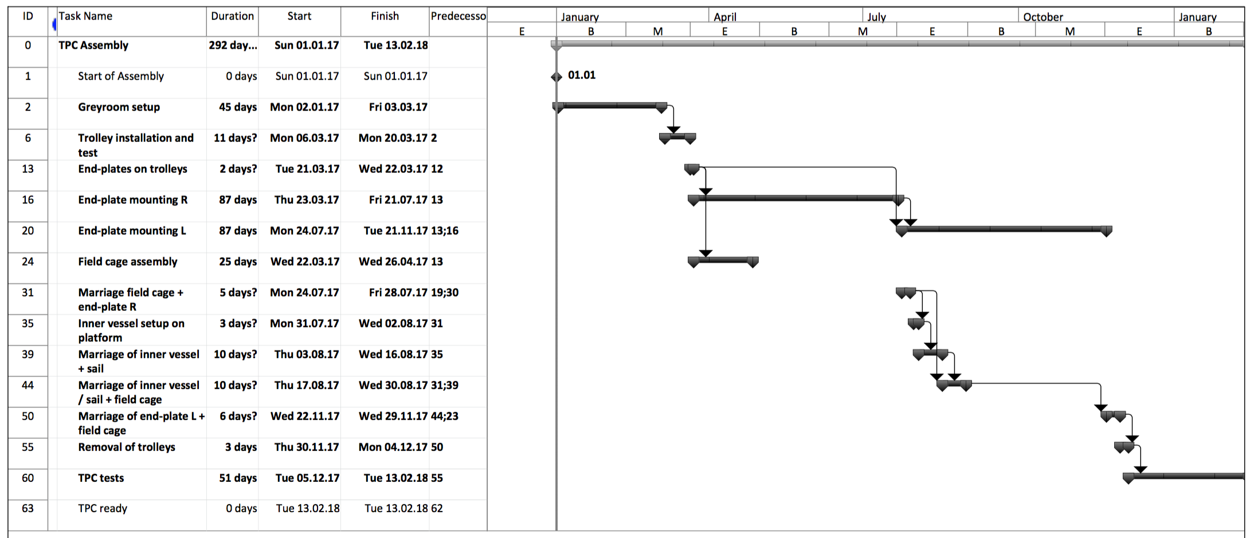
Horizontal procedure – time estimate

Slide 29
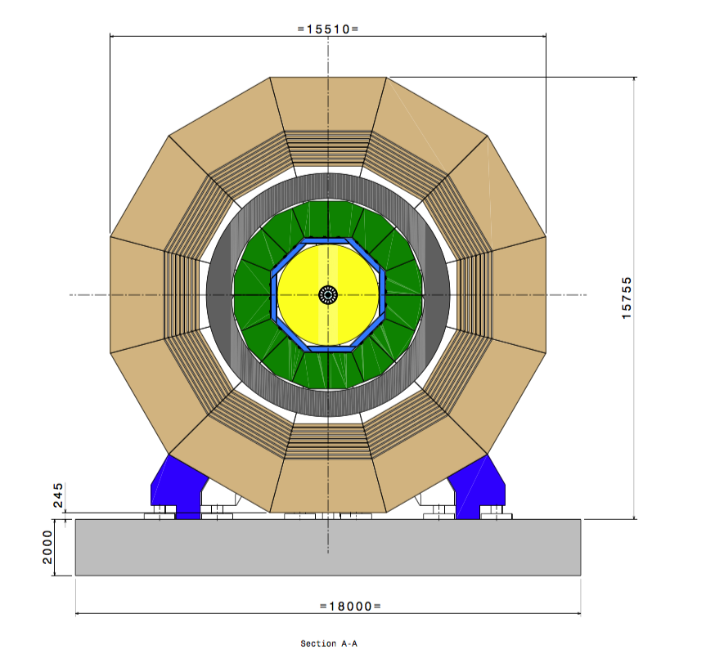
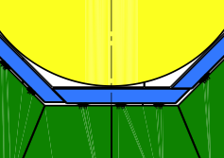
TPC insertion – mechanism?
Rails
Space?

Slide 31
Rail

Slide 36
Carbon bands

Slide 37
Carbon bands
How many?
Size?
How about
longitudinal strain?

Slide 39
Veeeeery preliminary conclusions
Currently, more in favour of vertical assembly:
Space requirements
Time requirements
Ease of access / logistics
…
But many steps need thorough planning, and many engineering solutions are still missing.
Also for insertion of TPC into ILD, and for mounting and suspension
Nevertheless – best current guess:
Assembly requires one year after delivery of field cage
Space requirements: 100 m² (ISO 7 / greyroom quality)
Plus space for module storage and testing, plus services

Slide 40
Some near-future steps
Continue to work on the models, assumptions and their consequences
Principal procedures, needs and requirements
Some important topics:
  Support of TPC in ILC?
  Prevention of longitudinal movement?
  Cathode design?
  End-plate design?
  Space and infrastructure in DH (gas, power, electronic hut etc.)
To be decided soon: Where to assemble TPC?
AH or research office building?
If research office building, then still full TPC system test before lowering in AH?
Draw on previous experience
Specifically ALICE → meeting in November at CERN
Get in touch with global integration efforts
Hope to intensify contact to Yasuhiro

