Slide 1
Phase Monitor Tests: Output vs. input signal level
Jack Roberts

Slide 2
Week Overview
First half of the week:
Took more measurements with close to nominal length pulse (~900ns).
Further R56 scans.
Feedforward measurements
Results similar to week before. Best way to optimise R56 needs some thought.
Second half of the week:
Parasitic phase monitor measurements, looking at saturation of the diodes.

Slide 3
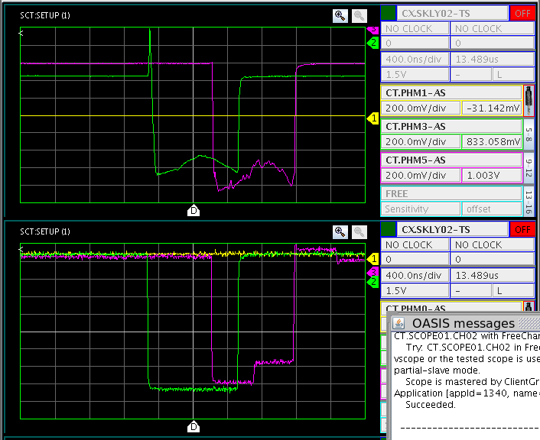
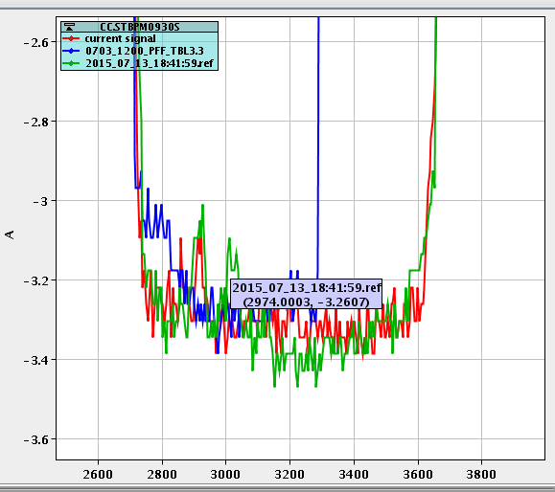
Saturation of Downstream Monitor Diode
Visible on downstream phase monitor mixer.
Reflection on diode
Not visible in downstream phase monitor diode.
Spike of losses near start of pulse seen in a downstream BPM signal.

Slide 4
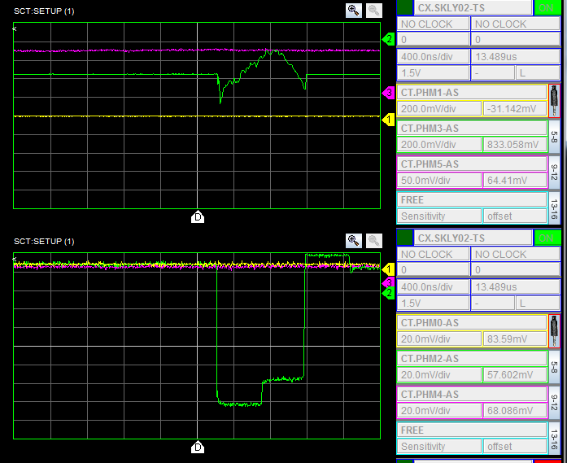
Downstream Monitor Swapped to Different Electronics
No clear difference.

Slide 5
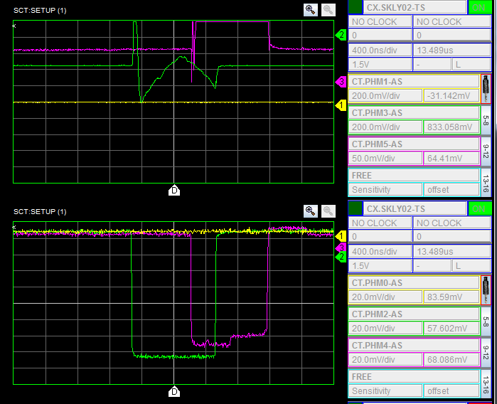
Downstream Monitor with 3dB on Input
Reflection still visible, slight hint of transmission spike.

Slide 6
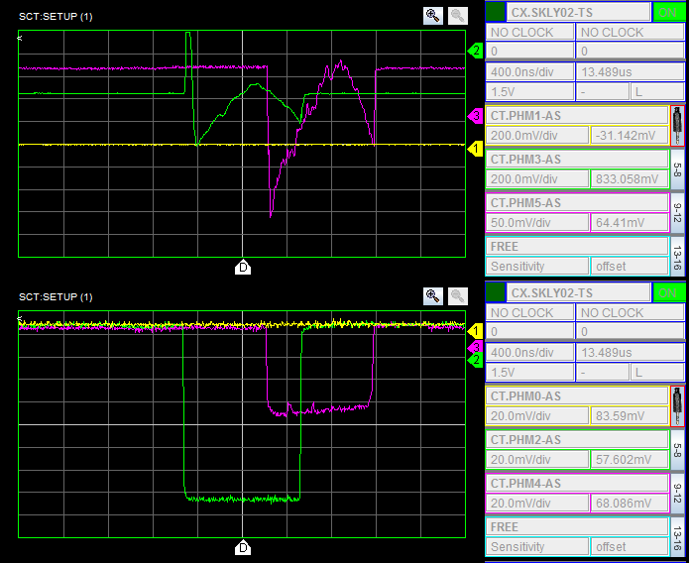
Downstream Monitor with 6dB on Input
No reflection and transmission spike clearly visible.

Slide 7
Some of the additional downstream phase jitter we measure could be caused by differences in transmission along the pulse, which can’t be removed without using the diode.
I then checked the output signal levels vs. attenuation added to the input for one of the upstream monitors to try to understand the behaviour of the mixers/diodes better.

Slide 8
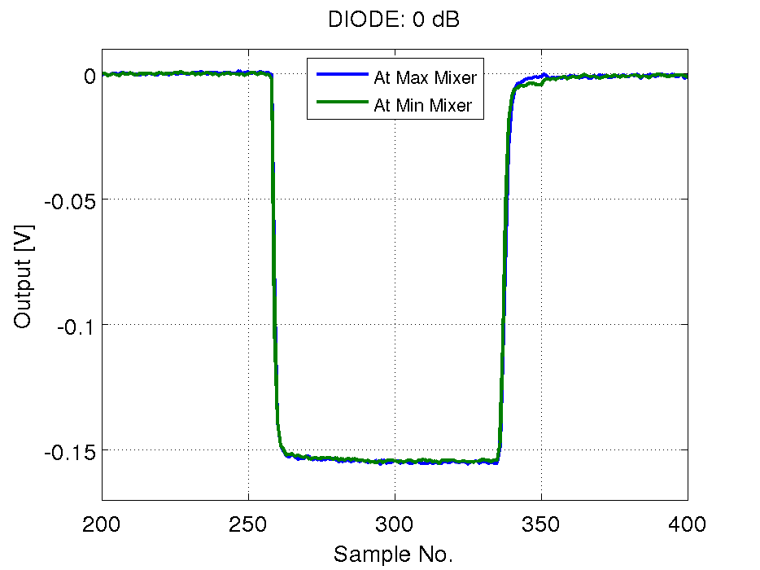
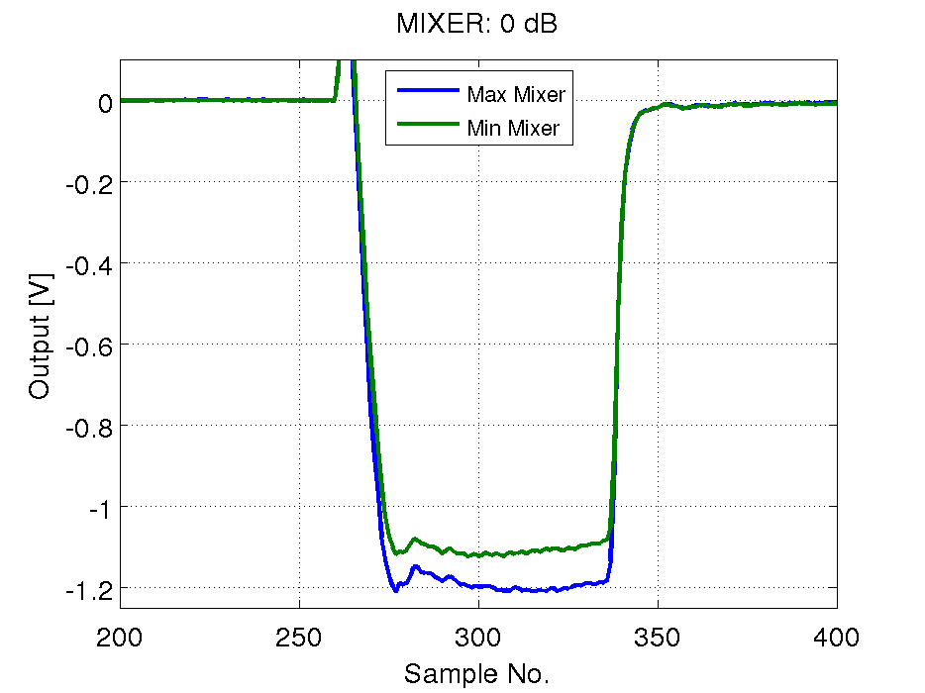
0dB on Input
Max mixer is sign flipped to make comparison easier.

Slide 9
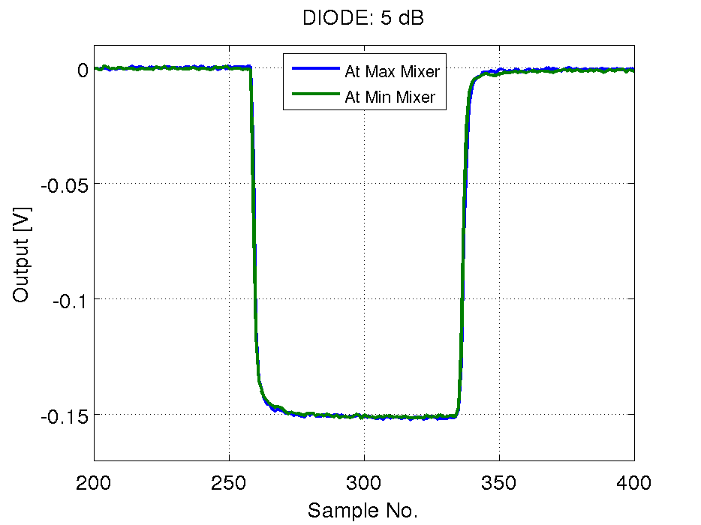
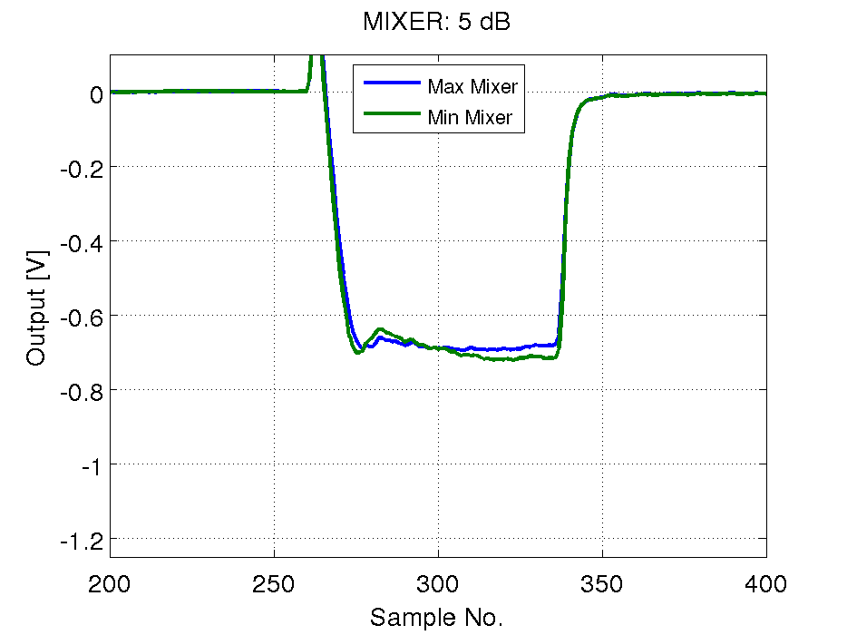
5dB on Input
Very little difference in diode output at 0dB and 10dB.

Slide 10
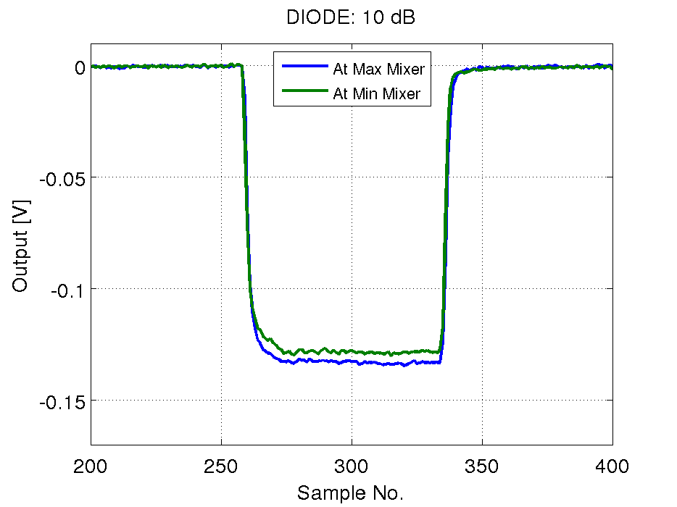
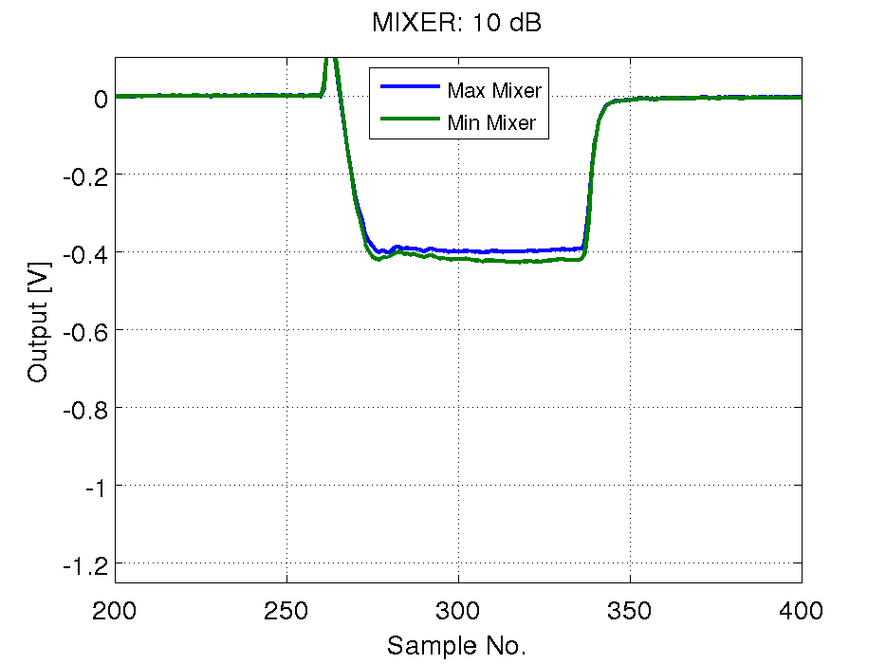
10dB on Input

Slide 11
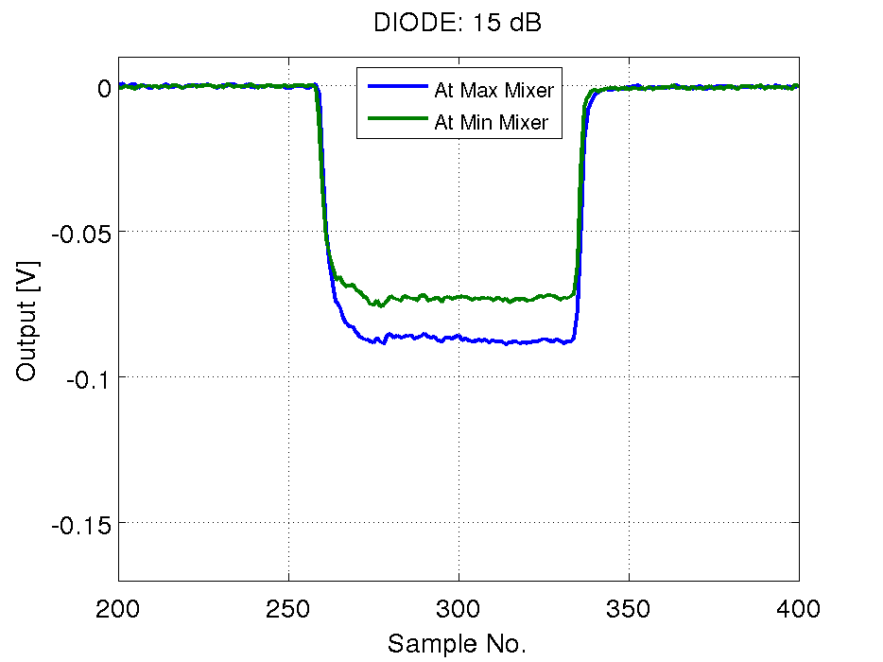
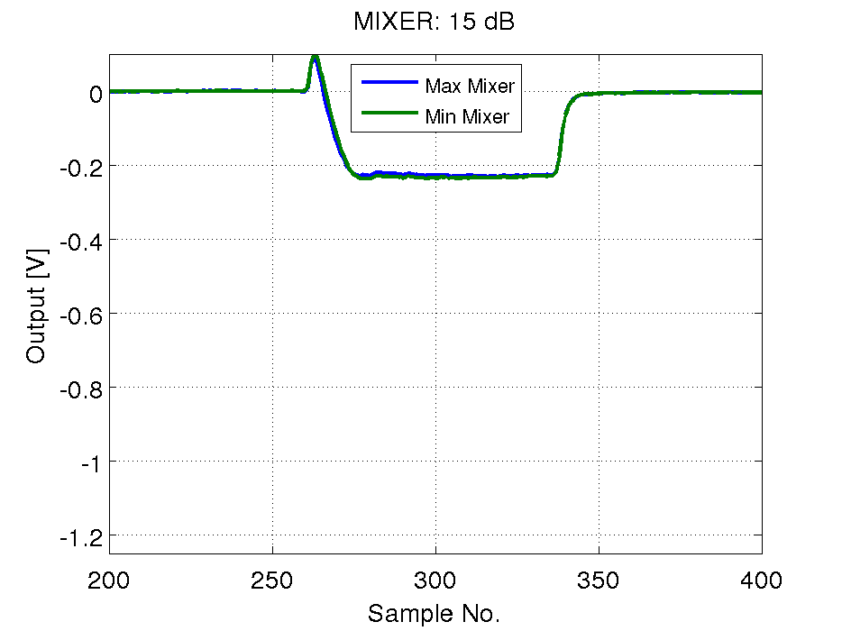
15dB on Input

Slide 12
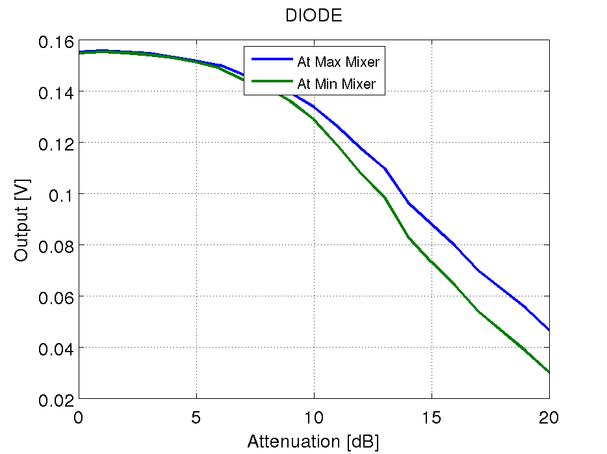
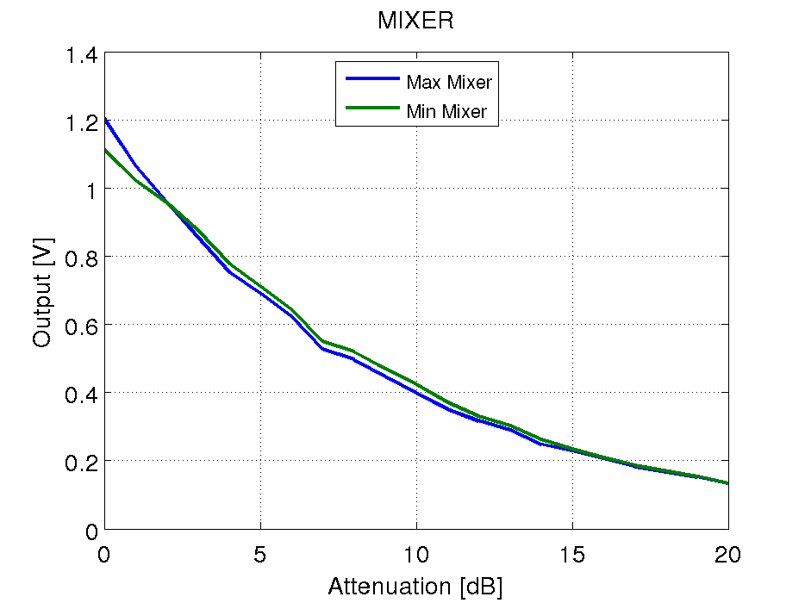
Diode/Mixer Output Vs. Attenuation
Diode output depends on Mixer output, effect more visible with higher attenuation.
Mixer output possibly also asymmetric, more visible at lower attenuation.

Slide 13
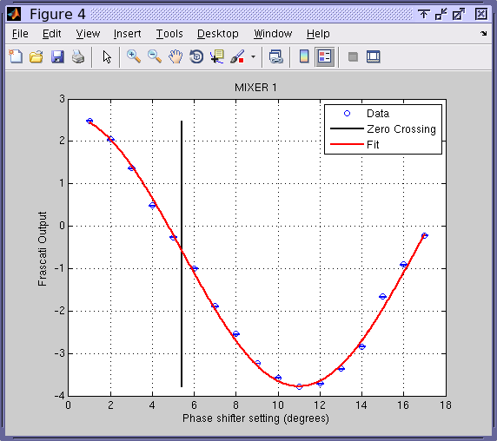
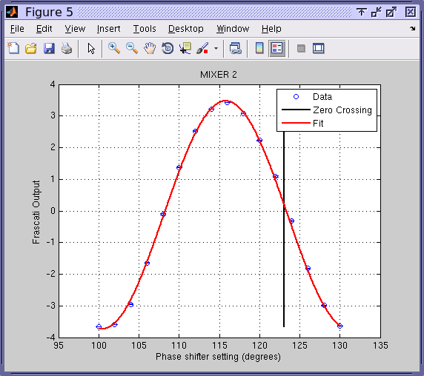
Calibrations with 10dB on both upstream monitors
Using diode

Slide 14
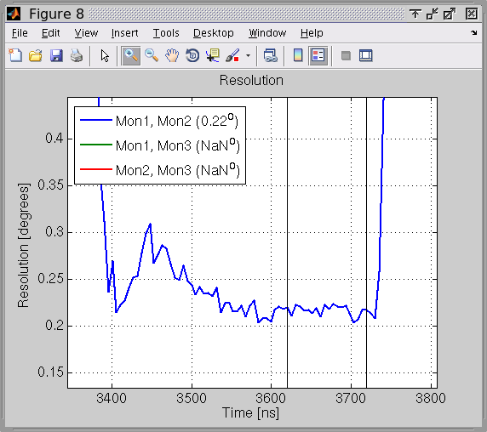
Resolution with 10dB On Both Upstream Monitors
Still measure ~0.2 degree resolution.
Diode output is not amplified so will have a large contribution from ADC noise.
Worse resolution near start of pulse suggests different calibration factor along the pulse.

Slide 15
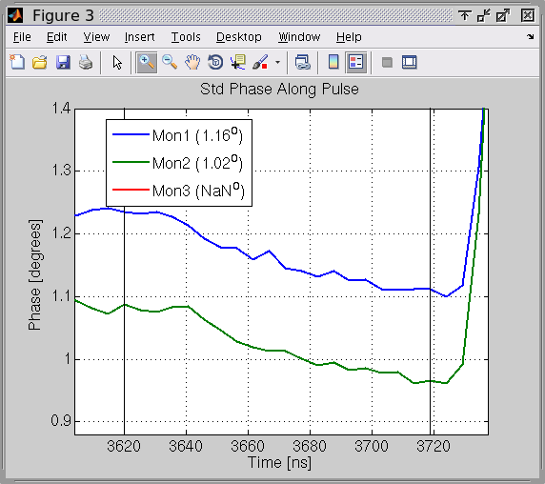
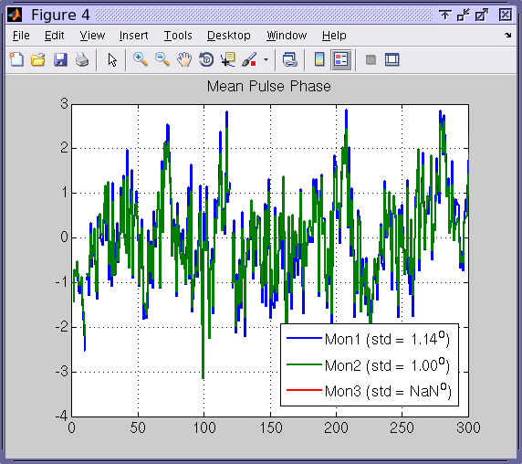
Phase Jitter with 10dB on both upstream monitors
Often see ~10% difference between the two. Need to check if this is coming from calibrations.

Slide 16
Summary
Diodes are saturated – need at least 6dB attenuation (upstream and downstream) to avoid saturating them.
When diodes are not saturated, output level depends on mixer.
Seen before in measurements by Alexandra.
Will try to revisit those measurements and take new measurements with a signal generator if possible.
Still measured 0.2 degrees resolution between upstream monitors with 10dB added on inputs.
Want to verify calibrations – difference in jitter between upstream monitors, variation along the pulse etc.

