Slide 1
Res vs sample no.

Slide 2
3BPM res – jitRun26_0dB_030
End of the final shift
High-beta optics
Charge 0.3 x 10¹⁰
C-band filters

Slide 3
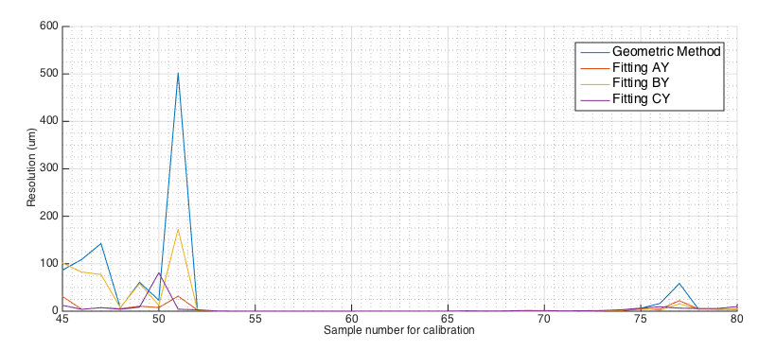
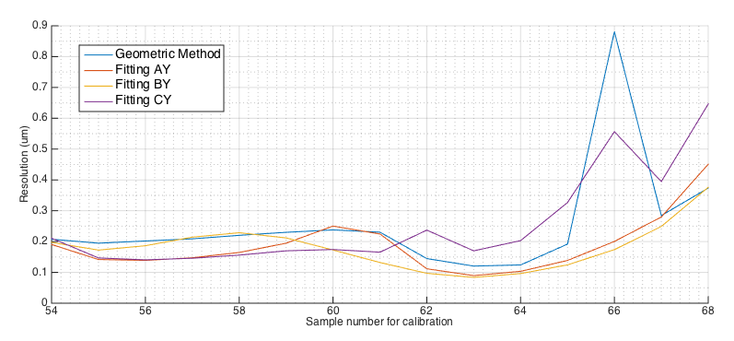
Resolution vs sample number - jitRun26_0dB_030
Best geometric: 0.120 +/- 0.004 um at sample number 63
(Outside central region, resolution explodes and waveform shape at minimum is not visible)

Slide 4
Resolution vs sample number - jitRun26_0dB_030
Best geometric: 0.120 +/- 0.004 um at sample number 63
(Plotted region around minimum resolution)

Slide 5
3BPM res – resol_0dB_8_FB_off
December 2014
High-beta optics
Charge 0.4 x 10¹⁰
714 MHz BPF on second stage electronics

Slide 6
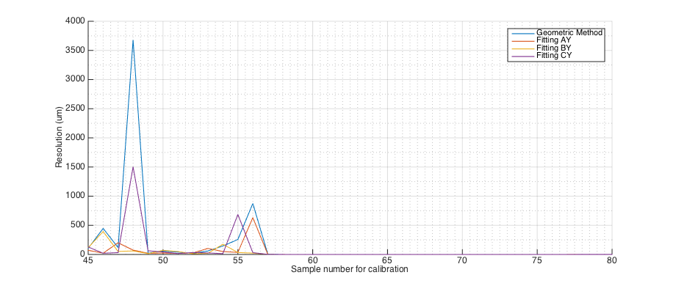
Resolution vs sample number - resol_0dB_8_FB_off
Best geometric: 0.051 +/- 0.001 um at sample number 61
(Outside central region, resolution explodes and waveform shape at minimum is not visible)

Slide 7
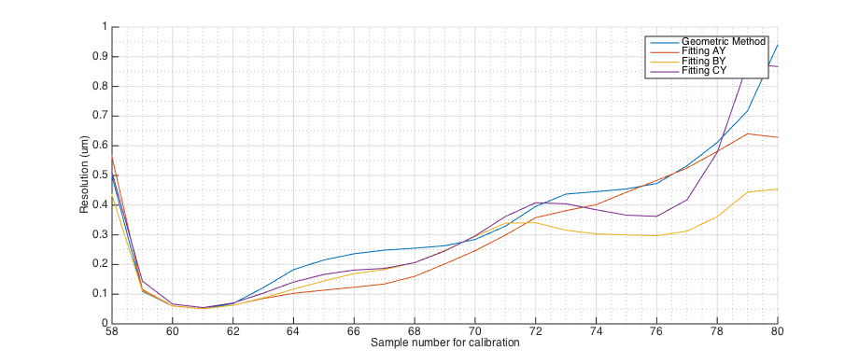
Resolution vs sample number - resol_0dB_8_FB_off
Best geometric: 0.051 +/- 0.001 um at sample number 61
(Plotted region around minimum resolution)

Slide 8
appendix
Waveforms and calibrations for two data sets

Slide 9
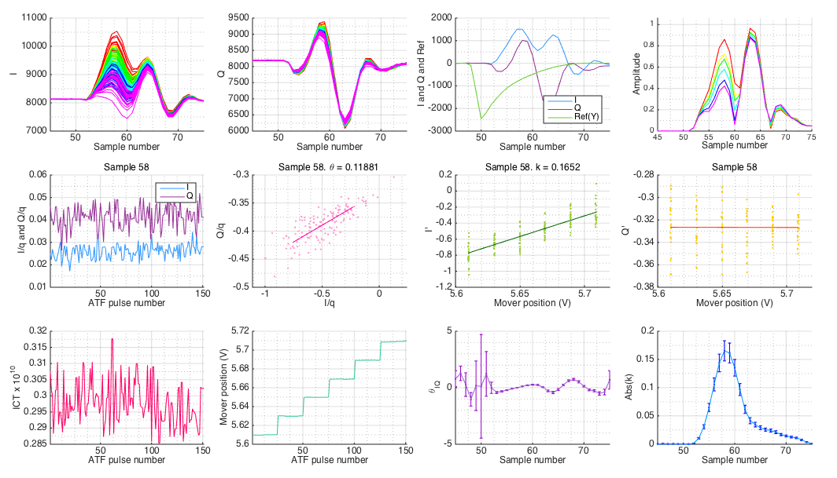
AY Mover Scan - jitRun26_0dB_030

Slide 10
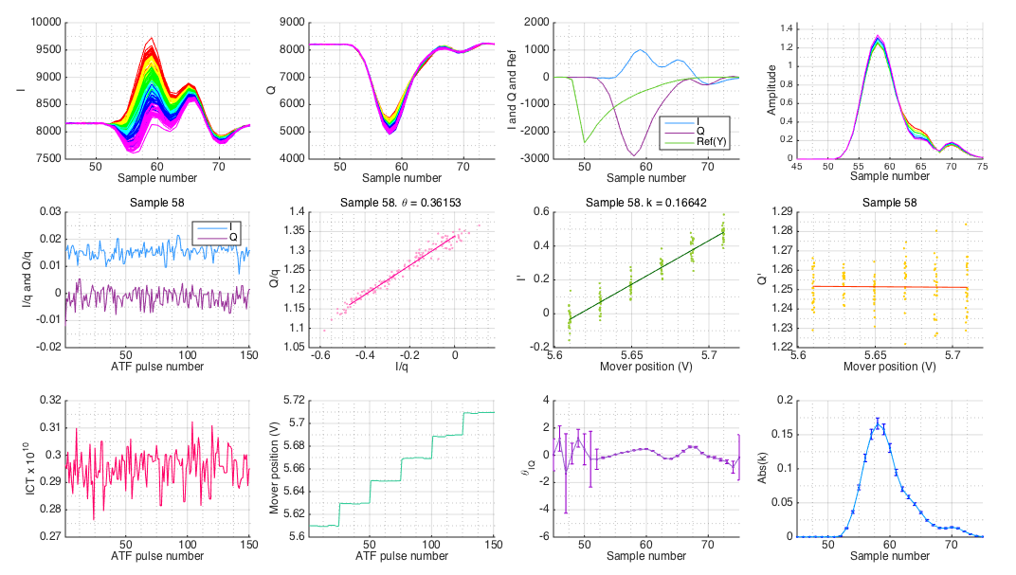
BY Mover Scan - jitRun26_0dB_030

Slide 11
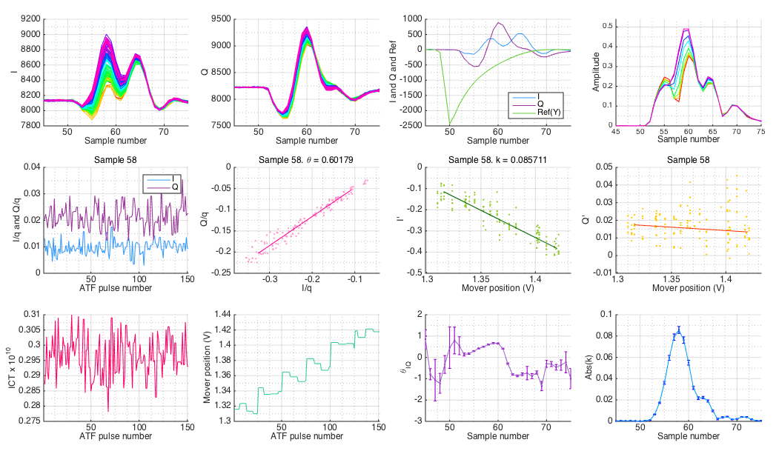
CY Mover Scan - jitRun26_0dB_030

Slide 12
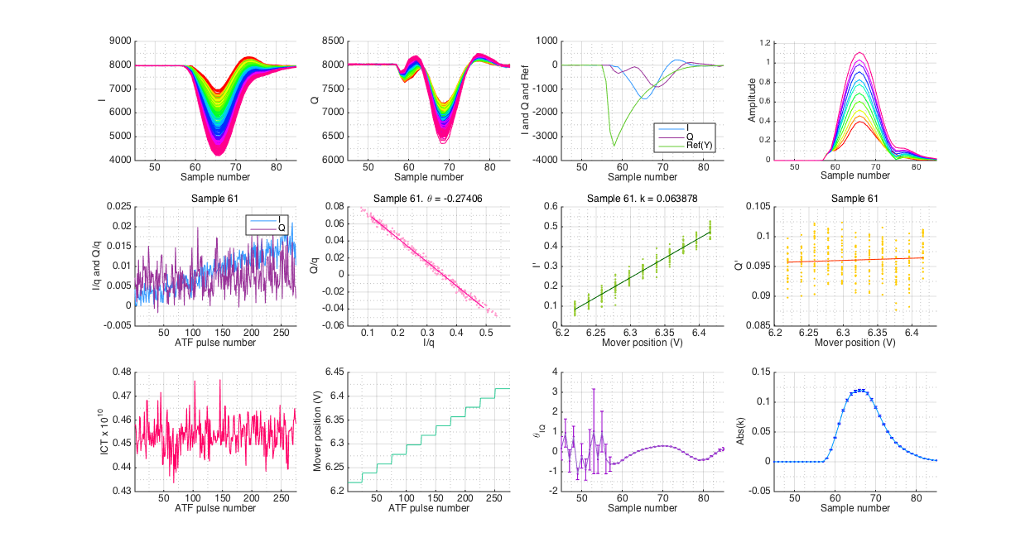
AY Mover Scan - IPB_0dB_recheck_cal

Slide 13
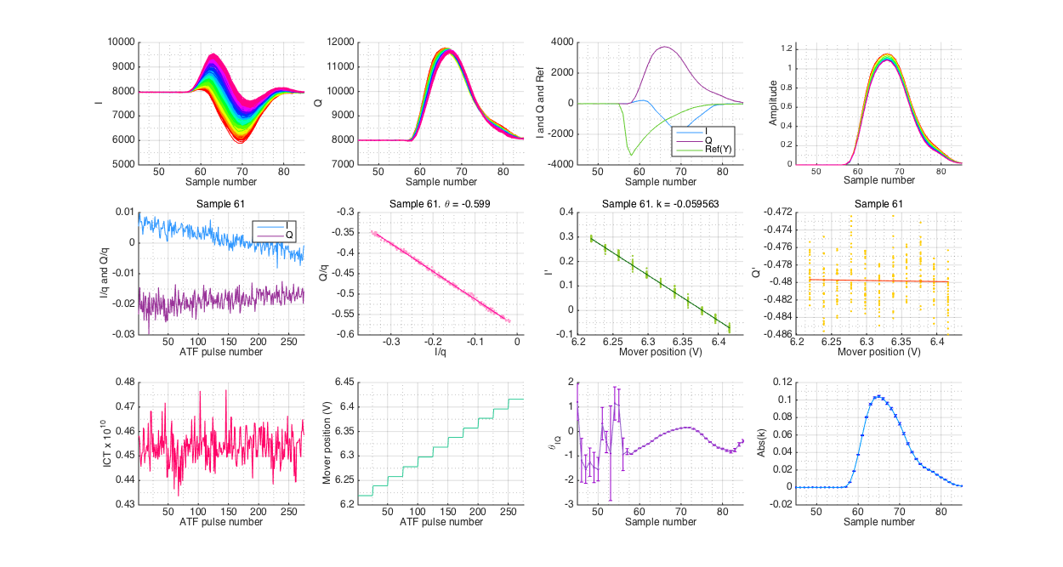
BY Mover Scan - IPB_0dB_recheck_cal

Slide 14
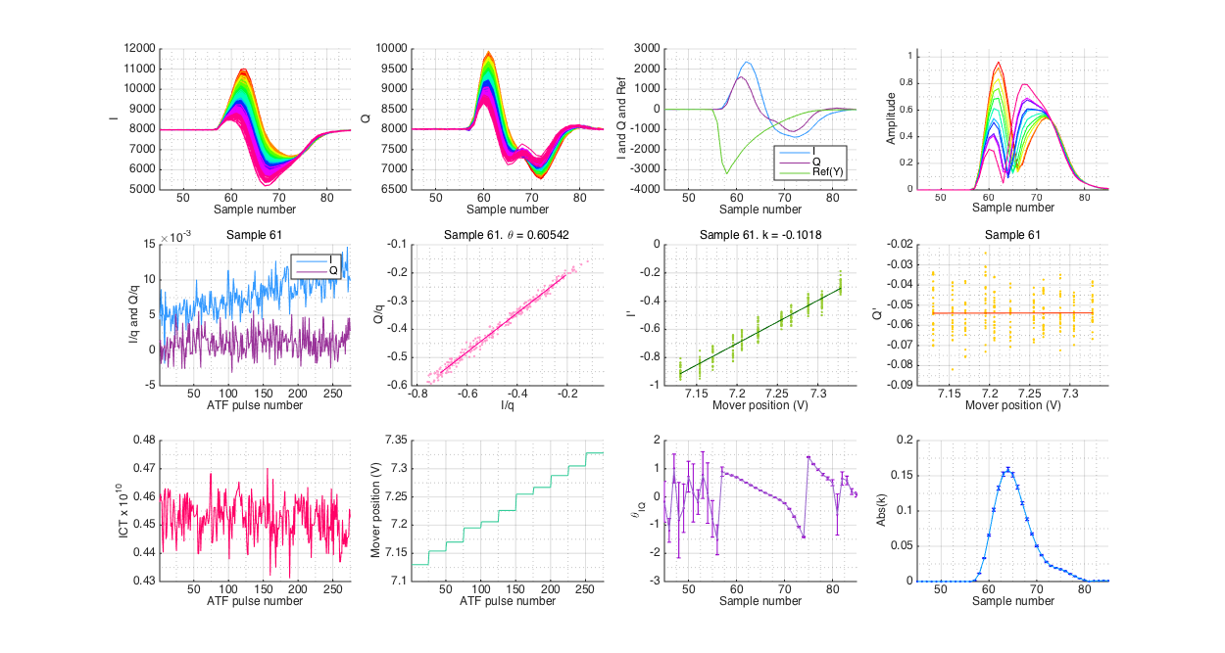
CY Mover Scan - IPC_0dB_recheck_cal

