Slide 1
Status Update for
NRI Commissioned Survey
Akira Yamamoto
A report on 21 July, 2015

Slide 2
ILC being studied in Japan
150421
SCJ
Recommendation
in 2013
MEXT
ILC Taskforce
formed in 2013
Commissioned Survey by NRI
( in 2014, and 2015)
Academic Experts Committee
in JFY 2014 ~ 2015
Particle & Nuclear Phys.
Working Group
in 2014 ~ 2015
TDR Validation
Working Group
in 2014 ~ 2015
Human Resource
Working Group
in 2015
planned
planned

Slide 3
JFY2015, Commissioned Survey by MEXT contracted with Nomura Research Institute (NRI)
Subjects for survey and analysis:
  Technical feasibility to realize the ILC
    Regarding components, system design, management, and infrastructure
  Technical issues to prepare for the ILC construction
    Regarding industrial technology, and necessary time-scale, and prototype works.
    Cost increase risk
  Cost reduction possibility
    with technical approaches not described in TDR

Slide 4
ILC Progress Report prepared to be useful as a starting point for surveys in 2015
It contains the LCC-ILC technical progress after TDR, respecting:
  Civil engineering studies
  Accelerator hardware design/development updates
  Accelerator system layout updates
  Integration/test facilities to be prepared for “hub-laboratory” functioning
  Project Implementation Plan
  Further preparatory work

Slide 5
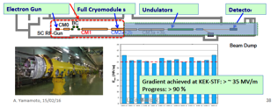



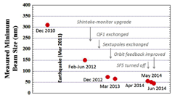

Issues to prepare for ILC Realization
Themes | Issues/Subjects | Global Cooperation/work-sharing
ADI | Acc. Parameter optimization & eng. Design Change Management (CM) | LCC-ILC-ADI to take a central role with global cooperation
SRF | Mass-production & Testing technology → Hub-lab functioning to be balanced Stabilization of the performance | TTC Collab., as a worldwide community - KEK-STF: Hub-Lab function - EXFEL: mass production and testing - LCLS : mass production and testing
Nano-beam | Ultra low emittance, Nano-beam, and the stability | ATF Collab., as a worldwide community KEK-ATF to be maximized in use, as a globalyl unique
CFS | Site-specific CFS design, env. assess. General plan, eng. Design, drawings | JP-CFS to serve a central role in cooperation with global experts.
Management | Preparation for the int’l ILC laboratory | A main Issue for the ILC to be prepared

Slide 6
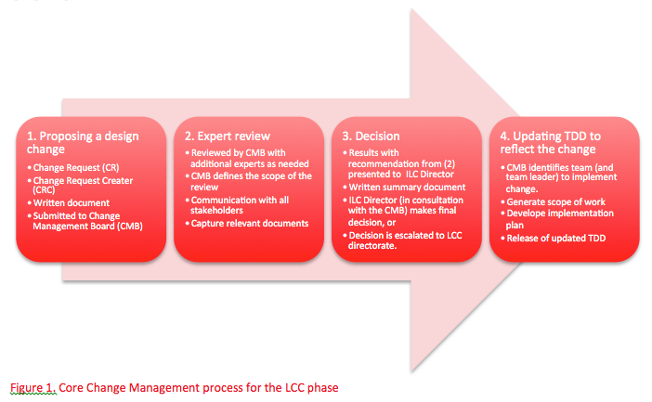
設計改定管理・基本プロセス
Change Management: The Basic Path
B. List, Design Integration and Configuration Management
提案
Propose
評価
Review
決定
Decide
実施・具体化
Implement
07.10.14

Slide 7
TDR 以降の設計の進展：
ILC Accelerator Design: Post-TDR Updates
Objectives: :
    Further optimize the ILC accelerator design parameters, assuming a site model in Japan, and to seek for the best cost-effective construction,
Process for the Change Management:
有識者会議からの
提言に応える努力
 |  | Decision | Note
CR-001 | Add return “Dogleg” to target by-pass | No approved
CR-002 | Adapt equal L* (4.1 m) for both detectors | Approved | 設計の統一、信頼性向上
CR-003 | Detector hall with vertical shaft access | Approved | 建設期間の確度向上
CR-004 | Extension of the e-e+ ML tunnels by about 1.5 km | Approved | 500 GeV 、到達確度向上
CR-005 | Update top-level parameter | Approved | 加速器設計値の確度
CR-006 | Add BPM down stream of QD0 | Approved
CR-007 | Adoption of the Asian design as sole baseline | Approved | TDR をアジア版に統一
CR-008 | Formal release TDR 2015a lattive | Approved
CR-TBD | ML tunnel central call to be thinner | To be evaluated | ビーム加速中アクセスなし
CR-TBD | Cryogenics system mainly on surface | To be evaluated | 安全対応
CR-TBD | BDS timmel allowing e-driven e+ source in parallel | To be evaluated | 陽電子源・確度向上
CR-TBD | Cost effective SRF cavity integration | In discussion | SRF 空洞コストの信頼性

Slide 8
10. Further Preparatory Work (1)
10.1 General
  It is anticipated that preparation (w/ appropriate funding) will take about 4 years
10.2 超伝導高周波技術：SRF technology
  Nb material, cutting sheet from Ingot w/ control grain size
  Tuner in cooperation w/ LCLS-II
  Coupler value engineering w/ simplified structure and new ceramic w. optimized process of CM assembly.
  Long term effort for further gradient to scope 1 TeV upgrade,
    Hydro-forming w/ seamless Nb cylilnder, or Cu cylinder followed by surface coating w/ Nb.
    High-Q realization w. new surface treatment or doping technology
  Mitigation of degradation during the process of the CM assembly
10.3 SRF 電力供給のための電源：Modulator industrialization for SRF
  Demonstration of the industrial manufacturing and long-term reliability

Slide 9
10. Further Preparatory Work (2)
10.4 試験システム技術・人材養成 Test/Qualification infrastructure at KEK
  Full prototype cryomodules under high power in which a beam can be accelerated must be completed with the highest priority.
  An assembly and cryogenic-test hall at KEK must be equipped with the entire infrastructure necessary for integrating full CMs and for testing, to demonstrate the capability of series production rate.
10.5 極小ビーム技術：Nano-beam technology
  The effort at the accelerator test facility (ATF) at KEK must be continued to achieve the technical goals of both the beam size and the stability at the final focus, providing sufficient operational margin.
10.6 陽電子源：Positron production
  The positron source is challenging. Further effort must be put into the undulator-based design including the convertor target. In parallel an alternative design using conventional means (which will exclude polarised positrons) must be pursued as a backup solution.

Slide 10
Status and Plan
7/10: ILC Progress Report pre-explained to NRI
7/17: PR explained to MEXT
7/23: PR to be reported to NRI (at the 1st study comm. Mtg.
---
7/15: Appointment requests sent out (by NRI) to
laboratories and industry in Europe,
during a period of 28 Sept. – 9 Oct.
- DESY, CEA-Saclay, LAL-Orsay, INFN-LASA,
INFN-Frascati, CERN, STFC Daresbury
- RI, E-Zanon, BN, Thales, Alsyom, (AL)
Soon: Requests to be sent out to Lab. and Ind., in the US,
during an expected period of 9 – 13 Nov.
- SLAC, Fermilab, Jlab
- AES. ROARK, CPI, (ATI-WC)

Slide 11
Appointment Request an example sent out
Dear ***
This is Michio Kitamura of Nomura Research Institute, which last year sent a team of experts and researchers to your organization to conduct interviews concerning the ILC. Our findings have now been written up into a report (a summary of which is currently being translated into English), and I would like to thank you once more for your kind assistance in our research. Our research on the ILC continues this year, though on different topics from last year, and so I would like to formally request permission for our research team to visit you again to interview representatives of your organization.
NRI has been commissioned by the Ministry of Education, Culture, Sports, Science and Technology (MEXT) of Japan to carry out a survey and analysis of the technical feasibility of the International Linear Collider (ILC) project and technical challenges posed by construction of particle accelerators for the ILC, and work on this study is now underway.
The study consists of the following three main elements:
A survey of the technical feasibility of construction of accelerators for the ILC
A survey of the technical issues that will need to be surmounted in order to mass produce the components required by the ILC’s accelerators
A survey of ways to reduce the cost of construction of the ILC’s accelerators
As part of this study, we plan to visit and interview leading research institutes and companies producing accelerators or related products in Europe and USA. The aim of our visit to *** is to obtain up-to-date information, expert opinion, suggestions, and other insights that contribute to the above three elements of our study.
Below please find a list of topics that we intend to cover in the interview, our desired schedule for the appointment, and contact information. I hope this request does not inconvenience you greatly, and would deeply appreciate your cooperation and assistance in making the necessary arrangements.
Kind regards,
Michio Kitamura, Nomura Research Institute, Ltd. (NRI)

