Slide 1


CLIC CTF3: Phase Feed Forward
Comparing the effect of the phase feed forward system on beam phase stability with various theoretical predictions.

Slide 2
Why compare with simulations?
Our real phase feed forward system is naturally limited by the equipment and physical limits of the correction process.
In light of this fact, we shall compare the real feed forward system with increasingly limited simulations, to study which limitation impacts the feed forward system the most, and how close the system comes to its theoretical performance.
The order of increasing limitation on the simulations is as follows:
Point by point correction with no limits
Global gain correction with no limit
Global gain restricted to +/-2 degrees (or +/-2.5)
Global gain with time offsets.
Global gain restricted to 30MHz (or 50MHz) bandwidth
Global gain restricted to +/-2 degrees and 30MHz bandwidth

Slide 3
A foreword about the data files used
The analysis was done using the following two sets of data files:
20150703_1855_R56_0.15.mat
20150703_1843_R56_0.3.mat
20150703_1842_R56_0.2.mat
20150703_1841_R56_0.1.mat
20150703_1840_R56_0.0.mat
20150707_2037_FFGain_63_Interleaved_Even(Odd).mat
20150707_2052_FFGain_53_Interleaved_Even(Odd).mat
20150707_2102_FFGain_43_Interleaved_Even(Odd).mat
20150707_2138_FFGain_43_Interleaved_Even(Odd).mat
20150707_2123_FFGain_33_Interleaved_Even(Odd).mat

Slide 4
Testing the Theoretical Gain
The first step in assessing the performance of the feed forward system, is to assess the accuracy of the theory used to gauge its performance.
The optimal gain factor is given by the following equation: Optimal Gain = Correlation between upstream and downstream phases * (ratio of the standard deviation of the phase downstream to that of the same upstream)
And so, using the R56.x files, A comparison between this theoretical gain and the best possible gain factor given the data was done.

Slide 5
Using Global Gain Factors
The first approach makes use of one global factor over the entire length of the pulse. This is also how the actual feed forward system works, and so this is where we begin.
To simulate the downstream phase after the correction is applied, we simply subtract from the downstream phase the upstream phase multiplied by the appropriate gain factor.
We do this for every pulse, as we traverse the sample range. After this, we take a mean over all of the pulses to get the mean phase, and take the standard deviation over all the pulses to get the jitter values.
In our initial analysis, we compare the performance of the theoretical best gain, with that of a gain optimized to reduce the jitter.

Slide 6
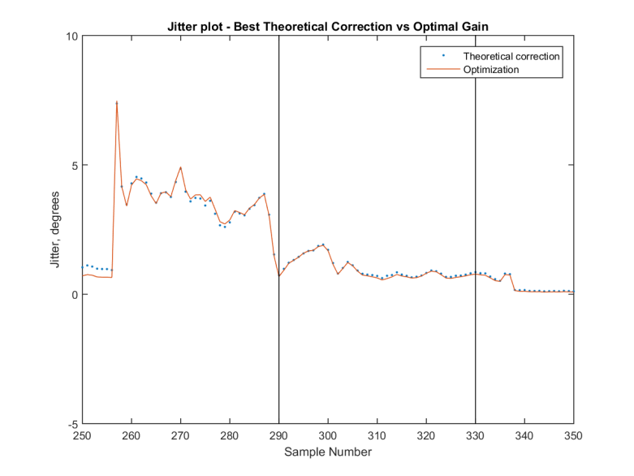
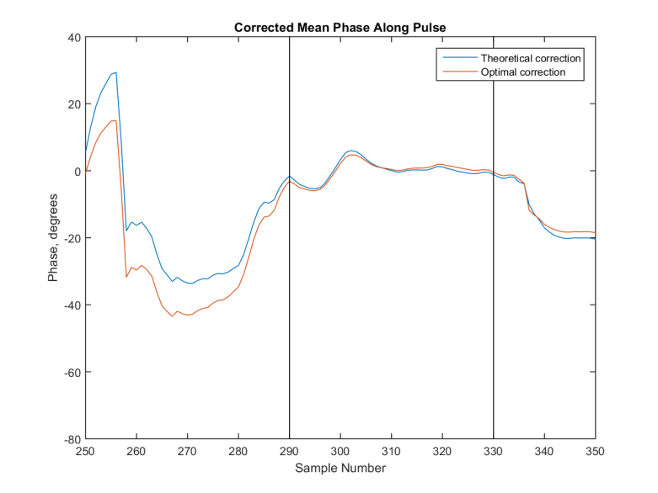
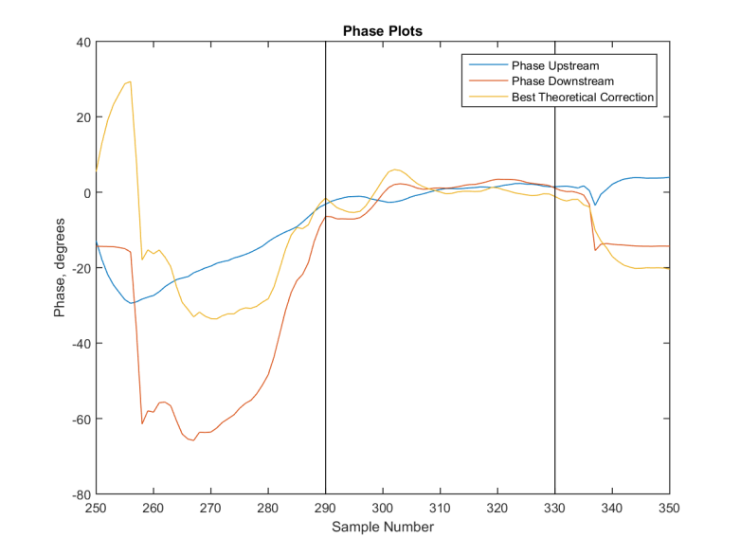
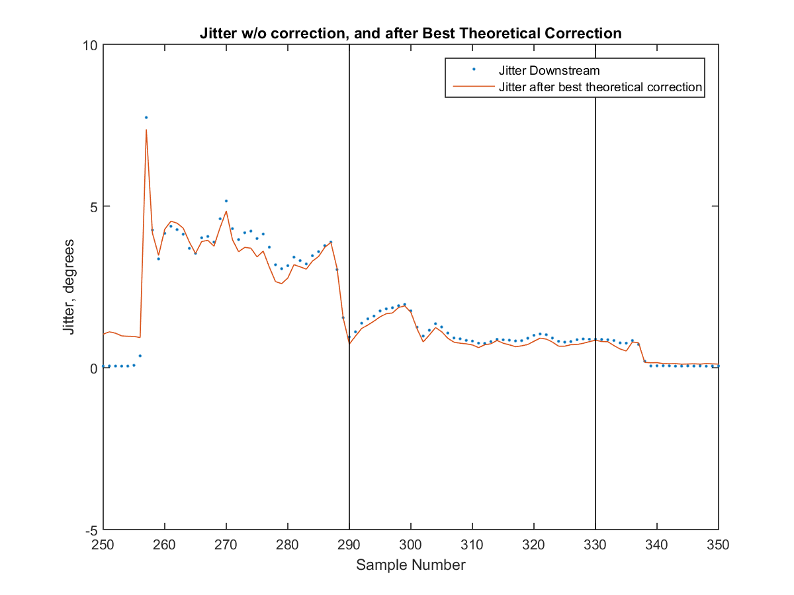
R56 0.2, global gain factor

Slide 7
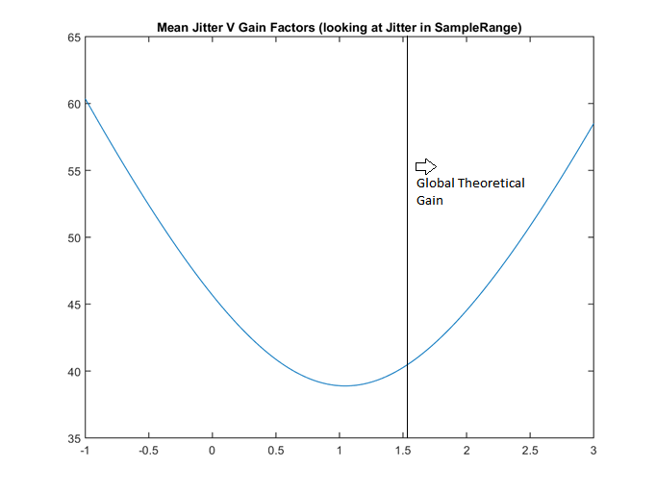
R56 0.2, Gain VS Jitter

Slide 8
In Summary
File Name | Theoretical Gain | Optimized Gain | Theoretical Best Jitter* | Optimized Best Jitter*
R56 0.0 | 1.1309 | 1.2943 | 2.8958 | 2.8945
R56 0.1 | 1.6458 | 1.2823 | 2.0938 | 2.0852
R56 0.15 | 1.594 | 1.3624 | .7559 | .7450
R56 0.2 | 1.5343 | 1.046 | .9871 | .9484
R56 0.3 | 1.0189 | .98999 | 1.9275 | 1.9275
Minima of the Jitter VS Gain plots
*The Jitters above are the mean Jitters in the sample range.

Slide 9
Using Variable Gains
In this method, the gain varied point by point along every pulse. This is then compared to the best Theoretical prediction, which is also found at every point.
Since this isn’t exactly what the feed forward does, this part of the analysis gives an idea of the best possible correction that can be applied.
In this way, this is representative of just how good a feedforward system could possibly get, given the beam parameters (correlations in phases, etc.).
The same files as the Global Gain assessment are used here.

Slide 10
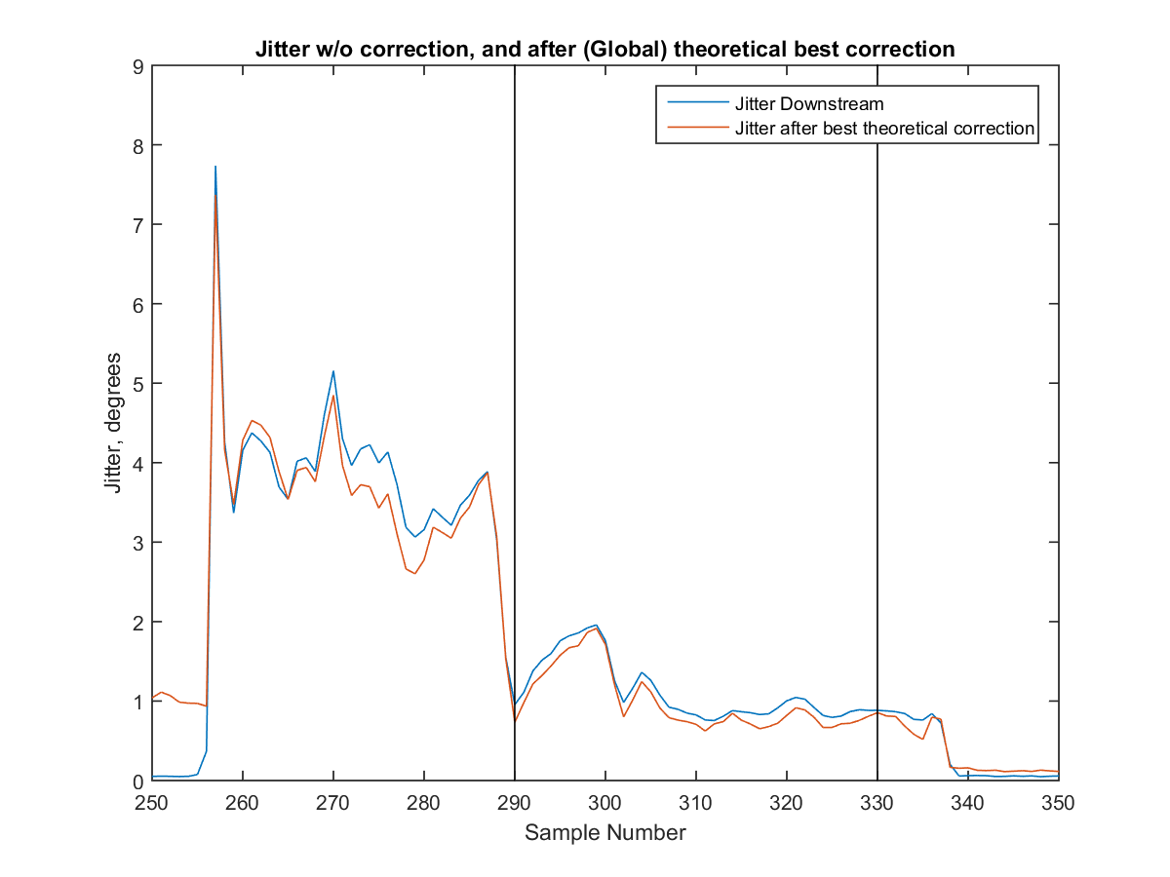
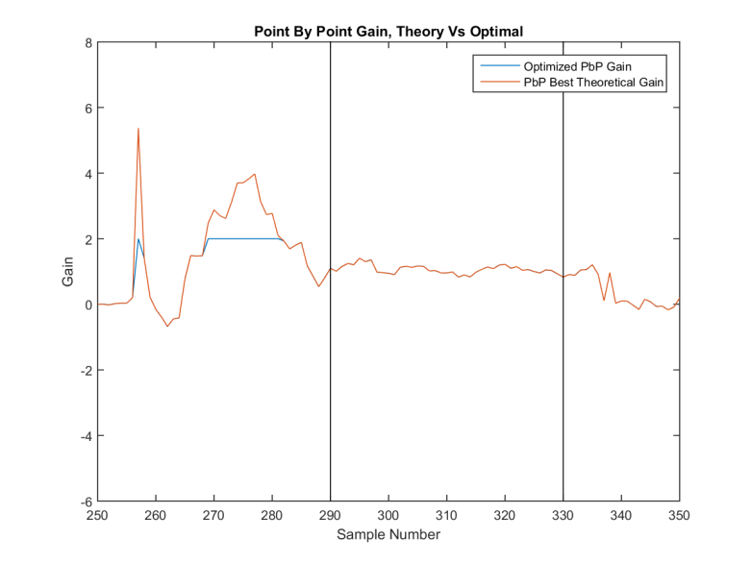
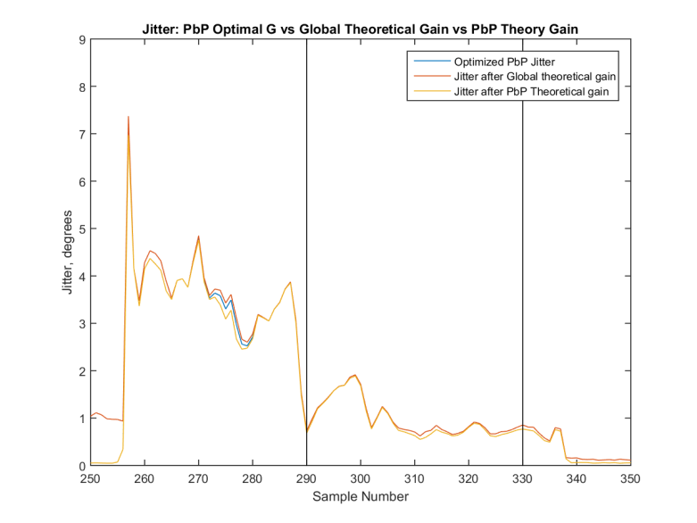
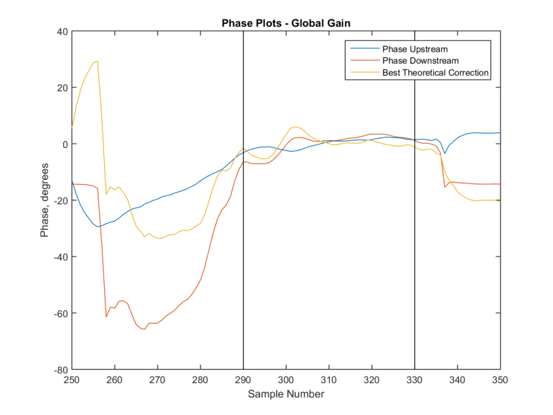
R56 0.2, Variable Gains

Slide 11
Point by Point VS Global Gain
Having studied the theoretical corrections involving both, point by point optimal theoretical corrections and global theoretically best corrections, we can now compare the impact of the two processes on the downstream phases.
File |  | Point By Point | Global
R56 0.0 | Downstream Jitter | 2.8830 | 2.8958
R56 0.1 | Downstream Jitter | 2.0791 | 2.0938
R56 .15 | Downstream Jitter | 0.7283 | 0.7559
R56 0.2 | Downstream Jitter | 0.9458 | 0.9871
R56 0.3 | Downstream Jitter | 1.9136 | 1.9275

Slide 12
Comparing Theory with the Feed Forward System
Having verified the theory, it is now possible to make an assessment of the Feed Forward system’s performance.
In addition to the Simulated Gain (Theoretical Gain), we will also be comparing against the known Simulated Feed Forward Gain (which in our case is the file name Gain * .0252).
Files used:
20150707_2037_FFGain_63_Interleaved_Even(Odd).mat
20150707_2052_FFGain_53_Interleaved_Even(Odd).mat
20150707_2102_FFGain_43_Interleaved_Even(Odd).mat
20150707_2138_FFGain_43_Interleaved_Even(Odd).mat -> 43 (2)
20150707_2123_FFGain_33_Interleaved_Even(Odd).mat

Slide 13
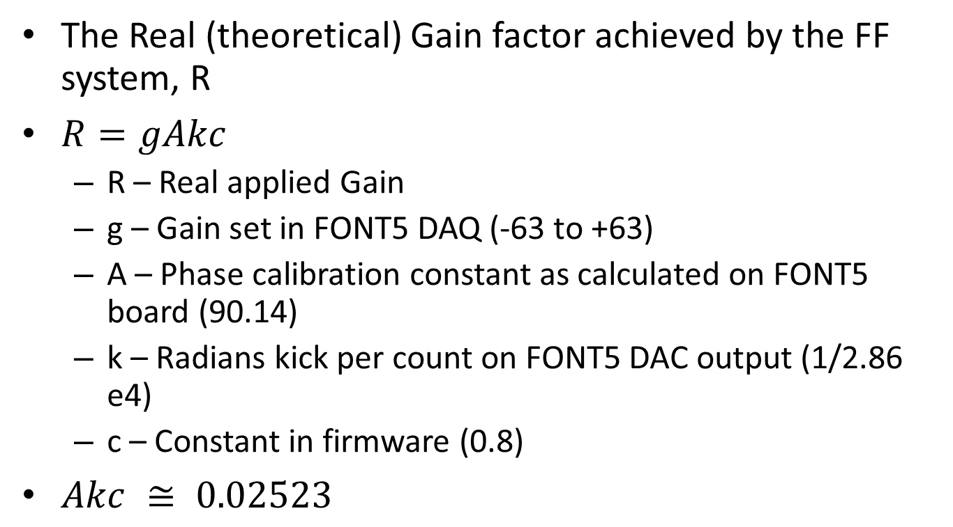
Origins of the FF Gain formula
The Real (theoretical) Gain factor achieved by the FF system, R
$R=gAkc$
R – Real applied Gain
g – Gain set in FONT5 DAQ (-63 to +63)
A – Phase calibration constant as calculated on FONT5 board (90.14)
k – Radians kick per count on FONT5 DAC output (1/2.86 e4)
c – Constant in firmware (0.8)
$Akc ≅ 0.02523$

Slide 14
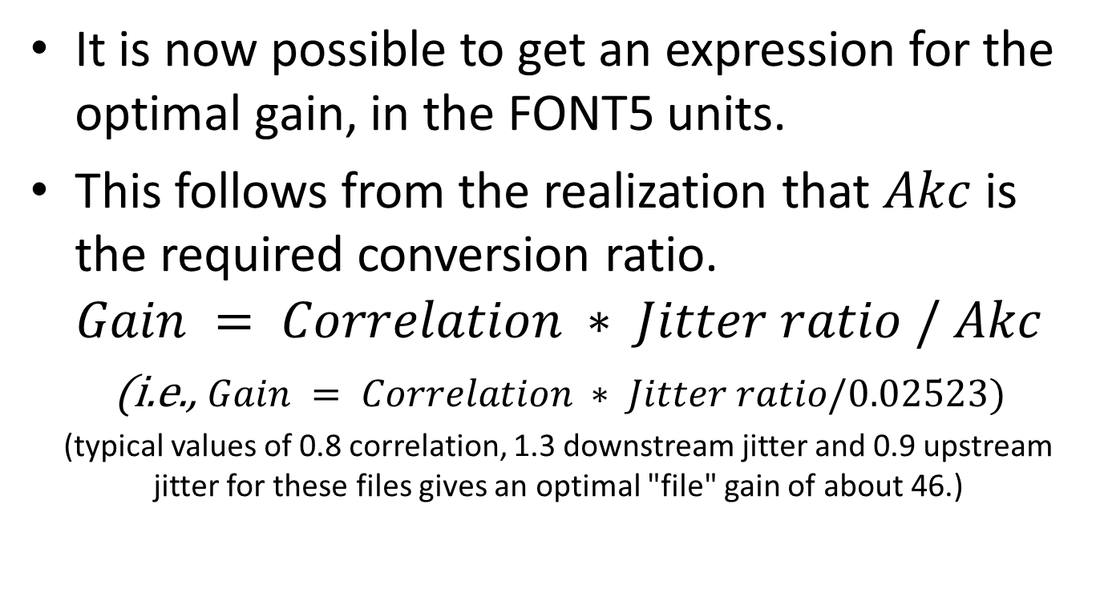
The Optimal Gain in FONT5 units
It is now possible to get an expression for the optimal gain, in the FONT5 units.
This follows from the realization that $Akc$ is the required conversion ratio.
$$Gain = Correlation ∗ Jitter ratio / Akc$$
(i.e., $Gain = Correlation ∗ Jitter ratio/0.02523)$
(typical values of 0.8 correlation, 1.3 downstream jitter and 0.9 upstream jitter for these files gives an optimal "file" gain of about 46.)

Slide 15
A note on procedure used
The interleaved files have data with both, the feed forward system turned on, as well as the system turned off.
We use the data in the FF off files to simulate the corrections and corrected phase and jitter values, and compare them with the values from the FF on files.
This thus enables us to perform the first true assessments of the FF perfornce.

Slide 16
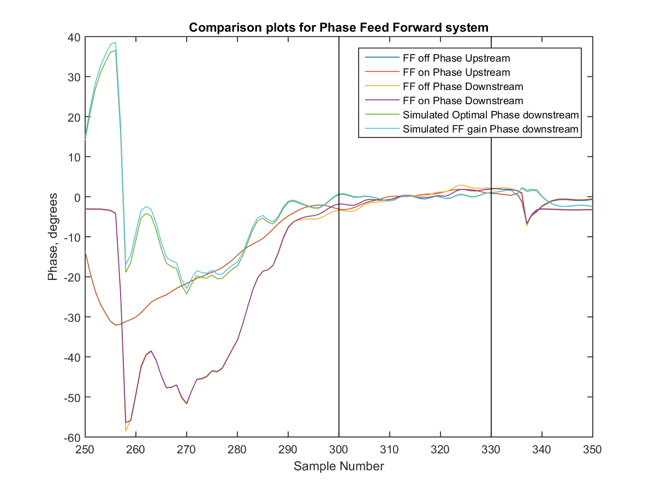
Gain 53, Phase Plots

Slide 17
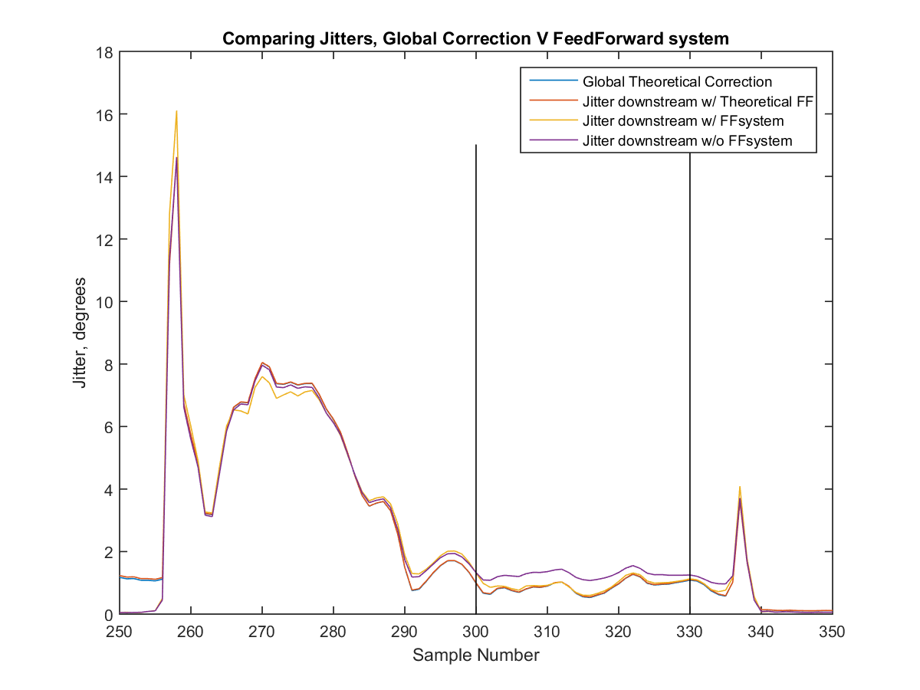
Gain 53, Jitter Plots

Slide 18
In Summary
File Gain | Initial Jitter down stream | Jitter after theoretical correction | Jitter after simulated Feed Forward Gain | Jitter after real Feed Forward Gain | Simulated Gain | Simulated Feed Forward Gain | Upstream Jitter – Feed Forward System Off | Upstream Jitter - Feed Forward System On | Correlation between Up and Downstream Phase.
63 | 1.3793 | 0.8145 | 0.8882 | 0.9679 | 1.3249 | 1.5876 | 0.9367 | 0.9027 | 0.8997
53 | 1.2684 | 0.8737 | 0.8857 | 0.9480 | 1.2728 | 1.3356 | 0.8545 | 0.9277 | 0.8574
43 | 2.1805 | 1.4342 | 1.4700 | 1.6105 | 0.95508 | 1.0836 | 1.8509 | 1.9037 | 0.8107
43 (2) | 1.1111 | 0.7978 | 0.7879 | 0.7703 | 1.1761 | 1.0836 | 0.7865 | 0.8037 | 0.8325
33 | 1.6656 | 1.0257 | 1.0041 | 1.3668 | 1.2731 | 0.8316 | 1.1496 | 1.1735 | 0.8539
It is clear that the feed forward, while improving the downstream jitter, is not achieving its full potential.
Further analyses which will include the theoretical predictions limited by the physical limitations of the system will serve as a truer benchmark to compare the feed forward system with.

Slide 19
Restricted Global Gain Simulations (+/- 2 degrees)
We now restrict the magnitude of our applied theoretical corrections to the phase to a small window of +/- 2 degrees. We allow the centre of this window to vary slightly as we try to find the simulation which most closely matches the real FF system, or which minimizes the Jitter downstream.
Along with the Phase and Jitter plots after these correction, plots for the fraction of pulses included in each window at every sample point, as well as both global and point by point theoretical gains are also included for a better understanding of the data.
The reason we simulate data with limited corrections is to more closely match the real FF system, and in this way assess just how much of a difference this makes on the overall performance of the F system.

Slide 20
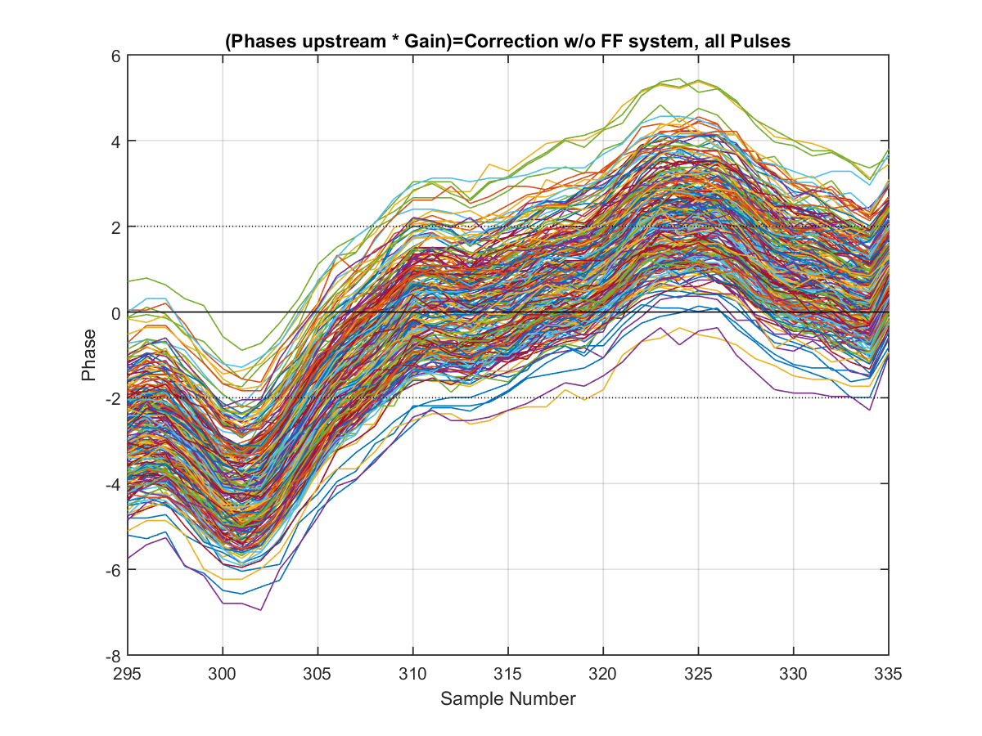
Gain 53, Pulse Phases (+/- 2 degrees)

Slide 21
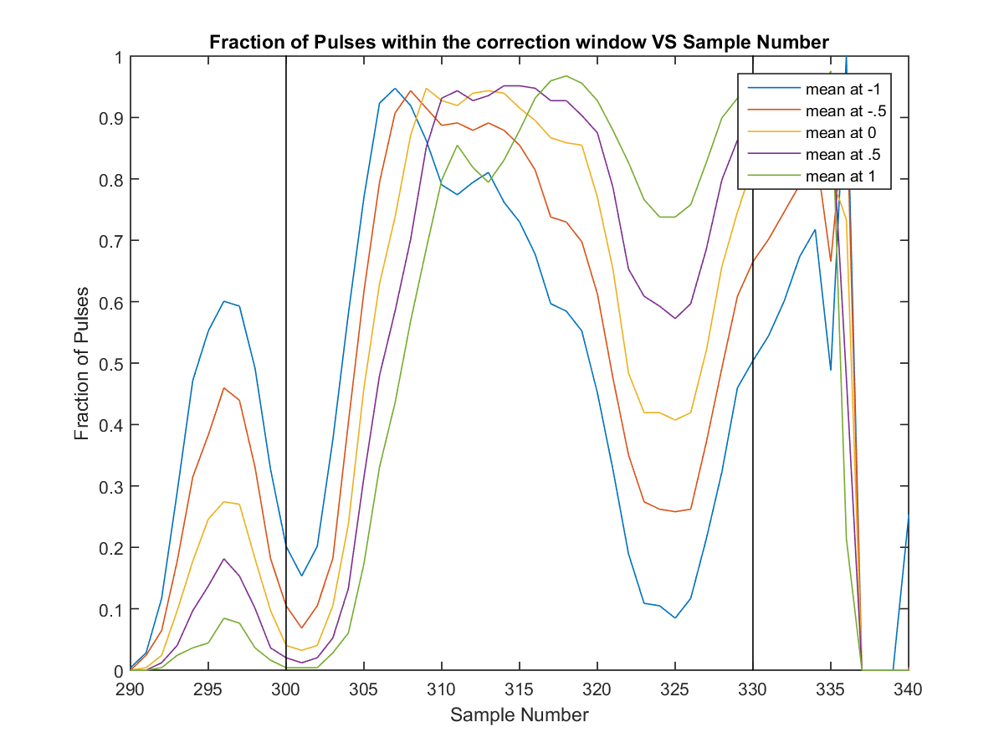
Gain 53, Fraction of Pulses (+/- 2 degrees)

Slide 22
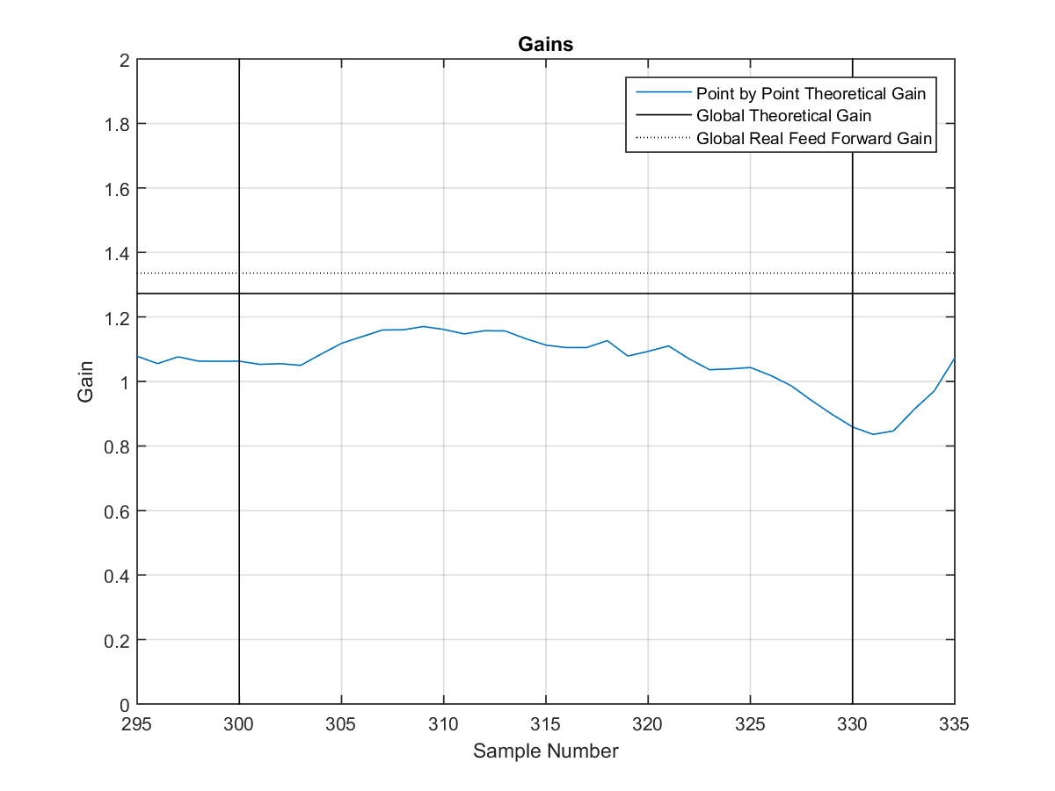
Gain 53, Gains

Slide 23
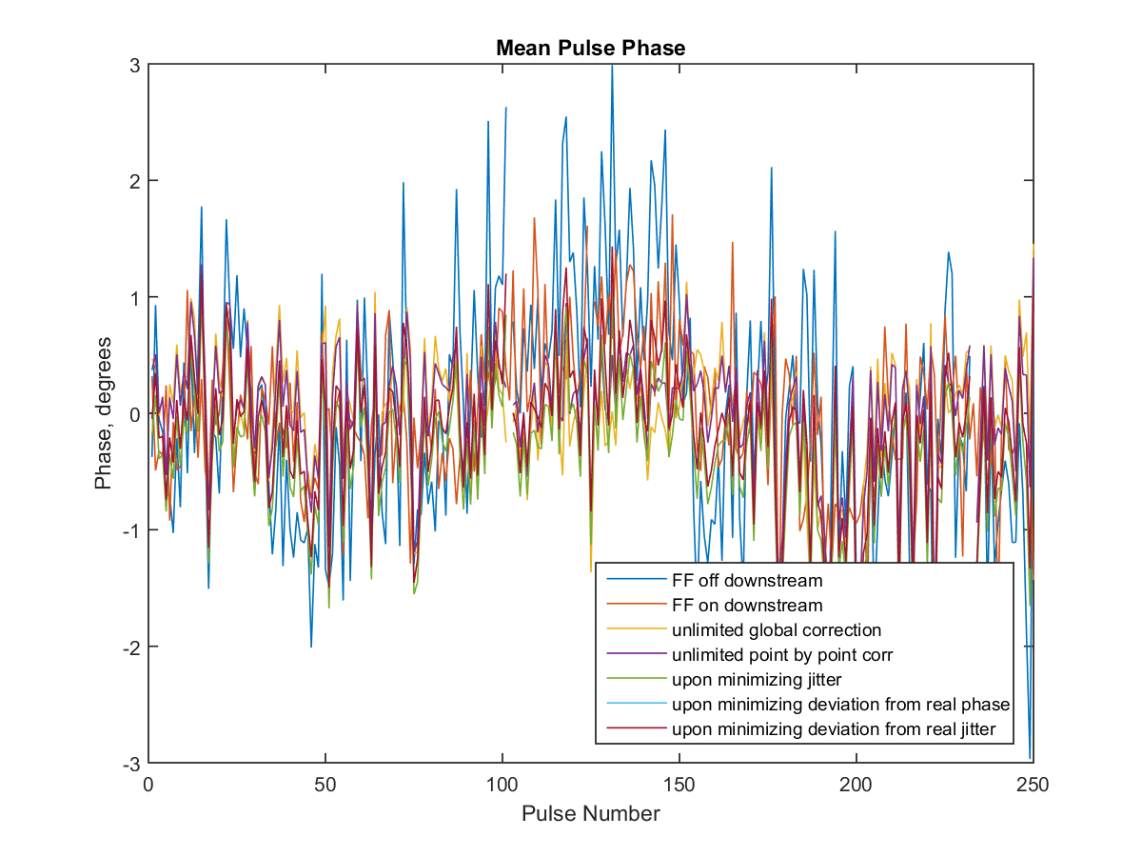
Gain 53, Mean Pulse Phases (+/- 2 degrees)

Slide 24
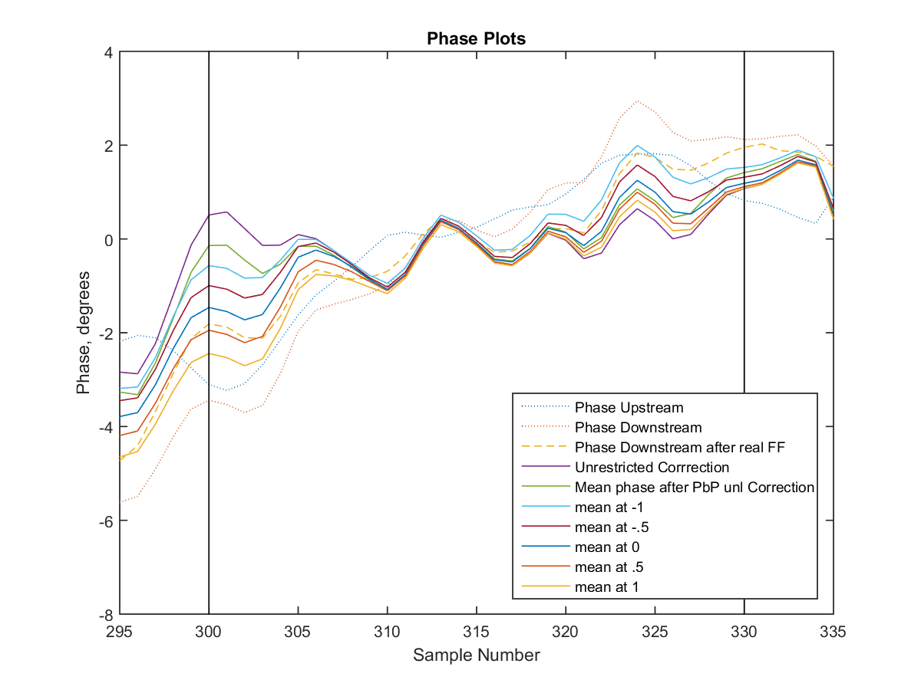
Gain 53, Phase Plots (+/- 2 degrees)

Slide 25
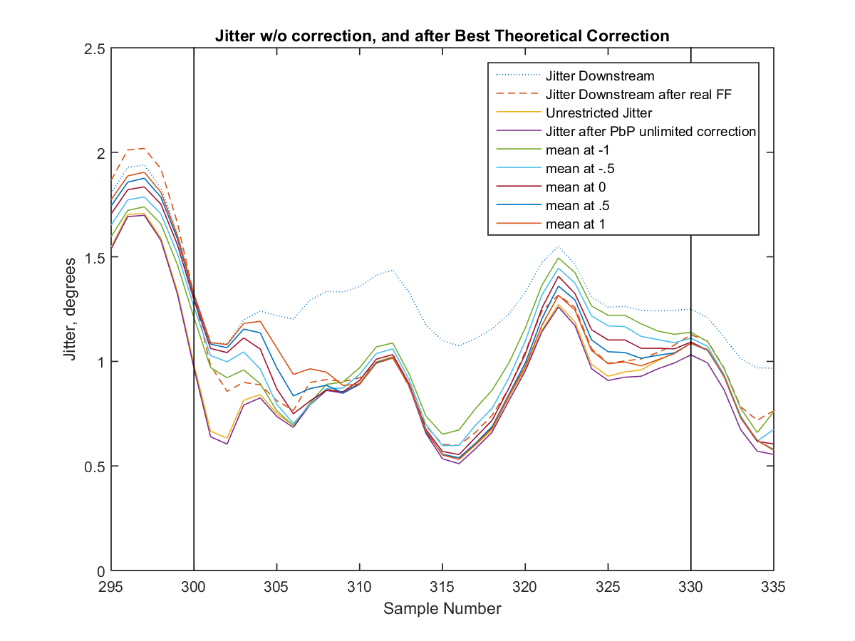
Gain 53, Jitter Plots (+/- 2 degrees)

Slide 26
Tables of key parameters (+/- 2 deg)
Gain | Initial Jitter | Jitter after FF system | Jitter after unlimited correction | Minimized Jitter | Jitter after min deviation to real FF (mean) | Jitter after min Jitter Deviation from real FF (mean) | Flatness upon minimizing the Jitter | Flatness upon minimizing the deviation to FF
63 | 1.3793 | 0.9679 | 0.8145 | 0.9683(1) | 0.9892 (0) | 0.9892 (0) | 1.0662 | 0.8659
53 | 1.2684 | 0.9480 | 0.8737 | 0.9696(.5) | 0.9753 (0) | 0.9753 (0) | 0.9270 | 0.8500
43 | 2.1805 | 1.6105 | 1.4342 | 1.5011(1) | 1.5012 (.5) | 1.6524 (-1) | 1.3220 | 1.1801
43(2) | 1.1111 | 0.7703 | 0.7978 | 0.8501(0) | .8529 (-.5) | 0.8727 (-1) | 1.0745 | 1.0639
33 | 1.6656 | 1.3668 | 1.0257 | 1.1430(.5) | 1.1430 (.5) | 1.1864 (-1) | 1.1340 | 1.1340
The minimum deviation is found by minimizing the mean of the square of the difference between the phase values, in the sample range.
The minimum deviation to the real FF jitter is found in a similar way, by minimizing the mean of the square of the difference between the jitters, in the sample range.
The values in the brackets represent the centers of the windows within which we accept the corrections to the phases.

Slide 27
Jitters on Mean Pulse Phases (+/- 2 degrees)
Gain | Initial | Real FF | Global Theoretical Gain | Point by Point Theoretical Gain | Upon minimizing Jitter | Upon minimizing Deviation to real FF phases | Upon minimizing Deviation to real FF Jitters
63 | 1.2318 | 0.6944 | 0.5487 | 0.5380 | 0.6357 | 0.6703 | 0.6703
53 | 1.0665 | 0.6383 | 0.5695 | 0.5480 | 0.6035 | 0.6263 | 0.6236
43 | 1.9855 | 1.3224 | 1.1740 | 1.1639 | 1.2166 | 1.2178 | 1.3950
43 (2) | 0.9388 | 0.5621 | 0.5342 | 0.5189 | 0.5480 | 0.5663 | 0.5980
33 | 1.4510 | 1.1083 | 0.7458 | 0.7065 | 0.8484 | 0.8484 | 0.8563
The Jitters here are the jitters in the Mean Pulse Plots. The Mean Pulse Phase plots were formed by taking the mean of the phases for each pulse within the sample range.

Slide 28
In Summary
First of all we note that, under the conditions where the corrections are limited to +/- 2 degrees, and by allowing the mean of our acceptance window to walk about a little bit, the best theoretical jitter produced was often slightly worse, or close to the real FF system. This thus represents a notable limitation of the FF system.
This now warrants an investigation into trying the same out with a bigger window, like +/- 2.5 or 4 degrees.

Slide 29
Gain 53, Pulse Phases (+/- 2.5 degrees)

Slide 30
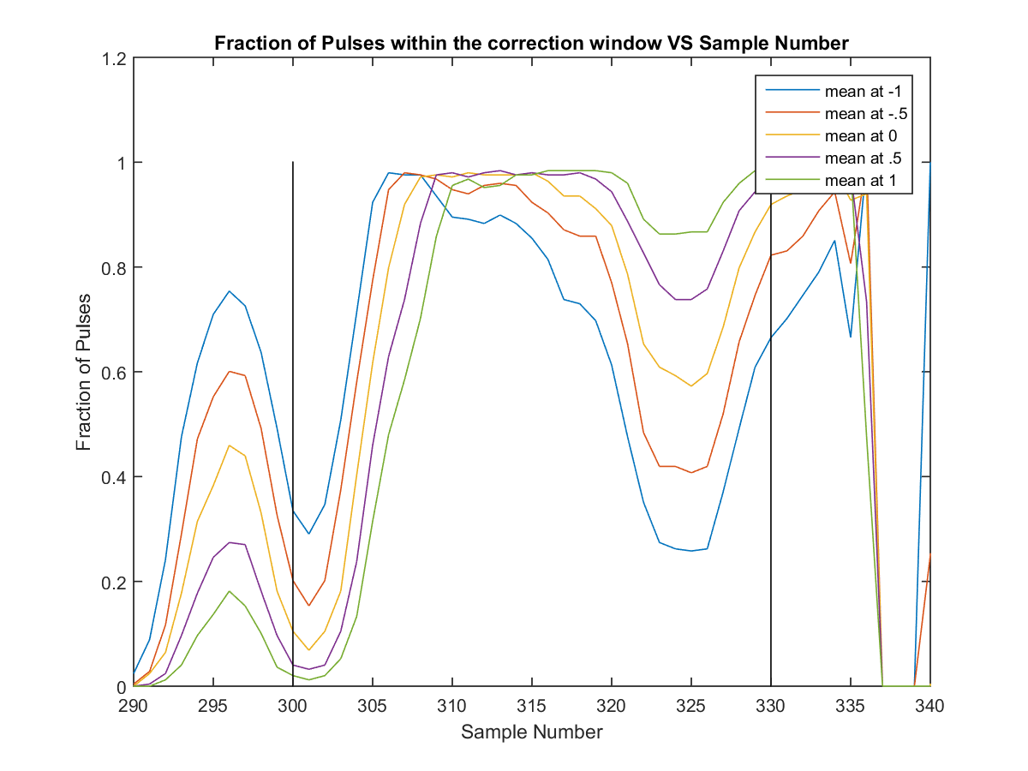
Gain 53, Fraction of Pulses (+/- 2.5 degrees)

Slide 31
Gain 53, Gains (same as before)

Slide 32
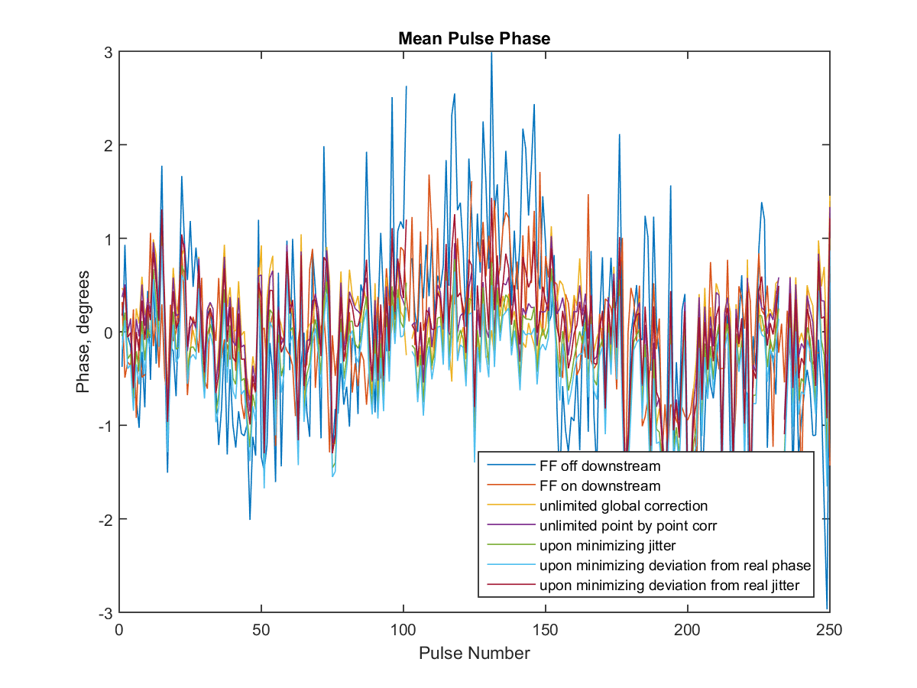
Gain 53, Mean Pulse Phase (+/-2.5 degrees)

Slide 33
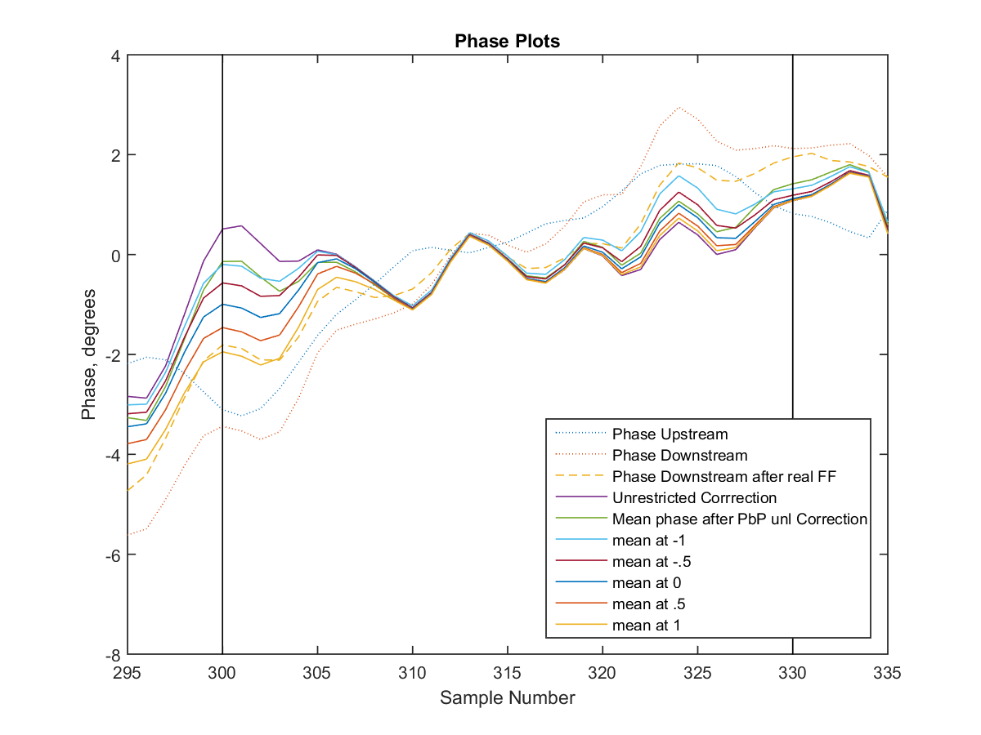
Gain 53, Phase Plots (+/- 2.5 degrees)

Slide 34
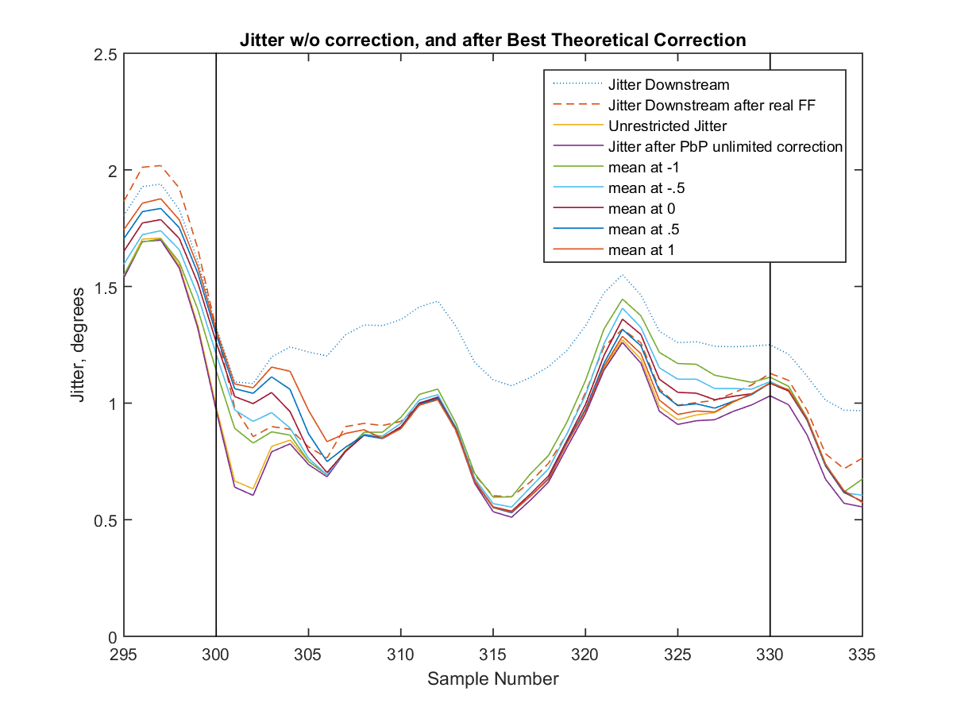
Gain 53, Jitter Plots (+/- 2.5 degrees)

Slide 35
Tables of key parameters (+/-2.5 deg)
Gain | Initial Jitter | Jitter after FF system | Minimized Jitter after unlimited global correction | Minimized Jitter | Jitter after min deviation to real FF phase (mean) | Jitter after min Jitter Deviation from real FF (mean) | Flatness upon minimizing the Jitter | Flatness upon minimizing the deviation to FF
63 | 1.3793 | 0.9679 | 0.8145 | 0.9288(.5) | 0.9288 (.5) | 0.9516 (-.5) | 0.7649 | 0.7649
53 | 1.2684 | 0.9480 | 0.8737 | 0.9421(.5) | 0.9495 (1) | 0.9504 (-.5) | 0.7539 | 0.8755
43 | 2.1805 | 1.6105 | 1.4342 | 1.4244(.5) | 1.4276 (1) | 1.5341 (-1) | 1.0249 | 1.1584
43(2) | 1.1111 | 0.7703 | 0.7978 | 0.8231(-.5) | 0.8762 (1) | 0.8283 (-1) | 0.8827 | 1.1151
33 | 1.6656 | 1.3668 | 1.0257 | 1.1021(0) | 1.1224 (-1) | 1.1269 (-1) | 0.8971 | 1.0908
The minimum deviation is found by minimizing the mean of the square of the difference between the phase values, in the sample range.
The minimum deviation to the real FF jitter is found in a similar way, by minimizing the mean of the square of the difference between the jitters, in the sample range.
The values in the brackets represent the centers of the windows within which we accept the corrections to the phases.

Slide 36
Jitters on Mean Pulse Phases (+/- 2.5 degrees)
Gain | Initial | Real FF | Global Theoretical Gain | Point by Point Theoretical Gain | Upon minimizing Jitter | Upon minimizing Deviation to real FF phases | Upon minimizing Deviation to real FF Jitters
63 | 1.2318 | 0.6944 | 0.5487 | 0.5380 | 0.5847 | 0.5847 | 0.6281
53 | 1.0665 | 0.6383 | 0.5695 | 0.5480 | 0.5705 | 0.5681 | 0.5982
43 | 1.9855 | 1.3224 | 1.1740 | 1.1639 | 1.1317 | 1.1330 | 1.2646
43 (2) | 0.9388 | 0.5621 | 0.5342 | 0.5189 | 0.5293 | 0.5413 | 0.5439
33 | 1.4510 | 1.1083 | 0.7458 | 0.7065 | 0.7801 | 0.8208 | 0.7842
The Jitters here are the jitters in the Mean Pulse Plots. The Mean Pulse Phase plots were formed by taking the mean of the phases for each pulse within the sample range.

Slide 37
In Summary (2)
As expected, with the larger window, the simulated correction performed better than before, and again it was able to result in jitters better than the real FF system could achieve.
It shows that the correction range is a limiting factor in the performance of the FF system.

Slide 38
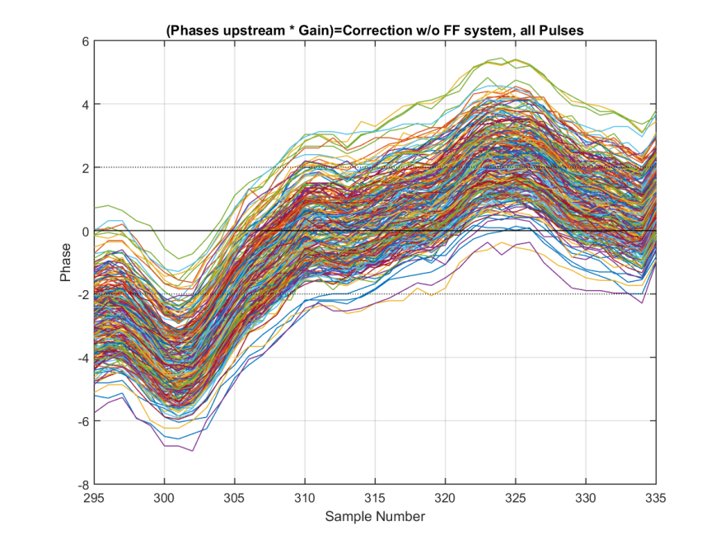
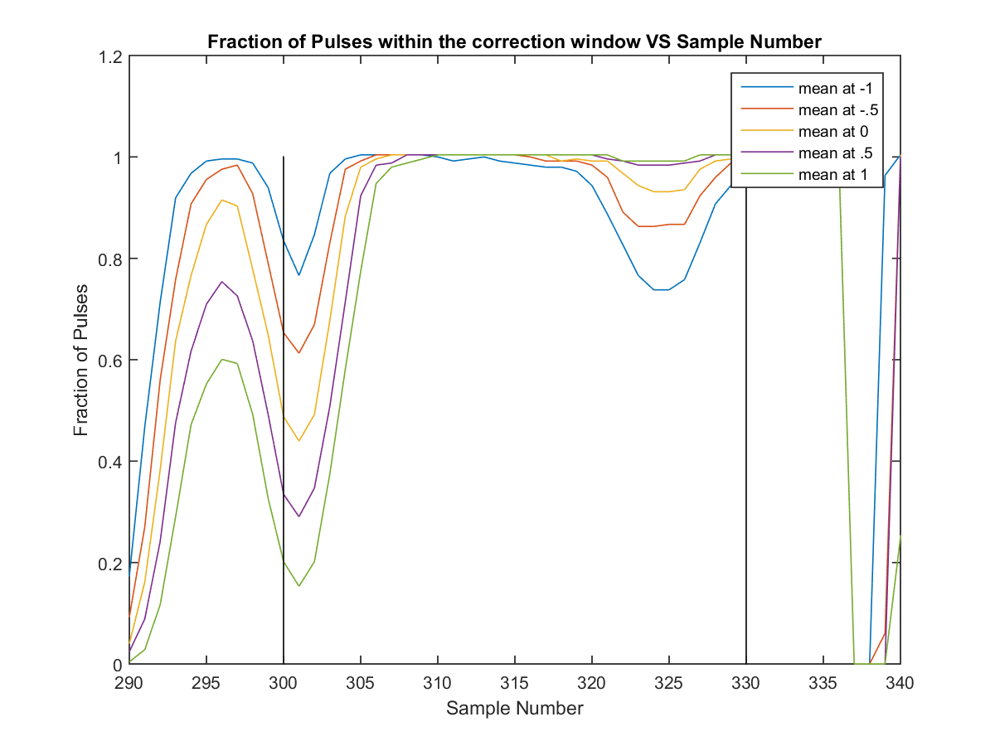
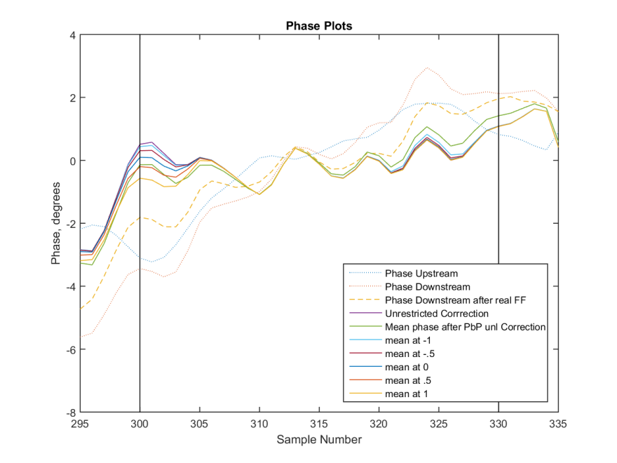
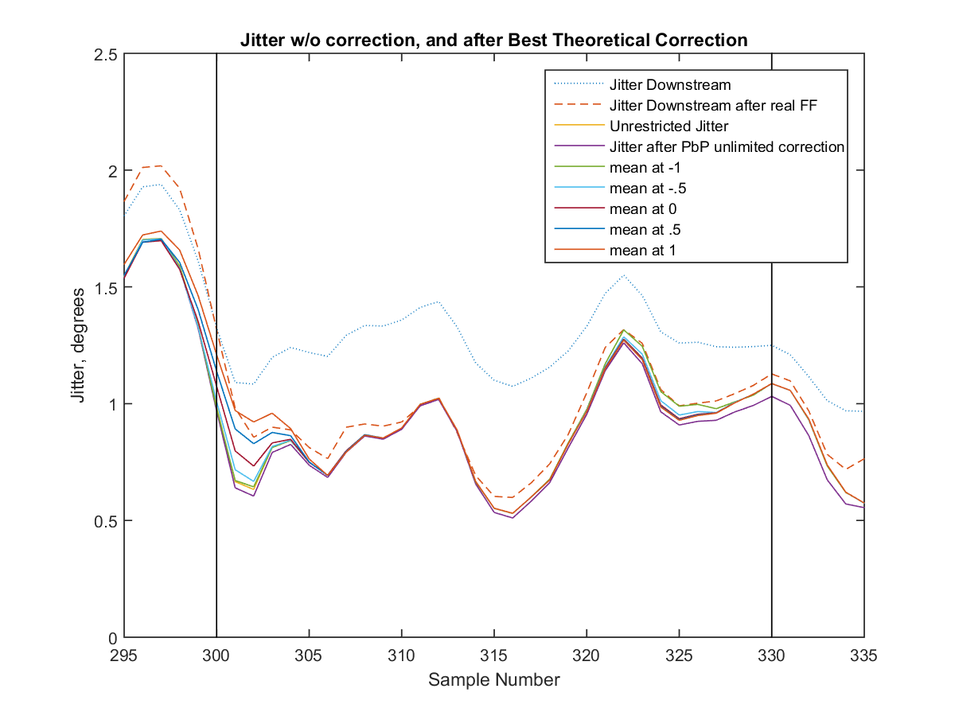
Gain 53 with +/- 4 degrees

Slide 39
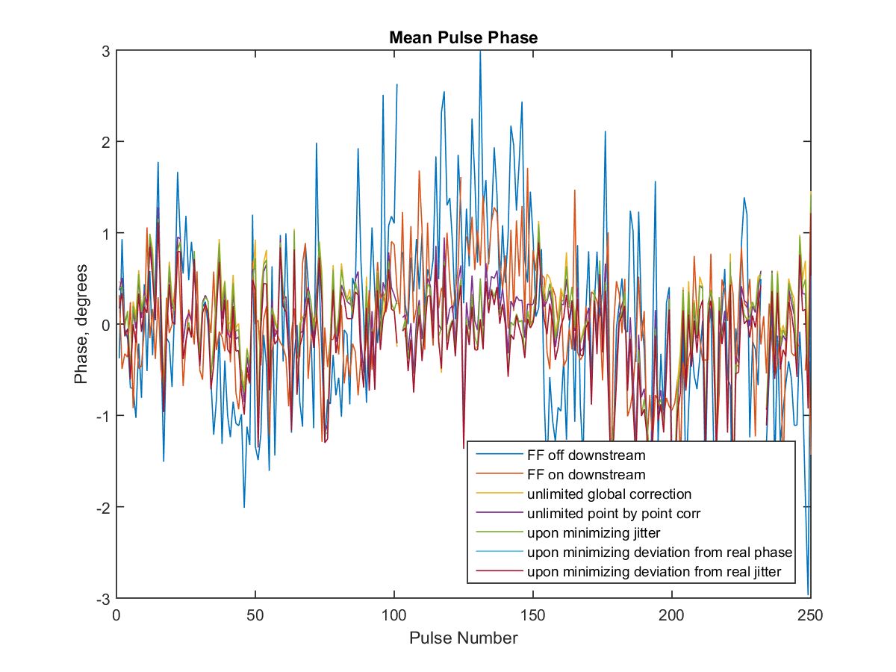
Gain 53, Mean Pulse Phase (+/-4 degrees)

Slide 40
Comparisons of different windows
Gain | Initial Jitter | Jitter after FF system | Jitter after unlimited correction (Point By Point gain) | Jitter after unlimited global correction | Minimized Jitter (+/- 2 deg) | Jitter after min Deviation from FF system (+/- 2 deg) | Jitter after min Jitter Deviation from FF system (+/- 2 deg) | Minimized Jitter (+/- 2.5 deg) | Jitter after min Deviation from FF system (+/- 2.5 deg) | Jitter after min Jitter Deviation from FF system (+/- 2.5 deg) | Minimized Jitter (+/- 4 deg) | Jitter after min Deviation from FF system (+/- 4 deg) | Jitter after min Jitter Deviation from FF system (+/- 4 deg)
63 | 1.3793 | 0.9679 | 0.8004 | 0.8145 | 0.9683 | 0.9892 | 0.9892 | 0.9288 | 0.9288 | 0.9516 | 0.8341 | 0.8661 | 0.8661
53 | 1.2684 | 0.9480 | 0.8557 | 0.8737 | 0.9696 | 0.9753 | 0.9753 | 0.9421 | 0.9495 | 0.9504 | 0.8812 | 0.9066 | 0.9066
43 | 2.1805 | 1.6105 | 1.3905 | 1.4342 | 1.5011 | 1.5012 | 1.6524 | 1.4244 | 1.4276 | 1.5341 | 1.2960 | 1.3087 | 1.3355
43 (2) | 1.1111 | 0.7703 | 0.7714 | 0.7978 | 0.8501 | 0.8529 | 0.8727 | 0.8231 | 0.8762 | 0.8283 | 0.7961 | 0.8333 | 0.7961
33 | 1.6656 | 1.3668 | 0.9892 | 1.0257 | 1.1430 | 1.1430 | 1.1864 | 1.1021 | 1.1224 | 1.1269 | 1.0162 | 1.0752 | 1.0752

Slide 41
Comparisons of different windows (Jitters on Mean Pulse Phase)
Gain | Initial | Real FF | Global Theory | Point by Point Theory | Upon minimizing Jitter (2deg) | Upon minimizing Deviation to real FF phases (2deg) | Upon minimizing Deviation to real FF Jitters (2deg) | Upon minimizing Jitter (2.5deg) | Upon minimizing Deviation to real FF phases (2.5deg) | Upon minimizing Deviation to real FF Jitters (2.5deg) | Upon minimizing Jitter (4deg) | Upon minimizing Deviation to real FF phases (4deg) | Upon minimizing Deviation to real FF Jitters (4deg)
63 | 1.2318 | 0.6944 | 0.5487 | 0.5380 | 0.6357 | 0.6703 | 0.6703 | 0.5847 | 0.5847 | 0.6281 | 0.5374 | 0.5416 | 0.5416
53 | 1.0665 | 0.6383 | 0.5695 | 0.5480 | 0.6035 | 0.6263 | 0.6236 | 0.5705 | 0.5681 | 0.5982 | 0.5609 | 0.5507 | 0.5507
43 | 1.9855 | 1.3224 | 1.1740 | 1.1639 | 1.2166 | 1.2178 | 1.3950 | 1.1317 | 1.1330 | 1.2646 | 1.0018 | 1.0189 | 1.0393
43(2) | 0.9388 | 0.5621 | 0.5342 | 0.5189 | 0.5480 | 0.5663 | 0.5980 | 0.5293 | 0.5413 | 0.5439 | 0.5279 | 0.5287 | 0.5279
33 | 1.4510 | 1.1083 | 0.7458 | 0.7065 | 0.8484 | 0.8484 | 0.8563 | 0.7801 | 0.8208 | 0.7842 | 0.7137 | 0.8446 | 0.7446

Slide 42
Conclusions
Theoretical optimal gain values (global and point by point) seem plausible, as the optimized gains are very close to the theoretical gains.
Lowest jitter in any of the simulations is about 0.7-0.8 degrees; Shows that the beam conditions still need to be improved to achieve 0.2 degrees point by point jitter.
+/-2 or +/-2.5 window simulations seem to give very close results to the real feedforward system.
With +/- 4 window (i.e. when we have double the power from the amplifier), expect roughly 0.1 degrees reduction in the jitter we can achieve with the feedforward system.

Slide 43
Further Analysis
Following the simulations that have been done so far, the next step involves adding a time offset between the upstream phase/correction and the downstream phase to see if the theoretical jitter values can be reduced further and to determine the effect on the jitter if the correction is out of sync with the beam.
After that, a bandwidth limit will be applied on the simulated corrections, to make it match even more closely the real feed forward system, and assess the impact this has on its performance.
Of course, it is apparent that the +/- 2.5 degrees minute is what brings us closest to the theory, so I expect the time/ bandwidth effects to have a smaller impact on the analysis.

