Slide 1
Multi-parameter fit
FINDING 3BPM RESOLUTION
Talitha

Slide 2
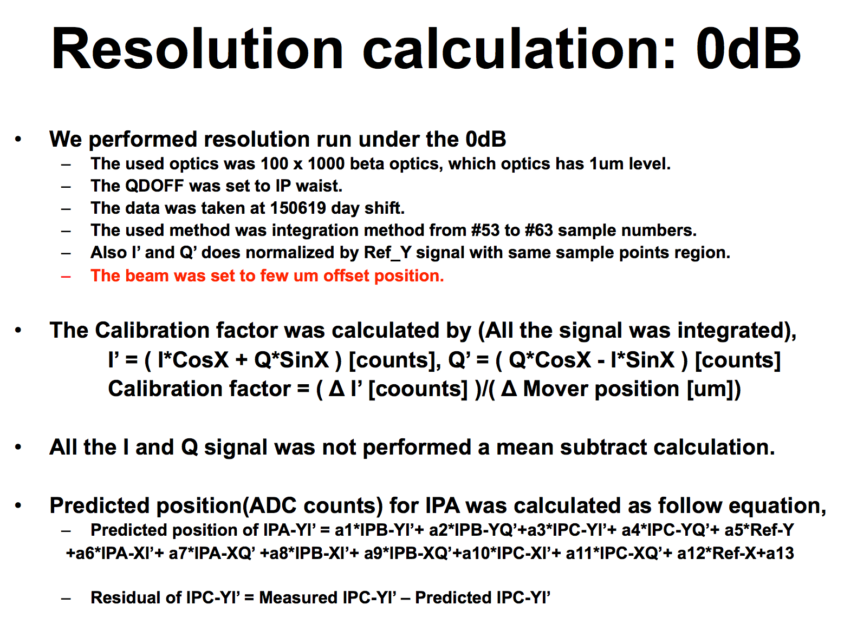
Siwon’s method

Slide 3
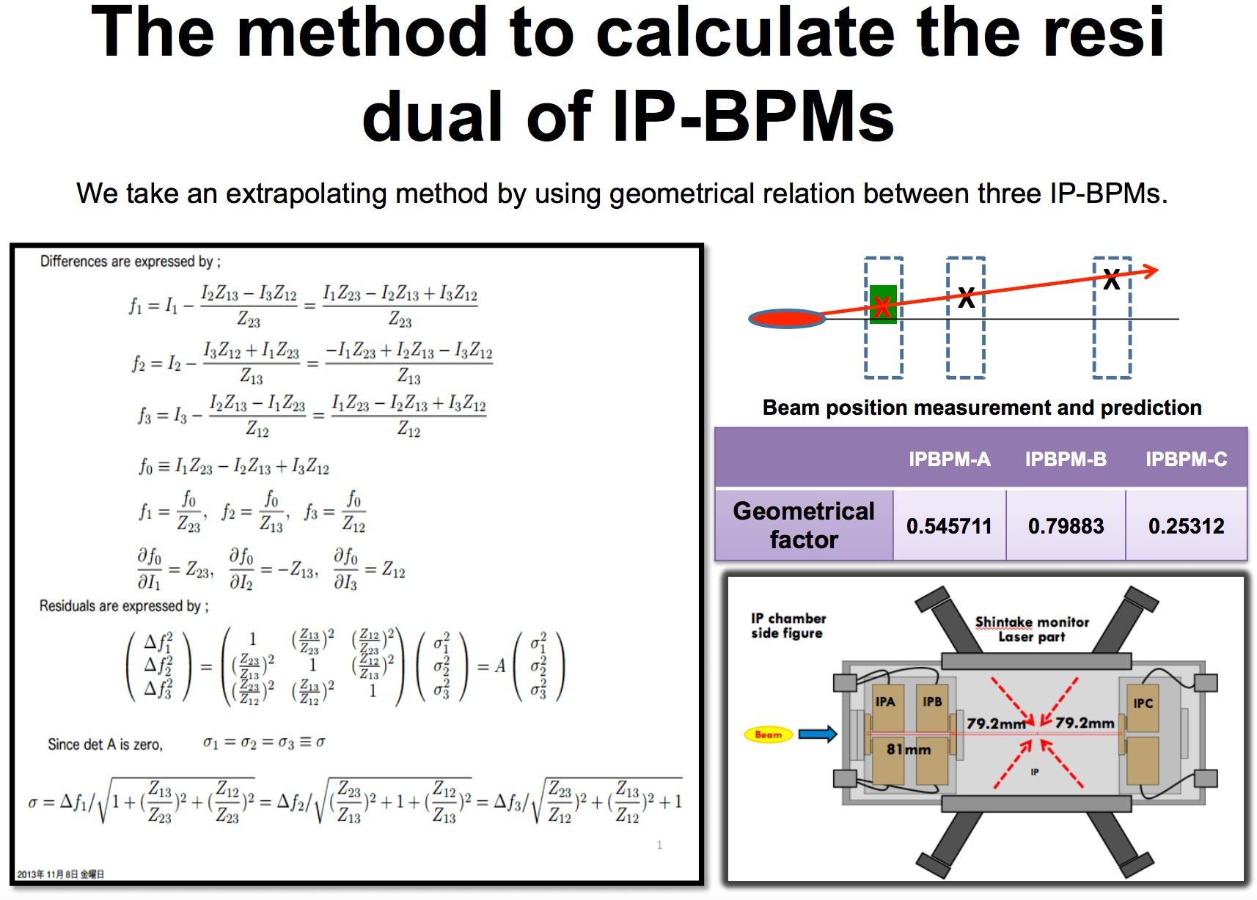
Siwon’s method

Slide 4
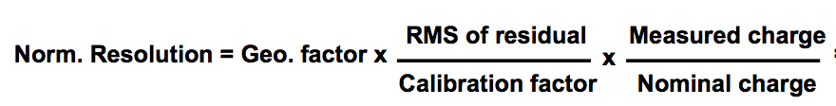
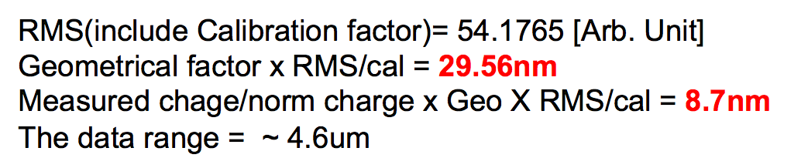
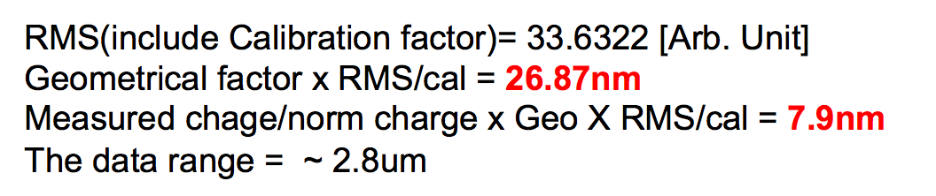
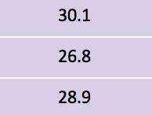
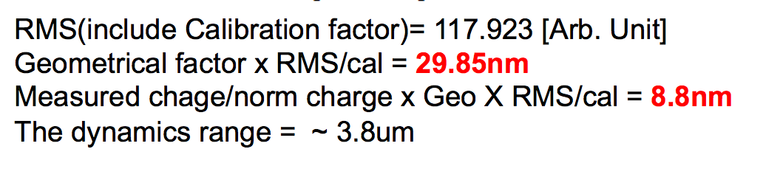
Siwon’s method
IPBPM-A
My results using Siwon’s method of calculation:
IPBPM-B
IPBPM-C

Slide 5
Multi-parameter fit
All I and Q values [counts] normalised by reference signals.
Example for predicting IPA-YI'
IPA-YI' = α₁IPB-YI' + α₂IPB-YQ' + α₃IPB-XI + α₄IPB-XQ + α₅IPC-YI' + α₆IPC-YQ' + α₇IPC-XI + α₈IPC-XQ + α₉IPA-XI + α₁₀IPA-XQ + α₁₁Ref-Y + α₁₂Ref-X + α₁₃
Resolution_{IPA-Y} = std(IPA-YI'^{meas} – IPA-YI'^{pred})
k_{IPA-Y} × GF
k = calibration factor [counts][μm]⁻¹
GF = geometric factor

Slide 6
When to apply calibration factor?
Siwon/Honda: perform fit using I and Q signals in ADC counts. Apply calibration from ADC counts into nm at the very last stage after fit has been applied, using just the calibration factor for the BPM currently calculating resolution for, which is found from a calibration run of that BPM.
FONT: perform fit using calibrated signals converted to positions. Apply calibration from ADC counts into nm before fitting, converting all I’ signals into positions using the three different calibration factors for each BPM determined from separate calibration runs.

Slide 7
Calibrating before and after fitting
IPA-YI' = α₁IPB-YI’ + α₂IPC-YI’ + α₃
jitRun28_0dB_030_ipbpm_150619 |  | FIT PARAMETERS
Fit description | IP BPM | (YI’)₁ | ( YI’)₂ | Constant | Resolution (nm)
2 parameters - apply calibration factor before performing fit: integration 53:63 | A | 1.377 | -0.432 |  | 173.6
 | B | 0.677 | 0.358 |  | 169.7
 | C | -1.355 | 2.283 |  | 190.1
2 parameters - apply calibration factory after performing fit: integration 53:63 | A | 1.447 | -1.084 |  | 147.6
 | B | 0.645 | 0.855 |  | 145.9
 | C | -0.54 | 0.956 |  | 363.1
3 parameters - apply calibration factor before performing fit : integration 53:63 | A | 0.76 | -0.869 | -6.834 | 181.1
 | B | 0.308 | -0.198 | -5.87 | 165.4
 | C | -0.495 | -0.278 | -11.322 | 181.6
3 parameters - apply calibration factor after performing fit: integration 53:63 | A | 0.799 | -2.18 | -7.534 | 109.4
 | B | 0.293 | -0.472 | -6.159 | 154
 | C | -0.197 | -0.116 | -4.975 | 203.6
Geometric parameters
1.4638 | -0.4638
0.6831 | 0.3169
-2.1559 | 3.1559
When fitting with no constant and calibrating before fitting (first data set), parameters can be compared to the geometric parameters (above in blue) derived from the known separation of the BPMs.
Integration 53:63 Calibrations
IP BPM | Theta | k
A | 0.053 +/- 0.005 | 1.102 +/- 0.026
B | 0.262 +/- 0.006 | 1.049 +/- 0.013
C | 0.392 +/- 0.015 | 0.439 +/- -0.011

Slide 8
Adding parameters
IPA-YI' = α₁IPB-YI' + α₂IPB-YQ' + α₃IPB-XI + α₄IPB-XQ + α₅IPC-YI' + α₆IPC-YQ' + α₇IPC-XI + α₈IPC-XQ + α₉IPA-XI + α₁₀IPA-XQ + α₁₁Ref-Y + α₁₂Ref-X + α₁₃
jitRun28_0dB_030_ipbpm_ 150619 |  | FIT PARAMETERS
Fit description | IP BPM | YI' | YQ' | XI | XQ | YI' | YQ' | XI | XQ | XI self | XQ self | Ref X | Ref Y | Constant | Resolution (nm)
3 parameters | A | 0.799 |  |  |  | -2.18 |  |  |  |  |  |  |  | -7.534 | 109.4
 | B | 0.293 |  |  |  | -0.472 |  |  |  |  |  |  |  | -6.159 | 154
 | C | -0.197 |  |  |  | -0.116 |  |  |  |  |  |  |  | -4.975 | 203.6
Add Q 5 parameters | A | 1.515 | -0.832 |  |  | -1.524 | -2.114 |  |  |  |  |  |  | 5.031 | 36.3
 | B | 0.538 | 0.475 |  |  | 0.555 | 1.321 |  |  |  |  |  |  | -1.695 | 40
 | C | -0.402 | -0.071 |  |  | 0.416 | -0.595 |  |  |  |  |  |  | 2.048 | 127
Add X 9 parameters | A | 1.504 | -0.724 | -0.411 | 0.835 | -1.541 | -2.377 | -0.089 | 0.505 |  |  |  |  | 1.565 | 27.7
 | B | 0.556 | 0.051 | -0.026 | -0.117 | 0.587 | 1.969 | 0.021 | -0.147 |  |  |  |  | -0.474 | 28.3
 | C | -0.382 | -0.105 | 0.02 | -0.018 | 0.357 | -0.527 | -0.289 | 0.094 |  |  |  |  | 1.227 | 112.7
Add self X 11 parameters | A | 1.539 | -0.589 | 0.022 | 0.822 | -1.472 | -2.478 | 0.111 | 0.241 | -0.054 | 0.105 |  |  | -0.027 | 26.7
 | B | 0.541 | 0.189 | 0.029 | -0.079 | 0.534 | 1.732 | -0.031 | -0.14 | -0.008 | -0.616 |  |  | 1.143 | 27.7
 | C | -0.379 | -0.099 | -0.032 | -0.023 | 0.357 | -0.539 | 0.006 | 0.145 | 0.12 | 0.024 |  |  | 0.798 | 109.9
Add Ref X 12 parameters | A | 1.696 | -0.745 | -0.066 | -0.389 | -1.236 | -2.341 | 0.059 | -0.05 | 0.241 | 0.241 | 0.003 |  | 12.136 | 18
 | B | 0.545 | 0.492 | -0.053 | -0.117 | 0.555 | 1.263 | -0.008 | 0.047 | 0.199 | 0.199 | -0.002 |  | -5.423 | 19.4
 | C | -0.539 | -0.457 | 0.02 | 0.037 | 0.749 | -0.587 | -0.062 | -0.21 | -0.064 | -0.064 | 0.002 |  | 6.978 | 77.1
Add Ref Y 13 parameters | A | 1.752 | -0.993 | 0.067 | -0.027 | -1.159 | -1.921 | 0.071 | -0.009 | 0.031 | 0.224 | -0.001 | 0.003 | 13.693 | 17.3
 | B | 0.539 | 0.536 | -0.028 | -0.108 | 0.528 | 1.162 | -0.02 | 0.038 | 0.02 | 0.046 | 0 | -0.001 | -5.136 | 18.7
 | C | -0.611 | -0.471 | -0.007 | 0.049 | 0.93 | -0.745 | 0.015 | -0.007 | 0.079 | -0.037 | 0 | 0.002 | 8.725 | 65.6
Geometric factor (as per Siwon's method) | A | 1.752 | -0.993 | 0.067 | -0.027 | -1.159 | -1.921 | 0.071 | -0.009 | 0.031 | 0.224 | -0.001 | 0.003 | 13.693 | 30.1
 | B | 0.539 | 0.536 | -0.028 | -0.108 | 0.528 | 1.162 | -0.02 | 0.038 | 0.02 | 0.046 | 0 | -0.001 | -5.136 | 26.8
 | C | -0.611 | -0.471 | -0.007 | 0.049 | 0.93 | -0.745 | 0.015 | -0.007 | 0.079 | -0.037 | 0 | 0.002 | 8.725 | 28.9
All calibrating using integration between 53 and 63, and calibrating after the fit. All except the final analysis use a geometric factor that contains all fit parameters (except the constant).

Slide 9
Fitting with I’ and Q’ vs with I and Q
Compare fitting:
IPA-YI' = α₁IPB-YI' + α₂IPB-YQ’ + α₅IPC-YI' + α₆IPC-YQ’ + α₁₃
jitRun28_0dB_030_ipbpm_150619 |  | FIT PARAMETERS
Fit description | IP BPM | YI' | YQ' | YI' | YQ' | Constant | Resolution (nm)
Add Q - 5 parameters - apply calibration factor after performing fit: integration 53:63 | A | 1.515 | -0.832 | -1.524 | -2.114 | 5.031 | 36.3
 | B | 0.538 | 0.475 | 0.555 | 1.321 | -1.695 | 40
 | C | -0.402 | -0.071 | 0.416 | -0.595 | 2.048 | 127
IPA-YI' = α₁IPB-YI + α₂IPB-YQ + α₅IPC-YI + α₆IPC-YQ + α₁₃
jitRun28_0dB_030_ipbpm_150619 |  | FIT PARAMETERS
Fit description | IP BPM | YI | YQ | YI | YQ | Constant | Resolution (nm)
Using I and Q instead of I' and Q' | A | 1.678 | -0.41 | -0.602 | -2.536 | 5.031 | 36.3
 | B | 0.512 | 0.503 | 0.009 | 1.433 | -1.695 | 40
 | C | -0.398 | -0.093 | 0.556 | -0.467 | 2.048 | 127
Two different methods result in identical resolutions, just different fit parameters.

Slide 10
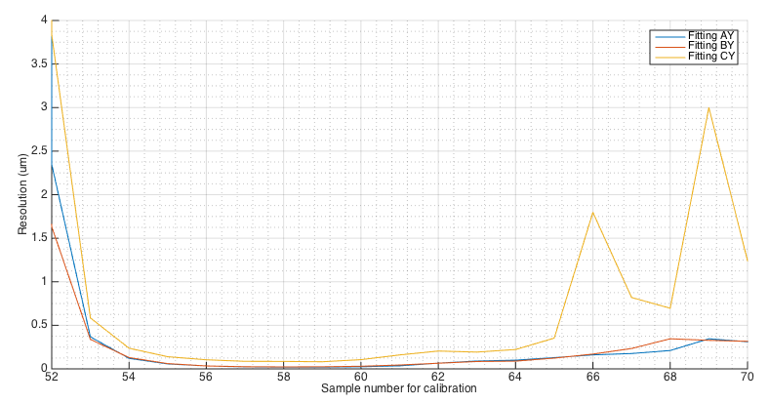
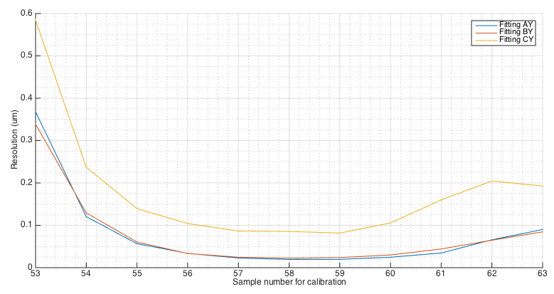
Resolution vs sample # - 13-multifit

Slide 11
Single sample integration
IPA-YI' = α₁IPB-YI’ + α₂IPC-YI’ + α₃
jitRun28_0dB_030_ipbpm_150619 |  | FIT PARAMETERS
Fit description | IP BPM | YI' | YI' | Constant | Resolution (nm)
2 parameters - apply calibration factor before performing fit: single sample 58 | A | 1.466 | -0.34 |  | 224.5
 | B | 0.591 | 0.308 |  | 214.4
 | C | -1.019 | 2.295 |  | 259.7
2 parameters - apply calibration factory after performing fit: single sample 58 | A | 1.593 | -0.778 |  | 199.3
 | B | 0.544 | 0.65 |  | 196.5
 | C | -0.445 | 1.088 |  | 454.8
3 parameters - apply calibration factor before performing fit : single sample 58 | A | 0.324 | -1.157 | -12.39 | 180.1
 | B | 0.22 | -0.247 | -6.185 | 220.1
 | C | -0.56 | -0.176 | -11.499 | 169
3 parameters - apply calibration factor after performing fit: single sample 58 | A | 0.353 | -2.653 | -2.231 | 98.6
 | B | 0.202 | -0.52 | -1.025 | 202.4
 | C | -0.244 | -0.084 | -0.903 | 189.7
Geometric parameters
1.4638 | -0.4638
0.6831 | 0.3169
-2.1559 | 3.1559
When fitting with no constant and calibrating before fitting (first data set), parameters can be compared to the geometric parameters (above in blue) derived from the known separation of the BPMs.
Single Sample Number 58 Calibrations
IP BPM | Theta | k
A | 0.112 +/- 0.007 | 0.180 +/- 0.004
B | 0.380 +/- 0.008 | 0.166 +/- 0.002
C | 0.574 +/- 0.019 | 0.079 +/- -0.002

Slide 12
Adding parameters
IPA-YI' = α₁IPB-YI' + α₂IPB-YQ' + α₃IPB-XI + α₄IPB-XQ + α₅IPC-YI' + α₆IPC-YQ' + α₇IPC-XI + α₈IPC-XQ + α₉IPA-XI + α₁₀IPA-XQ + α₁₁Ref-Y + α₁₂Ref-X + α₁₃
jitRun28_0dB_030_ipbpm_150619 |  | FIT PARAMETERS
Fit description | IP BPM | YI' | YQ' | XI | XQ | YI' | YQ' | XI | XQ | XI self | XQ self | Ref X | Ref Y | Constant | Resolution (nm)
3 parameters | A | 0.353 |  |  |  | -2.653 |  |  |  |  |  |  |  | -2.231 | 98.6
 | B | 0.202 |  |  |  | -0.52 |  |  |  |  |  |  |  | -1.025 | 202.4
 | C | -0.244 |  |  |  | -0.084 |  |  |  |  |  |  |  | -0.903 | 189.7
Add Q - 5 parameters | A | 1.646 | -0.591 |  |  | -0.591 | -0.591 |  |  |  |  |  |  | -0.591 | 23.8
 | B | 0.484 | -0.133 |  |  | -0.133 | -0.133 |  |  |  |  |  |  | -0.133 | 32.5
 | C | -0.382 | -0.625 |  |  | -0.625 | -0.625 |  |  |  |  |  |  | -0.625 | 147.1
Add X - 9 parameters | A | 1.518 | 0.27 | -0.117 | 0.112 | -1.425 | -3.993 | 0.185 | 0.032 |  |  |  |  | -0.757 | 23
 | B | 0.513 | 0.274 | 0.015 | 0.035 | 0.521 | 1.789 | -0.021 | -0.106 |  |  |  |  | -0.027 | 29.7
 | C | -0.366 | -0.308 | 0.017 | -0.013 | 0.263 | -0.187 | -0.235 | -0.003 |  |  |  |  | -0.555 | 132.4
Add self X - 11 parameters | A | 1.53 | 0.199 | -0.017 | 0.229 | -1.428 | -4.001 | 0.197 | 0.091 | -0.043 | -0.049 |  |  | -0.742 | 22.7
 | B | 0.509 | 0.319 | 0.057 | 0.046 | 0.507 | 1.706 | -0.06 | -0.125 | -0.113 | -0.229 |  |  | 0.116 | 29.7
 | C | -0.366 | -0.293 | -0.036 | -0.02 | 0.28 | -0.22 | 0.04 | 0.084 | 0.159 | 0.019 |  |  | -0.581 | 125.3
Add Ref X - 12 parameters | A | 1.893 | -0.825 | -0.124 | -0.112 | -1.171 | -2.998 | 0.085 | 0.038 | 0.019 | -0.003 | 0.001 |  | 2.051 | 20.7
 | B | 0.475 | 0.517 | 0 | 0.008 | 0.381 | 1.307 | -0.01 | -0.023 | 0.008 | 0.051 | 0 |  | -0.503 | 23.1
 | C | -0.467 | -0.383 | -0.02 | -0.009 | 0.597 | -0.527 | 0.008 | -0.011 | 0.128 | 0.012 | 0 |  | 0.334 | 98.6
Add Ref Y - 13 parameters | A | 2.03 | -1.278 | 0.006 | 0.11 | -1.077 | 0.074 | 0.074 | 0.093 | -0.027 | -0.002 | 0 | 0.001 | 2.949 | 19.4
 | B | 0.472 | 0.508 | 0.01 | 0.007 | 0.368 | -0.014 | -0.014 | -0.031 | -0.018 | -0.005 | 0 | 0 | -0.511 | 22.4
 | C | -0.512 | -0.332 | -0.034 | -0.007 | 0.75 | 0.048 | 0.048 | 0.068 | 0.124 | 0.036 | 0 | 0 | 0.859 | 85.6
Geometric factor (as per Siwon's method) | A | 2.03 | -1.278 | 0.006 | 0.11 | -1.077 | 0.074 | 0.074 | 0.093 | -0.027 | -0.002 | 0 | 0.001 | 2.949 | 39.6
 | B | 0.472 | 0.508 | 0.01 | 0.007 | 0.368 | -0.014 | -0.014 | -0.031 | -0.018 | -0.005 | 0 | 0 | -0.511 | 32.5
 | C | -0.512 | -0.332 | -0.034 | -0.007 | 0.75 | 0.048 | 0.048 | 0.068 | 0.124 | 0.036 | 0 | 0 | 0.859 | 34.6
All calibrating using single sample 58, and applying calibration after the fit. All except the final analysis use a geometric factor that contains all fit parameters (except the constant).

Slide 13
December 714 MHz BPF run
714 MHZ BPF DECEMBER: resol_0dB_8_FB_off |  | FIT PARAMETERS
Resolution run | IP BPM | YI' | YQ' | YI' | YQ' | Ref Y | Constant | Resolution (nm)
3 parameters - Integration 53:63 - Calibration after fitting | A | -1.228 |  | 0.272 |  |  | 3.13 | 53.4
 | B | -0.741 |  | 0.195 |  |  | 2.237 | 56.6
 | C | 3.119 |  | 3.707 |  |  | -10.362 | 37.6
Add Q' 5 parameter fit - Integreation 53:63 - Calibration after fitting | A | -1.3 | -0.674 | 0.25 | -0.33 |  | 1.326 | 35.3
 | B | -0.731 | 0.29 | 0.189 | -0.187 |  | 2.001 | 40.2
 | C | 3.262 | -2.057 | 4.043 | 1.081 |  | -6.943 | 25.5
Add Ref Y - 6 paramter fit - Integration 53:63 - Calibration after fitting | A | -1.276 | -0.455 | 0.252 | -0.312 | 0.000135 | 2.334 | 35.8
 | B | -0.74 | 0.188 | 0.188 | -0.212 | 0.000068 | 2.305 | 40.1
 | C | 3.261 | -2.078 | 4.047 | 1.103 | 0.000022 | -6.801 | 25.4

Slide 14
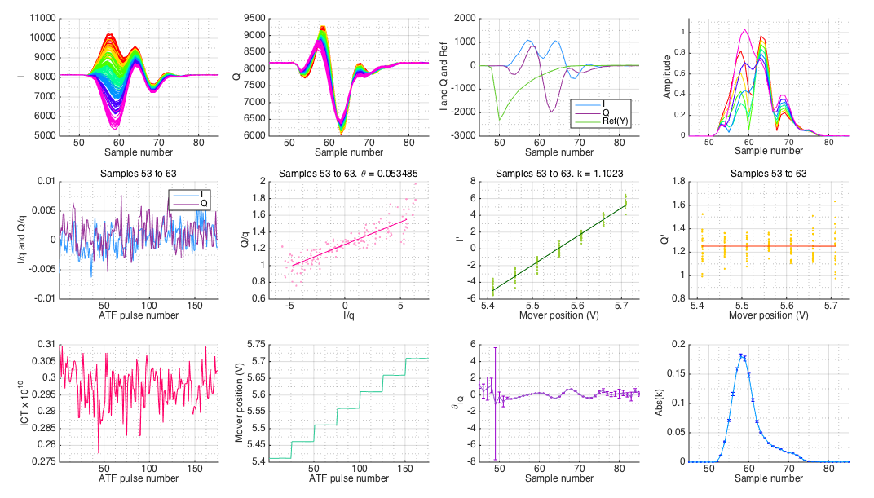
IPA calibration with C-band BPFs

Slide 15
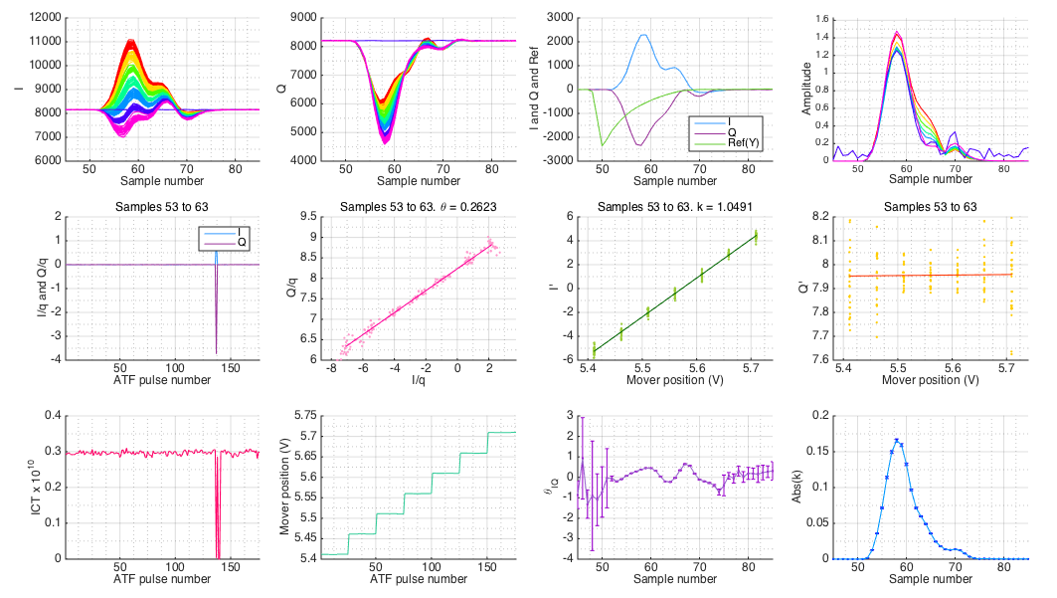
IPB calibration with C-band BPFs

Slide 16
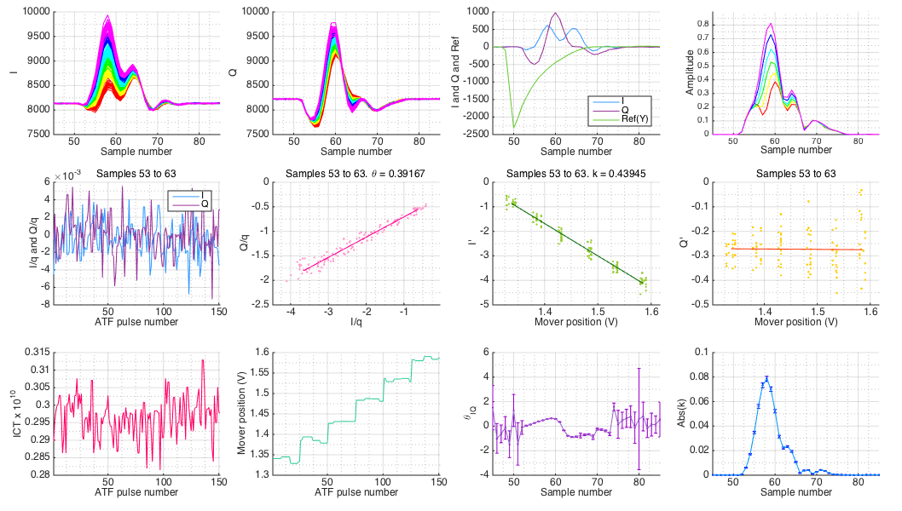
IPC calibration with C-band BPFs

