Slide 1
Phase Monitor Tests:
Output vs. input signal level
Jack Roberts

Slide 2
Overview
Taken measurements of all three sets of phase monitor electronics using a signal generator.
Aim: To identify optimal input power and better understand cross-talk between the Mixer and Diode.

Slide 3
Setup
Signal generator: Continuous 11.991 GHz output.
Phase Monitor electronics: 11.994 GHz.
    Slight frequency offset -> phase variation on output.
Mixer output was not amplified (to avoid saturating the amplifier at the higher input power levels).
Diode output is amplified (to ensure cross-talk not lost in ADC noise at lower input power levels).
Phase shift between Mixer and Diode cross-talk presumably due to amplifier latency + additional cable length.

Slide 4
Rough Schematic
PhMon Electronics
SiS
Digitisers
LO
LO
IN
MIXER
OUT
Amplifier
Signal Generator
Amplifier
RF
IN
DIODE
OUT
Power Meter

Slide 5
LO Input Levels
I have checked the power level of all the reference LO signals. Will also check levels of RF inputs coming from the beam once it is back.
Electronics 1: 20.6 dBm
Electronics 2: 21.6 dBm
Electronics 3: 23.2 dBm
NB: Input power level for the RF input on the following slides is before a ~1.6 dB cable.

Slide 6
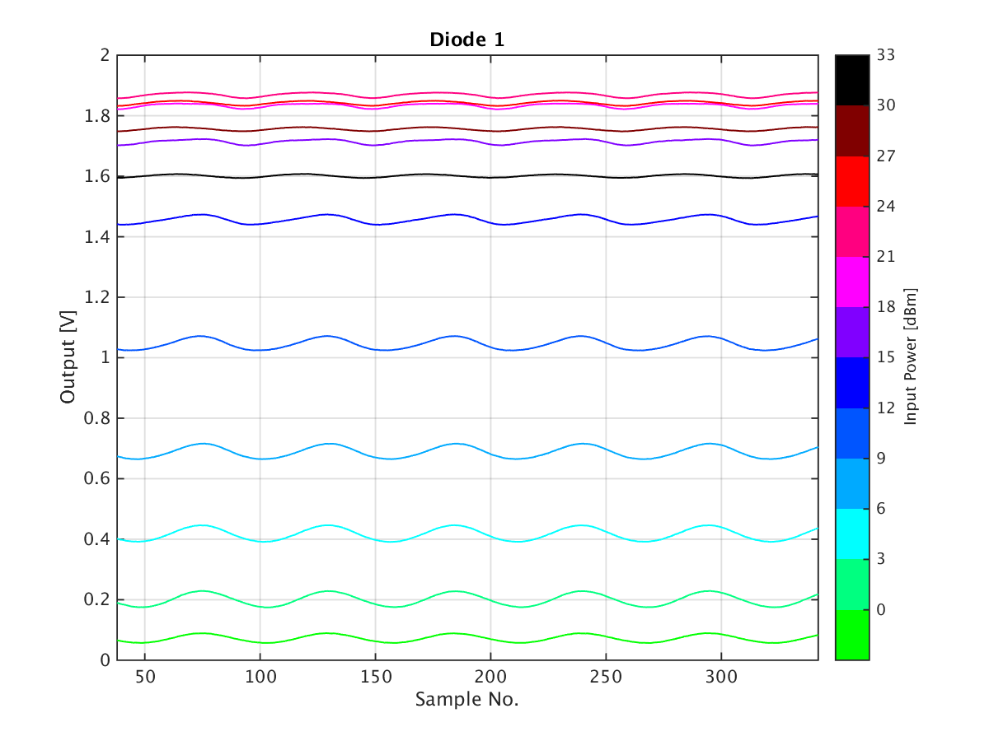
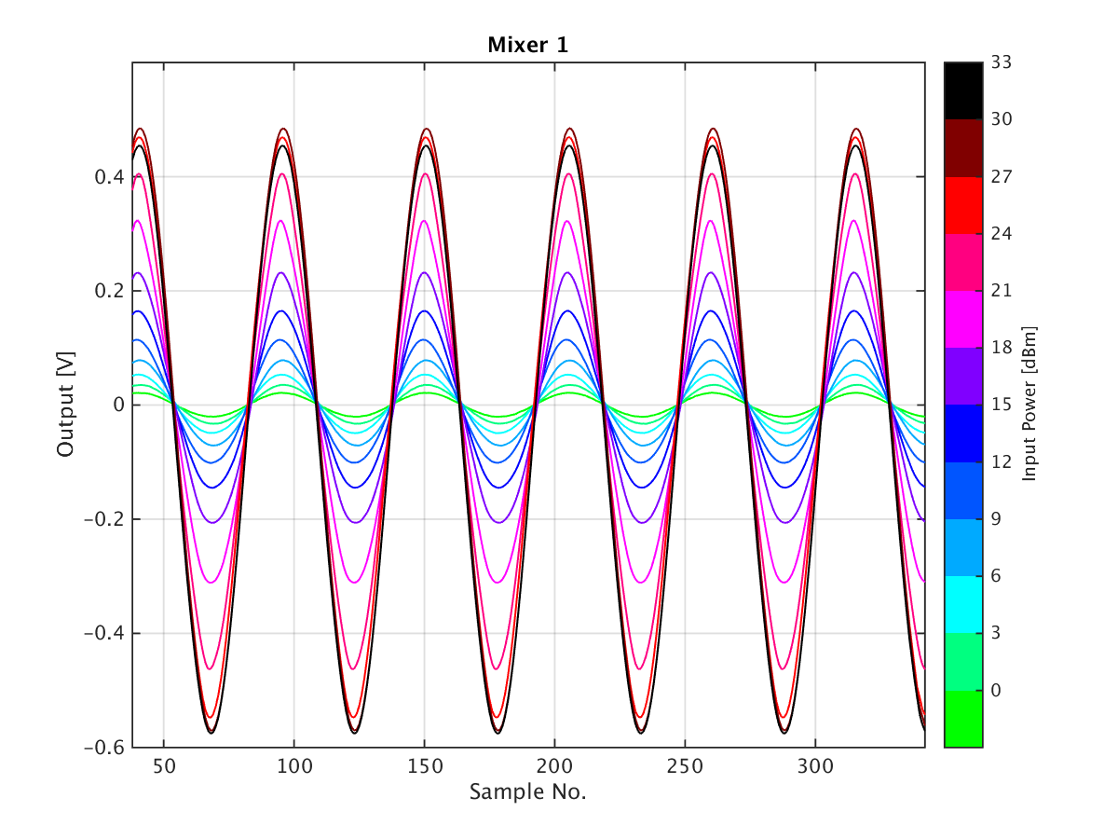
1st Set of Electronics (Upstream Mon1)
Diode output starts to decrease again above a certain input power.
Distortion of cross-talk on diode once you start to enter saturation.

Slide 7
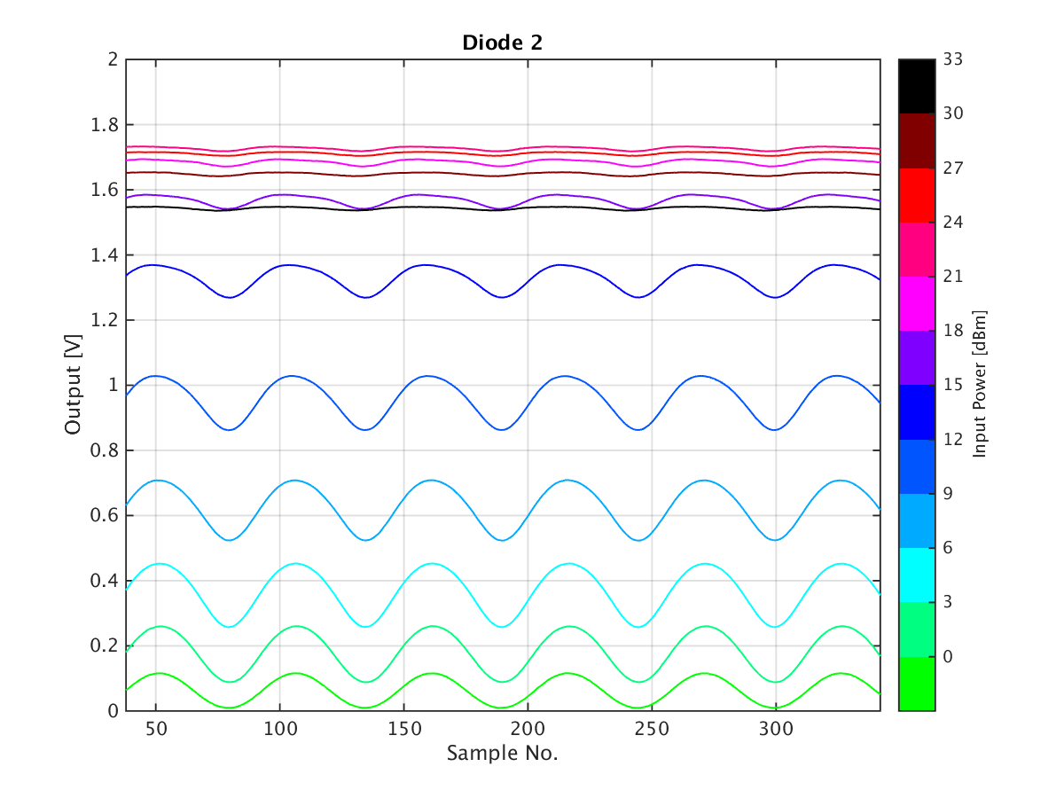
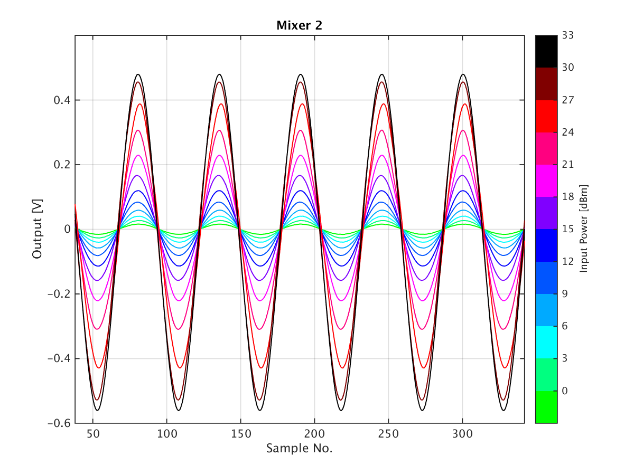
2nd Set of Electronics (Upstream Mon2)
Cross-talk on diode noticeably larger than 1st/3rd set of electronics.

Slide 8
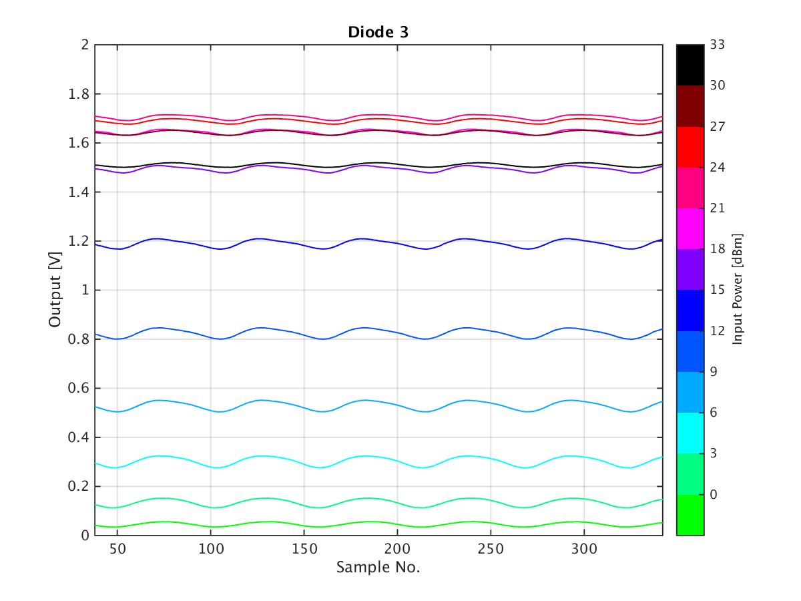
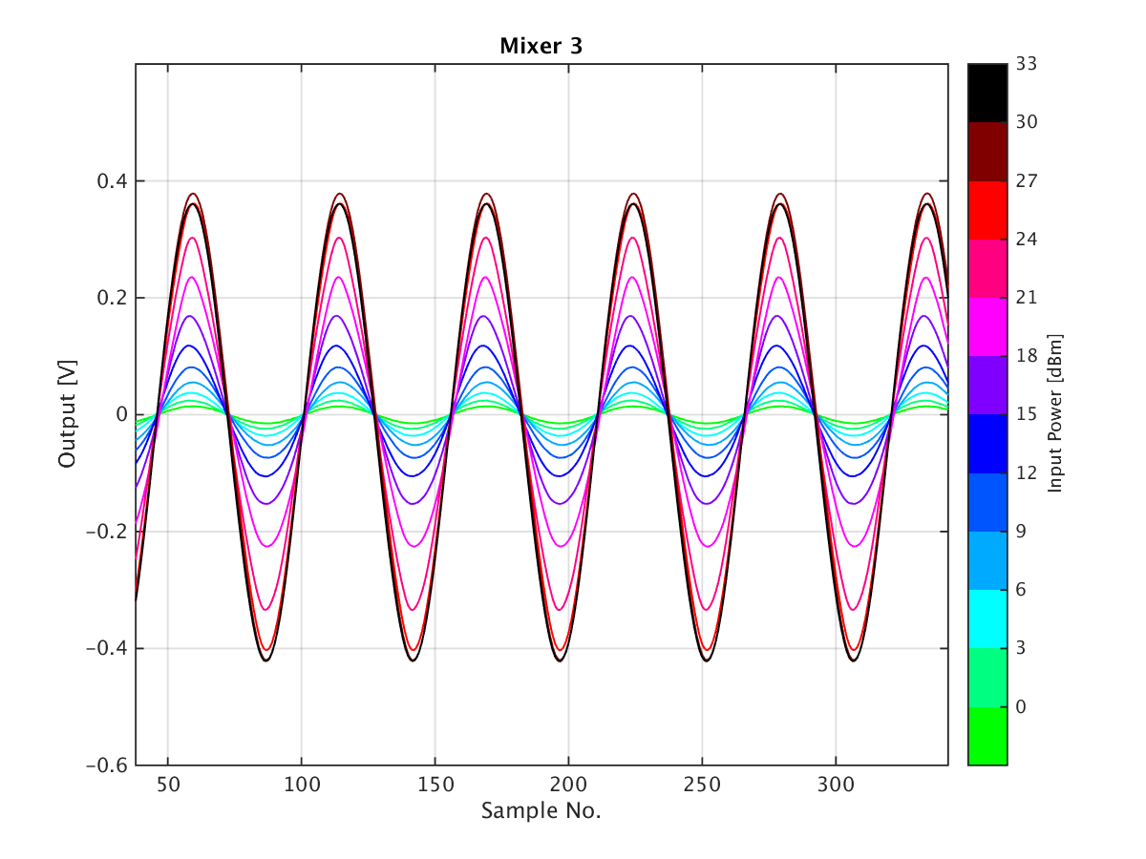
3rd Set of Electronics (Downstream Mon3)
Max mixer output lower than 1st/2nd set of electronics.

Slide 9
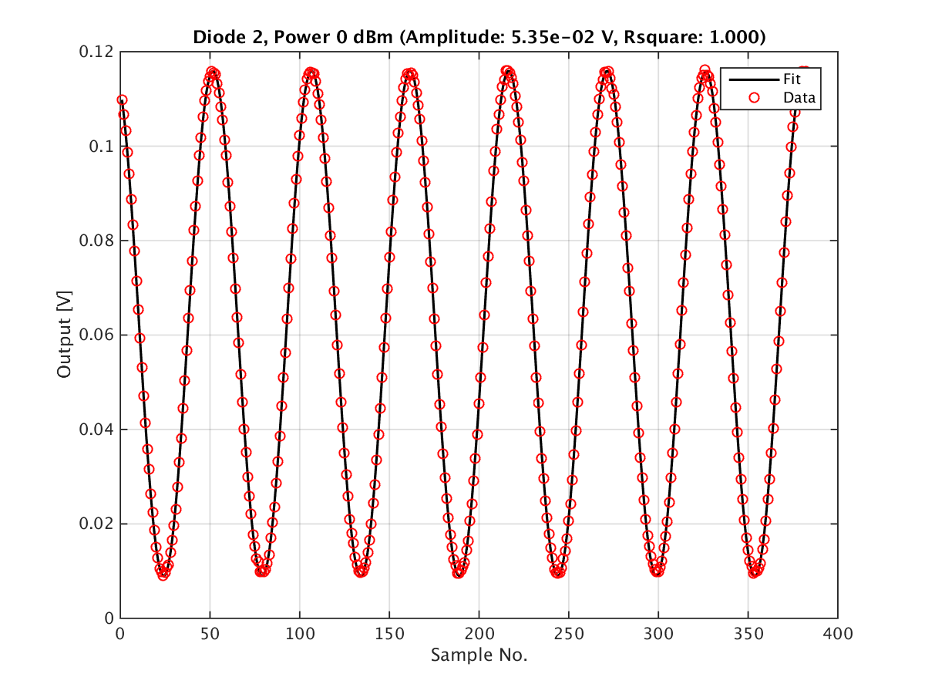
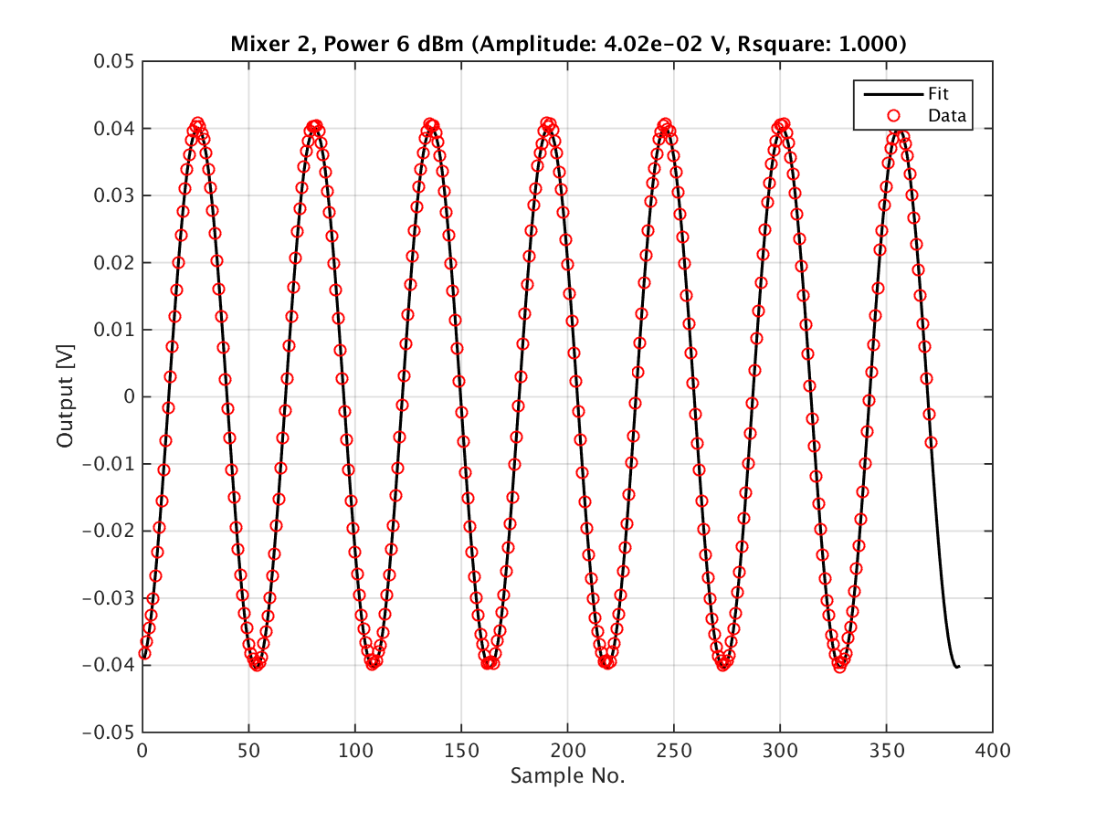
Examples of Good Fits
I have calculated the results using both fitted amplitudes and min/max output, the results are ~the same but just to show some of the fits are not great…

Slide 10
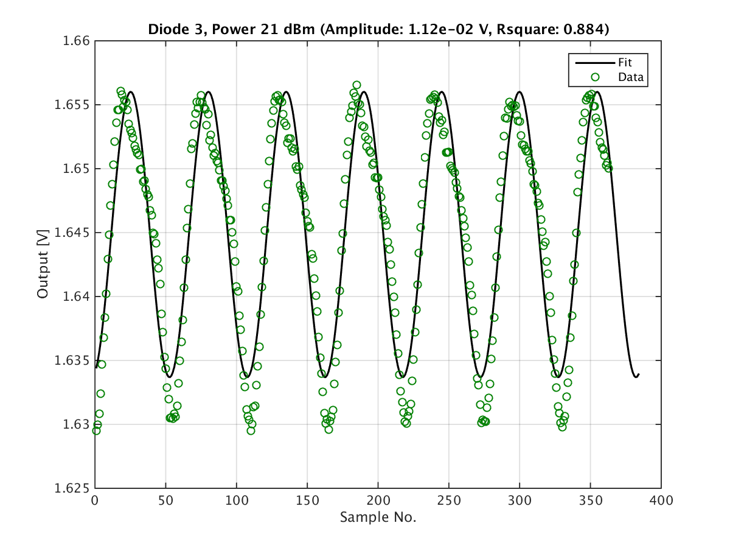
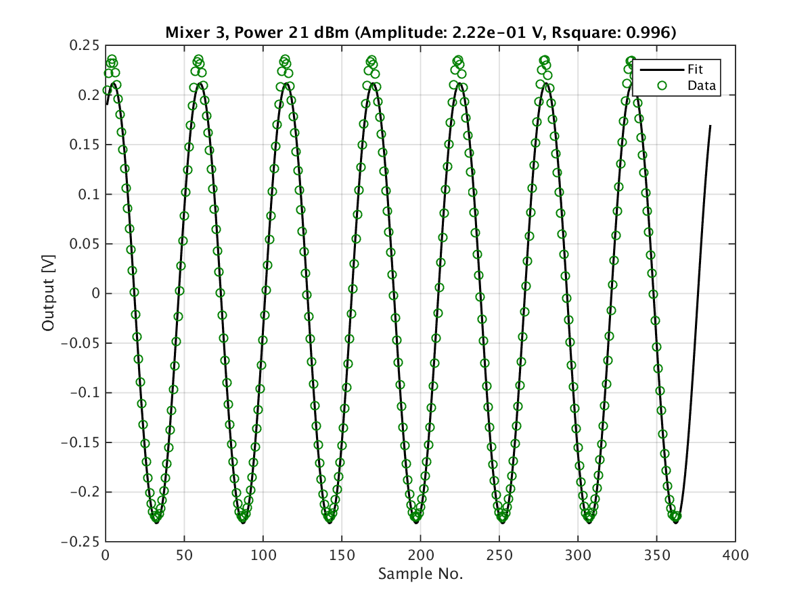
Examples of “Bad” Fits
Most of the bad fits are in the transition from no saturation to full saturation.

Slide 11
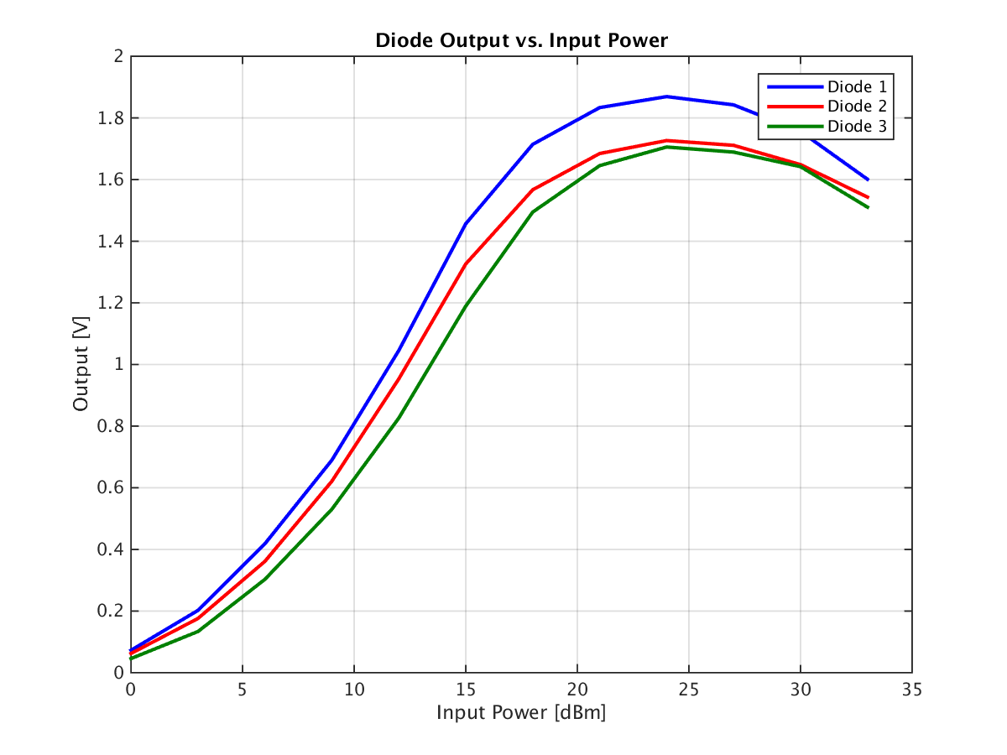
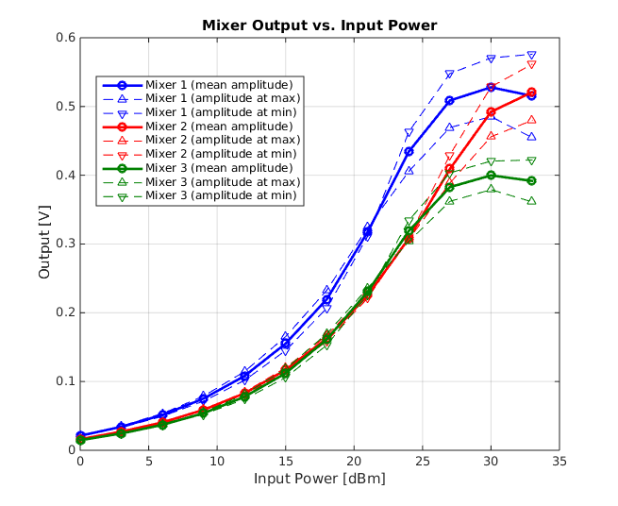
Output vs. Input Power (raw)
Diode output starts to decrease above 25 dBm.
Mixer 3 output saturates at a lower output level, but similar input power to Mixer 1.
Mixer 2 saturates later.
Cross-talk from diode on mixer clearly visible after you start to enter saturation.

Slide 12
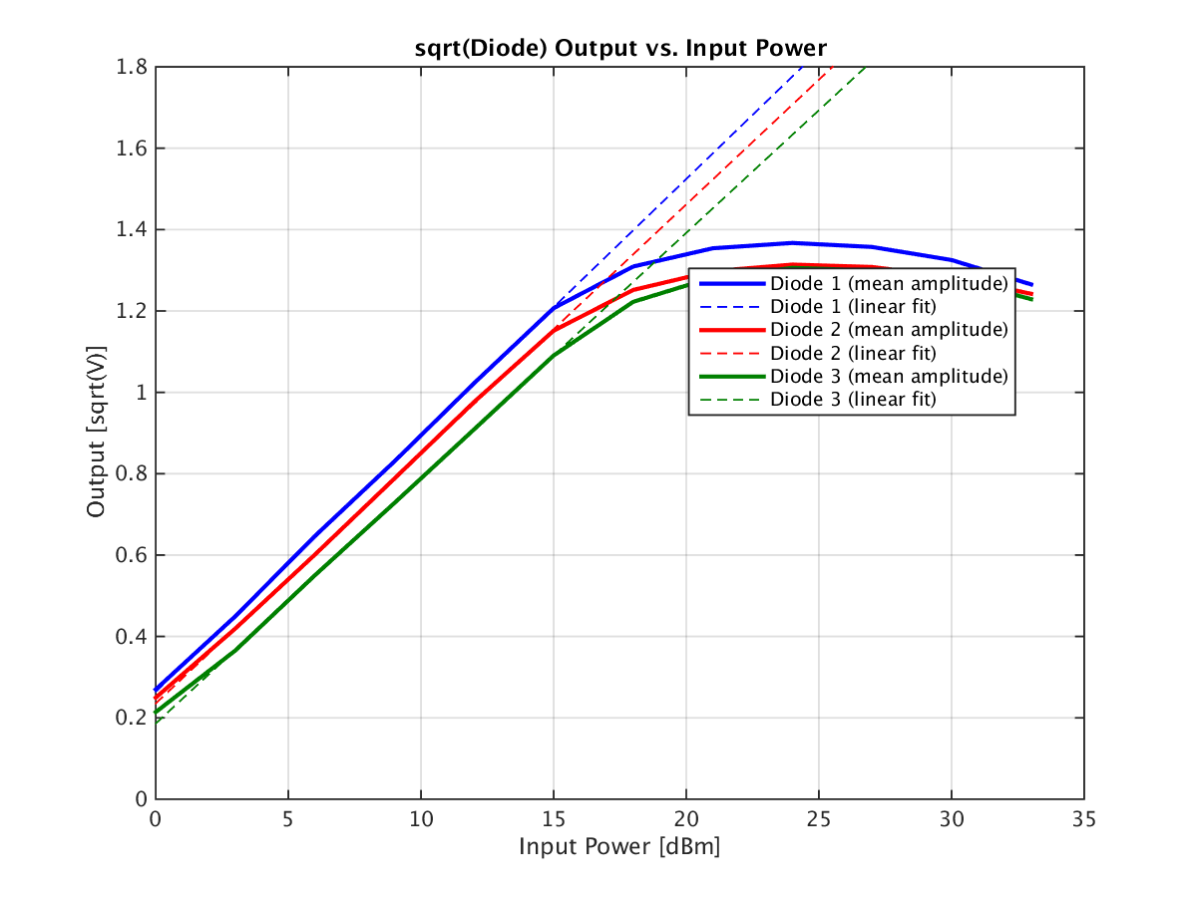
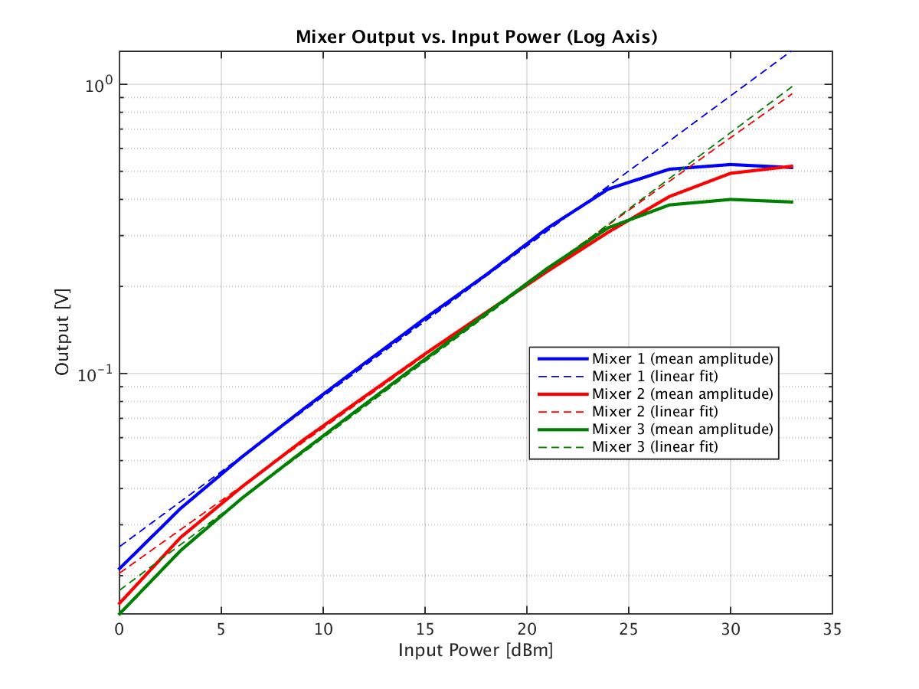
Output vs. Input Power (Linear)
sqrt(Diode) is proportional to power in dBm.
Log(Mixer amplitude) is proportional to power in dBm.

Slide 13


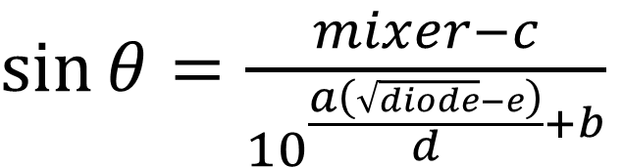


What is the correct normalisation?
If log(Mixer amplitude) is proportional to power in dBm, and sqrt(Diode) to power in dBm, surely Mixer/sqrt(Diode) isn’t the correct normalisation?
a contains power dependence (assumes constant power from beam between calibrations and along pulse)
Calibration without Diode
$$mixer=a\sin{θ}+b$$
$\sin{θ}=\frac{mixer −b}{a}$
Calibration with Diode
(assuming no cross-talk on diode)
$$\log\left(max⁡(mixer)\right)=aP+b$$
P = input power in dBm.
a, b: fitted log(Mixer amplitude) vs. P.
c: offset between mixer min/max (~0 out of saturation, has power dependence in saturation)
d, e: fitted sqrt(Diode) amplitude vs. P.
$$mixer=\max\left(mixer\right)\sin\left(θ\right)+c$$
$$\sqrt{diode}=dP+e$$
$\sin{θ}=\frac{mixer−c}{{10}^{\frac{a\left(\sqrt{diode}−e\right)}{d}+b}}$

Slide 14
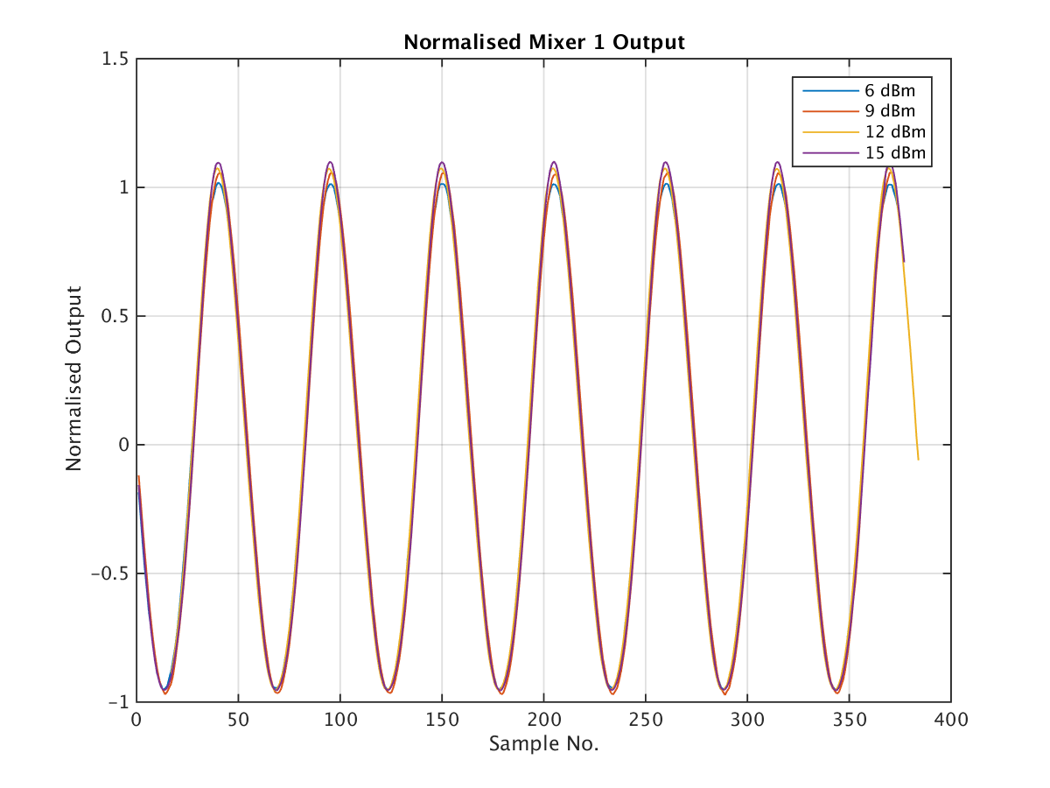
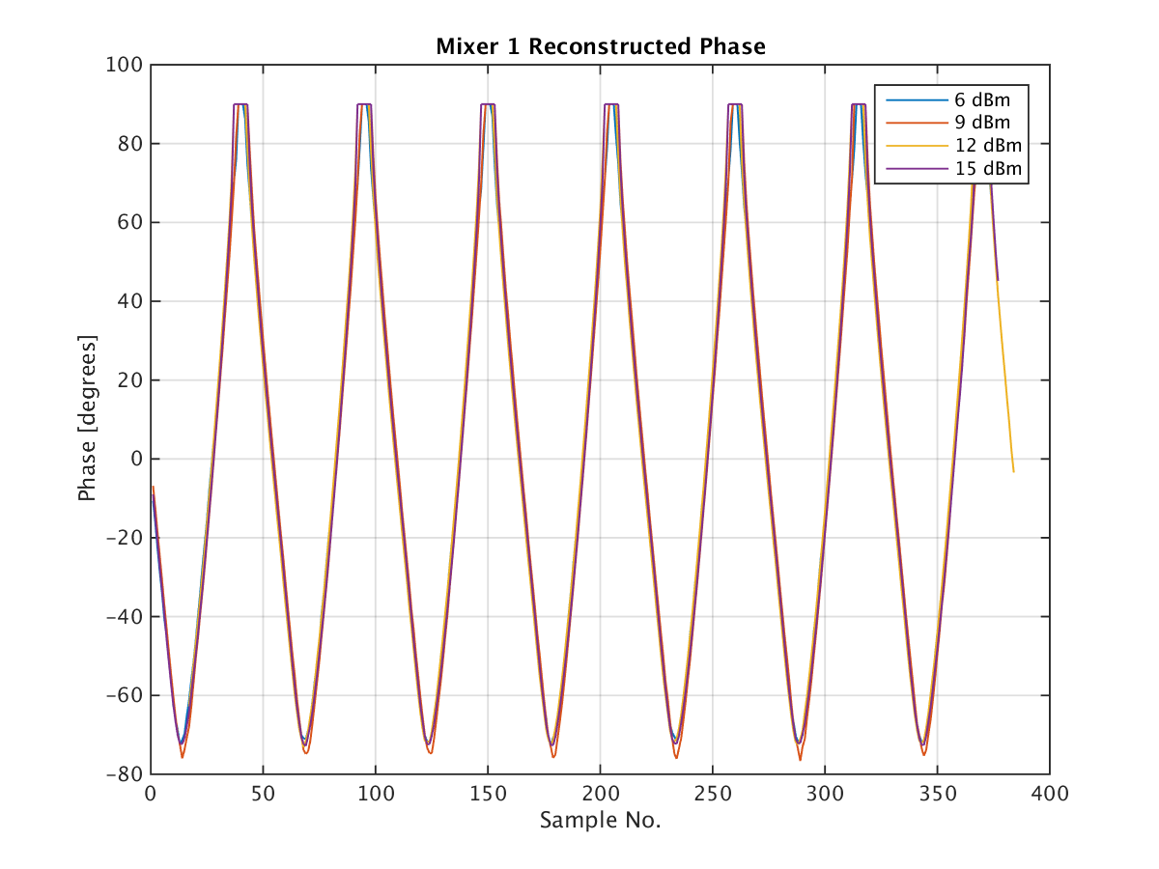
Electronics 1: Reconstructed phase: 6 dBm – 15 dbM
Works pretty well outside saturation and lowest power levels.

Slide 15
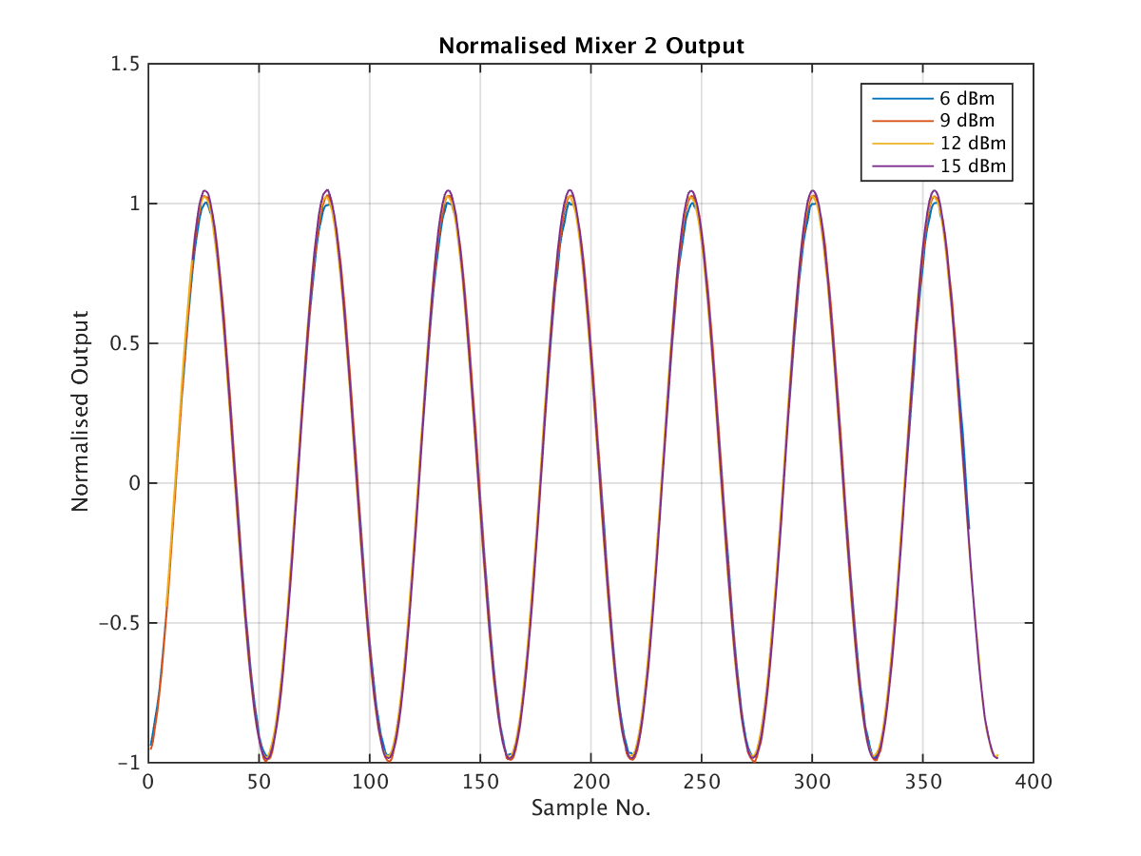
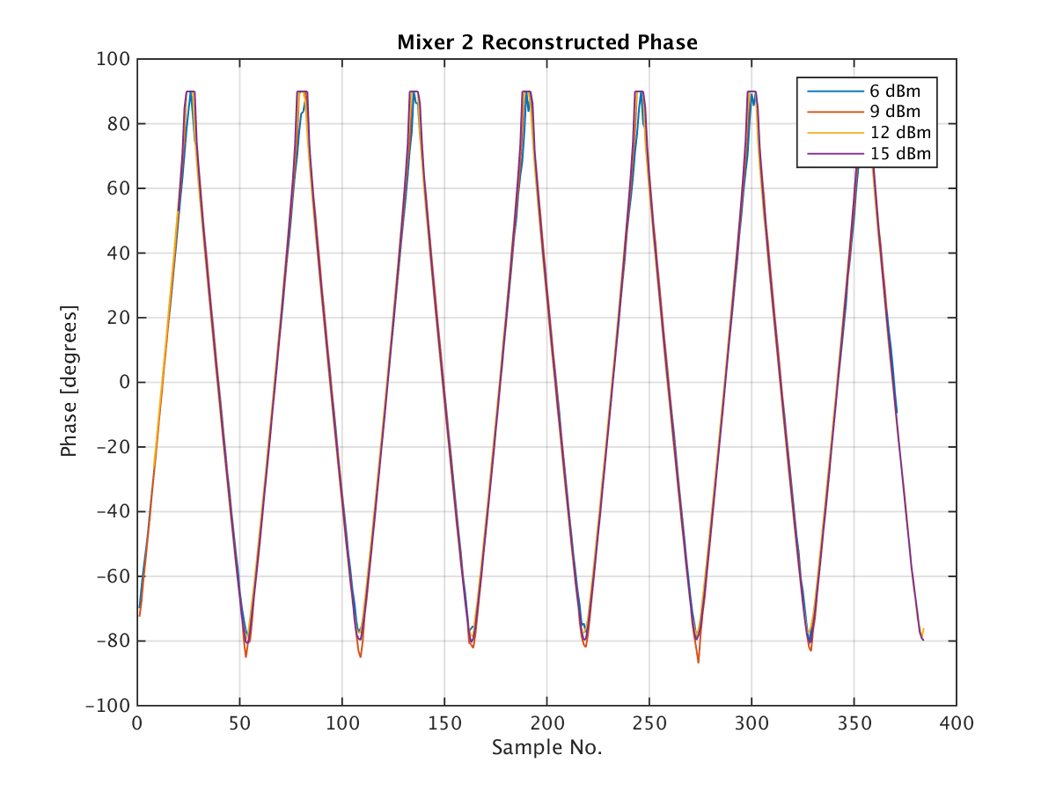
Electronics 2: Reconstructed phase: 6 dBm – 15 dbM
Works pretty well outside saturation and lowest power levels.

Slide 16
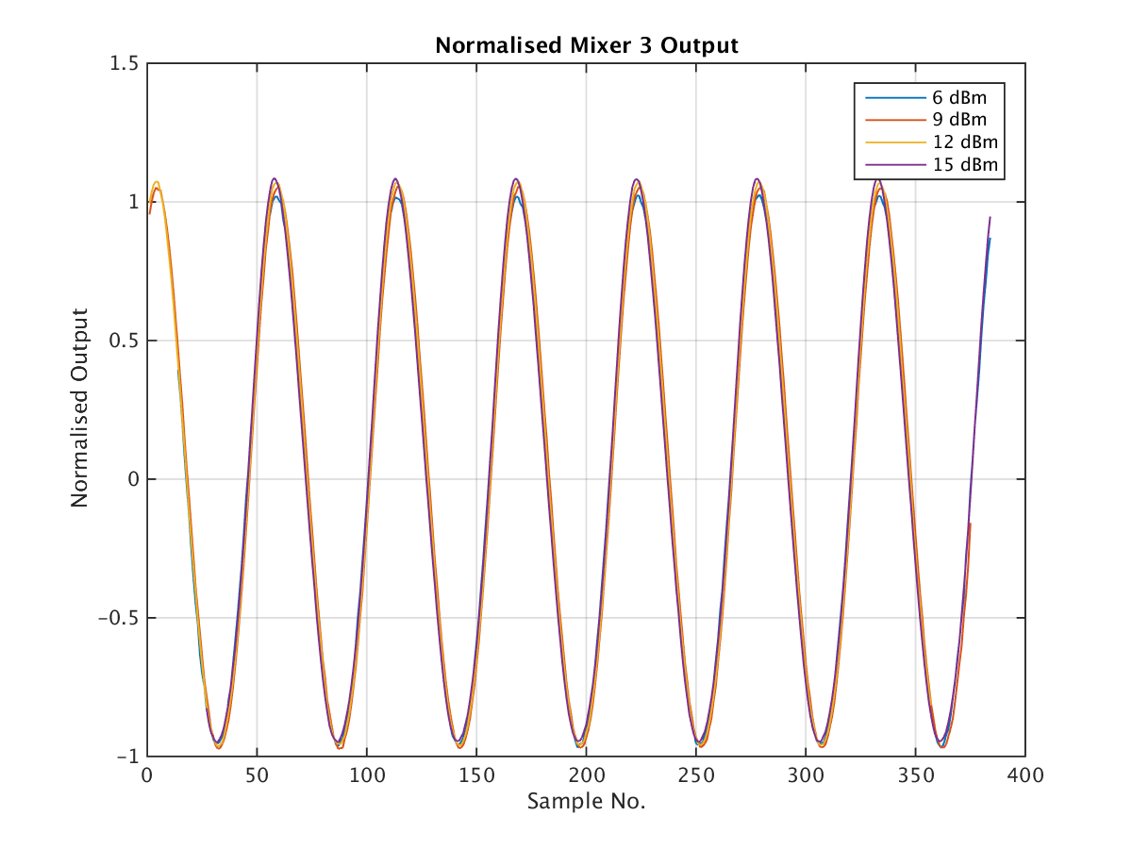
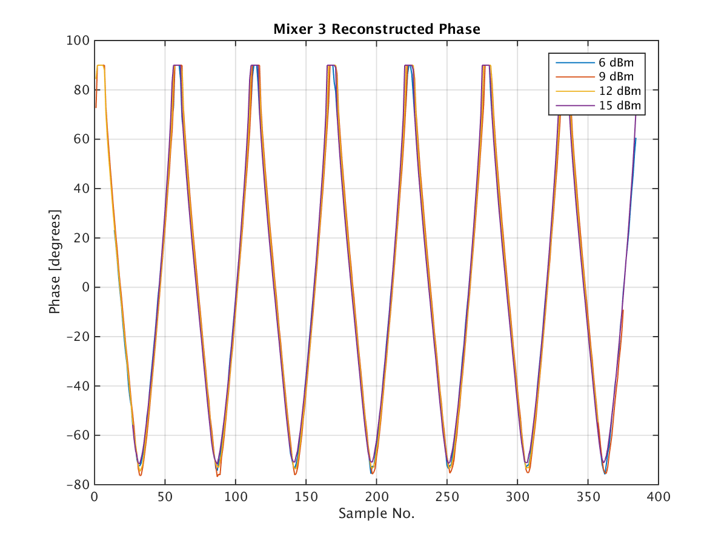
Electronics 3: Reconstructed phase: 6 dBm – 15 dbM
Works pretty well outside saturation and lowest power levels.

Slide 17
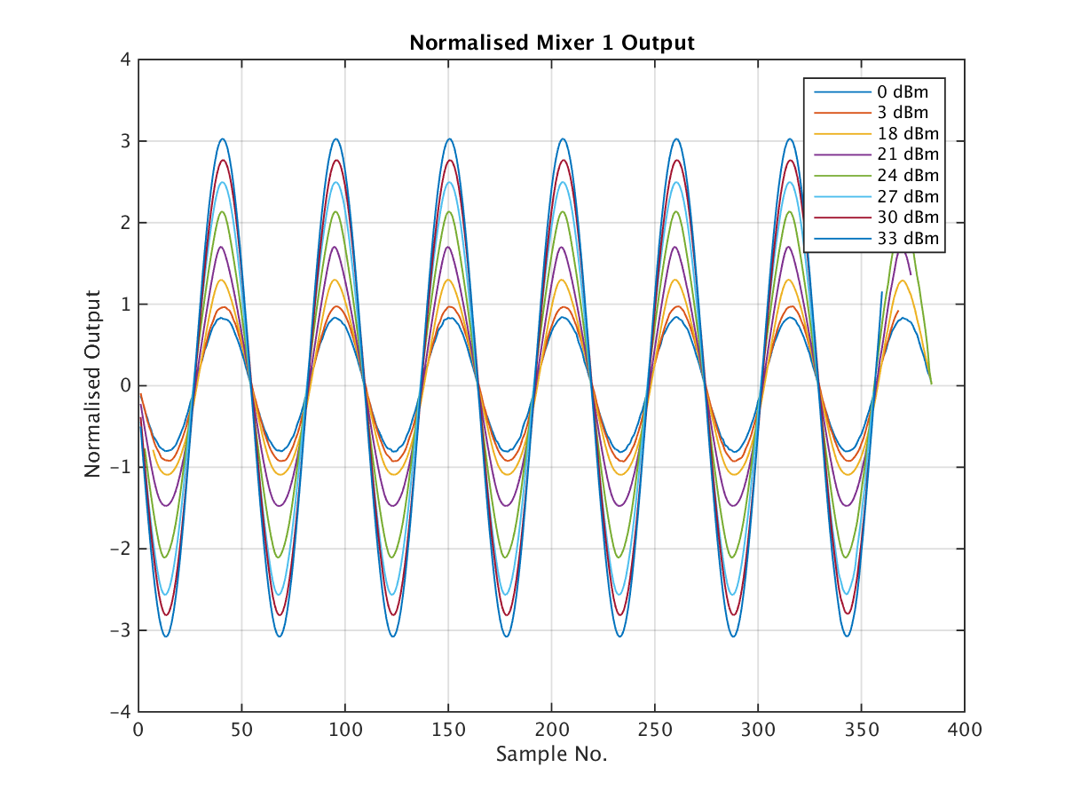
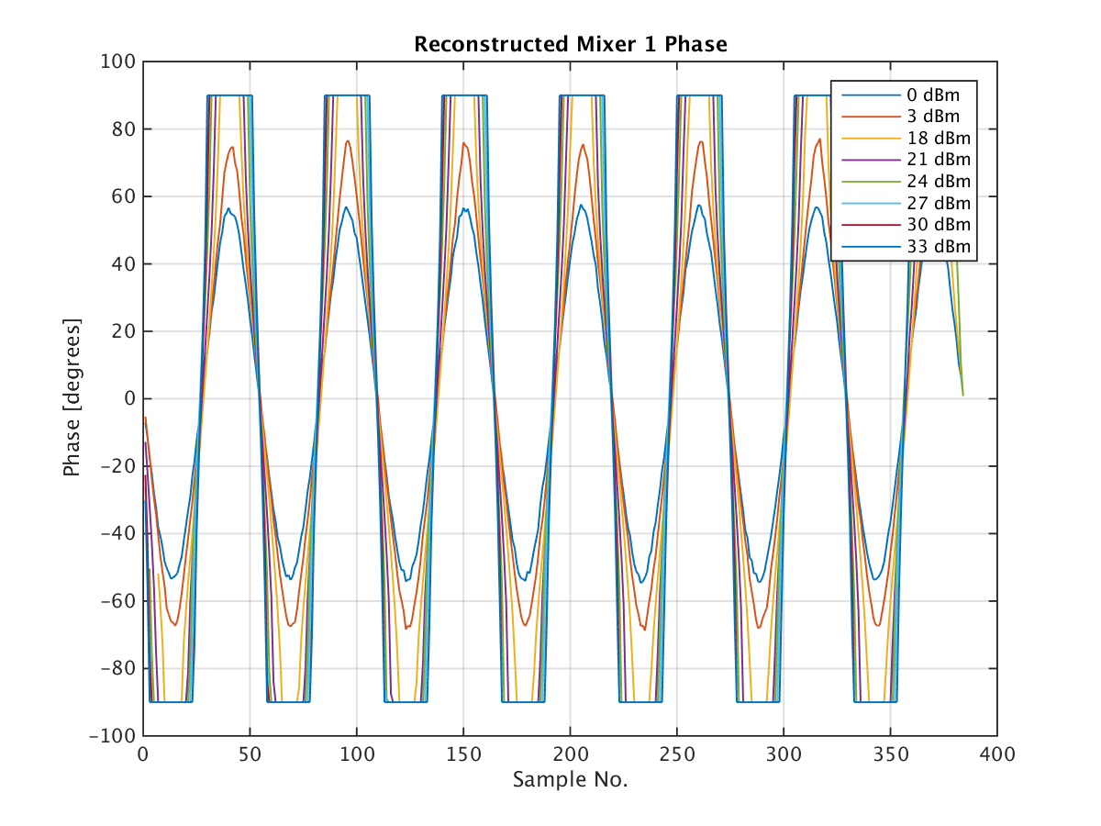
Electronics 1: Reconstructed phase: 0-3 and 18-33 dBm
Works badly in saturation and at lowest power levels.

Slide 18
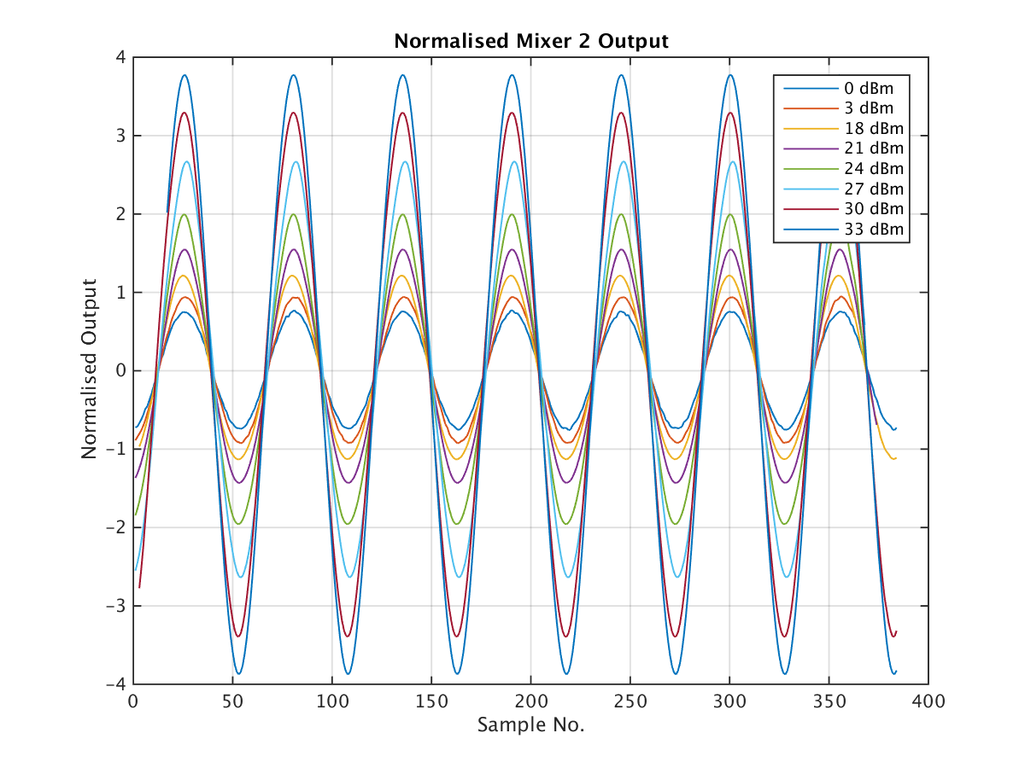
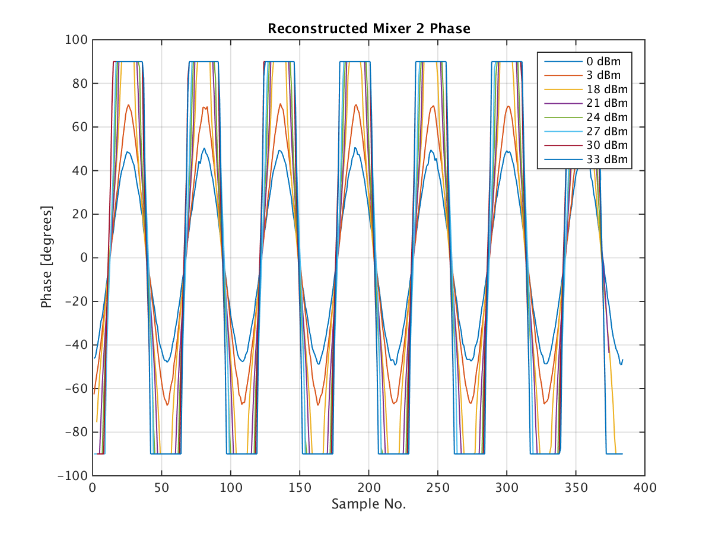
Electronics 2: Reconstructed phase: 0-3 and 18-33 dBm
Works badly in saturation and at lowest power levels.

Slide 19
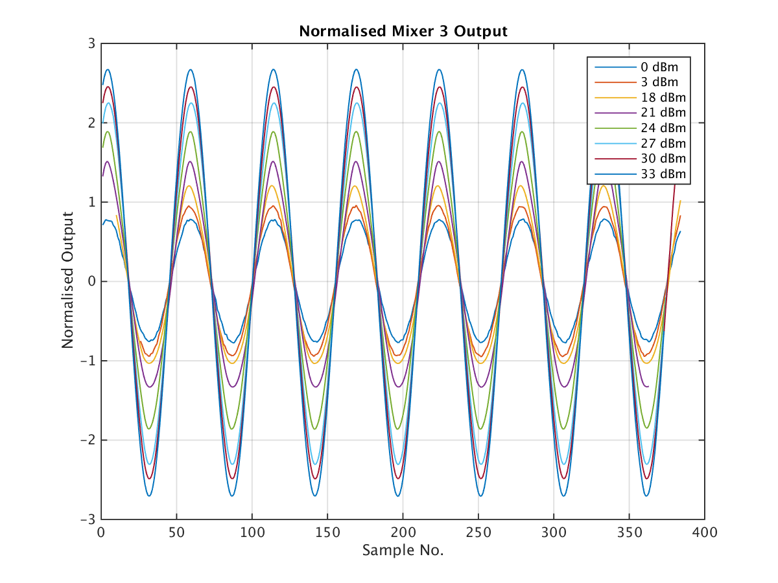
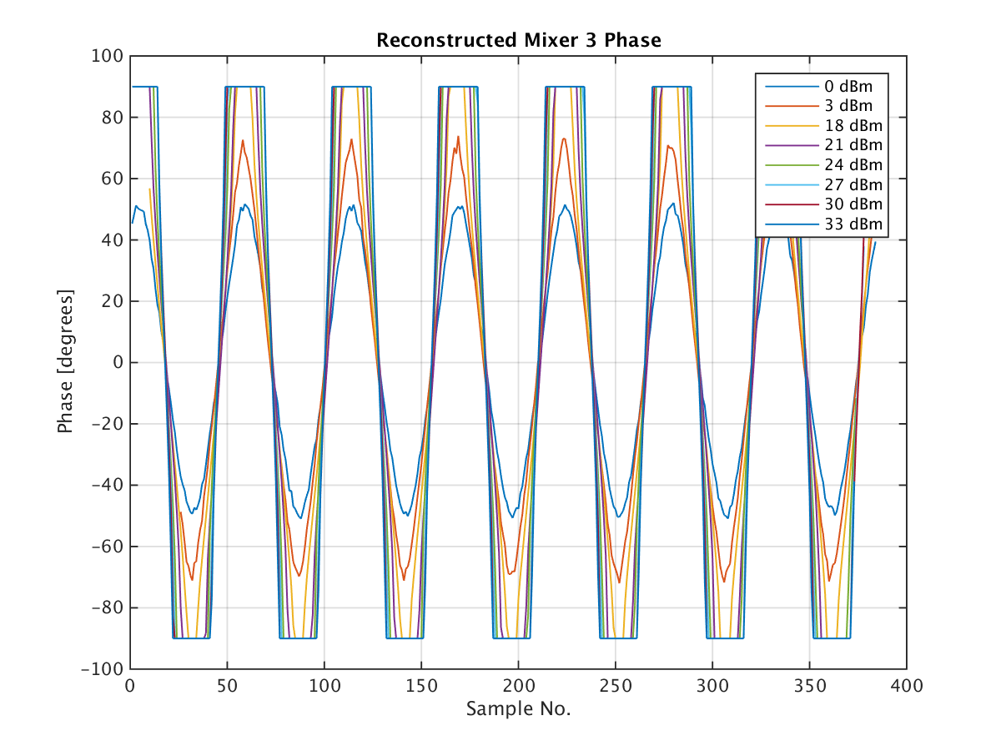
Electronics 3: Reconstructed phase: 0-3 and 18-33 dBm
Works badly in saturation and at lowest power levels.

Slide 20
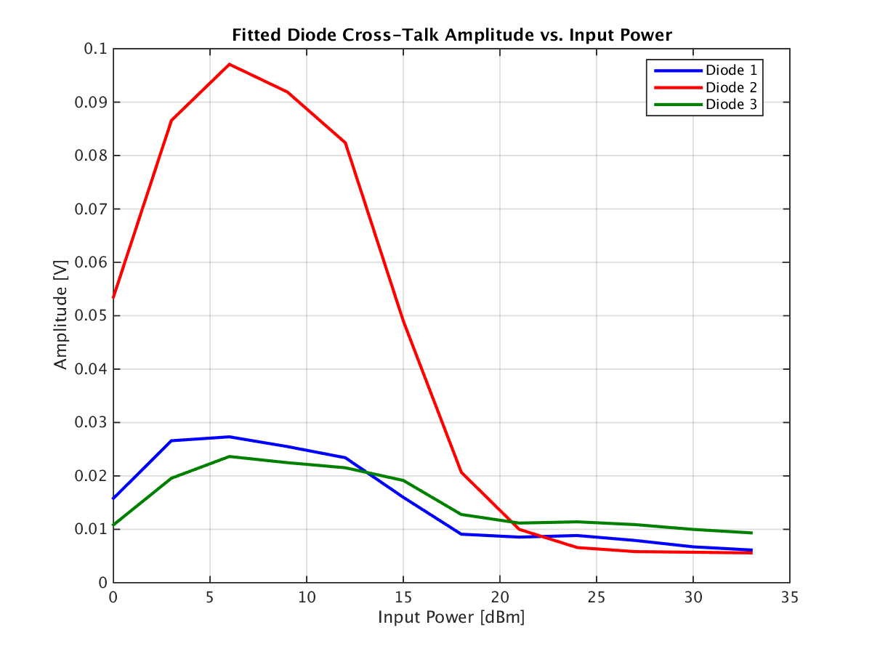
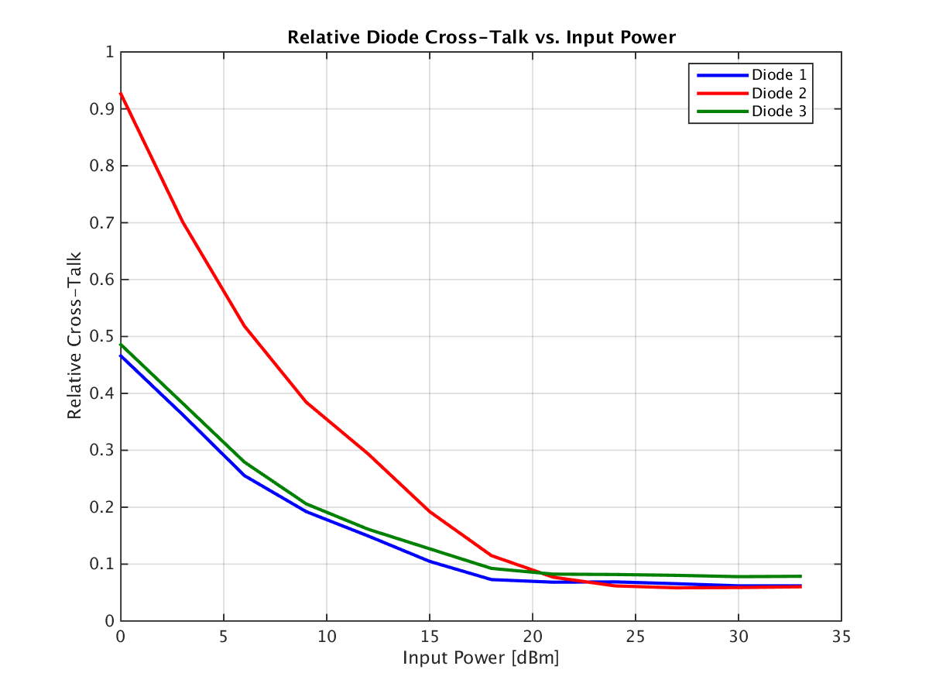
Amplitude of Cross-Talk on Diode vs. Input Power
Cross-talk much larger on 2nd set of electronics.
Even in saturation, cross-talk doesn’t reduce to 0.

Slide 21
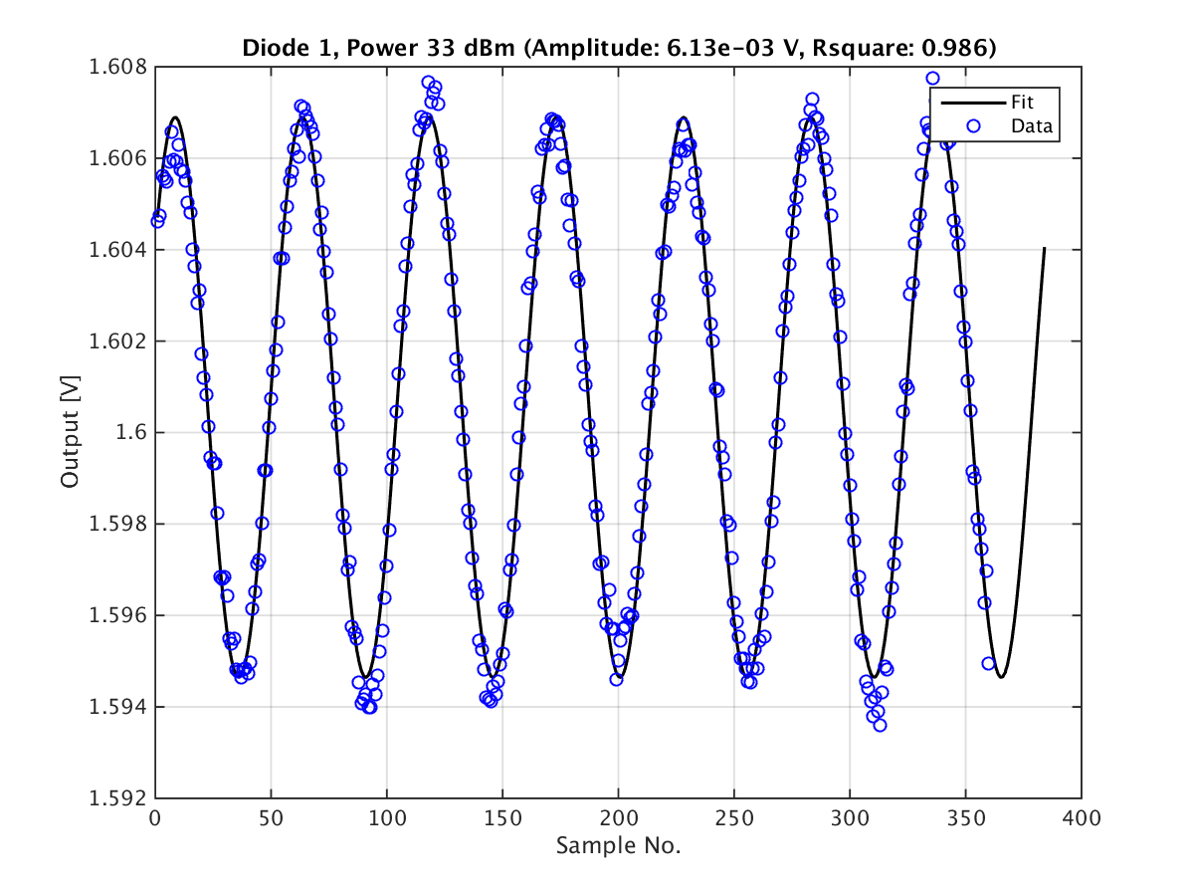
Cross-Talk Still Visible on Diode at 33 dBm
Amplitude is small but I was expecting the cross-talk to disappear completely.

Slide 22
Summary/Questions
Differences in response between sets of electronics:
  Much larger cross-talk visible on Diode 2.
  Output level in saturation much lower for Mixer 3.
What is the correct normalisation to use to reconstruct the phase?
  Log(Mixer amplitude) is proportional to Power in dBm.
  Sqrt(Diode) is proportional to Power in dBm.
Optimum input power level (assuming response is identical with beam)?
  Diodes appear to start to enter saturation at around 15 dBm.
  Mixers at around 24 dBm.
How to calibrate out the cross-talk? Is it necessary?
  I would like to put numbers on the effect on the reconstructed phase before embarking on a new, complex calibration procedure.
Is the response the same with beam as with the signal generator?
  Measurements taken before of one upstream monitor output vs. input attenuation. Can compare once verifying beam RF input power level.

