Slide 1

Top quark at Threshold at the ILC
Based on http://arxiv.org/abs/1310.0563 + A_{FB}
Analysis done by T. Horiguchi
Akimasa Ishikawa
(Tohoku University)
Talk on top quark at 500GeV to be given by Roman Poeschl.

Slide 2
Mission
We will take data at 350GeV after at 500GeV.
The mission is Precise measurements of the SM parameters by threshold scan and differential distributions, such as A_{FB}, top momentum p_{t}.
  Top mass
    In well defined mass scheme
    Important for EW vacuum instability in the SM
  Top width (or V_{tb})
    Sensitive to exotic decays/couplings
  Top Yukawa
    At the first stage of 500GeV, top Yukawa can be measured with ~38% uncertainty from ee→ttH.
    But need to understand QCD enhancement which should be given from top pair threshold ~350GeV
  Strong coupling
    Fundamental parameter
  Coupling to Z/γ
    But better at 500GeV than at 350GeV

Slide 3
Threshold Scan
Sensitive to m_{t}, Γ_{t}, y_{t} and α_{s}
Some parameters correlated : m_{t} VS α_{s} VS y_{t}
Beneke, Kiyo, Marquard, Penin, Piclum, Steinhauser 2015

Slide 4
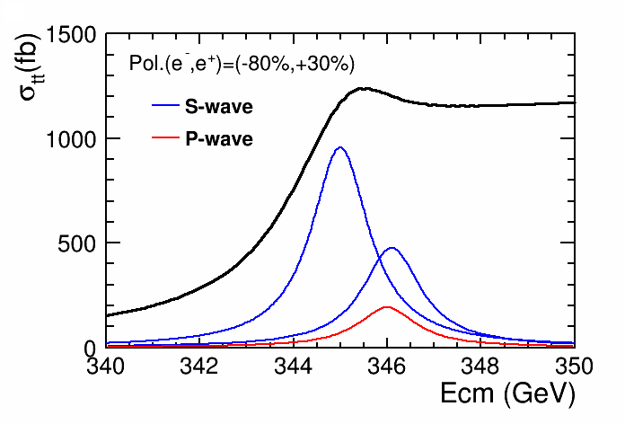
A_{FB} and top momentum
A_{FB} induced by an interference between S-wave and P-wave ttbar resonances.
  A_{FB} is sensitive to overlap of the resonances which controlled by Γ_{t}(or V_{tb}) and α_{s}
  Around 2P peak, A_{FB} is maximum
Top momentum is sensitive to the momentum space wave-function of the resonance
  <p_{t}> ~ α_{s}m_{t} (virial theorem)
  V_{tb} larger, p_{T} larger since top decay at deeper potential
  Basically, no uncertainty associated with m_{t}
Correlations of some parameters might be solved by adding measurements of A_{FB} and p_{t}

Slide 5
Theory Improvements at Threshold
Theoretical uncertainty on top quark MSbar mass at threshold is now ~50MeV !
4 loop calculation of conversion to MSbar mass
Marquard, Smirnov, Smirnov, Steinhauser 2015
NNNLO QCD + non-Resonant + EW + Higgs calculation
Beneke, Kiyo, Marquard, Penin, Piclum, Steinhauser 2015
Tomorrow, Kiyo-san will give a detailed talk on top quark.

Slide 6
Threshold Scan

Slide 7
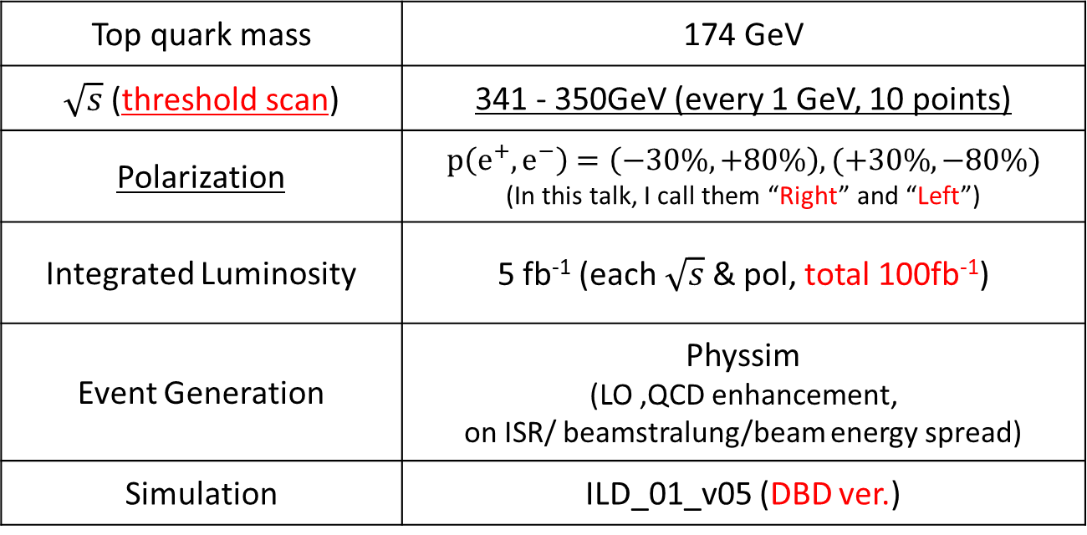
Simulation Setup for σ_{tt}
Top quark mass | 174 GeV
$\sqrt{s}$(threshold scan) | 341 - 350GeV (every 1 GeV, 10 points)
Polarization | $$p\left(e^{+}, e^{−}\right)=\left(−30\%, +80\%\right),(+30\%, −80\%)$$ (In this talk, I call them “Right” and “Left”)
Integrated Luminosity | 5 fb⁻¹ (each $\sqrt{s}$ & pol, total 100fb⁻¹)
Event Generation | Physsim (LO ,QCD enhancement, on ISR/ beamstralung/beam energy spread)
Simulation | ILD_01_v05 (DBD ver.)

Slide 8
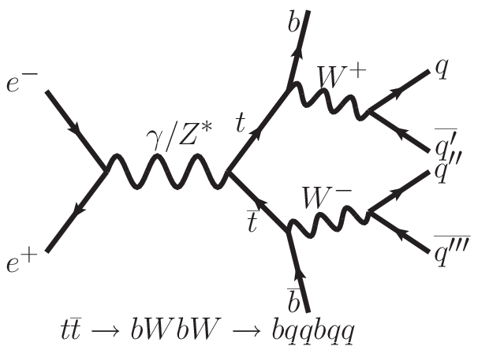
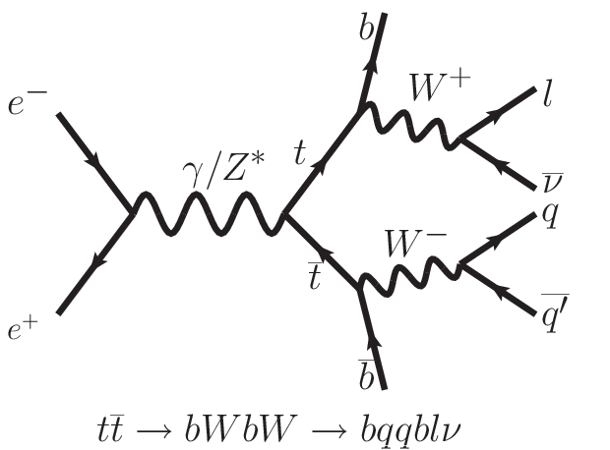
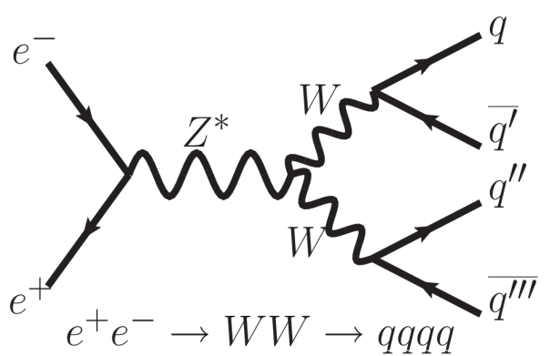
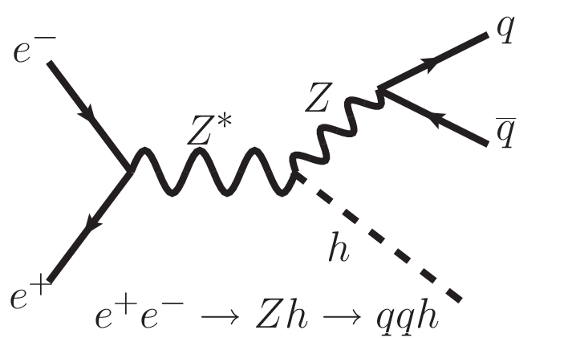
Signal and Backgrounds
6-Jet
4-Jet
Signal
background
SM bkg. which have 4 or 6 fermions in final state Main bkg.：WW, ZZ, ZH
Branching Ratio
6-Jet | 45%
4-Jet | 44%
2-Jet | 11%
e⁺e⁻ → tbW not included

Slide 9
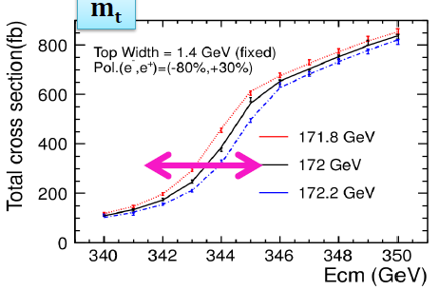
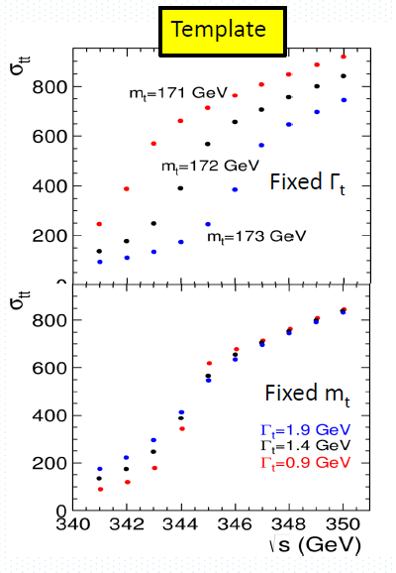
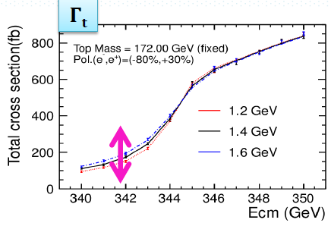
Fitting with templates
fit to σ_{tt} with template to extract three variables, m_{t}, Γ_{t} and y_{t} simultaneously.
  Two dimensional template (m_{t}, Γ_{t})
  y_{t} from normalization
  α_{s} is fixed at 0.12
Template is made from
  Theoretical σ_{tt}(s) from Y. Kiyo-san (NLO calc)
  Efficiency from Physsim (LO) and DBD setup
Should be updated to NNNLO calc.

Slide 10
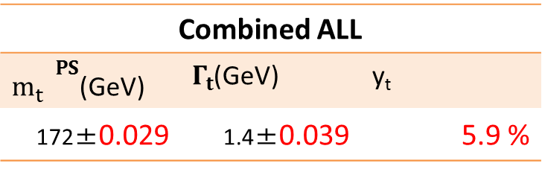
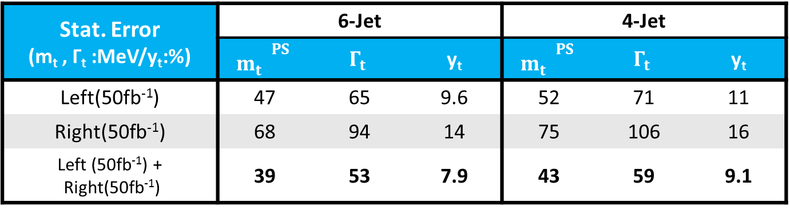
Results
Stat. Error (m_{t} , Γ_{t} :MeV/y_{t}:%) | 6-Jet |  |  | 4-Jet
 | $${m_{t}^{}}^{PS}$$ | $$Γ_{t}$$ | y_{t} | $${m_{t}^{}}^{PS}$$ | $$Γ_{t}$$ | y_{t}
Left(50fb⁻¹) | 47 | 65 | 9.6 | 52 | 71 | 11
Right(50fb⁻¹) | 68 | 94 | 14 | 75 | 106 | 16
Left (50fb⁻¹) + Right(50fb⁻¹) | 39 | 53 | 7.9 | 43 | 59 | 9.1
y_{t} uncertainty from theory (error on total cross section ~4%) is 22%
  Assuming flat error VS E_{CM}
Uncertainty from luminosity spectrum to be estimated.
If 200fb⁻¹ data is accumulate (H20 run scenario), errors can reduced by factor √2
Combined ALL
${m_{t}^{}}^{PS}$(GeV) | $Γ_{t}$(GeV) | y_{t}
172±0.029 | 1.4±0.039 | 5.9 %

Slide 11
Comparison with (2+1) and 3
(2+1) par fit : m_{t} and Γ_{t} simultaneously. y_{t} from normalization
3 par fit : all simultaneously
Mt worse than (2+1) fit but simultaneous fit should give correct error matrix
error | (2 + 1) param fit | 3 param fit
m_{t} | 19 MeV | 29 MeV
Γ_{t} | 38 MeV | 39 MeV
y_{t} | 4.6% | 5.9%
2 par fit
Correlation | (2 + 1) param fit | 3 param fit
m_{t} vs Γ_{t} | 0.52 | 0.57
m_{t} vs y_{t} | - | 0.72
Γ_{t} vs y_{t} | - | 0.33

Slide 12
A_{FB}

Slide 13
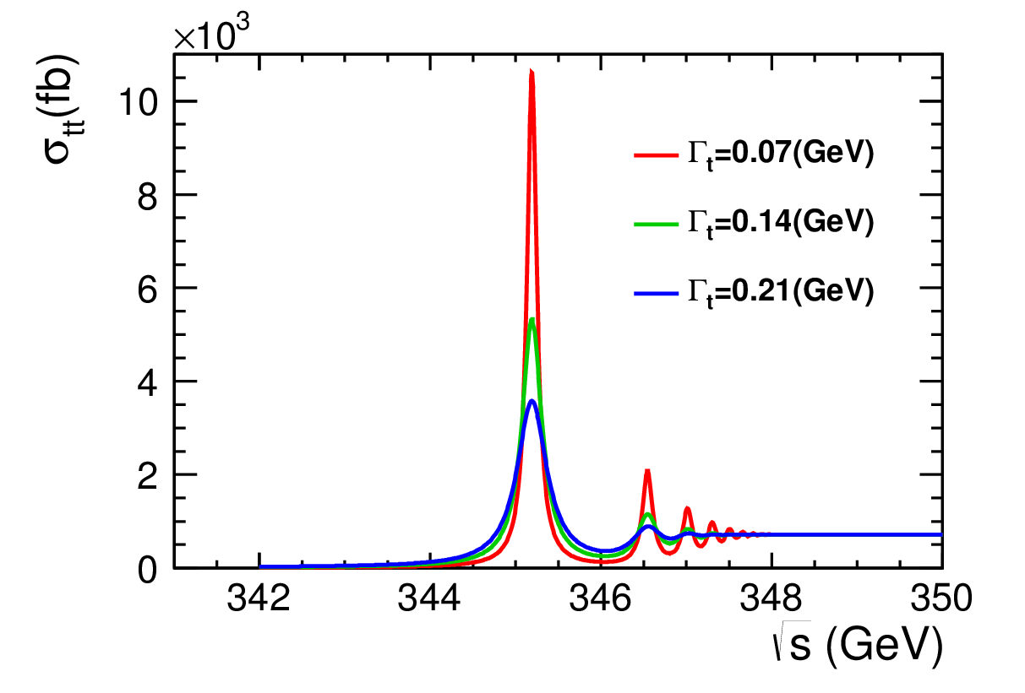
Forward-Backward Asymmetry
From S and P waves interference, A_{FB} is generated at threshold which is sensitive to Γ_{t} and α_{s} which control the overlap of S and P waves.
To identify the charge, 4jets+lepton mode is used.
We choose the √s=346GeV which gives the maximum interference
Interference of S- and P-wave
σ_{tt} when Γ_{t} is very small
Γ_{t}=1.4GeV

Slide 14
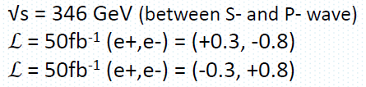
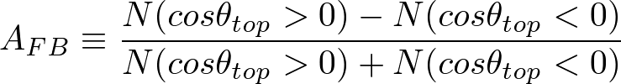
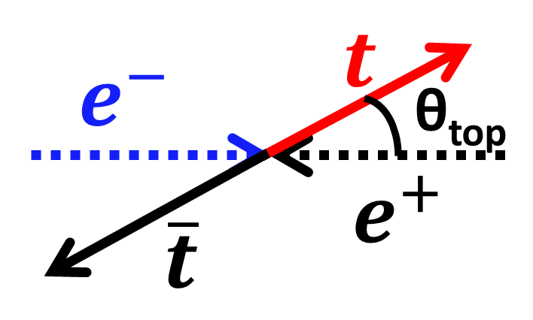
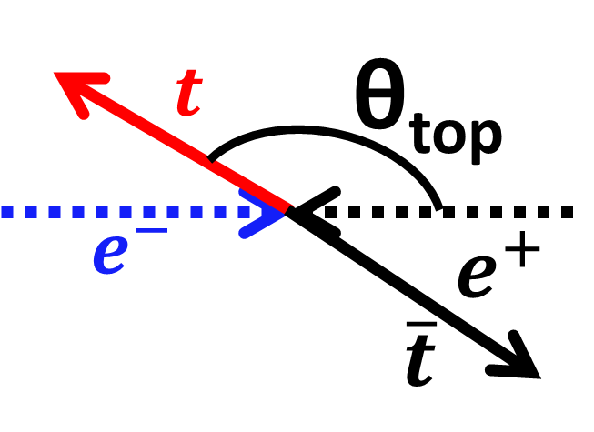
Setup
Forward
Backward

Slide 15
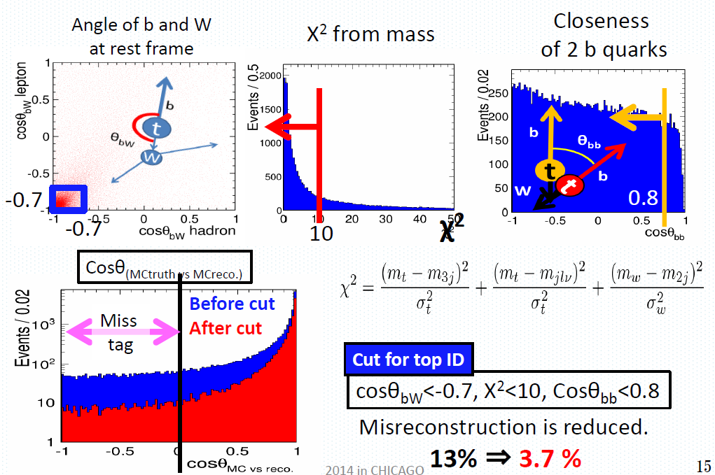
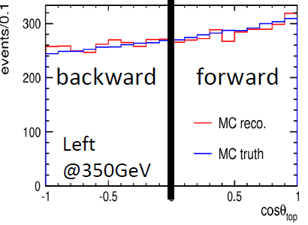
Reconstruction
To get correct combination, several selections are applied.
38% efficiency
Angle distribution after the selections.

Slide 16
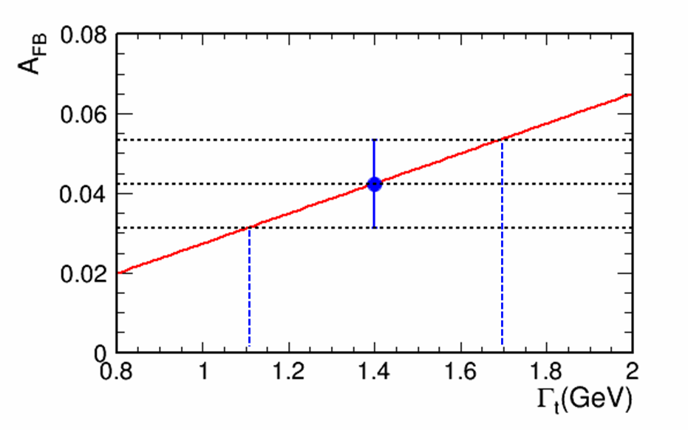
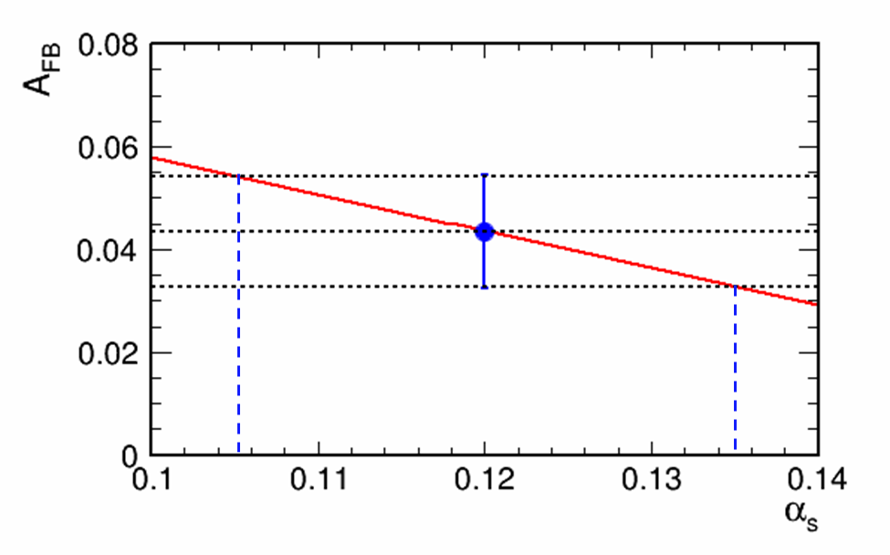
Results
From the 1σ error of A_{FB}, we estimated statistical errors of Γt and αs.
  δΓ_{t} = 290 MeV
  δα_{s} = 0.015
Input A_{FB}= 0.0427
50 fb⁻¹ | # of events (NNLO) | δA_{FB}
Left handed | 5537 | 0.013
Right handed | 2564 | 0.020
Left + Right (100 fb⁻¹) | 8101 | 0.011
A_{FB} VS Γ_{t}
A_{FB} VS α_{s}
Theoretical line
Theoretical line

Slide 17
Summary
Theory on ttbar threshold is greatly improved
  Now uncertainty on top MSbar mass is ~50MeV
Statistical uncertainty of m_{t}, Γ_{t} and yτ from threshold scan with 100fb⁻¹
  δm_{t} = 29MeV
  δΓ_{t} = 39MeV
  δy_{t} = 5.9%
Measure A_{FB} to extract α_{s} and Γ_{t}
  δΓ_{t} = 290MeV
  δα_{s} = 0.015 (13%, not so sensitive, PDG 1.6%)

Slide 18
Plan (or Study Items)
Top momentum and luminosity spectrum studies by Ozawa(Tohoku)
  Luminosity spectrum is common topic for Higgs recoil analysis in ee→ZH
Use newly calculated theory σ(√s) and its uncertainty for threshold scan
Complete systematic studies
  Luminosity spectrum
  Beam energy
  Reconstruction efficiency
  NNNLO QCD
  Conversion to MSbar
  Scale uncertainty
Combination of threshold scan and A_{FB} and p_{t} to extract fundamental four parameters : m_{t}, Γ_{t}, y_{t} and α
Determine the best threshold scan scenario with 200fb⁻¹ (H20)
Study of EW couplings at 500GeV by Sato (Tohoku)

