Slide 1
Single Seed Run of PLACET in the CLIC FFS
Code From Jochem Snuverink
Ryan Bodenstein
FONT Meeting
2015/08/21

Slide 2
Two meetings with Jochem
  (Re)installation, sharing of scripts
  Description of code basics
Code shared is correction scheme for the Final Focus System (FFS) in CLIC
  7 steps to this correction scheme
    No correction (just misaligned beamline)
    One-to-one correction AKA 1-2-1 (adjust each component)
    Dispersion Free Steering (DFS)
    Knob adjustment
    DFS again
    Multi-align (turned off)
    Further knob adjustment

Slide 3
After some adjustment of the code, was able to run for a single seed
  One seed on the interactive machine took over 26 hours
  As written, only records the final product, not the results at every step (except luminosity)
  This code is for single-beam tuning. It shows the beam at the IP just prior to collision, but does not include post-collision results.
    Single-beam tuning uses electrons, and the positrons are treated identically, so the results are the same.

Slide 4
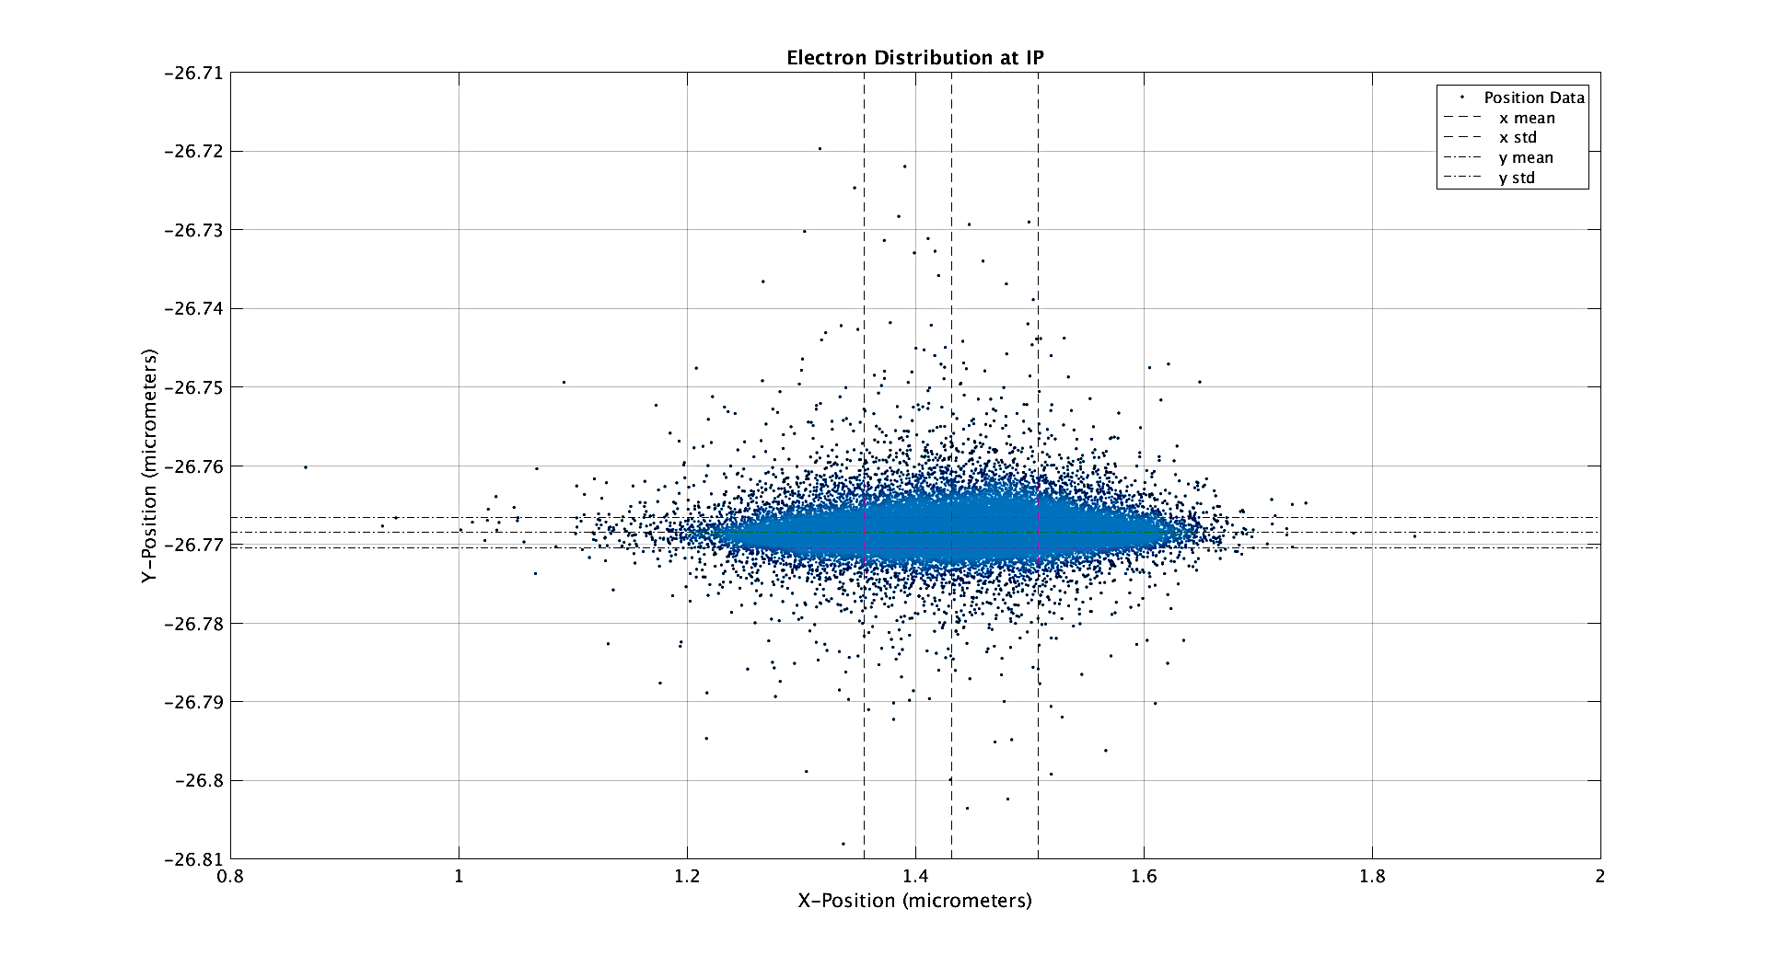

Slide 5
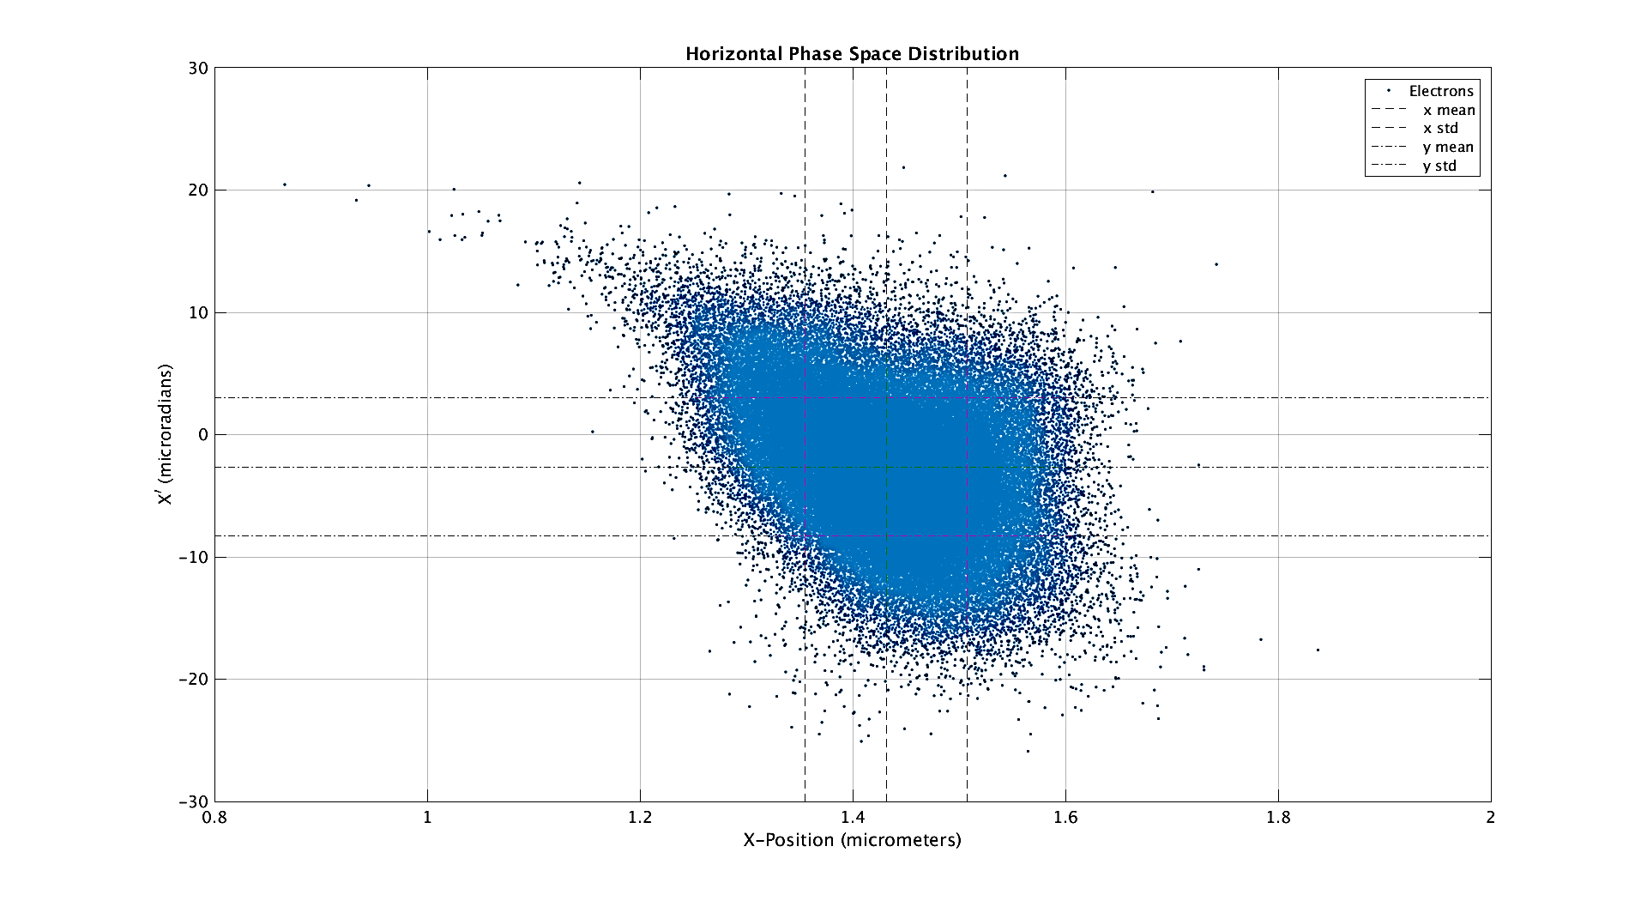

Slide 6
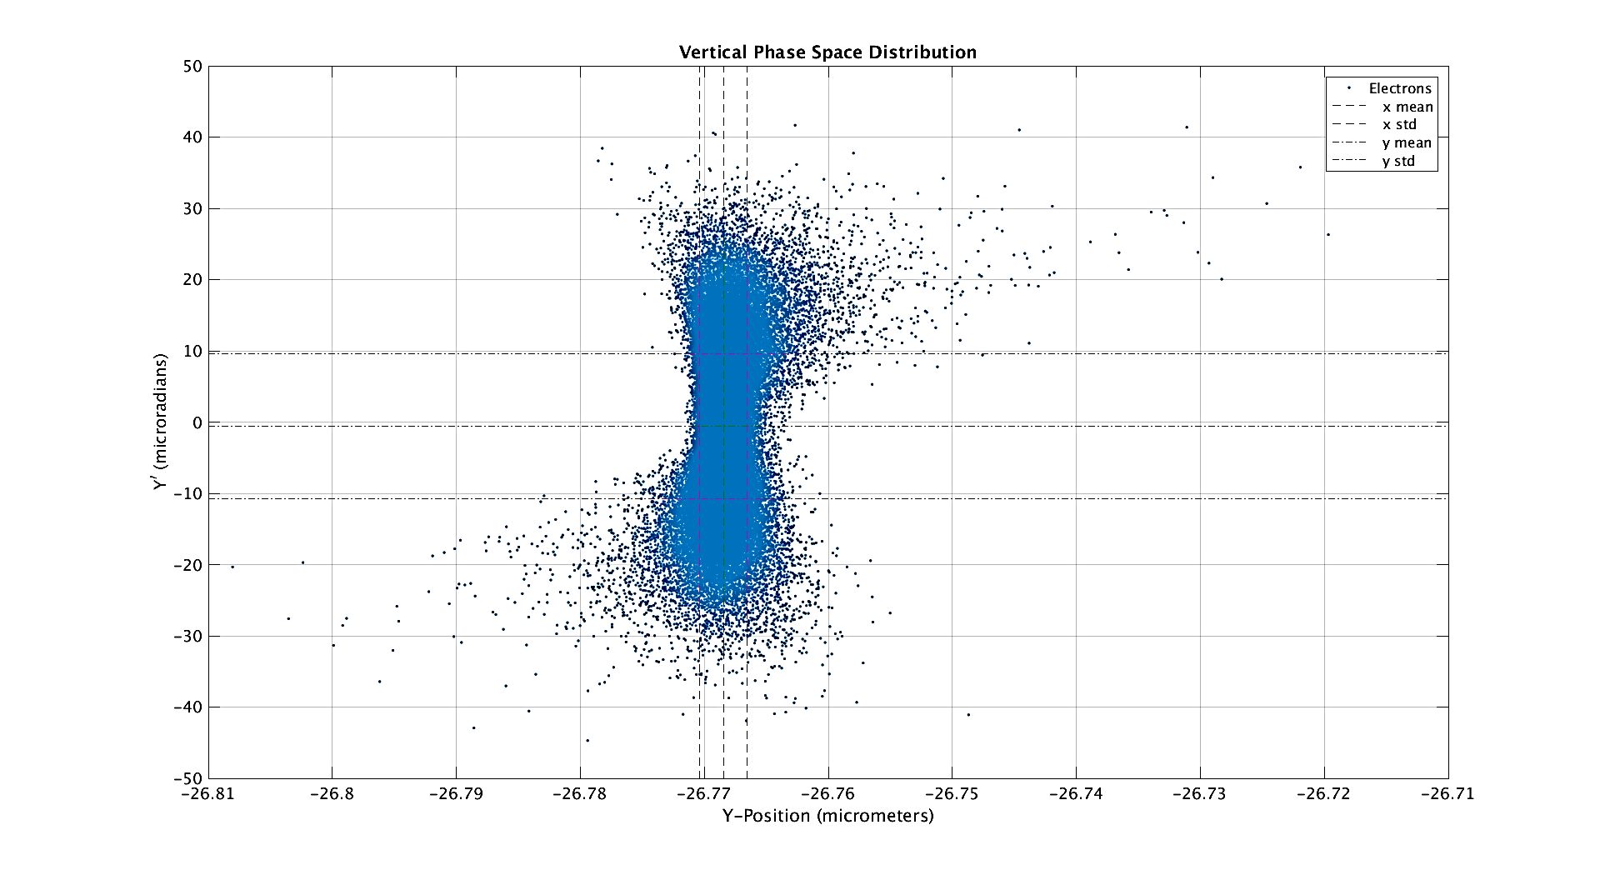

Slide 7
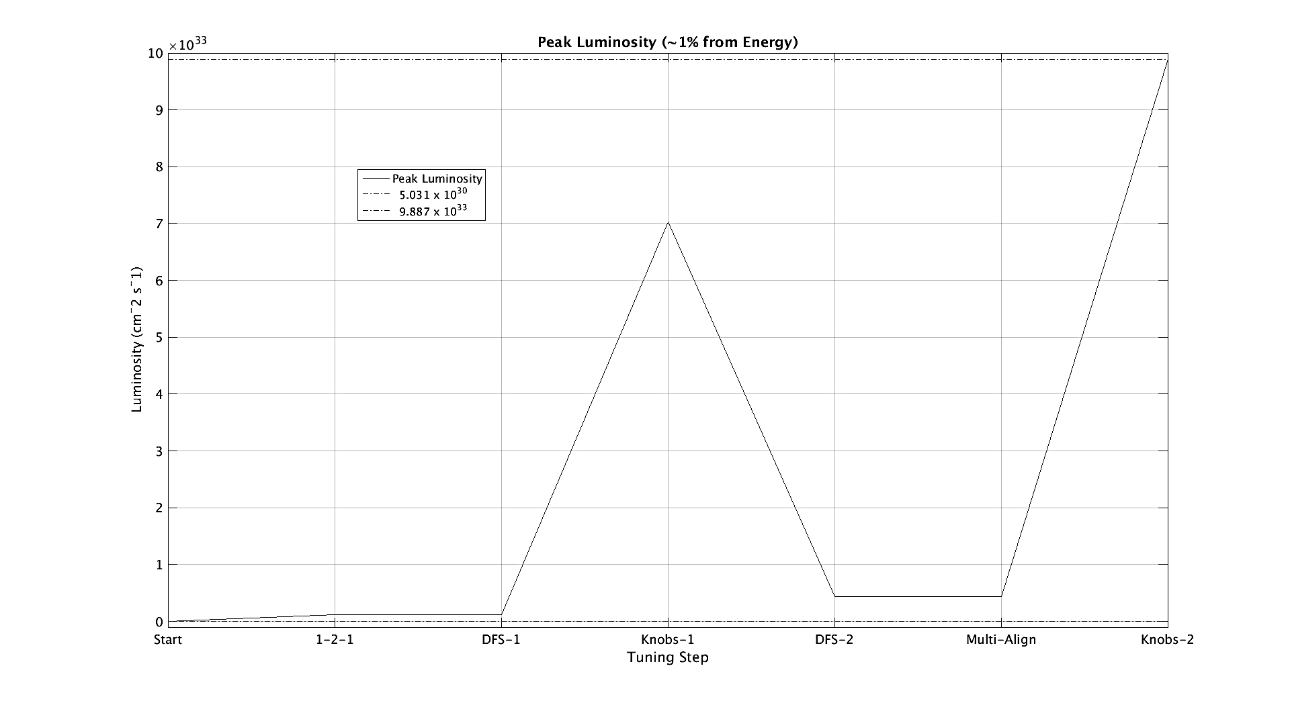

Slide 8
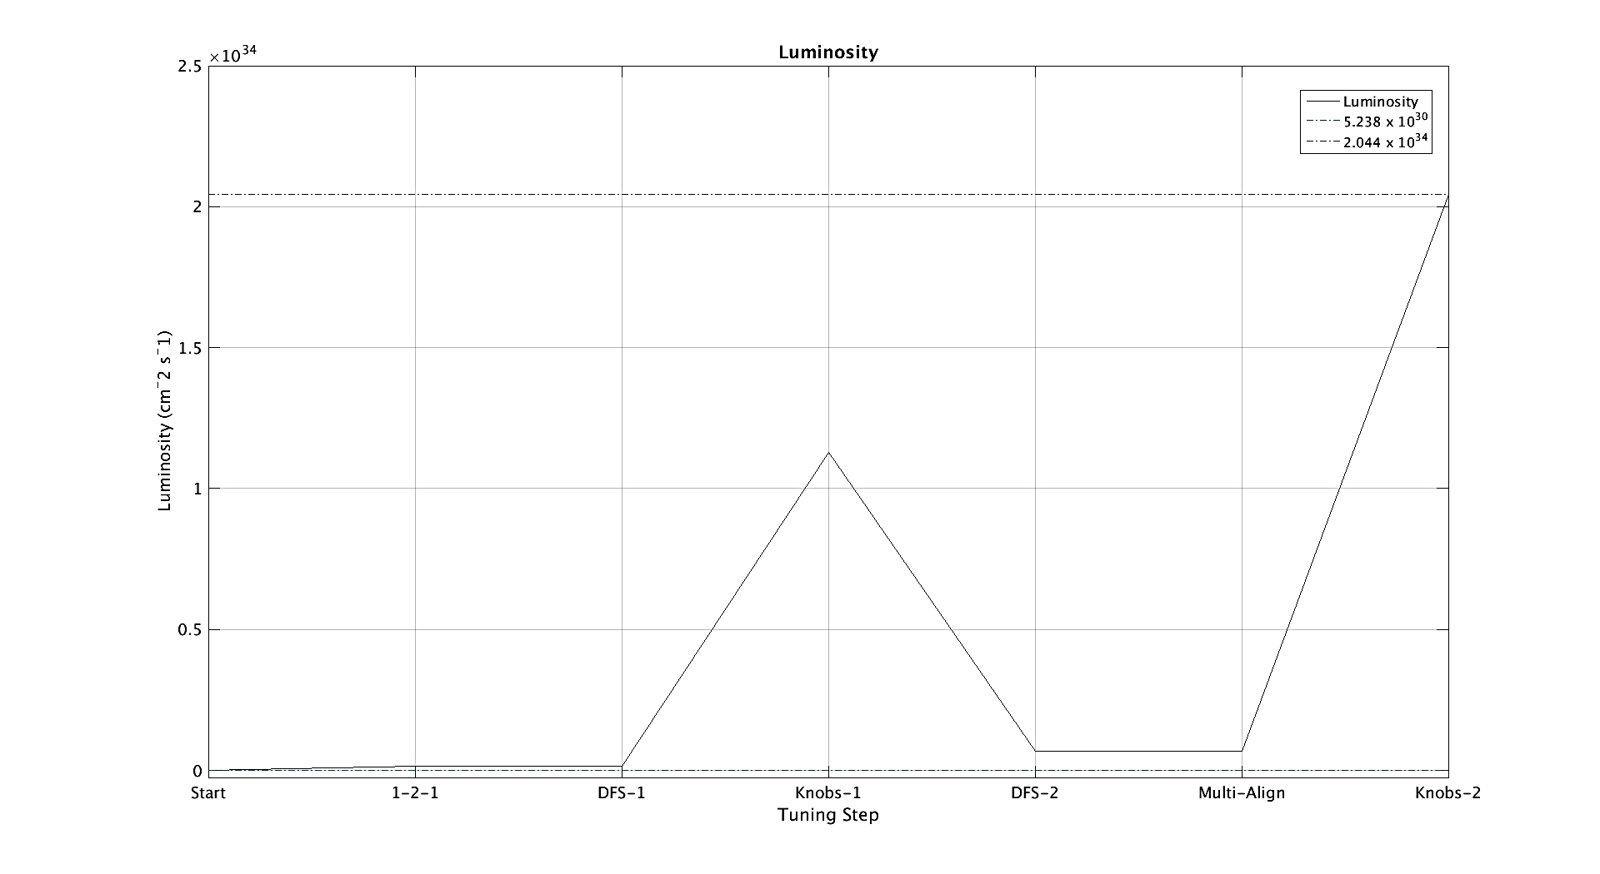

Slide 9
Unable to run multiple seeds on the BATCH system
  PLACET runs, but cannot call Octave
  Jochem and the UNIX/LINUX group couldn’t figure it out.
  Codes as written work at CERN, so going through registration process to be a user there.
Currently trying to understand each step in the code from Jochem
  Need to go backwards now.
    Learn how to get rid of misalignments and corrections to run a perfect machine.
    Learn how to add in each step individually.
    Should be able to apply this to all sections, not just FFS.

