Slide 1
Tests of New Phase Shifters
Jack Roberts

Slide 2
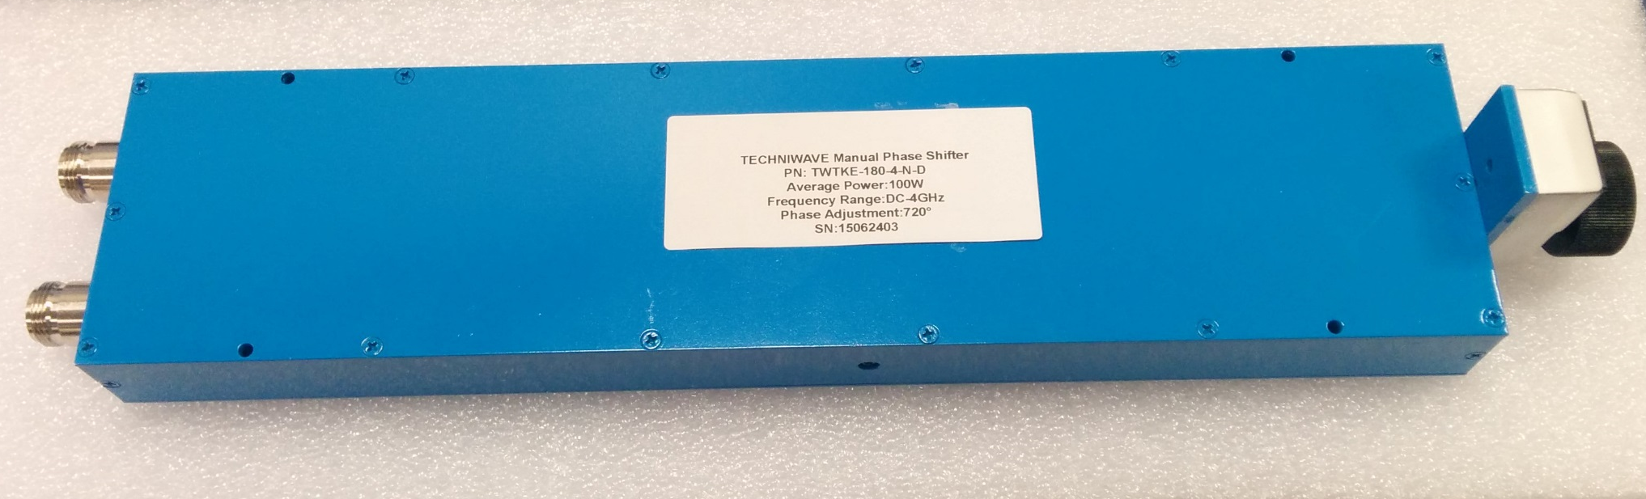
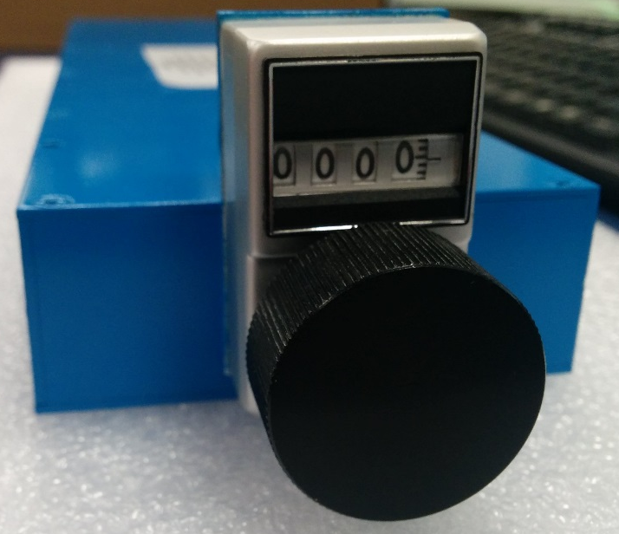
Overview
New mechanical phase shfiters for the phase monitor electronics arrived a few weeks ago. I checked them with a vector network analyser this week.
They are rated to give a range of 720 degrees at 4 GHz.
  We will use them at 3 GHz -> 540 degrees of 3 GHz range.
  Multiplied to 12 GHz after -> 2160 degrees of 12 GHz range for calibrations etc.
For all 3 shifters and both ports I checked reflected power, transmitted power, phase at ~120 different shifter settings.

Slide 3
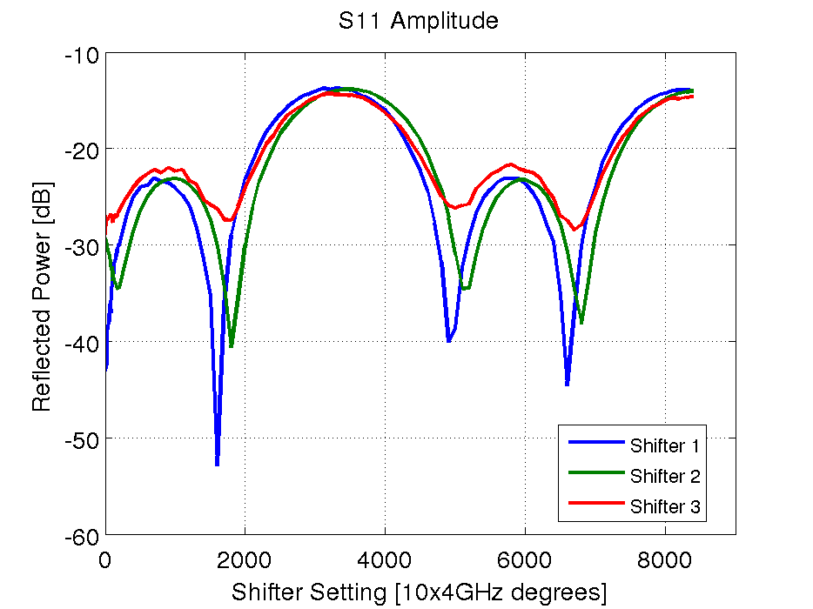
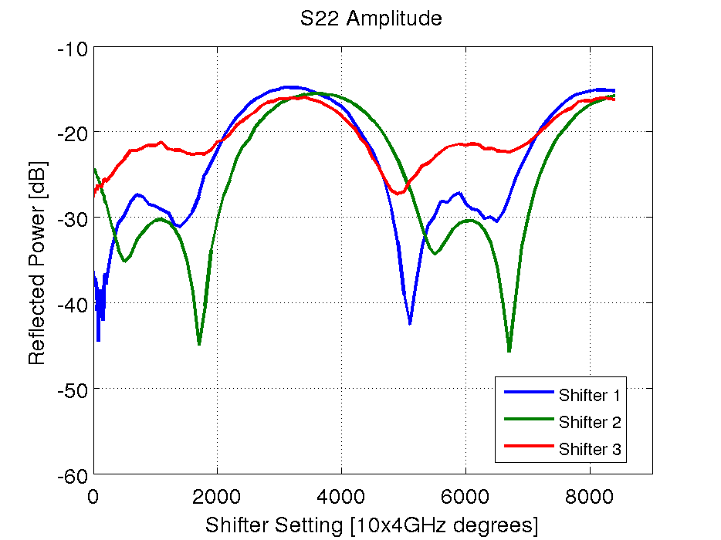
Reflected Power
Reflected Power From Port 1
Reflected Power From Port 2
Should try to avoid region from 2000-4000 and >6500?

Slide 4
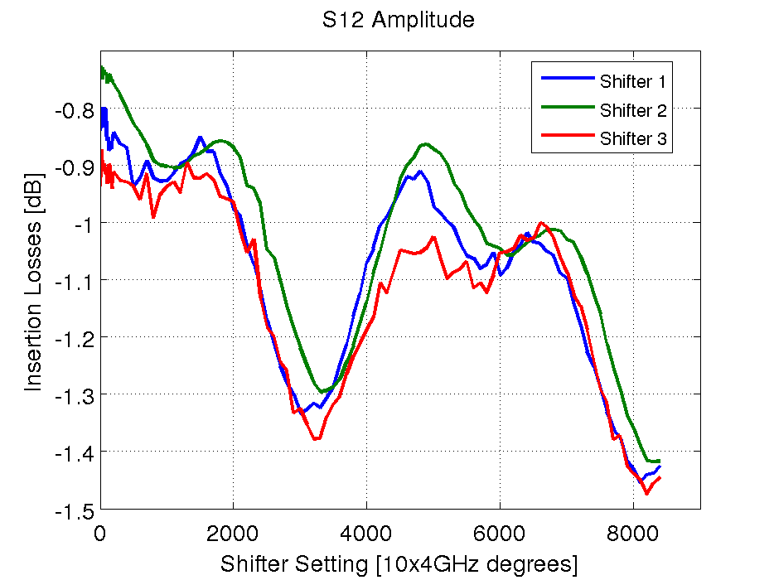
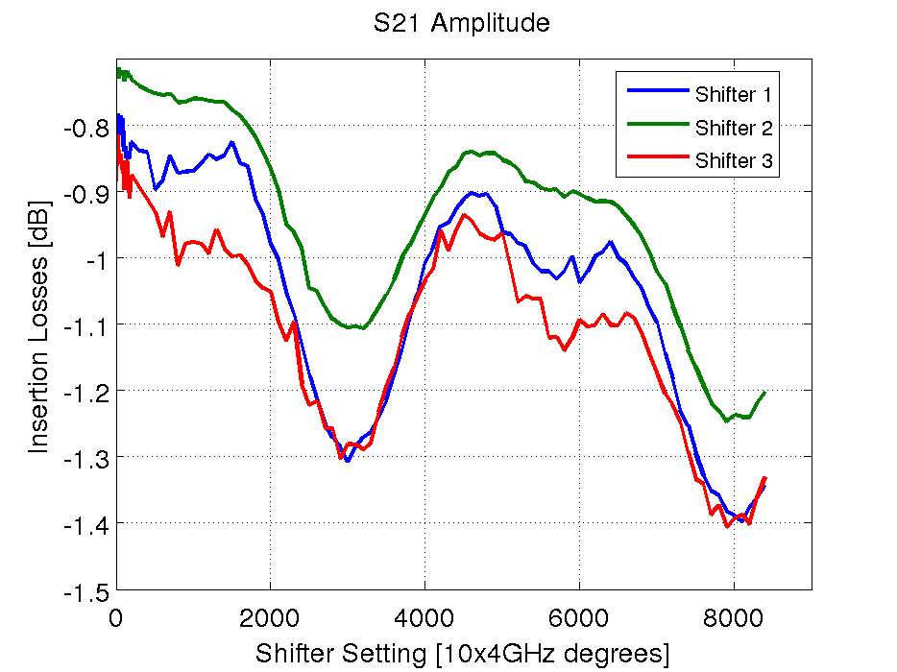
Transmitted Power
Signal Losses Port 1->Port 2
Signal Losses Port 2->Port 1
Should try to avoid region from 2000-4000 and >6500?

Slide 5
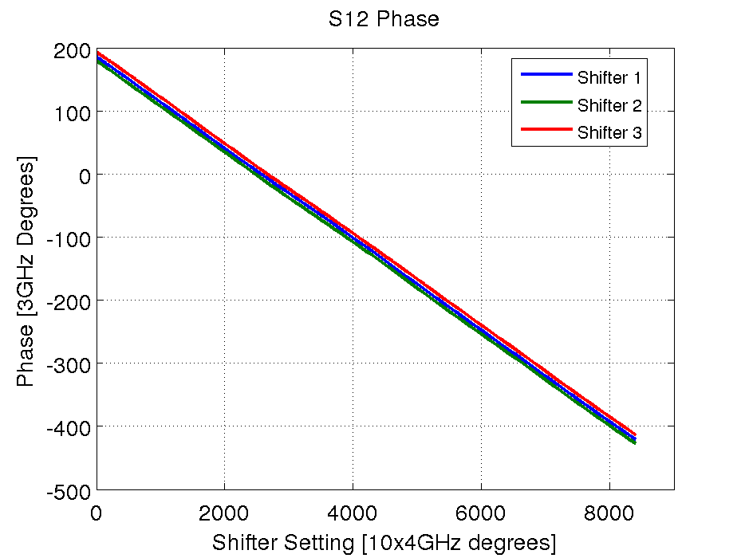

Phase
Phase vs. Setting: Port 1->Port 2
Phase vs. Setting: Port 2->Port 1
Fitted phase shift per shifter setting: 0.0723 degrees (expected 0.075).

Slide 6
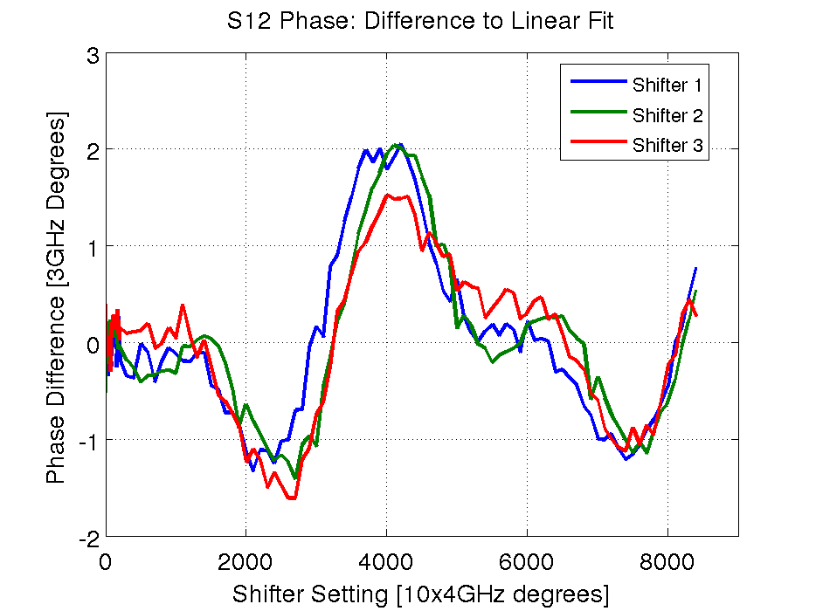
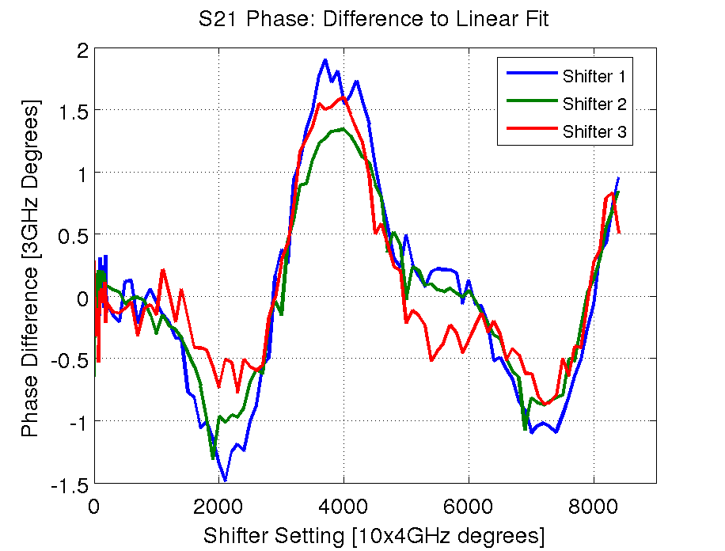
Phase: Difference to Linear Fit
Diff Phase to Fit: Port 1->Port 2
Diff Phase to Fit: Port 2->Port 1
Not sure what to expect but the +/-2 degrees (of 3GHz) seems large.
Region near zero looks best (but the first 21 points I took in steps of 10 rather than 100 which may bias fit to agree better there).

Slide 7
Summary
Overall looks like we should try to operate at shifter settings below 2000 for the best performance.
Anything to worry about? Up to +/-2 degrees of 3GHz deviation from linear fit across full range a problem?
Any need to take more points? Maybe in the 0-2000 range to better check precision there.

