Slide 1
Stripping Back the Bells and Whistles: Progress Toward a Basic CLIC FFS Simulation
Code Edited From Jochem Snuverink
Ryan Bodenstein
FONT Meeting
2015/08/28

Slide 2
As suggested, I’m in the process of stripping back all of the misalignments and corrections that are applied to the beamline.
  Trying to get a perfect beamline
  Editing the code to get all of the outputs for the perfect beamline
  Currently getting results, but not all of them, and I’m not sure if they are quite correct yet.
    Still, the few results that I have do seem to be more ideal.

Slide 4
I haven’t changed the initial parameters used by Jochem and others:
------------- beam parameter 1 ------------
energy : 1500 GeV ; particles : 3.72e+09
sigma_x : 43.0491 nm ; sigma_y : 1.01094 nm ; sigma_z : 44 micrometers
emitt_x : 0.68 emitt_y : 0.02 (mm.mrad)
beta_x : 8000 beta_y : 150 (micrometers)
offset_x : -9.297 nm ; offset_y : -0.01393 nm ; offset_z : 0 micrometers
waist_x : 0 waist_y : 0 (micrometers)
angle_x : 0 angle_y : 0 angle_phi : 0 (radians)
------------- beam parameter 2 ------------ (same as beam 1)
energy : 1500 GeV ; particles : 3.72e+09
sigma_x : 43.0491 nm ; sigma_y : 1.01094 nm ; sigma_z : 44 micrometers
emitt_x : 0.68 emitt_y : 0.02 (mm.mrad)
beta_x : 8000 beta_y : 150 (micrometers)
offset_x : -9.297 nm ; offset_y : -0.01393 nm ; offset_z : -0 micrometers
waist_x : 0 waist_y : 0 (micrometers)
angle_x : 0 angle_y : 0 angle_phi : 0 (radians)

Slide 5
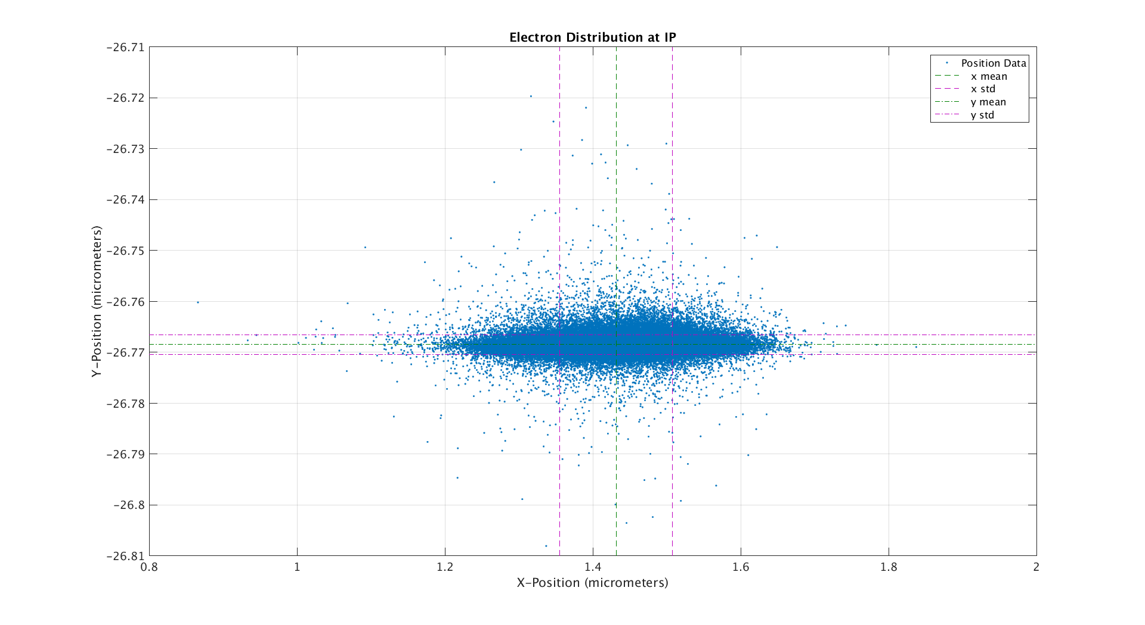

Slide 6
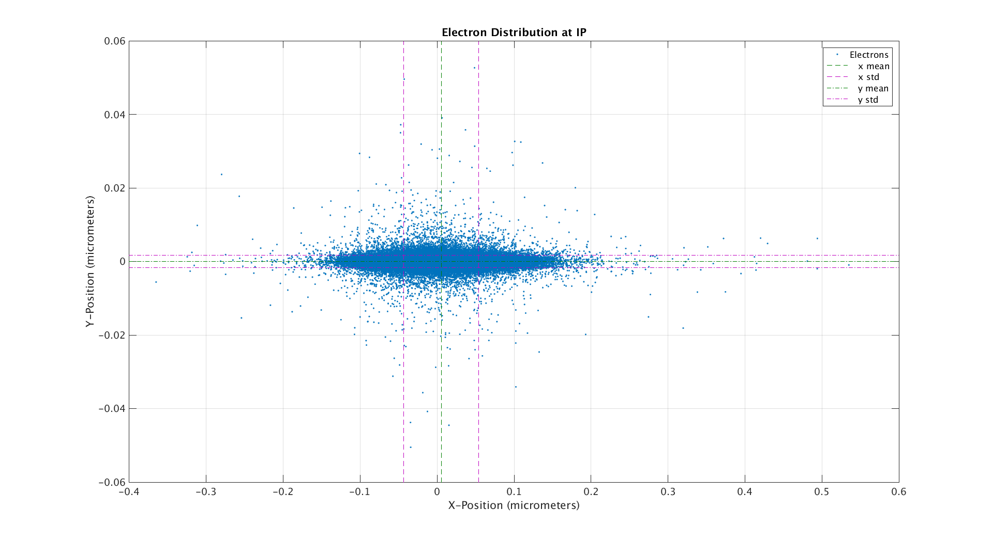

Slide 7
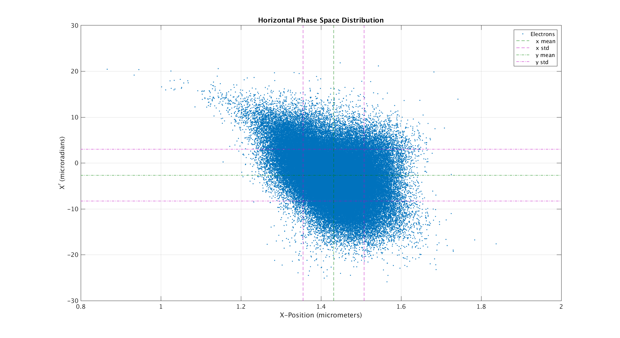

Slide 8
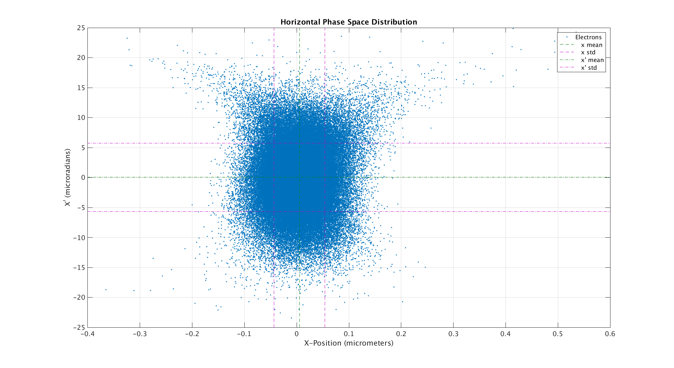

Slide 9
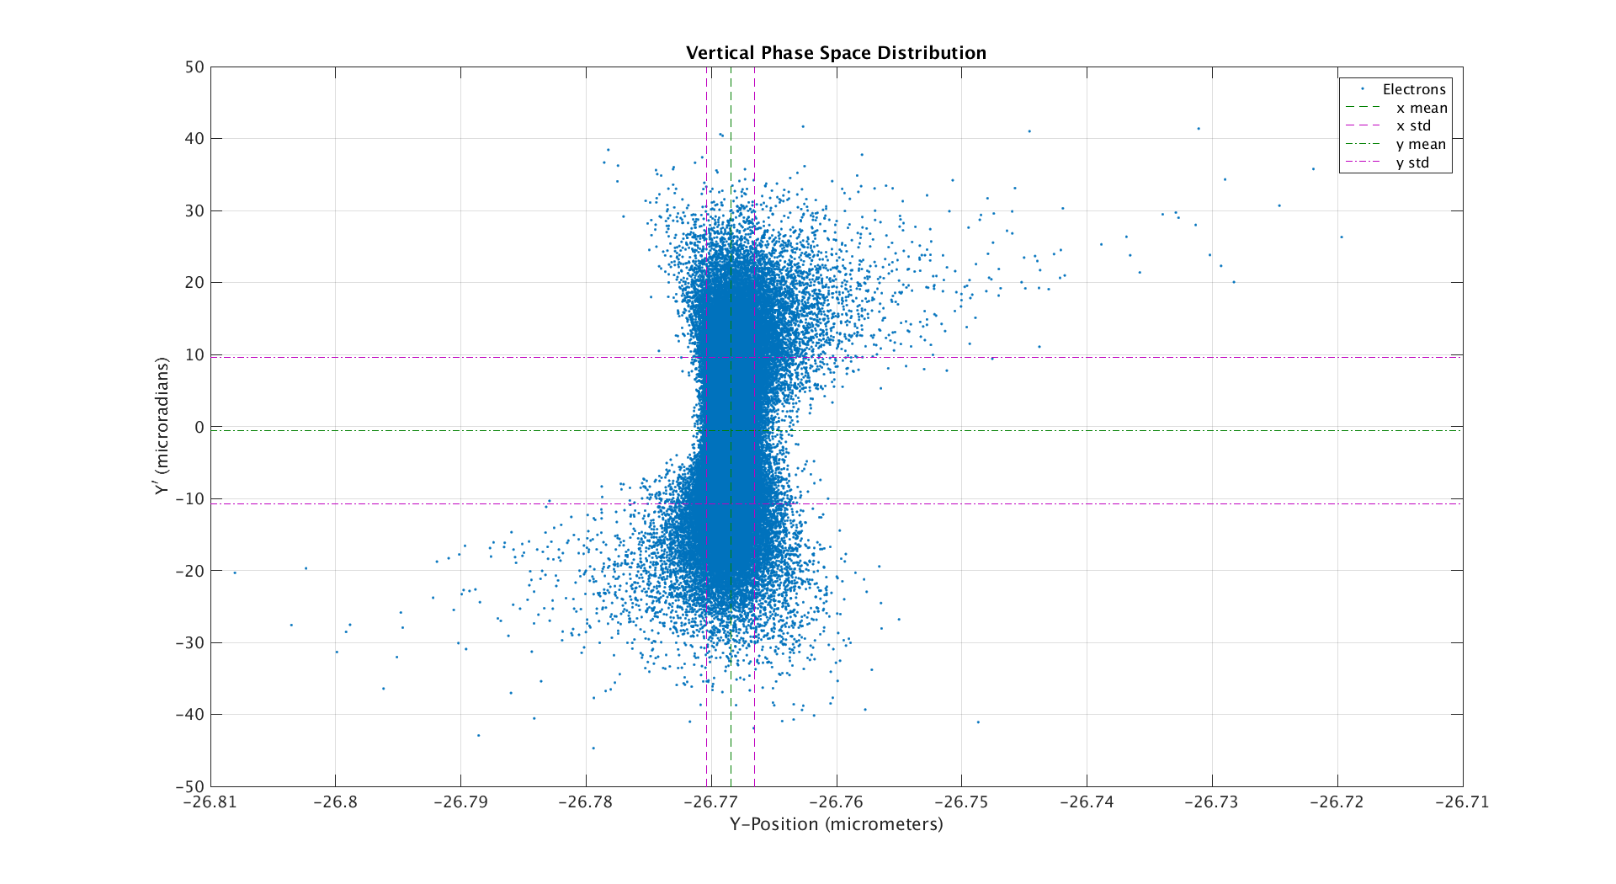

Slide 10
