Slide 1
ILC Cryogenics Layout:
A draft consensus for the
Change Request
CFS and Cryogenics Two-days Workshop at CERN
27 and 28, July, 2015

Slide 2
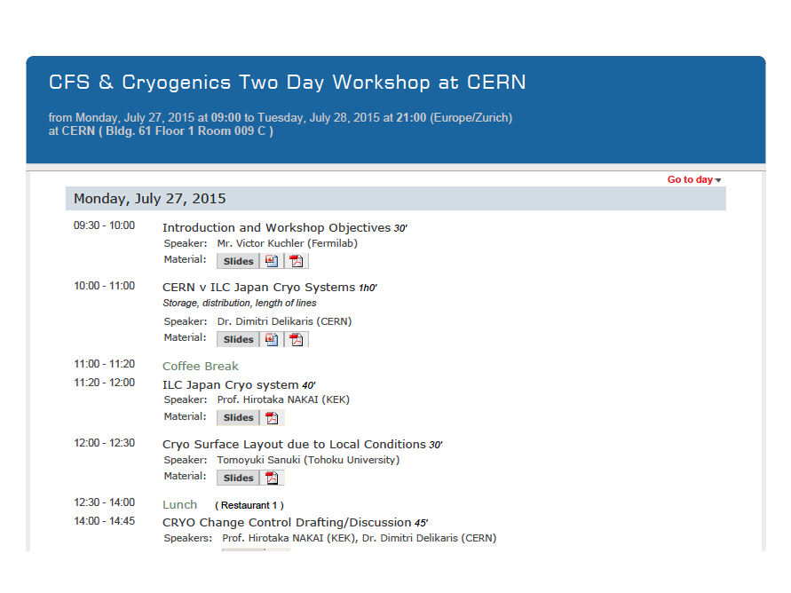

Slide 3
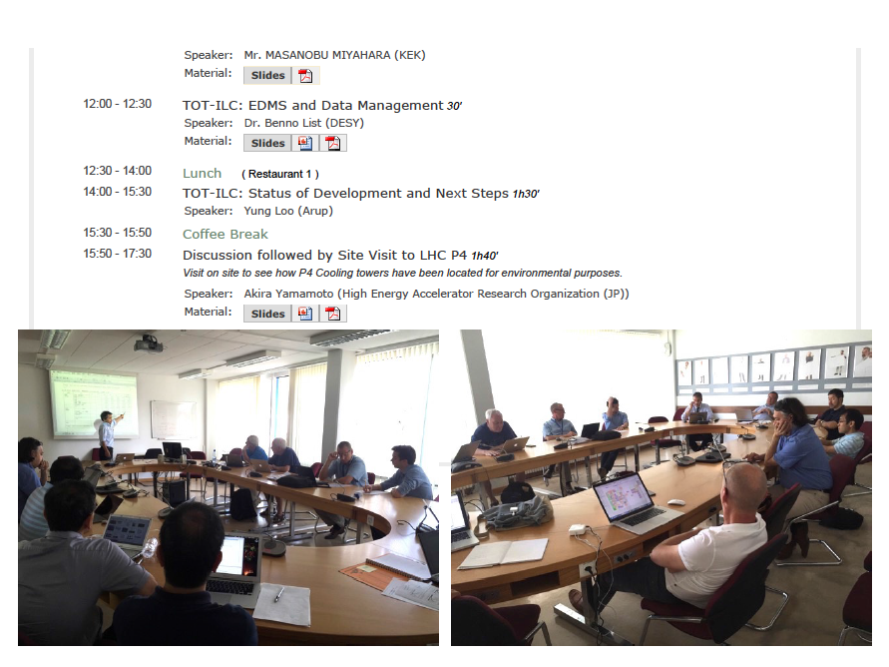

Slide 4
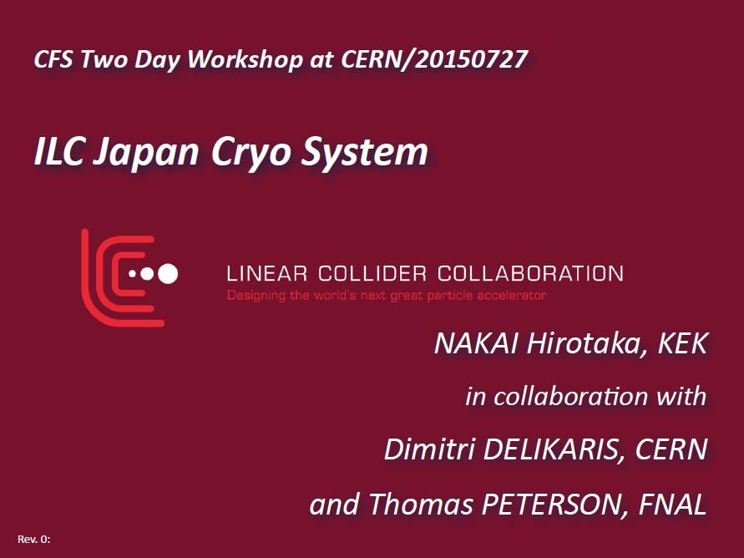

Slide 5
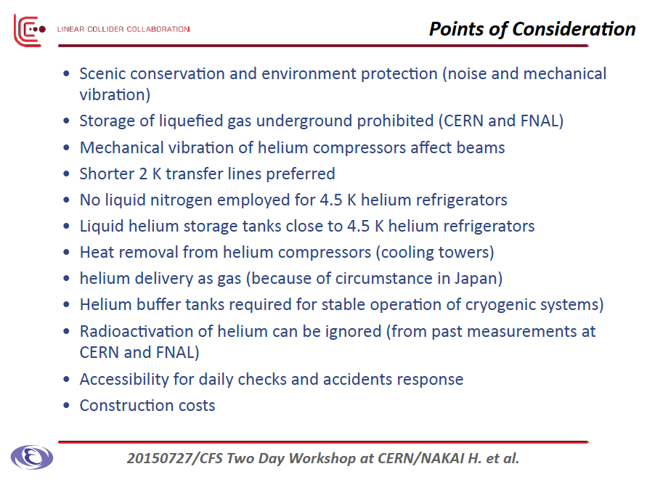

Slide 6
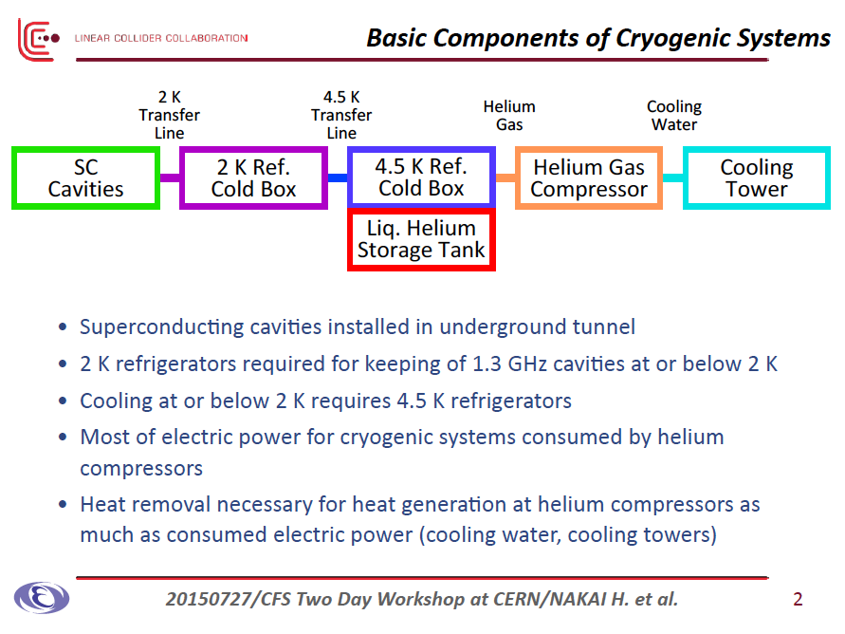

Slide 7
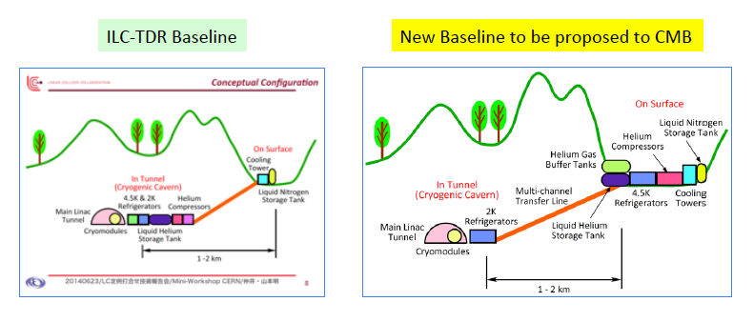
Change Request, to be submitted
Main Cryogenics Layout on Surface

Slide 8
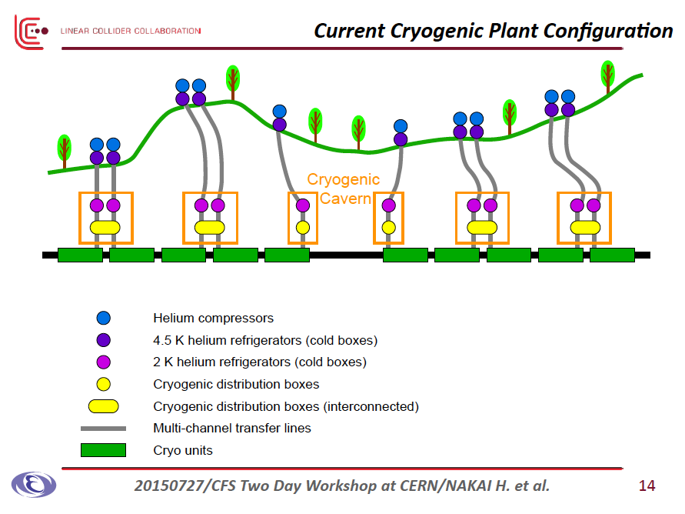

Slide 9
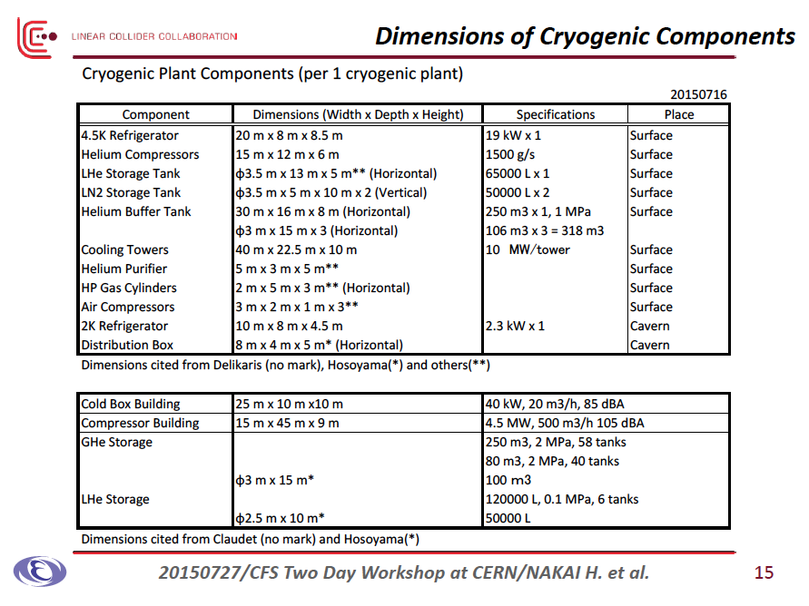

Slide 10
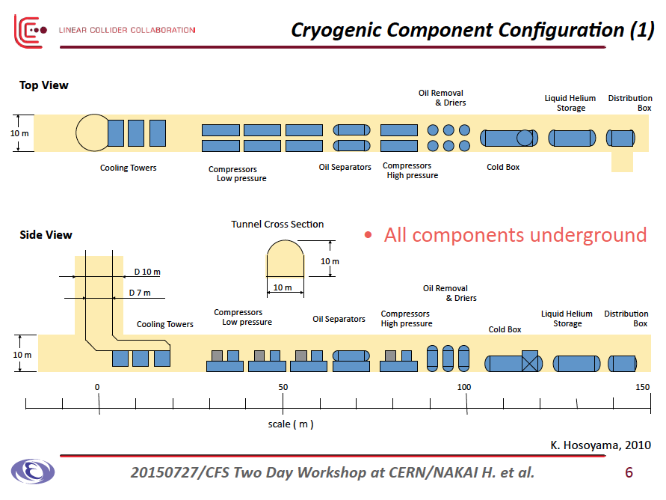
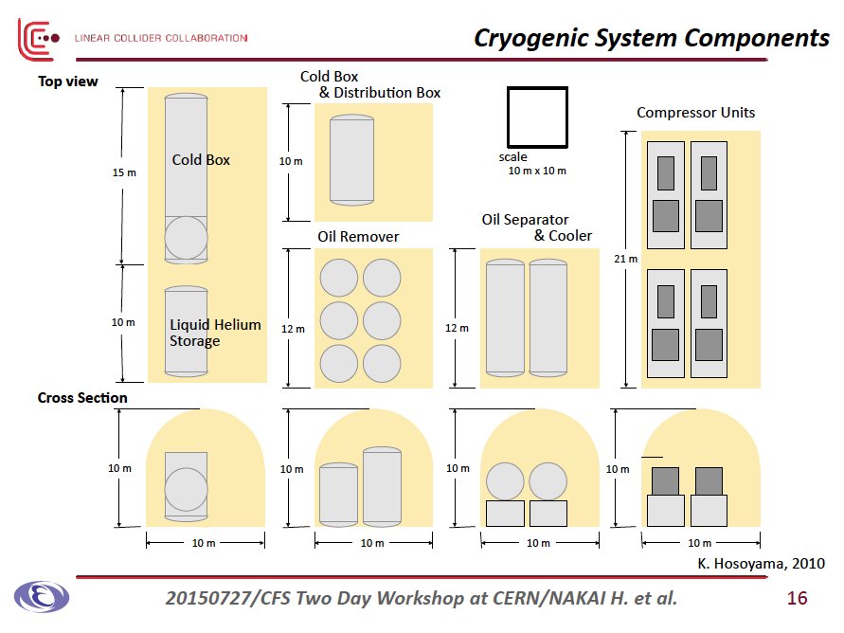
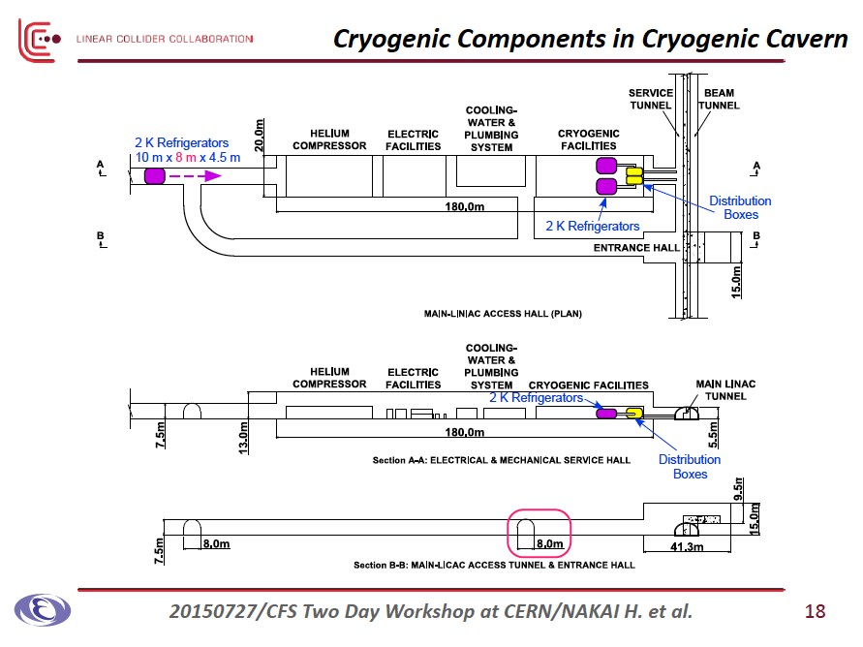
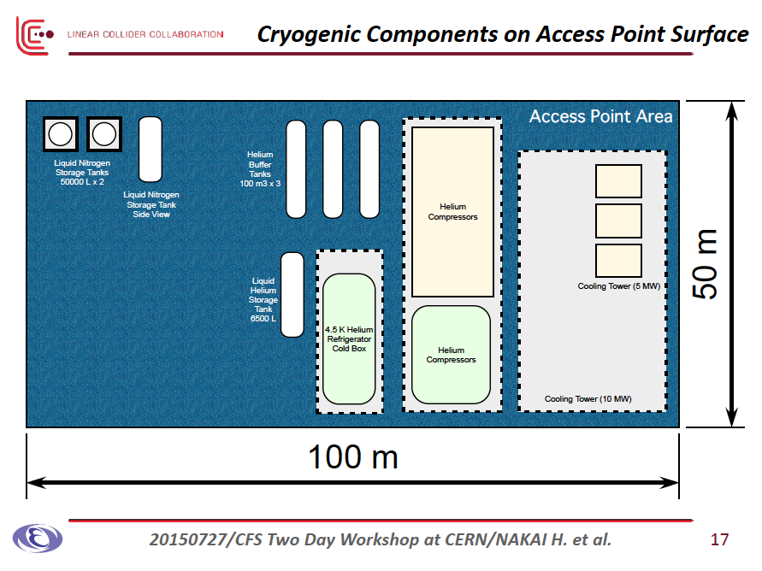

Slide 11


Slide 12
Some Comparisons
ILC – TDR Baseline
Main components underground
New Baseline in preparation
May components on surface
Features:
Scenic preseravation on surface
No major cryo-transfer-line
Lower cryogenic operational cost because of no 1 km transfer line.
A cost driver: Covern:
  13m(w) x 180m (l) x 10m(h)
  =23,000 m^3
Features:
Safety
Accessbility in daily operation
No concern for MC vibration
He storage flexibility
Smaller acess tunnel sizee because of no installation of 4.5 K Cryo-plant Under G.
A cost driviers:
Saving caver cost:
  → 23,000m^3x 0.5 = ~ 11,500 m^3
  200 CHF/m^3 x 2.30E4 = 2.3 MCHF
Additional transfer line cost:
→ 2 kCHF/m x 1,000 m = 2 MCHF

Slide 13
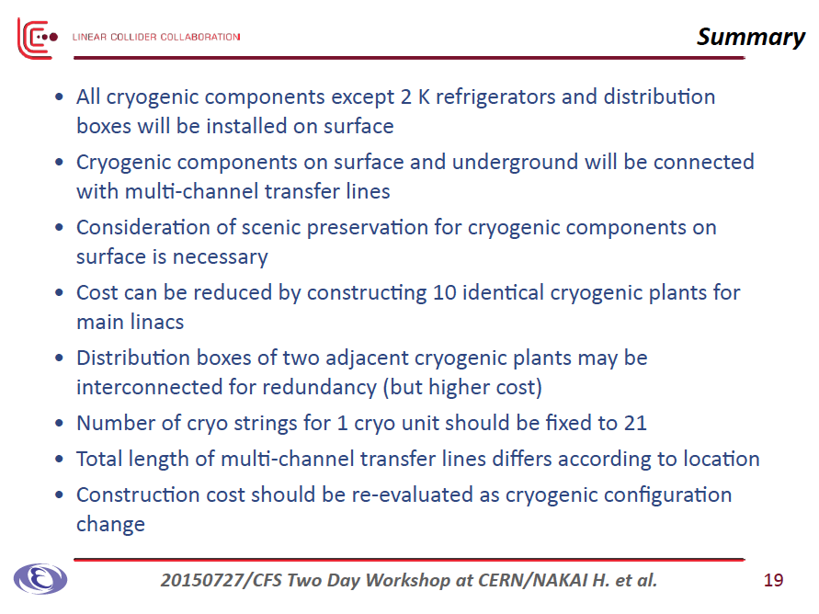

Slide 14
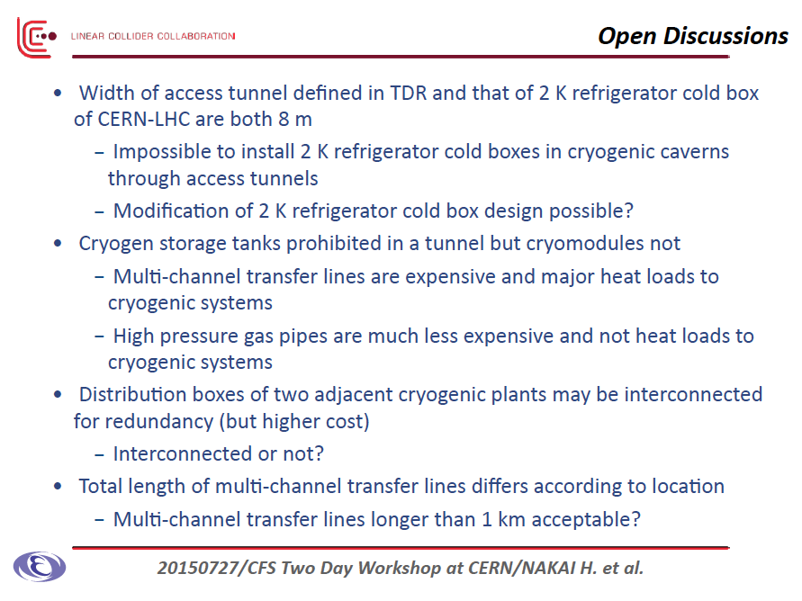

Slide 15
Conclusion
It has been a consensus to propose a new baseline cryogenics layout with major components located on surface,
Cost balance is basically neutral (and to be further investigated,
The Change Request can be submitted before LCWS2015.

Slide 16
Some further discussion after WS

Slide 17
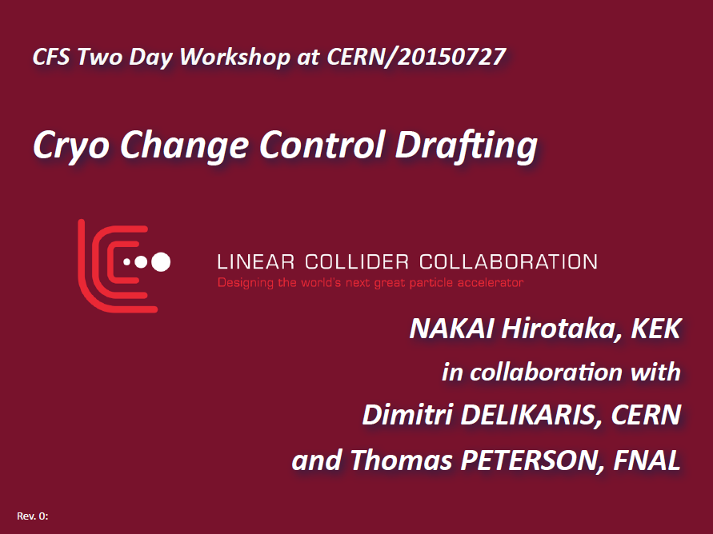

Slide 18
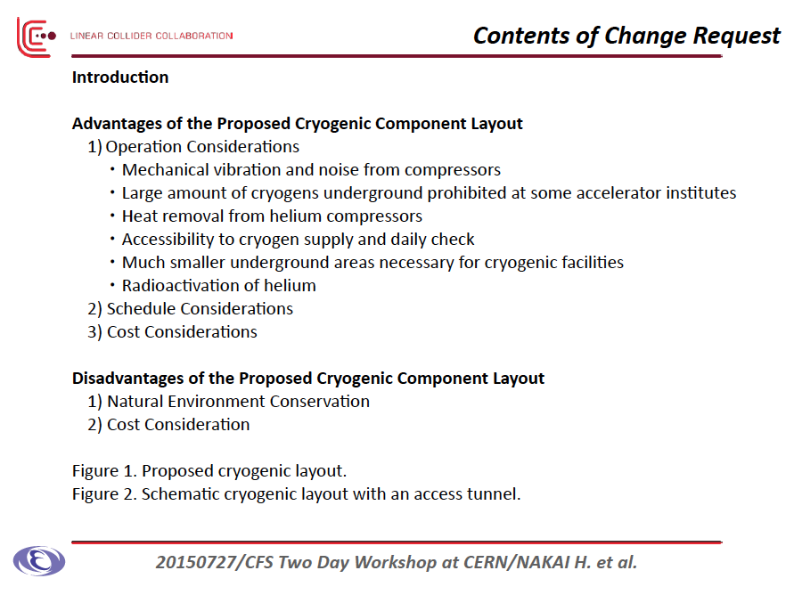

Slide 19
Comments given after WS
P. Lebrun
A. Yamamoto
D. Delikaris

Slide 20
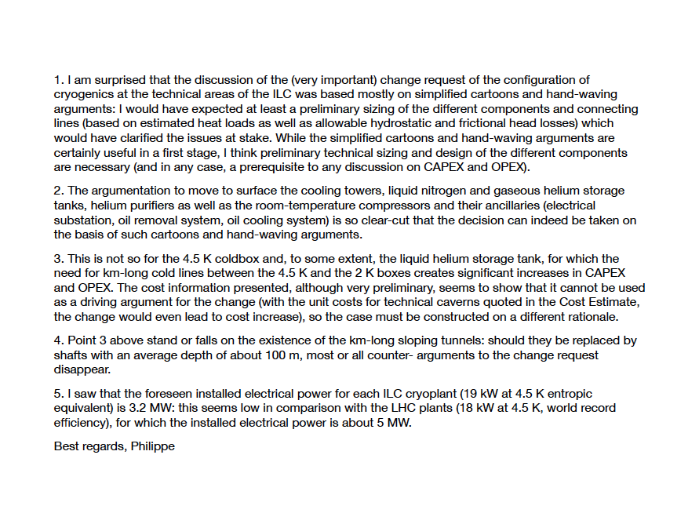

Slide 21
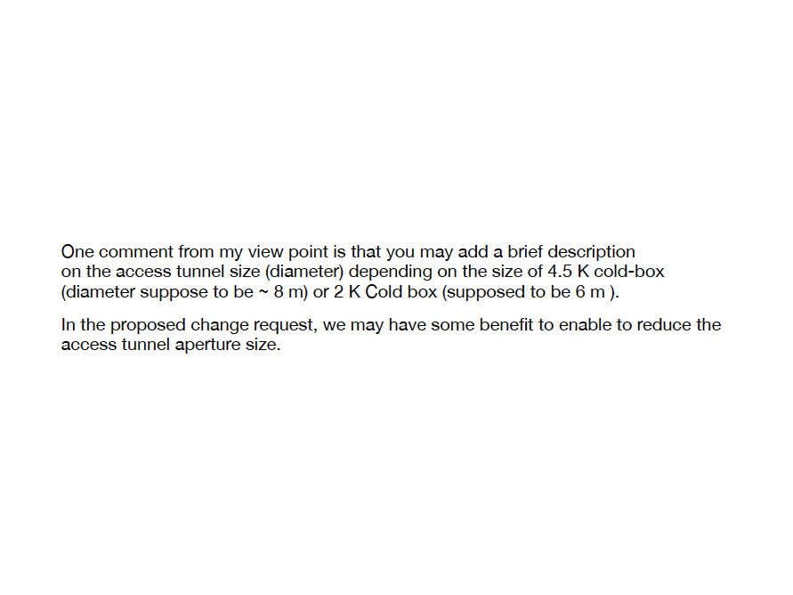
Akira Yamamoto

Slide 22
