Slide 1
ILC-CR-0007 and ILC-CR-0008 Implementation
Benno List, Nick Walker
10th CMB Meeting, 8.9.2015

Slide 2
Documents
EDMS ID | Title | Remark
D*0959505 | Design Register | WIP
 | ILC2015a Treaty Points (ILC2015a-Treatypoints.xlsx) | WIP
D*0966225 | Treaty Points Sources, Damping Ring, RTML | Done (combined with ML treaty points)
D*0970685 | Main Linac Treaty Points | Done
D*0972425 | Specifications for ML Treaty Points | Done
D*0975475 | eSource Beamline Sketch | WIP
D*0976695 | eSource Lattice
D*1426023 | eSource Lattice 3D visualisation
 | eSource element list | new
D*959325 | pSource Beamline Sketch | WIP
D*0977535 | pSource Lattice
D*1426073 | pSource Lattice 3D visualisation
 | pSource element list | new
D*0960185 | Damping Ring Lattice
D*1426123 | Damping Ring Lattice 3D visualisation
D*0961485 | Damping Ring Lattice 3D visualisation (e+) | Obsolete
D*0961515 | Damping Ring Lattice 3D visualisation (e+, 2) | Obsolete
D*0961445 | Damping Ring Lattice 3D visualisation (e-) | Obsolete
 | DR element list | new

Slide 3
Documents, cont’d
EDMS ID | Title | Remark
D*0977625 | RTML Lattice
D*1426183 | RTML Lattice 3D visualisation
 | RTML element list | New
D*0977355 | ML lattice (DKS)
D*1425843 | ML lattice 3D visualisation (DKS)
D*0972985 | BDS Lattice
D*0976435 | BDS component counts
D*0976385 | BDS Lattice 3D visualisation | Obsolete
D*1425973 | BDS Lattice 3D visualisation
 | BDS element list | new
D*0972665 | cryomodules component list
D*0983695 | magnets components list
D*0991345 | cryo parts list
D*0921195 | power supplies list
D*01049445 | Magnet specifications
D*0959325 | pSource Beamline Sketch
D*0967545 | RTML Beamline Sketch | WIP
D*0972985 | BDS Beamline Sketch
D*0982315 | Reference Points for CFS

Slide 4
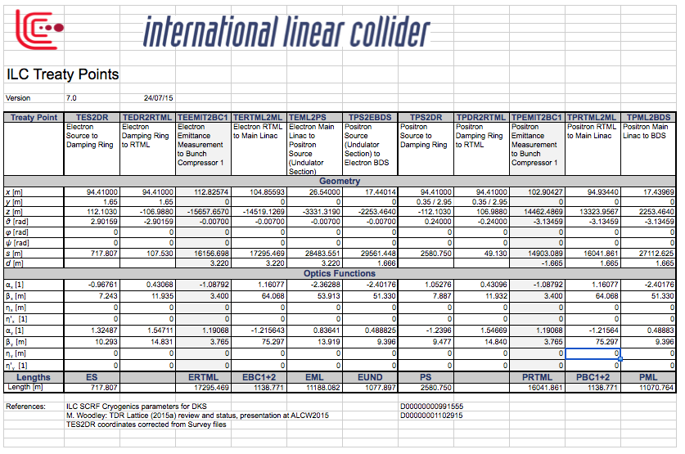
Treaty Points: done
Combines D*966255 and D*970685
Implements CR-0007 and -0008
In EDMS

Slide 5
Lattice files
6 separate lattice files for 6 accelerator systems
We now have a central repository for a complete lattice
-> replace by single lattice file in EDMS
Plan: Take a tagged version from Git repository
https://bitbucket.org/whitegr/ilc-lattices,
put a zipped version into EDMS
EDMS ID | Title | Remark
D*0976695 | eSource Lattice
D*0977535 | pSource Lattice
D*0960185 | Damping Ring Lattice
D*0977625 | RTML Lattice
D*0977355 | ML lattice (DKS)
D*0972985 | BDS Lattice

Slide 6
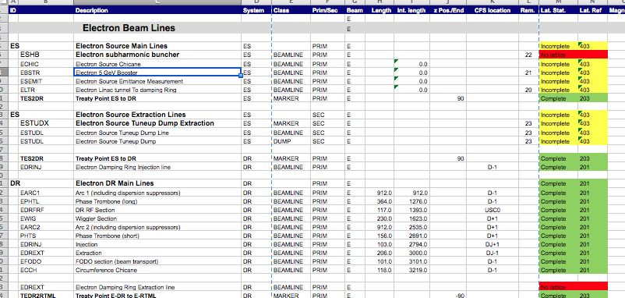
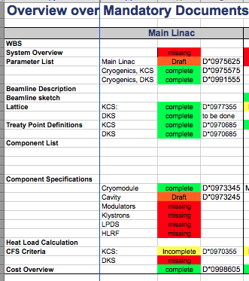
Design Register
Overview over beamline segments:
needs checking with lattice files -> work in progress
Mandatory documents list: remove KCS documents

Slide 7
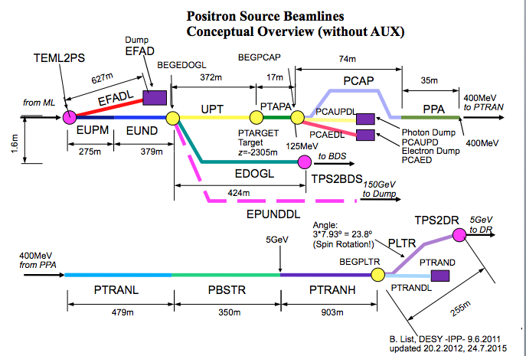
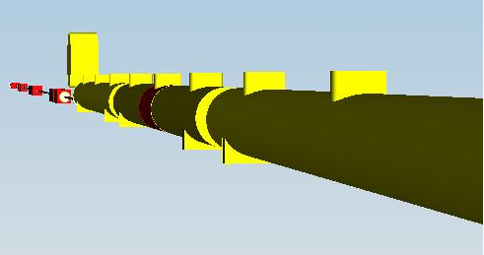
Additional documents
Beamline sketches:
should list same beamlines as
lattice / design register
-> being updated
Visualizations (3D models):
will be newly created
Component lists: Update may be
deferred until ILC2015b release

Slide 8
Summary
Lattice release in EDMS triggers consolidation and update of many documents
Will take time at current manpower situation
Priority will be given to documents needed for CFS planning and siting

