Slide 1
status
29/09/15

Slide 2
Trigger system: - Scintillator system : scintillator+pmt, discriminator+ coincidence module TLU module + PC + USB cable Detectors : - 6 channels floating power supply 0-5V, 0-3 A (voltage regulated, max current variable) - 1 Channel 0-300V voltage regulated, current limit/trip at 0.1microA (source meter from Keithly would be ideal) - Oscilloscope 500MHz - Electrical battery driven hand drill/screwdriver right/left rotation - Nuts for it : imbus 3mm, 4mm, 5mm Torx t20 - N2 bottle (50l, 200b) with pressure relief valve and ball flow meter and connection to 6mm plastic pipe 100 ml Alcohol (to clean) and dust free wipes - 220V power extension cables (12 outlets) - HV filter | Computing 1x Desktop computer (in the counting room) 2 x DAQ computer (bring by TAU) 10x RJ45 cable (5 meters) 1x RJ45 cable from the test beam area to the counting room 1x 1 TB disk for data 2x Gb ethernet hub 2x USB hub 1x monitor 4x long USB cable (USP to mini USB) NIM : 1x NIM crate 2 x discirminator (8 entries) 2 x NIM dual timer 2 x fanin/fanout 2 x logic unit 1 x nim to TTL 1 x negative HV module 1x 4 channel counter Lemo cables Lemo connectors (T,I) | Infrastructure - Table/support in beam line: size 50*50cm height 218mm below beam (adjustable?) - Table on side of beam pipe to support power supplies etc (2m long) - Work table to assemble close to beam area - Chairs

Slide 3
SRS system tests
Half sensor fully read
External trigger has been tested with cosmic
DAQ setup for a full sensor has been written
Fully sensor successfully read.

Slide 4
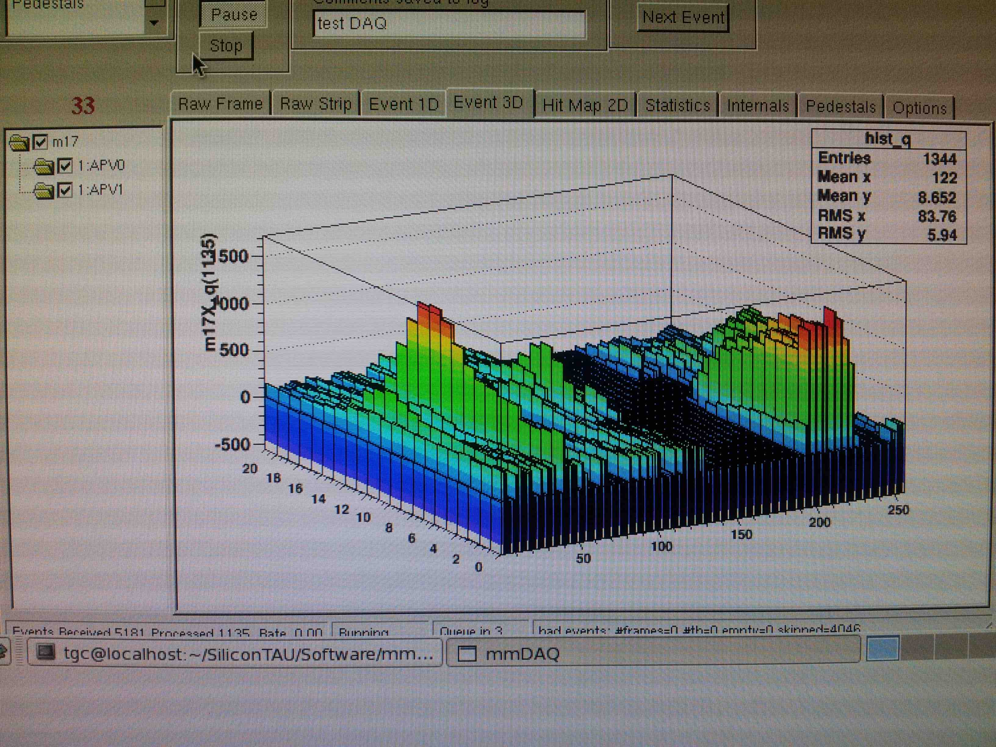
ADC count
Time (25ns unit)
Channel number

