Slide 1
July Phase Feedforward Runs:
Additional Analysis using Binned Data
Jack Roberts

Slide 2
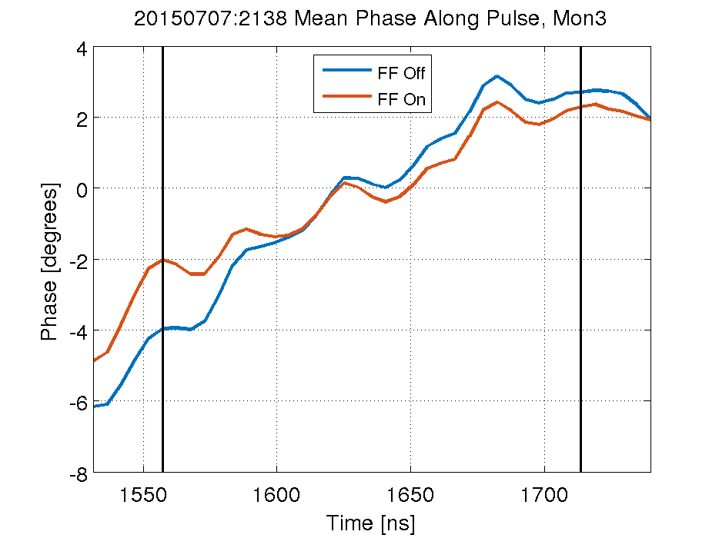
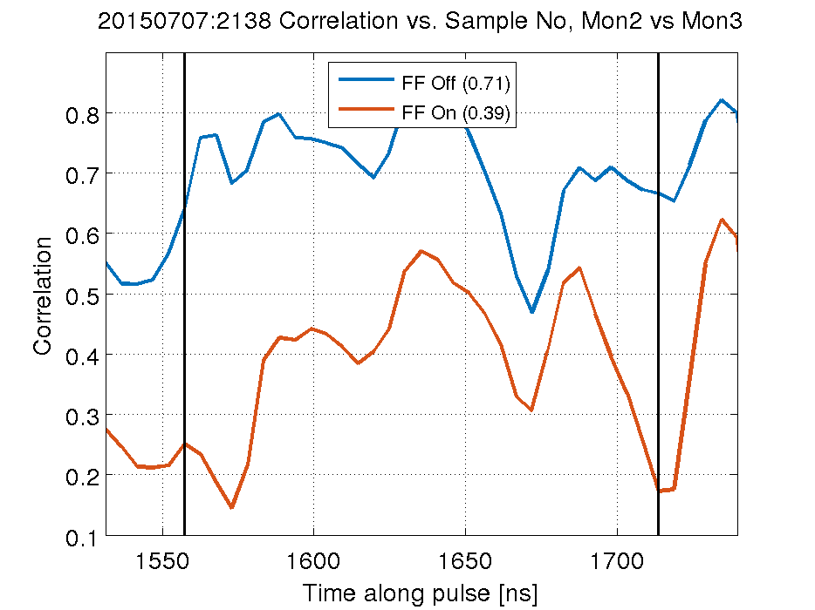
Intro (Results from 20150707_2138)
Why are we not able to flatten the phase along the pulse more and/or remove all correlation between the upstream and downstream phase?

Slide 3
Why can’t we flatten phase more / remove correlation?
Possible reasons:
Applied gain too low / out of range:
  Most datasets taken at gain 43 or 63 in FONT5 units.
  Based on my calculations and Murtaza’s results I believed this to be roughly optimal.

Slide 4
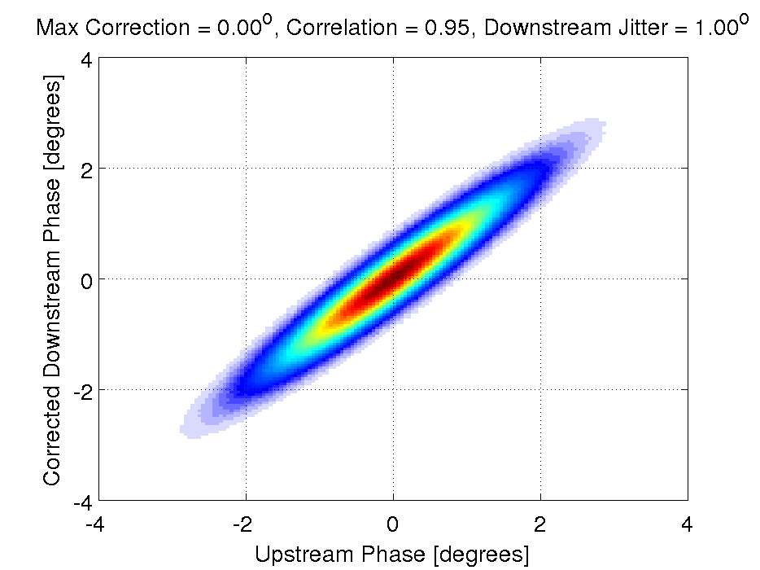
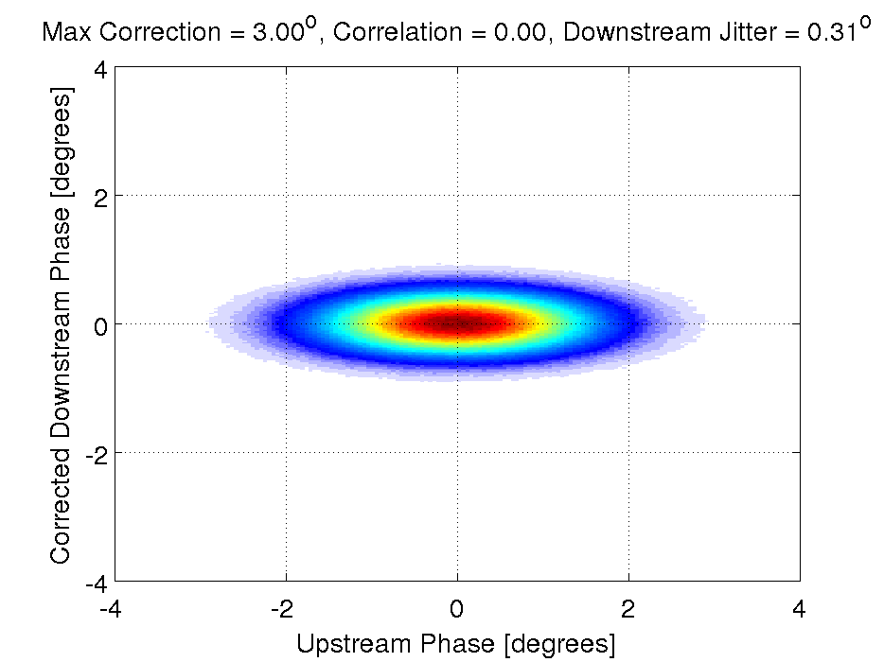
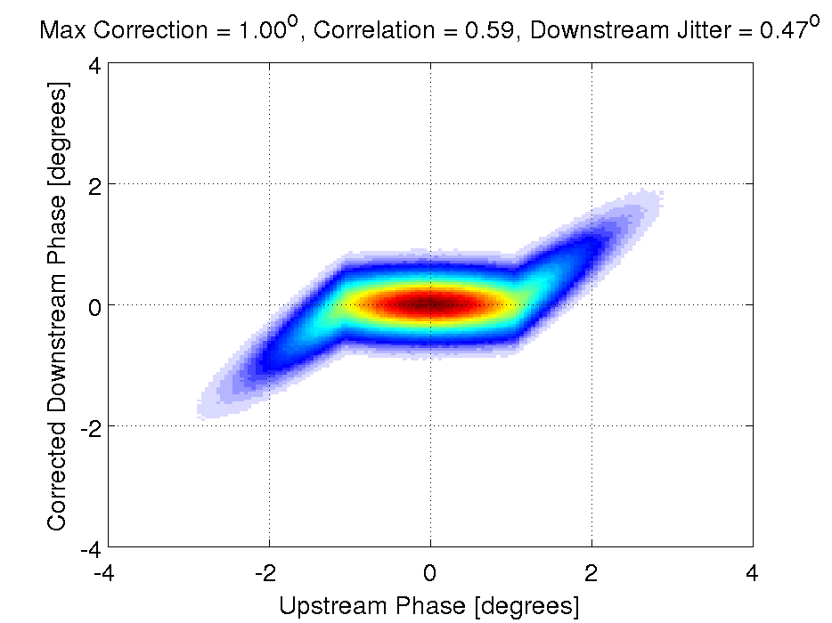
Why can’t we flatten phase more / remove correlation?
2. Effect of limited correction magnitude (i.e. amplifier being saturated).
NO FF
UNLIMITED FF
LIMITED FF
Jitter of pulses outside of the correction range cannot be removed, leaving correlated tails.
Should lead to different FF performance at different upstream phase offsets.
  Bin data based on upstream phase and compare results between bins.

Slide 5
Best July Datasets Summary
Data Set | Gain | Upstream Jitter | Downstream Jitter FF Off | Downstream Jitter FF On | Correlation FF Off | Correlation FF On
20150707_2037 | 63 | 0.90º | 1.23º | 0.69º | 0.90 | 0.48
20150707_2052 | 53 | 0.88º | 1.07º | 0.64º | 0.86 | 0.52
20150707_2138 | 43 | 0.78º | 0.94º | 0.56º | 0.83 | 0.54
20150715_1353 | 63 | 0.63º | 1.55º | 1.15º | 0.76 | 0.04
20150715_1414 | 63 | 1.05º | 1.56º | 1.00º | 0.80 | 0.11
2
1
3
1
Different pulse lengths on the 7th and 15th July (see next slide).
Best ratio reduction in jitter achieved on 7th (56% initial jitter, 64% best on 15th).
More correlation removed on 15th (10% or less residual correlation, 50% on 7th).
2
3
I didn’t realise there are actually datasets where we removed ~all correlation.

Slide 6
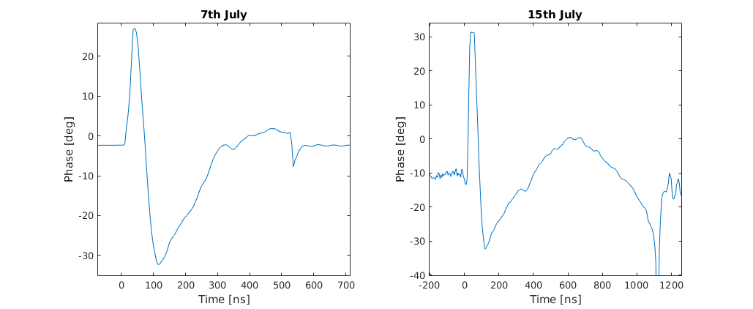
Difference Pulse Length 7th and 15th July
7th July: ~400ns pulse length, FF operated in flat part at end of pulse.
15th July: ~1µs pulse length, FF operated in flat central part.

Slide 7
20150715_1414_Gain63
Data Set | Gain | Upstream Jitter | Downstream Jitter FF Off | Downstream Jitter FF On | Correlation FF Off | Correlation FF On
20150707_2037 | 63 | 0.90º | 1.23º | 0.69º | 0.90 | 0.48
20150707_2052 | 53 | 0.88º | 1.07º | 0.64º | 0.86 | 0.52
20150707_2138 | 43 | 0.78º | 0.94º | 0.56º | 0.83 | 0.54
20150715_1353 | 63 | 0.63º | 1.55º | 1.15º | 0.76 | 0.04
20150715_1414 | 63 | 1.05º | 1.56º | 1.00º | 0.80 | 0.11
Rest of the presentation is results from this dataset.
  Results without binning.
  Results and simulations with binning.

Slide 8
Results without Binning

Slide 9
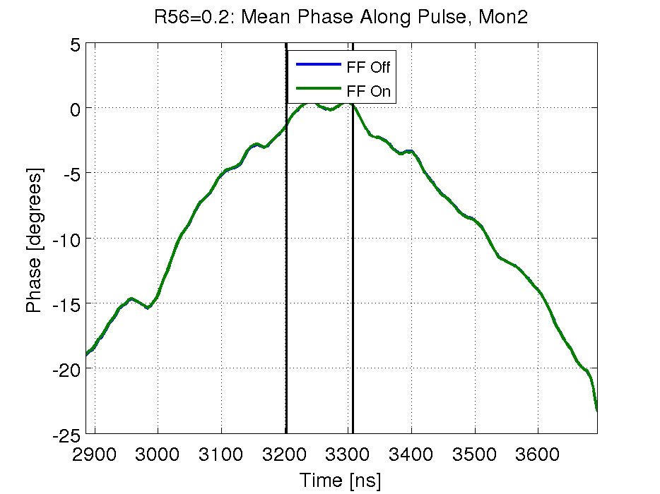
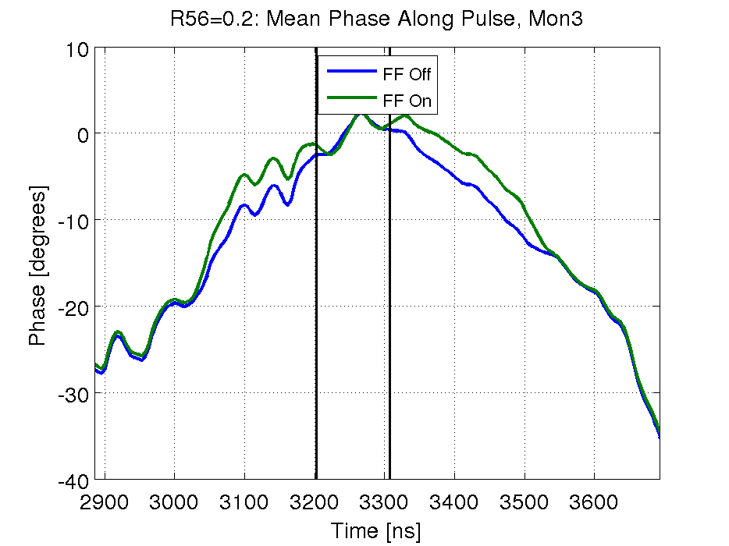
20150715_1414_Gain63: Mean Phase Along Pulse
Phase shifted up towards zero.
Residual uncorrelated shape.
FF On

Slide 10
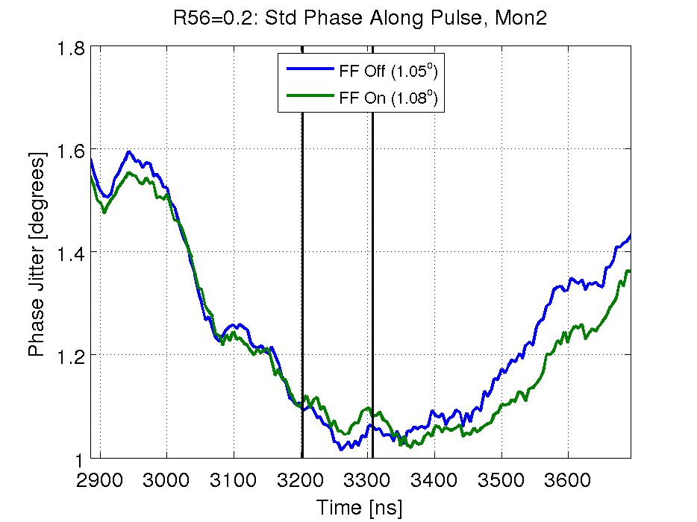
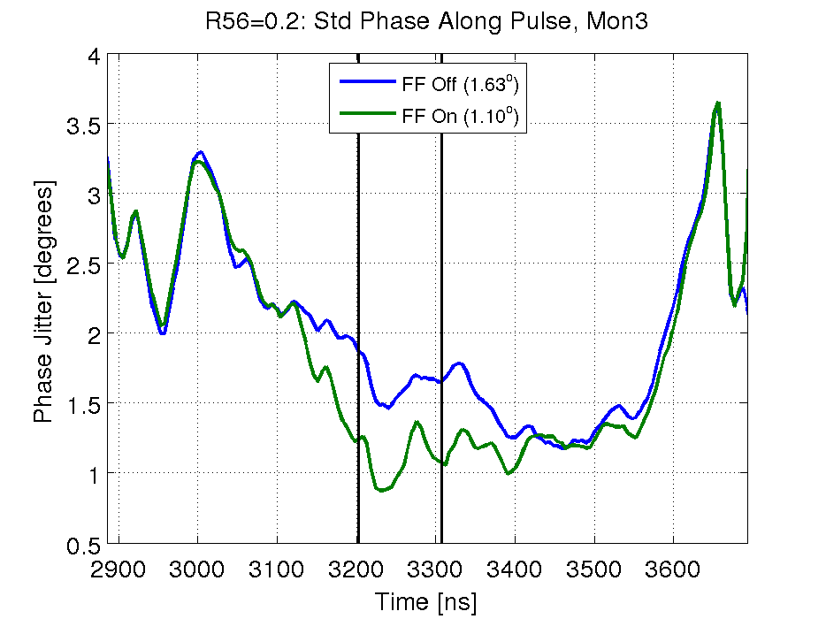
20150715_1414_Gain63: Phase Jitter Along Pulse

Slide 11
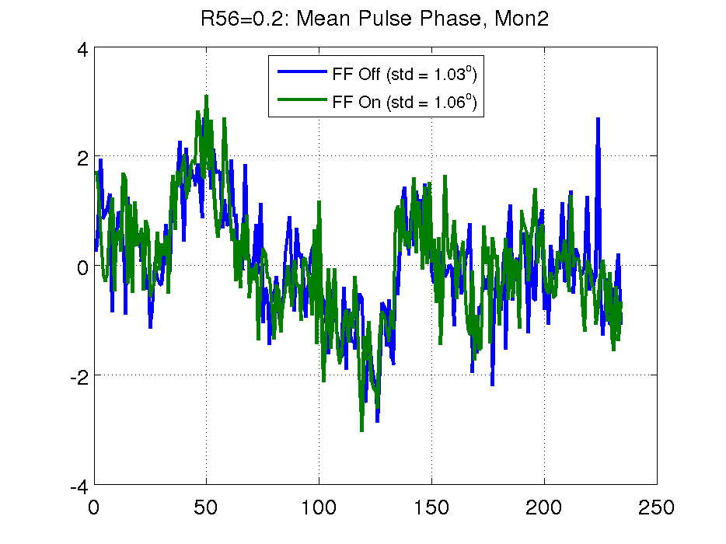
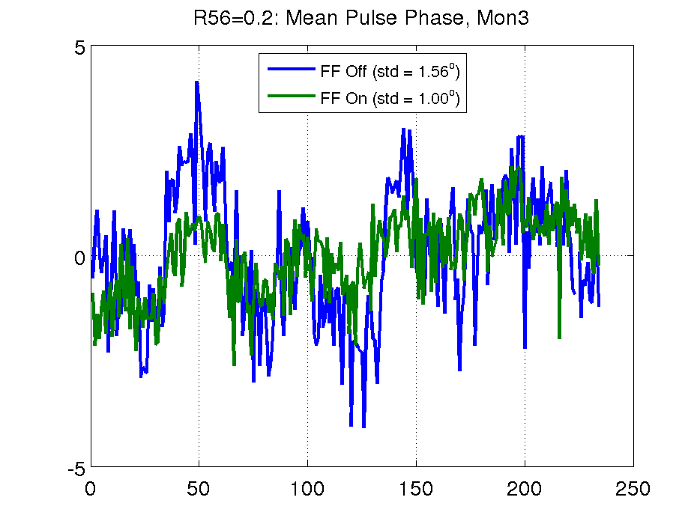
20150715_1414_Gain63: Mean Phase

Slide 12
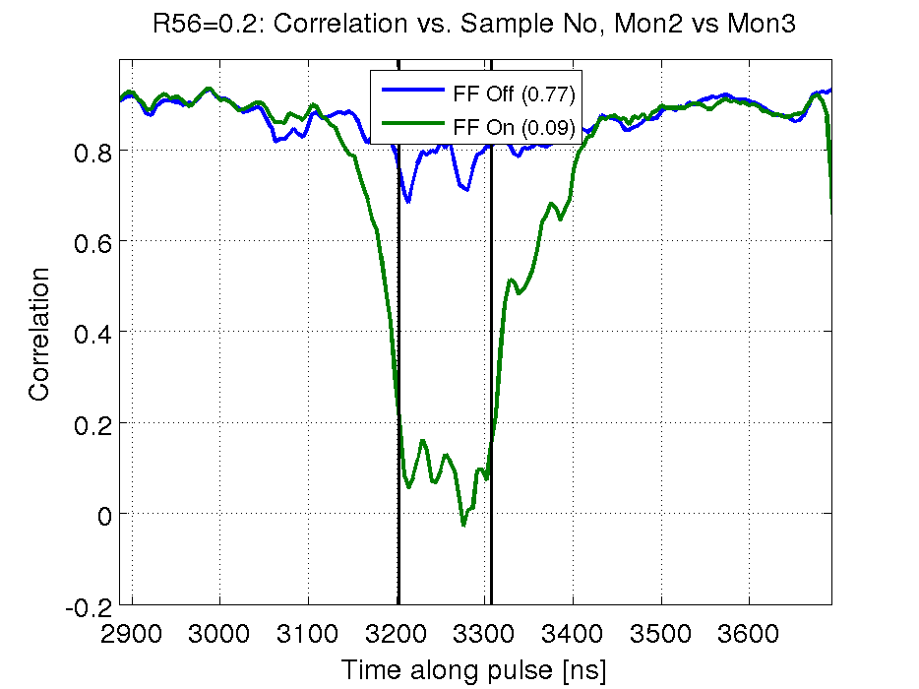
20150715_1414_Gain63: Correlation
Correlated tails: Phase sag means more pulses are outside correction range when you move away from flat central region of the pulse.

Slide 13
Results with Binning

Slide 14
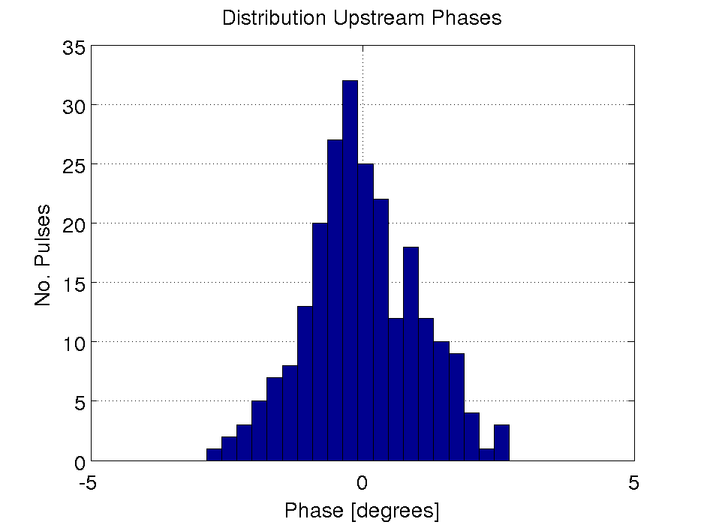
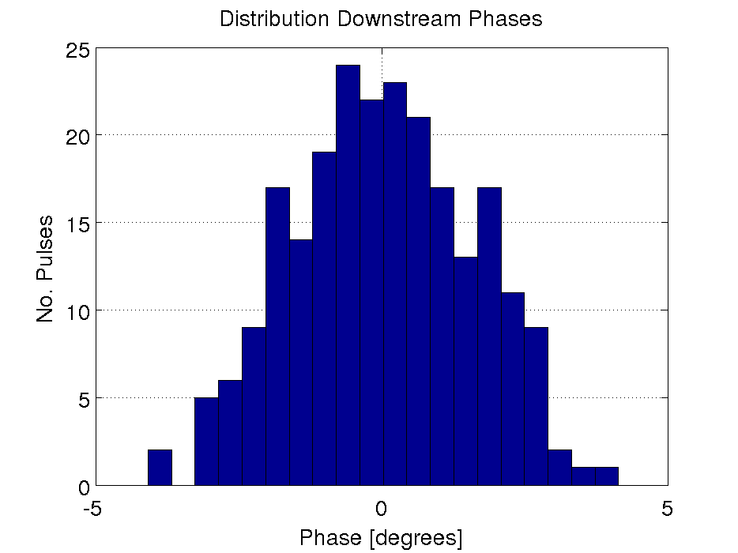
20150715_1414_Gain63: FF Off Distribution
FF OFF
BINS IN ANALYSIS ARE NOT AS SHOWN ON THESE HISTOGRAMS!
Pulses distributed between bins based on upstream phase:
8 x 0.5 degree width bins between +/- 2 degrees, plus one bin for all below -2 and one for all above +2.

Slide 15
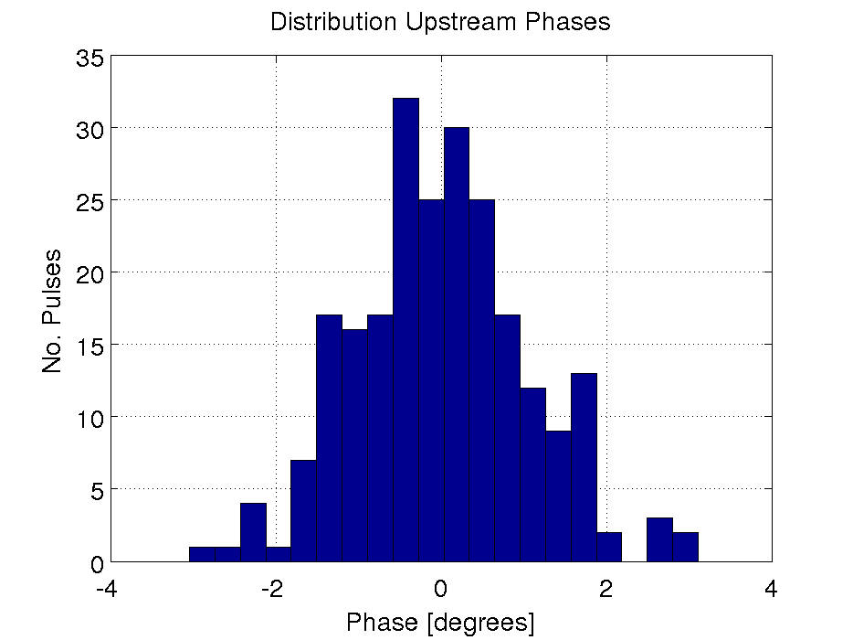
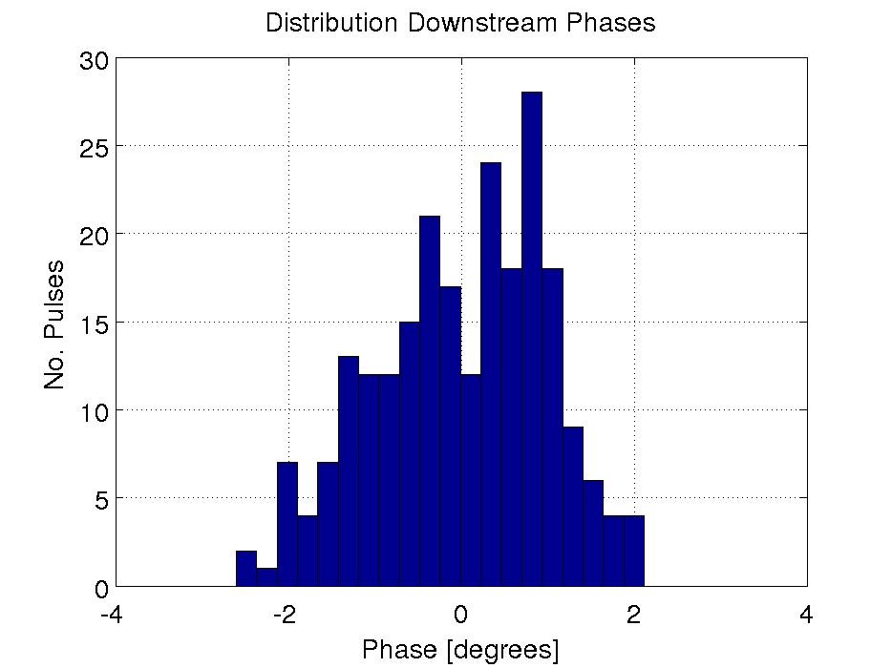
20150715_1414_Gain63: FF On Distribution
FF ON
BINS IN ANALYSIS ARE NOT AS SHOWN ON THESE HISTOGRAMS!
Pulses distributed between bins based on upstream phase:
8 x 0.5 degree width bins between +/- 2 degrees, plus one bin for all below -2 and one for all above +2.

Slide 16
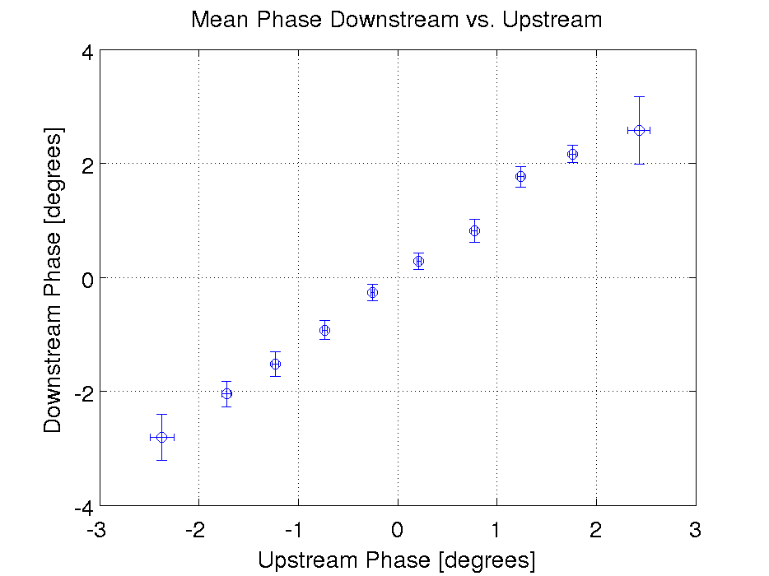
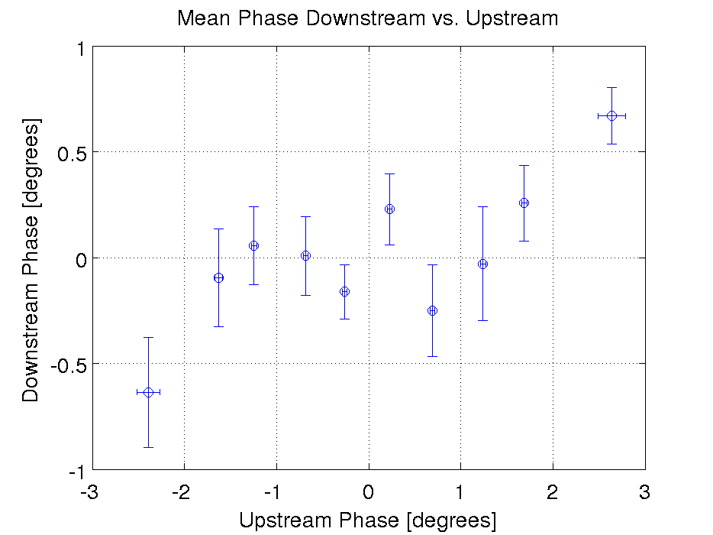
20150715_1414_Gain63: Mean Bin Phase
FF OFF
FF ON
Most extreme bins not corrected to zero.
Pulses distributed between bins based on upstream phase:
8 x 0.5 degree width bins between +/- 2 degrees, plus one bin for all below -2 and one for all above +2.

Slide 17
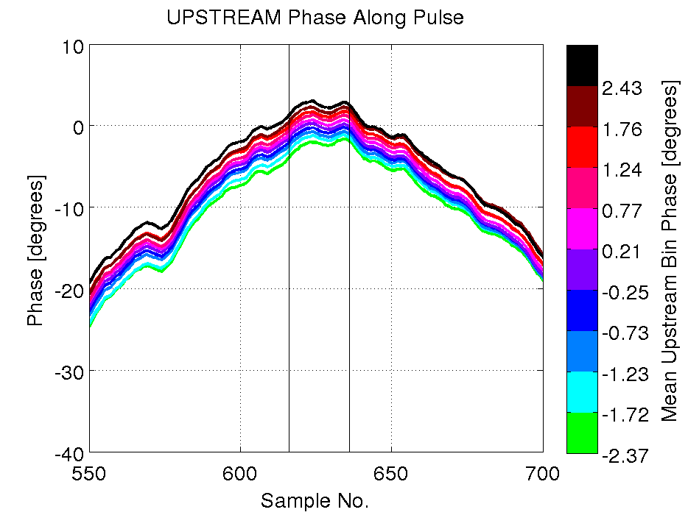
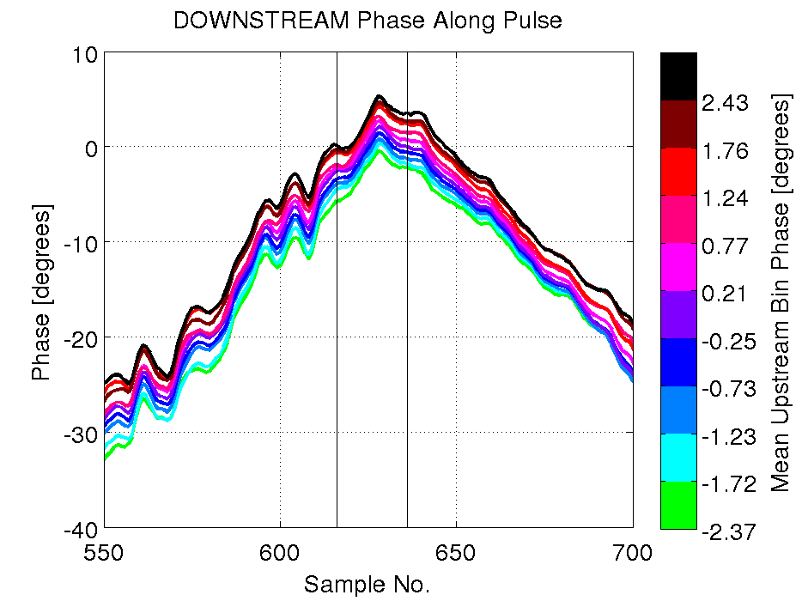
20150715_1414_Gain63: FF Off Binned Phase Along Pulse
FF OFF

Slide 18
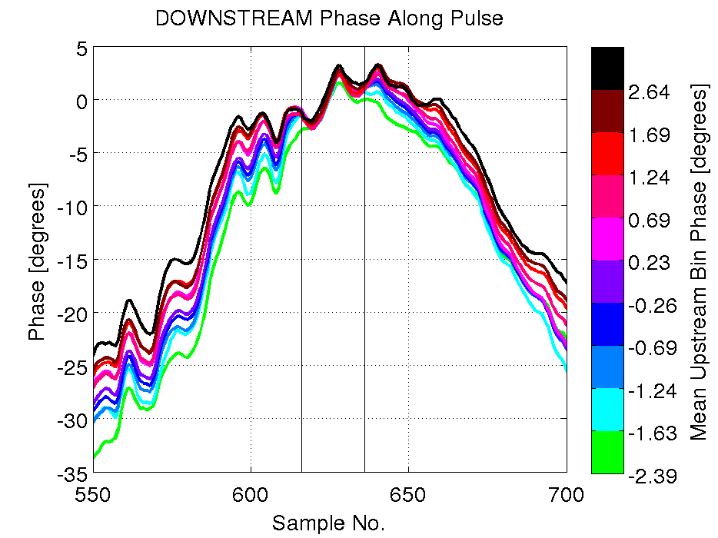
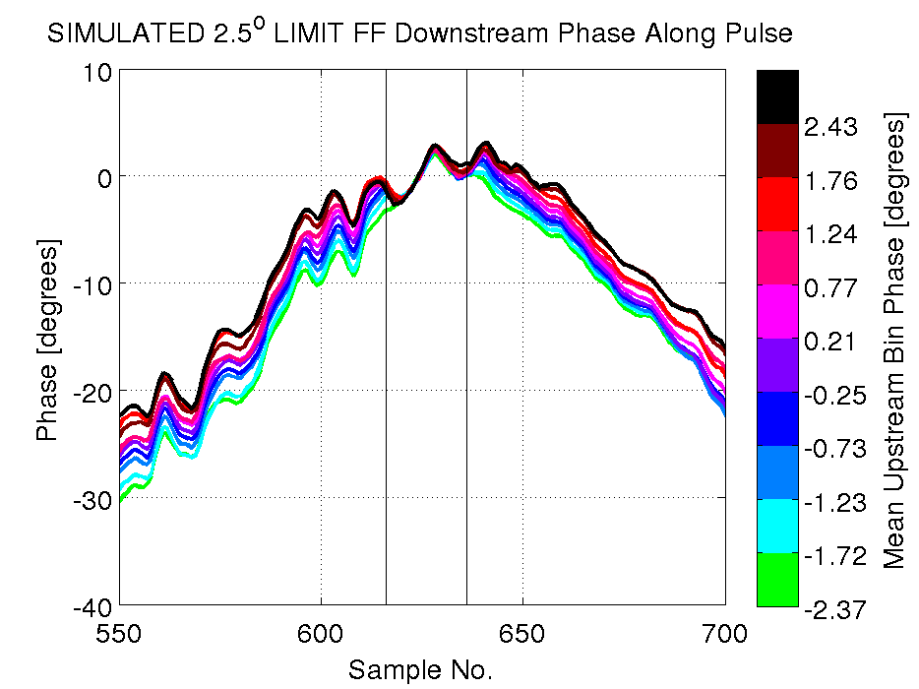
20150715_1414_Gain63: FF On Binned Phase Along Pulse
FF ON
FF SIMULATED +/-2.5
All bins overlapping in central region
Agreement between real FF and simulated 2.5 degree limit FF (using interleaved FF off data) is almost perfect!

Slide 19
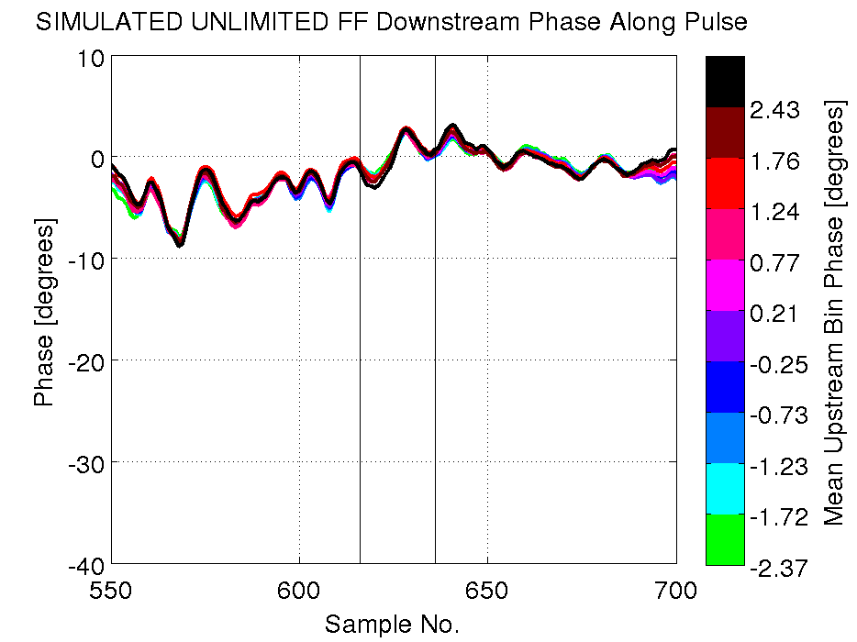
20150715_1414_Gain63: Binned Simulated Unlimited FF
FF SIMULATED UNLIMITED
Simulated unlimited FF results shows nature of remaining uncorrelated phase.
Without limit all bins overlap across the whole pulse length.
Wiggles along the pulse appear on the mean and for all bins -> static shape imposed on the upstream pulse phase.
Cause?
  Energy effects? But R56 optimised.
  Issue with downfield monitor/phase reconstruction from downstream monitor?
  Does it correlate with any other signals (BPMs, PETS)?

Slide 20
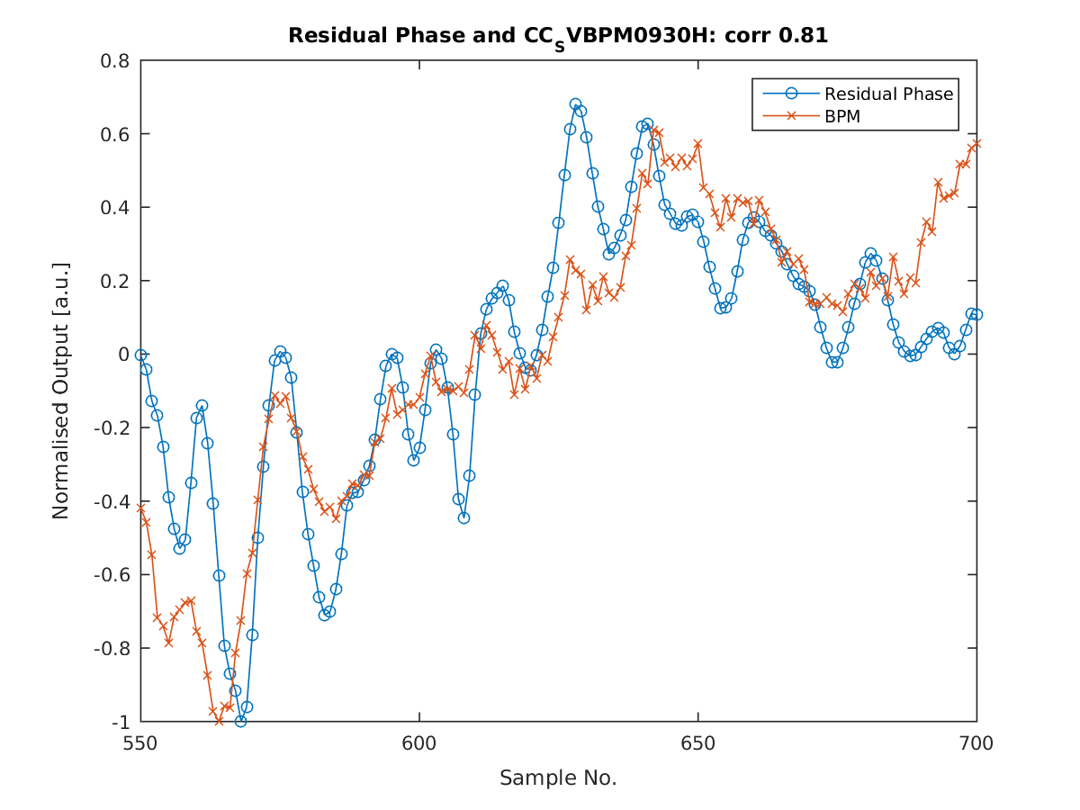
Searching for Correlation with Residual Static Static Shape
Seen hints of correlation with some horizontal positions, this being the most convincing example (last BPM end of TL2 chicane).

Slide 21
Jitter of Shape vs. Jitter of Mean
Jitter on shape:
  For each pulse, standard deviation of difference to mean phase of each sample along the pulse.
Jitter on mean:
  For the dataset, standard deviation of mean pulse phase.

Slide 22
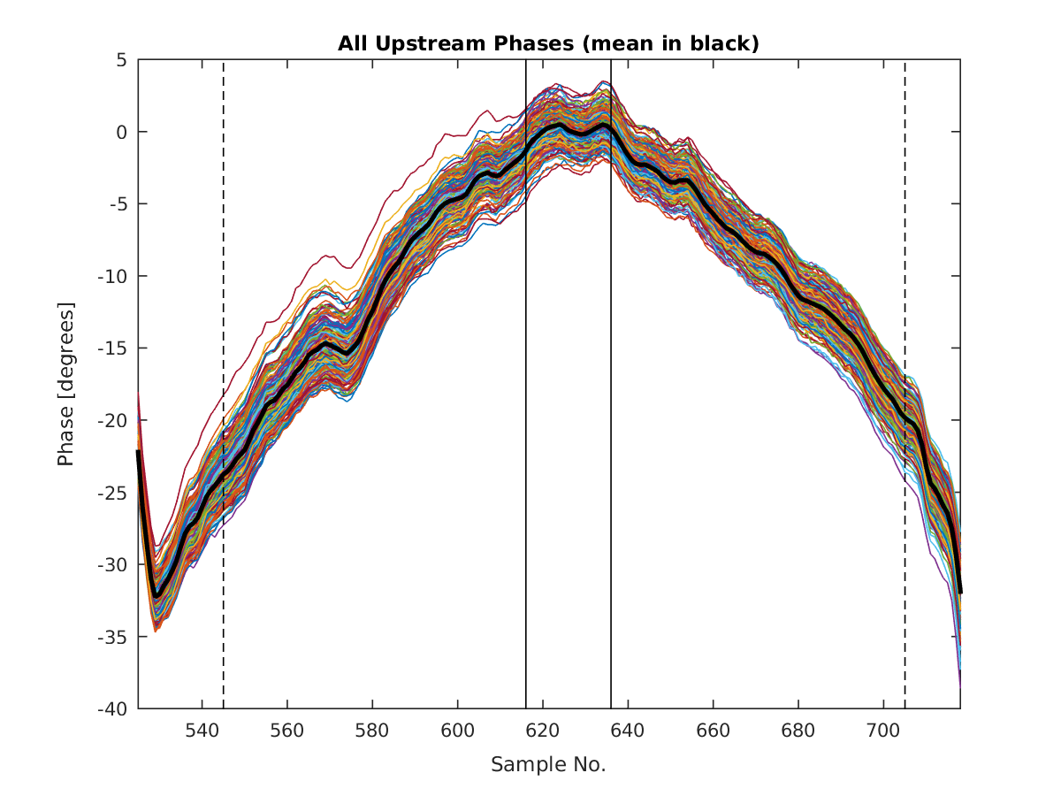
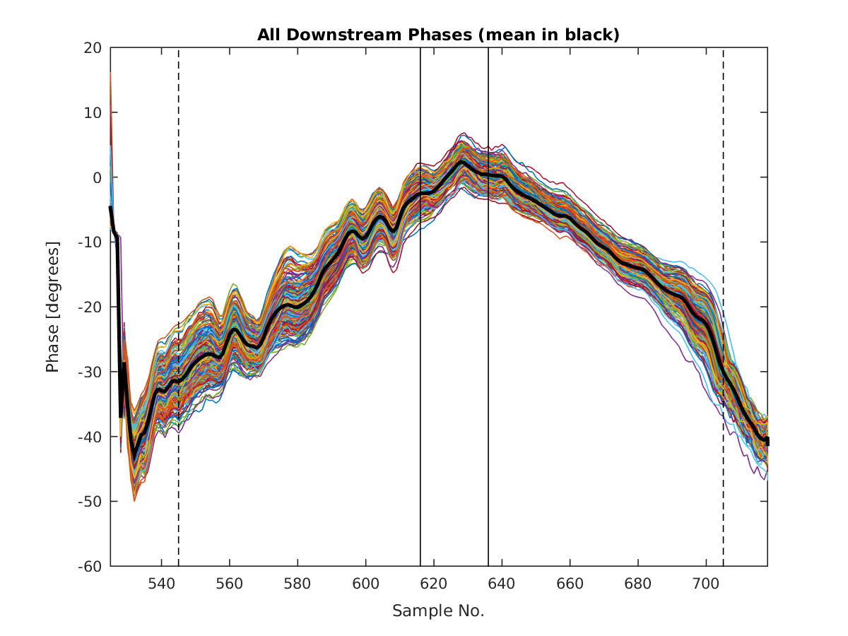
Phase Along Pulse for Whole Dataset
Short sample range (solid vertical lines): Range used for FF statistics calculation.
Long sample range (dashed vertical lines): Range covering ~whole pulse.
Impression by eye: jitter appears to be on mean (whole pulse shifted up/down) rather than shape, oscillations along the pulse preserved in all pulses.

Slide 23
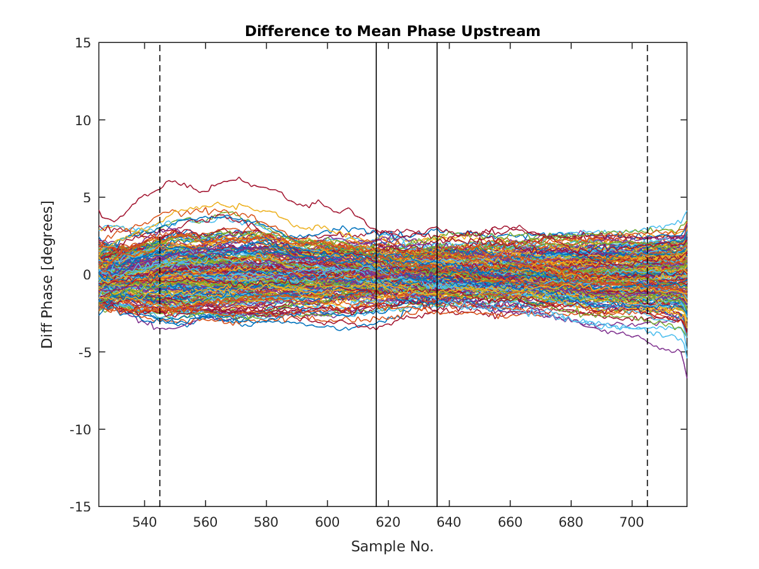
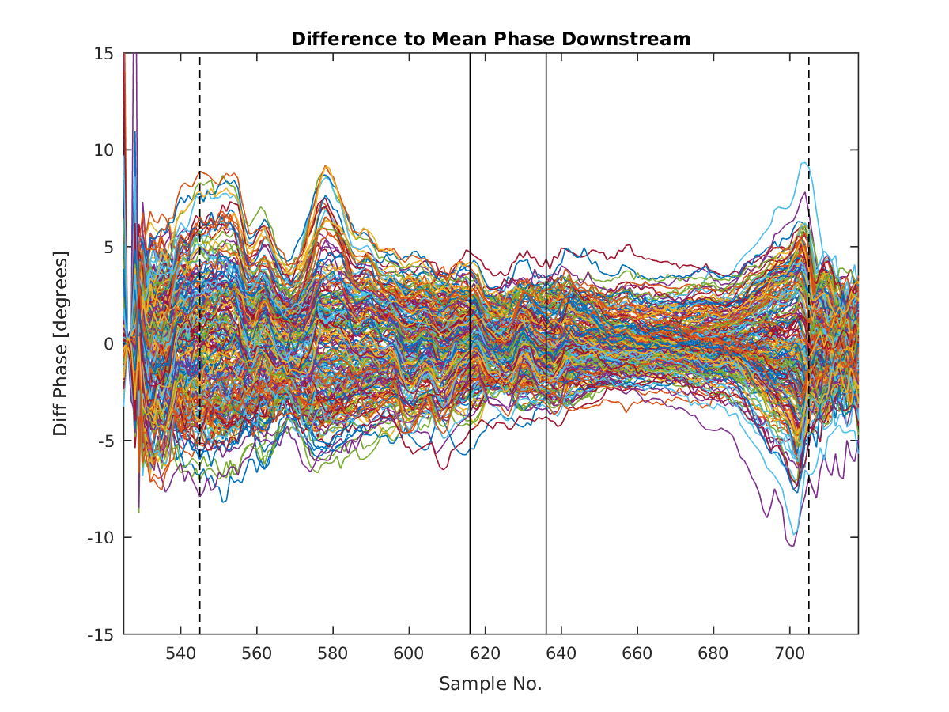
Difference to Mean Phase Along Pulse
Short sample range (solid vertical lines): Range used for FF statistics calculation.
Long sample range (dashed vertical lines): Range covering ~whole pulse.
Upstream the difference looks very flat (shape is conserved).
Downstream some oscillations appear (differences in shape).
Jitter on shape is standard deviation of points in the two sample ranges for each pulse.

Slide 24
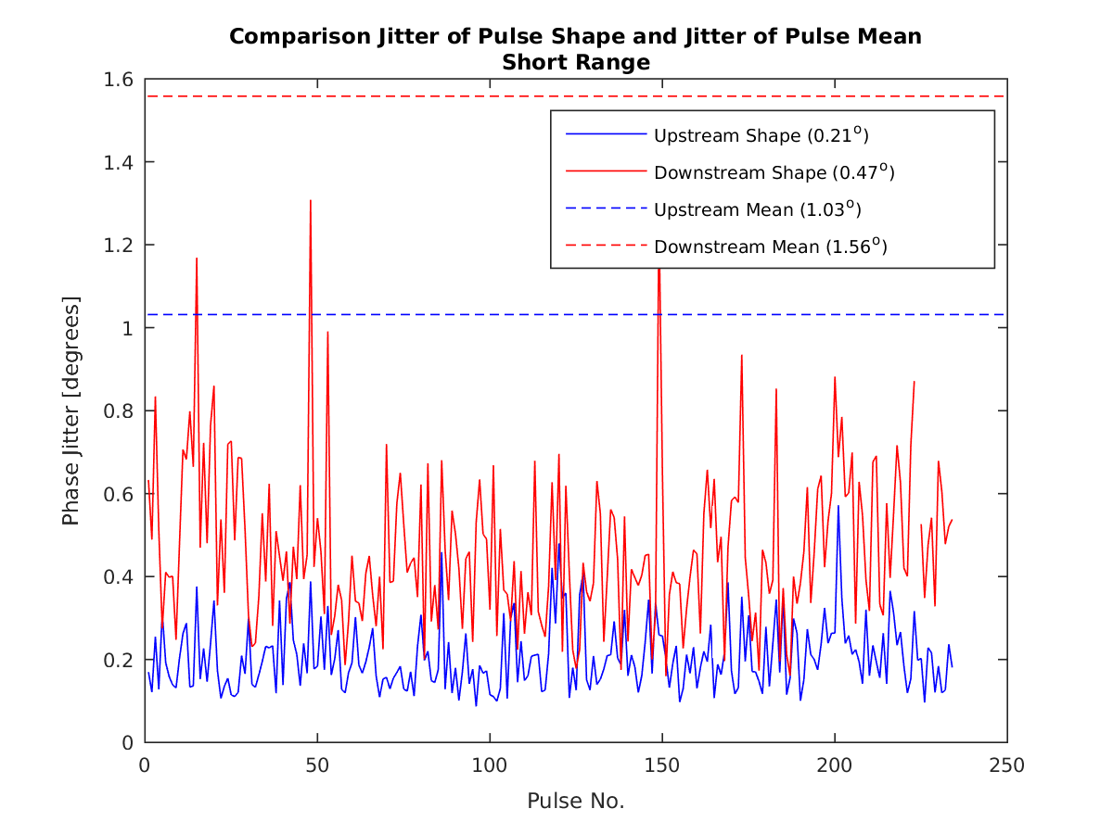
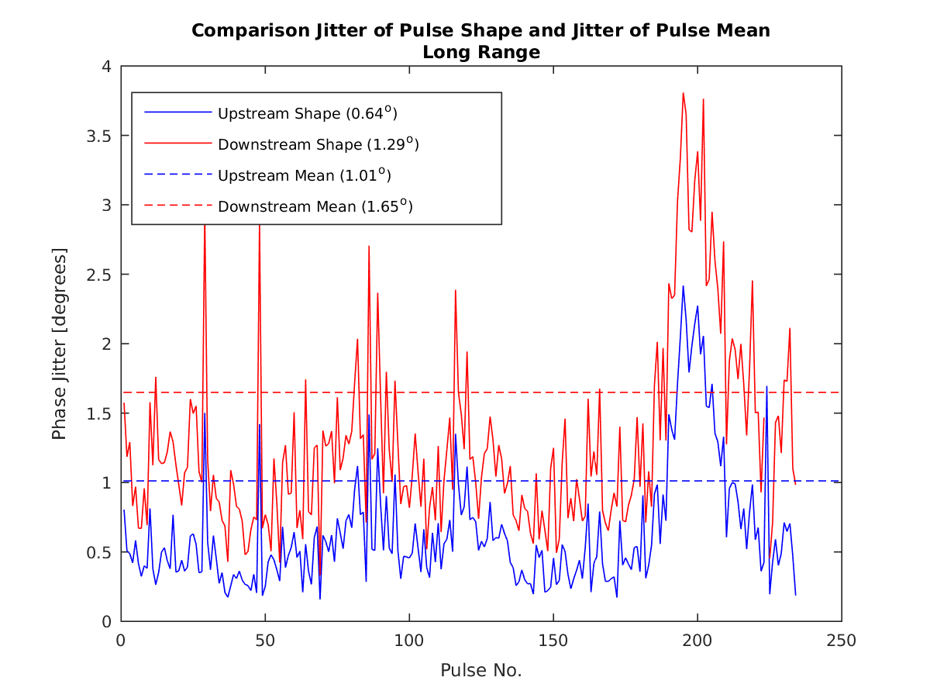
Comparison: Jitter on Shape vs. Jitter on Mean
In the short sample range: Jitter of shape much lower than jitter on mean. Upstream jitter on shape below resolution of monitor.
In the long sample range: Larger jitter on shape, suggests instability of shape at start/end of pulse. Correlates upstream and downstream so not losses.

Slide 25
Summary
Need to investigate why we could remove almost all correlation on the 15th, but were left with 40-50% correlation on the 7th July.
  I am convinced applied gain is ~optimal.
Best FF results agree very well with simulations considering current limitations (also backed up by Murtaza’s results).
Doubling correction range should have a large impact on achieved pulse flatness with FF. But effect on jitter in central region will probably be small.
Trying to identify source of remaining uncorrelated phase component:
  Static shape… or maybe not so static at start/end of pulse.
  Still also have higher jitter downstream -> possibly coming from monitor calibrations (also see jitter difference between upstream monitors).

