Slide 1
The DHCAL and the EIC
José Repond
Argonne National Laboratory
CALICE Meeting
Kyushu University
March 7 – 9, 2016

Slide 2
Funding of the DHCAL
Completely cut starting with FY 2015
Reasons for cut, as provided by people at the DOE
- The DHCAL and CALICE are not aligned with P5
- The problem with the DHCAL is that it was too successful
Recommendation #11: Motivated by the strong scientific importance of the ILC and the recent initiative in Japan to host it, the U.S. should engage in modest and appropriate levels of ILC accelerator and detector design in areas where the U.S. can contribute critical expertise. Consider higher levels of collaboration if ILC proceeds.
Recommendation 10: Complete the LHC phase-1 upgrades and continue the strong collaboration in the LHC with the phase-2 (HL-LHC) upgrades of the accelerator and both general-purpose experiments (ATLAS and CMS). The LHC upgrades constitute our highest-priority near-term large
Recommendation 7: Any further reduction in level of effort for research should be planned with care, including assessment of potential damage in addition to alignment with the P5 vision.

Slide 3
The DHCAL and SiD
SiD baseline
HCAL baseline has always been an RPC-based HCAL
Committee to re-evaluate HCAL options
Jim Brau, Marty Breidenbach, Roger Rusack
No consultation with DHCAL group whatsoever
Recommendation
Change baseline to scintillator-based calorimeter
Arguments summarized in a document (with serious misconceptions)
Protest from Argonne
Ignored

Slide 4
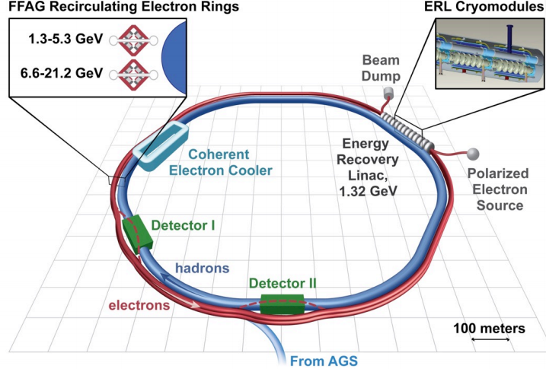
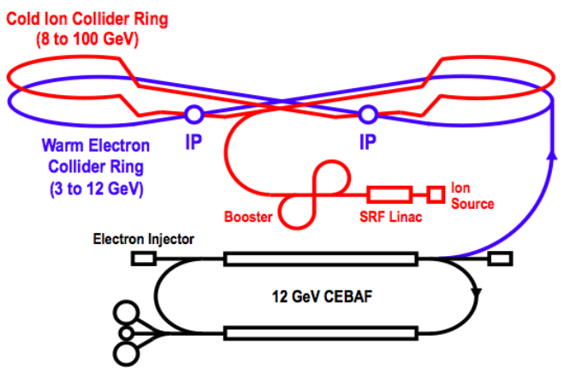
The Electron – Ion Colliders EICs
eRHIC
250 GeV/nucleon protons/ions
1.3 – 21.2 GeV electrons
√s_{ep}= 36 – 146 GeV
Luminosity ~ 4 x 10³³ cm⁻²s⁻¹
JLEIC
8 - 100 GeV/nucleon protons/ions
3 – 12 GeV electrons
√s_{ep}= 10 – 69 GeV
Luminosity ~ 5.6 x 10³³ cm⁻²s⁻¹
For comparison HERA
√s_{ep}= 318 GeV
Luminosity (peak) ~ 10³² cm⁻²s⁻¹

Slide 5
Nuclear Physics in the U.S.
NP Budget
Somewhat smaller than HEP budget: ~$620M
NP Community
Well organized and coherent
Current NP projects
Upgrade of CEBAF (Jefferson lab) to 12 GeV (electrons) ← Completed
Construction of FRIB (Facility for Rare Isotope Beams) ← Completion in 2021/2
Future of NP in U.S.
Construction of EIC (site to be determined, > 2022) ← Will happen

Slide 6
Argonne and the EIC
Physics division
Expertise in non-perturbative QCD
Strong interest in EIC physics (generalized parton distributions, DVCS…)
High Energy Physics Division
Expertise in ep physics (ZEUS at HERA)
Expertise in detector design and optimization
Expertise in detector construction
Collaboration between PD and HEPD
2nd concept of an EIC detector
Laboratory Directed Research and Development (LDRD)
In the process of submitting a ‘strategic proposal
Request for 4 different areas (Theory, Simulation, Detector R&D, Accelerator)

Slide 7
Current ANL Concept: Detector optimized for PFAs
Clear similarities to SiD detector, but
Longish solenoid (to bend forward going tracks)
Thinner solenoid with low field (could even be between ECAL and HCAL)
Perhaps larger inner diameter to enhance PFA performance
Plus: forward detectors (not shown)
Silicon vertex detector
Superconducting coil
Yoke instrumented with Muon chambers
Electromagnetic
calorimeter
Hadron calorimeter
Beam pipe
Silicon tracker

Slide 8
Detector R&D for the EIC
Areas of research
Silicon for both tracker and ECAL: emphasis on timing resolution (goal 10 ps)
RPC-DHCAL: long-term stability studies
Photosensors for RICH/TOF
Budget request
~ $500,000

Slide 9
Recent DHCAL Publications
Electronically Conductive Vanadate Glasses for Resistive Plate Chamber Particle Detectors,
N. Johnson et al., International Journal of Applied Glass Science, 1-8(2015)
→ Description of semi-conductive glass developed by COE college
Tests of a Novel Design of Resistive Plate Chambers,
B. Bilki et al., JINST(2015) 10 P05003
→ Validation of 1-glass RPC design
Measurements of the Rate Capability of Various Resistive Plate Chambers,
M. Affatigato et al., JINST (2015) 10 P10037
→ Tests of fast RPCs
Design, Construction and Commissioning of the Digital Hadron Calorimeter – DHCAL,
C. Adams et al., submitted to arXiv, to be submitted to JINST
Design, Construction and Testing of the Digital Hadron Calorimeter (DHCAL) Electronics,
C. Adams et al., submitted to arXiv, to be submitted to JINST
DHCAL with Minimal Absorber: Measurements with Positrons,
B. Freund et al., submitted to arXiv, to be submitted to JINST

