Slide 1

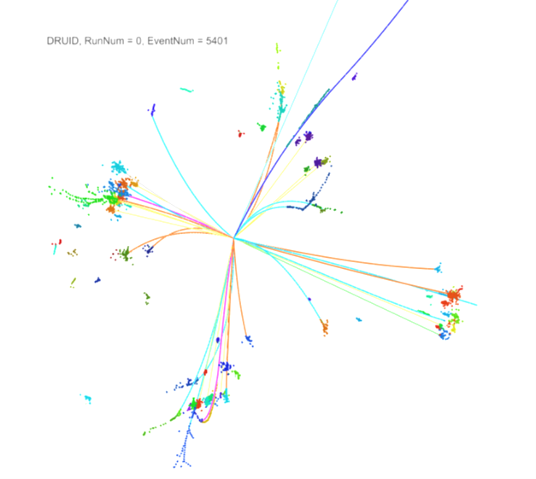





Status of Common DAQ for SDHCAL & Si-W ECAL
L. Mirabito, C. Combaret, F. Magniette, R. Cornat,

Slide 2
Goals
Preparation of a common test-beam (june’16) without modifying the existing systems
Keep all existing HW & SW interfaces
Access through high level functions (configuration, calibration, acquisition)
Evaluation of EUDAQ software
Common GUI for configuration
Central Run control and data collection
First approach of unified timings
HW main supervisor kindly prepared by IPNL (SPILL generator & fan-out, clocks signals, combination of BUSYs)
Mapped to a DCC
First test campaign
IPNL 1-2 March 2016

Slide 3
HW architecture
SDCAL HW & SW
Full 1 m3
HW Main
Supervisor
(DCC)
SPILL / Power-on
SDHCAL CCC
(DCC)
CLK 50 MHz
BUSY
SDHCAL PC
SDHCAL DAQ
+ EUDAQ
ECAL HW & SW
1 SLAB only
ECAL CCC
(EUDET CCC)
Software connectors
CLK 50 MHz
ECAL PC
PYRAME/CALICOES
TRIG_EXT (not used)

Slide 4
Test results : HW setup for synchronisation
Alignment of acquisition windows
SPILL triggers the power-up then a “start-acquisition” validated with a “val_event”
A proper alignment of the “val_event” windows is mandatory in order to get the same BCIDs, ECAL is about 1.4 ms late wrt. SDHCAL
SDHCAL “val_event” can be delayed (programmable in SDHCAL CCC)
Alignment within one slow clock period possible and done
400 ns skew on ECAL side (< 1 BCID)
2.5 µs skew on SDHCAL side has been fixed : now < 1 BCID
Synchronization of SPILL ID
SPILL counters are reset during the configuration procedures
Runs start with the ECAL and SDHCAL counters set to stable and known values (0)
Central clock
Even if it is not mandatory
ECAL CCC can be fed with the 50 MHz clock from the main HW supervisor (common clock)
Use of BUSY to optimize the dead-time
SPILL restarted immediately after end of busy
OK on SDHCAL
BUSY not transmitted by ECAL (fixed & now working at LLR)

Slide 5
Test results : Software
Control of configuration from EUDAQ
EUDAQ sends appropriate global configuration orders to detector systems
Configuration done is reported ok to central SW
EUDAQ state machine is not appropriate for a refined control
Run control and DAQ
EUDAQ generates a run id, sends appropriate orders to detector systems and collects data
Seen working independently for ECAL and SDHCAL alone
Several remarks sent to EUDAQ community
Showstopper issues when declaring two data collectors (may be our misunderstanding)
Support from EUDAQ community is asked for on-site debugging
Alternate Run Control and DAQ
Detector subsystems can be configured to collect data from other subsystems
ECAL SW collects data from SDHCAL (Preliminary test successful)
SDHCAL SW is able to collect data from ECAL SW (under development)

Slide 6
HW architecture for common DAQ at the end of the first test period
SDCAL HW & SW
Full 1 m3
HW Main
Supervisor
(DCC)
SPILL / Power-on
SDHCAL CCC
(DCC)
CLK 50 MHz
BUSY
SDHCAL PC
SDHCAL DAQ
+ EUDAQ (slow_control)
ECAL HW & SW
1 SLAB only
ECAL CCC
(EUDET CCC)
Software connectors
ECAL PC
PYRAME/CALICOES (DAQ)
TRIG_EXT

Slide 7
Conclusion : SiWECAL/SDHCAL Common DAQ
First attempts are satisfactory
  Successfully configured detectors from central EUDAQ SW
  Successfully acquired data from central SW (PYRAME) and attempts with EUDAQ
  Seen issues fixed now at lab. (ECAL BUSY ; SDHCAL jitter)
  Run starts with time_stamp counters properly reset
  Acquisition windows (and BCIDs) aligned within 0 … +1 :
  to be checked using several GDCC (ECAL)
Forthcoming tasks
  Add a SW controlled veto on Main HW supervisor to prevent SPILL during configuration
  Debug EUDAQ and/or develop alternate (straight forward) solutions
  Add more ECAL slabs and assemble the 2 detectors
  Monthly tests campaigns
Remarks have been sent to EUDAQ community
  Together with a demand for support and an invitation to come & help during our tests

Slide 8
Si-W ECAL
The Si-W ECAL system will not be modified
Can be considered as a black box
Known hardware & software interfaces
External master system provides necessary signals/software orders
Conversion from system clock to 50 MHz not provided (can be external or internal to the main supervisor)
SPILL / Power-on
Clock
PLL
CLK 50 MHz
ECAL inc. HW, PC & SW
System CLK
TRIG_EXT
BUSY
Main
supervisor
Software connectors

Slide 9
SDHCAL
The SDHCAL system will not be modified
(except at its interfaces)
Can be considered as a black box
Known hardware & software interfaces
External master system provides necessary signals/software orders
SPILL / Power-on
CLK 50 MHz
SDHCAL inc. HW (SDCC, DCCs, DIFS and ASUs),
PC & SW
CLK 50 MHz
TRIG_EXT
BUSY
Main
supervisor
Software connectors

