Slide 1
Brief Update: Simulations
Code Edited From Jochem Snuverink
Ryan Bodenstein
FONT Meeting
2015/10/02

Slide 2
Have a “perfect” beamline.
  Editing the code to get all of the outputs for the perfect beamline
    Can get the final ones, but I’m having issues getting the pieces from the rest of the beamline
  Perfect beamline is almost identical to what I had before.
Working on getting outputs throughout the beamline
Tried turning on some PLACET commands which failed for reasons that escape me
Meeting with Jochem moved to next Monday, should resolve some of these problems at least.

Slide 4
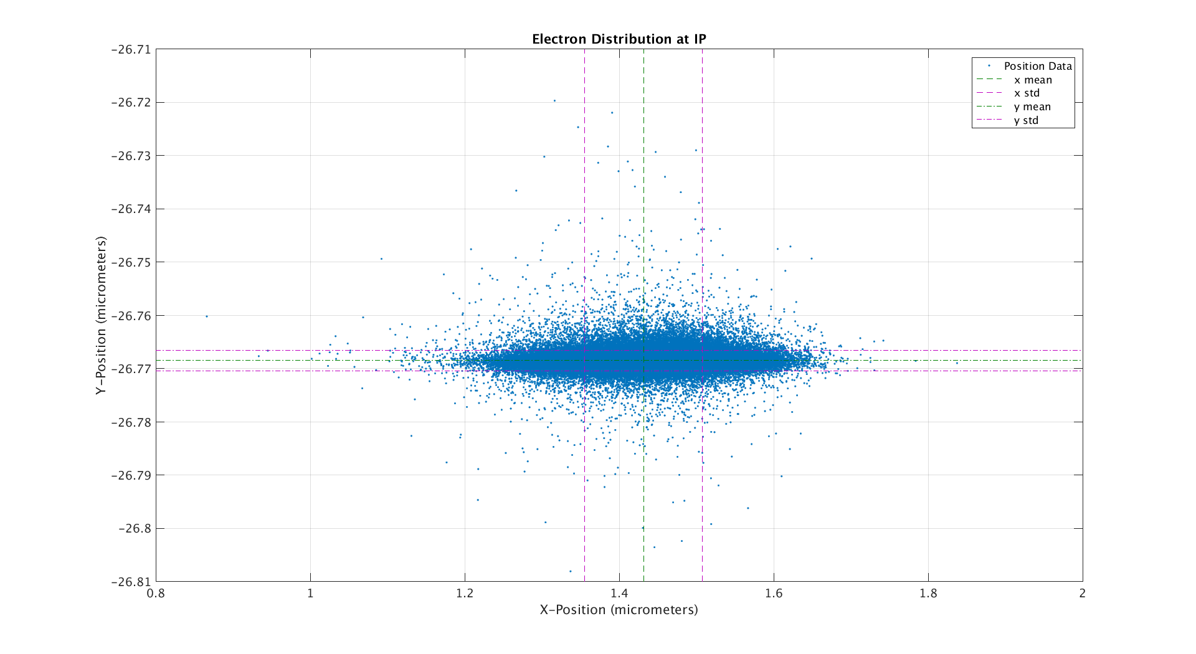

Slide 5
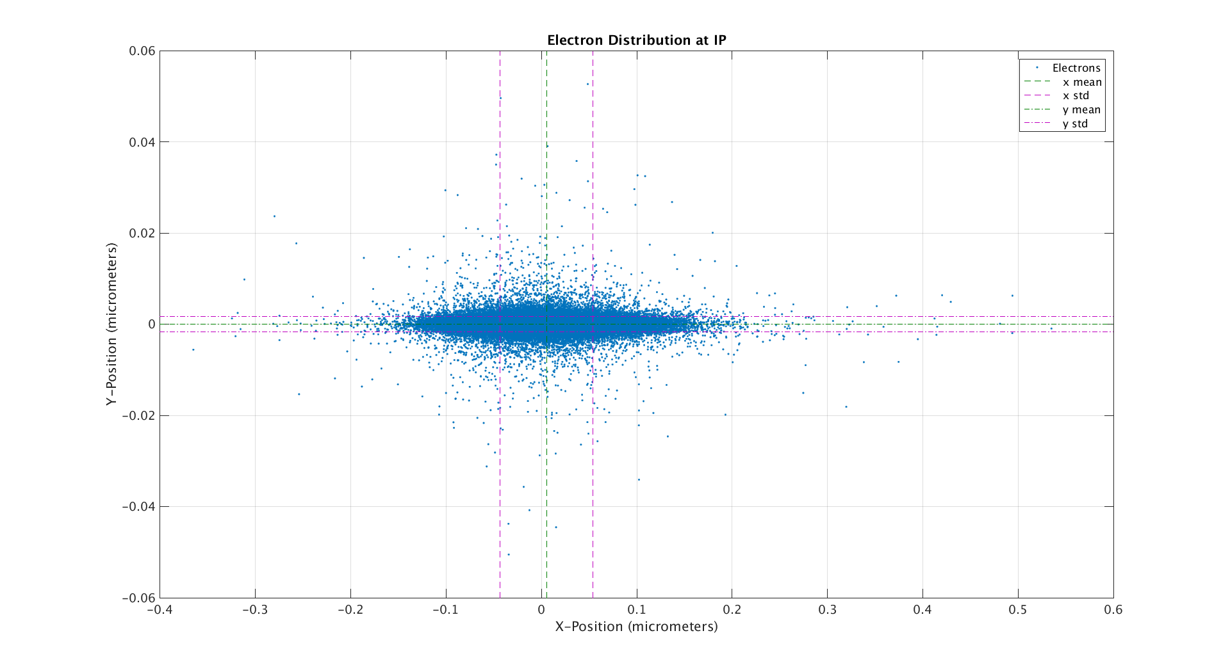

Slide 6
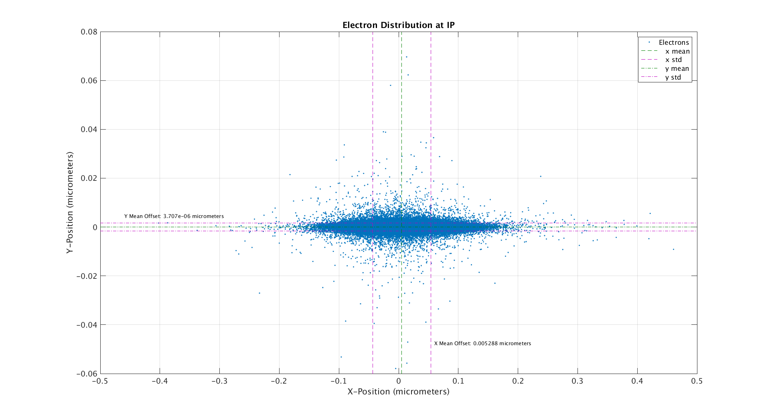

Slide 7
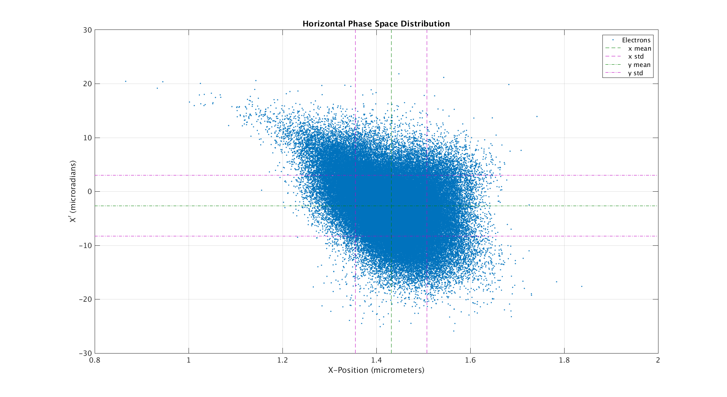

Slide 8
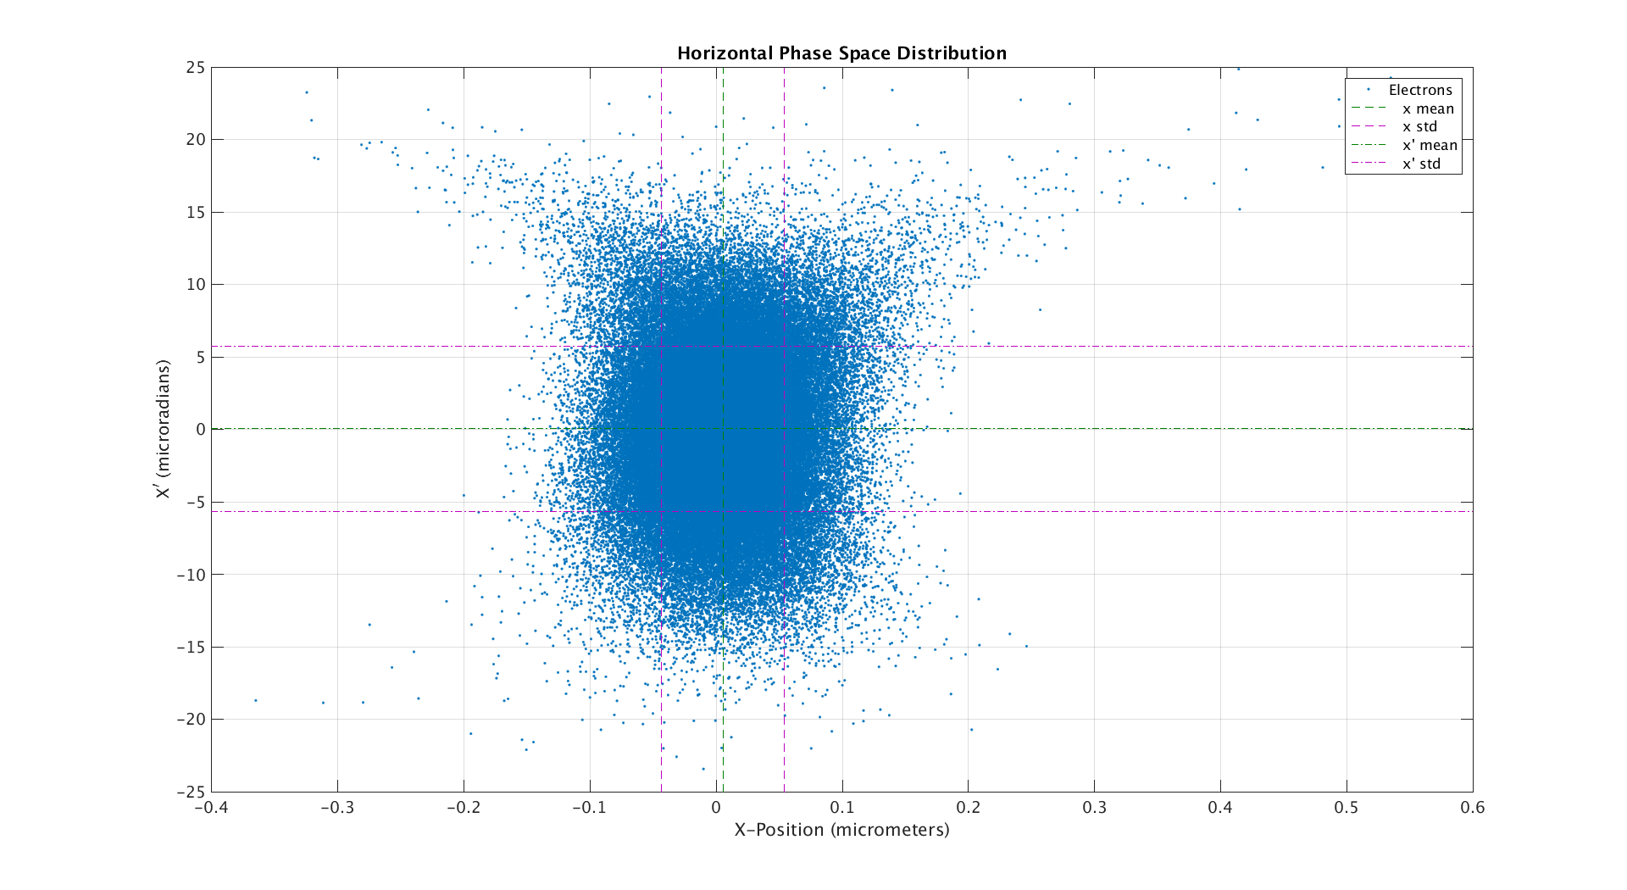

Slide 9
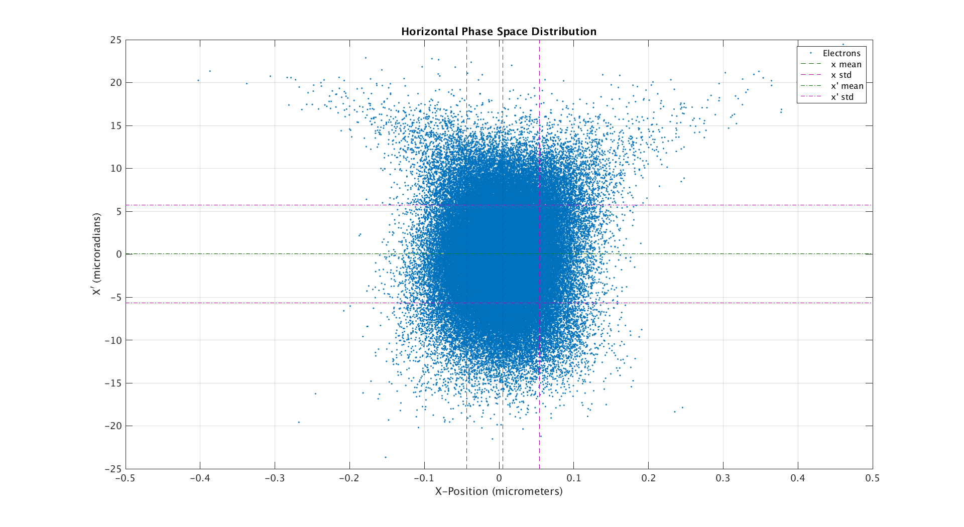

Slide 10
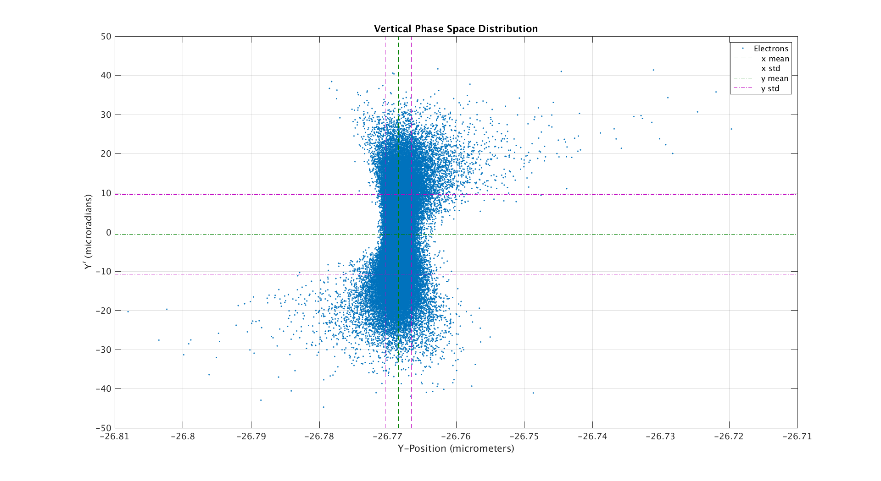

Slide 11
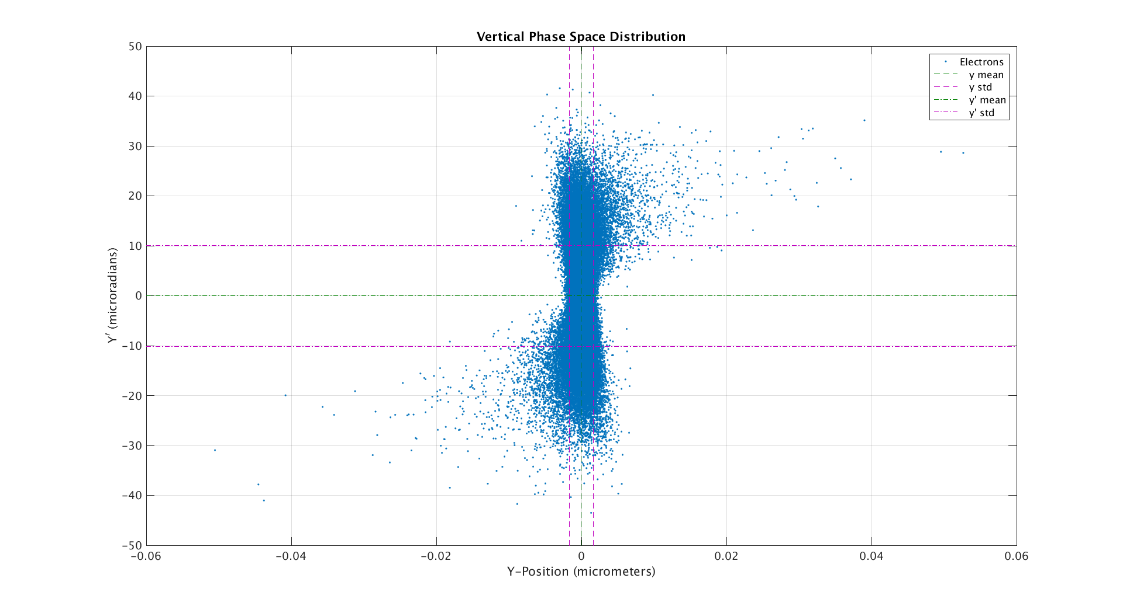

Slide 12
