Slide 1
Course B: rf technology
Normal conducting rf
Part 2: rf-to-Beam Coupling
Walter Wuensch, CERN
Ninth International Accelerator School for Linear Colliders
Whistler, British Columbia, Canada
26 October to 6 November 2015

Slide 2
We have looked rf structures in order to understand how to get an interaction between an rf field and a relativistic beam – the issues were mainly getting synchronism and getting the electric field to point in the right direction.
Now we are going to look at the terminology and formalism to describe how much acceleration the beam actually gets.
We are going to study how much energy you transfer to the beam from a certain stored energy in a standing wave cavity or power flow in a travelling wave cavity.
We approach this in steps.
First look at a dc gap,
then an rf gap
At this moment we will really focus on understanding the energy/power balance.
Then we will look at how travelling wave structures are dealt with.
Finally we will look at the details of efficiency in plus a number of special cases. In this section we cover not just getting the acceleration, but also getting it in a green and sustainable way!

Slide 3
The basics
Acceleration is typically measured in units of MV/m, ILC around 30 MV/m and CLIC 100 MV/m.
We are looking for the answers to precise questions like:
How much energy gain will I get from a particular structure if I put in 45 MW?
What fraction of my input power will go into accelerating a 1 amp beam? What happens if I increase the current to 2 amps?
We will develop quantities which variously relate
voltage seen by the beam
gradient
energy of the rf fields
power of the rf fields
power of the beam
We will of course tend to focus on the electric field since we are talking about accelerating electric charges!

Slide 4
Let’s look together for a moment at a simple capacitor plate (big enough one so we don’t have to worry about edge effects) to make sure we are familiar with all the relevant quantities in a simple case.
d [m] gap size, A [m²]area
Electric field:
cathode
anode
Energy gained by bunch:
charge q [C]
Stored energy in electric field:
- P [V]
ground

Slide 5
Now an rf ‘cavity’ (without being specific about the details of what it is):
The ‘voltage’ of an rf gap is of course more complicated because the fields are oscillating while the beam takes the time to cross the gap. Remember the definition of the transit time factor from section 1:
We will use the numerator again, which is the effective gap voltage:
The magnitude is the highest acceleration you get from the cavity.
remember this is a complex number
TM₀₁₀ mode

Slide 6
For the stored energy in a cavity we need to include both the electric and magnetic field:
Putting the two terms we can define:
Which has units of Ω.
R/Q – relates the amount of acceleration (squared) you get for a given amount of stored energy. If the electric fields are concentrated along the central axis of a cavity this term is large. You can use computer programs to get actual values.
The numerator and denominator both scale with field squared, so it is independent of field level. It turns out that this term is independent of frequency as well for scaled geometries.
You can do lots of useful calculations knowing this term. But let’s dig deeper.

Slide 7
Going a step further
Our goal now is to derive and understand the loss factor, k.
Accelerating a beam extracts energy from a cavity (and by the way that’s what we need to do to get high rf to beam efficiency).
The beam gains energy when you accelerate so the rf fields must loose energy.
We’ll attack this by considering the question “How much energy does a traversing beam leave behind in a particular mode of an empty cavity?” and then superimpose the solution on a filled cavity, which is how we normally think of acceleration.

Slide 8
Concepts we will use
In this section we will often consider the driven rf fields (driven by a klystron or whatever), consider the fields the beam leaves behind and add the two together to get our final answer – superposition of beam and rf fields.
There is another subtlety we will use which is that you can break the problem up mode by mode, add them up and get the right answer. Another way of saying this is that all the eigenmodes of the cavity are orthogonal basis functions for all the possible fields in the cavity. You can expand reality as a Fourier series over all the cavity modes.
We will also consider driving bunches, these are the real bunches of the problem with finite amount of charge, and witness charges. Witness charges are basically just integrals over fields but it is useful to think of charges which follow the main one but have almost no charge so don’t affect the fields themselves.

Slide 9
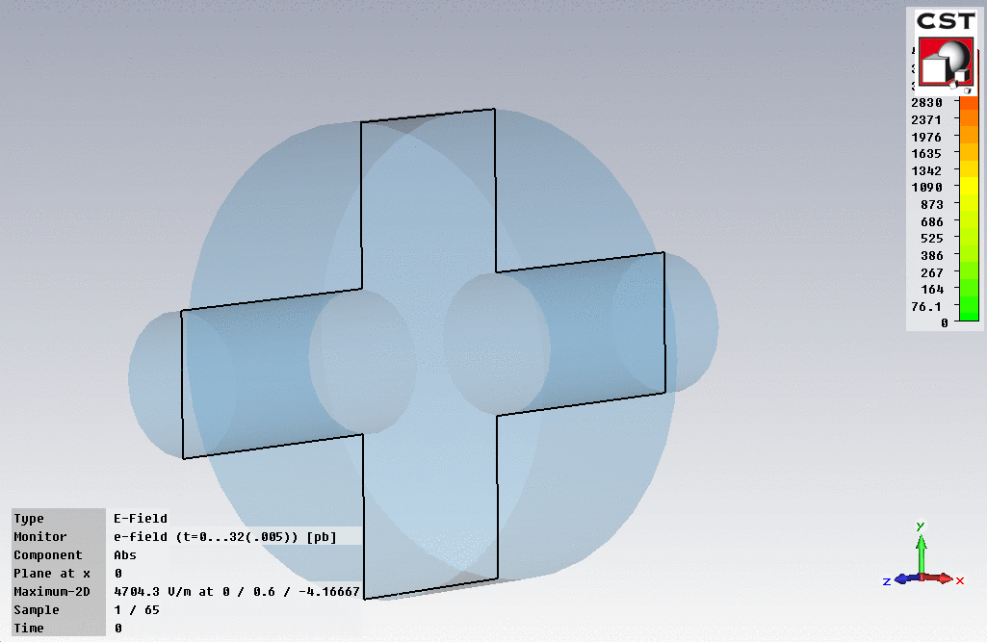
A charge passing through a cavity leaves behind it the cavity with voltage in it, and hence filled with energy. The beam loses the same amount of energy. The loses energy through interacting with an electric field, which in fact comes from itself.

Slide 10
Something to think about:
The charge interacting with the fields it makes itself is in direct analogy to the radiated electric field produced by a current that you see when discussing the retarded potential in free space. For a current in the y direction,
You normally think of currents producing magnetic fields but of course to transfer energy to an electromagnetic field there has to be movement of an electrical charge in the direction of an electric field.

Slide 11
The fundamental theorem of beam loading
The fundamental theorem of beam loading says that the voltage seen by beam which has traversed a cavity is half the voltage it leaves behind, that is the one that a following witness bunch would see.
A non-rigorous way of seeing this, is that the cavity is empty when the beam enters and only full when it leaves – so on average it sees the cavity only half full (or half empty, like the proverbial glass!). A more rigorous understanding requires the formalism of longitudinal wakefields we will cover in section 4.
Is this easier to understand than the free-space case?
But in the mean time let’s introduce a loss factor k which satisfies this factor of two. The voltage left is proportional to the charge so:

Slide 12
The loss factor k
Let’s now consider conservation of energy, what the bunch loses the cavity gains:
Equations we will use
So the higher the R/Q the more field left behind in a mode by a given charge.

Slide 13

Now let’s look at a cavity that already has fields in it
Everybody’s first understanding is that the beam is just sees the accelerating fields that are there because we pump lots of microwaves into a cavity. But this is only true if the bunch charge is low, and we have negligible rf-to-beam efficiency.
In a linear collider we have rf-to-beam efficiency in the range of 30% to deal with the 10’s of MW average power beams we need to accelerate.
So let’s now look at a cavity with field in it that gives V₀ and currents which are leaving fields which are non-negligible.
The essential insight is that a passing bunch reduces the fields inside a filled cavity in exactly the same way as an empty cavity - superposition:
V
$$V′$$
ΔV

Slide 14
Checking consistency through energy balance
Beam
Cavity
Before bunch passage
After bunch passage
Consistent!

Slide 15

Tonight you will re-do this consistency check – but with arbitrary input phase!
ΔV
V
$$V′$$

Slide 16
In a real cavity, we of course have the losses we saw in section 1. To deal with this we introduce the shunt impedance. We start with R/Q, which is independent of any losses,
And take our definition of Q,
To define the shunt impedance,
The units of R are again Ω, and a typical normal conducting cavity has an R in the range of M Ω. Note that both numerator and denominator scale with field squared. R is a measure of the acceleration to the losses and is often a quantity you optimize when designing an rf cavity.

Slide 17
Now travelling wave structures
We’ve just gone through an analysis where we have considered stored energy. This is straight forward to apply to standing wave structures
You will be doing some numerical examples in homework problems.
But the basic concepts remain the same for travelling wave structures. We have to extends things a bit and make sure we are accounting for all the energy going in and out of our problem.
Firstly we are going to consider a single cell of an infinitely long periodic structure which has been tuned to v_{phase}=c, i.e. a synchronous wave. This is quite reasonable since tuned cells are usually what we deal with.
The fact that the phase and beam velocities are the same gives us the periodicity to easily do all of our calculations on a single cell.

Slide 18
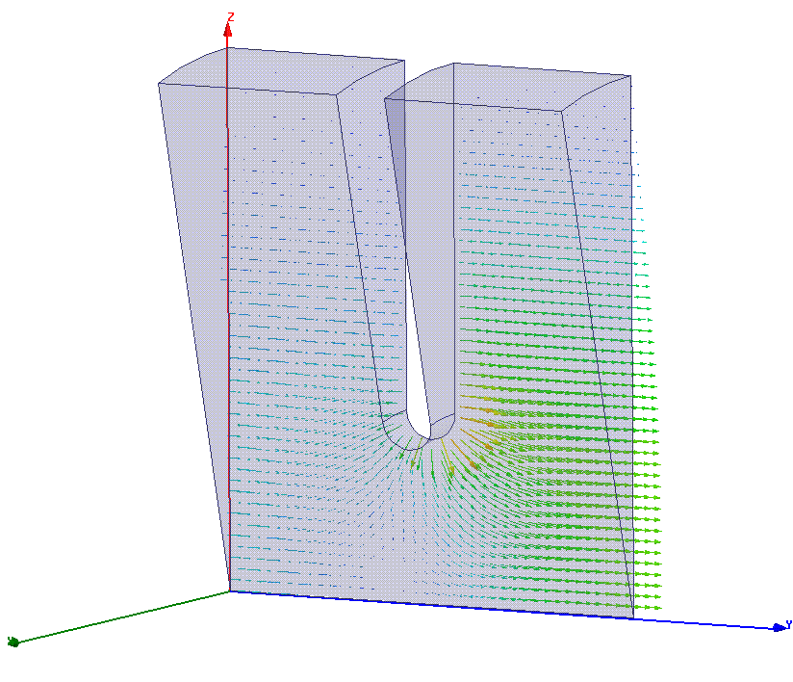
Single cell electric field pattern 2π/3 phase advance

Slide 19
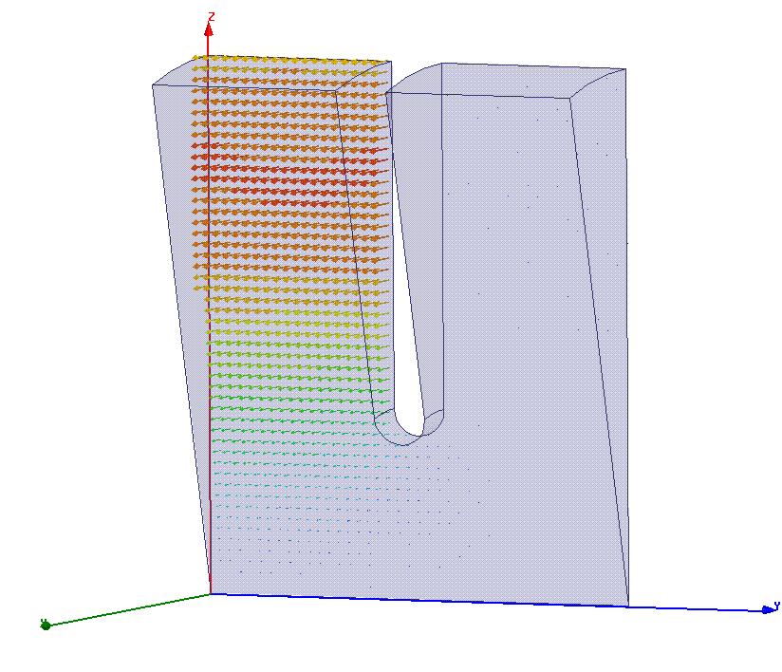
Single cell magnetic field pattern 2π/3 phase advance

Slide 20
Standing to travelling wave
We will take over our definition of R/Q and shunt impedance and define it per cell, but then divide by the length of the cell, l, to get R’/Q and R’ which are per unit length.
The other thing we will do is to put these quantities in terms of power flow rather than stored energy since this is the natural quantity for travelling wave structures.
The relationship between power flow and stored energy is,
And we can get the relationship between accelerating gradient G, voltage per unit length (which is valid over one cell length), and power flow,

Slide 21
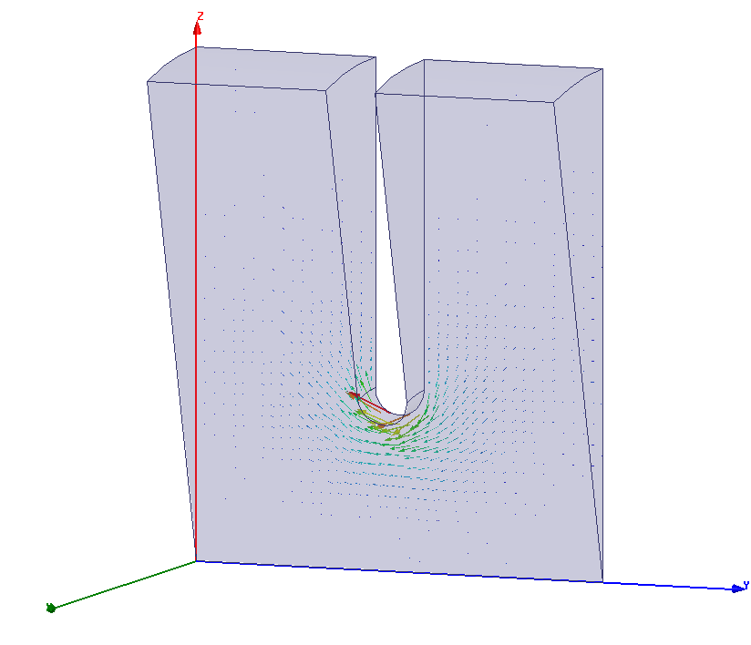
Power flow in disk loaded waveguide 2π/3 phase advance
Real part of complex Poynting vector

Slide 22
Now to meaningfully deal with travelling wave accelerating structures we will derive a differential equation which accounts for:
power flowing along the structure
power being transferred to the beam (acceleration)
power being lost to the cavity walls
Seeing the derivation of the differential equation will give you insight into how to approach specific problems and give you practice using the terms we have introduced.
In our initial analysis, we are only going to consider steady state conditions. We will generalize later.

Slide 23
Charge to current
We now need to make a little jump – from the beam loading due to a single bunch to thinking about beam loading from a current.
We know how to deal with a single charge q:
But we can add the voltages from successive bunches if they are spaced by integer number of fundamental wavelengths:
Δt
which give us a current:
We can also think of the Fourier series of the bunch train charge and make all our integrals of R/Q etc. for a wavelength equal to the mode we are considering. It amounts to the same thing.

Slide 24
Power flow and beam loading picture
Slice of power travelling at v_{g}
Bunch train travelling at c
Beam adds (in phase or 180 degrees out of phase) voltage to power slice.
Cavity walls attenuate power as it propagates.

Slide 25
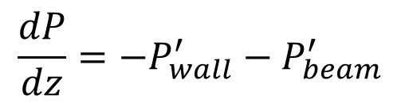
Let’s set up a differential equation based on power conservation
Power to the beam
Power to the wall
$$\frac{dP}{dz}=−P_{wall}^{′}−P_{beam}^{′}$$
The power losses to the walls are easiest:

Slide 26
Now power going from the rf to the beam
differentiating

Slide 27
Continuing bravely onwards
Beam loading term
We finally get:
Wall losses term

Slide 28
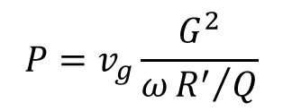

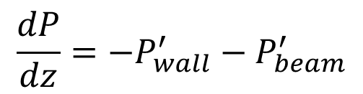
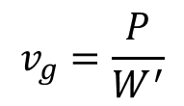
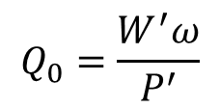
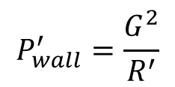
Tonight, during the homework session, you will re-derive and/or re-express this differential equation in terms of gradient. Here again are the terms you will need:
$$\frac{dP}{dz}=−P_{wall}^{′}−P_{beam}^{′}$$
$$P=v_{g}\frac{G^{2}}{ω{R^{′}}/Q}$$
$$v_{g}=\frac{P}{W^{′}}$$
and
Power flow relations
$$P_{wall}^{′}=\frac{G^{2}}{R^{′}}$$
$$Q_{0}=\frac{W^{′}ω}{P^{′}}$$
and
Wall losses
$$P_{beam}=GI$$
Beam acceleration

Slide 29
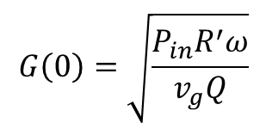
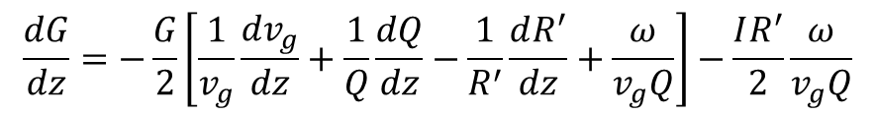
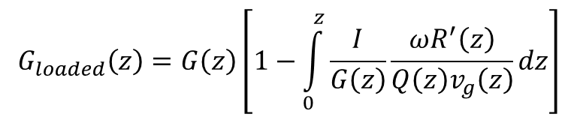
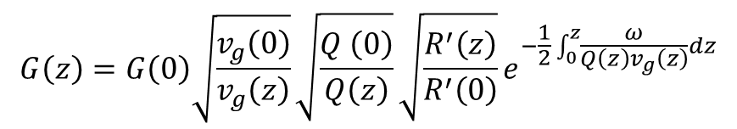
The general differential equation in terms of gradient
$$\frac{dG}{dz}=−\frac{G}{2}\left[\frac{1}{v_{g}}\frac{dv_{g}}{dz}+\frac{1}{Q}\frac{dQ}{dz}−\frac{1}{R^{′}}\frac{dR^{′}}{dz}+\frac{ω}{v_{g}Q}\right]−\frac{IR^{′}}{2}\frac{ω}{v_{g}Q}$$
$$G\left(0\right)=\sqrt{\frac{P_{in}R^{′}ω}{v_{g}Q}}$$
Solutions in closed form
$$G\left(z\right)=G\left(0\right)\sqrt{\frac{v_{g}\left(0\right)}{v_{g}\left(z\right)}}\sqrt{\frac{Q \left(0\right)}{Q\left(z\right)}}\sqrt{\frac{R^{′}\left(z\right)}{R^{′}\left(0\right)}}e^{−\frac{1}{2}\int_{0}^{z}{\frac{ω}{Q\left(z\right)v_{g}\left(z\right)}dz}}$$
$$G_{loaded}\left(z\right)=G\left(z\right)\left[1−\int_{0}^{z}{\frac{I}{G\left(z\right)}\frac{ωR^{′}\left(z\right)}{Q\left(z\right)v_{g}\left(z\right)}dz}\right]$$
A. Lunin, V. Yakovlev, A. Grudiev PRSTAB, 14, 052001 (2011)

Slide 30
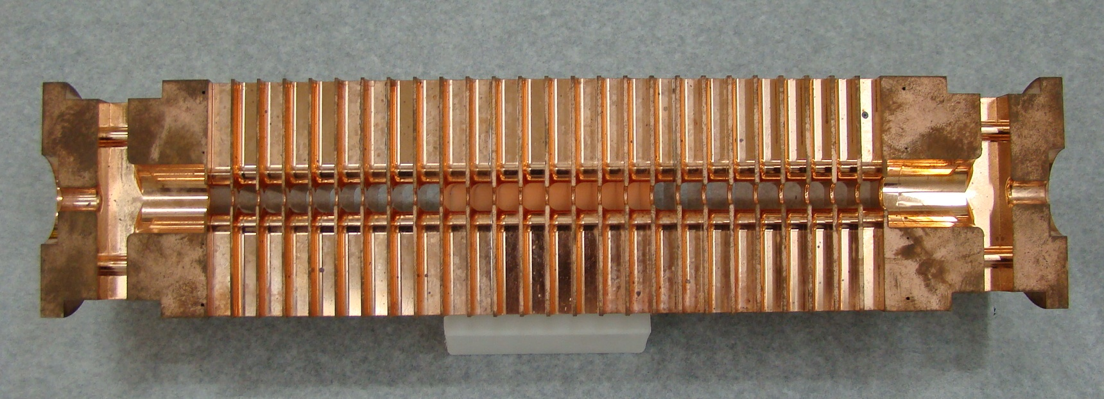
An example of the solutions to this equation for constant gradient (all cells are the same):
100 MV/m
Field goes down because of wall losses.
Field goes down because power goes into beam.
rf power in
Distance along structure
Wall losses
Less power out
Beam accelerated

Slide 31
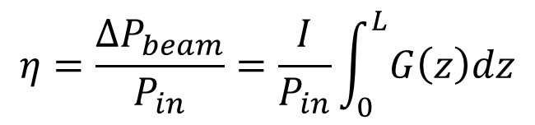

Now we ask ourselves – How efficiently have we converted rf power into beam power? To ask it using accelerator jargon – What is the rf-to-beam efficiency?
This is one of the most important performance issues for a normal conducting linear collider since it directly affects the overall performance.
Power into structure
Output coupler
Wall losses
Power into beam
$${∆P}_{beam}=I\left\langle G\right\rangle L$$
$$η=\frac{{∆P}_{beam}}{P_{in}}=\frac{I}{P_{in}}\int_{0}^{L}{G\left(z\right)dz}$$

Slide 32
Different amounts of beam loading and efficiency
0 current
More current, more efficient
Very efficient
Interesting question!
Distance along structure

Slide 33
HFSS Port and Plane Wave Excitations

Slide 34
Now let’s assume that every cell of the structure is the same.
The jargon for this is that we have a constant impedance structure.
This simplifies the equations a lot to give:

Slide 35
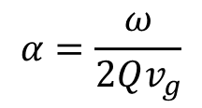
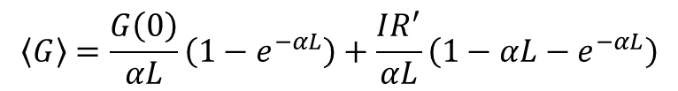

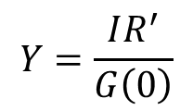

Constant impedance travelling wave structure, length L
$$G\left(z\right)=G\left(0\right)e^{−αz}−IR^{′}\left(1−e^{−αz}\right)$$
$$α=\frac{ω}{2Qv_{g}}$$
Note that:
$$G\left(∞\right)=−IR^{′}$$
Ohms law!
$$\left\langle G\right\rangle =\frac{G\left(0\right)}{αL}\left(1−e^{−αL}\right)+\frac{IR^{′}}{αL}\left(1−αL−e^{−αL}\right)$$
$$η=2Y\left(1−e^{−αL}\right)+2Y^{2}\left(1−αL−e^{−αL}\right)$$
$$Y=\frac{IR^{′}}{G\left(0\right)}$$
Where:

Slide 36
Optimising the accelerating structures - tapering
Accelerating
Gradient [MV/m]
Distance along structure
If we don’t do anything the fields drop along the length of the structure. We will see in the section on high-gradients that this is not optimum, we lose high-gradient potential because we are limited by the front of the structure.
Instead we taper the iris aperture of the structure down.

Slide 37
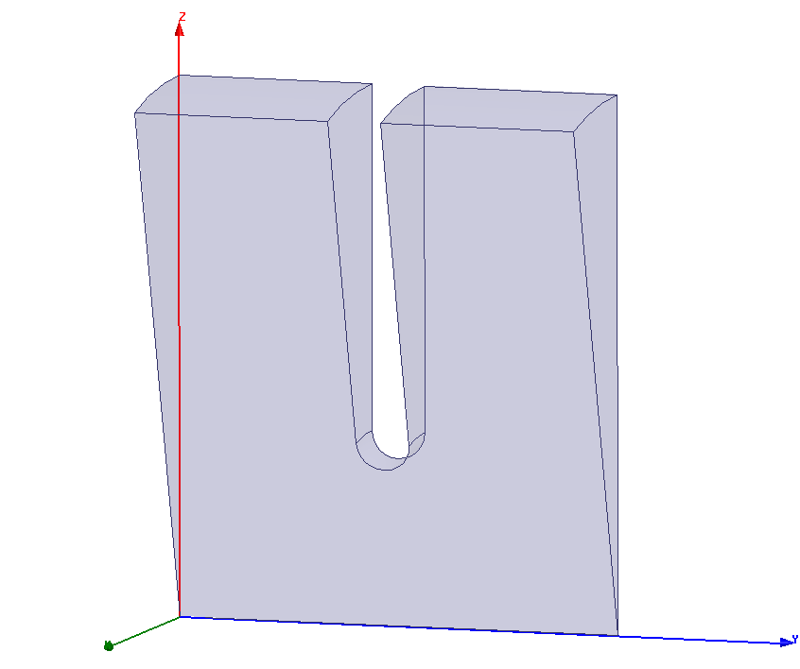
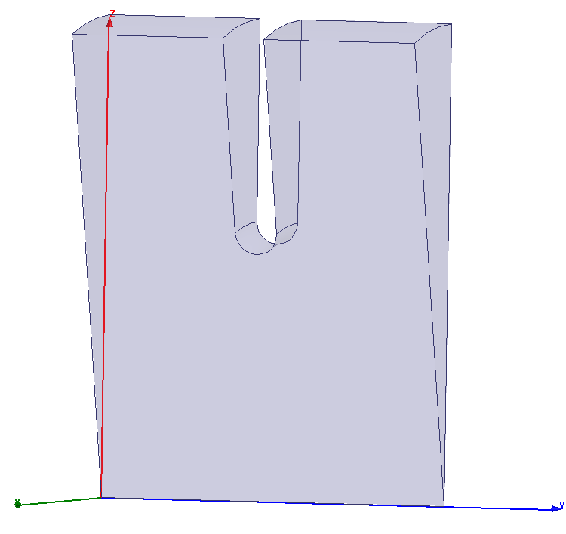

Tapered structures – iris aperture goes down to compensate for dissipated power while maintaining phase advance.
R’/Q goes up and v_{g} goes down so more accelerating gradient for a given power flow.
$$G=\sqrt{ω\frac{1}{v_{g}}\frac{R^{′}}{Q}P}$$

Slide 38
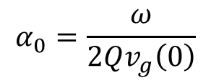

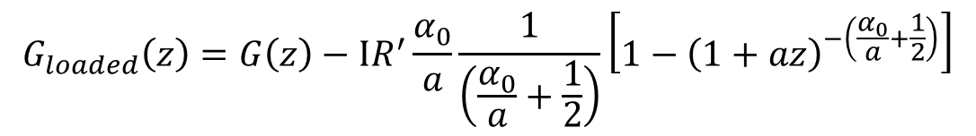

Solution to linearly tapered group velocity structure
$$α_{0}=\frac{ω}{2Qv_{g}\left(0\right)}$$
$$v_{g}=v_{g}\left(0\right)\left(1+az\right)$$
$$G\left(z\right)=G\left(0\right){\left(1+az\right)}^{−\left(\frac{α_{0}}{a}+\frac{1}{2}\right)}$$
$$G_{loaded}\left(z\right)=G\left(z\right)−IR^{′}\frac{α_{0}}{a}\frac{1}{\left(\frac{α_{0}}{a}+\frac{1}{2}\right)}\left[1−{\left(1+az\right)}^{−\left(\frac{α_{0}}{a}+\frac{1}{2}\right)}\right]$$

Slide 39




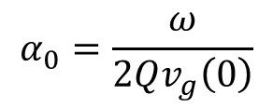
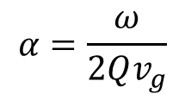
Unloaded structure with different degrees of group velocity tapering
$$v_{g}=v_{g}\left(0\right)\left(1+az\right)$$
$$a=−3α_{0}$$
$$a=−2α_{0}$$
$$a=0$$
$$α=\frac{ω}{2Qv_{g}}$$
$$α_{0}=\frac{ω}{2Qv_{g}\left(0\right)}$$

Slide 40
Now we will play around with some examples
Constant gradient
Tapered
Vary structure parameters and current to see the effect on efficiency, average gradient etc.

Slide 41
Room temperature RF
Part 2.1: Strong beam-cavity coupling
(beam loading)
30/10/2010
A.Grudiev
5th IASLC, Villars-sur-Ollon, CH

Slide 42
TWS efficiency in pulsed regime
In pulse regime, V ≠ const is a function of time. In simplest case of v_{g}=const, R’/Q₀=const, Q₀=∞
G(z,t)
t_{n} = z_{n}/v_{g}; t_{f} = L_{s}/v_{g}
In general, in TWS:
G₀
G(z,t₁)
G(z,t₂)
G(z,t₃)
G(z,t_{f})
z
z₁
z₂
z₃
L_{s}
V(t)=∫G(z,t)dz
V
P_{in}
t
t_{f}
t_{p}

Slide 43
Transient beam loading in TWS
Let’s continue with the simplest case of v_{g}=const, R’/Q₀=const, Q₀=∞
G(z,t)
I_{b} = 0; 0 < t ≤ t_{f}
G(z,t)
I_{b} > 0; t_{inj} < t ≤ t_{inj}+t_{f}
G₀
G(z,t₃)
G₀
G(z,t₁)
G(z,t₂)
G(z,t_{f})
G(z,t₁)
G(z,t₂)
G(z,t₃)
G₁=G₀-I_{b}R’αL_{s}
I_{b}
G(z,t₄)
z
z
z₁
z₂
z₃
L_{s}
z₁
z₂
z₃
L_{s}
Transient beam loading result in different voltage gained by the bunches during t_{inj} < t ≤ t_{inj}+t_{f}
V
V_{l}
P_{in}
I_{b}
t
t_{f}
t_{inj}
t_{inj}+t_{f}
t_{p}
t_{p}+t_{f}

Slide 44
Compensation of the transient beam loading in TWS
Let’s continue with the simplest case of v_{g}=const, R’/Q₀=const, Q₀=∞
Structure filling process:
I_{b} = 0; 0 < t ≤ t_{f}
Injection right after filling:
I_{b} > 0; t > t_{inj} = t_{f}
G(z,t)
G(z,t)
G₀
G₀
G(z,t₁)
G₁
G(z,t₂)
G(z,t₃)
G₁
G(z,t₁)
G(z,t₂)
G(z,t₃)
G(z,t_{f})
I_{b}
G(z,t_{f})
z
z
P_{in}-ramp
z₁
z₂
z₃
L_{s}
z₁
z₂
z₃
L_{s}
Two conditions:
Ramping the input power during the structure filling in such a way that the loaded gradient profile along the structure is formed.
The beam is injected right at the moment the structure is filled. (same as for SWS)
V
V_{L}
P_{in}
I_{b}
t_{f}
t_{p}
t_{p}+t_{f}
t
t_{inj}=t_{f}

Slide 45
Transient beam loading in TWS
Let’s consider general case of v_{g}(z), R’(z), Q₀(z) *
Model approximations:
Smooth propagation of energy along the structure (no reflections)
No effects related to the finite bandwidth of the signal and the structure (TWS bandwidth >> signal bandwidth)
Time of flight of the beam through the structure is much shorter than the filling time (L_{s}/c << t_{f})
[*] – A. Lunin, V. Yakovlev, A. Grudiev PRSTAB, 14, 052001 (2011)

Slide 46
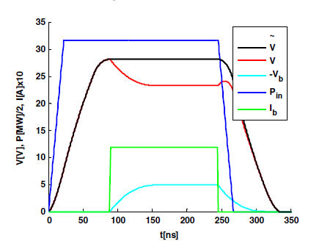
Uncompensated pulse

Slide 47
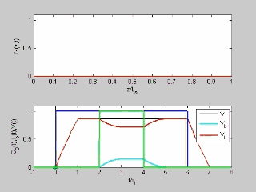
Transient beam loading in TWS (cont.)
where:

Slide 48
Compensation of the transient beam loading in TWS
In general case of v_{g}(z), R’(z), Q₀(z)

Slide 49
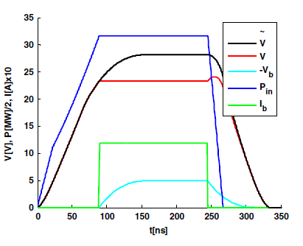
Compensated pulse

Slide 50
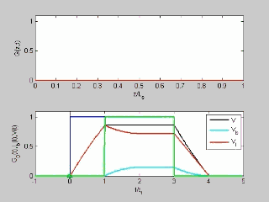
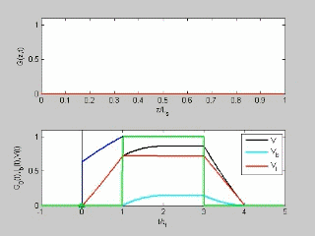
Compensation of the transient beam loading in constant impedance TWS
Let’s consider the case of constant impedance TWS: v_{g}=const, R’=const, Q₀=const
Uncompensated case
Compensated case

Slide 51
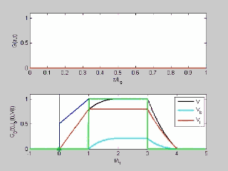
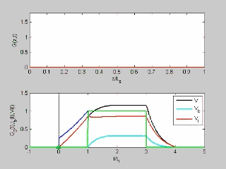
Compensation of the transient beam loading in constant gradient TWS
Let’s consider a case of linear v_{g}-tapering such that Q₀=const, R’=const but v_{g} = v_{g0}(1+az):
Constant gradient: a=-2α₀
a=-3α₀

Slide 52
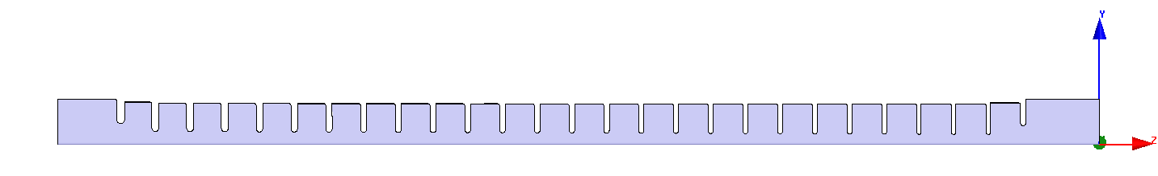
CLIC main linac accelerating structure in steady-state
Parameters: input – output
f [ GHz] | 12
L_{s} [m] | 0.25
v_{g}/c [%] | 1.7 – 0.8
Q₀ | 6100 – 6300
R’ [MΩ/m] | 90 – 110
I_{b} [A] | 1.3
t_{b} [ns] | 156
<G> [MV/m] | 100
In reality, v_{g} ≠ const, R’ ≠ const, Q₀ ≠ const and general expressions must be applied but often a good estimate can be done by averaging R’ and Q₀ and assuming linear variation of v_{g}
In this case: <Q₀>=6200; <R’>=100 MΩ/m; and v_{g}/c = 1.7 - 0.9/0.25·z
Parameters calculated
P_{in} [MW] | 67.6
η^{CW} [%] | 48
t_{f} [ns] | 70
η [%] | 33

Slide 53
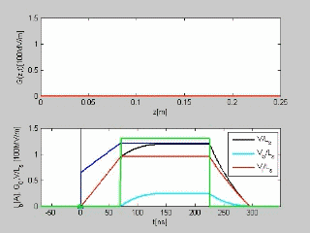
CLIC main linac accelerating structure during transient

Slide 54
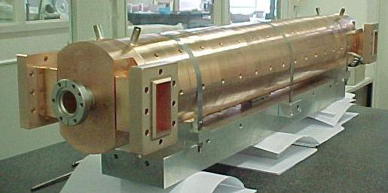
SICA - CTF3 3GHz accelerating structure in steady-state
Parameters: input – output
f [ GHz] | 3
L_{s} [m] | 1.22
v_{g}/c [%] | 5.2 – 2.3
Q₀ | 14000 – 11000
R’ [MΩ/m] | 42 – 33
I_{b} [A] | 4
Pin [MW] | 33
This structure is designed to operate in full beam loading regime
Parameters calculated
η^{CW} [%] | 95

Slide 55
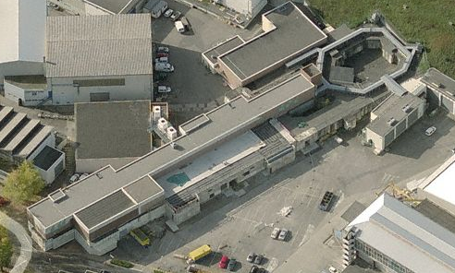
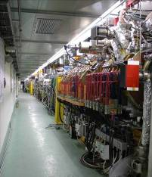
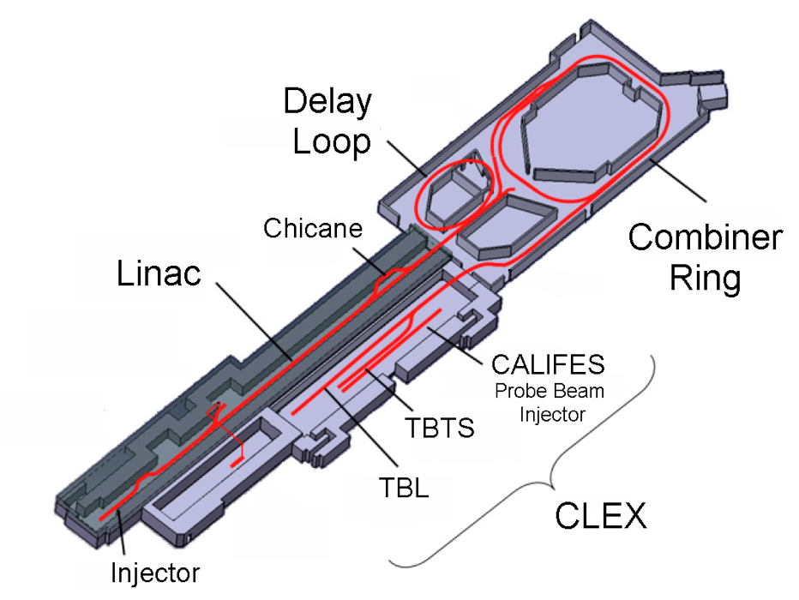
CLIC Test Facility (CTF3)
Operation of isochronous lines and rings
4 A, 1.4us
120 MeV
30 A, 140 ns
120 MeV
High current, full
beam-loading operation
Beam recombination and current multiplication by RF deflectors
12 GHz power generation by drive beam deceleration
High-gradient two-beam acceleration
30 A, 140 ns
60 MeV
Bunch phase coding

Slide 56
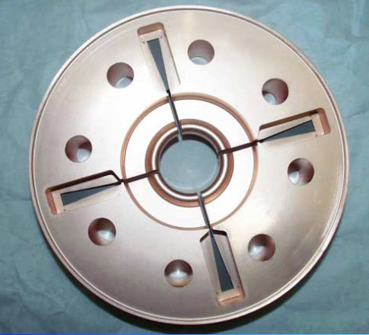
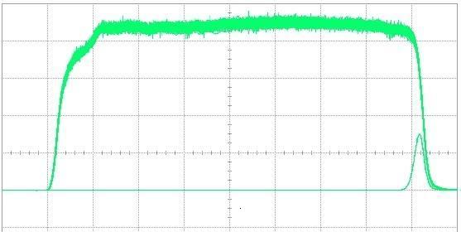
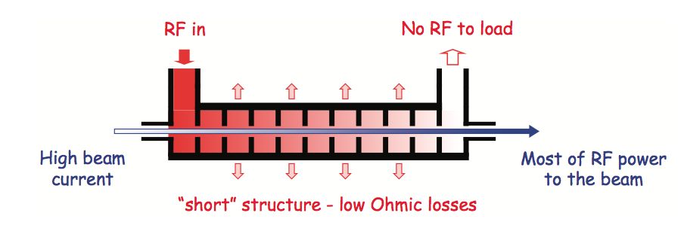
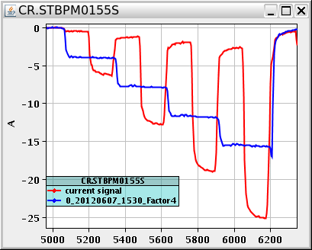
Drive Beam Generation
damping
slot
Full beam loading acceleration
95.3% RF to beam efficiency
Stable high current acceleration
Current stability
Isochronicity, phase coding
Factor 8 current & frequency multiplication
RF pulse at structure input
10 m
RF pulse at output
SiC load
RF in
No RF to load
High beam current
Most RF power
to beam
“short” structure – low Ohmic losses
Pulse charge measurement
Factor 8 combination

