Slide 1
Course B: rf technology
Normal conducting rf
Part 3: Linear Collider Hardware
Walter Wuensch, CERN
Ninth International Accelerator School for Linear Colliders
Whistler, British Columbia, Canada
26 October to 6 November 2015

Slide 2
We will now step back from theory and have a look at specific CLIC hardware.
We have already covered a lot of the theory although there is some more to come.
Still it is a good moment to look at real objects to give a context for all the abstract ideas that you have been seeing.
We will cover:
Accelerating structures
Two-beam concept
PETS (power generating) structures
A little bit about alignment and stabilization
This section will be basically a seminar on the CLIC rf system.

Slide 3
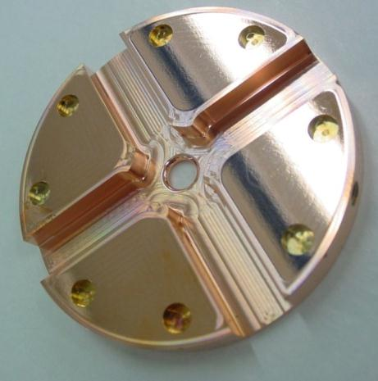
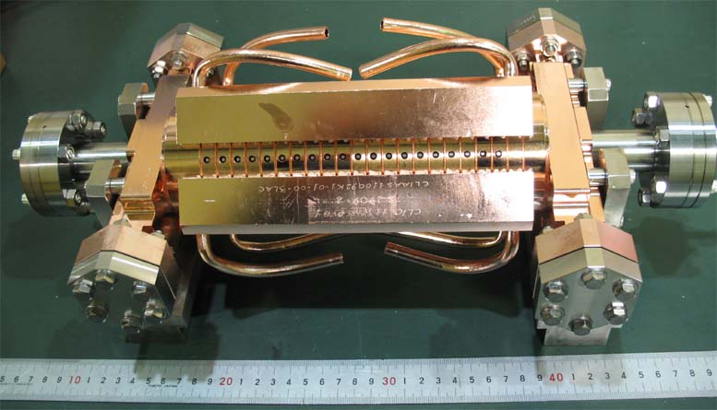
The CLIC accelerating structure
Now that you have a feeling for the basic mechanisms which underlie high-efficiency acceleration, we will look into the main features of the CLIC rf system.
Let’s start by looking at the CLIC accelerating structure:
The basic component: diamond turned and milled disk. We form a periodic structure by stacking them. The radial lines are damping waveguides
An assembled high-power test structure. Made in a collaboration between CERN, KEK and SLAC.

Slide 4
Accelerating structure specs.
High-gradient:
100 MV/m loaded gradient
156 (flat top)/240 (full) ns pulse length
Less than 3x10⁻⁷ breakdowns/pulse/m
we observe the interrelation

Slide 5

Accelerating structure specs
Beam dynamics:
5.8 mm diameter minimum average aperture (short range transverse wake)
< 1 V/pC/mm/m long-range transverse wakefield at second bunch (approximately x50 suppression).
but
J. Shi

Slide 6
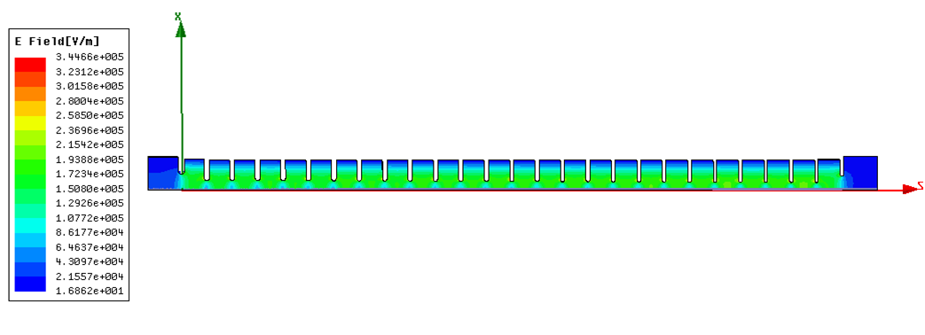
Accelerating structure characteristics
Operating frequency: 11.994 GHz
λ free space is 25 mm
Operating phase advance: 2π/3
Active length: 230 mm
Number of cells: 26+2
CLIC structures are tapered, for reasons of high-gradient performance and wakefield suppression which we will discuss later.
Power flow and beam direction

Slide 7
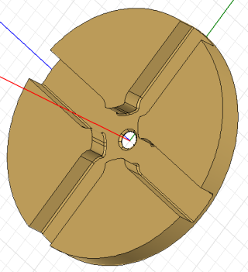
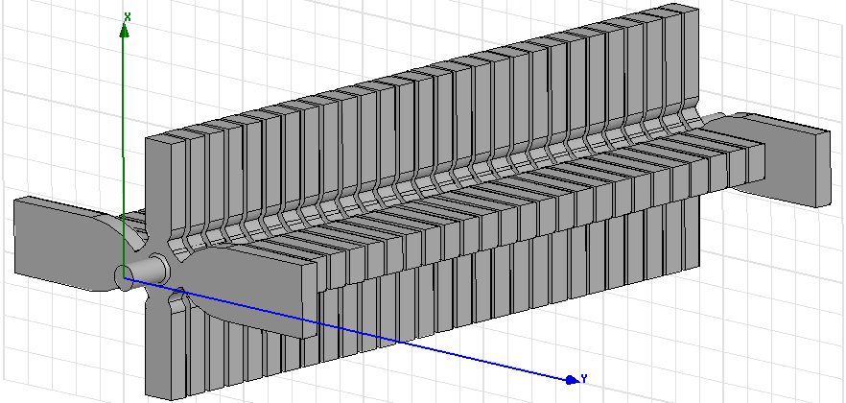
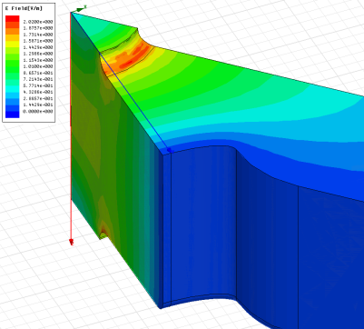
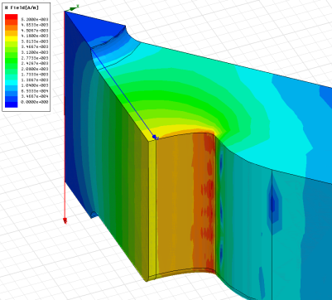
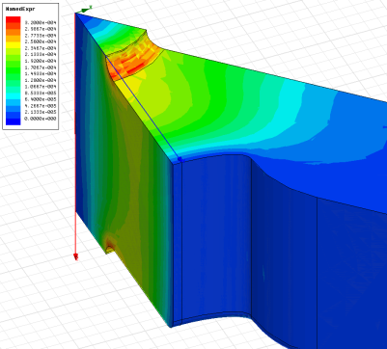
Accelerating structure features
E_{s}/E_{a}
H_{s}/E_{a}
S_{c}/E_{a}²

Slide 8
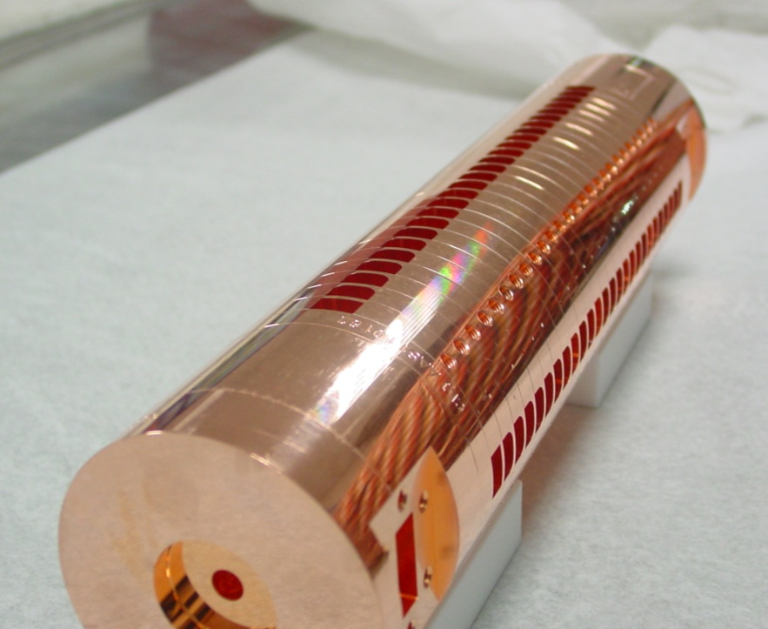
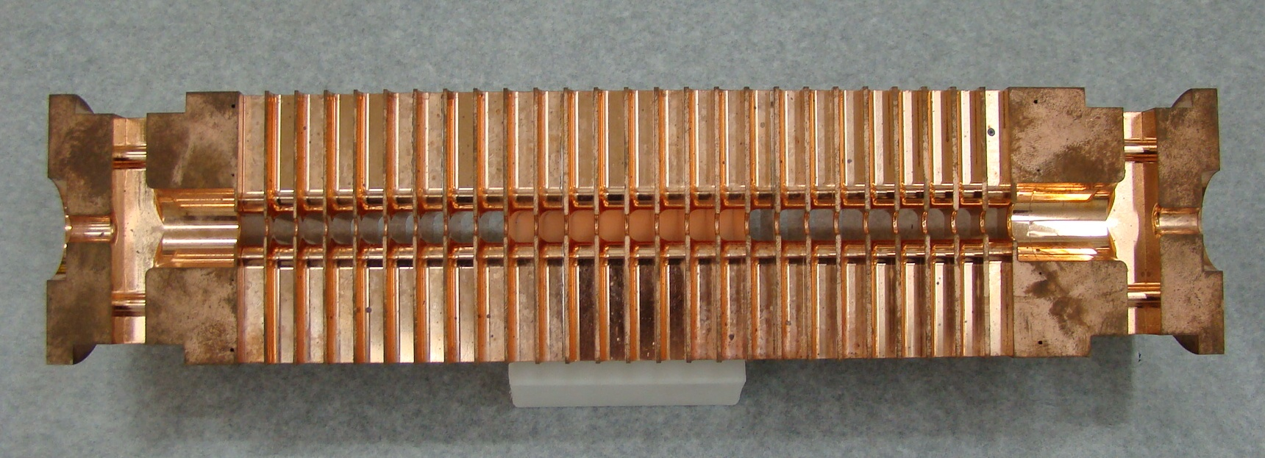
How it looks

Slide 9
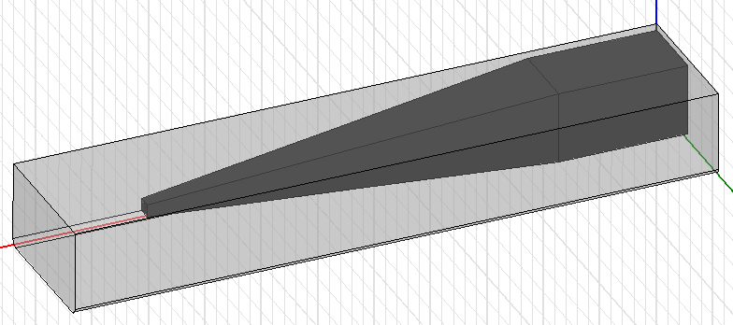
Higher-order mode damping
Cell | First | Middle | Last
Q-factor | 11.1 | 8.7 | 7.1
Amplitude [V/pC/mm/m] | 125 | 156 | 182
Frequency [GHz] | 16.91 | 17.35 | 17.80

Slide 10
Accelerating structure characteristics cont.
The aperture radii range from 3.15 to 2.35 mm with iris thicknesses of 1.67 to 1.00 mm. The resulting rf parameters are:
 | first | last
v_{g} [%c] | 1.65 | 0.83
R’/Q [kΩ/m] | 14.6 | 17.9
Q | 5536 | 5738
R’ [MΩ/m] | 81 | 103

Slide 11
Whole structure properties
The fundamental mode properties are shown in the regular cells.
The traces from top to bottom are:
Sc·50 [W/μm2](pink),
surface electric field [MV/m](green),
accelerating gradient [MV/m](red),
pulse surface temperature rise [K](blue).
Dashed traces are unloaded and solid are beam loaded conditions.

Slide 12
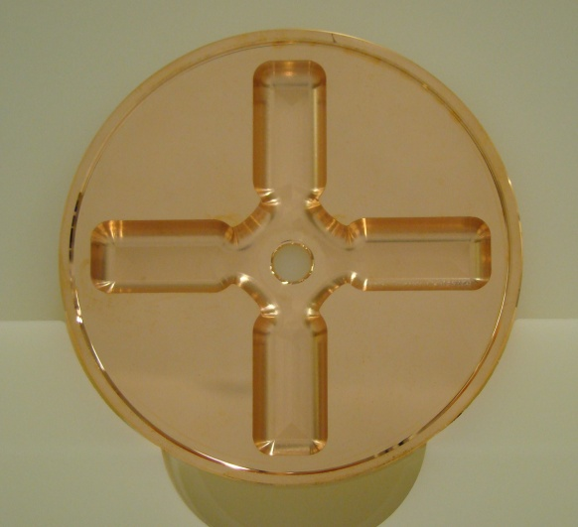
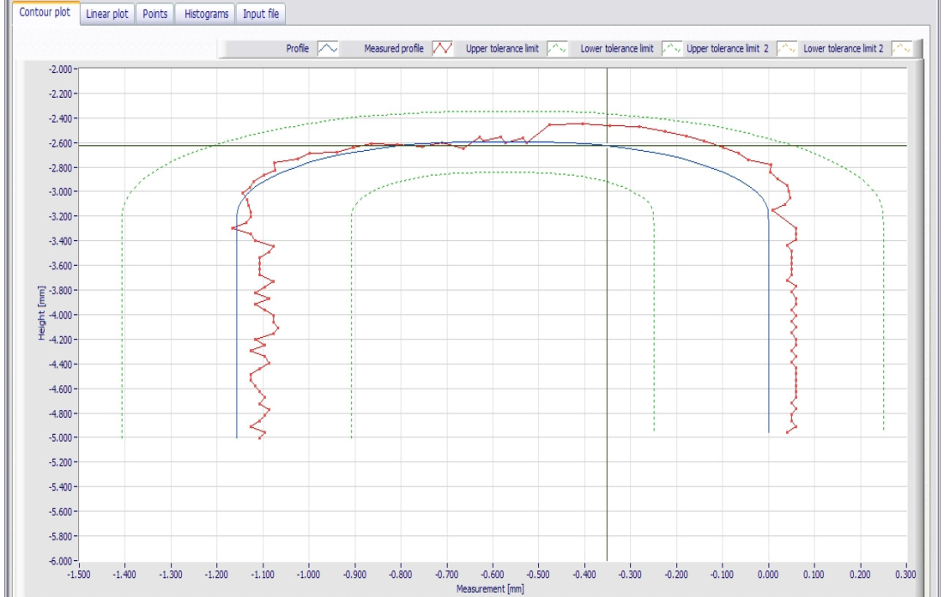
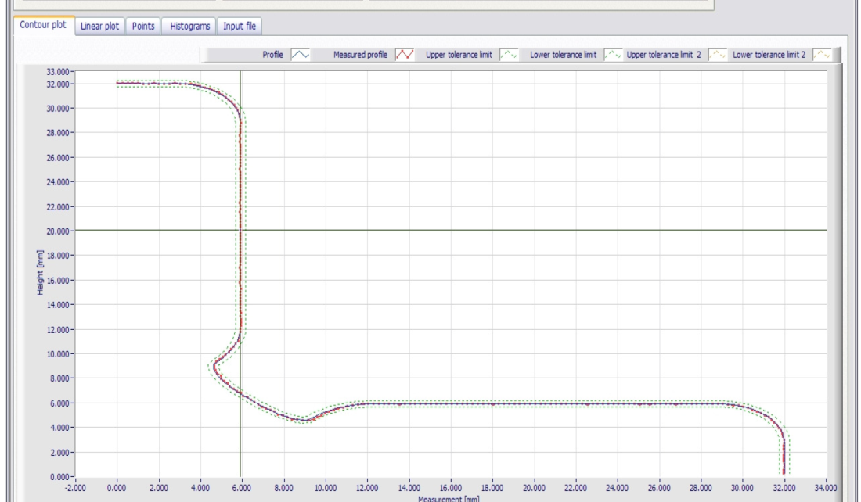
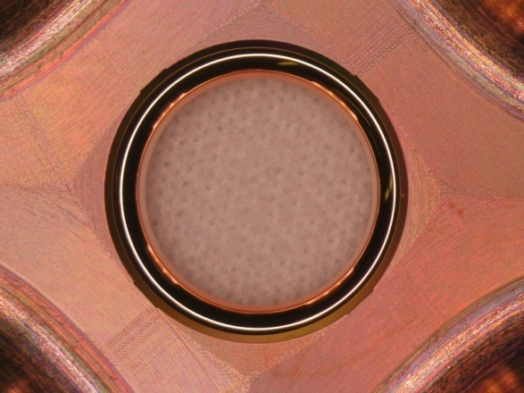
How to make ‘em
Machining: OFHC copper diamond milled and turned disks with micron precision.
+- 5 micron tolerance lines

Slide 13
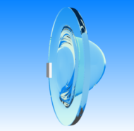
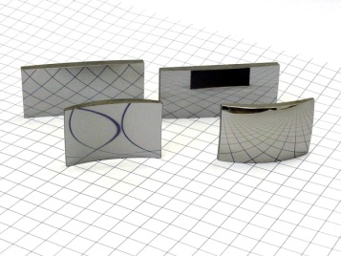
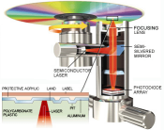
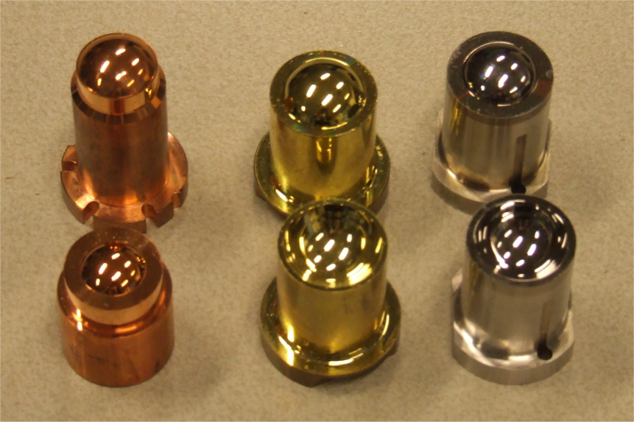
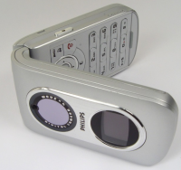
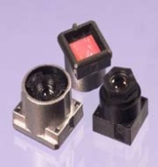
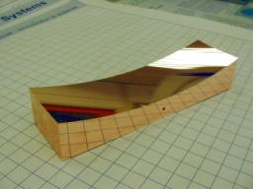
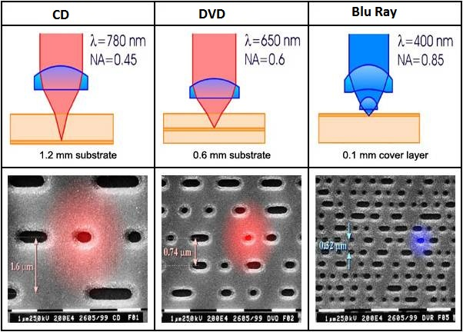
Evolution of the micron-precision market
The market for micron precision parts has evolved over the last decades.
Linear colliders are not alone.
Mirror optics
Optical recording
Injection molding of contact lenses
Imaging Optics
Freeform optics
1970’s
1980’s
1990’s
2000’s
2010’s
Optical recording was the driving force to achieve higher accuracies
  Form accuracy: 150 nm  50 nm
  Roughness Ra : 5 nm  2 nm

Slide 14
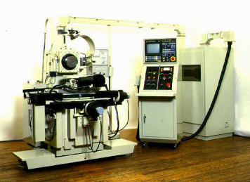
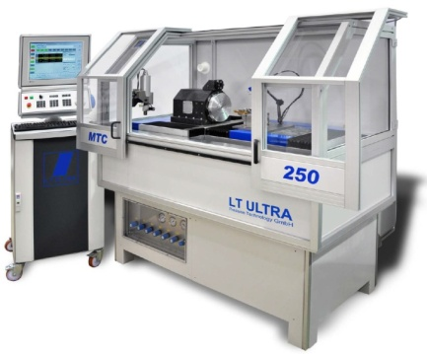
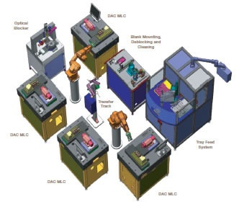
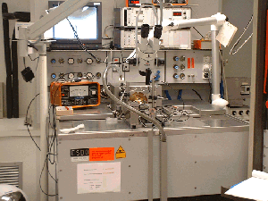
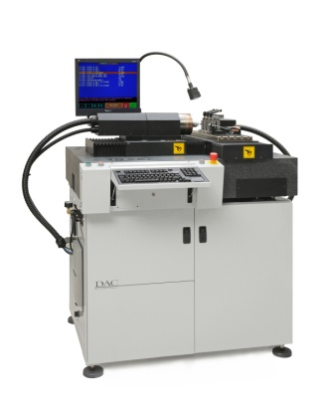
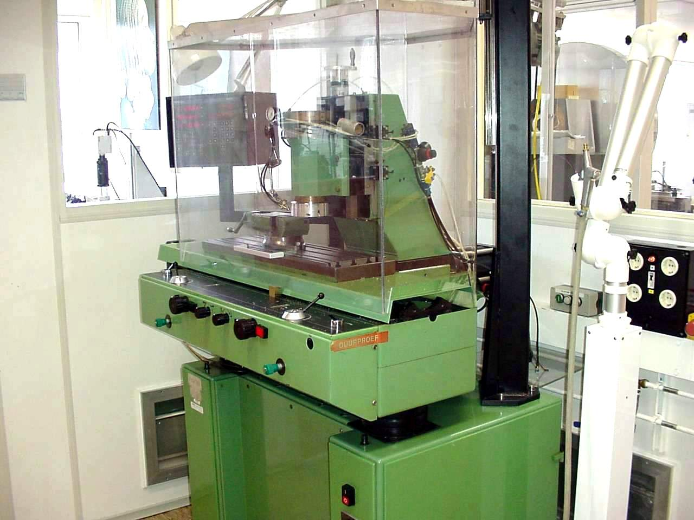
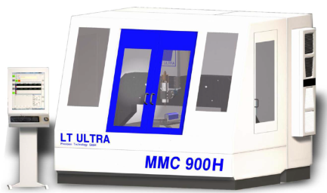
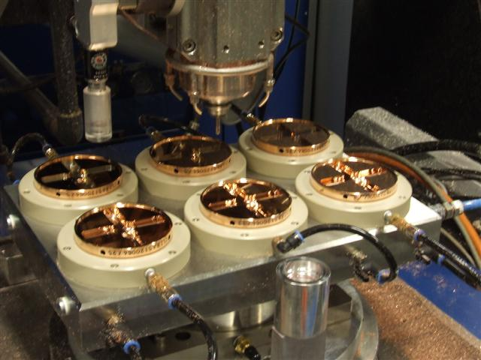
Evolution of machining capability
Single point diamond turning
Up to the 1980’s
1980’s - 1990’s
2000’s - 2010’s
Future ?
First machines at research institutes and universities
Start of industrialization
Optical recording
contact lenses
Larger machines
Multiple axis ( X/Y/Z and C)
Intelligent machines ?
  Robotisation ?
Ultra precision diamond milling (lagging more than a decade behind on turning)
Up to the 1990’s
1990’s - 2000’s
2010’s
Future ?
Limited to fly cutting
mirror optics
Laser scanner mirrors
Milling as add-on on lathes
Lens arrays
Intra ocular lenses
First proto type machines
Micro fluidics
Accelerator parts
Pallet machining?
  Robotisation ?

Slide 15
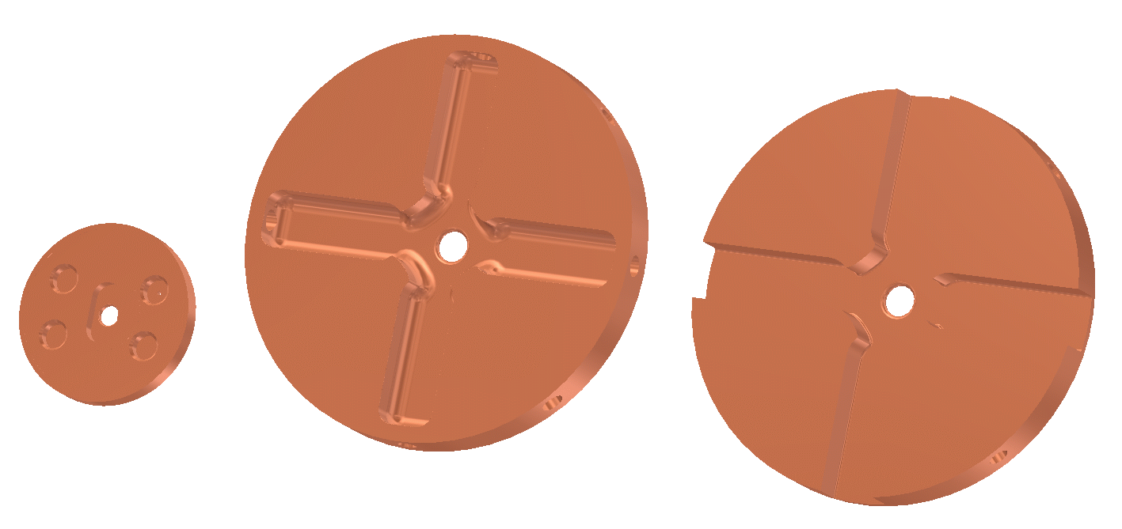
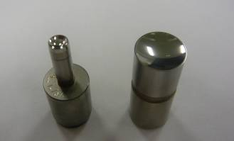
Current challenges for the basic technology
Bigger structures, same tolerances
  Started at ø35mm – now at ø80mm – in future up to ø200mm ?
Tight accuracy specifications for series manufacturing
  Moulds for DVD optics :
    50 nm form accuracy on ø 2 mm
    equals ratio of 1 / 40000
  CLIC disk -> series part
  2 µm accuracy on ø 80 mm
  equals ratio of 1 / 40000

Slide 16
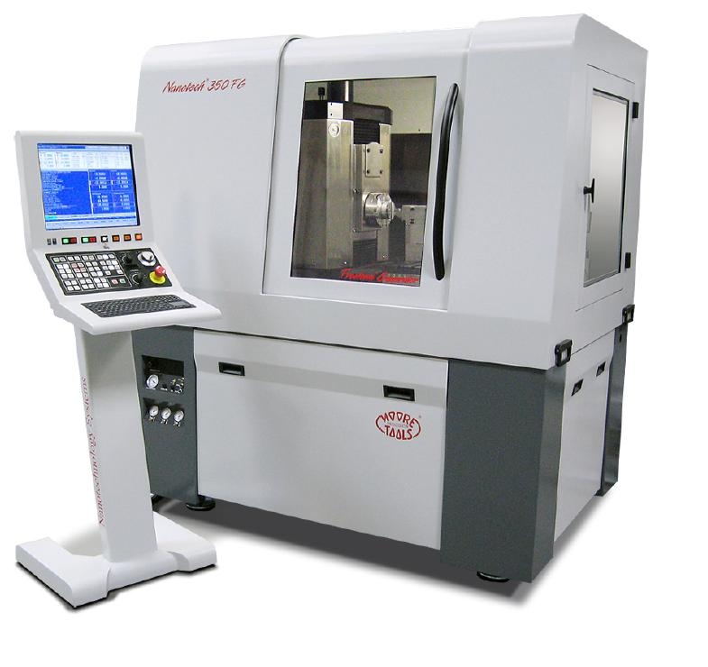
High accurate Machining
5-axis CNC turning milling machine
Technical characteristics:
X axis travel 350 mm
Y axis travel 150 mm
Z axis travel 300 mm
B and C axis travel 360 degrees
Swing capacity up to 20‘’
Air bearing Turning spindle 10,000 rpm
Air bearing Milling spindle 60,000 rpm
Precision
34 picometers resolution rules (0.034 nanometers)
Incremental programming 0.01 nanometer
Axial and radial spindle error ≤ 25 nanometers
B axis axial and radial error ≤ 100 nanometers
Shape defect ≤ 0.15 μm on diameter 75 mm
Surface finish Ra ≤ 3.0 nanometers
Machine delivered on january 2011
First structure TD24WFM delivered on novembre 2011.

Slide 17
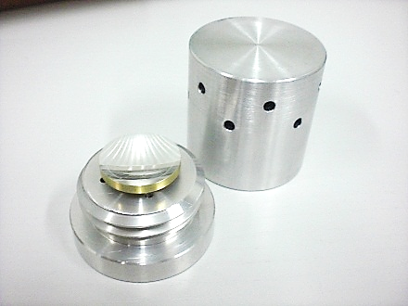
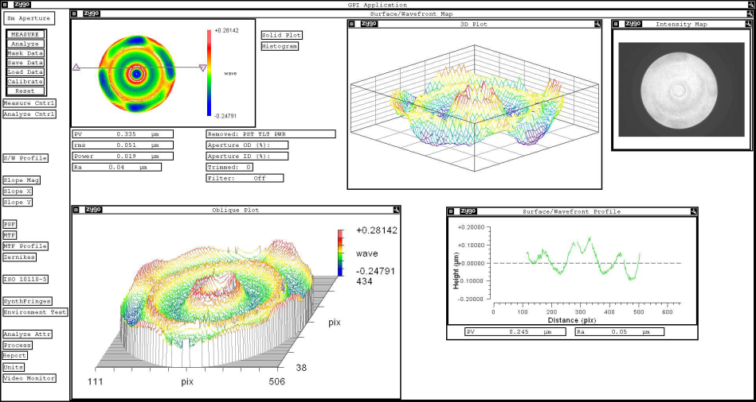
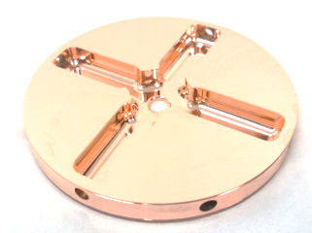
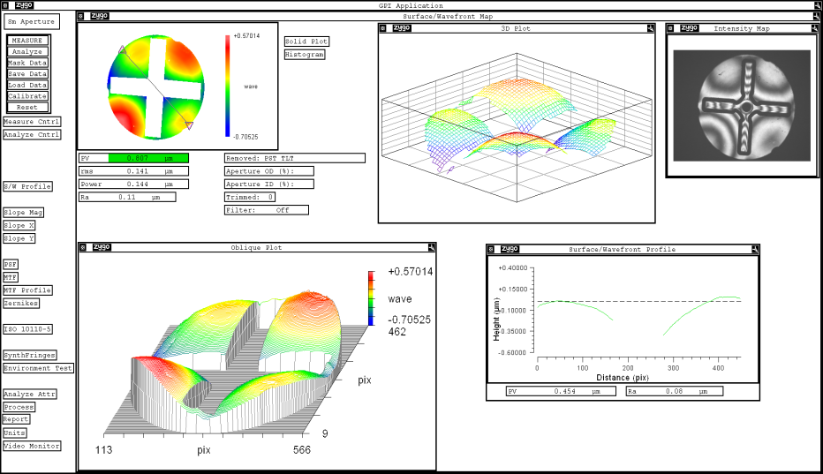
High Accuracy Machining
Aluminum mirror for satellite application on its support delivery
Results :
PV = 0.335 µm
Ra = 0.001 µm
RmS = 1,92 nm
Copper disk - accelerating structure
Results :
PV = 0.807 µm
Ra = 0.002 µm
RmS = 1,72 nm

Slide 18
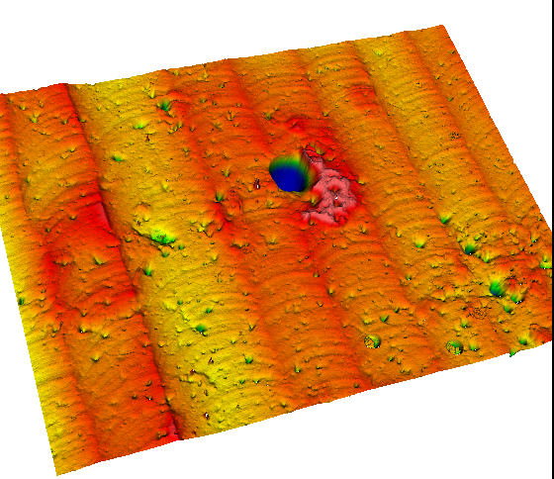
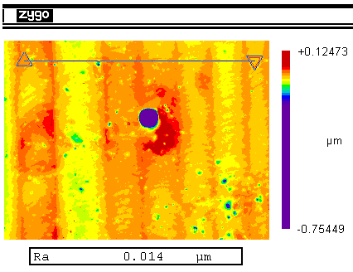
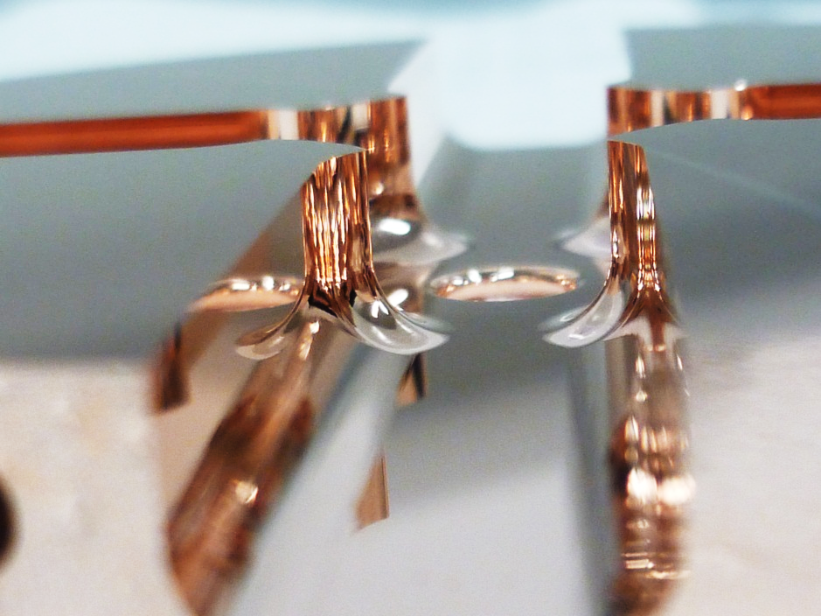
Milling surface finish improvement
Métrology mark
Results

Slide 19
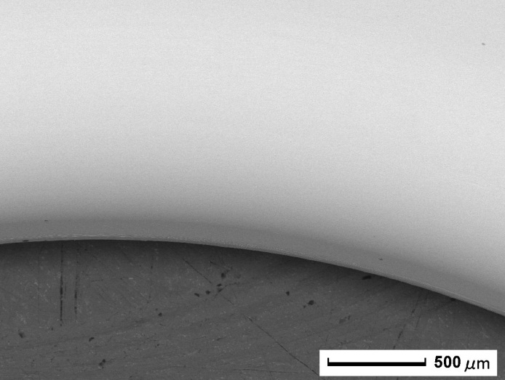
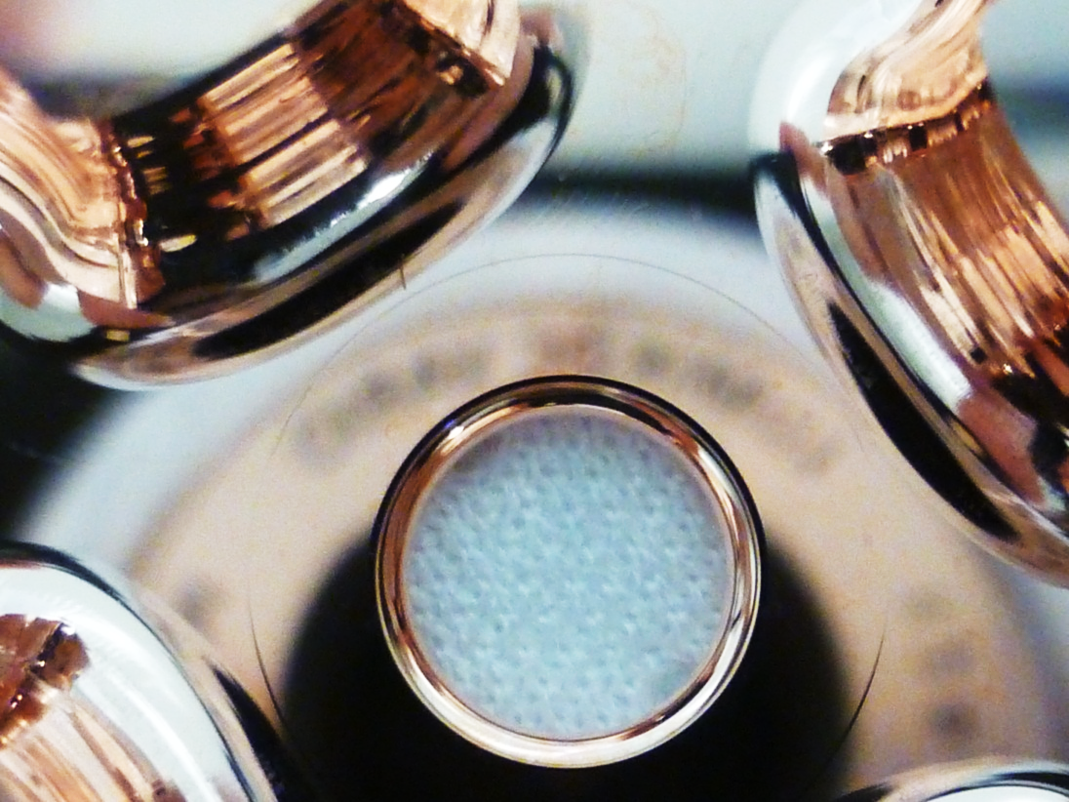
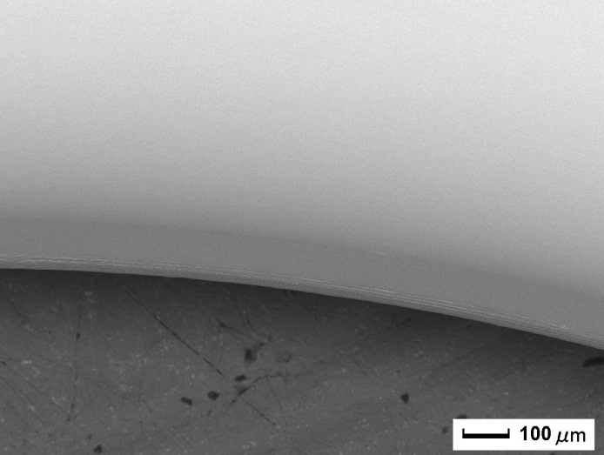
Iris machining
The machining of the iris start from diameter 20mm to erase milling perturbation in the center.
The height of the step is about 1µ.
Ra between 2nm to 5nm

Slide 20
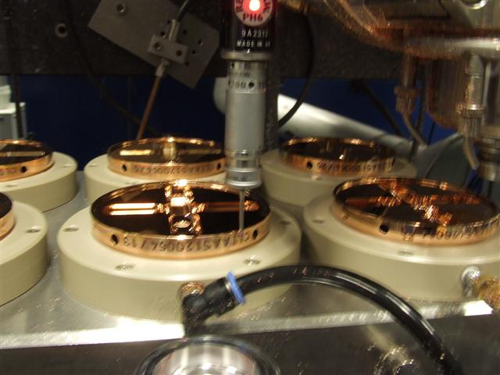
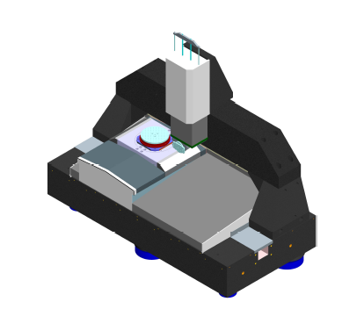
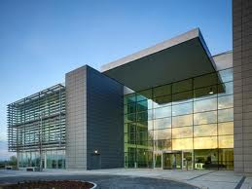
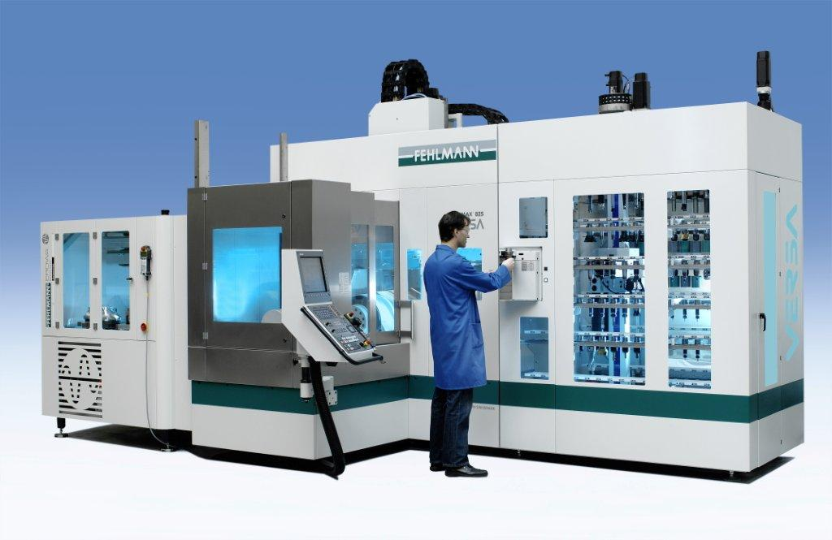
VDL ETG Industry Commitment
Investments in new skills
  H2 bonding
  Micro milling
  Pallet machining
  On machine metrology
Investments in people
  Cooperation programs with schools, universities, institutes
  Internal education
  Career paths
Investments in infrastructure
  Equipment
  New Facility
Guidance is required to steer investments in the right direction

Slide 21
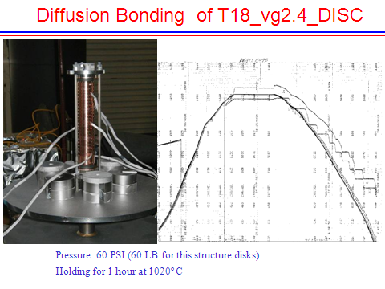
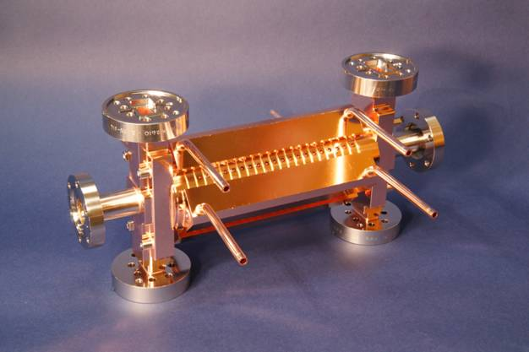


Accelerating structures – manufacture
TD18#3 at SLAC
TD18#2 at KEK
Stacking disks
Structures ready for test
Temperature treatment for high-gradient

Slide 22






Diffusion bonding of couplers under H₂ at 1 bar
    Done at Thales Electron Devices (TED) – Velizy (France)
    Degreasing and etching at CERN before bonding
    Applied weight: 43 kg equivalent to ~ 0.13 MPa; thermal cycle: flat top at 1035°C during 1h30
    Process validated on a test coupler: observation of crossing grains in the joint plan
    Some deformations observed on the outer faces after bonding : ~0.1 mm -> re-machining done
Coupler
Extremity cell
Assembly of couplers in the furnace
SEM observation of bonding plan after cutting
Thermal cycle
Crossing grains
Crossing grains

Slide 23






Diffusion bonding of structure under H₂ at 1 bar
    Also done at TED with degreasing and etching at CERN before bonding
    Applied weight: 33.7 kg equivalent to ~ 0.08 – 0.12 MPa;
    Same thermal cycle as couplers but with flat top at 1010°C
    No deformations observed on the external diameter after bonding
Disks after etching
Coupler
Structure n°1
Structure n°2
Assembly of disks in the furnace
Geometrical measurements on external diameter after bonding
Alignment = 9µm for ACS#1 and 12.6 µm for ACS#2
Angle = 90.0514° for ACS#1 and 90.0087° for ACS#2

Slide 24







Assembly of accelerating structure accessories
    Done at Bodycote – Villaz (France) and CERN
    Tuning studs and cooling circuits brazed with copper gold alloy below 1000°C under vacuum
    Good tightness and no drip of alloys observed in the cells
    Assembly test by screwing of WFM waveguides OK
Assembly of WFM waveguides
Assembly of tuning studs
Assembly of cooling circuits
S. Lebet

Slide 25





Bead-pull and RF tuning of structure n°1
    Done at CERN by Jiaru Shi the 22th of Feb. 2012
    Target frequency: 11991.65 MHz (considering freq. shift due to wire, nitrogen and temperature of 21.6 deg)
    All disks tuned with only one stud used for each disk
    Very successful tuning

Slide 26





Bead-pull and RF tuning of structure n°2
    Same procedure as structure N1, done the 6th of March 2012
    Disk 13 tuned by -10 MHz (the 4 studs were used), all the other
    disks were tuned +/- 3MHz like structure N1
    Very successful tuning also

Slide 27


Engineering Design Overview
VACUUM FLANGE
VACUUM MANIFOLD
& COOLING SYSTEM
RF FLANGE
VACUUM PORT
BEAM
DIRECTION
ALIGNMENT
1st AS
VACUUM PORT
2nd AS
502.5 mm
WAVEGUIDE
INTERCONNECTION
COOLING FITTING
WFM WAVEGUIDE
BEAM
DIRECTION
243.701 mm
COOLING TUBE
Slide from Anastasiya Solodko
BONDED DISC STACK
Compact coupler design (already in TD26 CC);
The body of an AS formed by high-precision copper discs joint by diffusion bonding at 1040 °C;
Two AS are brazed together to form a superstructure (SAS);
The SAS has 8 vacuum manifolds and 4 Wakefield Monitor (WFM) waveguides;
The cooling system is integrated into the vacuum manifolds in order to provide a more compact technical solution.

Slide 28
Accelerating structure parameters
Average loaded accelerating gradient | 100 MV/m
Frequency | 12 GHz
RF phase advance per cell | 2π/3 rad.
Average iris radius to wavelength ratio | 0.11
Input, Output iris radii | 3.15, 2.35 mm
Input, Output iris thickness | 1.67, 1.00 mm
Input, Output group velocity | 1.65, 0.83 % of c
First and last cell Q-factor (Cu) | 5536, 5738
First and last cell shunt impedance | 81, 103 MΩ/m
Number of regular cells | 26
Structure length including couplers | 230 mm (active)
Bunch spacing | 0.5 ns
Bunch population | 3.72×10⁹
Number of bunches in the train | 312
Filling time, rise time | 67 ns, 21 ns
Total pulse length | 243.7 ns
Peak input power | 61.3 MW
RF-to-beam efficiency | 28.5 %
Maximum surface electric field | 230 MV/m
Maximum pulsed surface heating temperature rise | 45 K

Slide 29



Main Linac Tolerances
Stabilise quadrupole
O(1nm) @ 1Hz
Pre-align BPMs+quads
accuracy O(10μm) over about 200m
3) Use wake-field monitors accuracy O(3.5μm)
2) Beam-based alignment
Test of prototype shows
  vertical RMS error of 11μm
  i.e. accuracy is approx. 13.5μm

Slide 30




Active Stabilization
Typical quadrupole jitter tolerance O(1nm) in main linac and O(0.1nm) in final doublet
Final Focus QD0 Prototype
Luminosity achieved/lost [%]
 | B10
No stab. | 53%/68%
Current stab. | 108%/13%
Future stab. | 118%/3%
Code
Machine model
Beam-based feedback
Close to/better than target

Slide 31



Elements of CLIC two-beam

Slide 32




Two-beam RF components
Waveguide network
high power
precise phase length
PETS
high-power
as short as possible
low longitudinal and transverse impedance
Choke mode flange
independent alignment of main and drive beam
ON/OFF mechanism
Accelerating structure
high-gradient
as long as possible
micron precision
transverse wake-field suppression
On/ramp/off
necessary (?) to react to breakdown and/or failure

Slide 33
The early days of multi-TeV linear colliders

Slide 34
CLIC two-beam in numbers
 | PETS | Accelerating structure
Aperture radius [mm] | 11.5 | 3.15-2.35
R’/Q [kΩ/m] | 2.2 | 15-18
v_{g}/c | 0.49 | 0.0165-0.0083
Gradient [MV/m] | -6.3 | +100

Slide 35

T3P: Wakefield Coupling PETS <-> TD24
PETS
Combined mesh model
with 21M elements (h~0.5mm)
(preliminary coupler geometry)
TD24
IWLC10 A. Candel

Slide 36

… and Simulation of RF power transfer
PETS
Low group velocity requires simulations with 100k time steps
p=1: 15k CPU hours
p=2: 150k CPU hours
p=3: 1.5M CPU hours
…
T3P models realistic, complex accelerator structures with unprecedented accuracy

Slide 37
PETS – specifications
High-power:
135 MW output power
170 (flat top)/240 (full) ns pulse length
<2x10⁻⁷ 1/pulse/m breakdown rate
Beam dynamics:
Fundamental mode: gives 23 mm diameter aperture which corresponds to a/λ=0.46 and v_{g}/c=0.49 to give 2.2 kΩ/m, longitudinal impedance
Single bunch transverse wake: < 8 V/pC/mm/m
Long-range transverse wakefield with effective suppression of main HOMs by Q_{n}(1-β_{n})<8 each

Slide 38
PETS parameters
Aperture, mm | 23
Iris thickness. mm | 2.0
Cell length, mm | 6.253
Phase advance/cell, degrees | 90
Corrugation depth, mm | 4.283
R/Q, Ohm/m | 2290
β=V_{g}/c | 0.453
Q-factor | 7200
Active length, m | 0.213 (34 cells)
RF pulse length, ns | 241
Drive Beam current, A | 101
Output RF power, MW | 133.7
Peak surface electric field, MV/m | 56
Peak surface magnetic field, MA/m | 0.08
Pulsed temperature rise, ⁰C | 1.8
Breakdown trip rate, 1/pulse/meter | 1×10⁻⁷

Slide 39




PETS – fundamental mode characteristics
Beam-driven structure so power rises quadratically with current and length,
135 MW for 100 A beam
213 mm active length
Maximum fields at output with values,
E_{surf}=56 MV/m
ΔT=1.8 (H_{surf}=0.08 MA/m)
S_{c}=1.2 MW/mm²
Surface electric field
Surface magnetic field

Slide 40
Overmoded couplers for PETS

Slide 41



PETS – HOM suppression features
ACE3P analysis of HOM properties
GdfidL and ACE3P benchmarking with analysis of PETS HOM properties
PETS for high-power testing with SiC absorbers installed.

Slide 42



PETS – the high-power testing challenge
To high-power test the PETS in nominal conditions would require a 100 A driving beam.
“Waveguide” test with klystron/pulse compressor
not many 135+ MW X-band power sources – ASTA at SLAC
much harder to run, full fields at input
Beam-based tests with CTF3 4-30 A beam.
1000 mm long PETS
Connect output to input – beam-driven rf resonant ring for lower, <10 A, current
Fields in klystron and recirculation tests
Fields in CLIC and CTF3 at high current

Slide 43



PETS testing in ASTA
PETS waveguide-mode PETS testing is being done at ASTA in SLAC an impressive facility but testing a single object with 135+ MW power is very challenging. The results you will see are a mixture of conditioning of the PETS and ASTA…
Experimental area
ASTA layout
Gate valve
Rf Phase
shifter
Uncompressed arm
SLED II with variable length and iris reflection
Two klystrons
50 MW@1.5us

Slide 44









ASTA test PETS version with damping slots and damping material (SiC)
load
Low RF power measurements
Reflection
Transmission
June 2010

Slide 45

Extraction of PETS breakdown trip rate
Part of the statistical distribution contributed to the BDR calculation
1.55x10⁷ pulses
1.55x10⁷ pulses were accumulated in a 125 hour run.
8 PETS breakdowns were identified giving a breakdown rate of 5.3x10⁻⁷/pulse.
Most of the breakdowns were located in the upper tail of the distribution, which makes BDR estimate rather conservative.
During the last 80 hours no breakdowns were registered giving a BDR <1.2x10⁻⁷/pulse.

Slide 46





TBTS is the test area in CLEX, where feasibility of the CLIC two beam acceleration scheme is…already demonstrated (not yet at a nominal 100 MV/m accelerating gradient).

Slide 47



TBTS: Two Beam Acceleration
CTF3 team
Maximum gradient 145 MV/m
Consistency between
produced power
drive beam current
test beam acceleration
TD24

Slide 48

Optimization procedure
<E_{a}>, f, ∆φ, <a>, da, d₁, d₂
Beam
dynamics
Bunch population
Cell parameters
N
Q, R/Q, v_{g}, E_{s}/E_{a}, H_{s}/E_{a}
Q₁, A₁, f₁
Structure
parameters
Bunch
separation
Beam
dynamics
N_{s}
L_{s}, N_{b}
η, P_{in}, E_{s}^{max}, ∆T^{max}
rf
constraints
YES
Cost function
minimization
NO

Slide 49

Beam dynamics input
FoM =L_{bx}/N · η
L_{bx}/N
BD
RF
BD optimum aperture:
<a> = 2.6 mm
Why X-band ?
Crossing gives
optimum frequency
High-power RF optimum aperture: <a>/λ = 0.1 ÷ 0.12

Slide 50
The CLIC Layout
Drive Beam Generation Complex
Main Beam Generation Complex

