Slide 1
Course B: rf technology
Normal conducting rf
Part 5: Higher-order-mode damping
Walter Wuensch, CERN
Ninth International Accelerator School for Linear Colliders
Whistler, British Columbia, Canada
26 October to 6 November 2015

Slide 2
But first, a broad overview of electromagnetic simulation
Now we will look at the basic tools which are used to actually implement the concepts you have been learning.
The most popular E&M codes used in the CLIC study are:
HFSS
GdfidL
CST Microwave and Particle Studio
ACE3P
But let’s step back and categorize things a bit. There are three major classes simulation:
eigenvalue
driven solution
time-domain

Slide 3
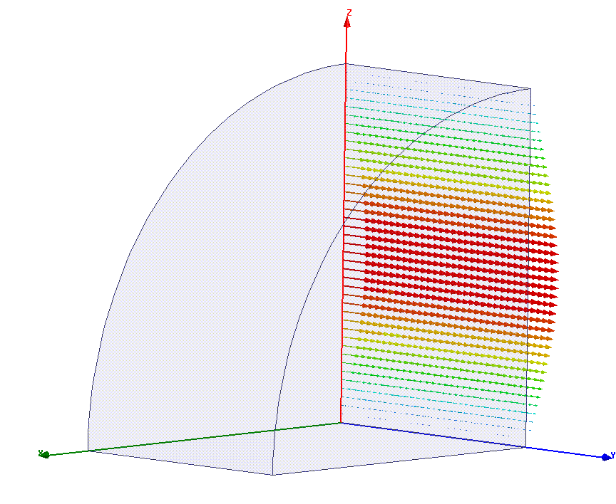

This is an eigenvalue problem:
Mostly for resonant cavities. You put in a closed geometry and get out field pattern, resonant frequency and corresponding Q factor - mode by mode.
Used for doing detailed design work - determining your geometry to make drawings, and calculating f, Q, R/Q, plot dispersion curves etc.
Used with periodic boundary conditions, you can simulate the travelling wave fields of infinitely long periodic structures.
Can include lossey dielectrics – frequency comes out as a complex number.
Often also used to understand features seen in time domain simulations.
$$e^{−iωt}$$

Slide 4
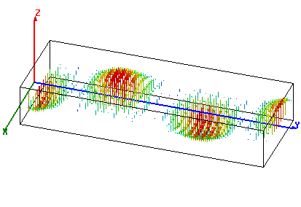
This is a driven problem:
Mostly for waveguide networks. You put in a closed geometry and one or more ports. For a specified driving frequency, the field pattern of the wavguide mode(s) on that port is computed and then the fields inside the geometry are computed. You get field pattern and the scattering matrices – S_{i,j}.
You get the frequency dependence by scanning the driving frequency.
Used for designing things like couplers, splitters, directional couplers, hybrids etc.
You use this to eliminate mismatches, standing waves etc.

Slide 5
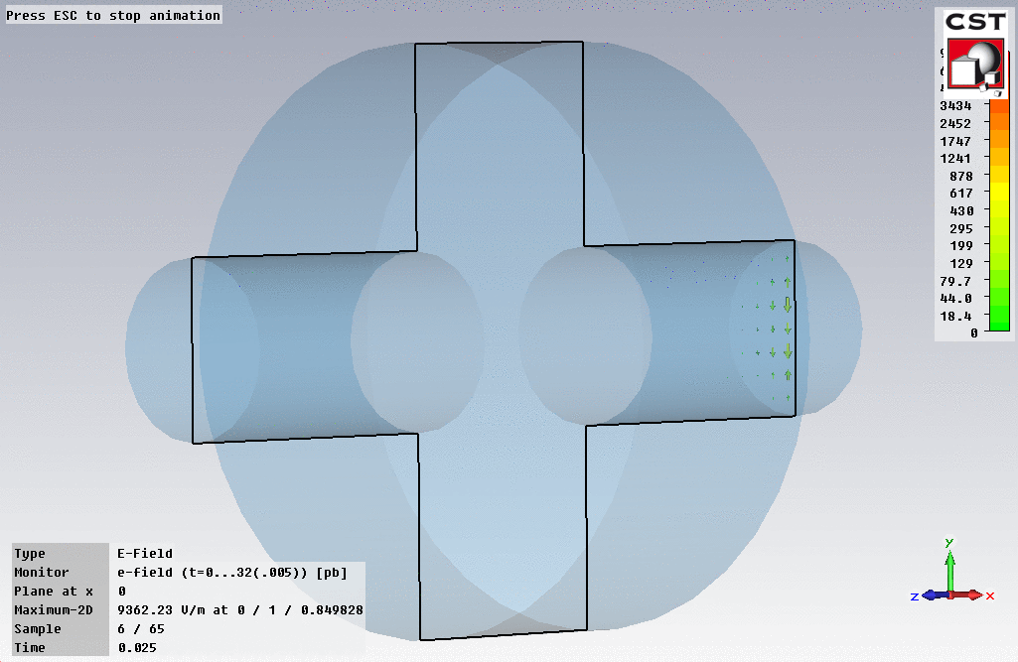
This is a time-domain problem:
These directly compute the interaction of a beam with a geometry.
It is useful to think of time-domain simulation as “experiments.” You can put in the whole geometry and verify that it is working like you expect.
The primary use is for the calculating wakefields we talked about in the previous section for complicated geometries.
If you see a resonance you didn’t expect, or frequencies that seem wrong, you can go back to the eigenvalue solver or driven solution and find out what is going on. You know where to look from time domain.
There is also S parameter time domain – you get a band of frequencies all at once.

Slide 6
How the most popular E&M codes are used in the CLIC study :
HFSS – Eigenvalue and driven solution. Accelerating structures, PETS and waveguide components. For understanding how fields look and very very accurate determination of solutions. Tetrahedral meshing for high accuracy. Likes computers with lots of RAM.
GdfidL – Time-domain. Super-efficient work-horse code for wake-field calculations. Very well parallelized so well adapted to clusters of PCs. Also can do PIC.
CST Microwave and Particle Studio – Eigenvalue, driven and wakefield. Very easy to get started doing accelerator applications with built in functions. Popular with youngsters.
ACE3P – Supercomputer super code developed at SLAC for the ultimate calculations. Everything - eigenvalue solver, time domain, tracker (for multipactor for example) through PIC. Tricky to use, tricky to get access to… For specialists only.
COMSOL – Multi physics also.
**** Huge field and I give you only a very specific perspective from CLIC ****

Slide 7
The fundamental issue:
Misalignments between the beam and rf structures will result in the excitation of higher-order transverse modes. For example TM₁₁₀-like modes.
Because linear collider beams consist of trains of bunches, these modes which are excited by a bunch, will act on following bunches.
Because the modes are transverse, they will cause deflections of following bunches.
And because the beam is intense, in order to have high efficiency, this effect is quite strong.
Hence we have the potential for a transverse instability.
There are also high-order longitudinal modes which affect energy spread but we will not speak much about them – they mostly get taken care of automatically.
Higher order mode
Beam direction and axis

Slide 8
In order to prevent the beam instability, we need to act on the transverse mode while minimizing the effect on the fundamental, accelerating, mode.
We can do this in two ways.
Selectively damp the transverse, higher-order, modes. This means adding features to the cells which selectively couple to the unwanted modes. Lowering their Q so the amplitude of the mode is suppressed between bunches. In a linear collider this means reducing the dipole mode Q’s to values below 10.
Messing around with the dipole mode frequencies, while leaving the fundamental unchanged, so that bunches get kicks from different parts of the structure with different phases. This causes a net wakefield cancellation and is called detuning.
In reality we almost always do a bit of both.
In order to do this in practice we need to address the question:
How do the modes differ?
Damping first. Then detuning.

Slide 9
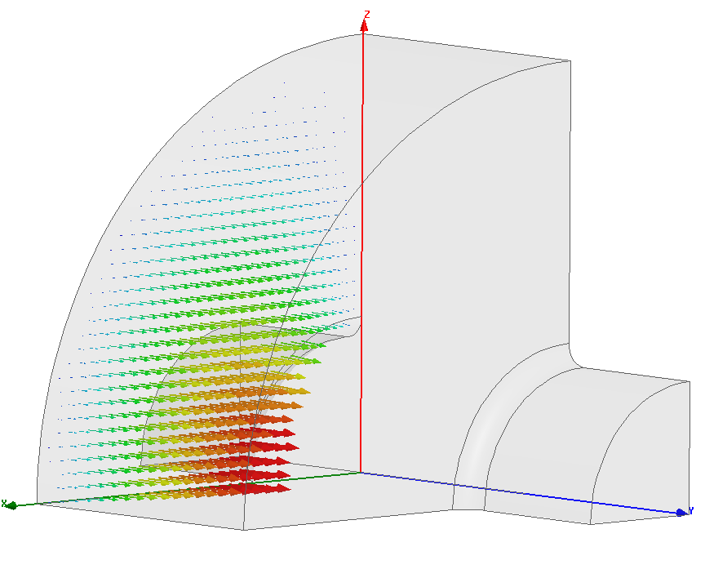
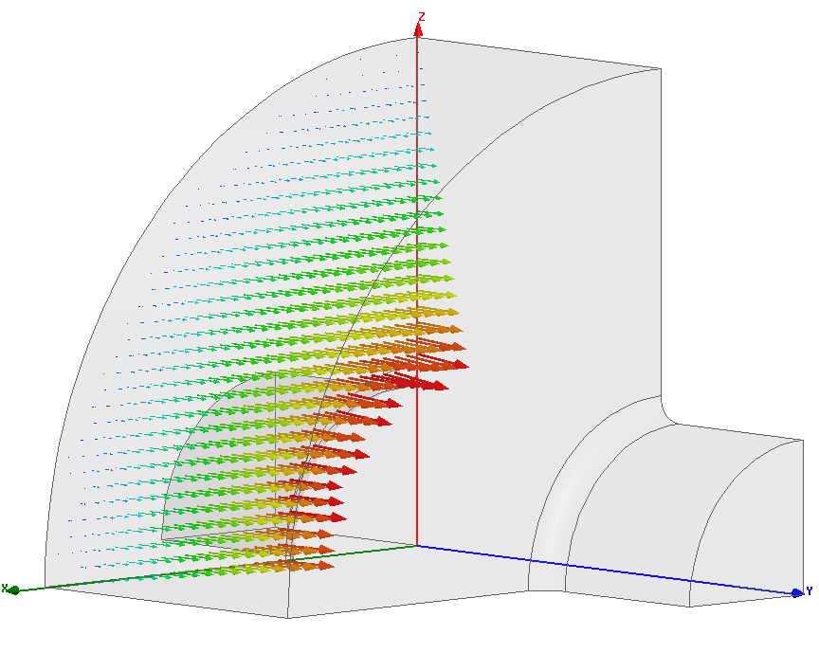
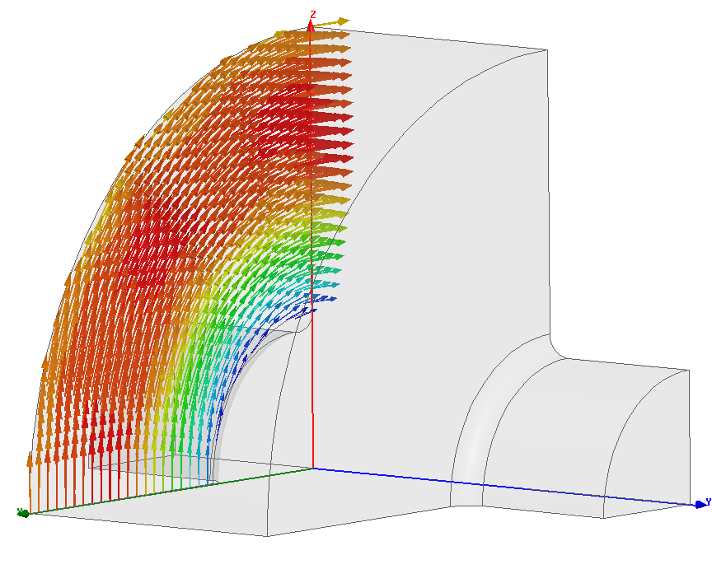
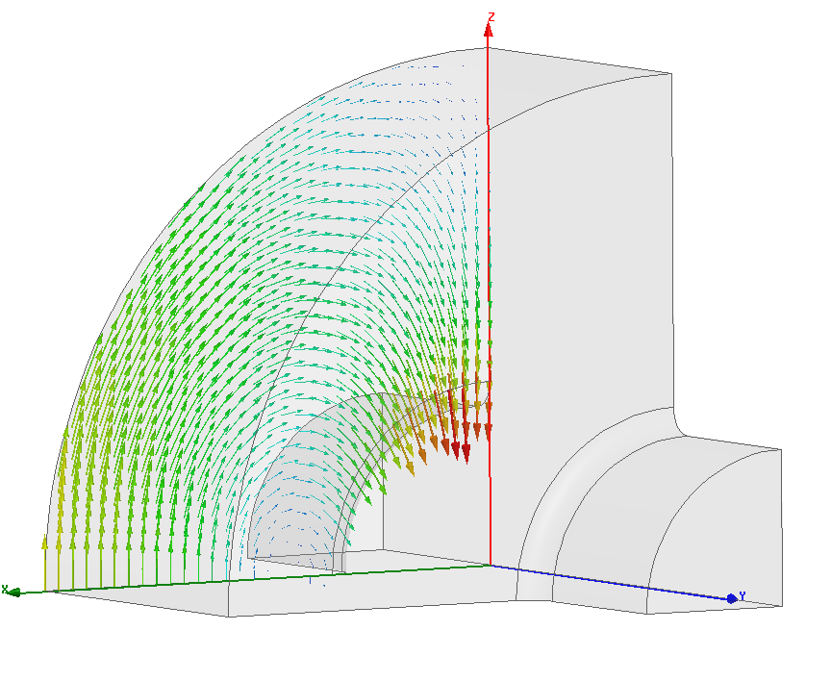
What the modes look like:
Transverse, m=1 mode
longitudinal, m=0 mode
surface electric field
f=11.994 GHz
f=18.014 GHz
surface magnetic field

Slide 10
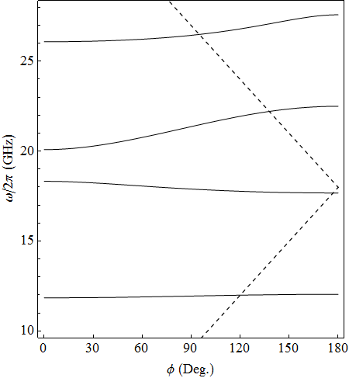
Dispersion curves: Mid cell
Third dipole
We of course need to consider the beam/mode interaction in multi cell structures.
Consequently we go back to dispersion curves, Brillouin diagrams.
Here we see the synchronous crossings of the dispersion curves with the speed of light line.
Second dipole
First dipole
Light line
Monopole
Thanks to Vasim Khan for the detuning plots!

Slide 11
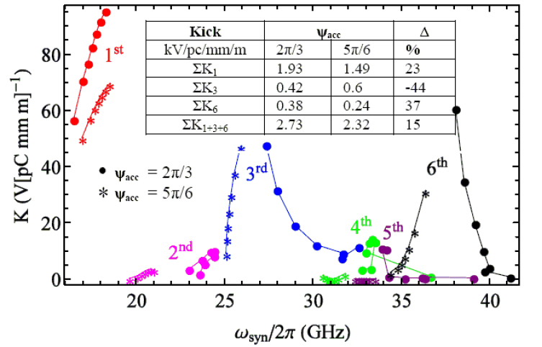
Not all of the modes kick equally. The mode characteristics of disk loaded waveguide are complicated hybrids of more TM-like and more TE-like hybrids.

Slide 12
The types of modes differ in both frequency and symmetry.
Lets consider their difference in frequency first.
The most straightforward way of selectively damping is to introduce a waveguide into the cell which has a cutoff frequency above the fundamental mode, 12 GHz in our example, but below the lowest dipole mode, 18 GHz.
Fundamental mode power is in cut-off so does not propagate, dipole mode power does.
This is called waveguide damping and is used in the CLIC baseline structure.
We’ll look more closely at the CLIC structure now, to get the bigger picture of a damped structure before moving on to the other types of wakefield suppression.

Slide 13
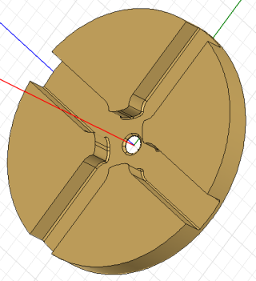
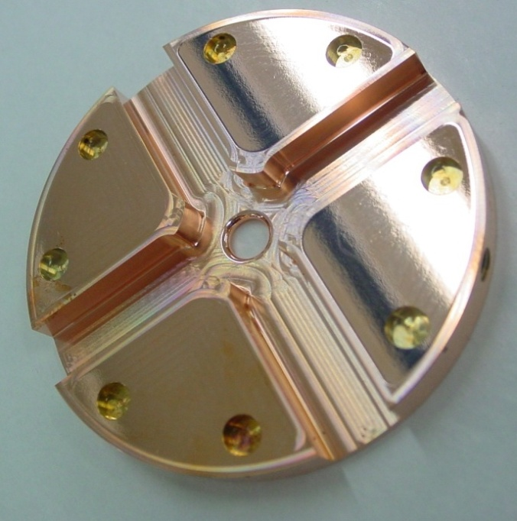
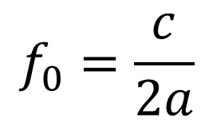
Waveguide damped cell topology
The cells have 11 mm wide waveguides. This gives a cutoff frequency of 13.6 GHz for the TE_{1,0} which is given by the relation:
$$f_{0}=\frac{c}{2a}$$
18 GHz propagates, 12 GHz is in cut-off. The Q of the dipole mode is around 10.

Slide 14
Frequency and time behavior
CLIC bunch spacing
f₀=18 GHz, Q=10
[ns]
[GHz]

Slide 15
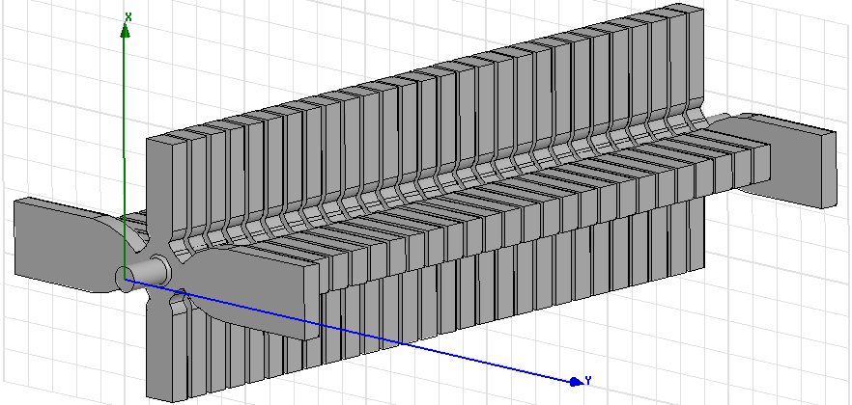
Every cell has to be damped in a linear collider

Slide 16
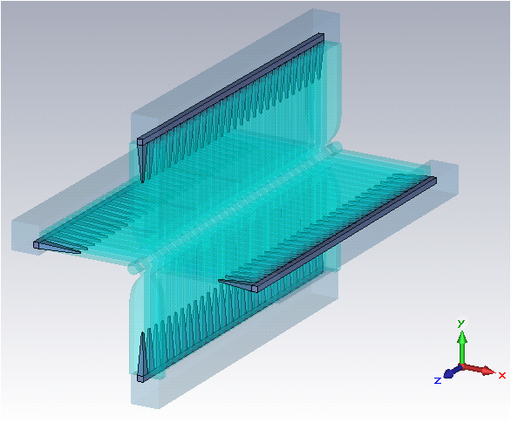
With terminations

Slide 17
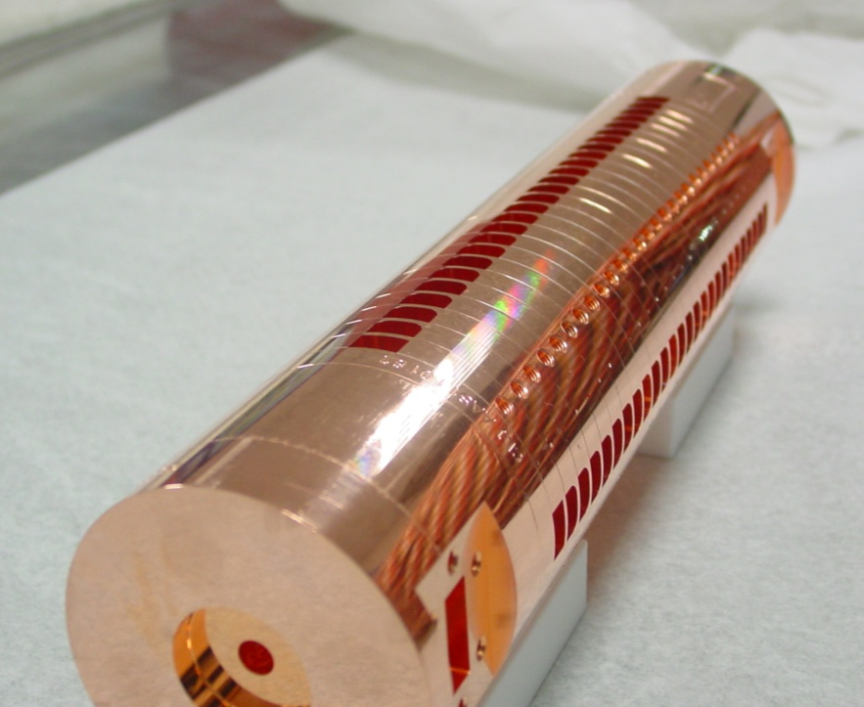
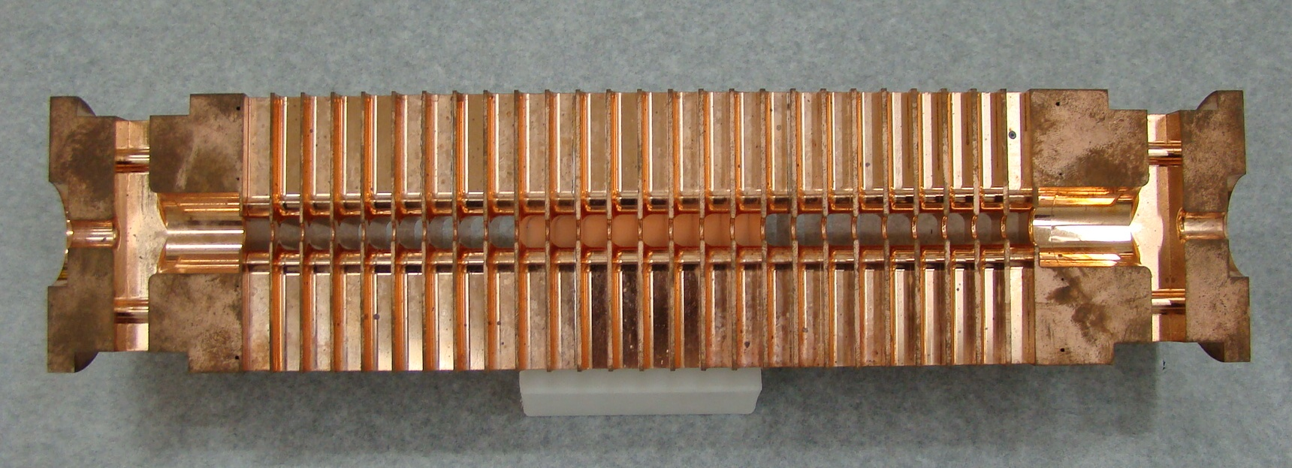
How it looks

Slide 18
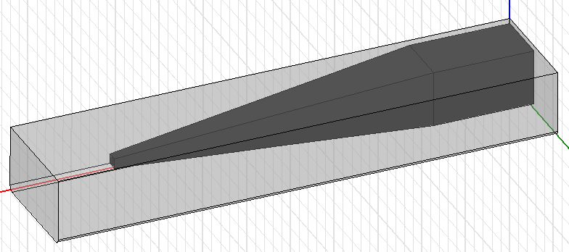
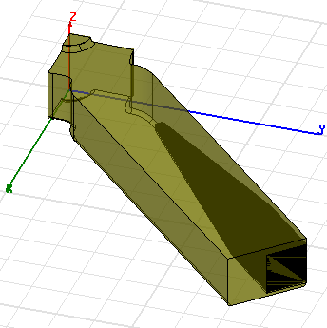
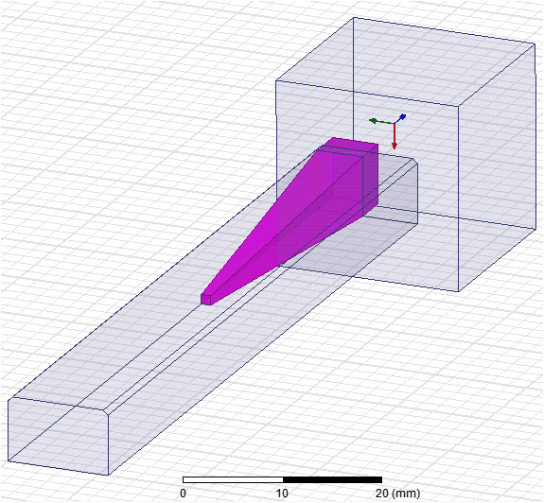
Then you need to terminate each waveguide with an absorbing load

Slide 19
You can make a pretty good approximation to the wakefield from a heavily damped structure by getting frequencies from an undamped dispersion curve and Q’s from an eigenvalue solver.
But in practice the wakefield from such a structure is solved using a time domain code.

Slide 20
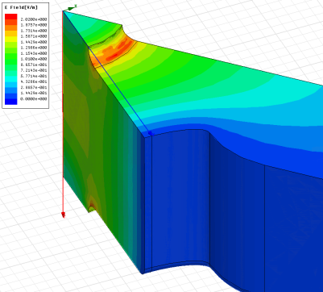
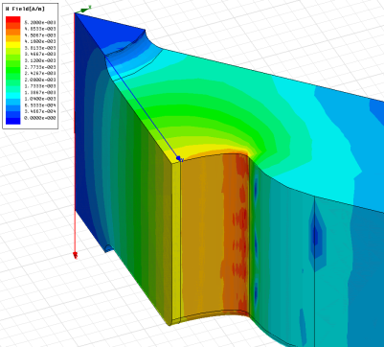
There is however a price to pay for including damping.
You lose a bit in shunt impedance.
There is a concentration of surface magnetic field on the outer cavity wall, which can cause problems at high power.
Mechanical complexity – milling is required.
E_{s}/E_{a}
H_{s}/E_{a}

Slide 21
Bunch Passage through TD26
Thanks to Oleksey Kononenko

Slide 22
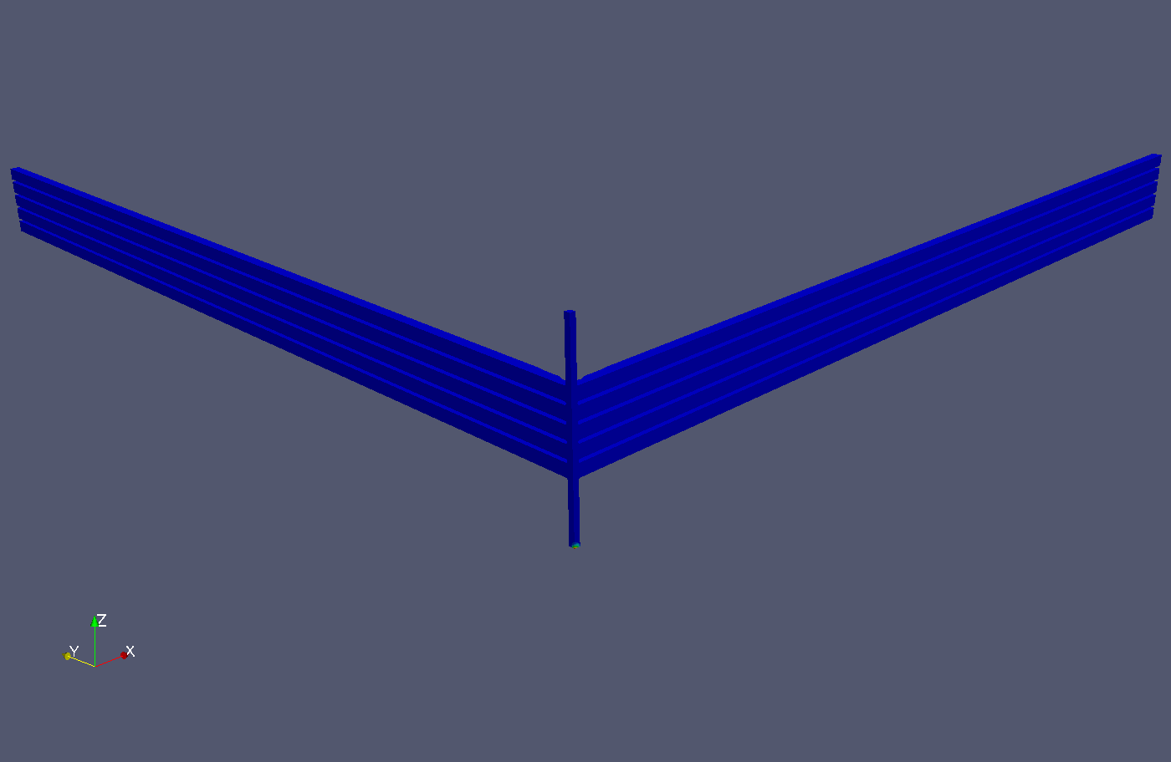
Waveguide damping from Kyrre Sjobaek

Slide 23
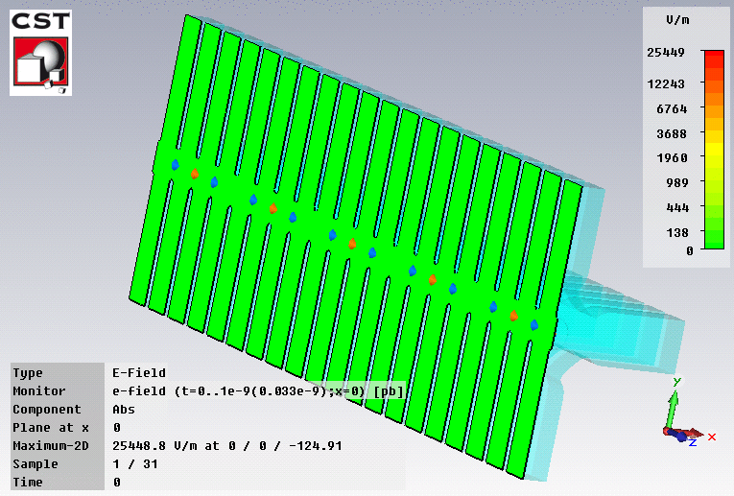
CST Particle Studio
Another view of wakefield damping from Giovanni De Michele

Slide 24
Now we will consider damping which takes advantage of the different symmetry of the monopole and dipole modes.
Another way of saying it is that we will take advantage of the different field patterns of the two modes.
The form of damping is called slotted-iris damping.
This type of damping is used in the CTF3 drive beam linac accelerating structures, in the CLIC PETS structures and has been considered as a alternative CLIC main linac structure.

Slide 25
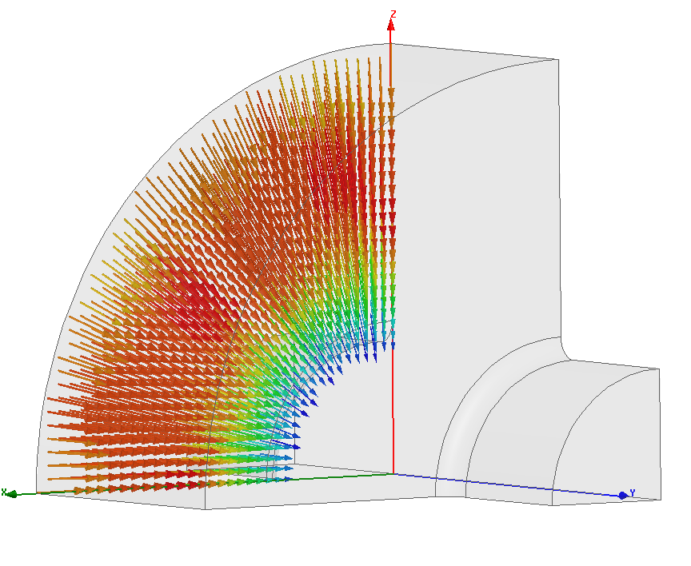
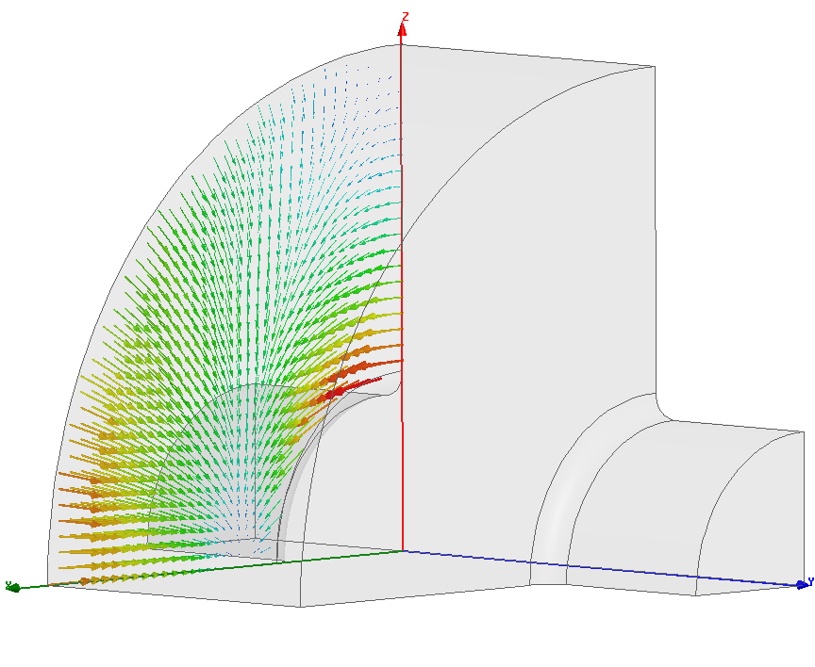
Slotted iris damping
put slot here
surface current
25
25
fundamental mode
dipole mode
25

Slide 26
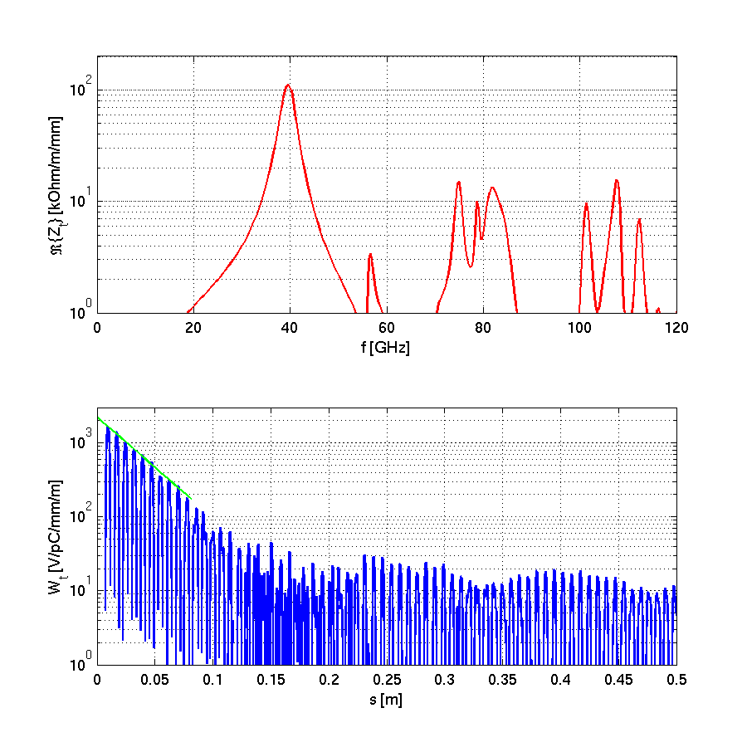
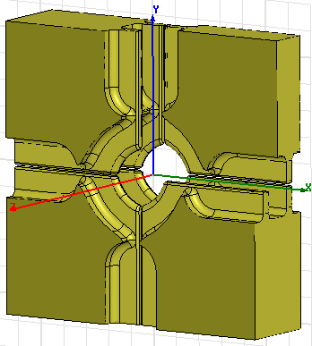
Hybrid Damped Structure (HDS)
Combination of slotted iris and radial waveguide (hybrid) damping
results in low Q-factor of the first dipole mode: ~ 10

Slide 27
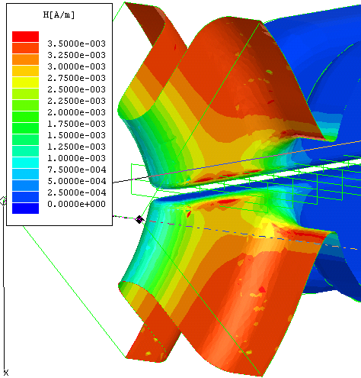
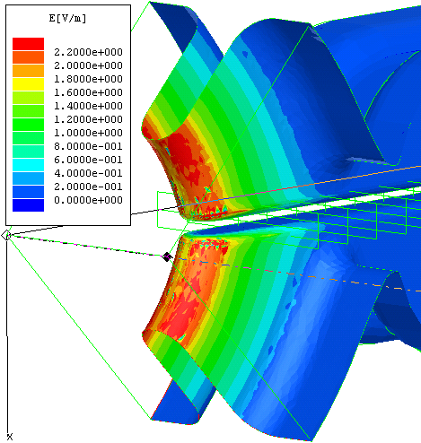
Surface magnetic field
Surface electric field

Slide 28
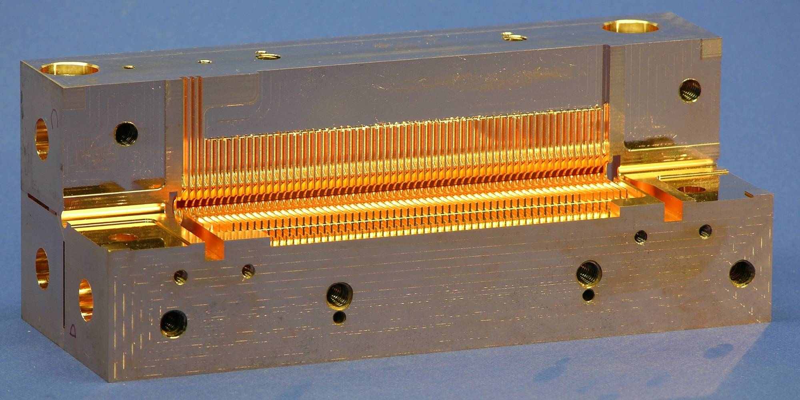
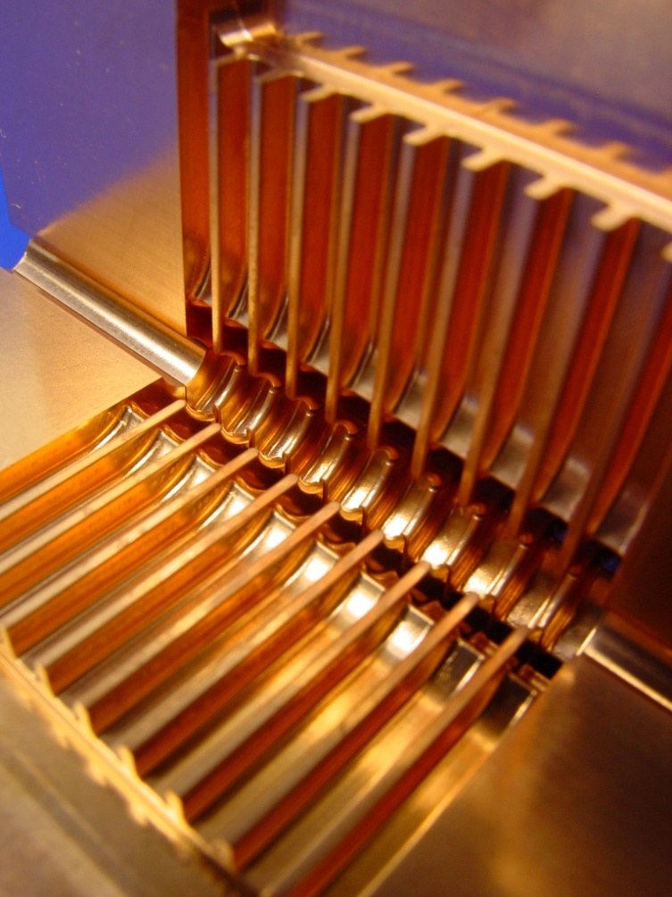
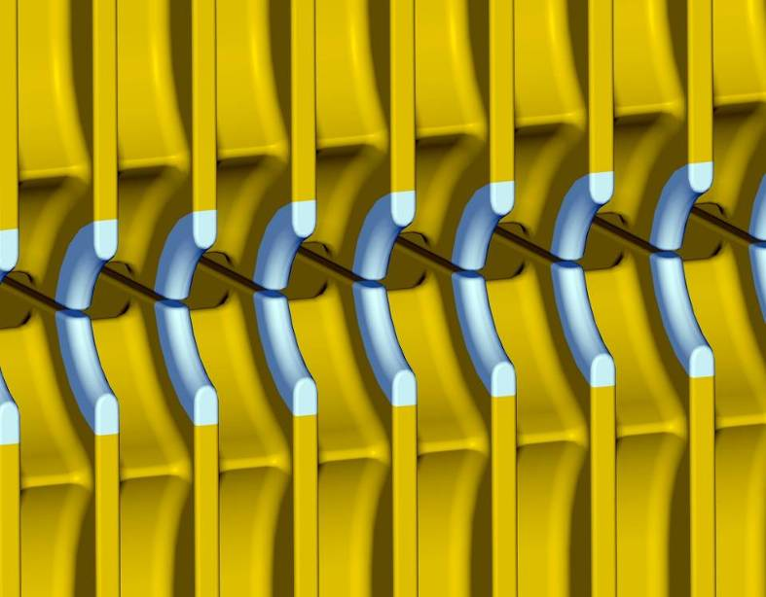

Slide 29
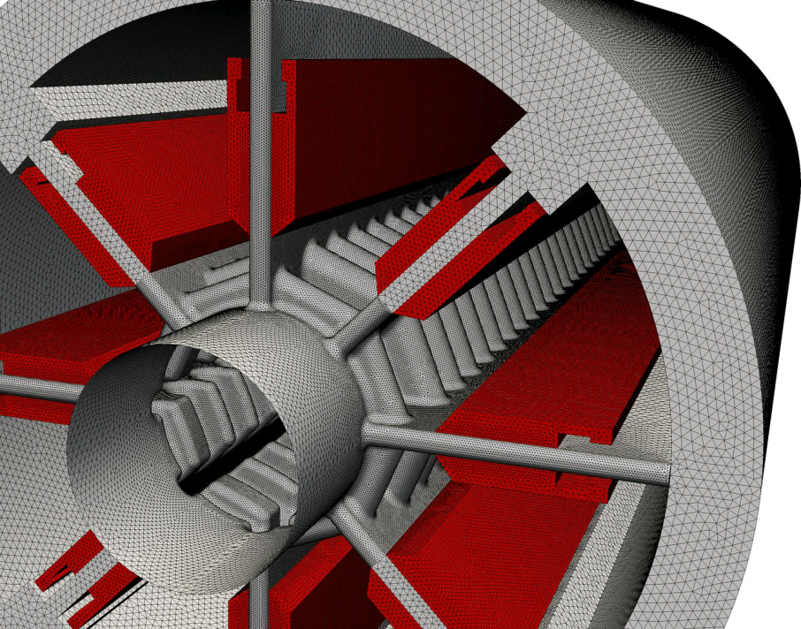
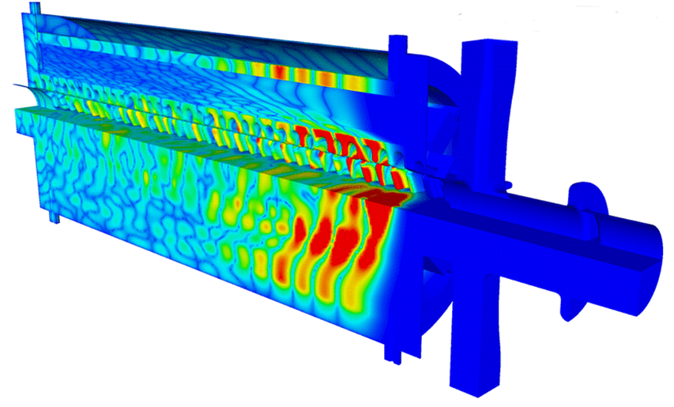
Slotted iris damping in the CLIC PETS structures
Q’s below 10

Slide 30
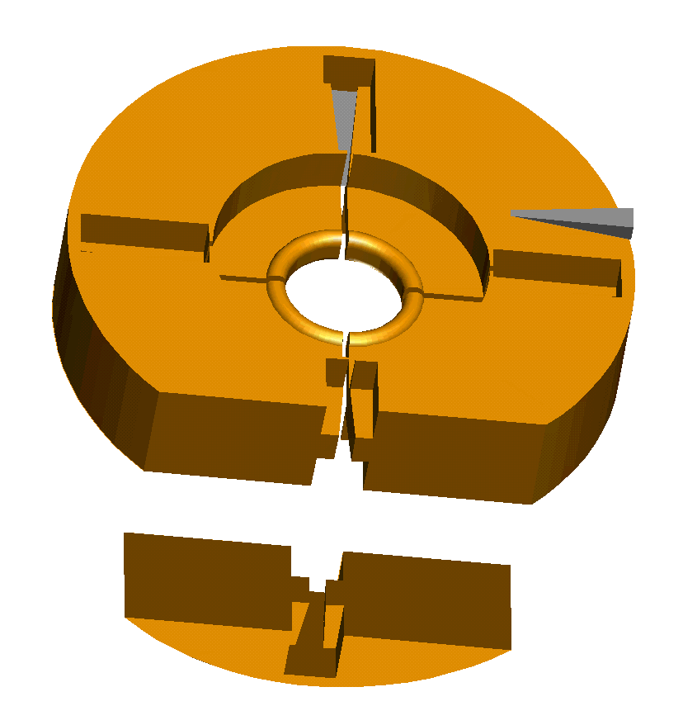
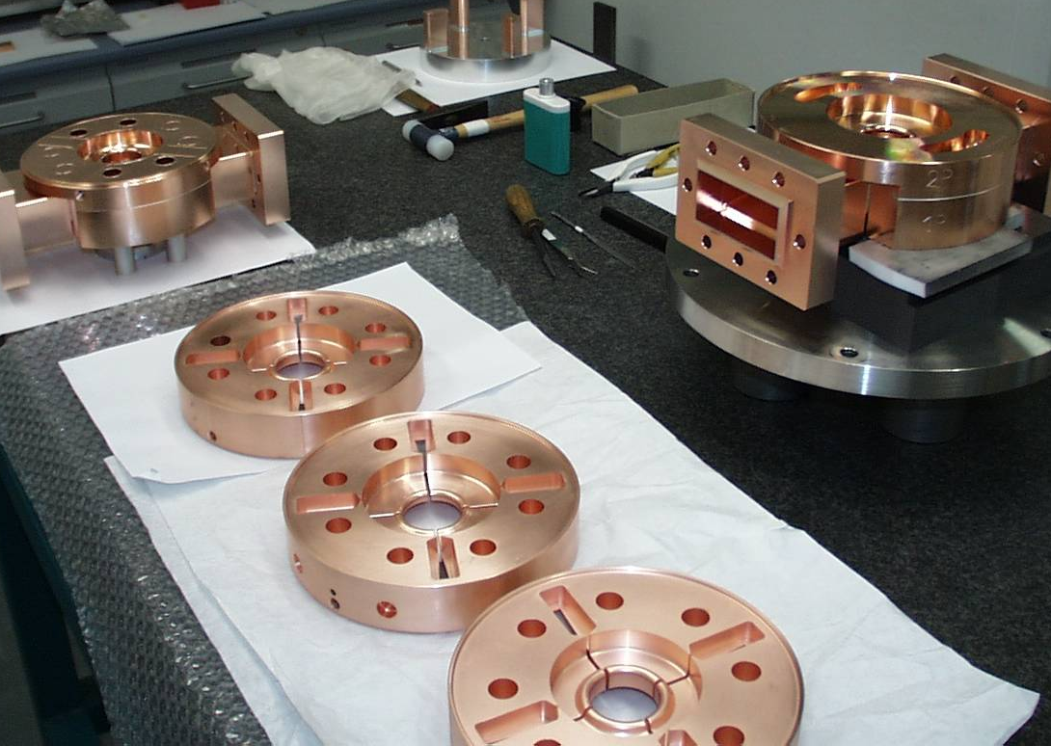
SICA geometry. CTF3 drive beam linac

Slide 31
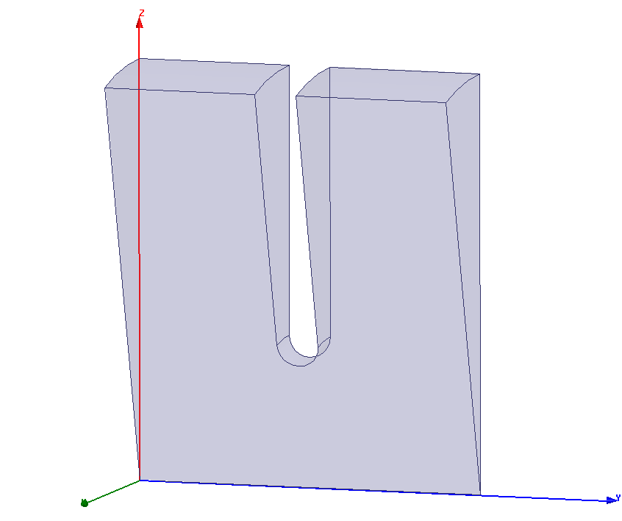
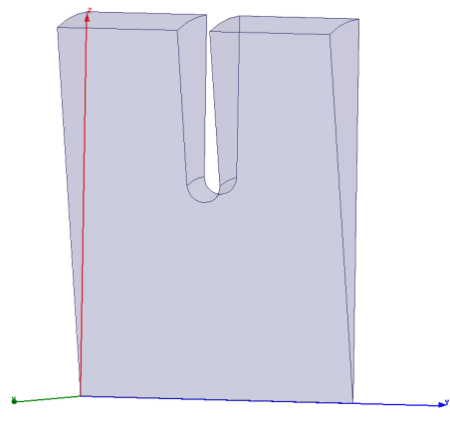
Detuning
Introduce a variation in the dimensions of a structure such that the fundamental, accelerating mode synchronous frequency is unchanged, but higher order modes are detuned.
Remember these figures from part 1?

Slide 32
How it looks
Small iris
Big iris

Slide 33
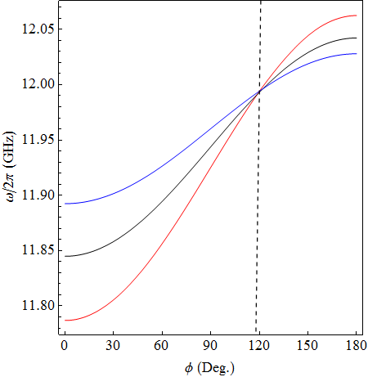
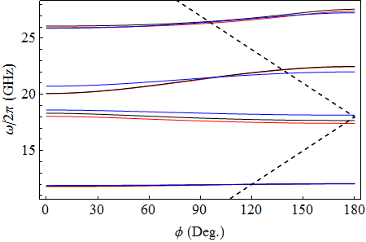
Detuning
Monopole
Third dipole
Second dipole
Last cell
First dipole
Monopole
Mid cell
First cell

Slide 34
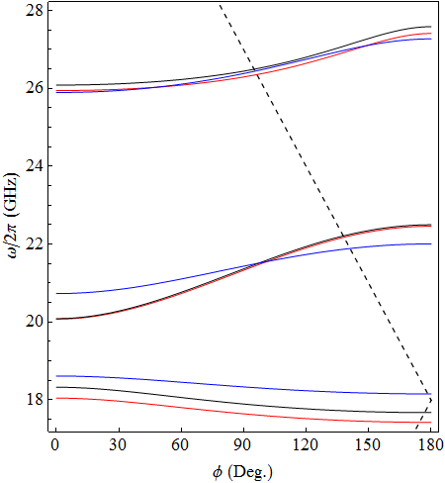
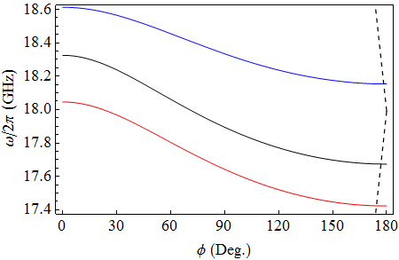
Detuning – close upon dipole modes
Third dipole
Lowest dipole band
Dipole bands
Last cell
Mid cell
Second dipole
First cell
First dipole

Slide 35
From these dispersion curves we get the frequency spectrum of the transverse modes, from which we can determine the time dependence through the Fourier transform:
t₀
Broader spectrum gives faster roll-off.

Slide 36
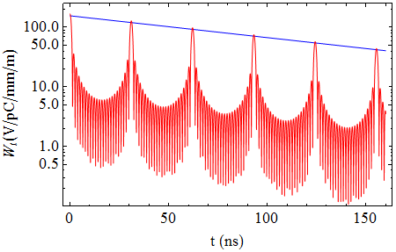
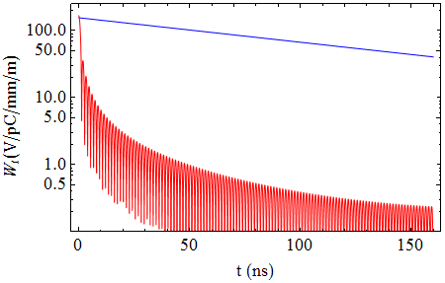
Lowest dipole band
No tapering (Q_{cu} = 6500)
No. of Cells =24
Linear tapering
(Q_{cu} = 6500)
No. of Cells =196
(8 structures)

Slide 37
Putting damping and detuning together
Cell | First | Middle | Last
Q-factor | 11.1 | 8.7 | 7.1
Amplitude [V/pC/mm/m] | 125 | 156 | 182
Frequency [GHz] | 16.91 | 17.35 | 17.80

Slide 38
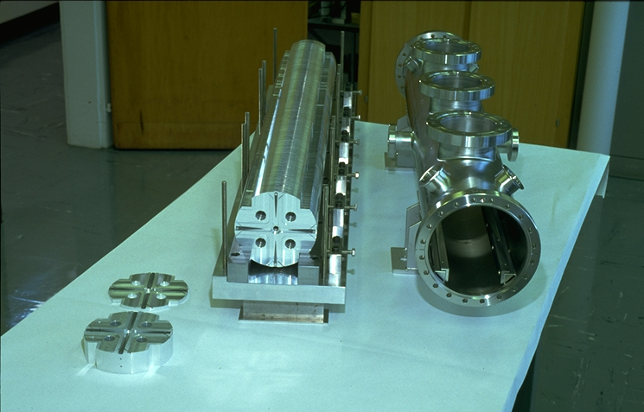
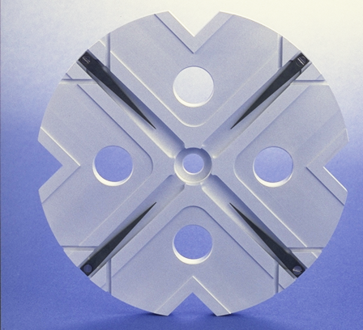
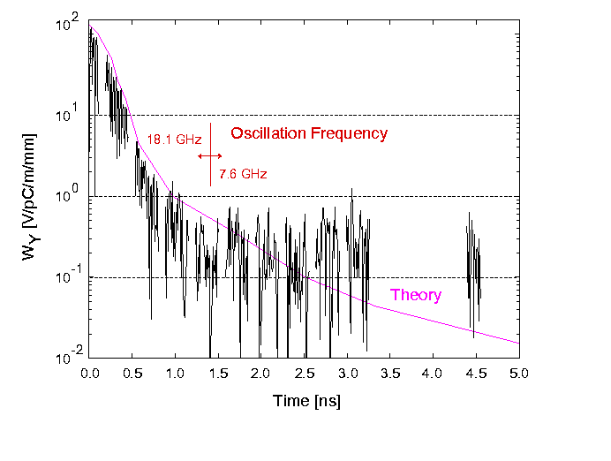
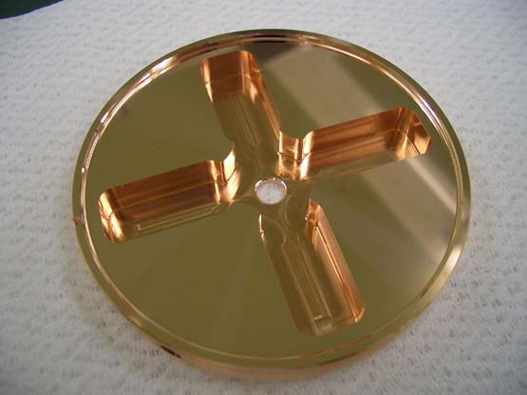
150 cells/structure, 15 GHz
Higher-order mode damping demonstration in ASSET
Then
Now
Double band circuit model
24 cells/structure, 12 GHz
(loads not implemented yet)
An Asset Test of the CLIC Accelerating Structure, PAC2000

Slide 39
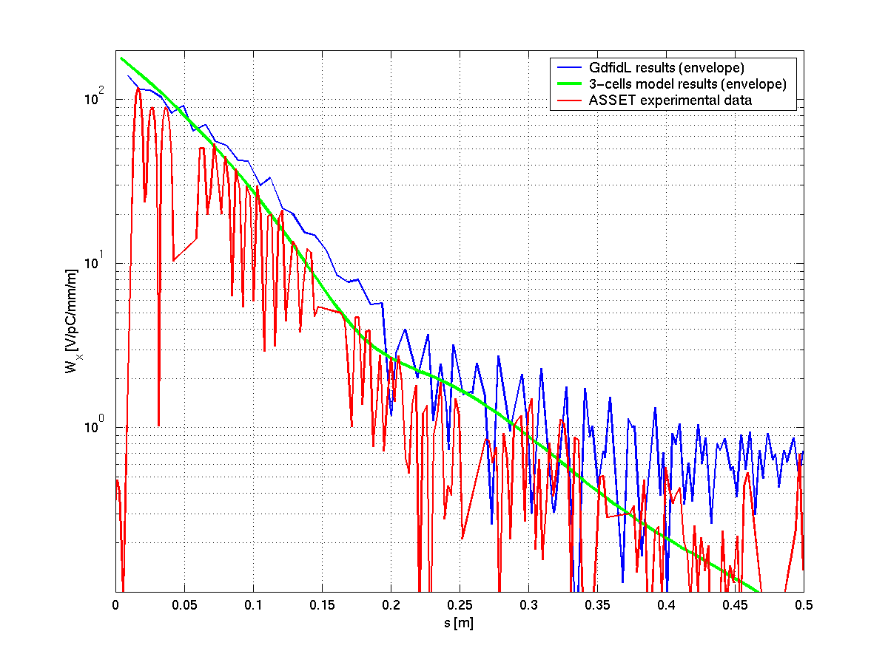
Full length TDS results comparison
But not clear if FACET or ASSET are available anymore.

Slide 40
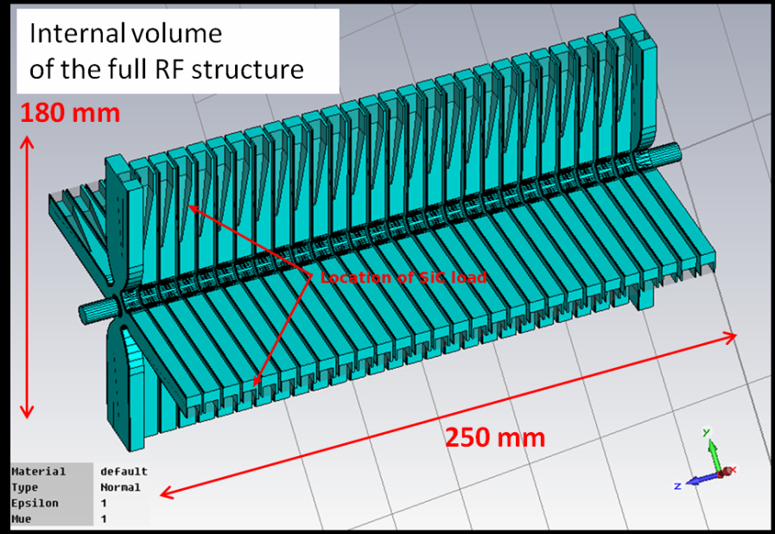

Transverse long-range Wakefield in CLIC-G structure
Structure name | CLIG-G TD26cc
Work frequency | 11.994GHz
Cell | 26 regular cells+ 2 couplers
Length (active) | 230mm
Iris aperture | 2.35mm - 3.15mm
transverse long-range wakefield calculation
using Gdfidl code:
Peak value :
250 V/pC/m/mm
At position of second bunch (0.15m):
5~6 V/pC/m/mm
Beam dynamic requirement:
< 6.6 V/pC/m/mm
Beam dynamic requirement
Very strong damp : 40 ~ 50 times
Position of second bunch

Slide 41



Direct wakefield measurement in FACET
Prototype structure are made of aluminium disks and SiC loads (clamped together by bolts).
6 full structures, active length = 1.38m
FACET provides 3nC, 1.19GeV electron and positron.
RMS bunch length is near 0.7mm.
Maximum orbit deflection of e- due to peak transverse wake kick (1mm e+ offset): 5mm, BPM resolution: 50um
AS
AS
AS
AS
AS
Aluminium disk
AS
Damping
material (SiC)
e-, NRTL
e+, Driven bunch
Dump
e-, Witness bunch
Dipole
Dipole
e+
Kick
Downstream BPMs
e-
CLIC-G TD26cc
Transverse offset
deflected orbit
e+, SRTL

Slide 42

FACET structure

Slide 43



Measurement of $R_{12}$
Calculation of absolute value for the wake-kick relies on $R_{12}$
However, $R_{12}$ is not directly measurable.
We using upstream correctors to create a “virtual kick”.
correctors
Simulated kick
Downstream BPMs
Tested structure
Nearest Upstream
BPM
Nearest Downstream
BPM
“response orbit”

Slide 44


Final results
Peak value is 12% lower than simulations.
Wake potential at second bunch separation = 5V/pC/m/mm < 6.6 V/pC/m/mm

Slide 45



Timing correction

Slide 46
Additional techniques for HOM damping

Slide 47

Another way of taking advantage of the frequency difference – choke mode damping.
Basic idea:
Put in a slot around the structure to let all modes out.
Add a choke (a sort of narrow band-stop filter which acts like a short circuit) to keep the fundamental mode in.
This is another example where frequency selection is used.

Slide 48

Implementation at X-band

Slide 49



Equivalent circuit model
Some HOMs could be also fully (or mostly) reflected.
For accelerating mode, ϕ₃=π/2, so z=∞. Then It is fully reflected by choke.
H. Zha

Slide 50


Thin-neck choke design
Purpose of thin-neck design:
Increase the 2nd fully reflected frequency
Reduce reactance of HOMs
The joint planes (Plane A and Plane D) are equivalent as impedance transformers
S12
Plane C
Plane A
Plane D
Plane C
Plane A
section a
section b
Plane D
z3
Zca
zb
za
Zcb =K*Zca
Short load
K | 1 | 2 | 3 | 4
f2 | 36GHz | 49GHz | 60GHz | 69GHz
La
Lb

Slide 51


Wakefield simulation results
 | W⊥ (s=0.15m)
WDS | 5
CDS-A | 20~30
+Thin-neck | 10~17
+Matching step | 7~10
+Dipole detuning (CDS-C) | 5~6
 | CDS | WDS
Fc | 1 | 1
Frms | 4 | 5
Fworst | 25 | 20

Slide 52







Radial line experiments
H. Zha, Tsinghua University

Slide 53
Elliptical-rod Design at 11 GHz
Standing wave design with 2 matching cells, one test cell
Axially powered via TM₀₁ mode launcher
Structure has elliptical inner rods
  Spread large H field over larger region
  → reduce pulsed heating
Performance at 100 MV/m
 | Round | Elliptical
Power | 5.9 MW | 4.4 MW
Peak Surface E Field | 208 MV/m | 207 MV/m
Peak Surface Magnetic Field | 890 kA/m | 713 kA/m
Pulsed Heating for 150ns Flat Pulse | 131 K | 84 K
B. J. Munroe, MIT

Slide 54

PBG Structure Fabricated at SLAC

