Slide 1
3 BPM Resolution
Data cuts
Geometric / Fitting / Multi-parameter fits
Single sample / integration / multi-sample averaging
T. Bromwich

Slide 2
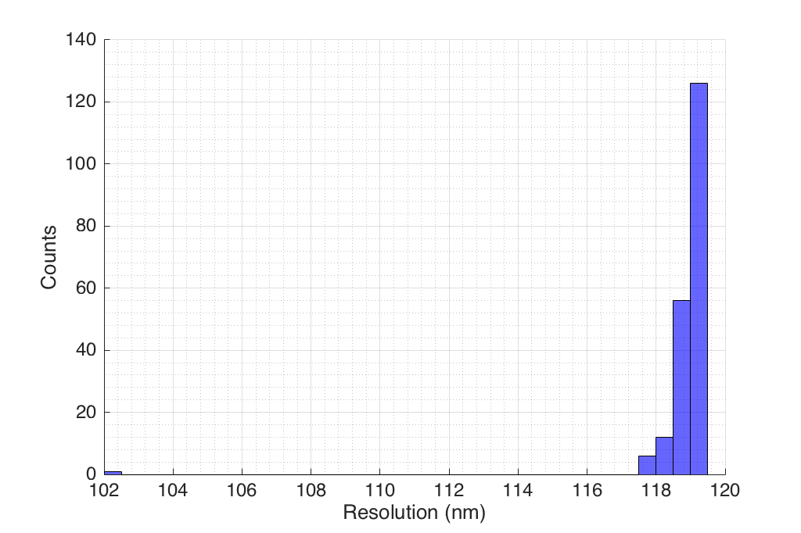
Data cuts
Previously observed that on bad data sets, 3 sigma cuts have large impact on resolution result. Colin suggested trying randomly removing pulses and checking the resolution distribution.
jitRun3_0dB_ipbpm_150612
201 triggers
Geometric method
Single sample (57)
Removal of 1 pulse
causes ~20 nm drop in
resolution. This point is
removed by 3-sigma cut
on I-signal.

Slide 3
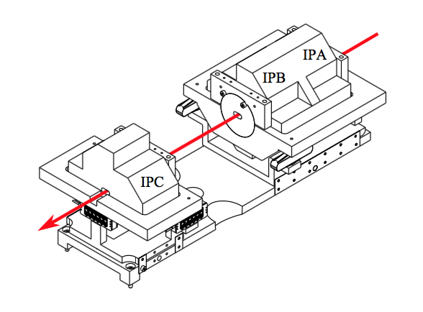
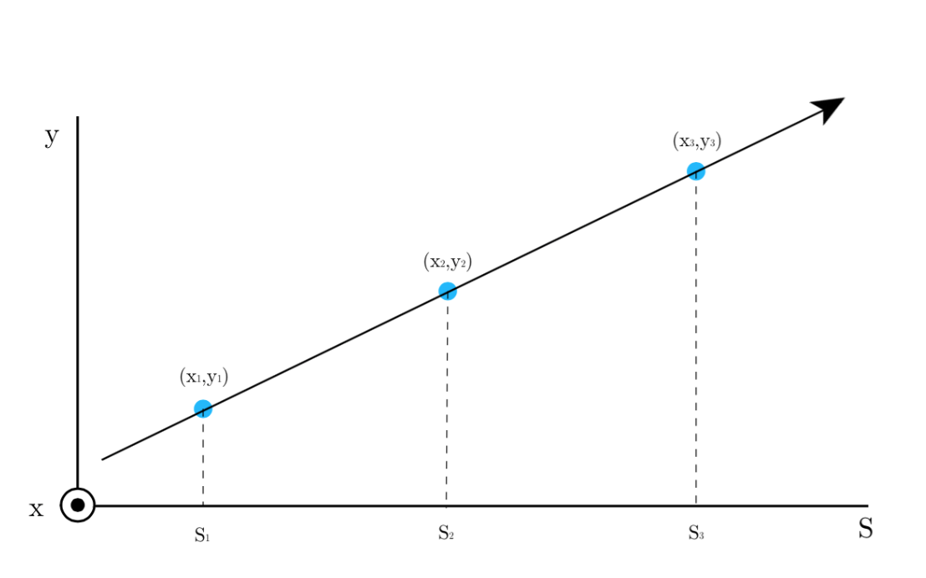
3BPM resolution study
Trying to measure the resolution of the three ATF interaction point (IP) beam position monitors (BPMs).
Use the measured position at two of the three BPMs to predict the position at the third. Then compare with what was actually measured at that third BPM.

Slide 4
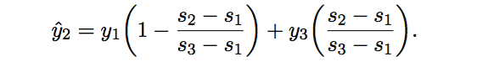
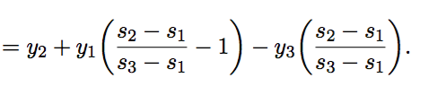

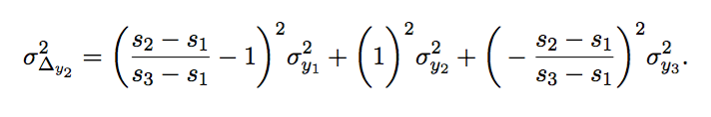
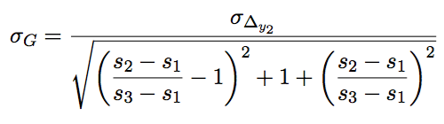
Geometric method
Use known separations of the BPMs to predict vertical position
at BPM 2:
Residual is the difference between the predicted and measured position:
Apply error propagation to find standard deviation of the residual in terms of the resolution at the BPMs:
Assume resolution the same at all three BPMs and rearrange:

Slide 5


Fitting method
Instead of constraining the position prediction to the known geometric separations, apply a linear fit:
Following exactly the same logic as for the geometric method, the resolution becomes:
Allowing the fitting coefficients for different BPMs to be unconstrained, means the three different calculations for residuals at different BPMs will result in three different BPM vertical position resolutions (unlike the geometric method which produces only one).

Slide 6
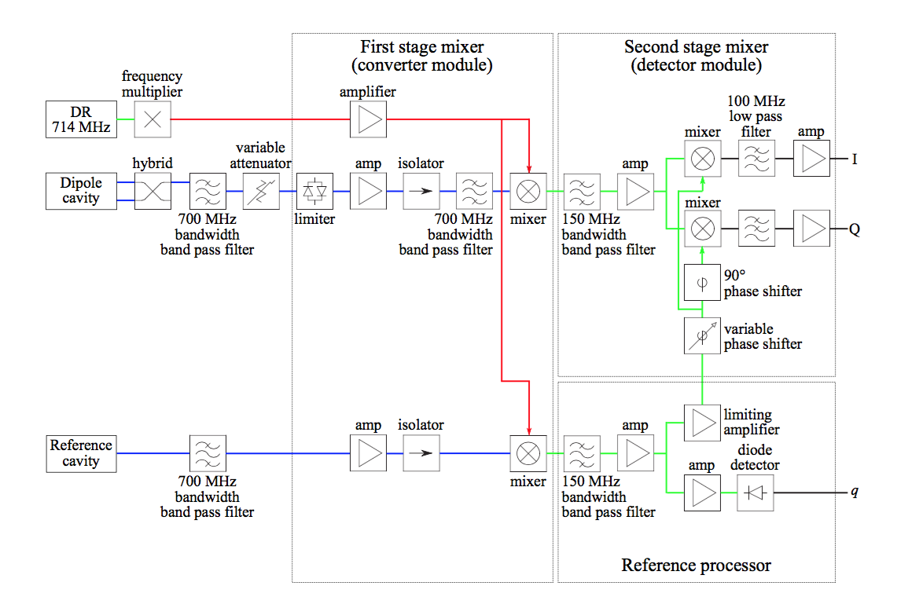
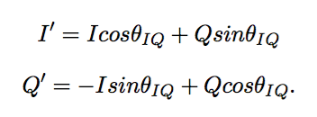

Fitting before calibrating to position
Positions at the BPMs are determined from the I and Q electronic signals and the charge, q.
Normalise I and Q to remove charge dependence.
Convert I and Q into I’ and Q’, so all position information is contained in I’.
Use calibration constant, k, from calibration run to convert I’ into a position.

Slide 7
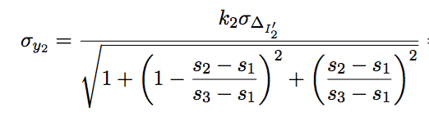

Fitting before calibrating to position
Instead of converting signals into a position, y, and then applying the geometric or fitting method to find the resolution, others in the ATF IPBPM collaboration instead apply a fit to the I’ and Q’ or raw I and Q signals, and convert to a position measurement after the residual has been determined.
Fitting with I’ and Q’ means using only one calibration constant for the BPM where you are predicting, instead of all three required to convert to positions at the beginning.
It also means any remaining position dependence in the Q’ signal is incorporated.
Fitting with I and Q means there is additionally no phase rotation step (determined from a Q vs I calibration run).

Slide 8

Multi-parameter fit
It is possible to include additional fit terms, such as x-port signals, or the beam charge.
This involves making separate assumptions about the predicted position signal and actual position. Here you include x and and q in the definition of predicted y:
But once the fit has been performed, the resolution must then be calculated by adopting a geometric-dependent model of the actual position:
You have no choice but to do this if you include additional parameters, and it is not clear to me that these two separate assumptions are not contradictory.

Slide 9
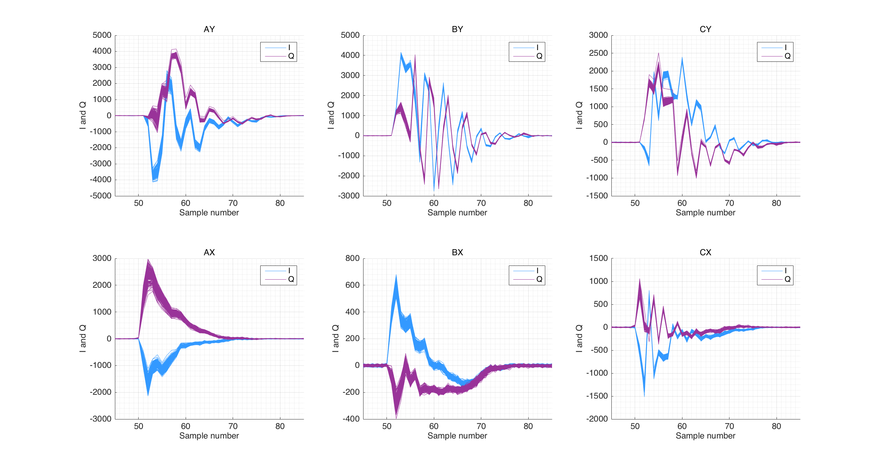
Different sampling
Single sample – use one sample
from each pulse – calibrate and
find position from I and Q signals
Multi-sample averaging – use
multiple samples from each pulse – calibrate each sample individually to find positions, then average the positions
Integration – use the sum of multiple samples from one pulse – calibrate the combined samples into one position

Slide 10
4 data sets
ANALYSIS METHOD
(1) Geometric method
Fitting methodS:
(2) y = ay + by
(3) y = ay + by +c
(4) y = ay + by + cy’ + dy’ + e
(5) I’ = aI’ + bI’
(6) I’ = aI’ + bI’ + c
(7) I’ = aI’ + bI’ + cQ’ + dQ’ + e
(8) I’ = aI + bI + cQ + dQ + e
No BPFs
714 MHz BPFs
C-band BPFs
December 714MHz BPFs
SAMPLING METHOD
Single sample
Multi-sample averaging
Integration

Slide 11
jitRun3_0dB_ipbpm_150612
No band pass filters

Slide 12
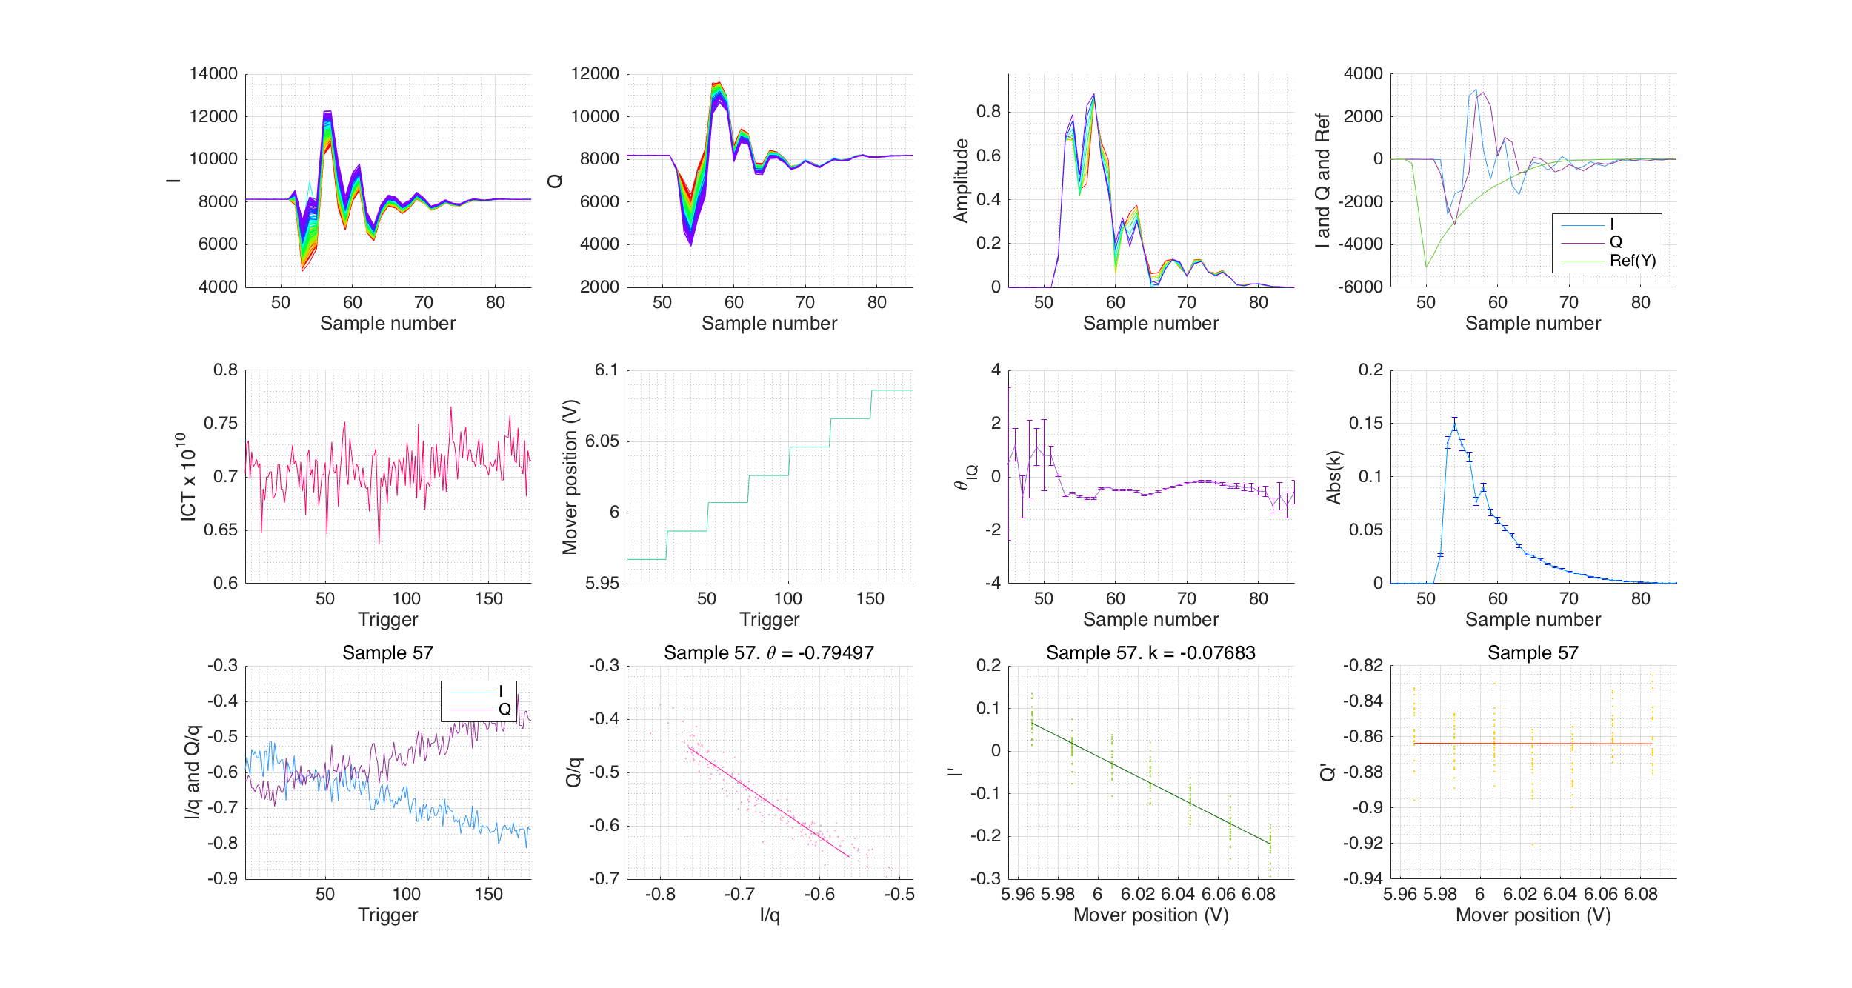
jitRun3_0dB_ipbpm_150612
No band pass filters

Slide 13
jitRun3_0dB_ipbpm_150612
 | Single Sample
 | geo | before | before_c | before_IQ | after | after_c | afterIQPr | afterIQ
IPA | 101 | 90 | 90 | 52 | 66 | 66 | 52 | 39
IPB | 101 | 92 | 94 | 66 | 144 | 139 | 66 | 43
IPC | 101 | 89 | 91 | 35 | 43 | 43 | 35 | 46
Average | 101 | 90 | 92 | 51 | 85 | 83 | 51 | 43
Sample no. | 57 | 58 | 58 | 57 | 58 | 58 | 57 | 54
 | Integration
 | geo | before | before_c | before_IQ | after | after_c | afterIQPr | afterIQ
IPA | 76 | 51 | 51 | 31 | 44 | 44 | 26 | 18
IPB | 76 | 51 | 51 | 33 | 53 | 52 | 26 | 26
IPC | 76 | 51 | 54 | 32 | 65 | 58 | 42 | 42
Average | 76 | 51 | 52 | 32 | 54 | 52 | 32 | 28
Sample start | 56 | 57 | 57 | 54 | 57 | 57 | 53 | 53
Sample finish | 58 | 61 | 61 | 59 | 61 | 61 | 59 | 59
 | Multi-Sample Averaging
 | geo | before | before_c | before_IQ
IPA | 54 | 50 | 49 | 29
IPB | 54 | 49 | 49 | 37
IPC | 54 | 49 | 51 | 32
Average | 54 | 49 | 50 | 33
Sample start | 56 | 56 | 56 | 54
Sample finish | 58 | 58 | 58 | 59

Slide 14
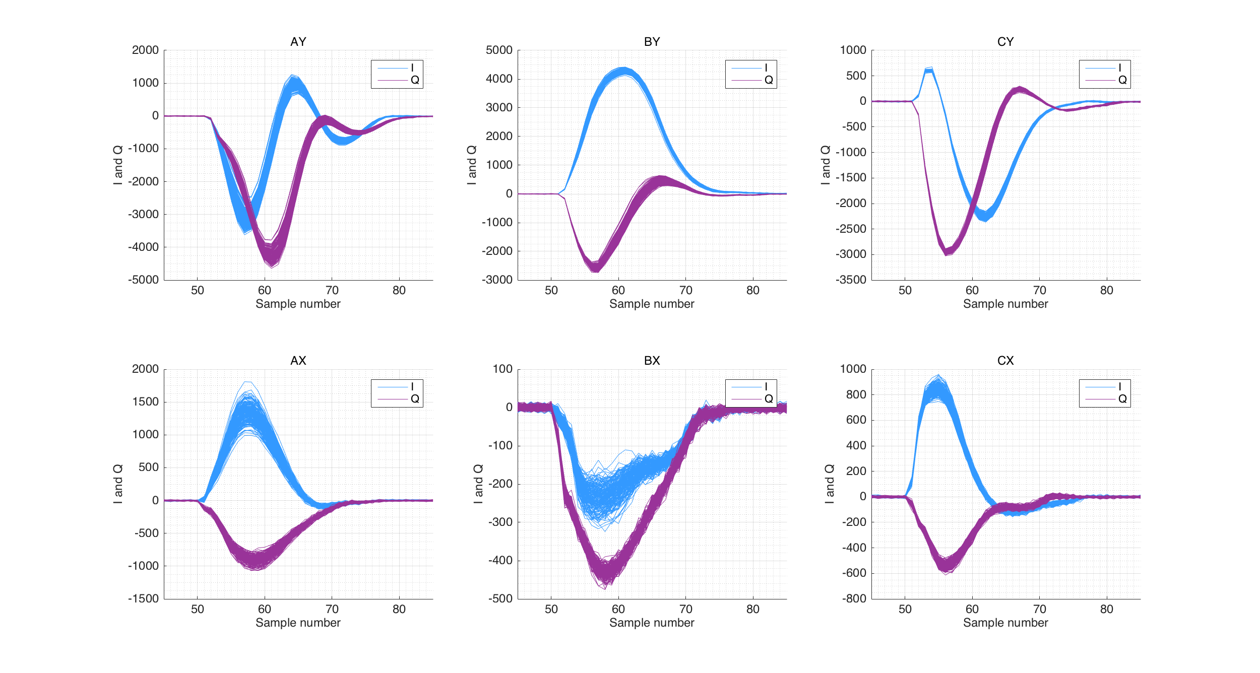
jitRun7_0dB_ipbpm_150612
714 MHz BPF on the 2nd stage electronics

Slide 15
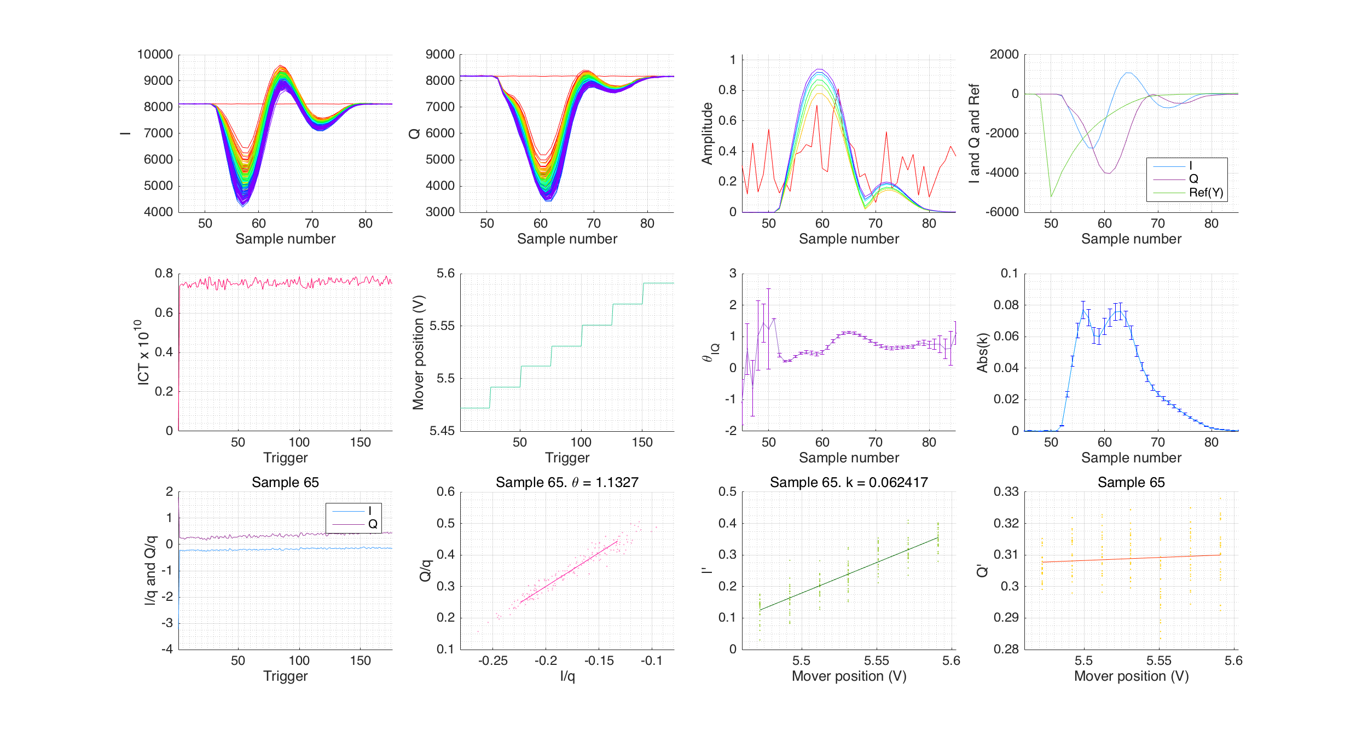
jitRun7_0dB_ipbpm_150612
714 MHz BPF on the 2nd stage electronics

Slide 16
jitRun7_0dB_ipbpm_150612
 | Single Sample
 | geo | before | before_c | before_IQ | after | after_c | afterIQPr | afterIQ
IPA | 163 | 130 | 121 | 69 | 196 | 136 | 56 | 34
IPB | 163 | 119 | 111 | 80 | 107 | 88 | 66 | 35
IPC | 163 | 120 | 203 | 66 | 86 | 76 | 59 | 60
Average | 163 | 123 | 145 | 71 | 130 | 100 | 60 | 43
Sample no. | 54 | 56 | 56 | 65 | 56 | 55 | 66 | 65
 | Integration
 | geo | before | before_c | before_IQ | after | after_c | afterIQPr | afterIQ
IPA | 163 | 132 | 136 | 51 | 205 | 148 | 51 | 32
IPB | 163 | 121 | 121 | 57 | 109 | 91 | 57 | 33
IPC | 163 | 123 | 178 | 57 | 83 | 70 | 57 | 57
Average | 163 | 126 | 145 | 55 | 132 | 103 | 55 | 41
Sample start | 54 | 56 | 56 | 65 | 56 | 55 | 65 | 65
Sample finish | 55 | 57 | 57 | 68 | 57 | 56 | 68 | 66
 | Multi-Sample Averaging
 | geo | before | before_c | before_IQ
IPA | 162 | 134 | 137 | 53
IPB | 162 | 122 | 121 | 59
IPC | 162 | 124 | 182 | 57
Average | 162 | 127 | 146 | 56
Sample start | 54 | 56 | 56 | 65
Sample finish | 55 | 57 | 57 | 68

Slide 17
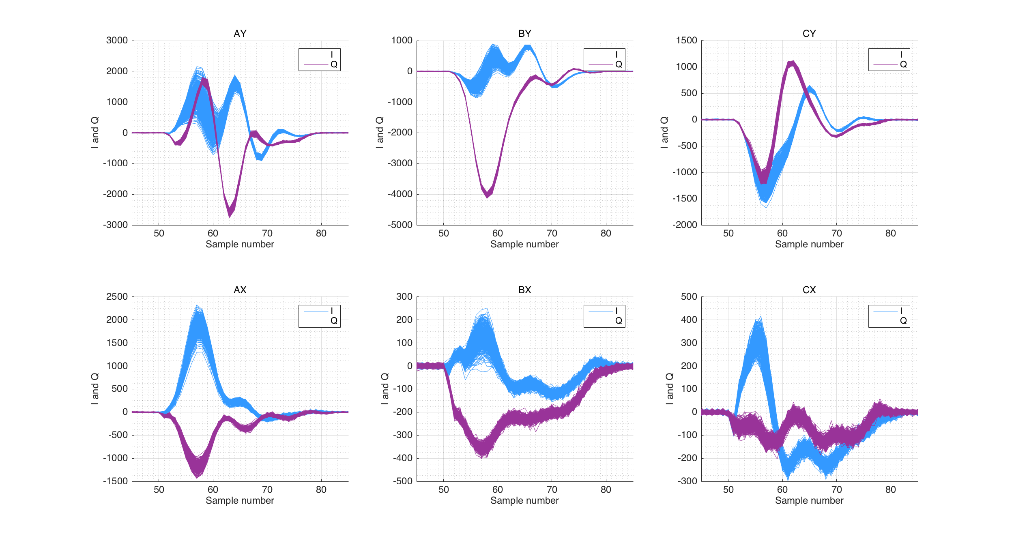
jitRun16_0dB_045_ipbpm_150619
C-band BPFs between the hybrid and variable attenuator inside tunnel

Slide 18
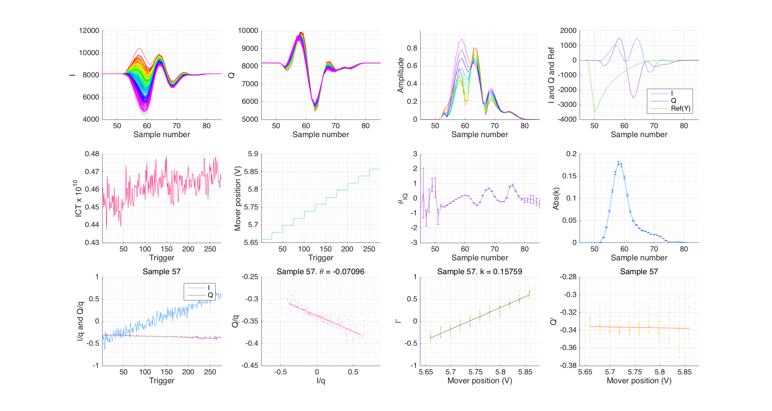
jitRun16_0dB_045_ipbpm_150619
C-band BPFs between the hybrid and variable attenuator inside tunnel

Slide 19
jitRun16_0dB_045_ipbpm_150619
 | Single Sample
 | geo | before | before_c | before_IQ | after | after_c | afterIQPr | afterIQ
IPA | 63 | 112 | 58 | 39 | 190 | 58 | 39 | 39
IPB | 63 | 106 | 56 | 43 | 127 | 52 | 43 | 43
IPC | 63 | 121 | 94 | 38 | 61 | 52 | 38 | 33
Average | 63 | 113 | 69 | 40 | 126 | 54 | 40 | 38
Sample no. | 63 | 62 | 63 | 57 | 63 | 63 | 57 | 57
 | Integration
 | geo | before | before_c | before_IQ | after | after_c | afterIQPr | afterIQ
IPA | 62 | 52 | 49 | 44 | 63 | 53 | 35 | 35
IPB | 62 | 52 | 48 | 37 | 45 | 47 | 37 | 37
IPC | 62 | 95 | 76 | 40 | 122 | 56 | 36 | 32
Average | 62 | 66 | 58 | 40 | 77 | 52 | 36 | 35
Sample start | 63 | 63 | 63 | 62 | 62 | 63 | 56 | 56
Sample finish | 64 | 67 | 65 | 65 | 67 | 64 | 57 | 57
 | Multi-Sample Averaging
 | geo | before | before_c | before_IQ
IPA | 65 | 65 | 53 | 39
IPB | 65 | 65 | 51 | 43
IPC | 65 | 117 | 84 | 39
Average | 65 | 82 | 63 | 41
Sample start | 63 | 61 | 63 | 57
Sample finish | 64 | 66 | 64 | 58

Slide 20
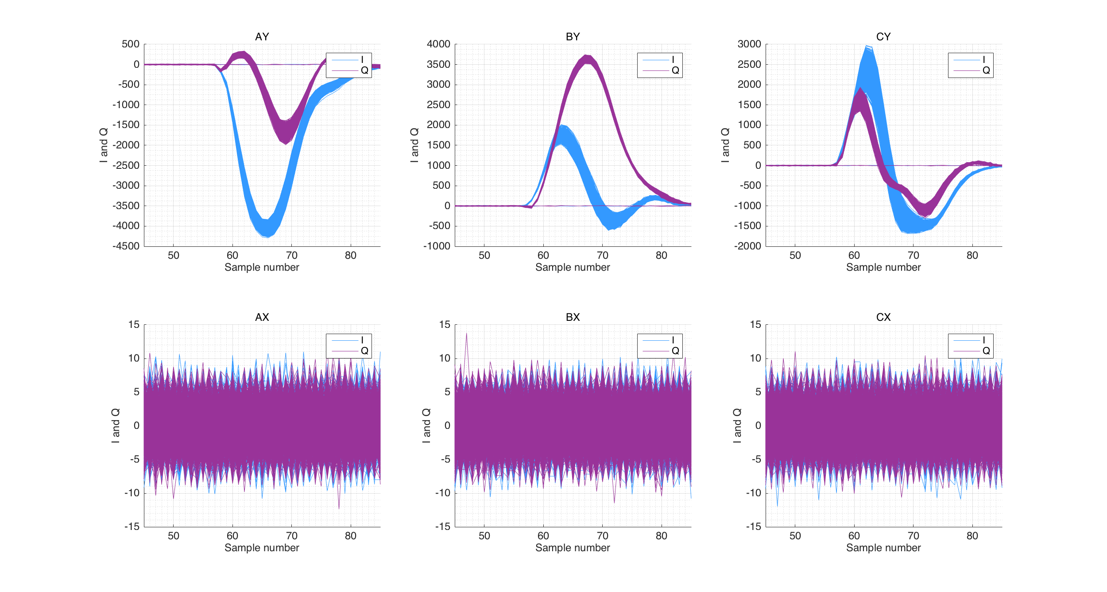
resol_0dB_8_FB_off_ipbpm_141220
December run – 714 MHz BPFs

Slide 21
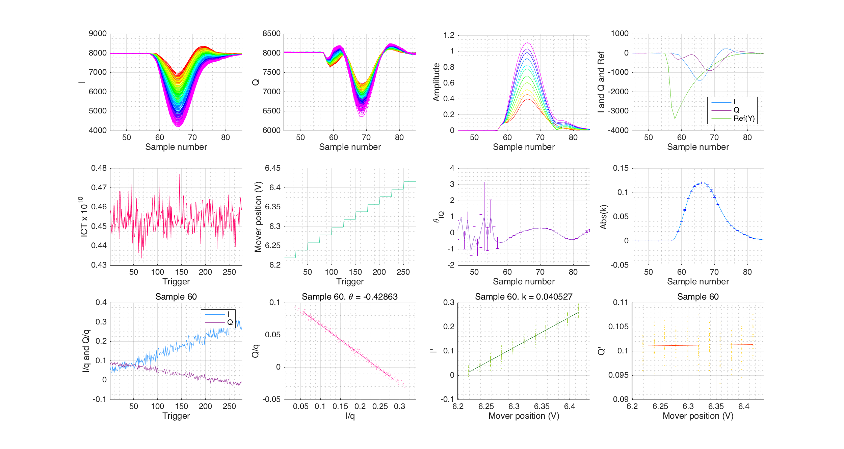
resol_0dB_8_FB_off_ipbpm_141220
December run – 714 MHz BPFs

Slide 22
resol_0dB_8_FB_off_ipbpm_141220
 | Single Sample
 | geo | before | before_c | before_IQ | after | after_c | afterIQPr | afterIQ
IPA | 50 | 162 | 51 | 32 | 240 | 48 | 32 | 34
IPB | 50 | 146 | 50 | 38 | 122 | 50 | 38 | 30
IPC | 50 | 392 | 54 | 34 | 224 | 43 | 34 | 29
Average | 50 | 233 | 52 | 35 | 196 | 47 | 35 | 31
Sample no. | 61 | 59 | 61 | 62 | 60 | 61 | 62 | 62
 | Integration
 | geo | before | before_c | before_IQ | after | after_c | afterIQPr | afterIQ
IPA | 46 | 201 | 45 | 28 | 239 | 42 | 27 | 29
IPB | 46 | 177 | 45 | 34 | 119 | 45 | 34 | 26
IPC | 46 | 316 | 48 | 28 | 214 | 40 | 28 | 25
Average | 46 | 231 | 46 | 30 | 191 | 42 | 30 | 27
Sample start | 60 | 58 | 59 | 61 | 59 | 59 | 60 | 61
Sample finish | 61 | 59 | 62 | 63 | 61 | 62 | 64 | 63
 | Multi-Sample Averaging
 | geo | before | before_c | before_IQ
IPA | 45 | 164 | 45 | 28
IPB | 45 | 146 | 44 | 34
IPC | 45 | 427 | 47 | 28
Average | 45 | 246 | 45 | 30
Sample start | 60 | 60 | 60 | 61
Sample finish | 62 | 61 | 62 | 63

Slide 23
Results
The fitting analysis method with raw I and Q data, sampled using integration, always produces the smallest resolution.
All of these results are in nanometers, and have an uncertainty of +/- 1 nm from propagated uncertainties in the calibration factors and uncertainties in the measured geometric distances.
I am still looking into incorporating uncertainties on the fit parameters. At the moment the uncertainty in the std(residual) is just the statistical variation.
 | Single sample | Integration | Multi-sample
No BPFs | 43 | 28 | 33
714 MHz | 43 | 41 | 56
C-band | 38 | 35 | 41
Dec 714 MHz | 31 | 27 | 30

Slide 24
Conclusions
It is vital to include a 3-sigma cut on the I and Q signals, as well as on the Reference signal, to remove outliers.
Including Q in a fit to the raw BPM signals has the largest impact on the position resolution calculation → suggests the Q vs I phase rotation in analysis is not sufficient to isolate all position dependence in I’.
Optimised integration sampling appears to always produce the lowest overall resolution result, regardless of the pulse shape (with or without BPFs).
It is not clear if including x-port and charge information in fits is a valid mathematical method due to contradictory assumptions - unless we accept that the position signal dependence and actual position relationships can
both be simultaneously valid (?)
Including BPFs (either 714 MHz or C-band) at various locations in the electronics to remove the static signal in pulses does not improve position resolution.

