Slide 1
Phase Monitor Calibrations Vs. Sample No.
Jack Roberts

Slide 2
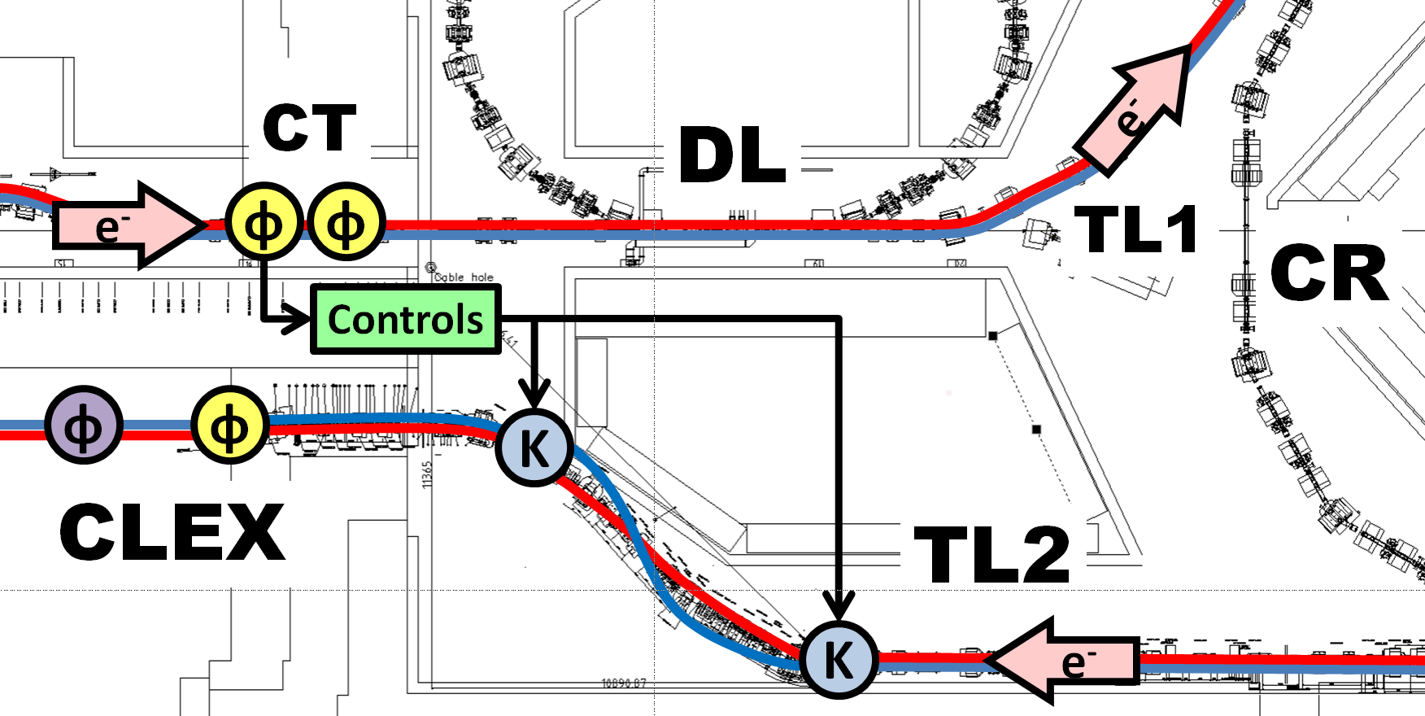
Brief Phase Monitor Intro
Mon1
Mon2
Mon3
Measure arrival time of beam compared to ideal.
Expressed as phase: 360 degrees of 12 GHz ~80 pico seconds.
3 phase monitors: 2 upstream (Mon1 and Mon2), 1 downstream (Mon3).

Slide 3
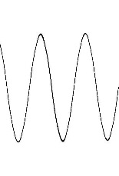
Rough Phase Monitor Electronics Schematic
Phase Monitor Electronics (mixers)
Phase Shifter
LO
(12 GHz Reference phase)
Mixer ~ Asin(θ)
Phase Monitor
Diode~ A^2
e-
Σ
Hybrid
Calibration procedure: Measure mixer output for a range of phase shifter values.

Slide 4
Calibration Procedure: Data Taking
Phase shifters:
  1 x phase shifter, dial with readings in 1 GHz degrees (Mon2).
  2 x phase adjusters, no reading so count turns of nut (Mon1 and Mon3).
Usually take 20 pulses at these shifter settings (~10 points total):
  Mon1 and Mon3: 100 – 130º in steps of 3º(360º of 12 GHz in steps of 36º).
  Mon2: 0 to 16.75 turns of the nut in steps of 2 turns (~260º in steps of ~31º).

Slide 5
Calibration Procedure: Data Processing
Convert raw signals in SiS counts to volts.
Subtract mean baseline noise.
Pick a sample range to use: usually take mean of 3 samples in a stable part of the pulse (same range for all monitors).
Remove any points >3 sigma away from mean at that shifter setting.
Calculate mean and std at each shifter setting.
  1/std^2 used as fit weights.

Slide 6

Calibration Procedure: Fit (without diode)
$$Mixer=A\sin\left(bx+c\right)+d$$
Mixer: mixer output at each shifter setting.
A: amplitude of sine curve.
b: conversion between shifter setting and 12 GHz radians.
x: shifter setting
c: phase offset of sine at shifter=0.
d: zero offset of sine curve.
NB: Baseline noise already subtracted so d should be small.
Make initial estimate for parameters:
  A: (|maxMixer|+|minMixer|)/2
  b: (12/shifterFrequency)*(pi/180)
  c: based on mixer output at first point -> NOT WORKING CORRECTLY!
  d: (|maxMixer|-|minMixer|)/2
MatLab custom equation fit (uses finite differencing) with confidence intervals on parameters.
  Found that fit is failing in some cases this week, mostly for Mon3 and at least partly due to incorrect choice of initial value for c.
  Will fix / investigate difference methods.
A and d are most critical for phase reconstruction. I don’t normally use b and c after the fit.

Slide 7
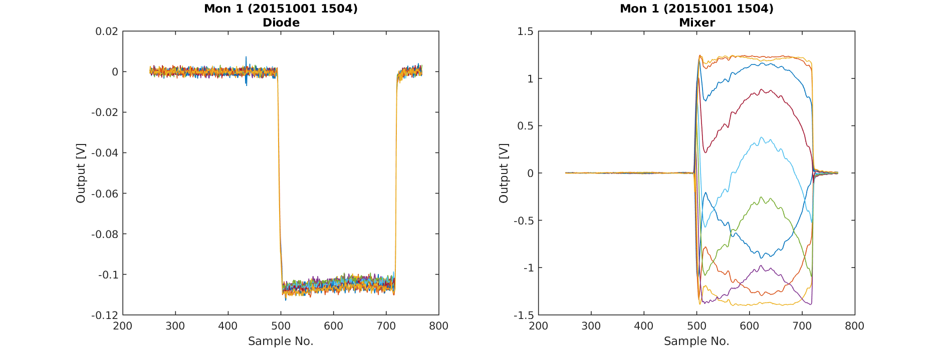
Initial Results (considering fit issues): 20151001
MON1

Slide 8
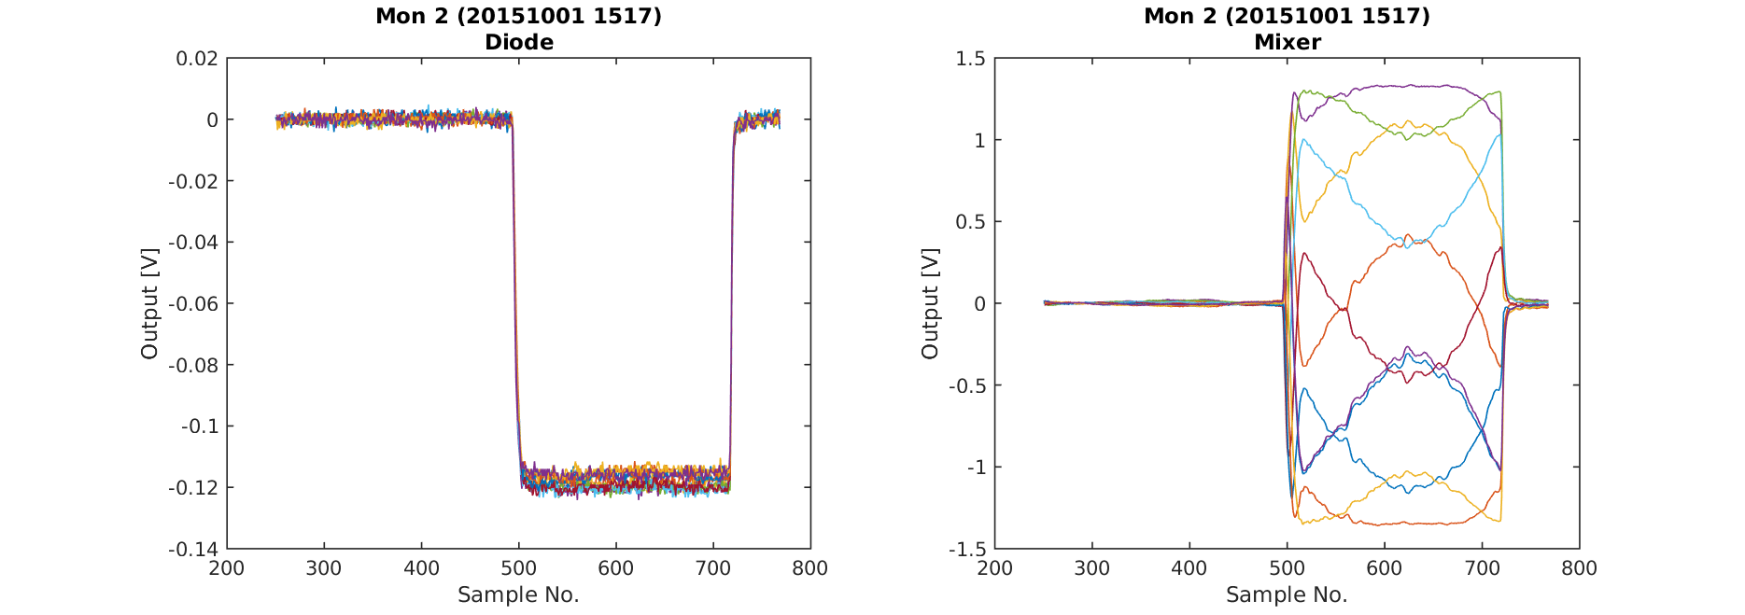
Initial Results (considering fit issues): 20151001
MON2

Slide 9
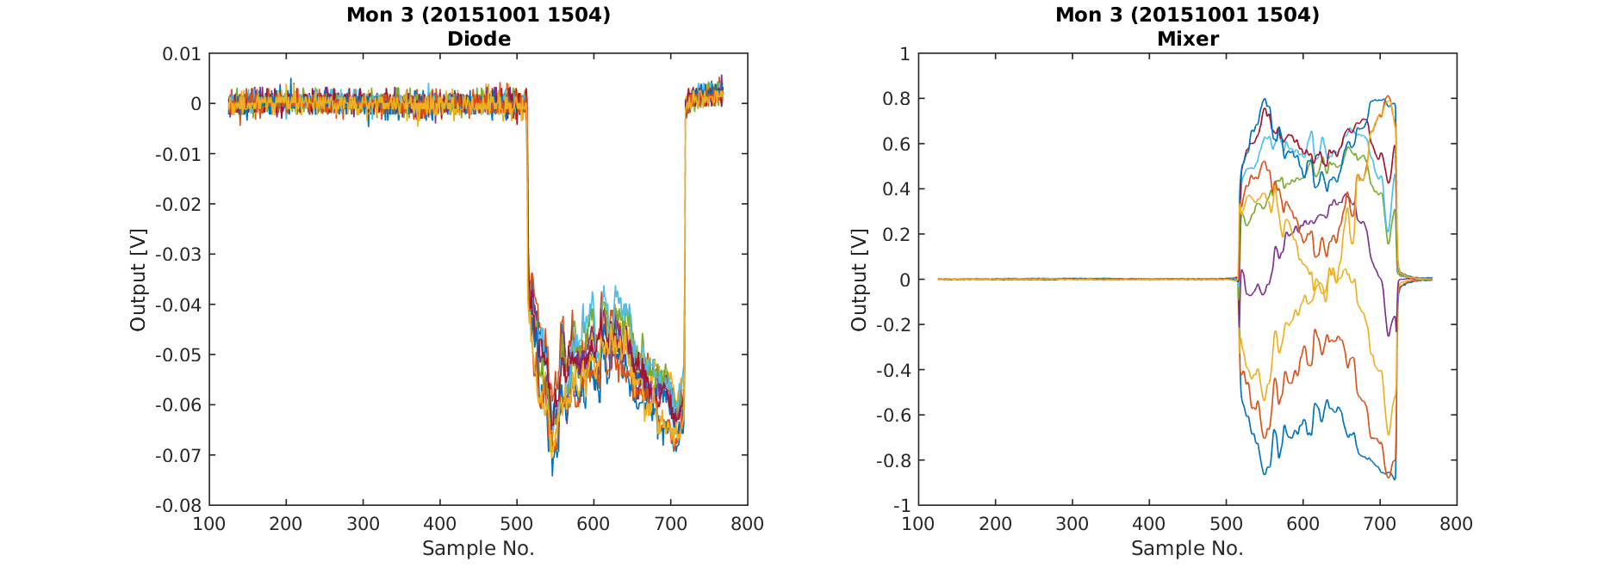
Initial Results (considering fit issues): 20151001
MON3
Pretty poor beam downstream.

Slide 10
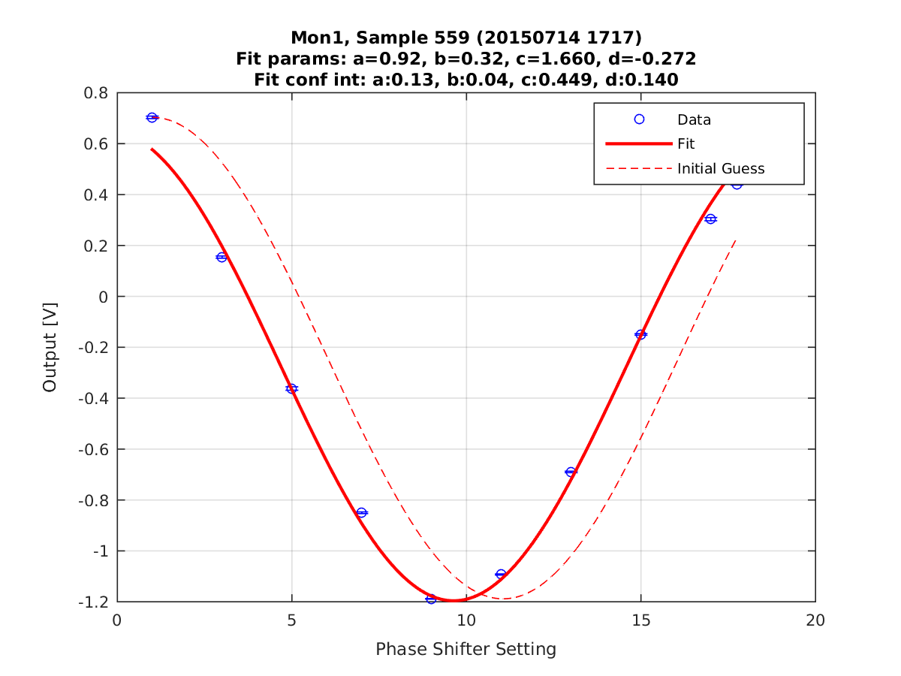
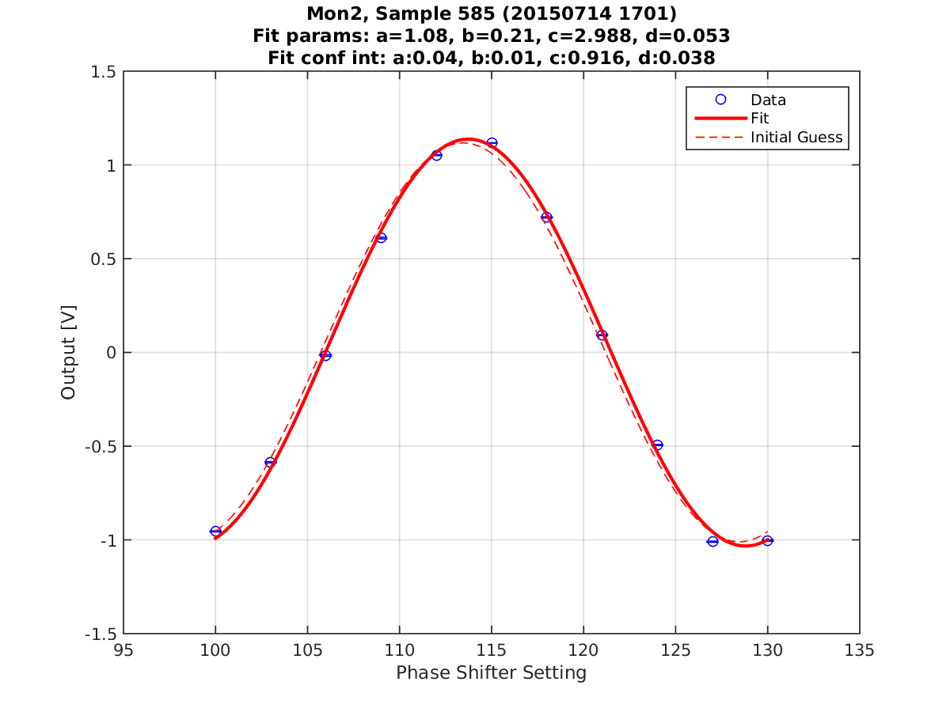
Fit Examples
MON1
MON2

Slide 11
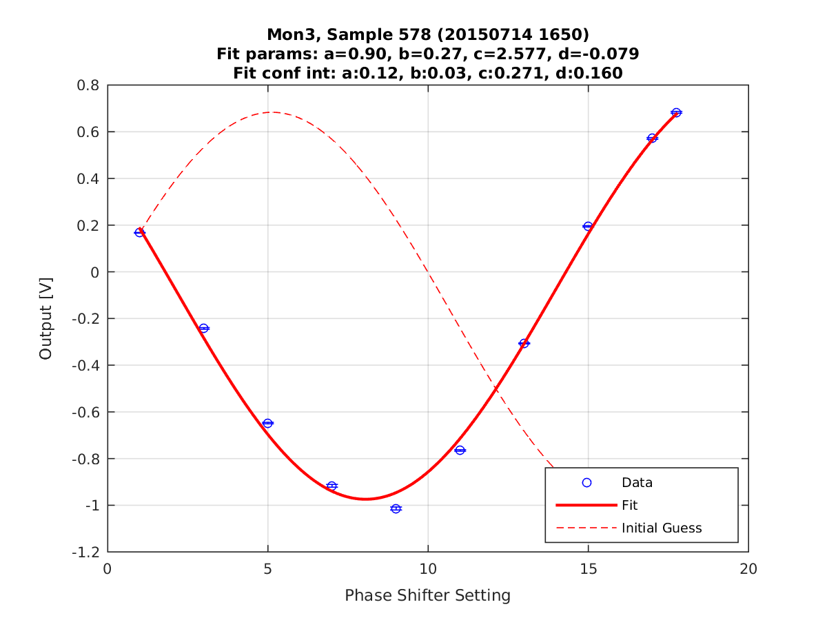
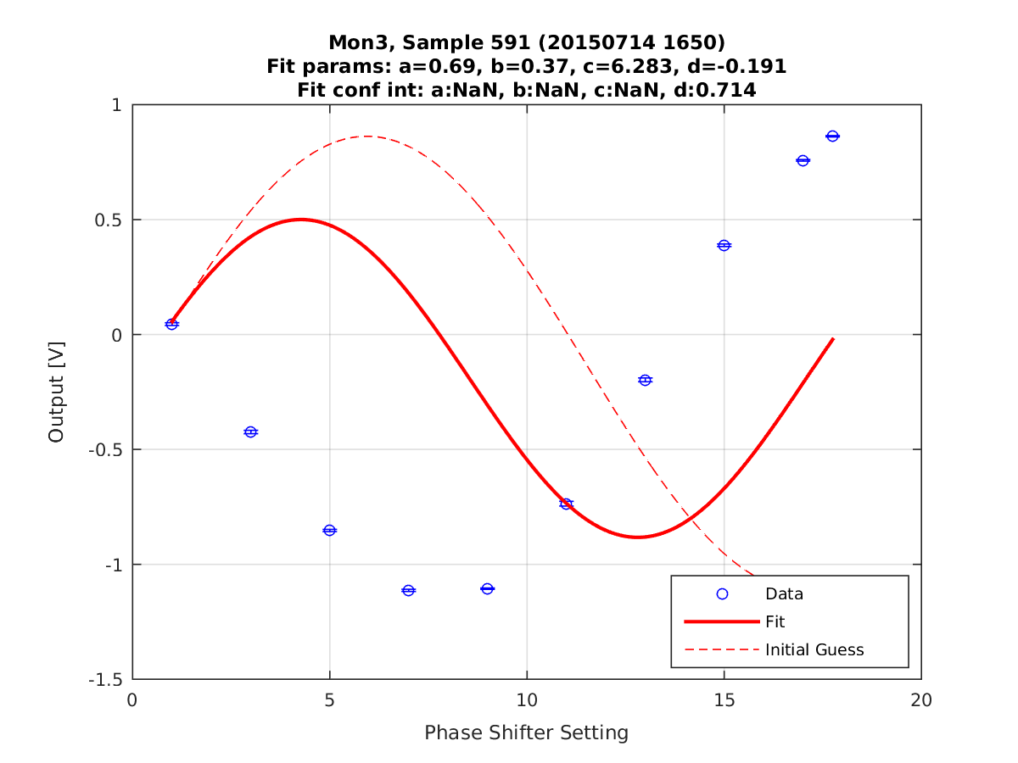
Fit Examples
MON3 - Good
MON3 - Bad

Slide 12
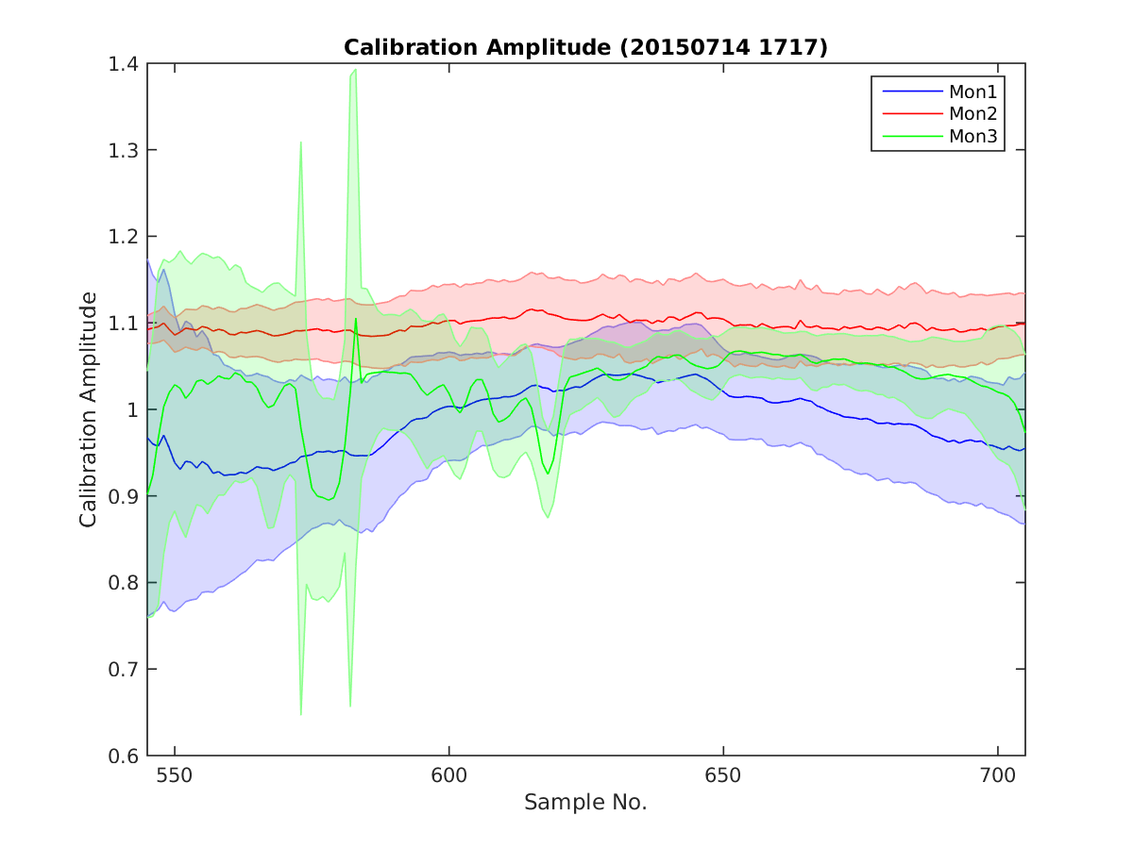
Calibration Amplitude vs. Sample (A)

Slide 13
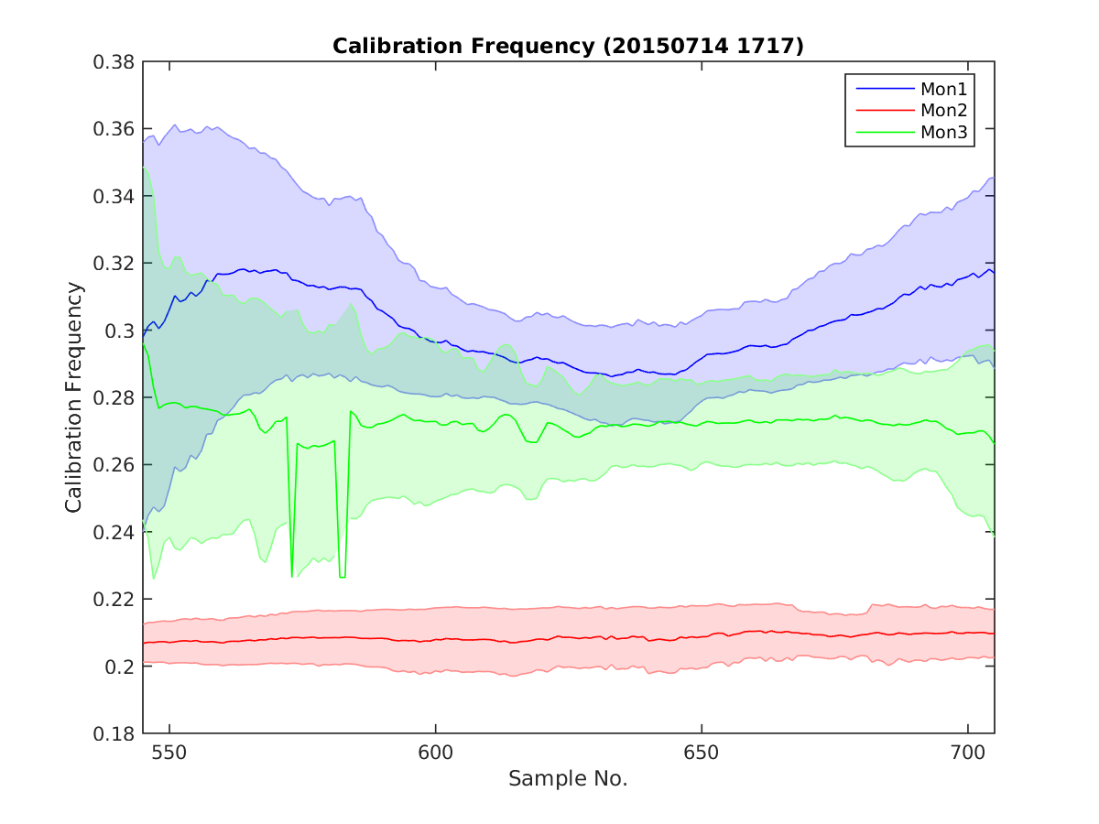
Calibration Frequency vs. Sample (b)

Slide 14
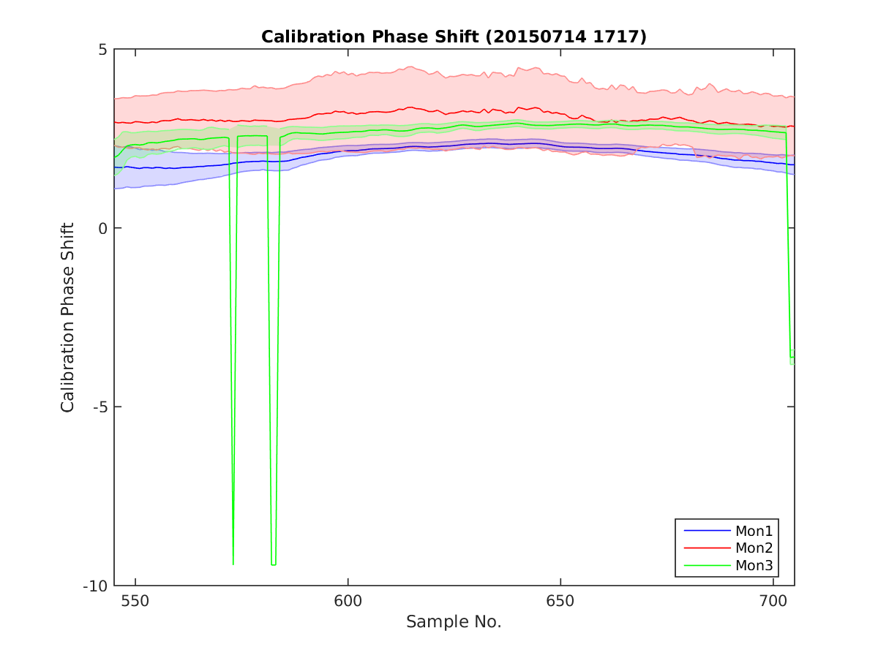
Calibration Phase Offset vs. Sample (c)

Slide 15
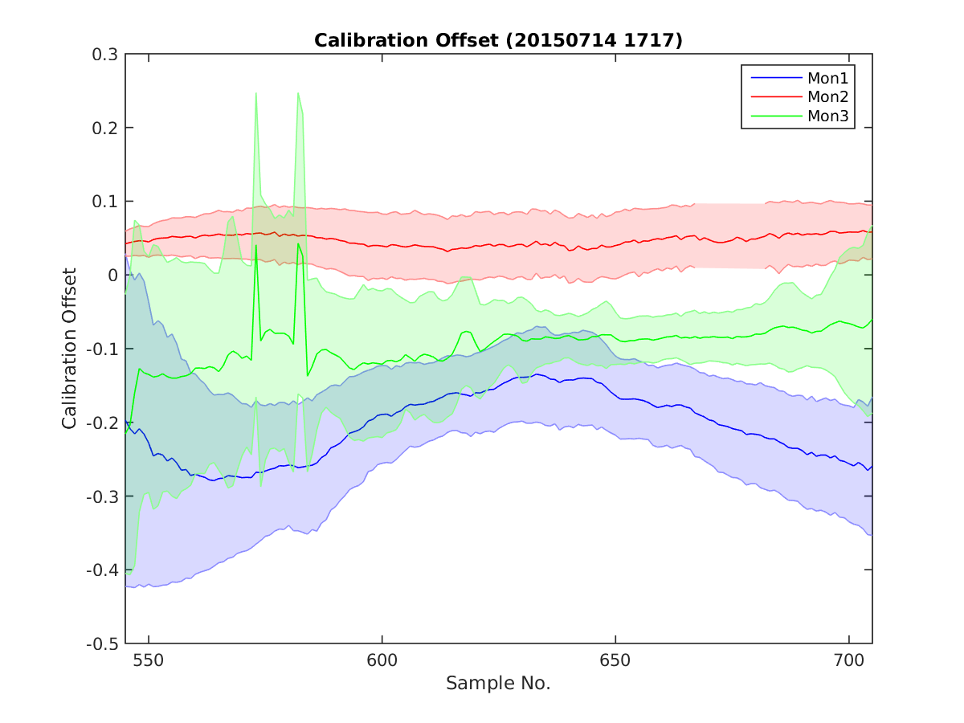
Calibration Amplitude Offset vs. Sample (d)

Slide 16
Summary
Need to work on the fitting procedure.
Initial impressions:
  Calibrations done with the phase adjusters are worse than with the “proper” shifter.
  Mon2 (with shifter) calibration vs. sample no. seems fairly flat along the pulse.

