Slide 1

P. Colas, CEA Saclay, LCTPC Phone meeting Nov. 12
ILD tracking
PDAP meeting and LCB report
ILD meeting

Slide 2
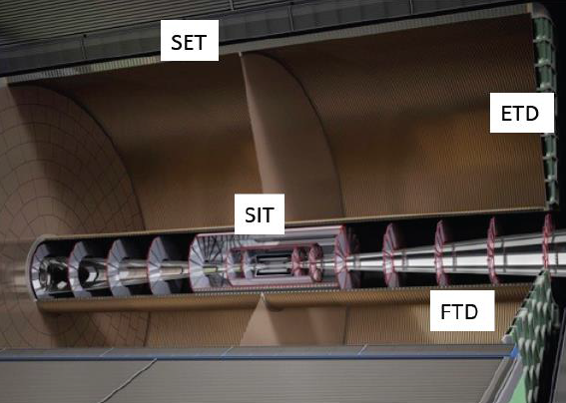
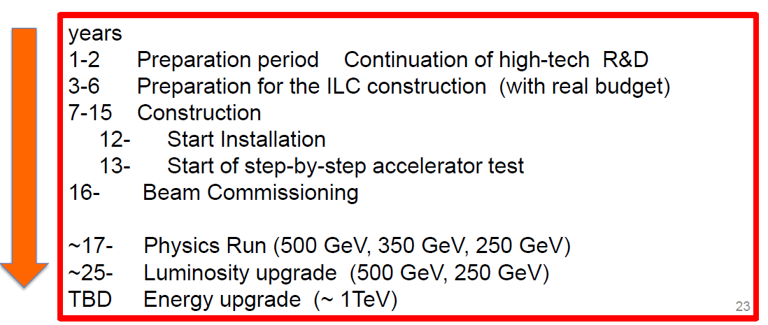
Tracking:
Vertex detector
TPC
Silicon →
(no one working on SET?)
Magnet
We now have a realistic (though unofficial) estimate of the schedule (S. Komamiya, Lepton-photon 2015) :
Start
2016? 2018?
2033 ?

Slide 3
t0 = Ground Breaking
2033?
After Y. Sugimotos
The yoke and the solenoid have to be assembled on surface site very early (start Y3)
The remaining of the tracker is for end of Y8

Slide 4
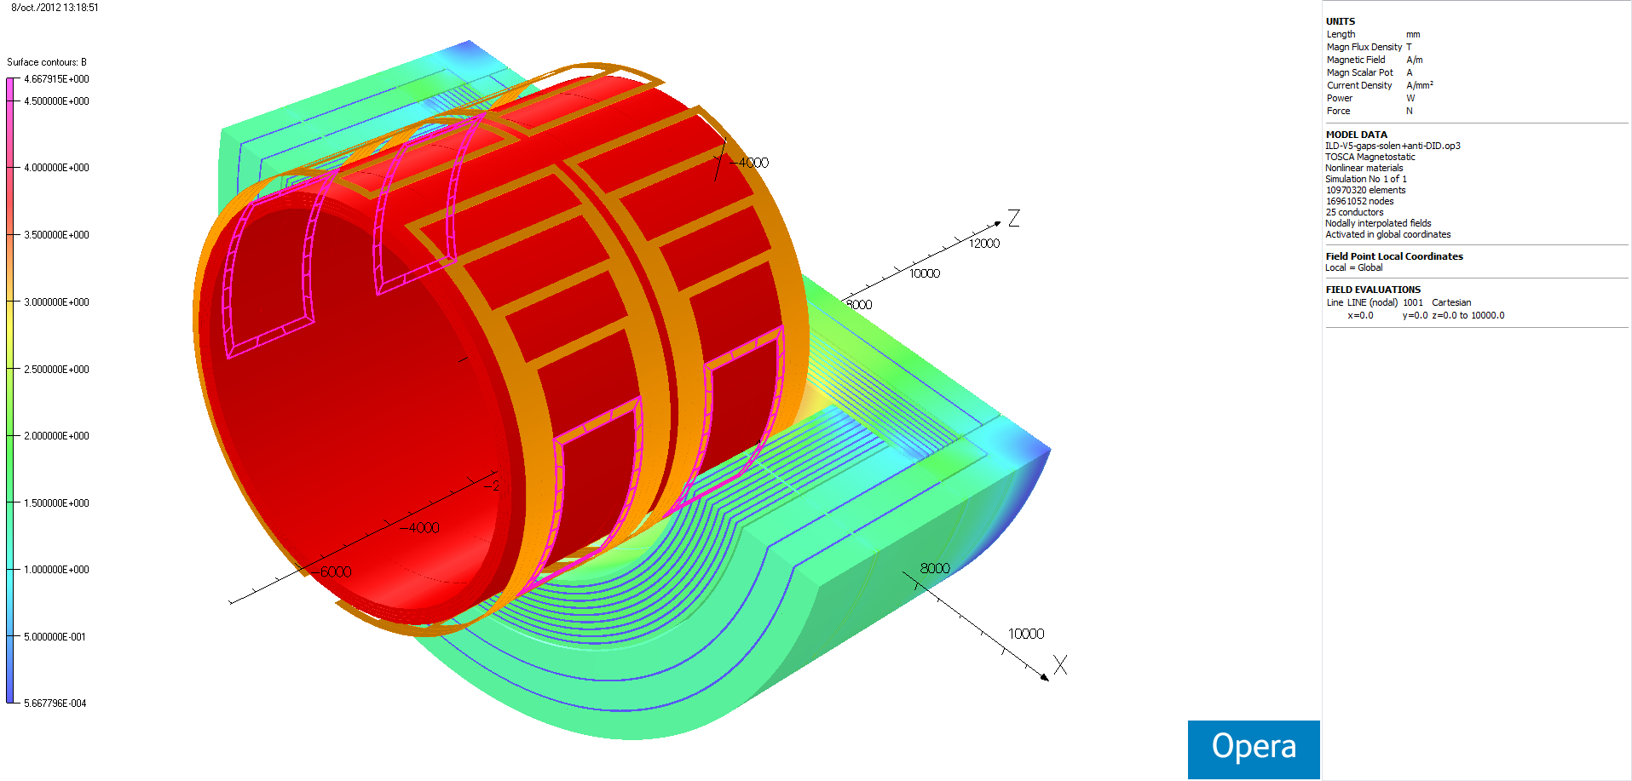
Anti DID
DBD
Recent evolution :
Quadrupole re-design might allow reducing the crossing angle (14 10-12 mrad) (B. Parker at Oshu, 9/2014)
Anti-DID might be around the beam pipe
Disaligning the two halfs of the solenoid might play the role of the anti-DID
Re-estimation 2013 of the cost : 131 MILCU (including yoke)

Slide 5
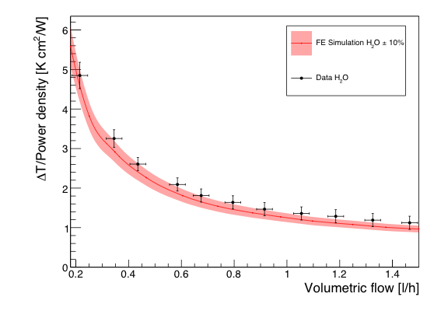

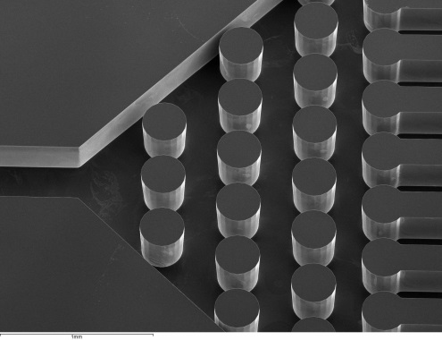

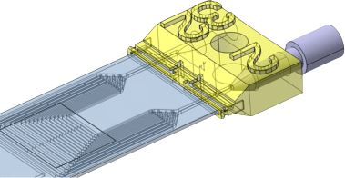


Micro-Channel Cooling on ultra-thin Silicon sensors
6W
H2O
Micro-channel pattern in handle wafer
Standard etching procedure
Low cost mono-phase fluid: H2O
Low volumetric flow (~1l/h) and low pressure (< 1bar) are enough to dissipate the heat in the front end
Good agreement with the FE simulation inside an error area of 10%
Thermal Figure of Merit (TFM) of ~ 1 K·cm²/W
Peek tube
3D-printed adaptor
See talk in Vertex/Tracking session on Tuesday
Advanced vertex detector cooling concepts: from air flow to micro-channel cooling
M.A. Villarejo, I. Garcia (IFIC Valencia)

Slide 6
Micro-Channel Cooling on ultra-thin Silicon sensors
6W
H2O
Air cooling? Unifiy technologies for cooling?
Micro-channel pattern in handle wafer
Standard etching procedure
Low cost mono-phase fluid: H2O
Low volumetric flow (~1l/h) and low pressure (< 1bar) are enough to dissipate the heat in the front end
Good agreement with the FE simulation inside an error area of 10%
Thermal Figure of Merit (TFM) of ~ 1 K·cm²/W
Peek tube
3D-printed adaptor
See talk in Vertex/Tracking session on Tuesday
Advanced vertex detector cooling concepts: from air flow to micro-channel cooling
M.A. Villarejo, I. Garcia (IFIC Valencia)

Slide 7


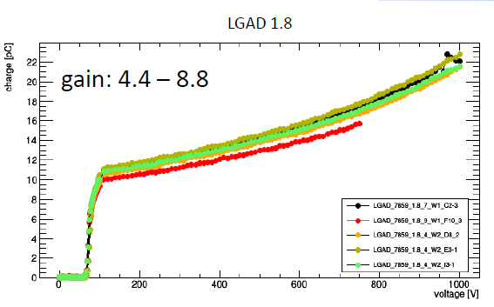
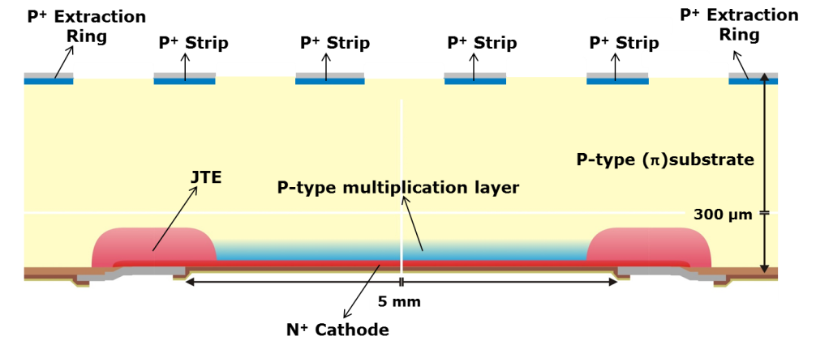
R&D on microstrips: ILGAD
RD50
Sensors material dominant contribution to the material budget.
Internal signal amplification in the sensor allows for thinner sensor preserving the SNR.
Developing strip-like Low Gain Avalanche Detectors (reach-trough avalanche photodiode with n++ / p+/p-/p+ structure) with typical signal gain < 20 with reduced excess noise.
Amplification observed in pad and strip like LGAD with segmented amplification region and electron readout
To cope with spacial non-uniformities in the amplification:
new prototypes with non-segmented amplification region Inverted-LGAD (with hole readout)
Manufacturing run @ CNM ongoing.
PAD layout
Electron readout
See talk by I. Vila at Wednesday afternoon tracking session

Slide 8
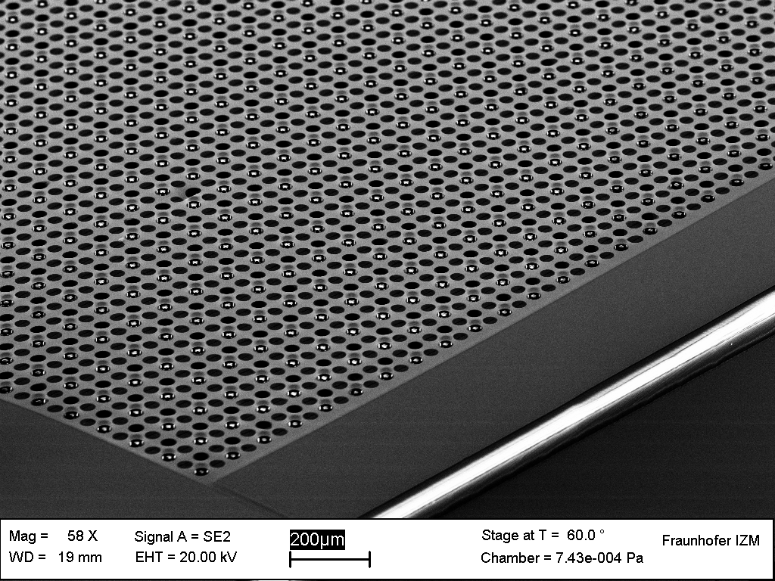
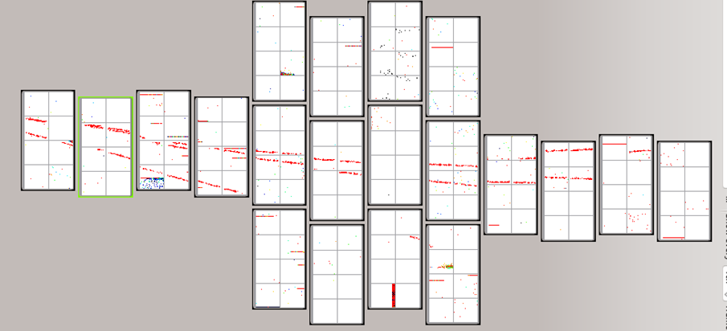
GridPix progress
Wafer-based post-processing to add a protection layer and a mesh on pillars on top of the chips (107 chips at a time)
March 2015, there was a successful test with 3 modules (96 chip each) partially equipped : 160 chips!
This shows that this technique is applicable to large areas
This opens the way for ultimate dE/dx resolution

Slide 9
PDAP
Detector Advisory Panel
Light-weight review led by P. Grannis, with Jungi Haba and Sandro Palestini.
Also present: LCB (Hitoshi Yamamoto, Maxim Titov –by phone, Jan Strube)
Message from ILD: we are ready with proof of principle and part of integration work, we need funds to make engineering design. We feel that a green light from Japan is needed for this.
Hitoshi insists on ‘running in front’ improving the design.
Next review not before 1 and ½ years, or about 1 year after the ‘go’.

Slide 10
PDAP
LCB Report
Discussion on the status : several partial contributions
Plan was not clear : by institute or by technology? Signatories?... To be sorted out in the coming days by/with the conveners.
Present status: drafts by Bonn, Carleton, DESY and Saclay.

Slide 11
ILD IA
No quorum (31 whereas 35 was necesssary) -> no decisions are endorsed yet. Will be dealt with electronically.
Nomination of Tohru Takeshita (deputy chair of IA), and Kawagoe (deputy spokesperson), K. Fujii (Physics), F. Gaede (software)
4 new institutes (1 or 2 did not show up)
Call for nominations for 2 members of executive board (with no defined role so far)

Slide 12
LC meetings 2016
CLIC January
ILD integration March 14-15 at KEK
ECFA LCWS June 13? (but AIDA also?) Santander
LCWS2016 in Asia (Japan? Vietnam?)

