Slide 1
Towards 2nd generation of SMD HBU:
Assembly preparations and tests of white solder mask performance
10.12.15 – AHCAL main meeting 2015
at DESY
JGU Mainz – Phi Chau
Norman Bhatti, Volker Büscher, Julien Caudron, Reinhold Degele, Karl Heinz Geib, Sascha Krause, Yong Liu, Lucia Masetti, Anna Rosmanitz, Uli Schäfer, Stefan Tapprogge, Rainer Wanke

Slide 2
Preparation for 2nd generation SMD HBU board

Slide 3
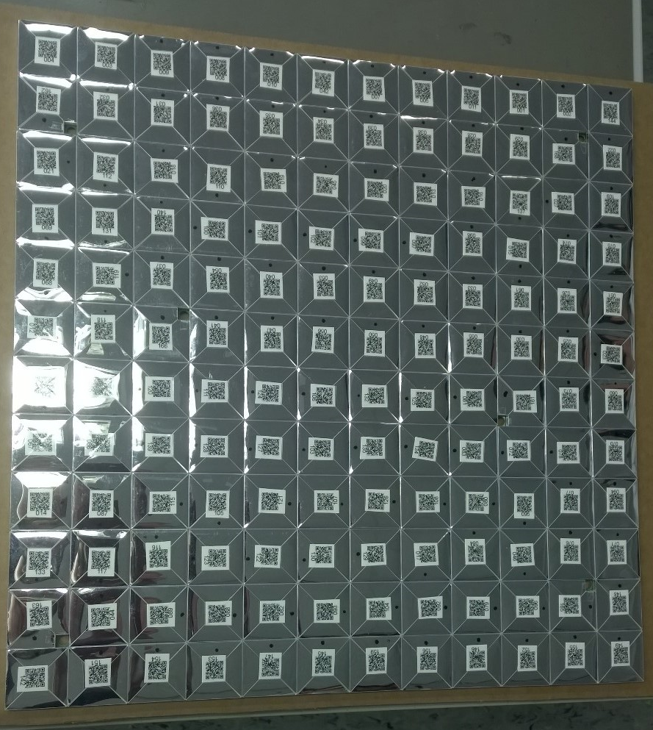
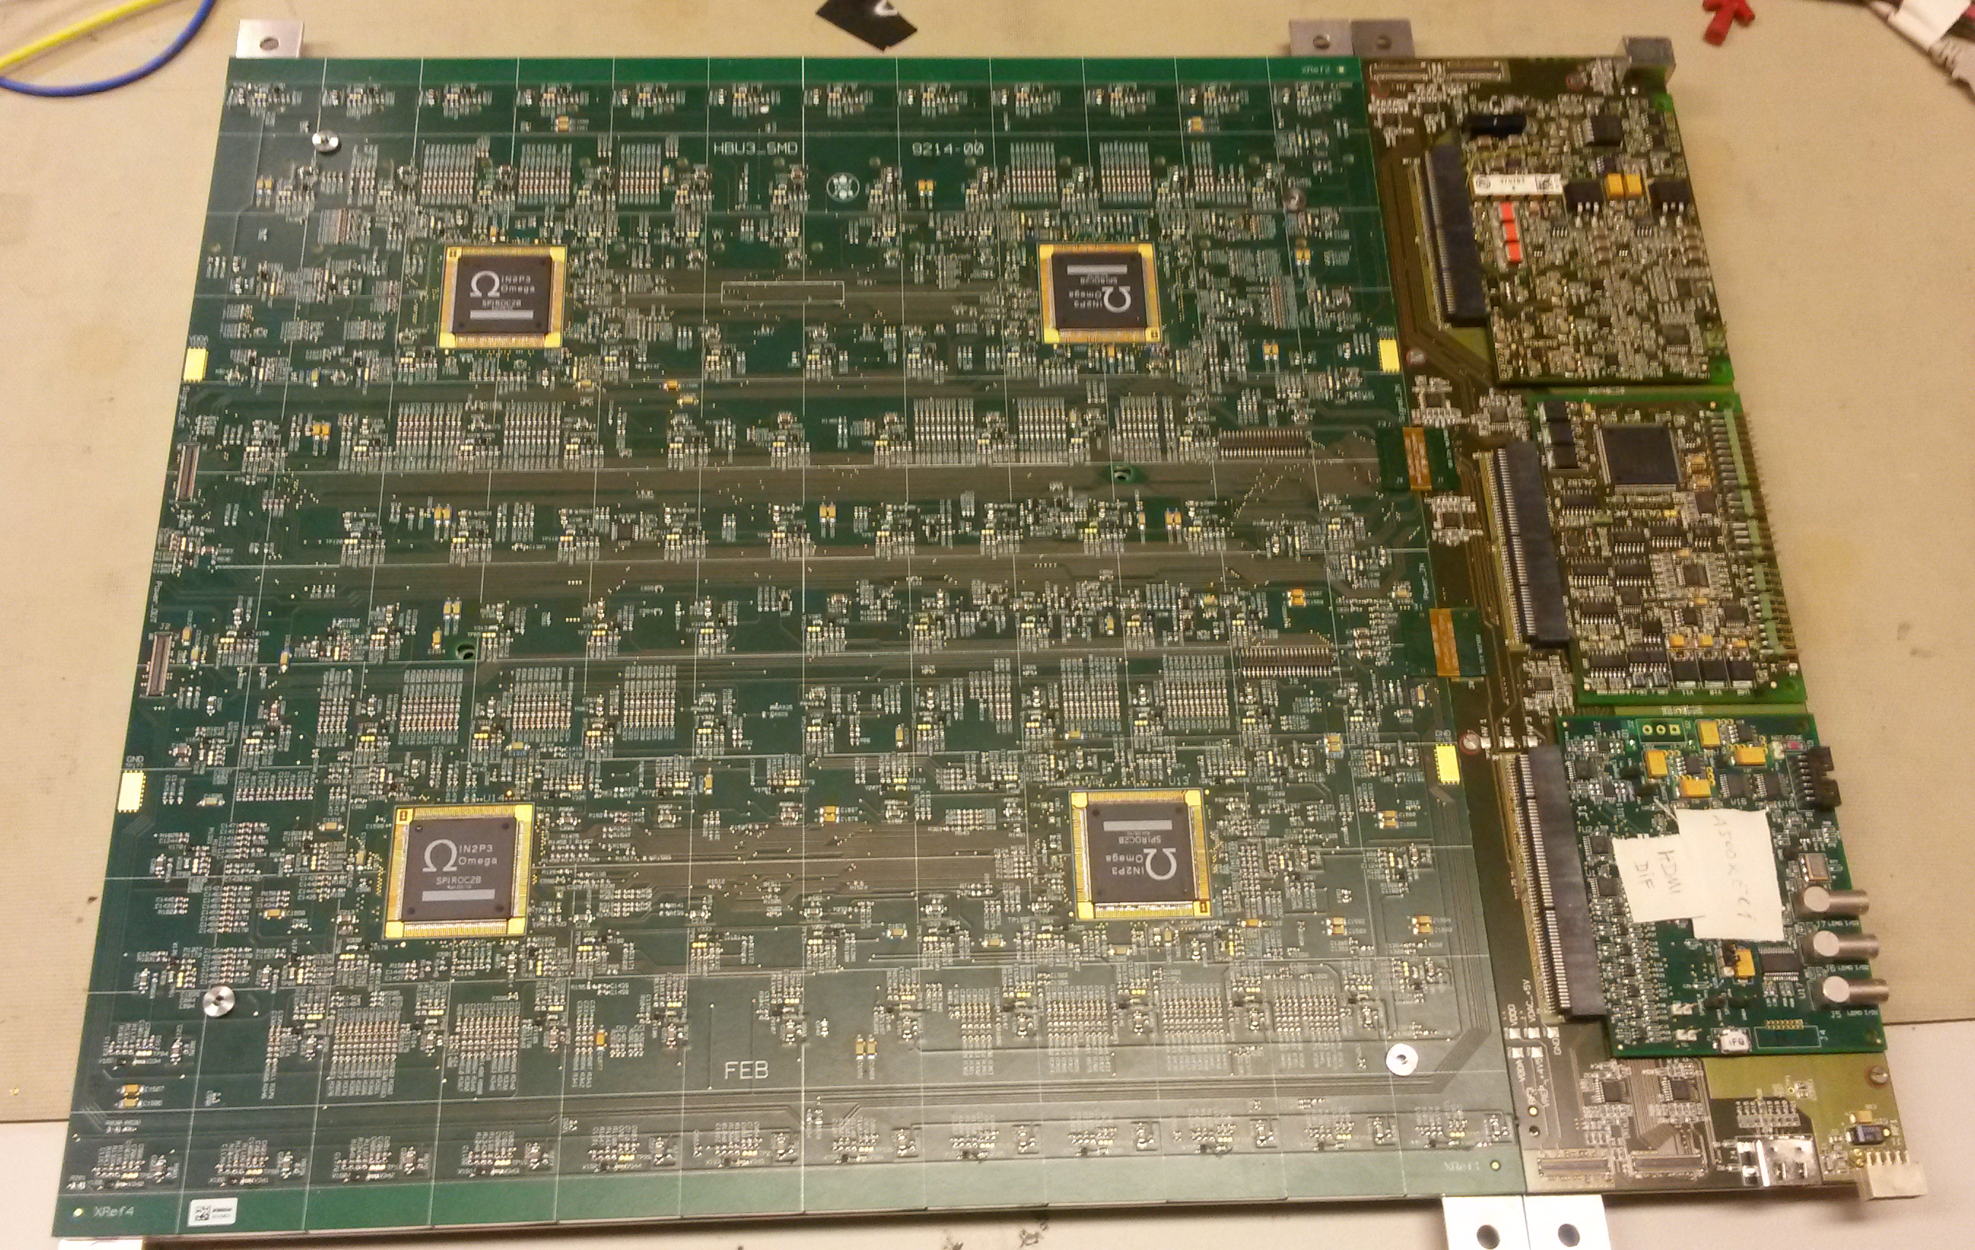
Short reminder of 2nd generation SMD HBU
Components:
  PCB design and production for SMD HBU board will be done by DESY
  Tiles:
    Surplus material from Mainz NA62 group
    Tiles will be milled in Mainz
      Slightly different shape of the dimple (due to larger SiPMs)
    Wrapping of ~160 tiles will be done by Universität Hamburg
  SiPMs: MPPC S13360-1325PE
    2668 pixel, 25 μm pitch, 1.3 x 1.3 mm² sensitive area, with trenches
Assembly will be done by prodesign (assembly company) and/or in house (Mainz university has purchased a new pick & place machine)
Schematic of Uni Mainz SMD design
Reflector foil
Dimple
Scintillator tile
SiPM
PCB

Slide 4
Plans to improve assembly for next SMD HBU
Assembly is planned for spring next year
DESY FEB group is currently re-designing the new PCB with following improvements:
  Bigger edge (to assure the detection of the fiducials)
  2 LED positions instead of 7 (will reduce management of different tile types)
  New LEDs (old ones are not available in Germany anymore)
  New soldering pads for new SiPM type
University of Hamburg is working on reducing the air gap between foil and tile for the wrap tile design (to assure the mass assembly of tiles)
SiPMs are bought on tapes and stored in nitrogen atmosphere (by DESY)
  This will reduce one Steps during assembly (no tempering necessary anymore)
  Also an automatic assembly of SiPMs can be done (due to right feeding format for the machine)

Slide 5
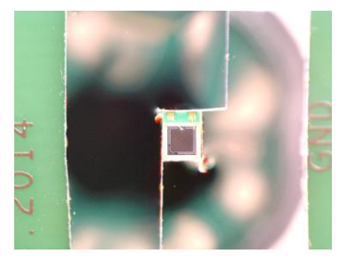
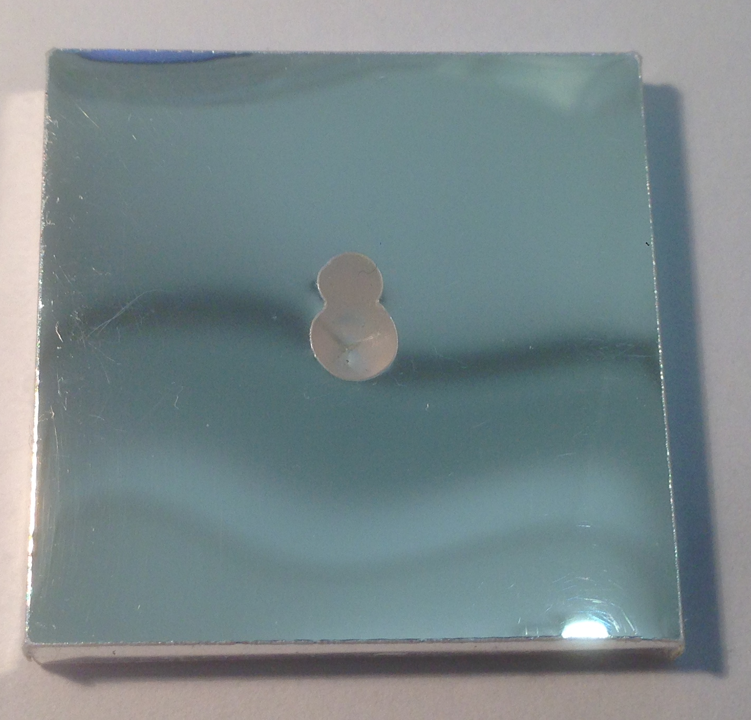
Reflective surface around SiPM
Additional light yield increment possible if the whole bottom side of the tile is reflective (also surface of the board under the dimple)
Simulations with FRED (ray tracing program) shows that an increment of the light yield is possible
  custom cut solution with 3M DF2000MA foil shows a light yield increment of 16%
Potential solution compatible with mass production:
  White solder mask
    The whole HBU board could be white
    Tested for durability
    Whole surface of PCB is white
    Low heat discoloration degree
    Measure of reflectance index is planned in the nearer future
New reflective area

Slide 6
Design and performance of white adapter board

Slide 7
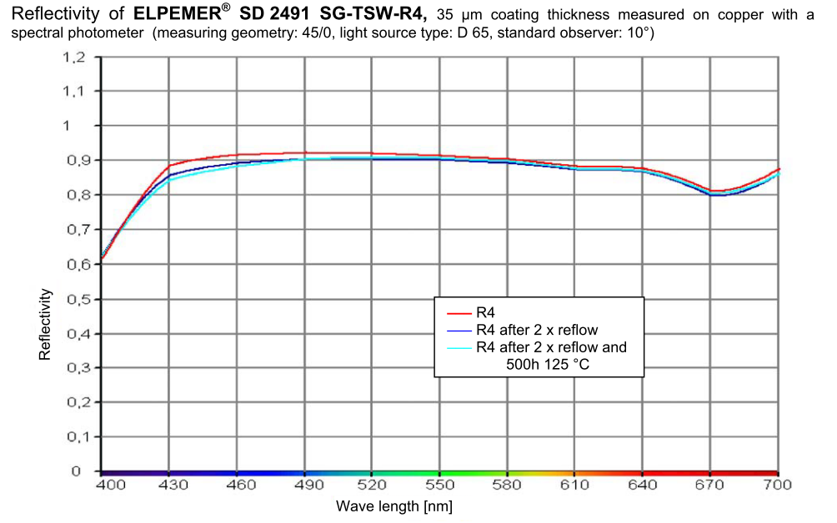
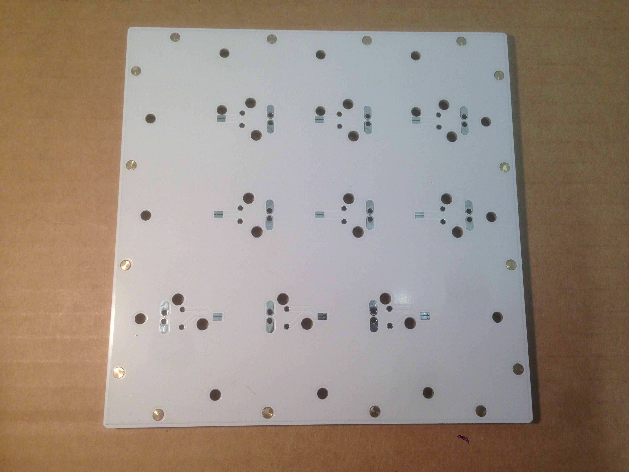
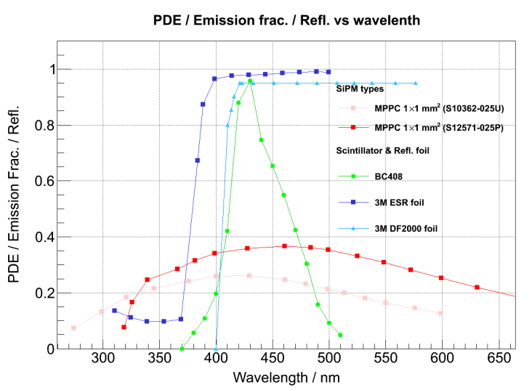
PCB solder mask
Chosen solder mask:
ELPEMER SD2491 SG-TSW-R4
> 85% reflectivity for expected 430 nm light
Affordable (whole PCB cost ~60 € including white solder mask, depends on PCB manufacturer)

Slide 8
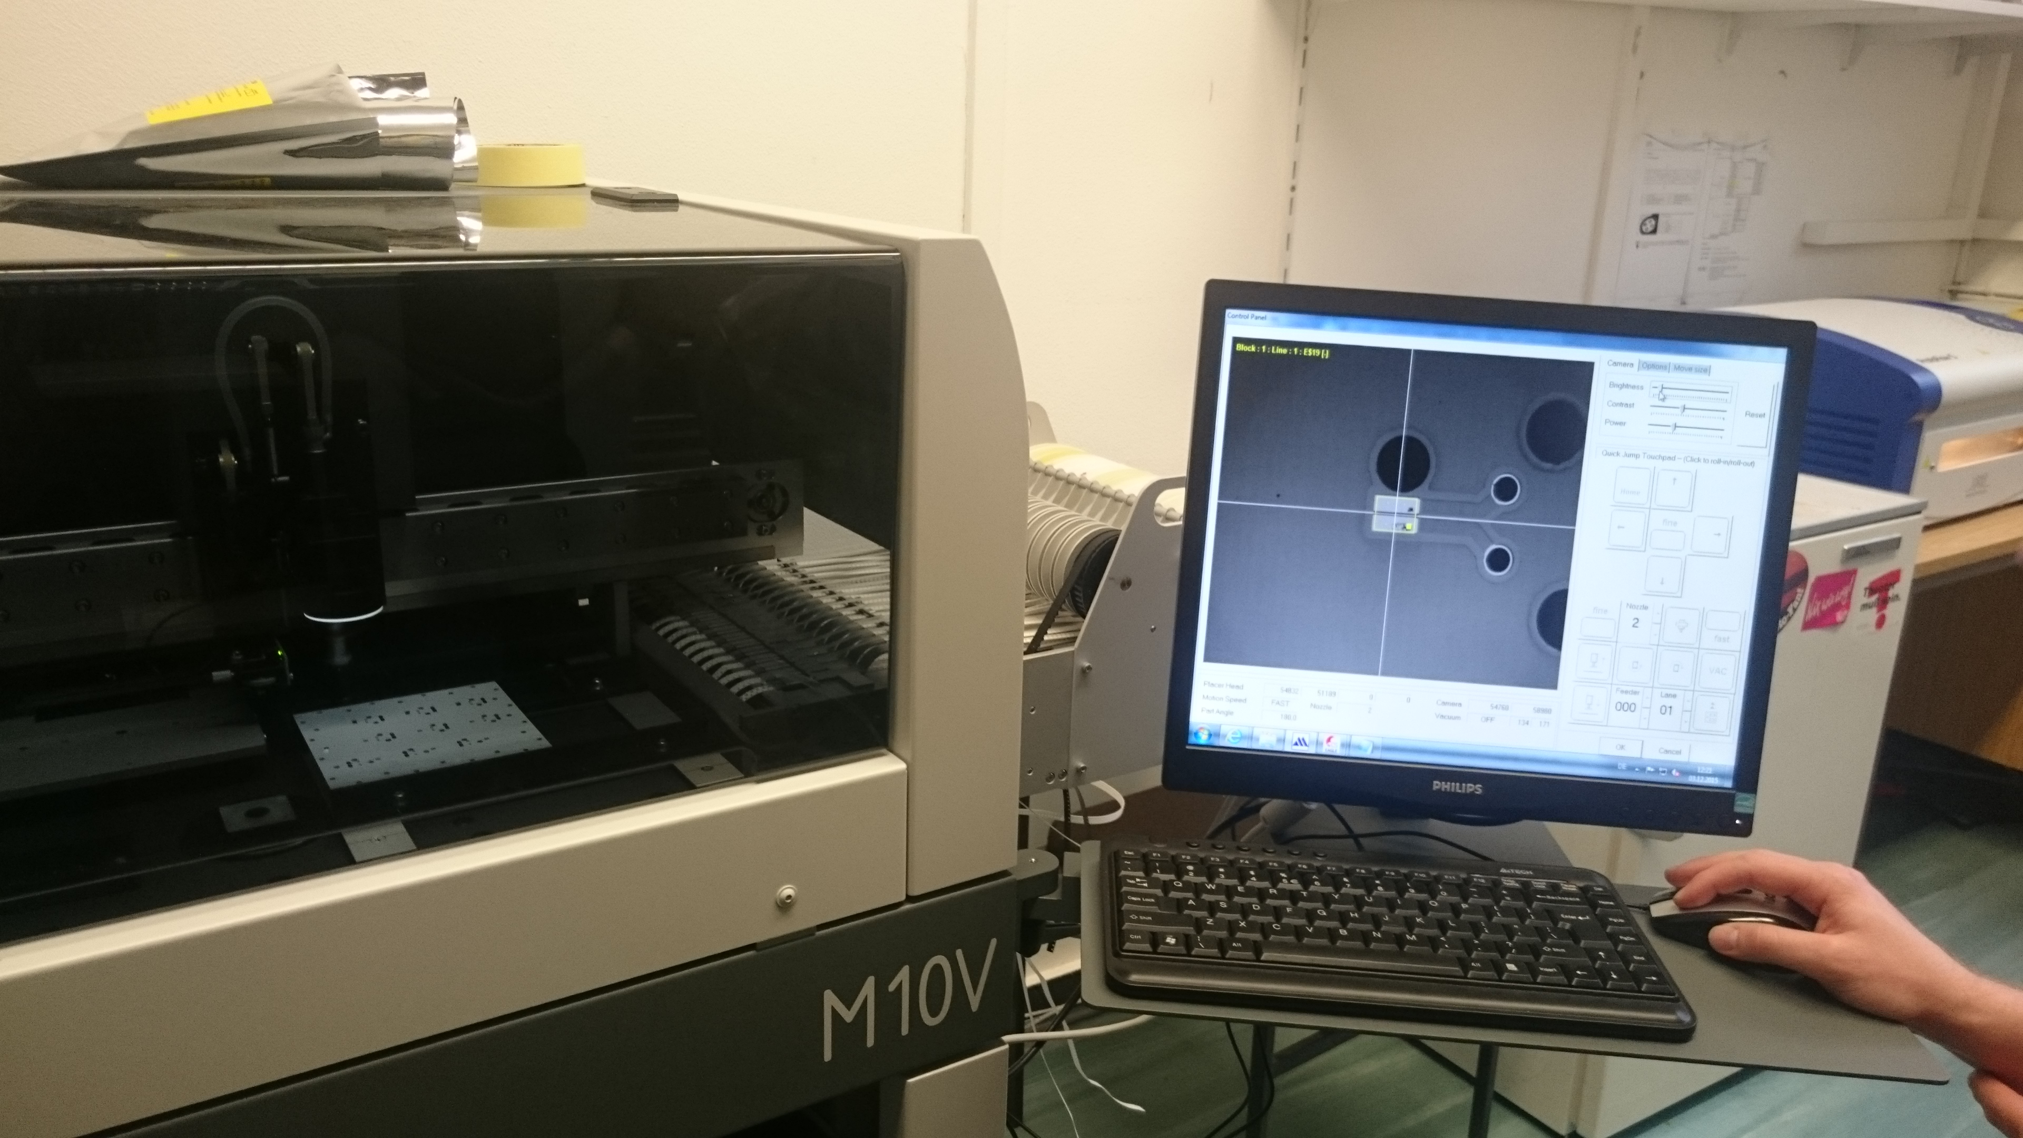
Assembly test for PCBs with white solder mask
Camera and assembly tests for SiPMs on white surface
  Non trivial for camera to detect metalized structures on white (reflecting) surfaces
    Placement and soldering were successful
  Also first automatic assembly of SiPMs for Mainz-CALICE-Group with Mainz Pick-and-Place machine

Slide 9
Design of white PCB
PCB with 9 SiPM pads with pitch similar to HBU boards
  First prototype with 2x MPPC 12571-025P (SiPM type used on SMD HBU)
This PCB is designed as an adapter board
  Top side with SiPMs/Tiles, Bottom side with female connectors for connection of preamp/bias to SiPM → Plug-in system
Dimple
Female pin
Connector
SiPM
White PCB
Scintillator tile

Slide 10
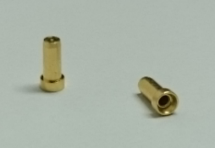
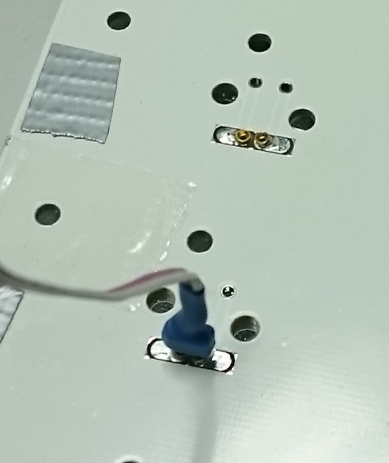
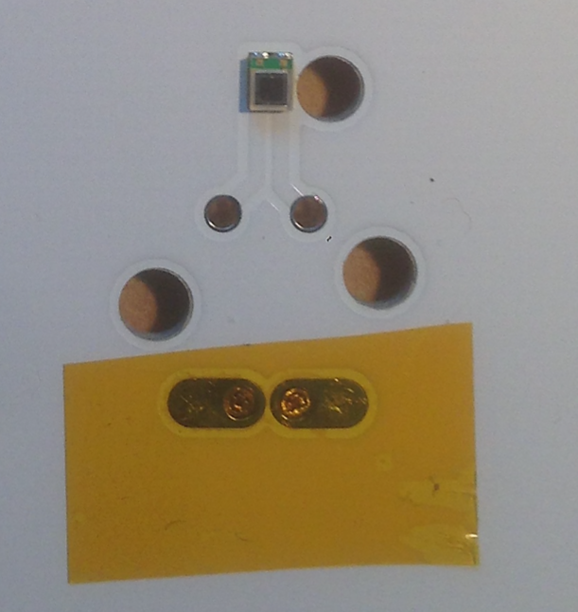
Design of white PCB
PCB with 9 SiPM pads with pitch similar to HBU boards
  First prototype with 2x MPPC 12571-025P (SiPM type used on SMD HBU)
This PCB is designed as an adapter board
  Top side with SiPMs/Tiles, Bottom side with female connectors for connection of preamp/bias to SiPM → Plug-in system
Dimple
Female pin connector
Female pin
Connector
SiPM
White PCB
Scintillator tile
Top side of white PCB board
Bottom side of white
PCB board

Slide 11
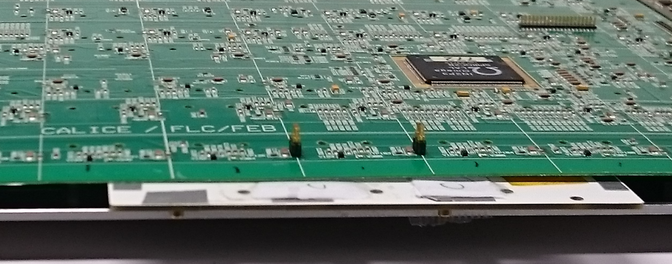
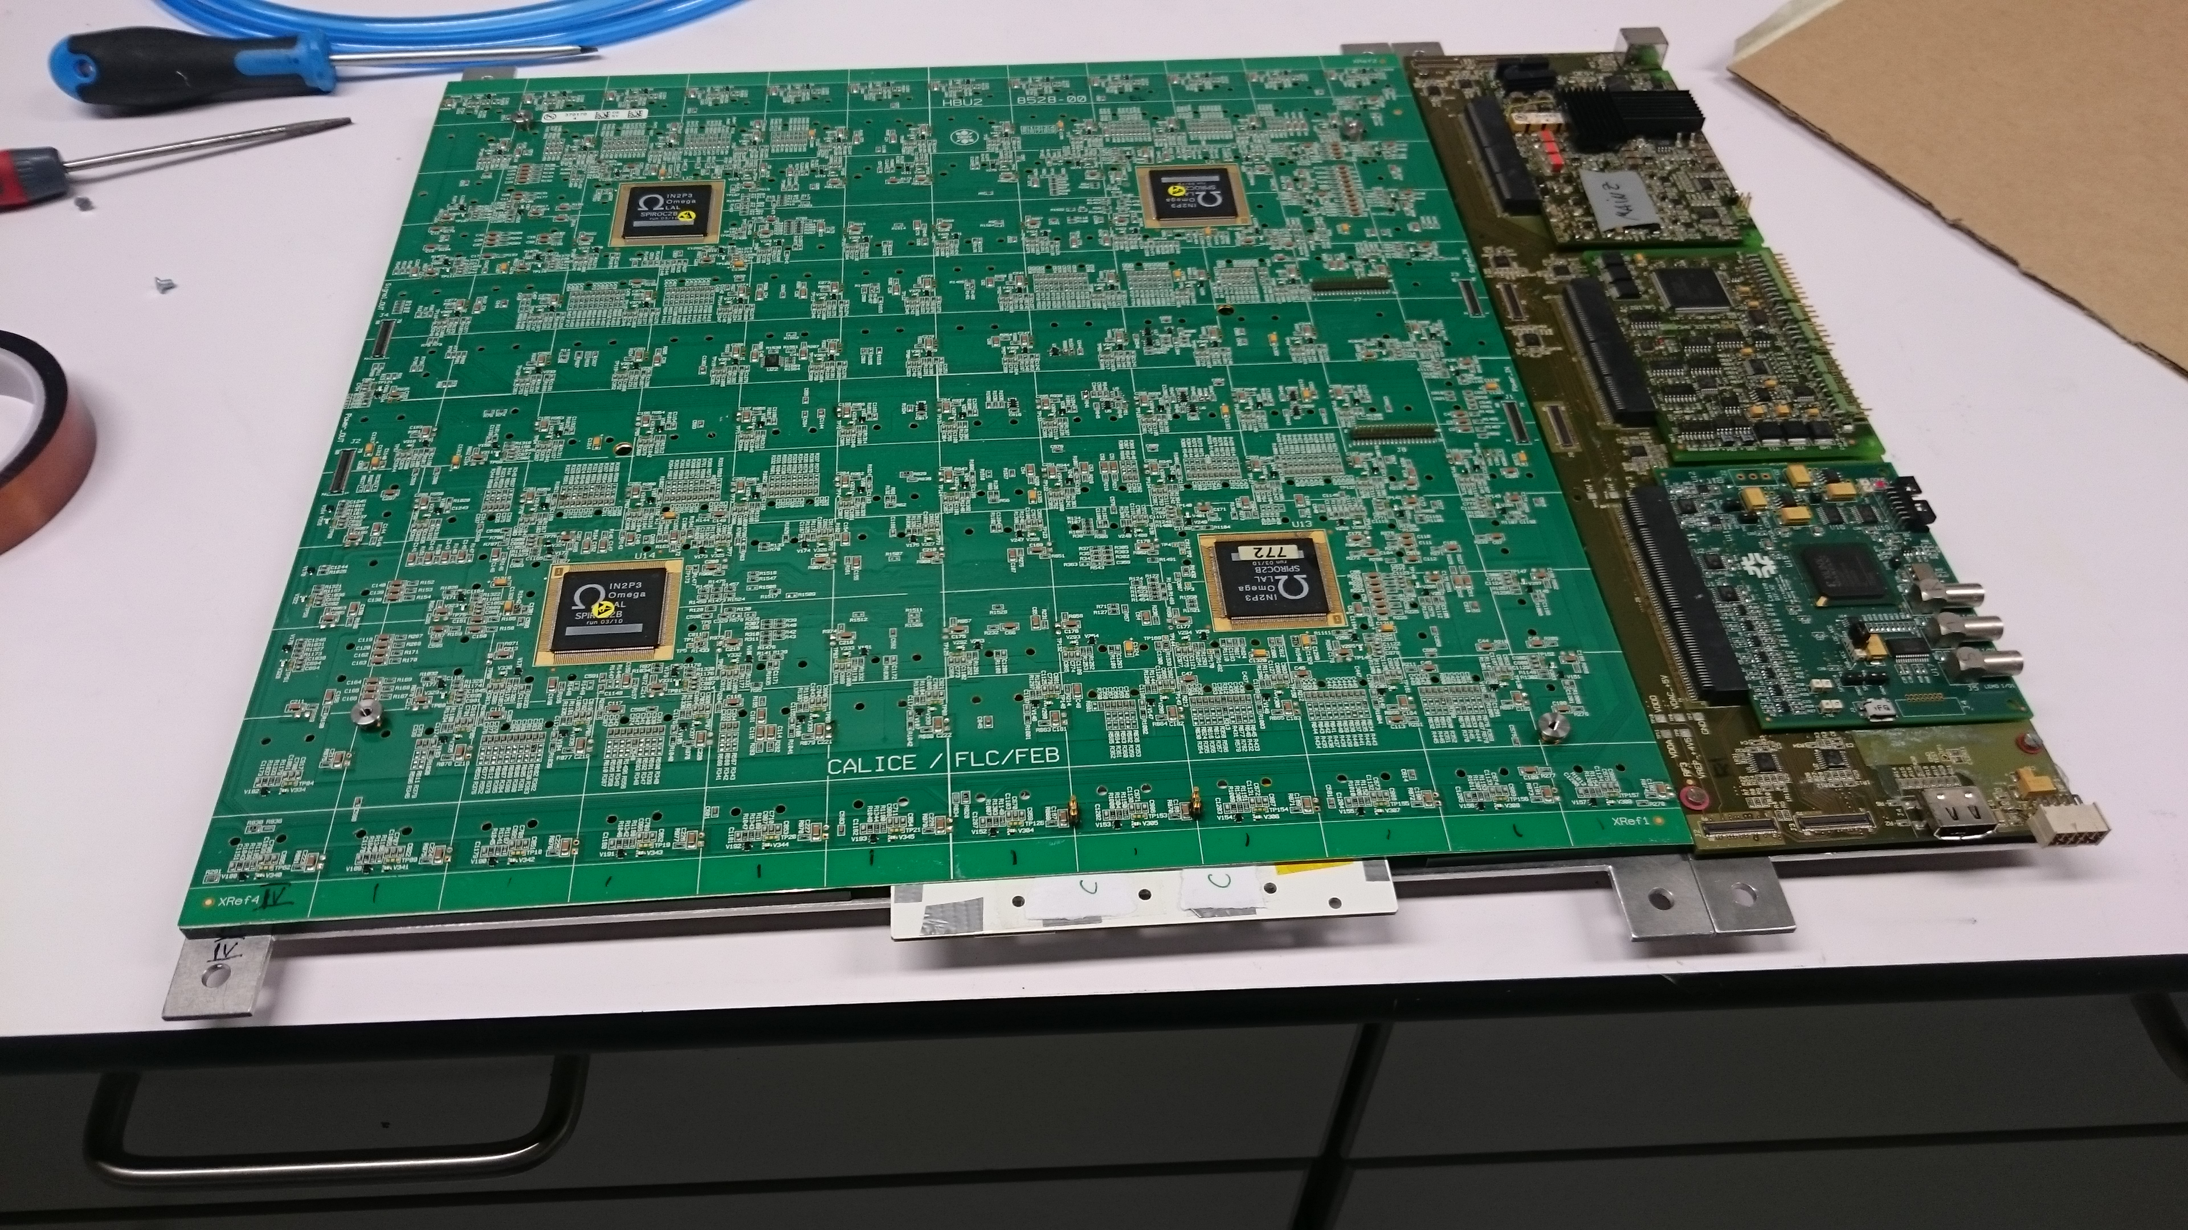
Design of white PCB
PCB with 9 SiPM pads with pitch similar to HBU boards
  First prototype with 2x MPPC 12571-025P (SiPM type used on SMD HBU)
This PCB is designed as an adapter board
  Top side with SiPMs/Tiles, Bottom side with female connectors for connection of preamp/bias to SiPM → Plug-in system
Dimple
Adapter board is designed for compatibility to THT HBU boards
Plug-in system (no soldering necessary)
HBU’s Preamps, Voltage supply, readout electronics are used for measurements
Female pin
Connector
SiPM
White PCB
Scintillator tile
Pin
HBU board
LED

Slide 12
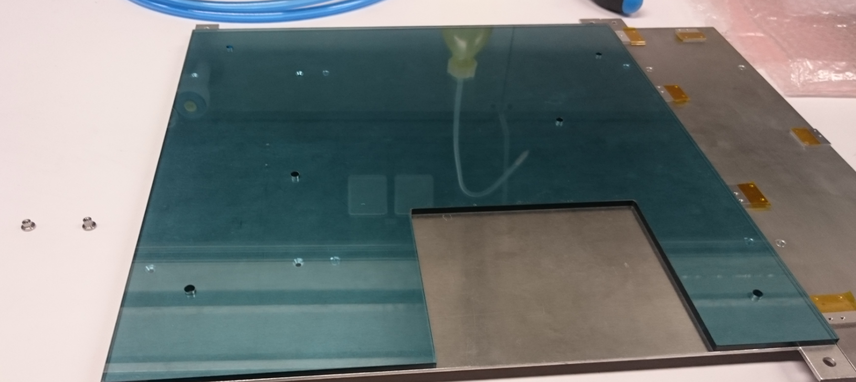
Design of white PCB
PCB with 9 SiPM pads with pitch similar to HBU boards
  First prototype with 2x MPPC 12571-025P (SiPM type used on SMD HBU)
This PCB is designed as an adapter board
  Top side with SiPMs/Tiles, Bottom side with female connectors for connection of preamp/bias to SiPM → Plug-in system
Dimple
Adapter board is designed for compatibility to THT HBU boards
Plug-in system (no soldering necessary)
HBU’s Preamps, Voltage supply, readout electronics are used for measurements
Female pin
Connector
SiPM
White PCB
Scintillator tile
Pin
HBU board
LED
Spacer for mechanical stability
(setup is compatible for normal AHCAL lab mechanics)

Slide 13
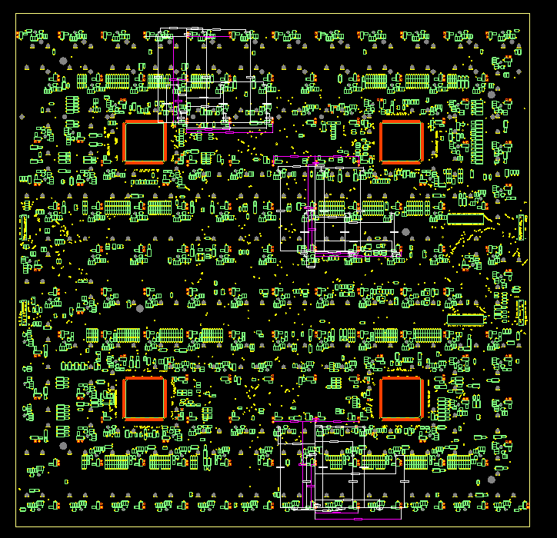
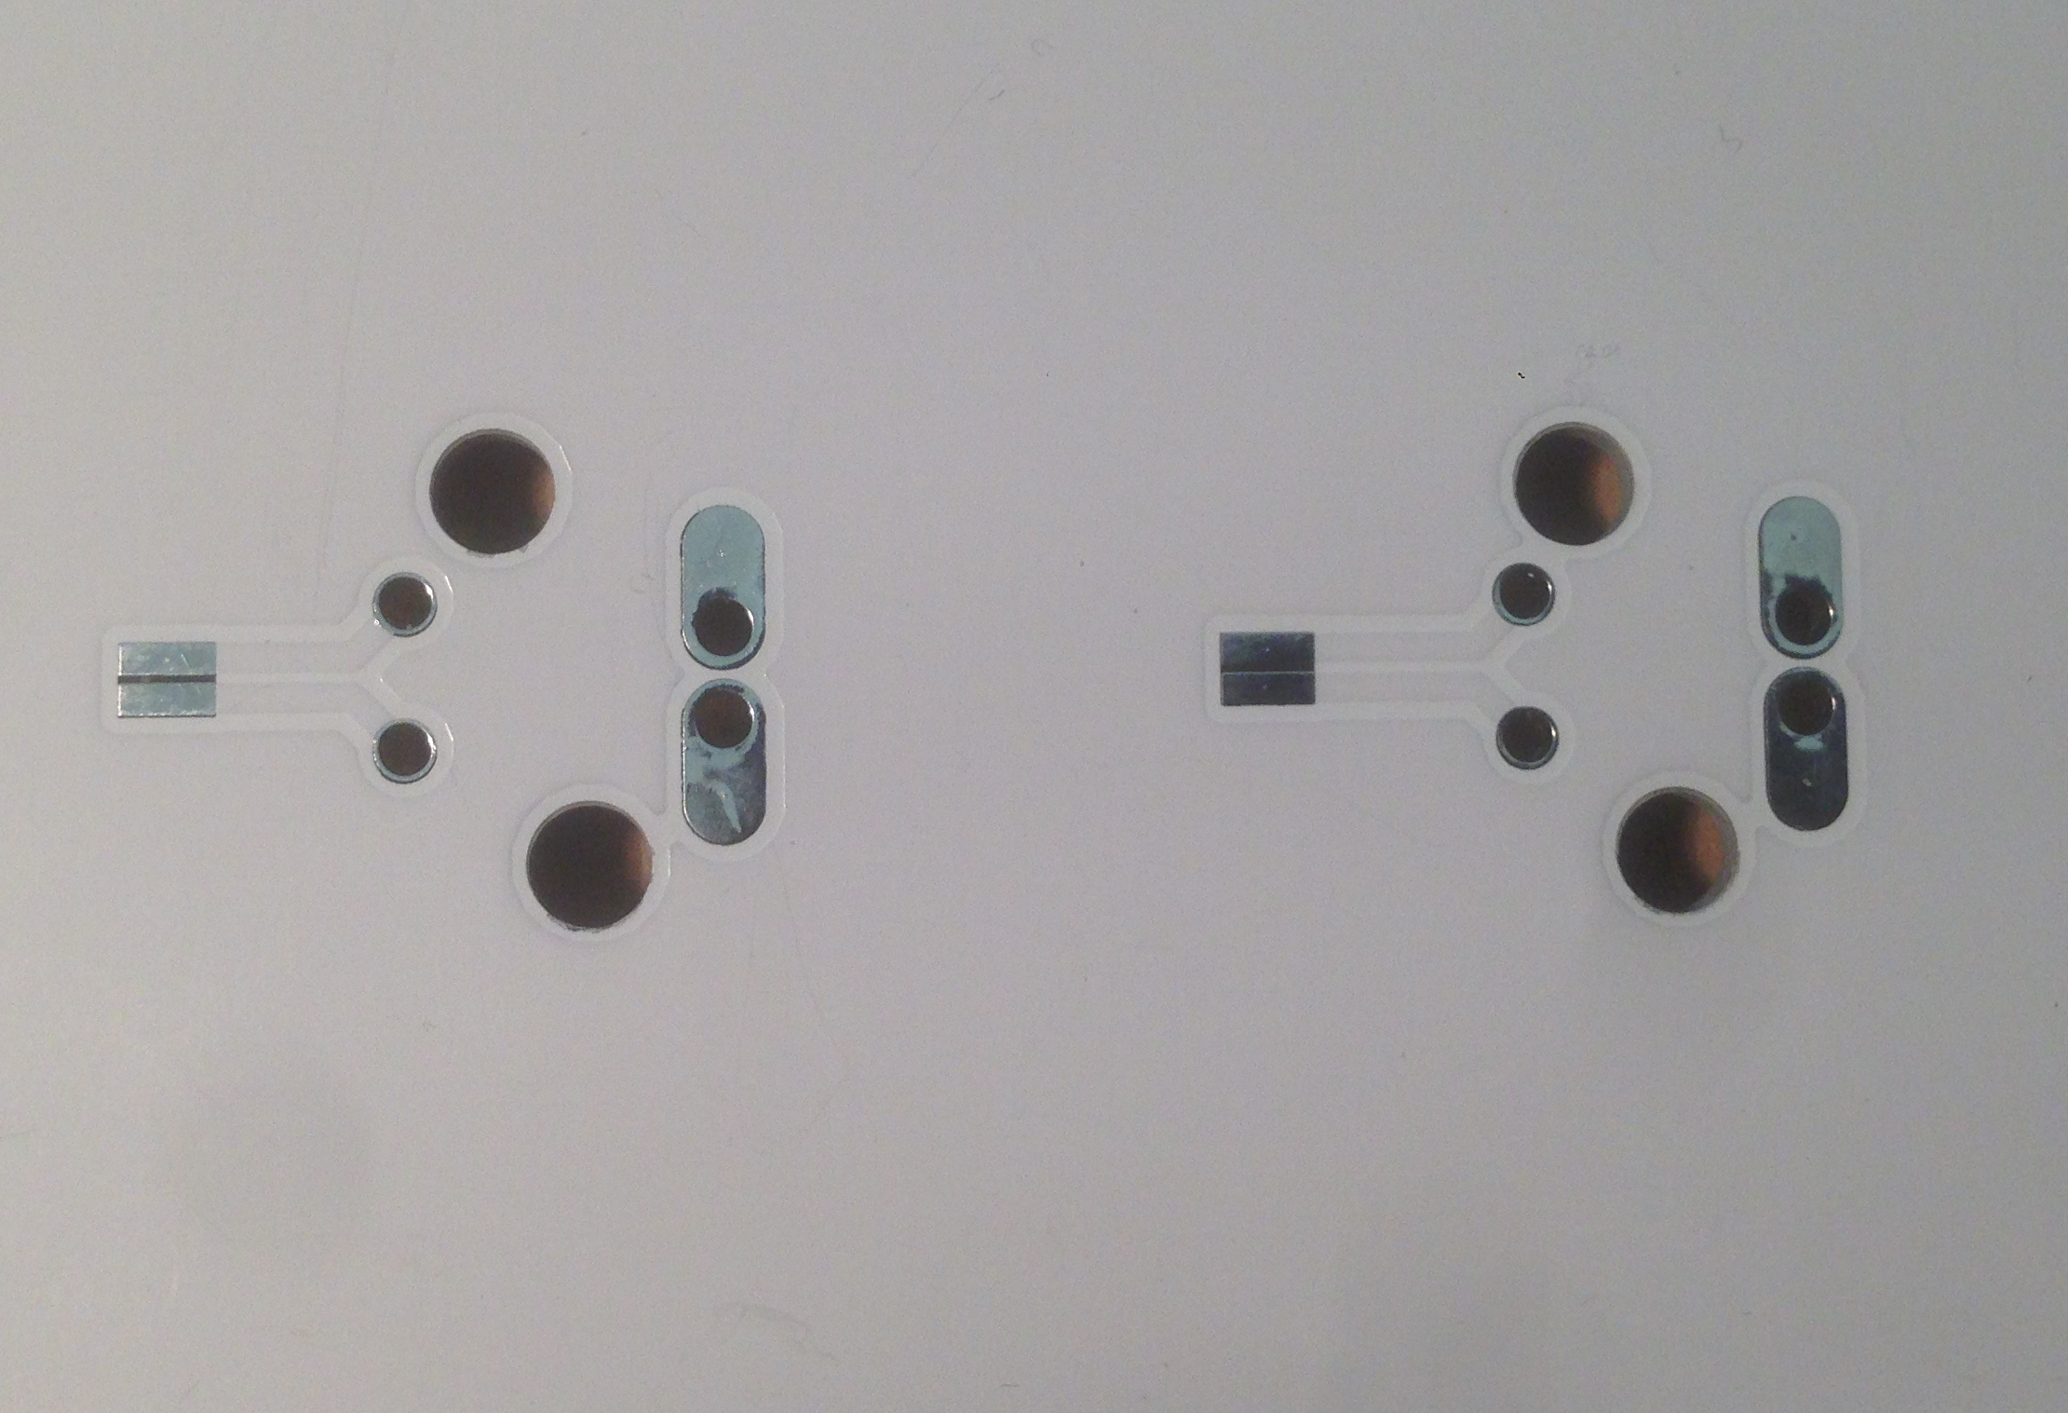
Design of white PCB
Tile/SiPM position are rotated in THT HBU design → search for a repetitive pattern of SiPM pin holes to maximized possible positions on HBU board
One pattern of 3x3 SiPM pin orientation was chosen from HBU design
  This pattern occurs 3x on THT HBU Boards (white boxes in the drawing)
  LED holes are also drilled through this adapter board (2-3 for each tile position)
LED holes

Slide 14
Test of white adapter board on THT HBU board
First tests with an slightly damaged HBU board (ASIC 3 broken, some HV )
  Unluckily exactly the 2 chosen SiPM positions on ASIC 1 has lower operation voltage and IDAC doesn’t work
    ~65.5 V (~1.6V overvoltage), recommended by Hamamatsu: 67.4 V (3.5 V overvoltage)
    Try to compensate setting the preamps → not working (gain to low?)
Future plans:
  Change of ASIC position and repeat this test (current status: waiting for new spacer)
  Alternative Solutions:
    Move SiPMs to a position with correct bias voltage
    Change power board output voltage to compensate SiPM voltage

Slide 15
Preliminary light yield measurement
1 tile was measured with cosmics on white adapter board and on a green pcb with reflective foil for an fast overview of light yield increment (with same preamp but different SiPMs)
Expectation 16% for specular foil
  Reflectivity is different (85% instead of 99.8%), also diffuse reflectivity
→ Light yield increment should be lower than expected 16 %

Slide 16
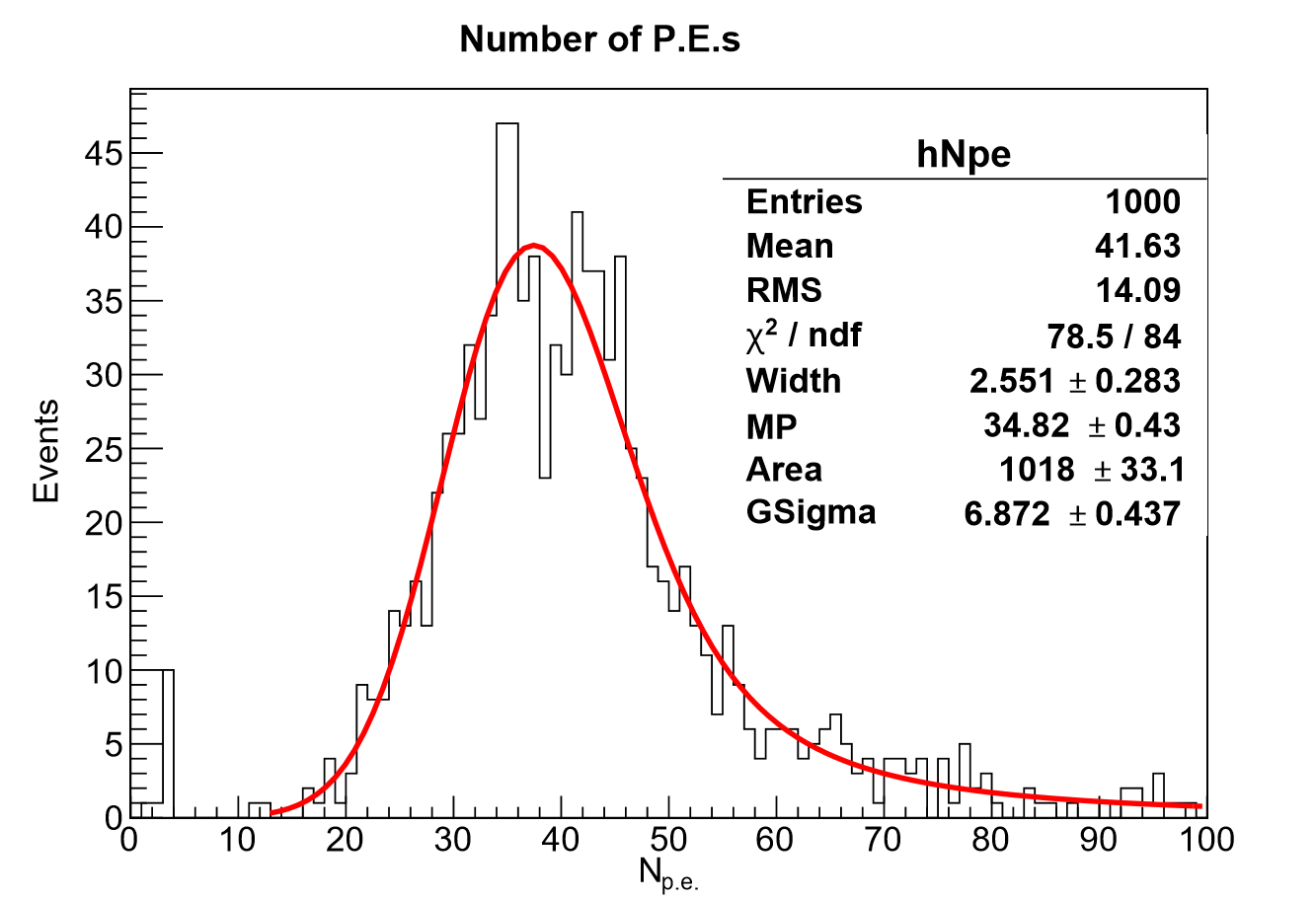
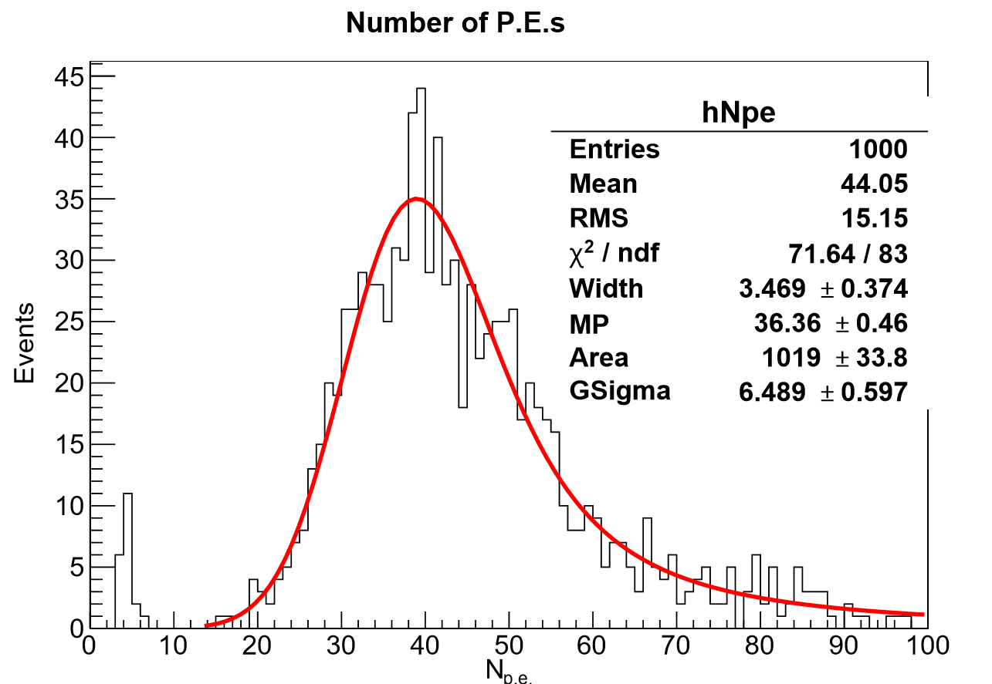
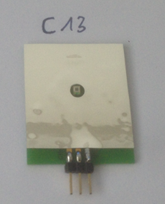
Preliminary light yield measurement
1 tile was measured with cosmics on white adapter board and on a green pcb with reflective foil for an fast overview of light yield increment (with same preamp but different SiPMs)
Expectation 16% for specular foil
  Reflectivity is different (85% instead of 99.8%), also diffuse reflectivity
→ Light yield increment should be lower than expected 16 %
  LED hole position within dimple
  On mini PCB part of the LED hole are covered with reflective foil (needed for different measurements and should stay unchanged)
  → We area correction we expect ~10% increment (optimized measurement will be done next week)
Dimple and
LED hole
on green PCB
Fast preliminary measurement !
on white PCB
LED hole
within dimple are
Mini PCB
with green
dimple area
4.2 %
34.82 p.e.
36.36 p.e.

Slide 17
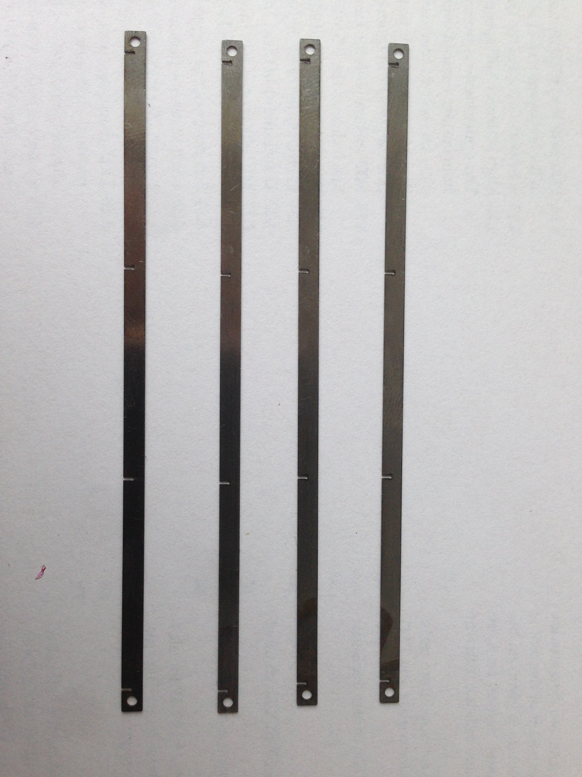
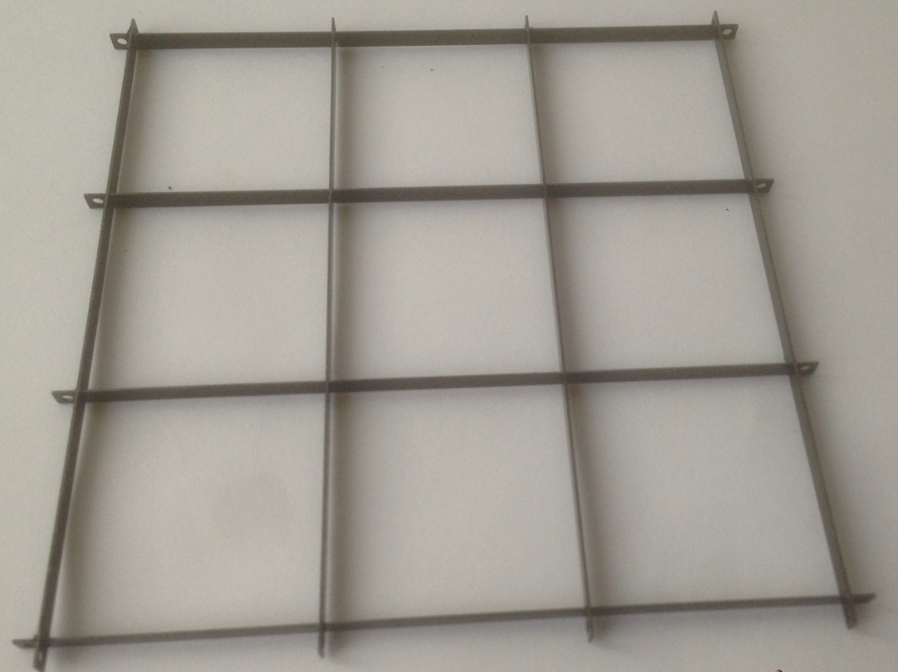
Test of 3x3 metal strip array
A strip design was designed and build to estimate light yield and crosstalk probability of metal strip design (s. Yongs talk)
30.15 mm
Grooves
Grooves for proper positioning and alignment
Thickness 3.5 mm, height 3 mm
Strips is designed for HBU pitch

Slide 18
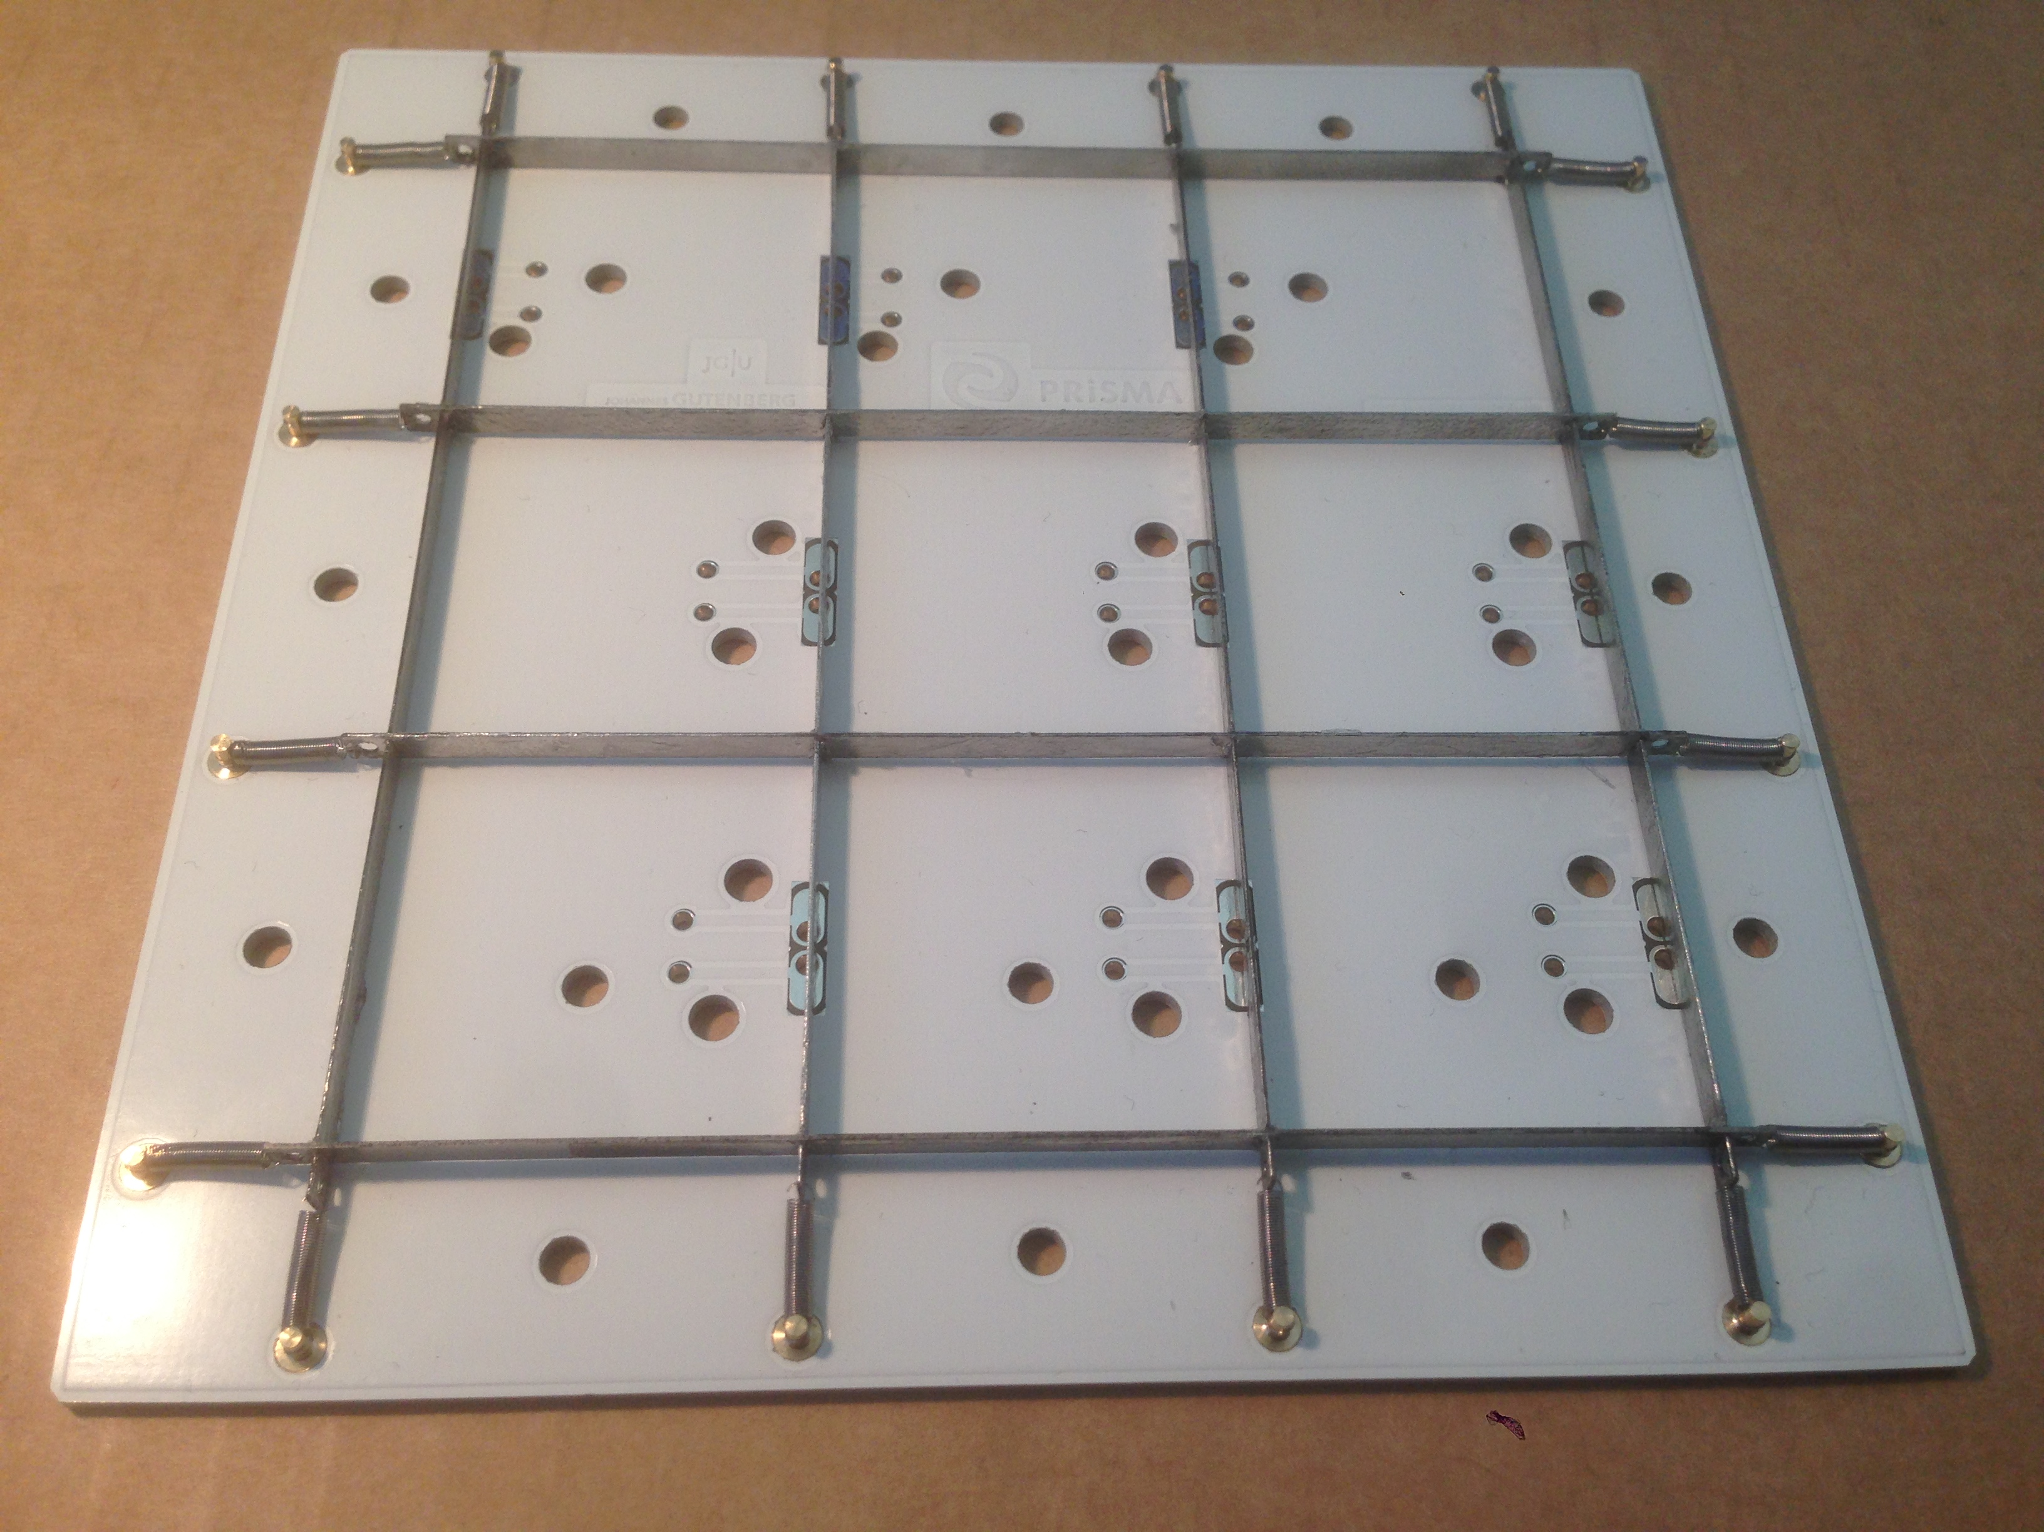
Test of 3x3 metal strip array
A strip design was designed and build to estimate light yield and crosstalk probability of metal strip design
Springs are fixed to strips and alignment pins on the adapter board
Optimal setup for cross talk measurements
  Test with HBU electronics and/or single preamps and voltage supply
  Current status: Measurement of light yield and tile to tile crosstalk probability with strips coated with reflective layer
Springs
Alignment pins

Slide 19
Status: Cosmic ray test stand

Slide 20
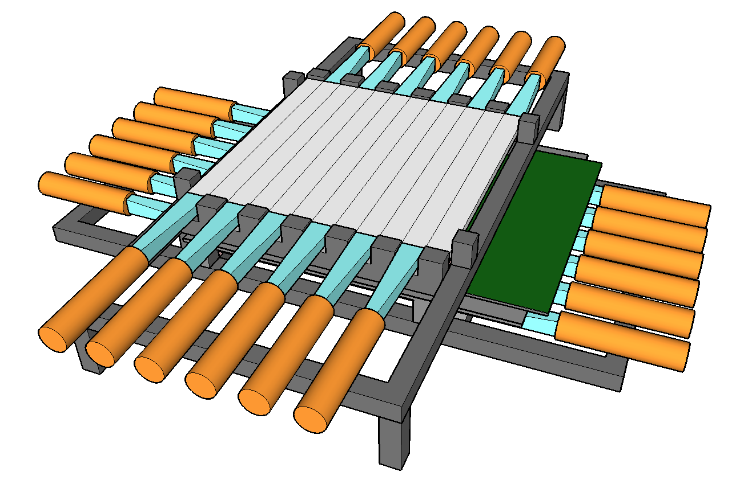
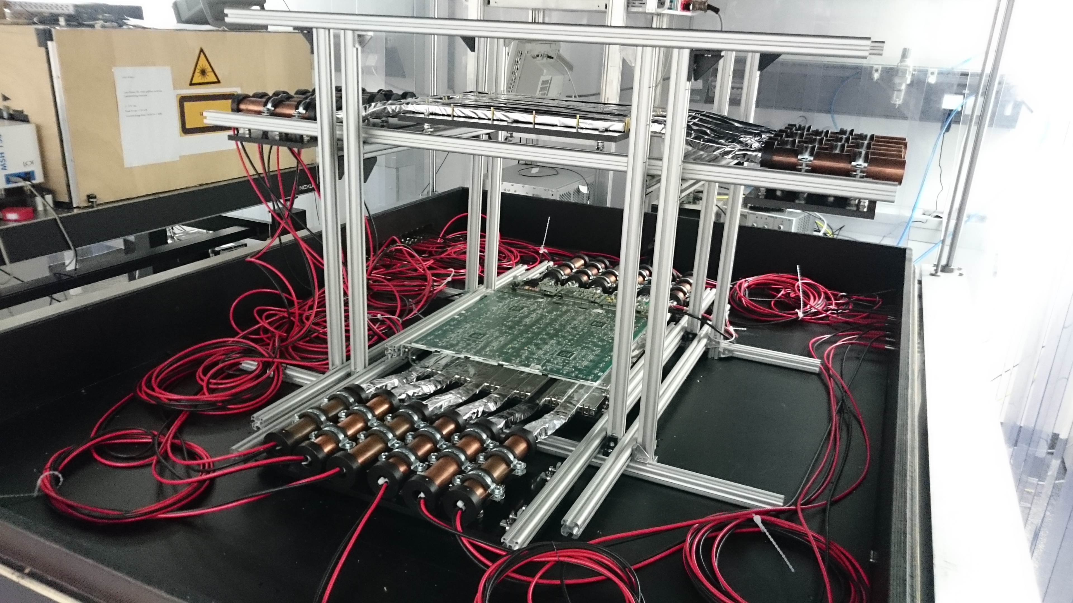
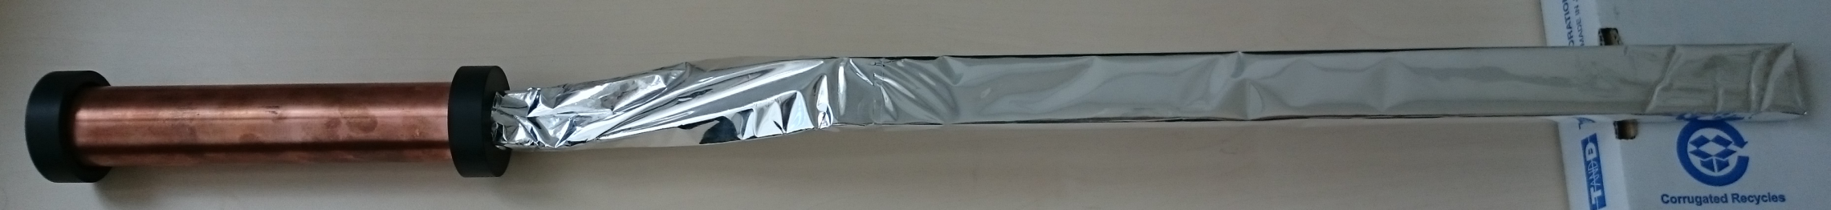
Cosmic ray test stand update
Mechanic construction is finished
Next step for cosmic ray test stand:
  Production of adapter boards for FPGA (connection of Trigger signals, HDMI connector for HBU commands and Clock)
  Implementation of FPGA for trigger assignment
Scintillator
365 mm
PMT holding system

Slide 21
Conclusion & Outlook

Slide 22
Conclusion
Preparation of automatic assembly of 2nd SMD HBU board are ongoing
White solder mask seems to improve the light yield as expected
First test with the white PCB are promising
  Mechanics of cosmic ray test stand is finished, implementation of FPGA is currently tested
Assembly of 2nd SMD HBU beginning of next year
Further tests for white PCB surface are ongoing
White PCB as a crosstalk test stand will be continued
  Further tests for white PCB – HBU connectivity will be done
Cosmic Ray test stand:
  Completing the test stand and measurement of the SMD HBU board
Outlook

Slide 23
Thank you for your Attention!

Slide 24
Backup

Slide 25
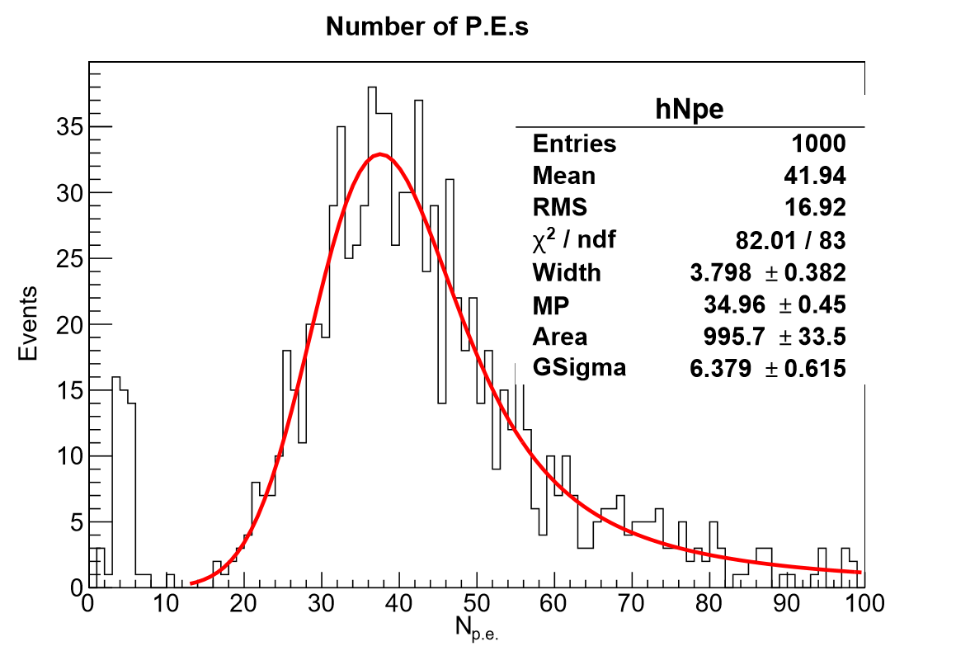
Light yield measurement
2nd tile measured on PCB
Tile 150 on white PCB

