Slide 1
ATF Operational Status in FY2015
N. Terunuma, KEK
19th ATF TB/SGC meeting
Jan. 13 2016, LAL Orsay

Slide 2
Overview of FY2015 operations
Several shifts were lost by failures but quickly/successfully fixed by a maintenance team.
No long failures more than a week was happen.
The startup time looks shorten compare to the past years, and is used for short R&Ds.
Most of the R&Ds were done at ATF2 beamline.
More than 80% of shifts were for ATF2 goal-1 and 2.
Non-KEK colleagues could recover a primary beam by themselves and keep R&Ds especially on owl shifts.

Slide 3
FY2015 Apr–Dec Shift Results
Total
142 shifts
more than 80 %
for ATF2
goal 1&2

Slide 4
Budgetary issue for ATF operation in FY2015
Electricity charge of ATF was maintained by KEK.
It is better than FY2014 and no Spring shutdown in FY2015.
On the other hand, the maintenance budget is very limited. It is a trade off for a beam time; i.e., electricity.
Purchase of spare for expensive devices had to be postponed if we have a spare at least . Obviously, it is very risky for annual operation but no choice.
  LINAC RF Klystron should be purchased in FY2016. 180k$.
For the case of a severe failure, we should discuss with KEK executives how KEK can cure it in this FY.
  kicker thyratron
    KEK supported 60k US$ for 2 of 4 last manufacture by company
    remaining 2 units have to be paid in FY2016.

Slide 5
History of ATF Beam Weeks
Fiscal Years
Electricity cost became twice.
CERN/CLIC supported 2 weeks. No beam for Jan-Mar.
Apr-Dec: 11 weeks,
Jan-Mar: 7 weeks are scheduled.

Slide 6
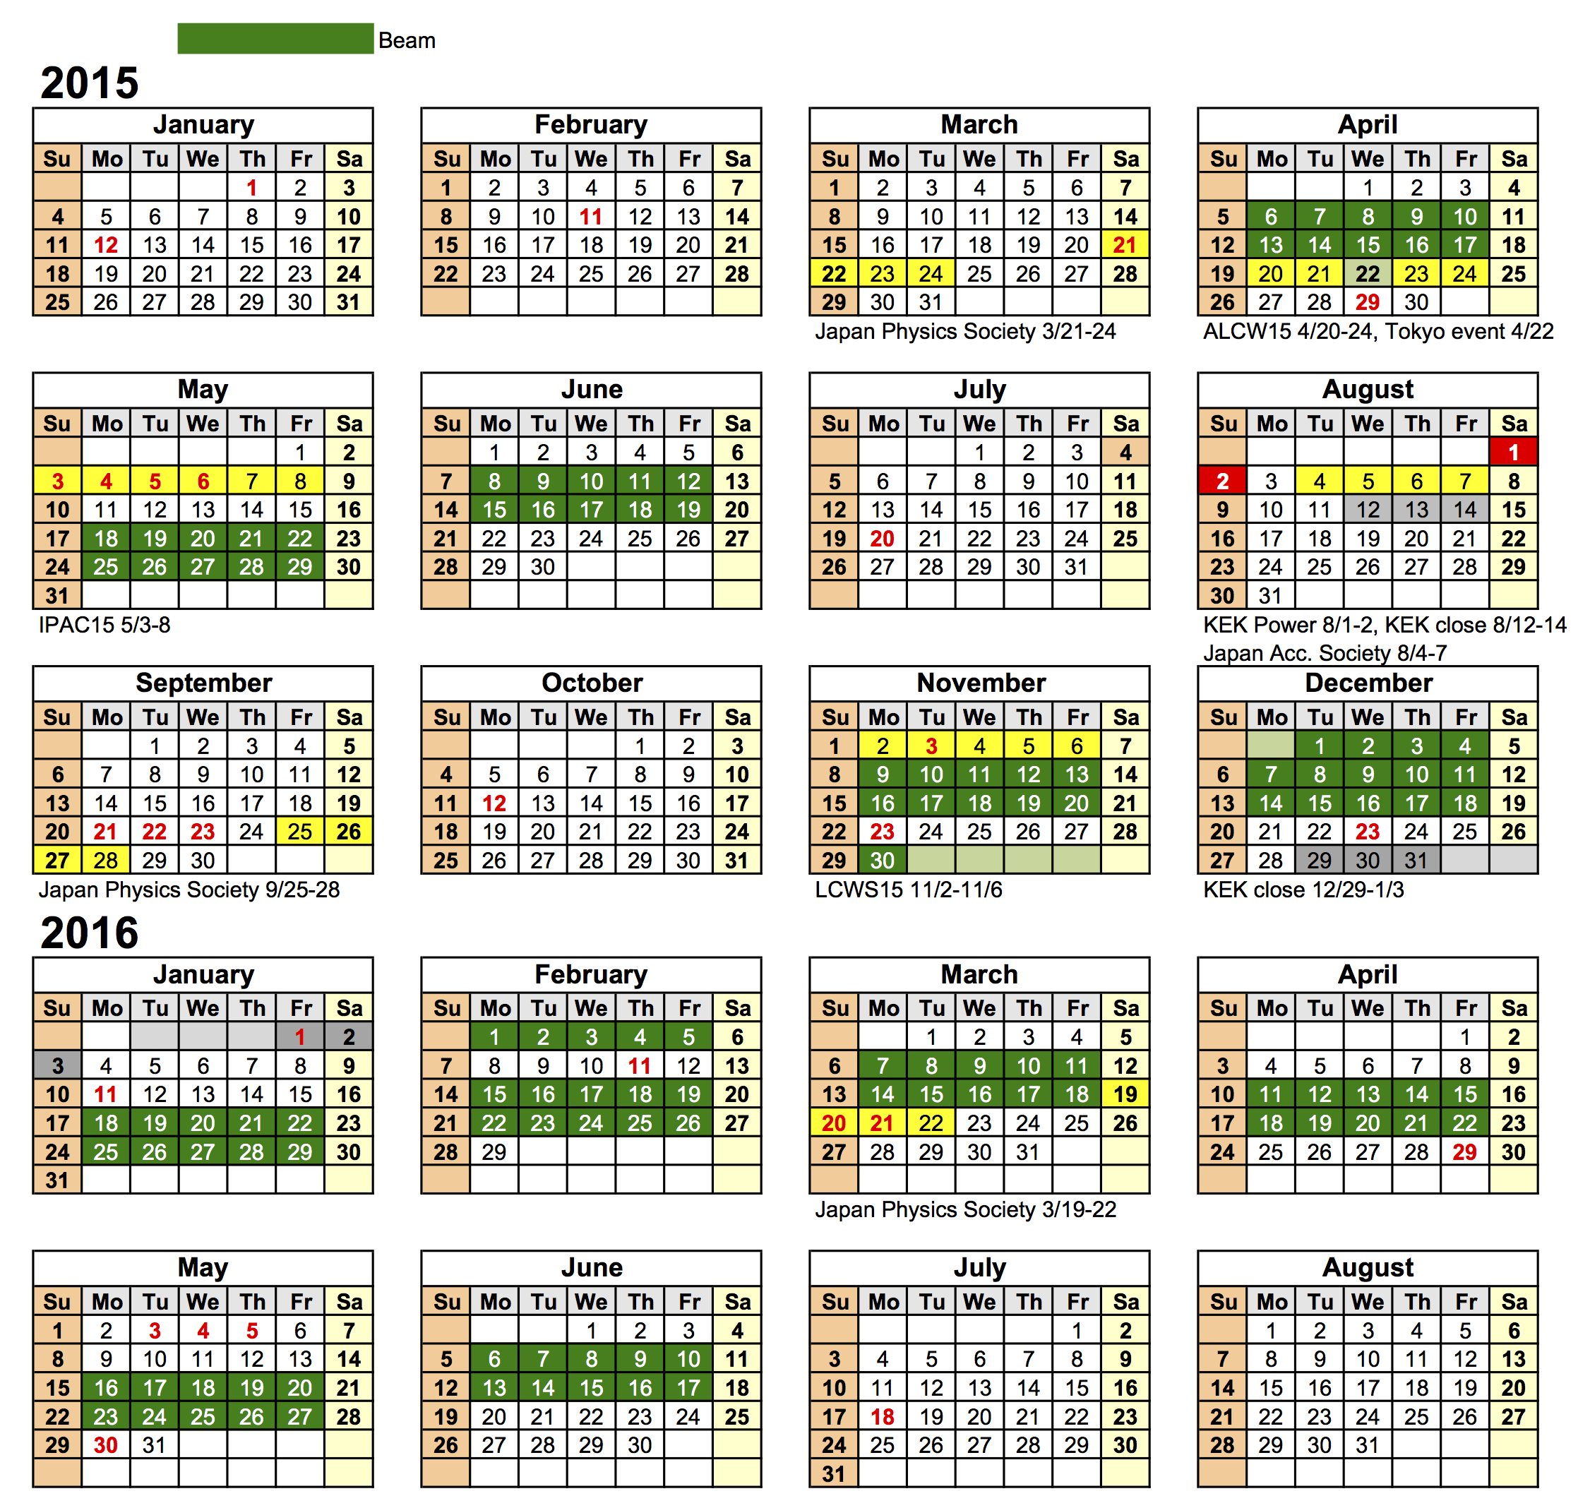
FY2015: 18 weeks (11+coming 7)

Slide 7
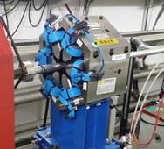
Coming installations for R&Ds (1/3)
Strengthen the ATF2 skew sextupoles (KEK)
  under installation for next beam runs.
  shorten a pole gap and widen the dynamic range for a beam tuning. φ160 → φ60

Slide 8
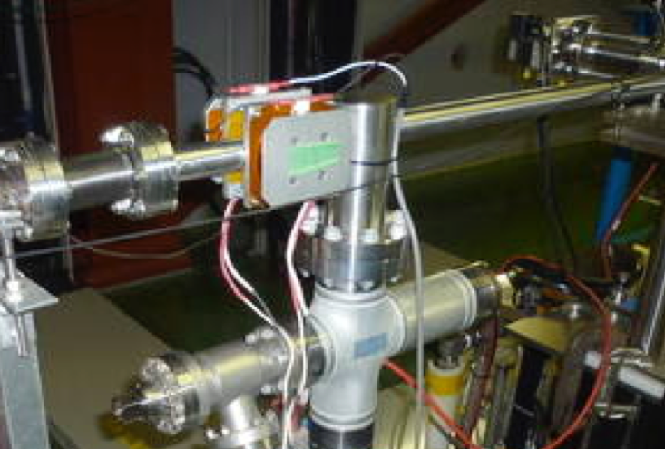
Coming installations for R&Ds (2/3)
Air-core dipoles in EXT/FF (KEK)
  a pair of vertical dipoles were successfully functioned in December run for slow orbit feedback and jitter studies.
  a pair of horizontal dipoles will be installed before April.

Slide 9
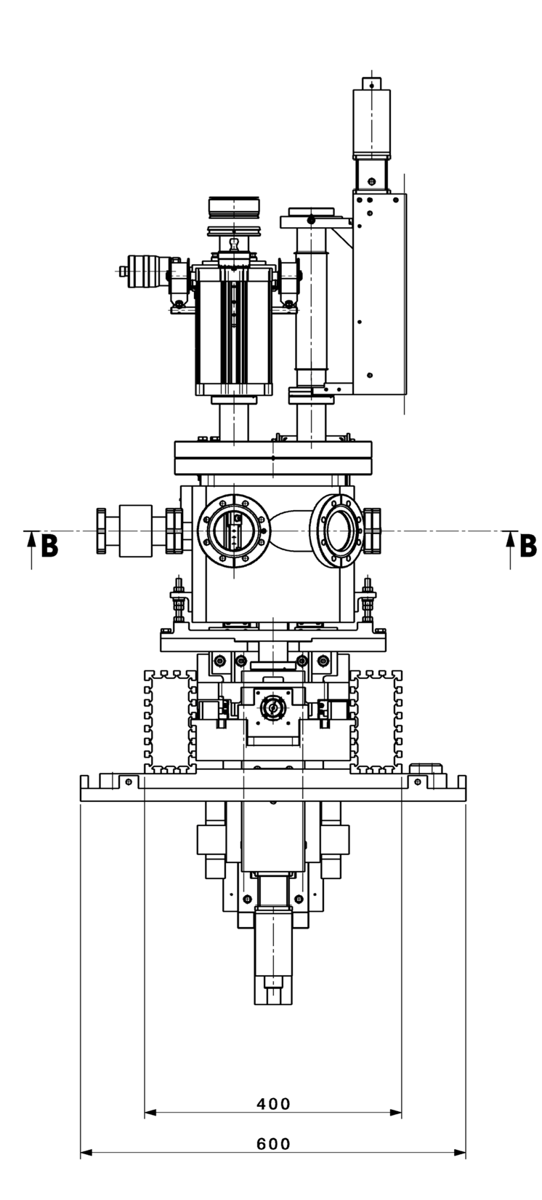
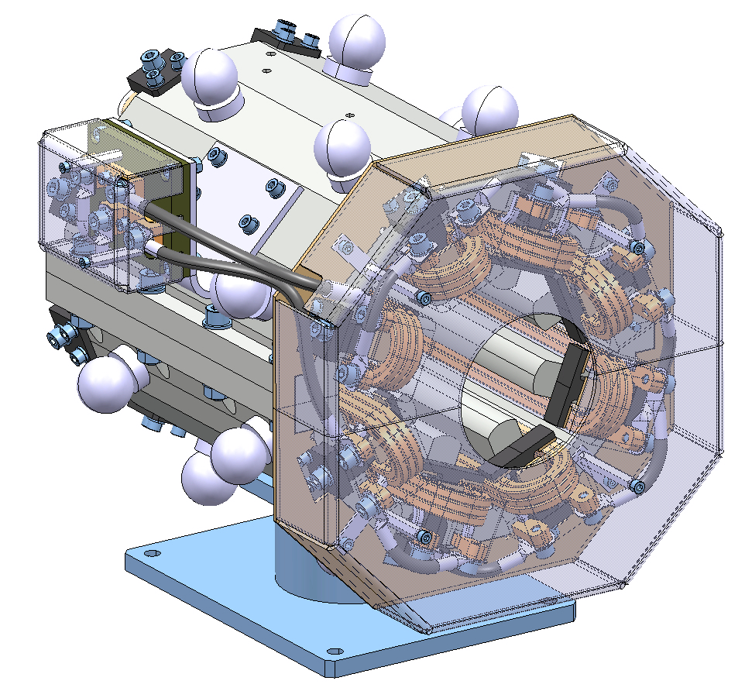
Coming installations for R&Ds (3/3)
OTR/ODR system (RHUL/CERN)
  Six boxes had been delivered from CERN to ATF.
  Installation will be done in February.
Collimator system (IFIC/LAL)
  Shipping and installation: planned in Spring.
Octupoles (CERN)
  Shipping and installation: planned in Spring.

