Slide 1
Wakefield studies
ATF TB/SGC Mtg. 201601
K.Kubo

Slide 2
Outline
Intensity dependence of IP beam size
Studies using on-mover structures
  Beam size at IP
  Orbit change
Studies of orbit jitter and beam size
Wake-free steering experiment
Comparison of wakefield effects at ILC and ATF2

Slide 3
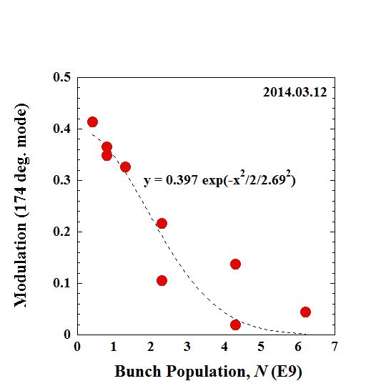
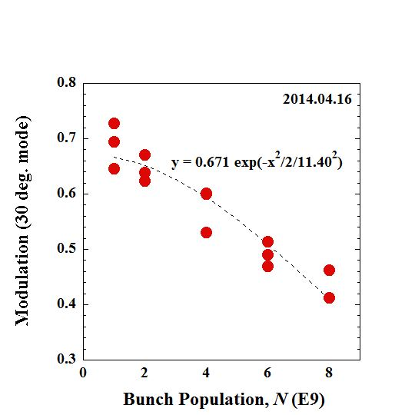
Presented in IPAC14
Beam Size Depends on Bunch Intensity
IPBSM modulation as function of bunch population. Measured with crossing angle 174 degrees (left) and 30 degrees (right).
with modified OTR chamber, position adjusted,
reduced to ~60nm/nC

Slide 4
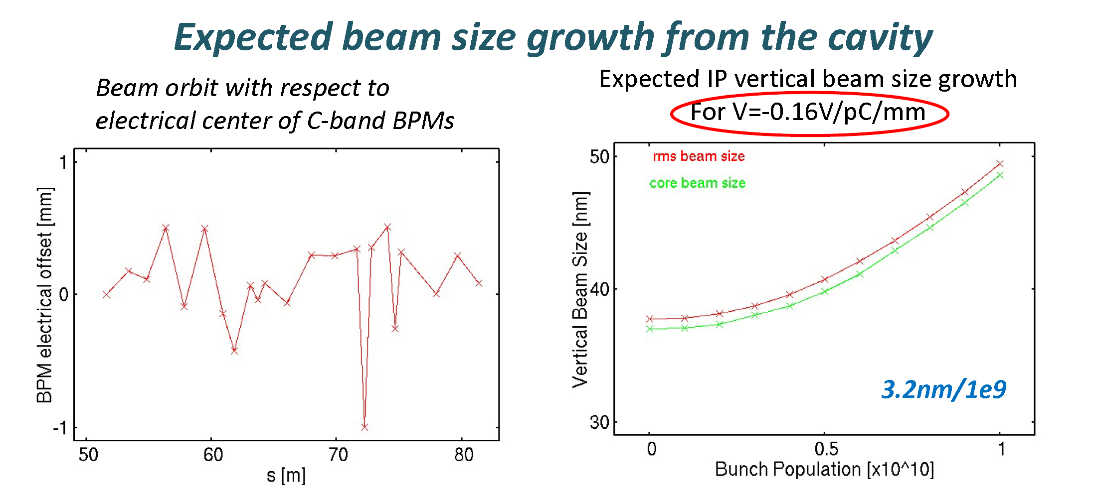
Intensity dependence due to wakefield of Cavity BPMs
Okugi’s slide in proj. mtg. Feb. 2014
(19 nm/nC)
About factor 3 difference between this calculation and experiments.
This calc. included cavity BPMs only. Underestimating wakefield of all components.
But factor 3 seems too large (?)

Slide 5
Wkaefield source on mover experiments and calculations
C-band BPM Reference Cavity
OTR chamber
Orbit change vs. position
Beam size at IP vs. position

Slide 6
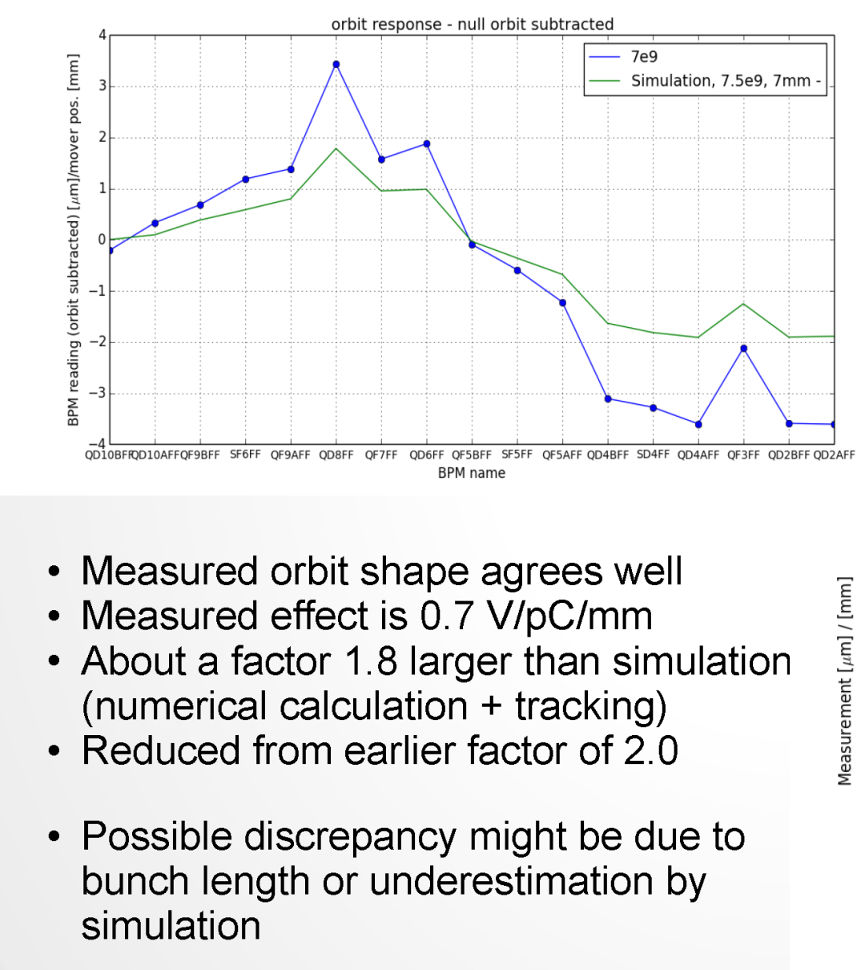
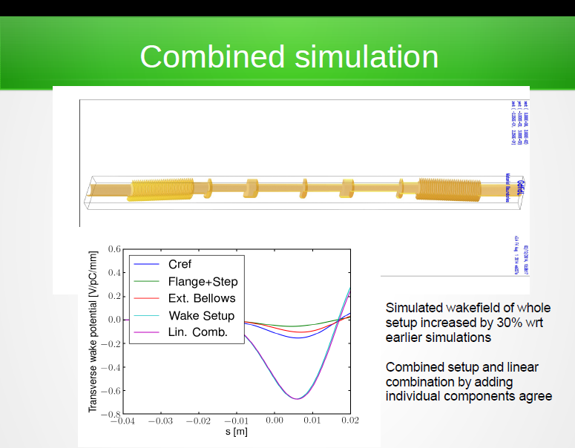
BPM reference Cavity on mover experiment -- orbit change
J.Snuverink, et.al., LCWS2014
2015
Further updated calculation (including other moving components)
reduced the factor 1.8 → 1.4

Slide 7
ATF2 weekly meeting 20130708 K.Kubo
IP beam size vs. mover position experiment (ref.cav. Etc.)
Effect of offset 1 mm, bunch charge 1 nC. IP beam size increase (nm/nC/mm)
Experimental data analyzed by Okugi
2 C-band ref. +2 no mask deforming bellows | 1 C-band ref. +2 no mask deforming bellows | No mask Bellows +2 masked deforming bellows | Masked Bellows +2 masked deforming bellows
157 | 102 | 57 | 14.5
 | C-band ref. | No mask Bellows | Masked Bellows
Experiment | 55 | 47~50 | 7
Calc | 32.2 | 22.6 | ?
Factor 1.7 – 2.2 larger than calculation

Slide 8
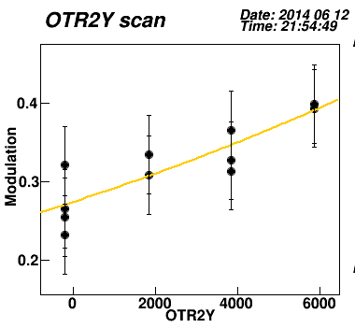
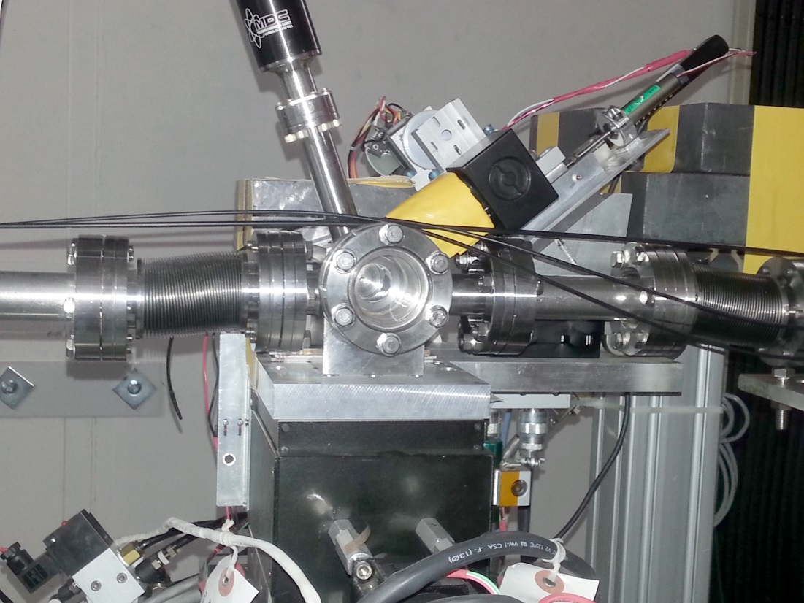
OTR monitor chamber (beam size monitor in EXT line) to IP vertical beam size was found (June 2014)
IPBSM 174 degrees
N~0.3E10

Slide 9
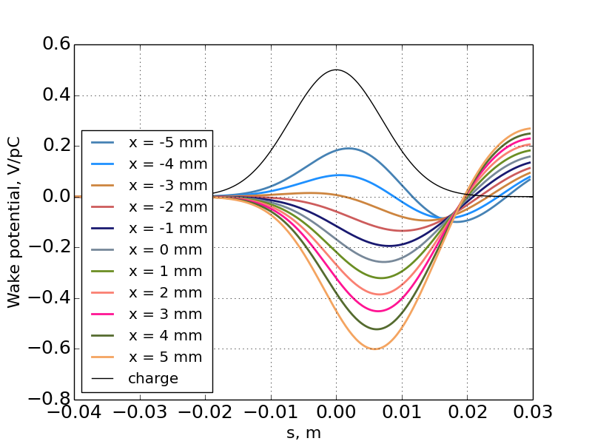
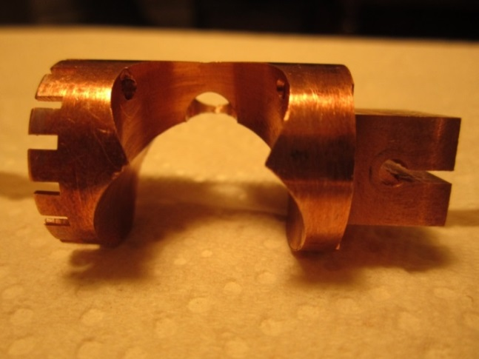
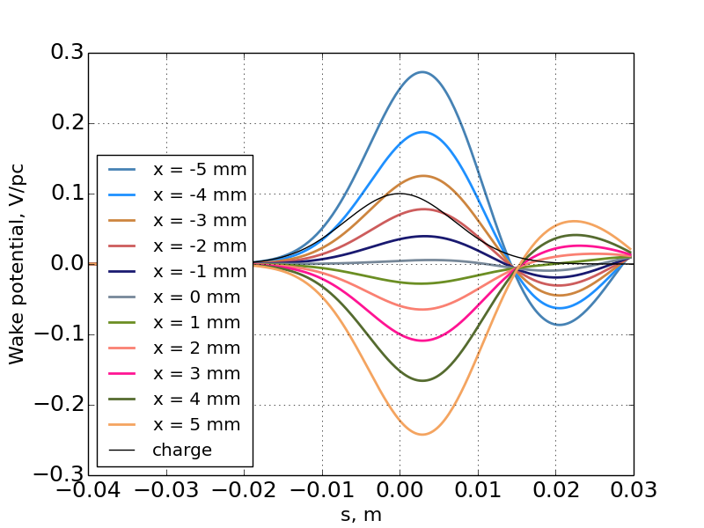
OTR monitor View Port Shield
No shield
by A. Lyapin
Photo by D. McCormick
Remove vertical asymmetry
Reduce position dependent wake
(factor 0.6)
0.08 V/pC/mm → 0.05 V/pC/mm
With shield
by A. Lyapin

Slide 10
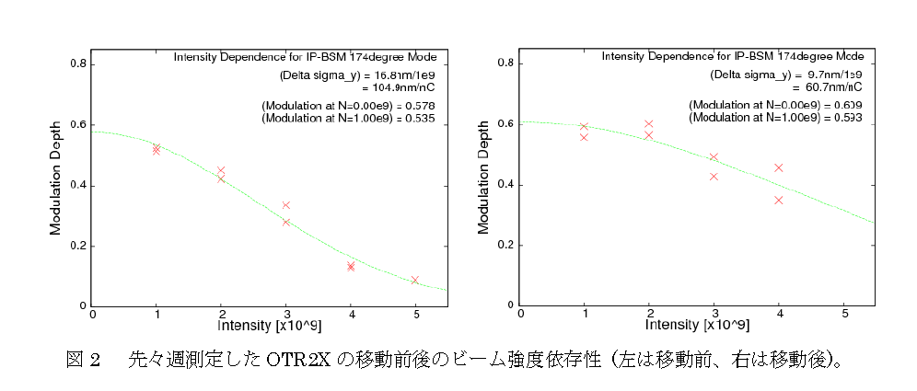
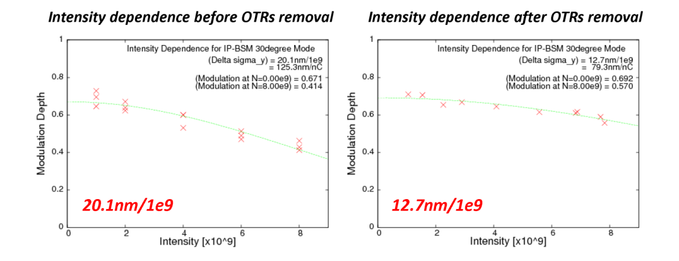
Before OTR2X position optimization After optimization (174 deg mode)
By Okugi, 2014.6.23
100 nm/nC → 58 nm/nC
Removal of all OTRs
(30 deg mode)
Okugi, 2014.6.26 ATF Op. meeting
121 nm/nC → 76 nm/nC
Dependence reduced by optimizing position or removing chamber. (similar effect)
(30 deg mode tend to give stronger dependence than 174 deg mode.)
Slide by K.Kubo in ATF operation meeting Nov 7, 2014

Slide 11
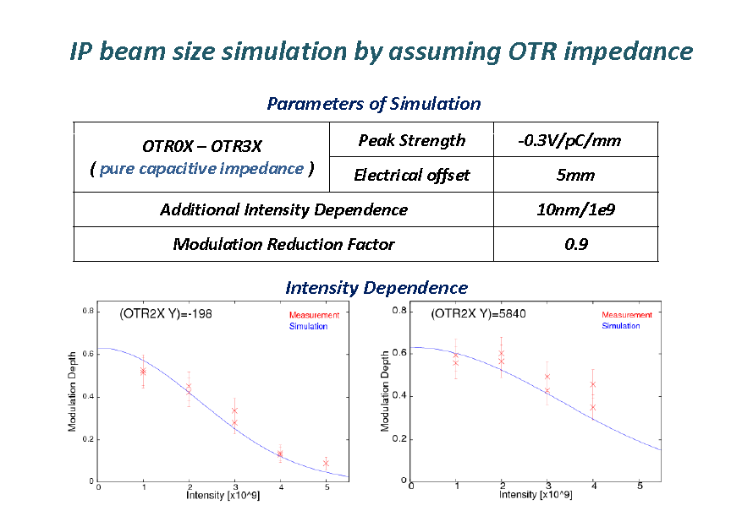
Beam size vs. OTR chamber position
Okugi, 2014. June 6, ATF Operation meeting
Wakefield 0.3V/pC/mm explains the strong beam size dependence on intensity + OTR chamber position.

Slide 12
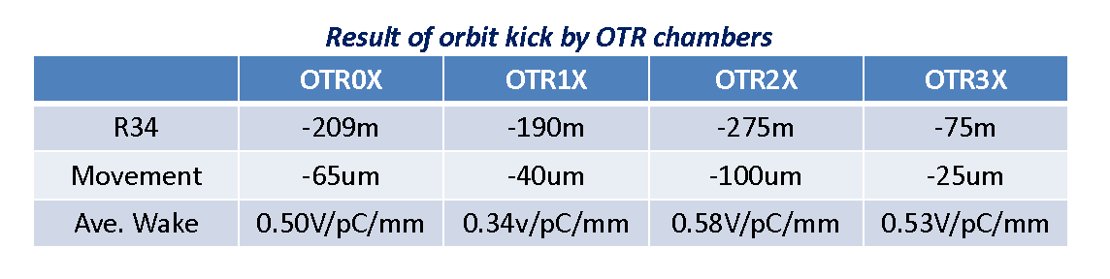
Orbit Change vs. OTR chamber position
(Oct. 28, 2014, one BPM)
(Okugi, 2014.10.31 ATF Op. meeting)
(Nov. 11, 2014, many downstream BPMs )
 | Kick angle/offset (urad/mm) | Wake (average in a bunch) (V/pC/mm)
OTR0 | 0.374 | 0.47
OTR1 | 0.317 | 0.40
OTR2 | 0.233 | 0.30
OTR3 | 0.240 | 0.30
(Kubo, 2014.11.11 owl shift log)
Wakefield ~0.5V/pC/mm can explain orbit dependence on OTR chamber position
(about factor 6-10 larger than old calculation)

Slide 13
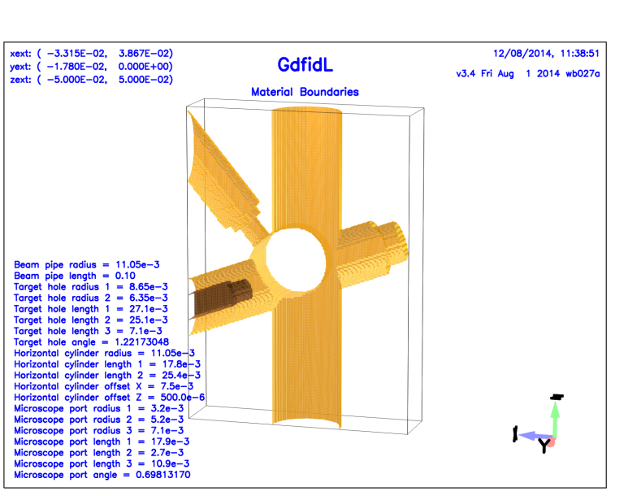
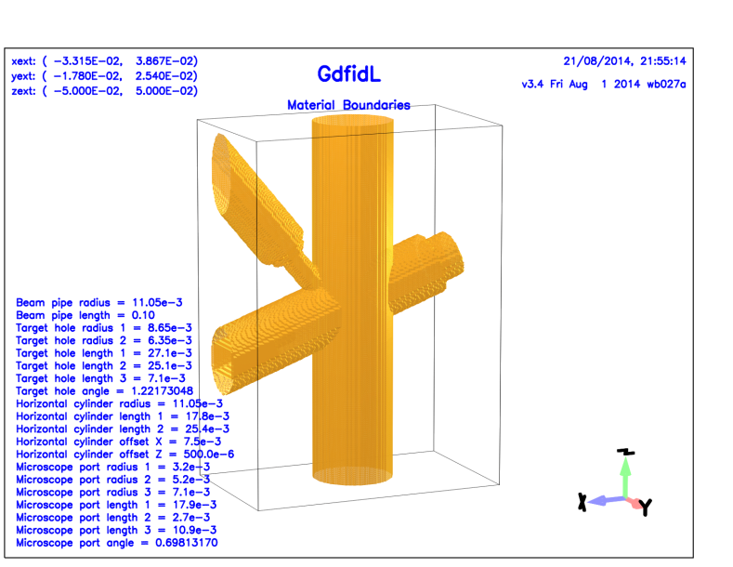
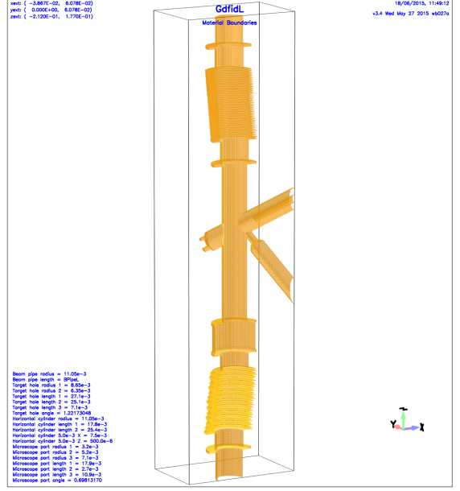
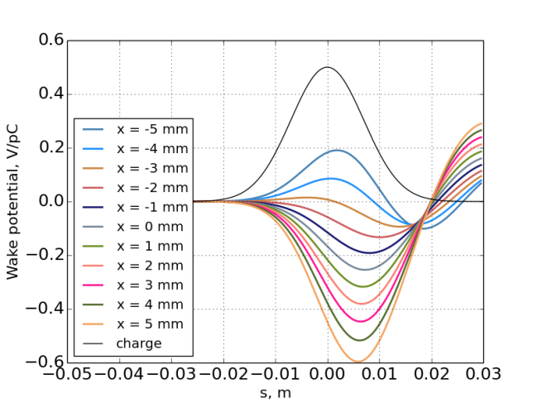
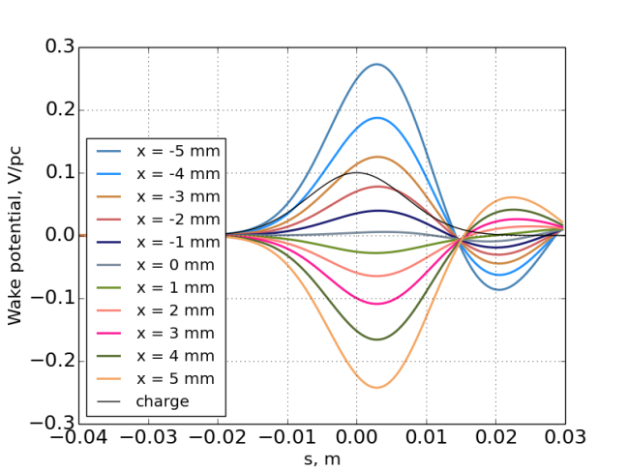
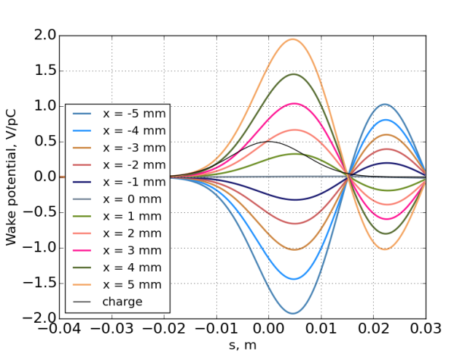
OTR Chamber wake calculation (by Alexey Lyapin)
New calc. consistent with experiments.
Old Chamber only
New (shielded) Chamber only
Include all moving components
~0.08 V/PC/mm
~0.05 V/PC/mm
~0.4 V/PC/mm

Slide 14
Orbit change and Beam size vs. OTR chamber position
Orbit change vs. OTR chamber position change experiment
About 0.3 V/pC/mm wake
IP beam size intensity dependence vs. OTR chamber position change experiment
0.3 ~ 0.5 V/pC/mm wake
Wake of chamber only is not so strong but including other moving components (bellows etc.), 0.3 V/pC/mm is approximately consistent with calculations.

Slide 15
Experiments compared with calculations summary (static misalignment)
  Position of Wake sources on movers (IP beam size and Orbit)
Reference cavity on mover
  Larger by factor ~1.4
OTR chamber wake
  Consistent (Bellows are significant wakefield sources)
Strong intensity dependence after optimizing cavity and chamber positions
Not understood yet.

Slide 16
Dynamic effect (wake + orbit jitter)
We observed orbit jitter in EXT-FF line about 0.3σ of nominal beam size.
Orbit jitter at wakefield sources in high-beta region can increase beam size at IP.
0.3σ jitter at IP will increase measured beam size only 4%
  This is from orbit jitter of “position at IP” phase
But, with wakefield, effect may be significant.
  Orbit jitter of “angle at IP” phase is important
    Can be measured by BPMs in FF
    No conclusion from recent experiments (need more data)
  Excite “position at IP” phase orbit
    It is hard to detect by BPMs. (Except for IPBPM)

Slide 17
(n+1/2) π
Angle-at-IP phase
oscillation
IP
Wakefield induce
position-at –IP phase deviation

Slide 18
Dynamic effect summary
Large orbit jitter and strong wakefield can explain observed intensity dependence.
Wakefield sources at high beta regions are important.
Data selection for in IPBSM analysis, using BPM position, was tried but clear improvement could not be seen.
  For confirmation, we need data of fringe scans with large number of pulses (many scans and/or many pulses/scan) at high intensity
See reports in Proj. meeting tomorrow.

Slide 19
Wakefield Free Steering (WFS) experiments
Demonstrated the method with intentionally increased wakefeild (increased offset of wakefeild source)
Difficulties (compared with linacs)
  Complicated beam line (no periodicity)
  Many different types of wakefield sources
See presentation of A. Latina & N. Fuster

Slide 20
Wakefield in ILC FF compared with ATF2
Effects of transverse wakefield will be much smaller than in ATF2
  High energy, short bunch length (see next slide)
  Beam pipe aperture will be similar
    Except for collimators (special care will be necessary)
  Careful design of beam pipe and structures in the beam line
But, understanding the intensity dependence and comparison between observations and calculations are important
See http://atf.kek.jp/twiki/pub/ATF/CompareWakeILCAT2/wakecompare-ILCATF-v3.pdf
and next slide

Slide 21
Misalignment
 | ILC | ATF2 | Dependence | Ratio of effect ILC/ATF2
Beam Energy | 250 GeV | 1.3 GeV | 1/E | 0.0052
Bunch length | 0.3 mm | 7.0 mm | Shape pf wake | ~0.5
Emittance | 0.07 pm | 12 pm |  | 13
Sum of Beta-function | 310 km | 58 km |  | 2.3
Total |  |  | 0.078 | 0.078
Orbit jitter
 | ILC | ATF2 | Ratio of effect ILC/ATF2 | Ratio of effect ILC/ATF2
Beam Energy | 250 GeV | 1.3 GeV | 1/E | 0.0052
Bunch Length | 0.3 mm | 7.0 mm | Shape pf wake | ~0.5
Sum of Beta-function | 310 km | 58 km |  | 5.3
Total |  |  | 0.014 | 0.014

Slide 22
Misalignment
 | ILC | ATF2 | Dependence | Ratio of effect ILC/ATF2
Beam Energy | 250 GeV | 1.3 GeV | 1/E | 0.0052
Bunch length | 0.3 mm | 7.0 mm | Shape pf wake | ~0.5
Emittance | 0.07 pm | 12 pm |  | 13
Sum of Beta-function | 310 km | 58 km |  | 2.3
Total |  |  | 0.078 | 0.078
Effect of misalignment at ILC with bunch population 2E10 will be similar to that at ATF with bunch population 1.6E9.
Effect of betatron oscillation at ILC with bunch population 2E10 will be similar to that at ATF with bunch population 0.3E9.
Orbit jitter
 | ILC | ATF2 | Ratio of effect ILC/ATF2 | Ratio of effect ILC/ATF2
Beam Energy | 250 GeV | 1.3 GeV | 1/E | 0.0052
Bunch Length | 0.3 mm | 7.0 mm | Shape pf wake | ~0.5
Sum of Beta-function | 310 km | 58 km |  | 5.3
Total |  |  | 0.014 | 0.014

Slide 23
SUMMARY
Orbit change and beam size vs. Position of Wakefield sources
  Experiments and calculations are (almost) consistent
Beam size intensity dependence with optimized wake source (on movers) positions
  Still not understood
  It seems mostly from dynamic effect: orbit jitter + wakefield
  Experimental data analysis so far can not show clear results.
    Need more data?
    IPBSM with 2-bunch feedback data should give more information.

