Slide 1
IPBPM resolution test at Dec 2015
Siwon Jang
Korea University

Slide 2
Contents
IQ rotation angle variation due to different attenuation.
Calibration factor due to different attenuation.
Resolution calculation under 0dB with high beam intensity
Resolution calculation due to different beam intensity

Slide 3
IQ rotation angle variation due to different attenuation
The purpose of this study
  Can we estimated the absolute variation of IQ rotation angle due to different attenuation? Then we don’t need to take calibration for each attenuation conditions.
This study was performed under 0dB to 40dB attenuation cases.
The used optics was high beta optics with 100 x 1000 and sample number #53 to #63.
The c-band BPF was used for the rejection of static signals.

Slide 4
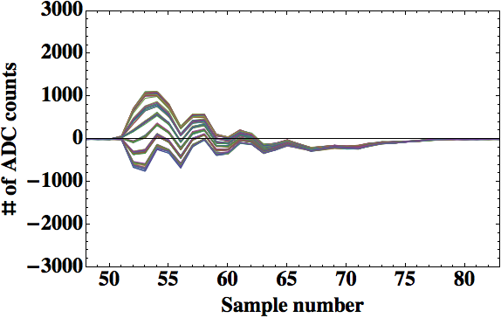
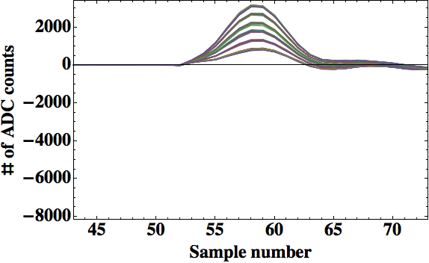
IQ rotation angle calculation
To calculate right IQ rotation angle under 0dB, we added C-band BPF to reject static signals.
  YI port static signal elimination by using c-band BPF
Without C-band BPF
With C-band BPF

Slide 5
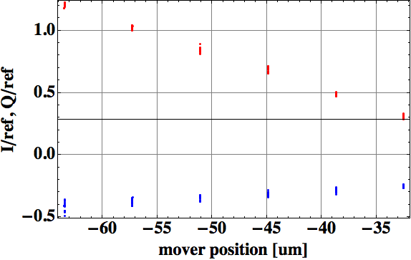
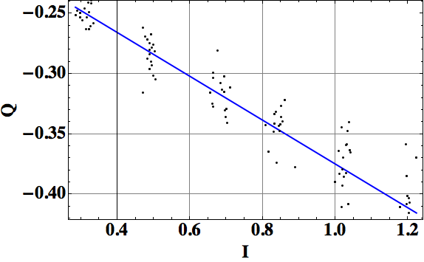
IQ rotation angle calculation
Integrate I/ref and Q/ref signal data from #53 to #63 samples
Fit the integrated I vs Q values
Calculate Arctangent value then we get the IQ rotation angle value in [rad]
Fit value= -0.181787
Fit value= -0.181787
ArcTan[-0.181787]=-0.179823 [rad] or -10.3031 [deg]

Slide 6
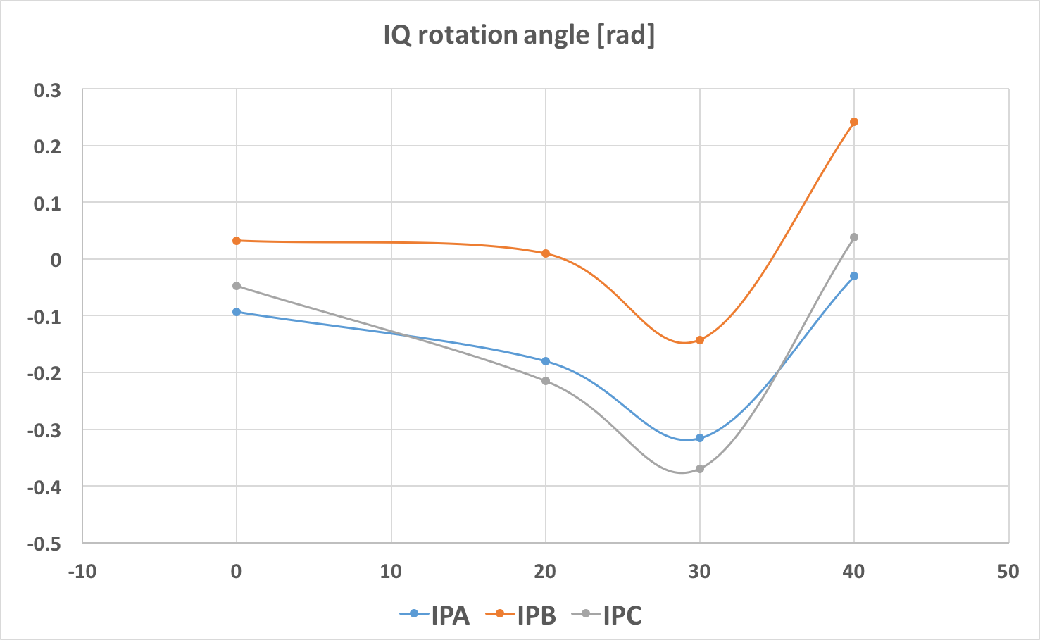
IQ rotation angle variation due to different attenuation
IQ rotation angle [rad]
The changed absolute variation of
IQ rotation angle shows similar for each BPM case.
However, there is no correlations between different attenuation cases.
Attenuation [dB]

Slide 7
Calibration run of IPBPM
We performed calibration run under the 0dB.
  The used optics was 100 x 1000 beta optics, which optics has 1um level jitter.
  The QDOFF was set to IP waist.
  The data was taken at 151218 day shift.
  The used method was integration method from #53 to #63 sample numbers.
  Also I’ and Q’ does normalized by Ref_Y signal with same sample points region.
The Calibration factor was calculated by (All the signal was integrated),
I’ = ( I*CosX + Q*SinX ) [counts], Q’ = ( Q*CosX - I*SinX ) [counts]
Calibration factor = ( Δ I’ [coounts] )/( Δ Mover position [um])
All the I and Q signal was not performed a mean subtract calculation.
Because we installed C-band region band pass filters.
IPC added 9dB(14-5dB) gain to matched calibration factor with IPA and IPB

Slide 8
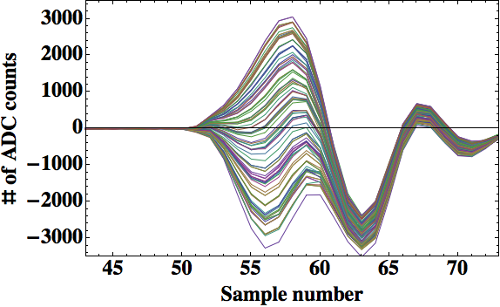
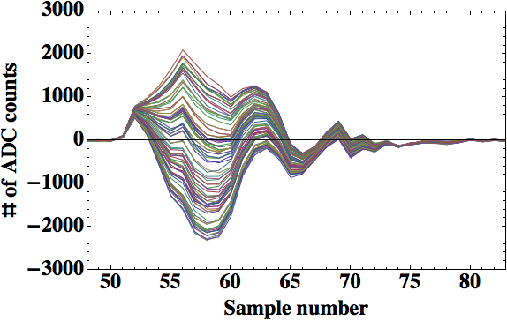
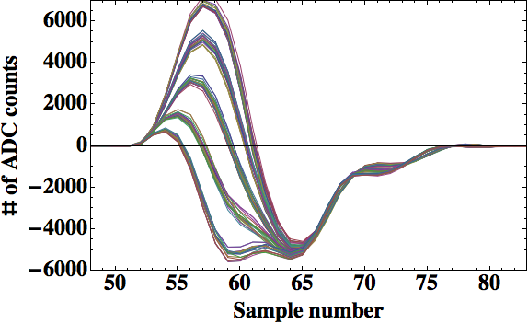
IPBPM raw signal of YI channel
IPAYI
IPBYI
IPCYI

Slide 9
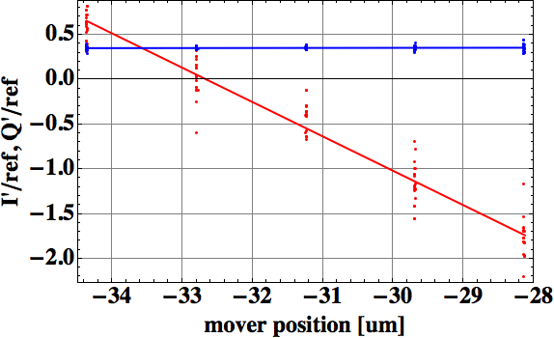
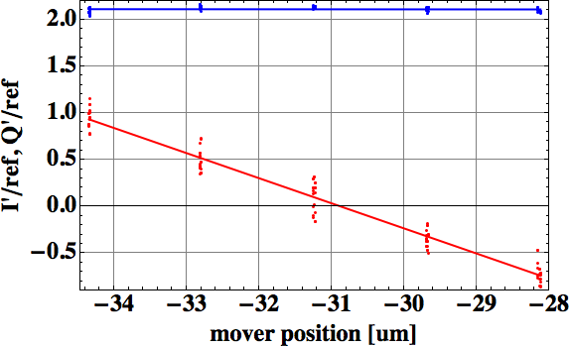
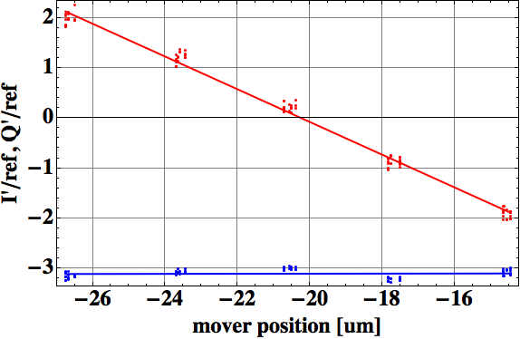
IPBPM calibration for Y-port
IPB
Ref. Y [ADC counts]
=15914.1counts
IPA
Channel of BPM | Calibration factor [ADC counts/um] | Norm. Calibration factor [/um]
IPA-YIQ | 6101.47 | 0.3834
IPB-YIQ | 4274.54 | 0.2686
IPC-YIQ | 5208.69 | 0.3273
IPC

Slide 10
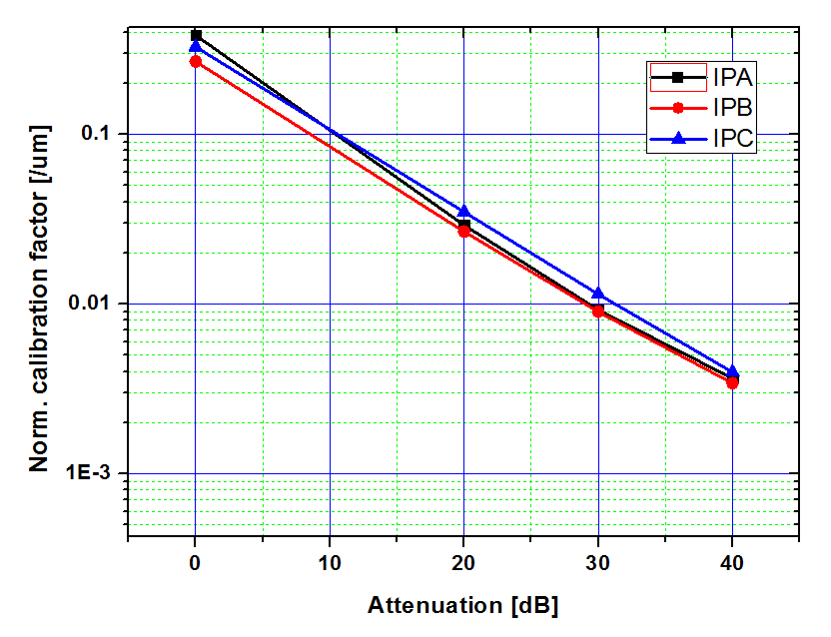
IPBPM calibration for Y-port due to different attenuation

Slide 11
Resolution calculation: 0dB
We performed resolution run under the 0dB
  The used optics was 100 x 1000 beta optics, which optics has 1um level.
  The QDOFF was set to IP waist.
  The data was taken at 151218 day shift.
  The used method was integration method from #53 to #63 sample numbers.
  Also I’ and Q’ does normalized by Ref_Y signal with same sample points region.
  The beam was set to few um offset position.
The Calibration factor was calculated by (All the signal was integrated),
I’ = ( I*CosX + Q*SinX ) [counts], Q’ = ( Q*CosX - I*SinX ) [counts]
Calibration factor = ( Δ I’ [counts] )/( Δ Mover position [um])
All the I and Q signal was not performed a mean subtract calculation.
Predicted position(ADC counts) for IPA was calculated as follow equation,
  Predicted position of IPA-YI’ = a1*IPB-YI’+ a2*IPB-YQ’+a3*IPC-YI’+ a4*IPC-YQ’+ a5*Ref-Y
  +a6*IPA-XI’+ a7*IPA-XQ’ +a8*IPB-XI’+ a9*IPB-XQ’+a10*IPC-XI’+ a11*IPC-XQ’+ a12*Ref-X+a13
  Residual of IPC-YI’ = Measured IPC-YI’ – Predicted IPC-YI’

Slide 12
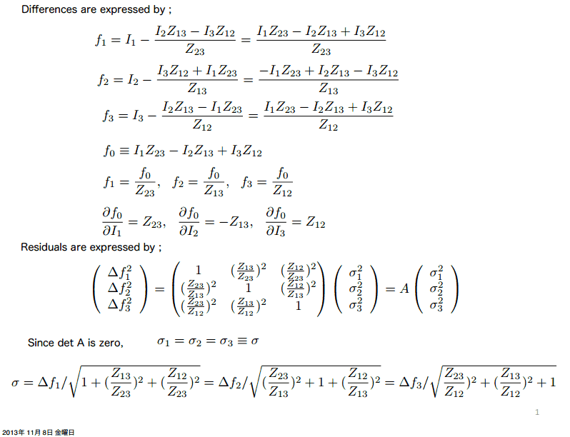
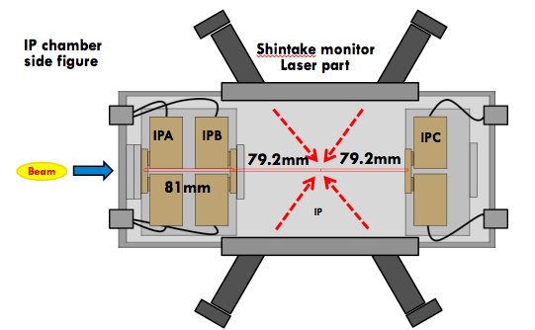
The method to calculate the residual of IP-BPMs
We take an extrapolating method by using geometrical relation between three IP-BPMs.
X
X
X
Beam position measurement and prediction
 | IPBPM-A | IPBPM-B | IPBPM-C
Geometrical factor | 0.545711 | 0.79883 | 0.25312

Slide 13
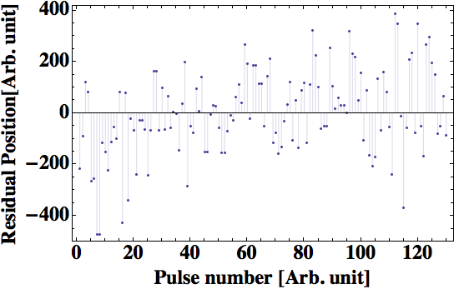
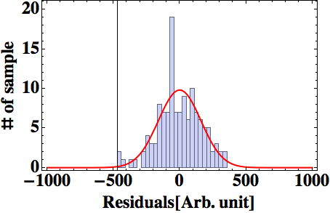
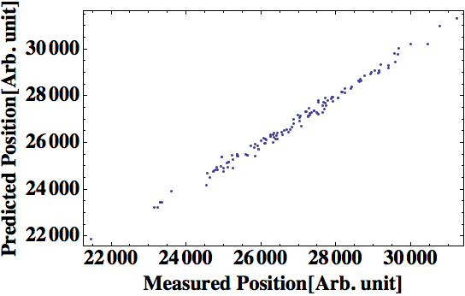
The results of IPBPM resolution test
at Dec 2015 in ATF2
X
X
X
Beam position prediction
Convert to
residual
Residual value
= measured position – predicted position
X
X
X
Measured resolution
= 15.0193nm
Measured beam charge
= 0.5423x1.6nC
~54% beam charge
Beam position measurement
Norm. Resolution = Geo. factor x
RMS of residual
x
Measured charge
= 8.1nm
Calibration factor
Nominal charge

Slide 14
IPBPM-A resolution
RMS of residual for IPA resolution calculation:
RMS(include Calibration factor)= 160.439 [Arb. Unit]
Geometrical factor x RMS/cal = 15.0193nm
Measured chage/norm charge x Geo X RMS/cal = 8.1nm
The average beam charge was 0.5423 x 10^10 particles.
Preliminary
Preliminary
14

Slide 15
Resolution calculation due to different beam intensity
For the last beam operation period of June in 2015, we achieved 27nm measured resolution and 8nm norm. resolution with 30% of beam charge conditions. So, we want a check the beam intensity dependency of IPBPM resolution.
From 15% beam intensity to 55% beam intensity cases are studied with 0dB attenuation cases.
We performed resolution run under the 0dB
  The used optics was 100 x 1000 beta optics, which optics has 1um level.
  The QDOFF was set to IP waist.
  The data was taken at 151218 day shift.
  The used method was integration method from #53 to #63 sample numbers.
  Also I’ and Q’ does normalized by Ref_Y signal with same sample points region.
  The beam was set to few um offset position.

Slide 16
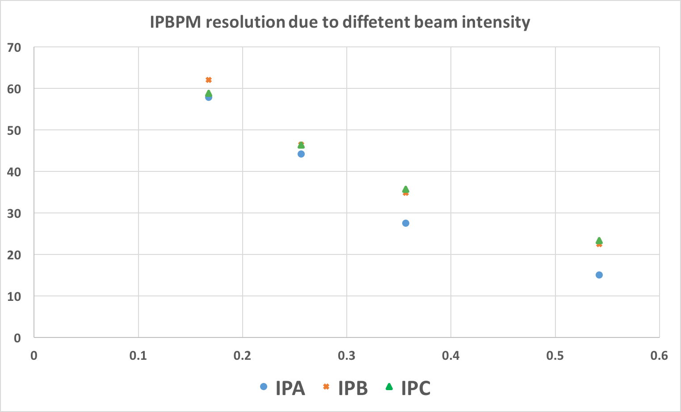
Resolution calculation due to different beam intensity
IPBPM measured resolution [nm]
Intensity (x 1.6nC) | 0.1674 | 0.2561 | 0.3565 | 0.5422
IPA [nm] | 57.86 | 44.16 | 27.47 | 15.01
IPB [nm] | 61.99 | 46.41 | 34.85 | 22.41
IPC [nm] | 58.75 | 46.28 | 35.70 | 23.27
Beam intensity [x 1.6 nC]

Slide 17
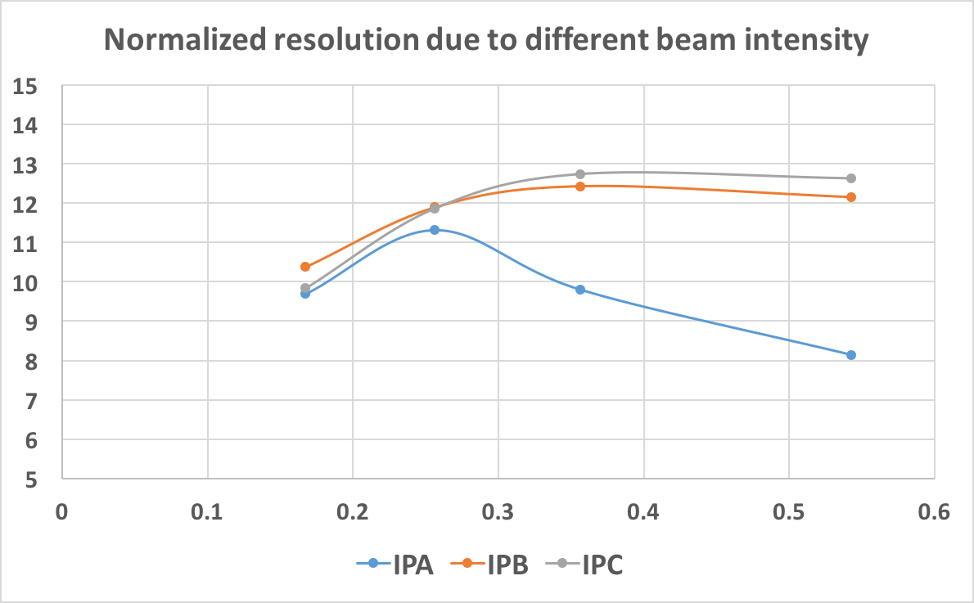
Resolution calculation due to different beam intensity
IPBPM normalized resolution [nm]
Beam intensity [x 1.6 nC]

Slide 18
Conclusion
The IQ rotation variation could not be estimated due to different attenuation cases.
The position resolution of IPA was measured 15nm with higher beam of 55% nominal beam current, which 15nm corresponds to 8.1 normalized resolution. However still we need analysis for these data to confirm correctly.
The position resolution due to different beam charge conditions was studied and the measured resolution was decreased due due to increased beam intensity.

