Slide 1
Review of Wakefield studies
+ questions
ATF2 Proj. Mtg. 201601
K.Kubo

Slide 2
Outline
Intensity dependence of IP beam size
Studies using on-mover structures
  Beam size at IP
  Orbit change
Studies of orbit jitter and beam size
Wake-free steering experiment
Comparison of wakefield effects at ILC and ATF2

Slide 3
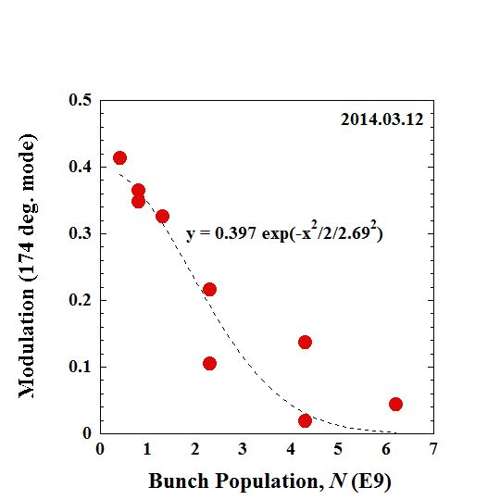
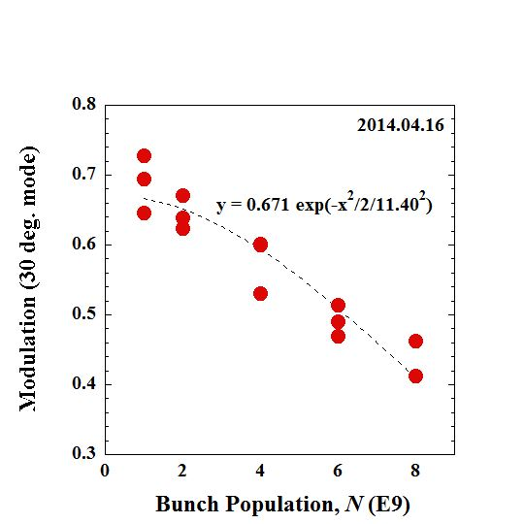
Presented in IPAC14
Beam Size Depends on Bunch Intensity
IPBSM modulation as function of bunch population. Measured with crossing angle 174 degrees (left) and 30 degrees (right).
with modified OTR chamber, position adjusted, reduced to ~60nm/nC

Slide 4
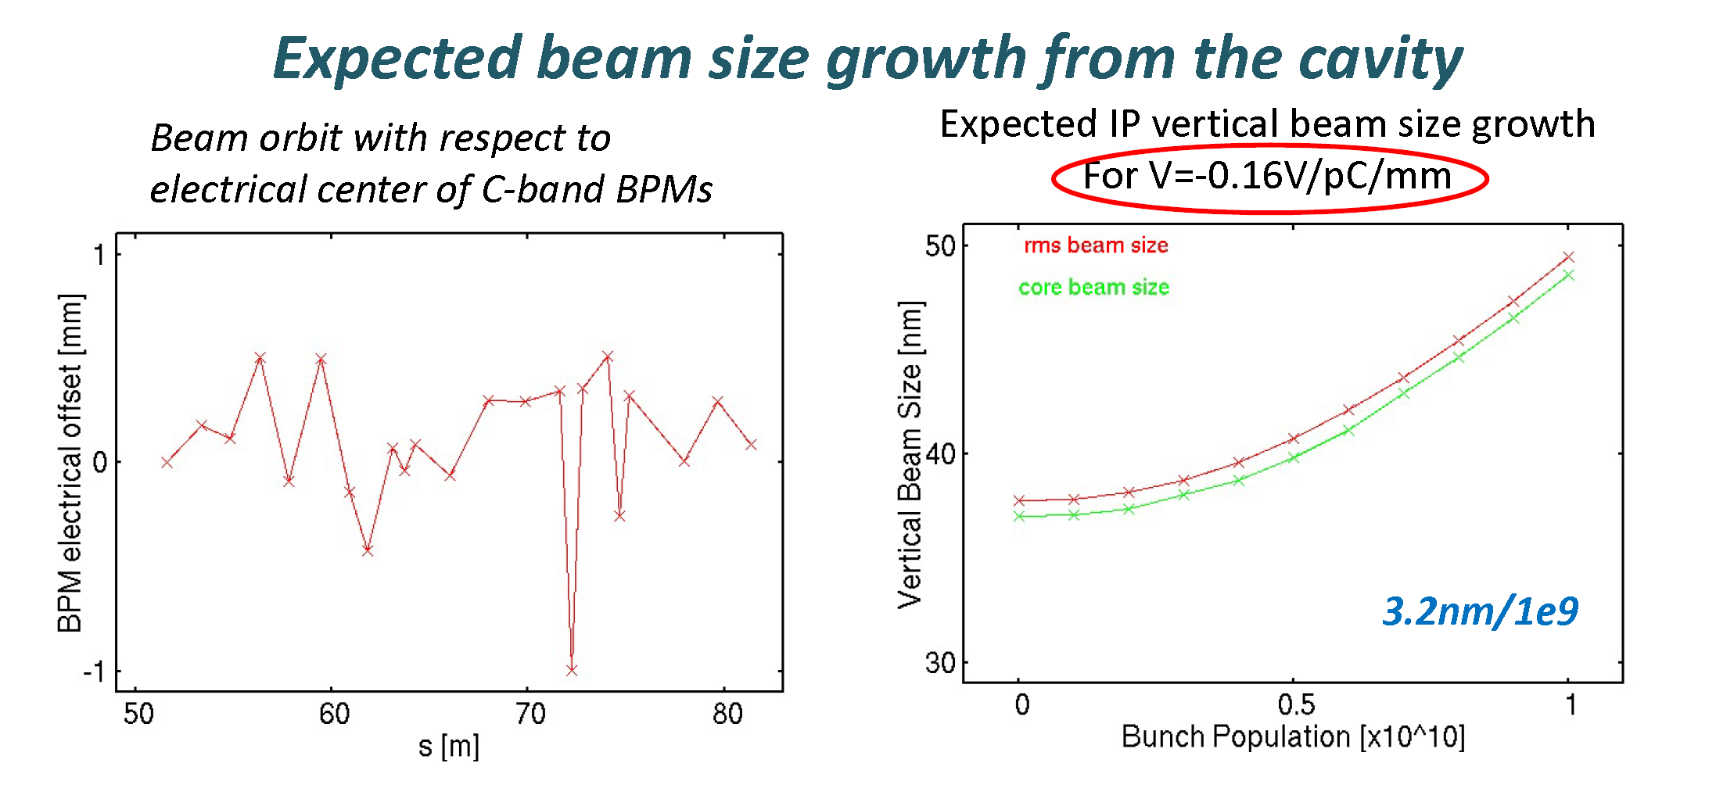
Okugi’s slide in proj. mtg. Feb. 2014
(19 nm/nC)
About factor 3 difference between this calculation and experiments.
This calc. Included cavity BPMs only.
Underestimating wakefield of all components.
But factor 3 seems too large (?)

Slide 5
Examples of wake calculations
Calc. by A. Lyapin
More calculations

Slide 6
Wkaefield source on mover experiments and calculations
C-band BPM Reference Cavity
OTR chamber

Slide 7
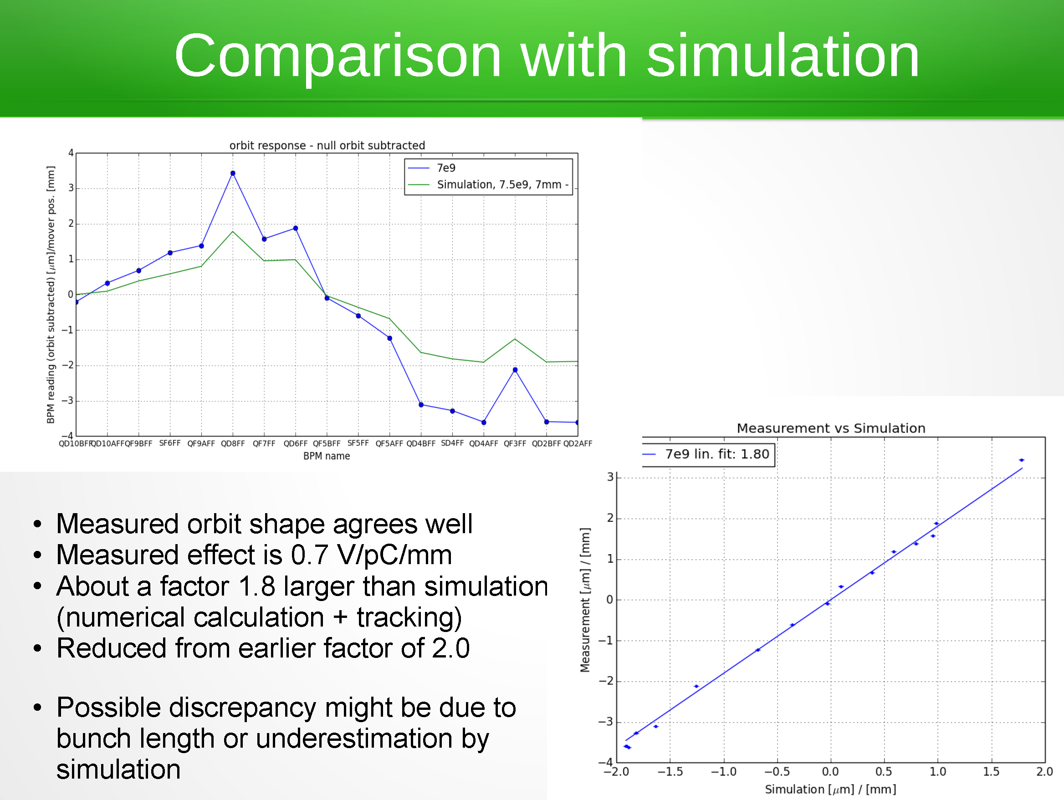
Reference Cav. Position → orbit change
J.Snuverink, et.al., LCWS2014
Wake source on mover experiment
-- orbit change

Slide 8
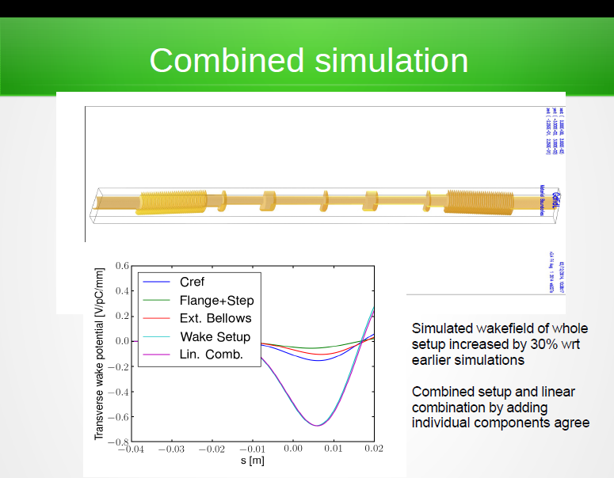
Reference Cav. On mover
Now, discrepancy is factor ~1.4

Slide 9
ATF2 weekly meeting 20130708 K.Kubo
IP beam size vs. mover position experiment
Effect of offset 1 mm, bunch charge 1 nC. IP beam size increase (nm/nC/mm)
Experimental data analyzed by Okugi
2 C-band ref. +2 no mask deforming bellows | 1 C-band ref. +2 no mask deforming bellows | No mask Bellows +2 masked deforming bellows | Masked Bellows +2 masked deforming bellows
157 | 102 | 57 | 14.5
1 ref.cav. : 157-102=55
2 no mask def bellows: 102-55= 47
Assume 2 masked deforming bellows
= 1 masked bellows
1 masked bellows: 14.5/2=7
1 no mask def bellows: 57-7=50
2 no mask deforming bellows
~ 1 no mask bellows

Slide 10
IP beam size vs mover position
experiment and calc.
ATF2 weekly meeting 20130708 K.Kubo
Effect of wake source at the mover, offset 1 mm, bunch charge 1 nC.
IP beam size increase (nm/mm/nC)
 | C-band ref. | No mask Bellows | Masked Bellows
Experiment | 55 | 47~50 | 7
Calc | 32.2 | 22.6 | ?
Factor 1.7 – 2.2 larger than calculation
consistent with orbit change measurement
Now, not really consistent compared with factor 1.4 from orbit experiment

Slide 11
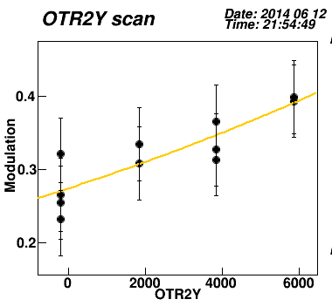
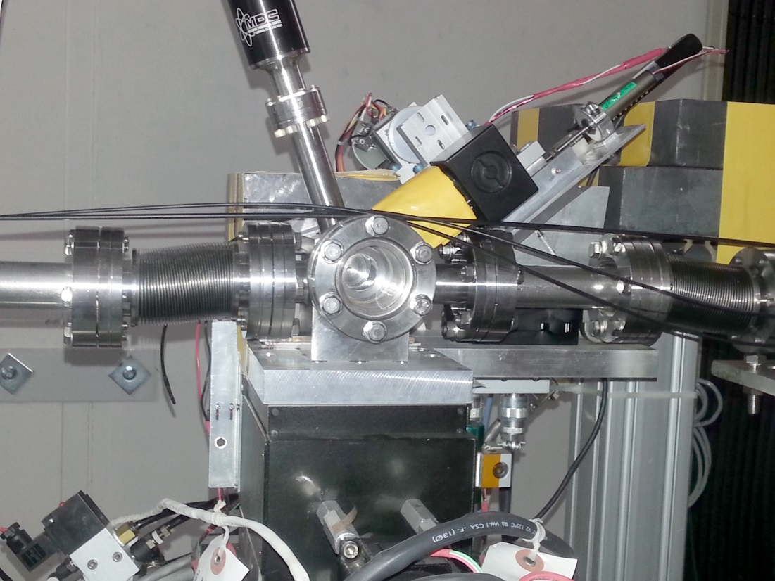
Effect of OTR monitor chamber (beam size monitor in EXT line) to IP vertical beam size was found (June 2014)
IPBSM 174 degrees
N~0.3E10

Slide 12
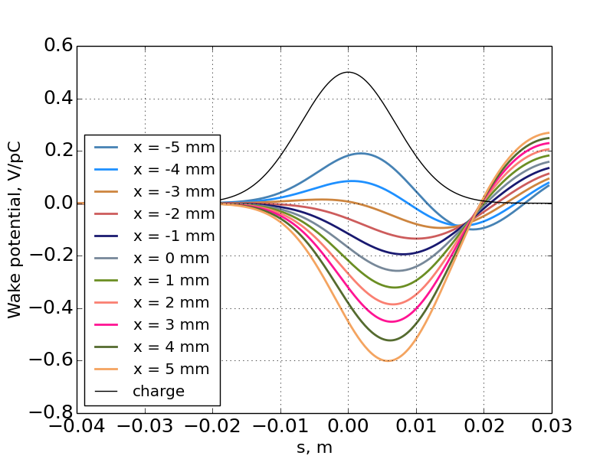
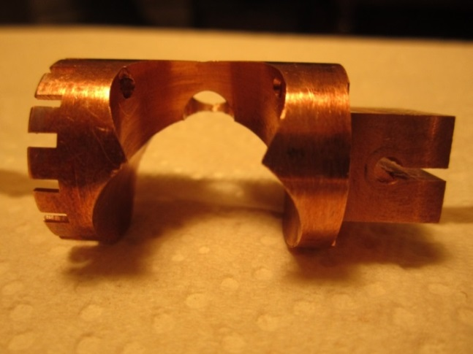
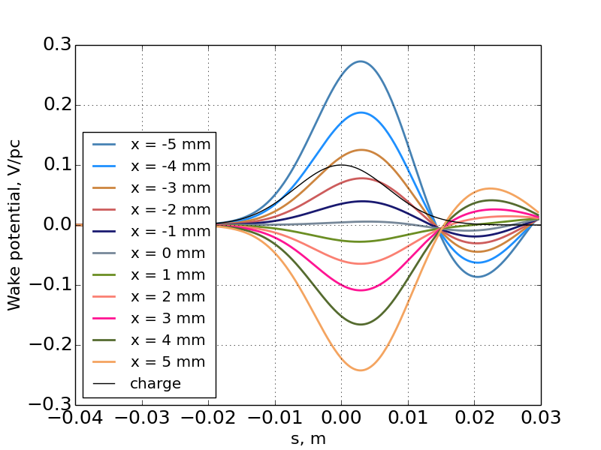
OTR monitor View Port Shield
No shield
by A. Lyapin
Photo by D. McCormick
Remove vertical asymmetry
Reduce position dependent wake
(factor 0.6)
0.08 V/pC/mm → 0.05 V/pC/mm
With shield
by A. Lyapin

Slide 13
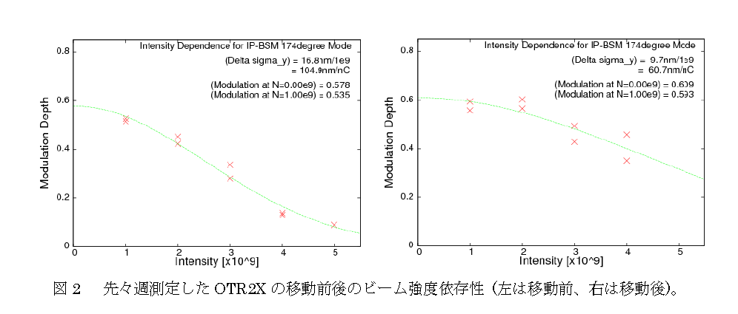
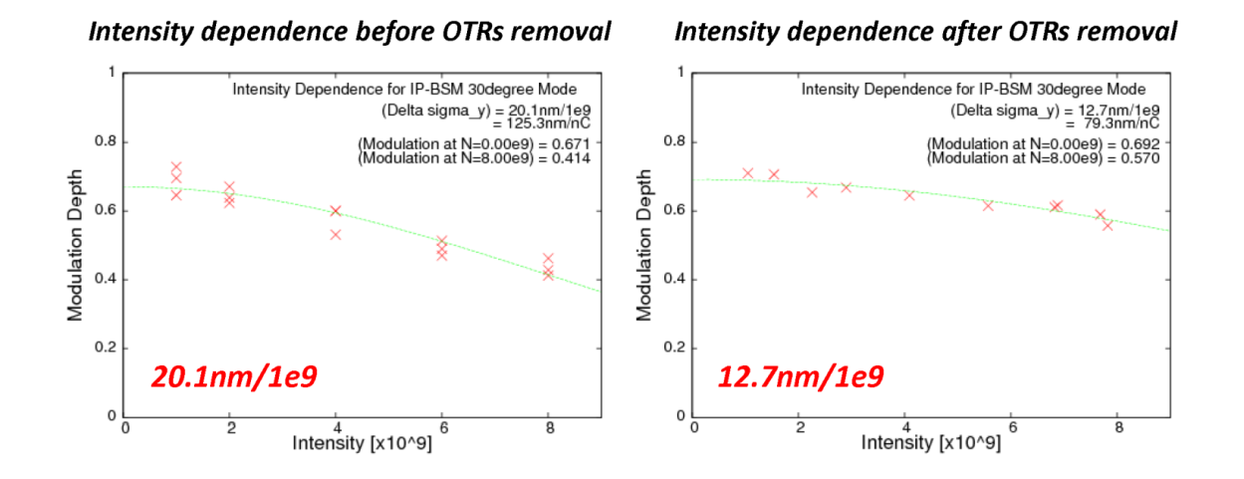
Before OTR2X position optimization After optimization (174 deg mode)
By Okugi, 2014.6.23
100 nm/nC → 58 nm/nC
Removal of all OTRs
(30 deg mode)
Okugi, 2014.6.26 ATF Op. meeting
121 nm/nC → 76 nm/nC
Dependence reduced by optimizing position or removing chamber. (similar effect)
(30 deg mode tend to give stronger dependence than 174 deg mode.)
Slide by K.Kubo in ATF operation meeting Nov 7, 2014

Slide 14
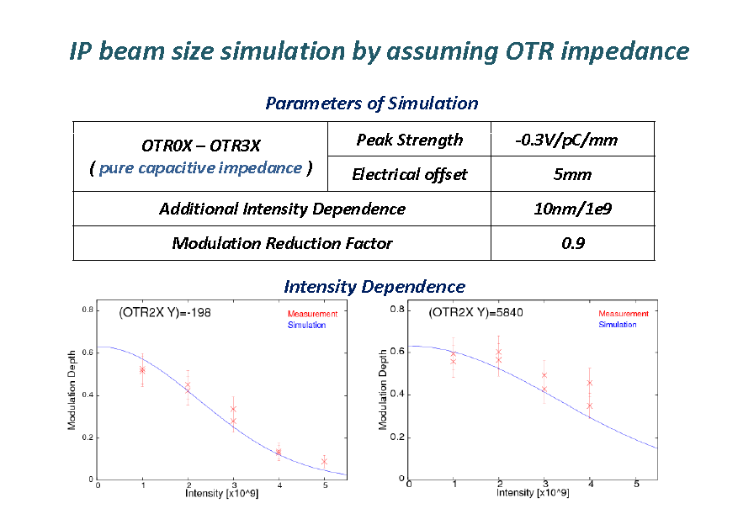
Beam size vs. OTR chamber position
Okugi, 2014. June 6, ATF Operation meeting
Wakefield 0.3V/pC/mm and 5 mm offset explains the strong beam size dependence on intensity + OTR chamber position.
(about factor 6 larger than old calculation)

Slide 15
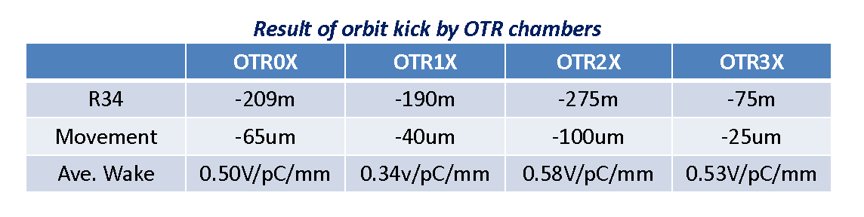
Orbit Change vs. OTR chamber position
(Oct. 28, 2014, one BPM)
(Okugi, 2014.10.31 ATF Op. meeting)
(Nov. 11, 2014, many downstream BPMs )
 | Kick angle/offset (urad/mm) | Wake (average in a bunch) (V/pC/mm)
OTR0 | 0.374 | 0.47
OTR1 | 0.317 | 0.40
OTR2 | 0.233 | 0.30
OTR3 | 0.240 | 0.30
(Kubo, 2014.11.11 owl shift log)
Wakefield ~0.5V/pC/mm can explain orbit dependence on OTR chamber position
(about factor 6-10 larger than old calculation)

Slide 16
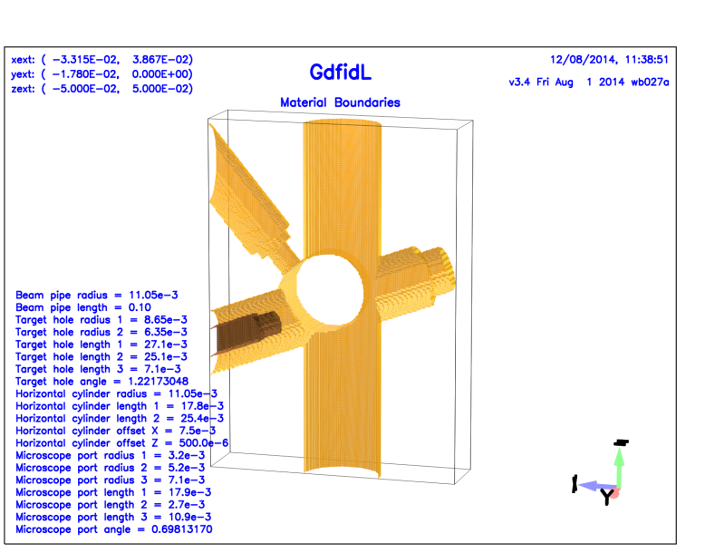
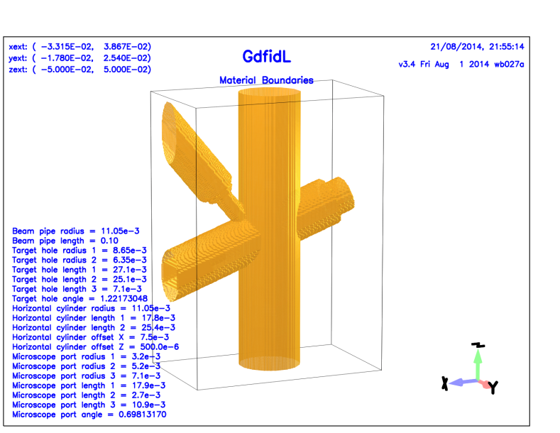
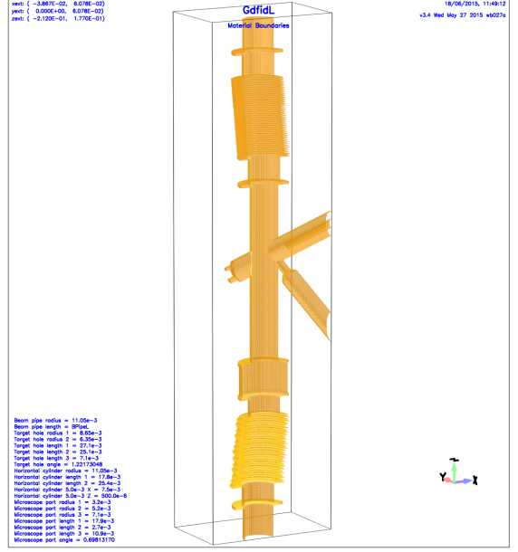
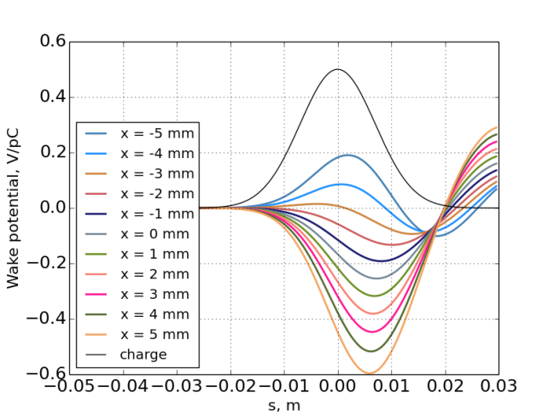
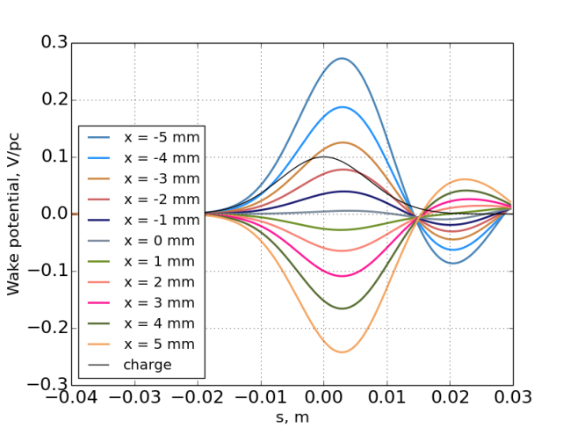
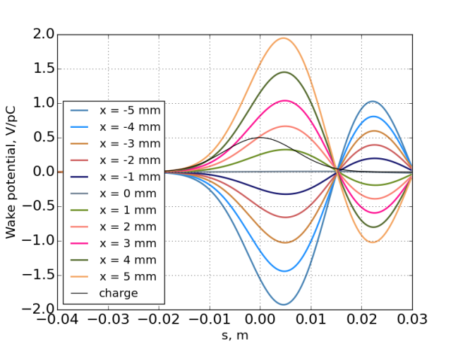
OTR Chamber wake calculation (by Alexey Lyapin)
New calc. consistent experiments.
Old Chamber only
New (shielded) Chamber only
Include all moving components
~0.08 V/PC/mm
~0.05 V/PC/mm
~0.4 V/PC/mm

Slide 17
Experiments compare with calculations
  Position of Wake sources on movers (IP beam size and Orbit)
Reference cavity on mover
  Larger by factor ~1.4
OTR chamber wake
  Consistent (Bellows are significant wakefield sources)
Strong intensity dependence after optimizing cavity and chamber positions
Not understood yet.

Slide 18
Dynamic effect (wake + orbit jitter)
We observed orbit jitter in EXT-FF line about 0.3σ of nominal beam size.
Orbit jitter at wakefield sources in high-beta region can increase beam size at IP.
0.3σ jitter at IP will increase measured beam size only 4%
  This is from orbit jitter of “position at IP” phase
But, with wakefield, effect may be significant.
  Orbit jitter of “angle at IP” phase is important
    It is hard to detect by BPMs. (Except for IPBPM)

Slide 19
(n+1/2) π
Angle-at-IP phase
oscillation
Wakefield induce
position-at –IP phase deviation

Slide 20
Simulation - projected beam size at IP vs.
Wakefield strength
Projection of
100 bunches
60 nm/nC
= 10 nm/1e9
38 nm/nC
= 6 nm/1e9
(Presented in Proj. meeting Feb. 2015)

Slide 21
Data selection by BPM data - simulation
Simulate data selection by MQD10AFF, compared
all data used and
use data of position within +- 1 RMS of position jitter
Better way is use many BPMs for fitting y’ at IP
(Presented in Proj. meeting Feb. 2015)

Slide 22
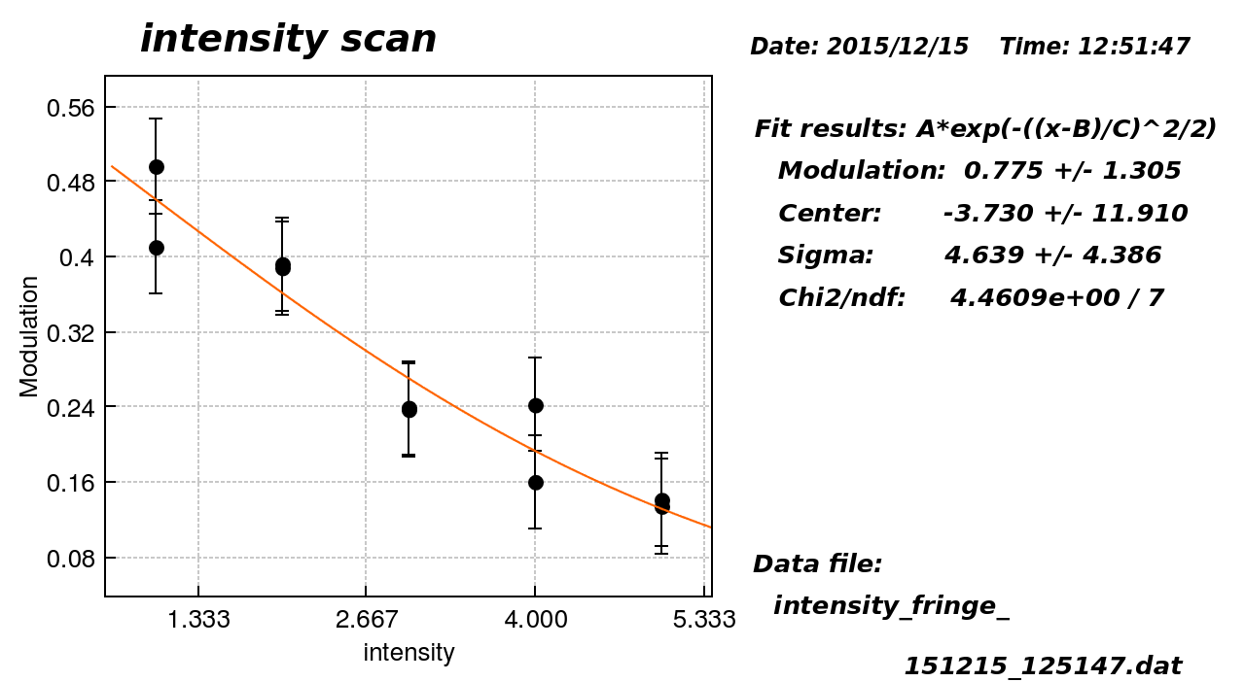
Recent experimental data
Intensity dependence measurement
These two fringe scans were analyzed

Slide 23
Fitted y’ at IP
Use all BPMs and fit y’ at IP
2 fringe scans, 21 set phases/scan, 10 pulses/set phase ~ 420 pulses
Distribution of vertical angle at IP
RMS ~ 60 urad
Nominal beam angle divergence ~ 350 urad

Slide 24
Data selection by y’ at IP
No clear effect??
May be
May not be

Slide 25
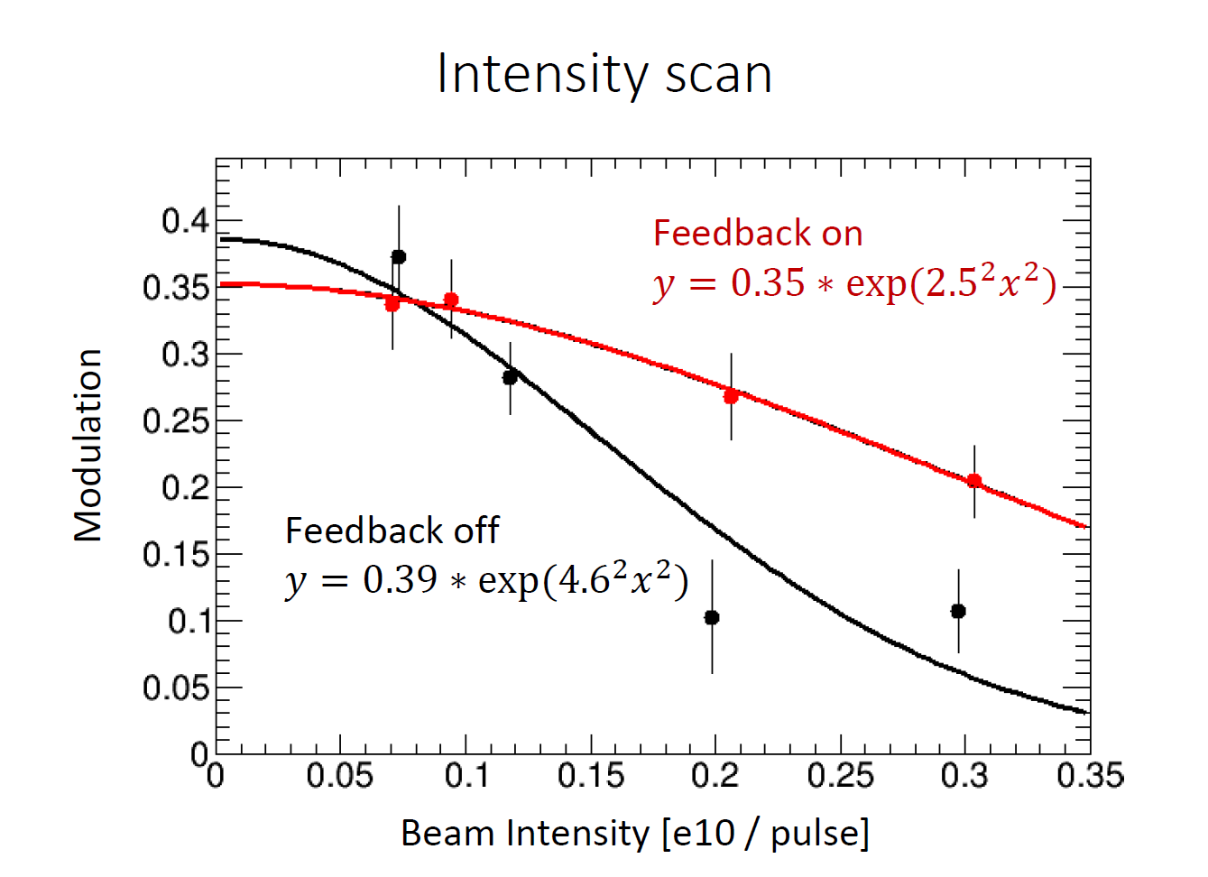
2-bunch IPBSM with upstream FONT feedback,
From Y. Kano ATF Meeting Dec. 18 2015
Beam size of 2nd bunch
with and without feedback

Slide 26
2-bunch IPBSM with upstream FONT feedback,
From Y. Kano ATF Meeting Dec. 18 2015
Data selection using FONT BPMs should increase Modulation

Slide 27
Dynamic effect Summary
Large orbit jitter and strong wakefield can explain observed intensity dependence.
0.3σ orbit jitter and 1.7~2.1 times stronger wake than CavBPM
explain intensity dependence of 60~75 nm/nC (previous meeting)
Wakefield sources at high beta region are important.
Data selection for in IPBSM analysis, using BPM position, was tried but clear improvement could not be seen.
  For confirmation, we need data of fringe scans with large number of pulses (many scans and/or many pulses/scan) at high intensity (?)
See also Kano’s presentation (IPBSM with upstream FONT feedback)
  Can we use FONT BPMs for data selection?

Slide 28
Wakefield Free Steering experiments
Demonstrated the method with intentionally increased wakefeild (increased offset of wakefeild source)
Difficulties (compared with linacs)
  Complicated beam line (no periodicity)
  Many different types of wakefield sources
See presentation of A. Latina & N. Fuster

Slide 29
Wakefield in ILC FF compared with ATF2
Effects of transverse wakefield will be much smaller than in ATF2
  High energy, short bunch length (see next slide)
  Beam pipe aperture will be similar
    Except for collimators (special care will be necessary)
  Careful design of beam pipe and structures in the beam line
But, understanding the intensity dependence and comparison between observations and calculations are important
See http://atf.kek.jp/twiki/pub/ATF/CompareWakeILCAT2/wakecompare-ILCATF-v3.pdf
and next slide

Slide 30
Misalignment
 | ILC | ATF2 | Dependence | Ratio of effect ILC/ATF2
Beam Energy | 250 GeV | 1.3 GeV | 1/E | 0.0052
Bunch length | 0.3 mm | 7.0 mm | Shape pf wake | ~0.5
Emittance | 0.07 pm | 12 pm |  | 13
Sum of Beta-function | 310 km | 58 km |  | 2.3
Total |  |  | 0.078 | 0.078
Orbit jitter
 | ILC | ATF2 | Ratio of effect ILC/ATF2 | Ratio of effect ILC/ATF2
Beam Energy | 250 GeV | 1.3 GeV | 1/E | 0.0052
Bunch Length | 0.3 mm | 7.0 mm | Shape pf wake | ~0.5
Sum of Beta-function | 310 km | 58 km |  | 5.3
Total |  |  | 0.014 | 0.014

Slide 31
Misalignment
 | ILC | ATF2 | Dependence | Ratio of effect ILC/ATF2
Beam Energy | 250 GeV | 1.3 GeV | 1/E | 0.0052
Bunch length | 0.3 mm | 7.0 mm | Shape pf wake | ~0.5
Emittance | 0.07 pm | 12 pm |  | 13
Sum of Beta-function | 310 km | 58 km |  | 2.3
Total |  |  | 0.078 | 0.078
Effect of misalignment at ILC with bunch population 2E10 will be similar to that at ATF with bunch population 0.16E10.
Effect of betatron oscillation at ILC with bunch population 2E10 will be similar to that at ATF with bunch population 0.03E10.
Orbit jitter
 | ILC | ATF2 | Ratio of effect ILC/ATF2 | Ratio of effect ILC/ATF2
Beam Energy | 250 GeV | 1.3 GeV | 1/E | 0.0052
Bunch Length | 0.3 mm | 7.0 mm | Shape pf wake | ~0.5
Sum of Beta-function | 310 km | 58 km |  | 5.3
Total |  |  | 0.014 | 0.014

Slide 32
SUMMARY
Orbit change and beam size vs. Position of Wakefield sources
  Experiments and calculations are (almost) consistent
Beam size intensity dependence with optimized wake source positions
  Still not understood
  Theoretically, it seems from orbit jitter + wakefield
  Experimental data analysis so far can not show clear results.
    Need more data?
    IPBSM with 2-bunch feedback data should give more information.

Slide 33
Discussion/Questions
Intensity dependence sources are dominantly in FF line? (After OTRs?)
All important wakefields have similar shape as C-band reference cavity or OTR chamber?
Further reduction of wakefield sources possible?
  Removal or replacement of components?
    (e.g. unshielded bellows)
Analysis using other monitors data?
  FONT upstream BPM?
  IPBPM?
?
?

