Slide 1
Orbit jitter and IPBSM
(IPBSM data selection using EXT/FF BPM)
20160114 K.Kubo

Slide 2
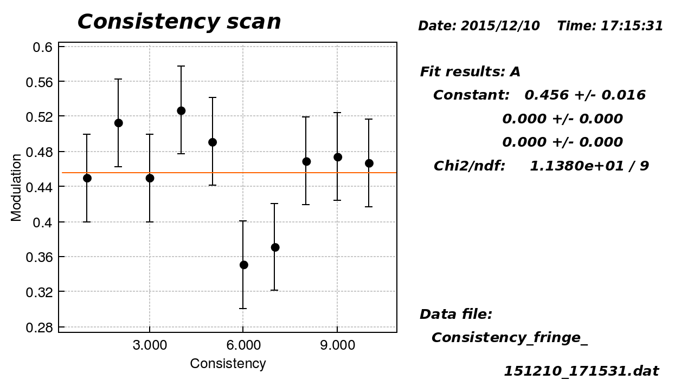
Data of 10 fringe scans are used.
Regarded as one fringe scan.
10pulse/set phase x 21 set phase/scan x 10 scans

Slide 3
SVD of BPM vertical data of all pulses
Largest 4 modes
IP y’ phase?
IP y phase?
?
?dispersion??

Slide 4
Mode 1, mode 2 amplitude, position and angle at IP
Mode1 amplitude (model independent)
vs.
IP angle (model dependent)
Mode2 amplitude (model independent)
vs.
IP position (model dependent)
Mode 2 amplitude 1 ~ 0.7 um at IP
Jitter RMS
Position ~ 14 nm, angle ~ 56 urad

Slide 5
IPBSM data selection by mode 2 amplitude change width
Data select +- width
Mode 2 amplitude 1 ~ 0.7 um at IP
No visible effect
Consistent with small jitter of IP position
(~14 nm)

Slide 6
IPBSM data selection by mode 2 amplitude change center, fixed width
?no explanation?

Slide 7
IPBSM data selection by mode 2 amplitude (y at IP ?), change center, fixed width
(Consistency check: fitted phase and beam position)
(260 nm → 2pi)

Slide 8
data selection by mode 1 amplitude,
change center, fixed width
This mode include
position phase orbiy too?

Slide 9
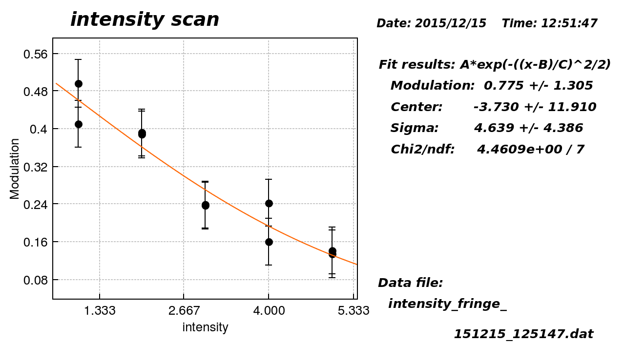
High intensity data from
Intensity dependence measurement
These two fringe scans were analyzed
(Only 2 scans, 10 pulses/phase set)

Slide 10
y’ phase jitter + wake affect beam size
(n+1/2) π
Angle-at-IP phase
oscillation
Wakefield induce
position-at –IP phase deviation

Slide 11
Data selection by y’ at IP
No clear effect??
May be
May not be
Need more data

Slide 12
Summary
From BPM data
  Orbit Jitter was small, 14 nm and 56 urad
  37% of nominal beam size (including effect of BPM resolution?)
  17% of nominal beam angle divergence (Effect of BPM resolution is negligible?)
IPBSM data selection using fitted position at IP
  No visible effects to modulation
  Fitted fringe phase and fitted position seem consistent
Can we use data of FONT upstream BPM?
  Confirm 2-bunch feedback results? (see Kano’s presentation)
Need data of high beam intensity with large number of pulses.

