Slide 1
IP-BSM
2-bunch operation
Yuya Kano
University of Tokyo
19th ATF2 Project Meeting, 14 Jan. 2016

Slide 2
Outline
Introduction
IPBSM measurement with FONT upstream feedback
  Study with jitter generation by steering magnets
  Beam intensity dependence study
Summary

Slide 3
Introduction

Slide 4
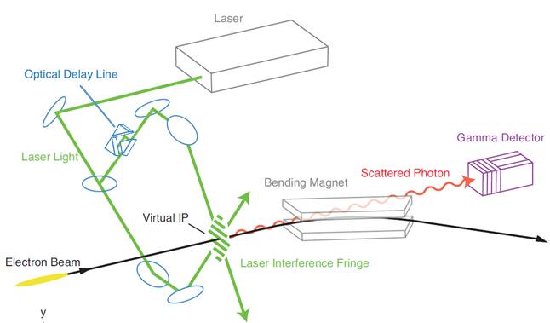
Setup of IPBSM

Slide 5
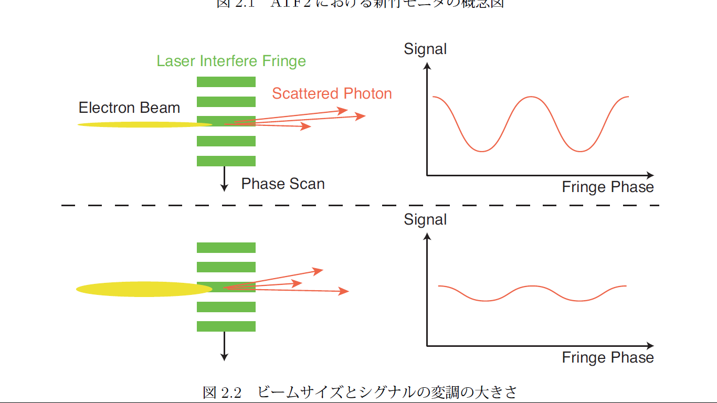
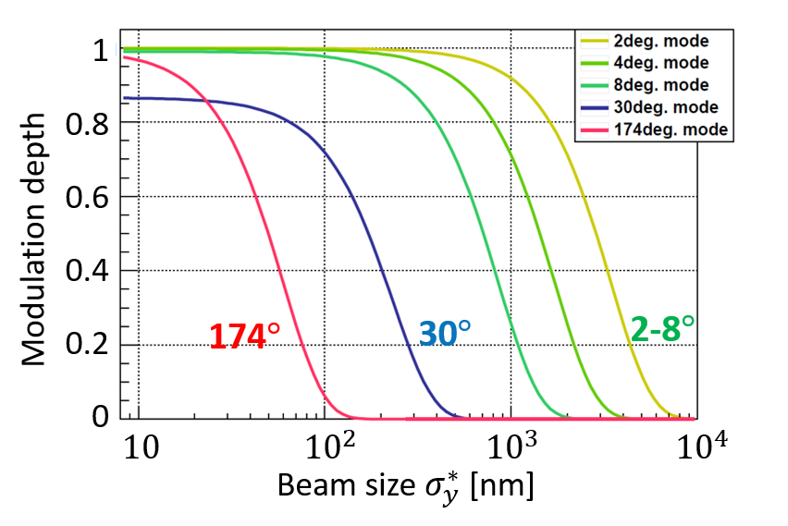





Concept of IPBSM
$$N_{+}$$
Small beam size $⇒$ large $M$
$$N_{−}$$
Large beam size $⇒$ small $M$
Modulation depth$M=\frac{N_{+}−N_{−}}{N_{+}+N_{−}}$

Slide 6


2nd bunch IPBSM measurement
Laser
$$e^{−}$$
$$e^{−}$$
Detector signal
~200 ns
Fringe phase
Timing of the IPBSM laser is matched to 2nd bunch timing
Beam size measurement is done by measuring 100-200 pulses
It is not possible to measure the beam size of 1st&2nd bunch at the same time

Slide 7
IPBSM measurement with
FONT upstream feedback

Slide 8
Aim
Aim:
  To observe the IP vertical beam orbit stabilization by FONT upstream feedback, using IPBSM
At 2-bunch beam operation, using FONT upstream feedback, beam orbit jitter of 2nd bunch at the IP should decrease
This effect should be observed using IPBSM as a decrease in observed beam size

Slide 9
Measurements
Study of IP beam orbit stabilization using FONT upstream feedback, with jitter generation by steering magnets
Study of beam intensity dependence of IPBSM Modulation, with FONT upstream feedback

Slide 10
1. Study with jitter generation by steering magnets

Slide 11
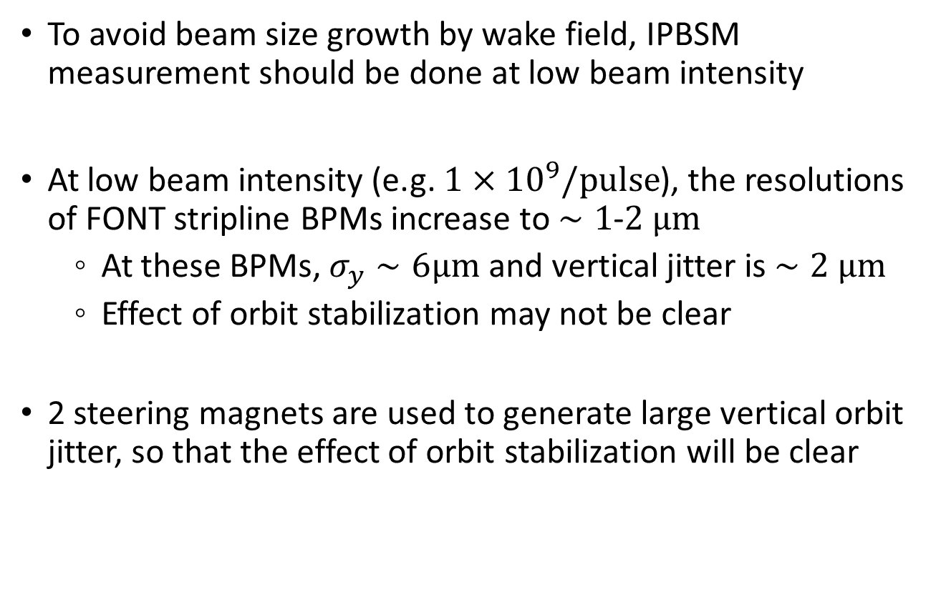
Jitter generation using steering magnets
To avoid beam size growth by wake field, IPBSM measurement should be done at low beam intensity
At low beam intensity (e.g. $1×{10}^{9}/pulse$), the resolutions of FONT stripline BPMs increase to $∼1$-$2 μm$
  At these BPMs, $σ_{y}∼6μm$ and vertical jitter is $∼2 μm$
  Effect of orbit stabilization may not be clear
2 steering magnets are used to generate large vertical orbit jitter, so that the effect of orbit stabilization will be clear

Slide 12
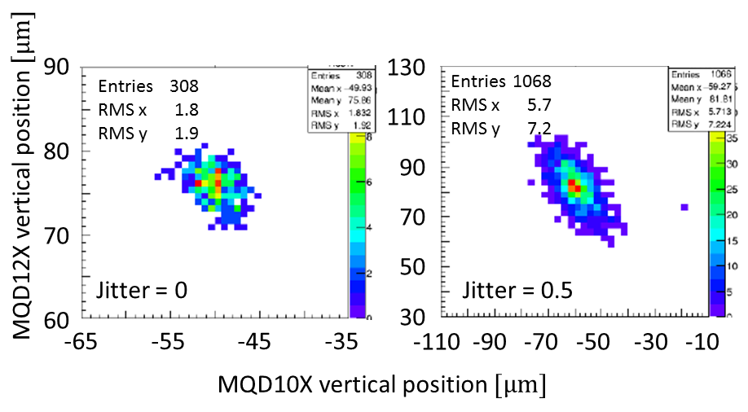
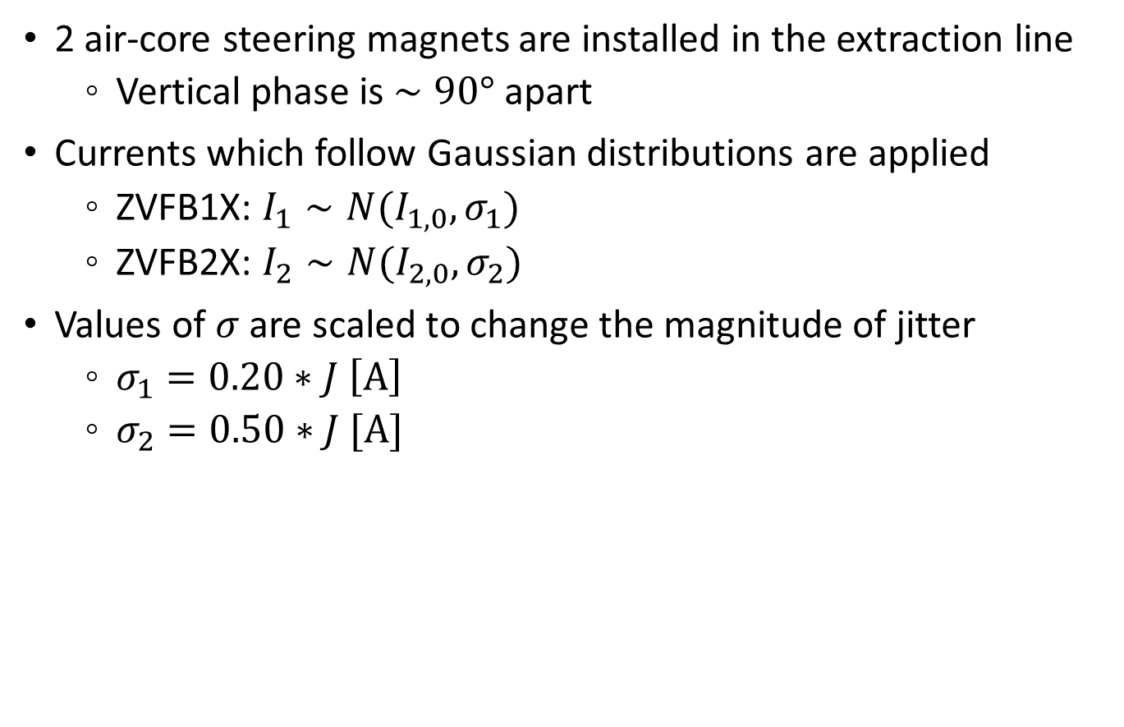
Jitter generation using steering magnets
2 air-core steering magnets are installed in the extraction line
  Vertical phase is $∼90°$ apart
Currents which follow Gaussian distributions are applied
  ZVFB1X: $I_{1}∼N(I_{1,0}, σ_{1})$
  ZVFB2X: $I_{2}∼N(I_{2,0}, σ_{2})$
Values of $σ$ are scaled to change the magnitude of jitter
  $σ_{1}=0.20∗J \left[A\right]$
  $σ_{2}=0.50∗J [A]$
(plots by Okugi-san)

Slide 13
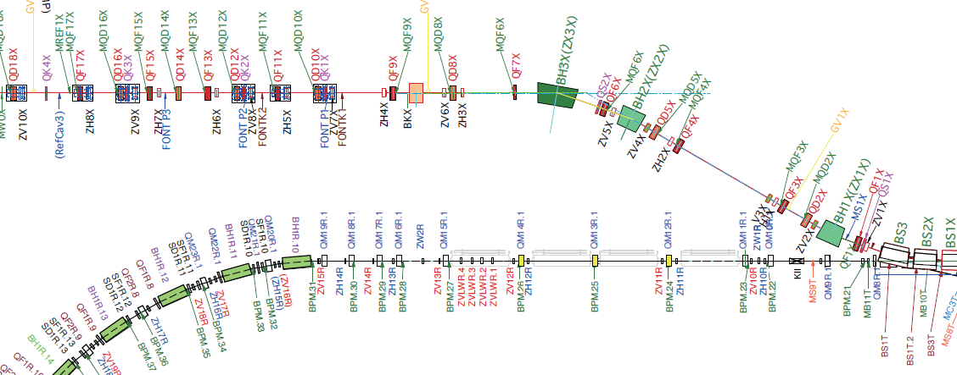
Placement
Vertical steering magnets
Extraction line
FONT stripline BPMs and kickers
Damping Ring

Slide 14
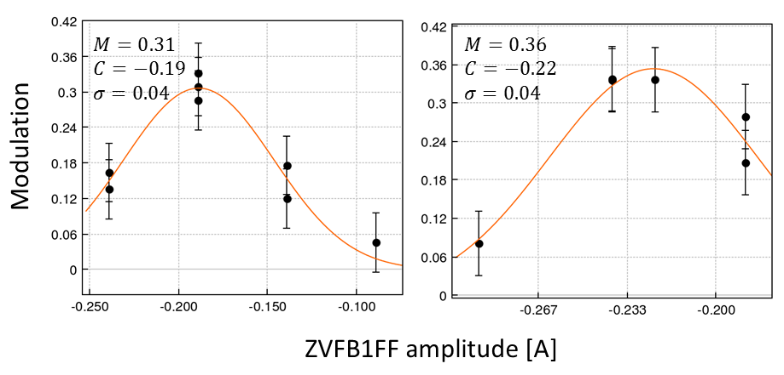
Procedure
ZVFB1FF amplitude tuning was done, before doing measurements with feedback on/off
  ZVFB1FF: vertical steering magnet in the FF
  This is because the center value of the vertical beam position may change, using FONT feedback
Thus, the condition of measurements with feedback on/off is not completely the same
Feedback off
Feedback on

Slide 15
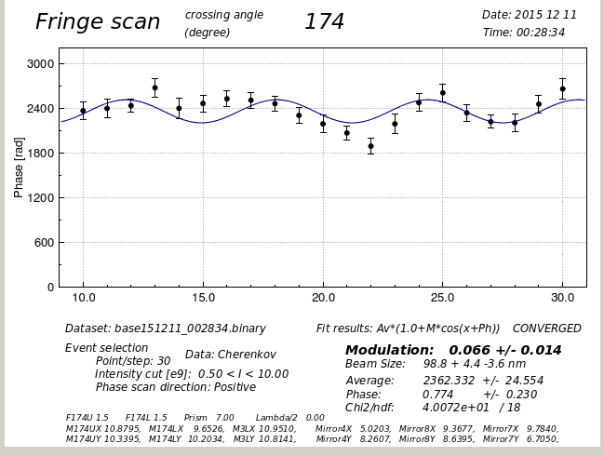
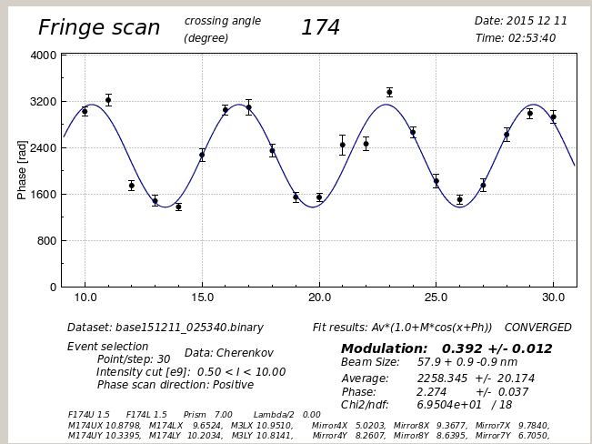
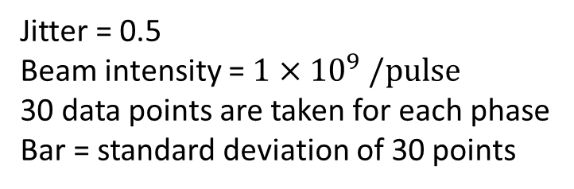
IPBSM 174 deg mode measurement
Feedback off
Feedback on
Cherenkov detector signal [CH]
Phase [rad]
Jitter = 0.5
Beam intensity = $1×{10}^{9} /pulse$
30 data points are taken for each phase
Bar = standard deviation of 30 points

Slide 16
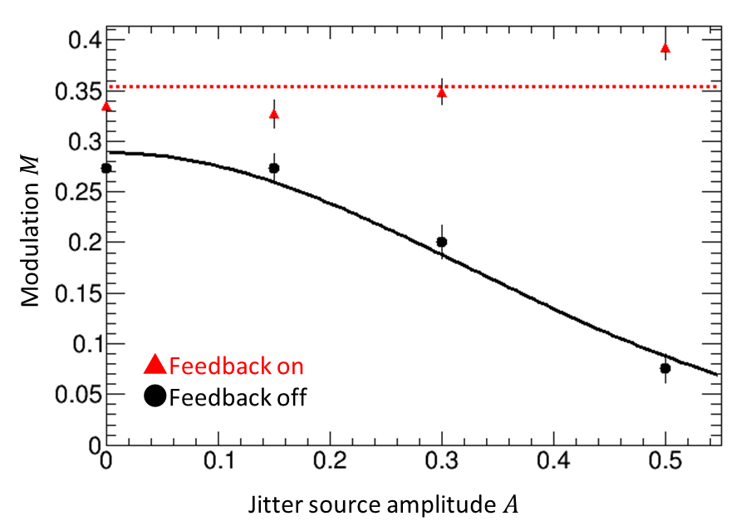

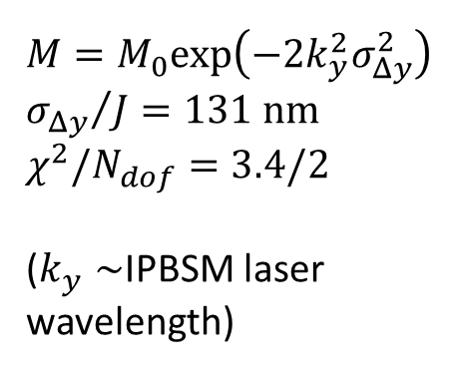

Jitter source amplitude dependence
$$Bar = fit error$$
Standard deviation= 0.03
Modulation
$M=M_{0}exp\left(−2k_{y}^{2}σ_{Δy}^{2}\right)$
${σ_{Δy}}/J=131 nm$
$χ^{2}/N_{dof}=3.4/2$
($k_{y}∼$IPBSM laser wavelength)
Jitter source amplitude $J$
Notes:
M=0.29+-0.01

Slide 17
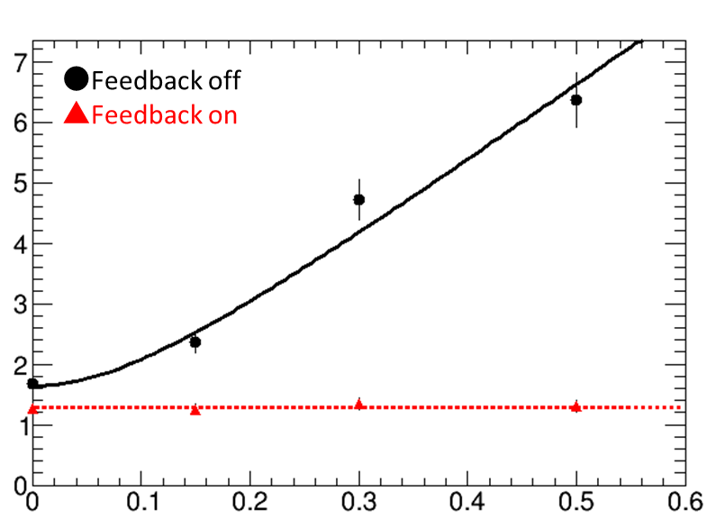
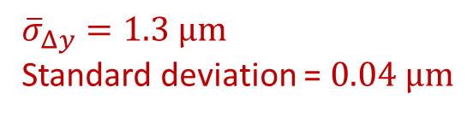

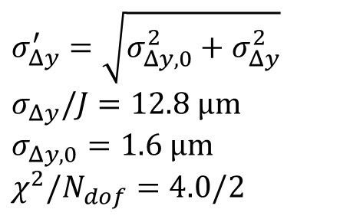

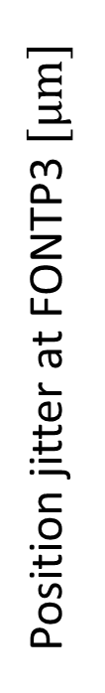
Position jitter at FONTP3
$$Bar=jitter/\sqrt{2\left(100−1\right)}$$
$σ_{Δy}^{′}=\sqrt{σ_{Δy,0}^{2}+σ_{Δy}^{2}}$
$σ_{Δy}/J=12.8 μm$
$σ_{Δy,0}=1.6 μm$
$χ^{2}/N_{dof}=4.0/2$
Position jitter at FONTP3 $[μm]$
${\overline{σ}}_{Δy}=1.3 μm$
Standard deviation = $0.04 μm$
Jitter source amplitude $J$

Slide 18
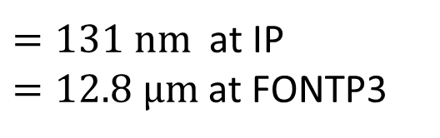
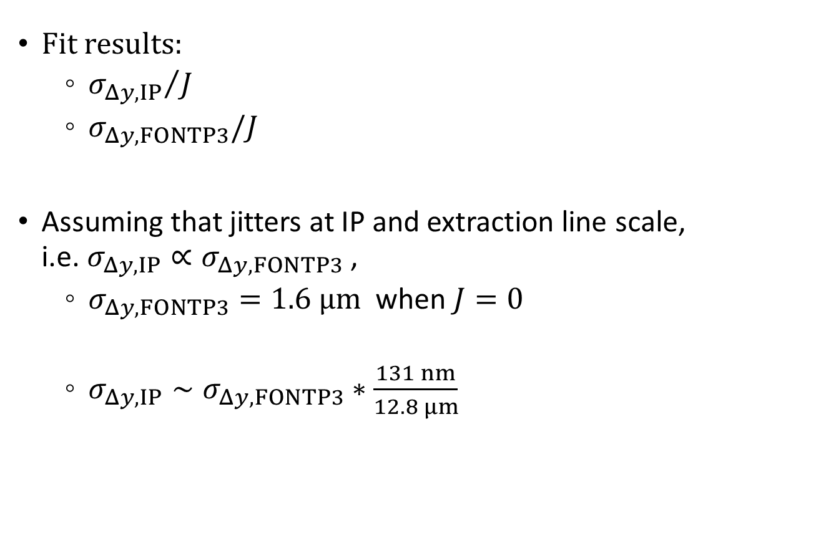
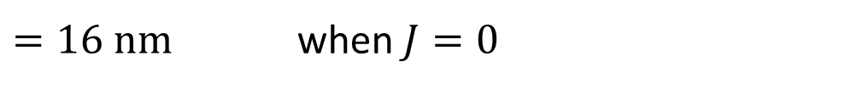
Rough assumption of jitter at IP
Fit results:
  ${σ_{Δy,IP}}/J$
  $σ_{Δy,FONTP3}/J$
Assuming that jitters at IP and extraction line scale, i.e. $σ_{Δy,IP}∝σ_{Δy,FONTP3}$ ,
  $σ_{Δy,FONTP3}=1.6 μm$ when $J=0$
  $σ_{Δy,IP}∼σ_{Δy,FONTP3}∗\frac{131 nm}{12.8 μm}$
  $=131 nm$ at IP
  $=12.8 μm$ at FONTP3
  $=16 nm$ when $J=0$

Slide 19
2. Beam intensity dependence study

Slide 20
Measurement
There is no jitter generation using steering magnets
Beam intensity was changed, then IPBSM measurement was done
  The resolutions of FONT stripline BPMs are expected to decrease
  Beam size is expected to increase
Tuning
  Before measurements with feedback off, extraction kicker amplitude tuning was done
  Before measurements with feedback on, ZVFB1FF amplitude tuning was done

Slide 21
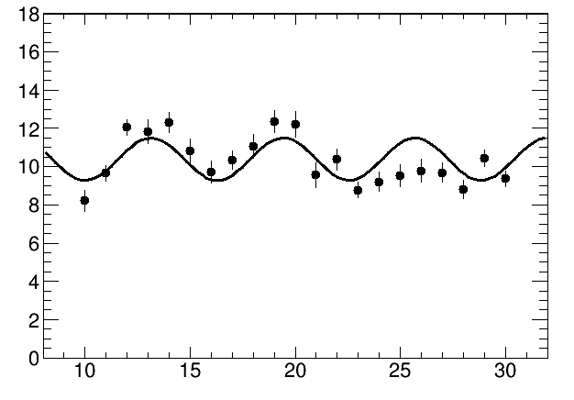
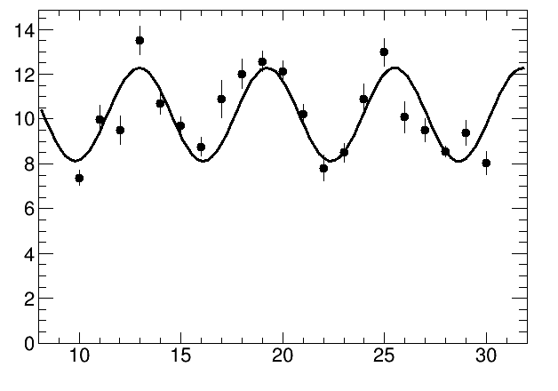
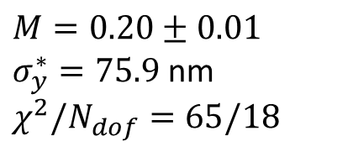
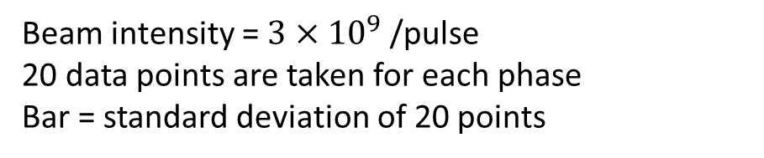
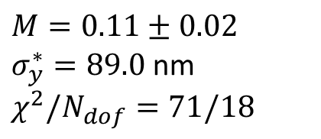
IPBSM 174 deg mode measurement
Feedback off
Feedback on
Cherenkov detector signal [a.u.]
$M=0.11±0.02$
$σ_{y}^{∗}=89.0$ nm
$χ^{2}/N_{dof}=71/18$
Phase [rad]
$M=0.20±0.01$
$σ_{y}^{∗}=75.9$ nm
$χ^{2}/N_{dof}=65/18$
Beam intensity = $3×{10}^{9}$ /pulse
20 data points are taken for each phase
Bar = standard deviation of 20 points

Slide 22
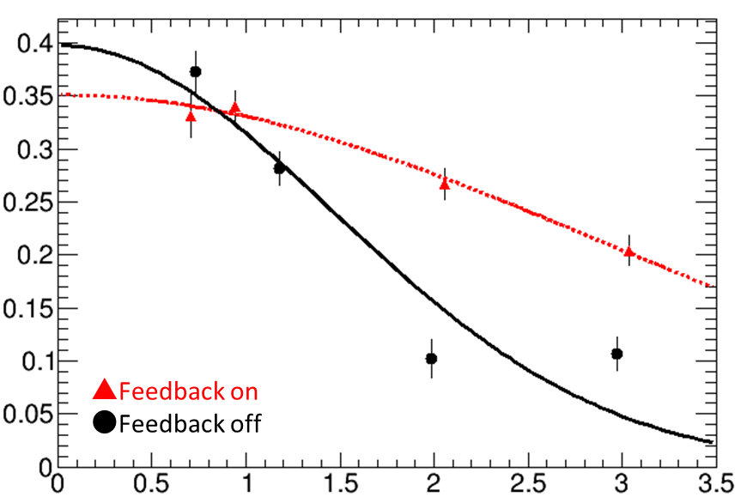
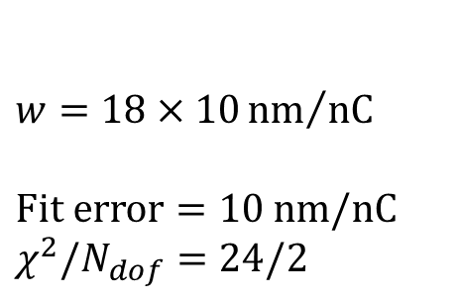

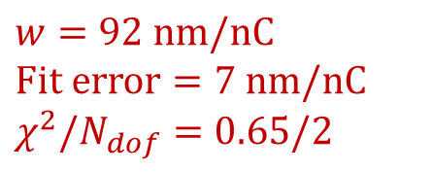


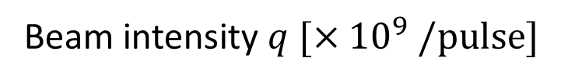

Beam intensity dependence
$$Bar = fit error$$
$$M=M_{0}exp\left[−2{\left(k_{y}wq\right)}^{2}\right]$$
$w=92 nm/nC$
$Fit error=7 nm/nC$
$χ^{2}/N_{dof}=0.65/2$
$$(15 nm/1e9)$$
Modulation
$w=18×10{nm}/{nC}$
$Fit error=10 nm/nC$
$χ^{2}/N_{dof}=24/2$
$$(29 nm/1e9)$$
Beam intensity $q$ $[×{10}^{9} /pulse]$

Slide 23
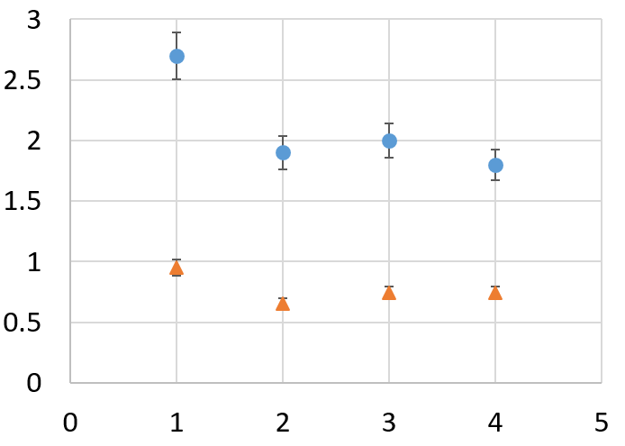

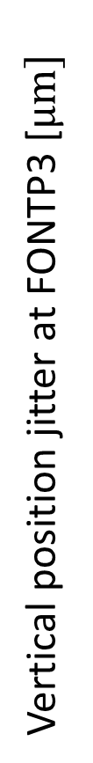

Position jitter at FONTP3
$$Bar=jitter/\sqrt{2\left(100−1\right)}$$
Vertical position jitter at FONTP3 [$μm]$
Beam intensity $[×{10}^{9} /pulse]$

Slide 24
Summary
As a study of IP beam orbit stabilization using FONT upstream feedback, 2 measurements were done:
  Study with jitter generation by steering magnets
  Study of beam intensity dependence
Vertical beam orbit at the IP is stabilized by several 10s of nm
Closer investigation is probably needed to verify the result of the beam intensity dependence of upstream feedback

Slide 25
Backup

Slide 26
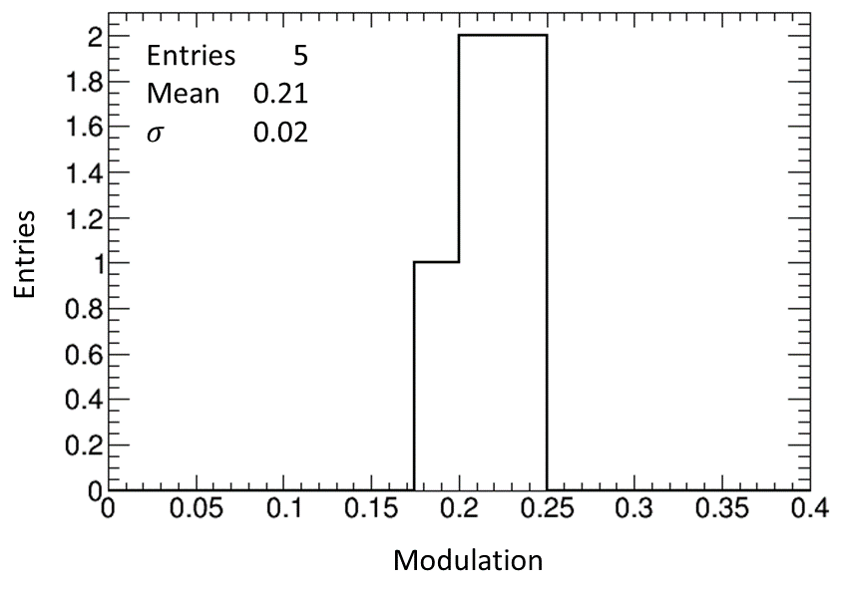
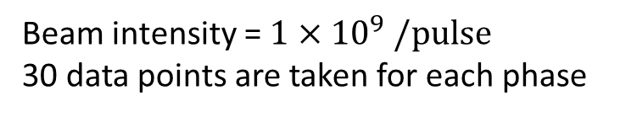
Result of consecutive measurements when jitter=0.3
Beam intensity = $1×{10}^{9} /pulse$
30 data points are taken for each phase

Slide 27
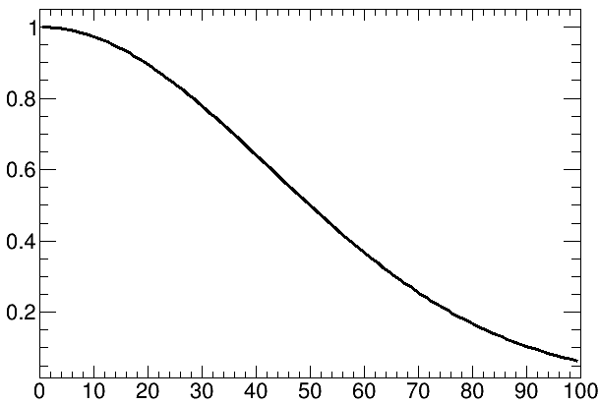

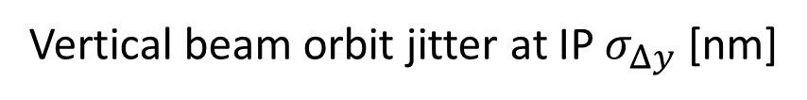
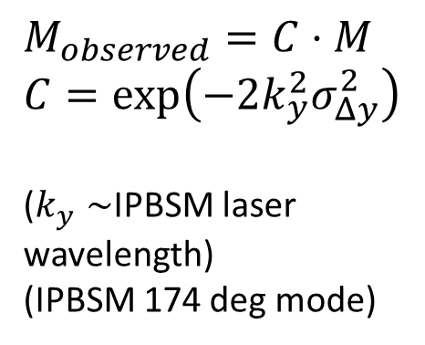
Calculation of Modulation reduction factor by vertical beam orbit jitter
$M_{observed}=C⋅M$
$C=exp\left(−2k_{y}^{2}σ_{Δy}^{2}\right)$
($k_{y}∼$IPBSM laser wavelength)
(IPBSM 174 deg mode)
Modulation reduction factor $C$
Vertical beam orbit jitter at IP $σ_{Δy}$ [nm]

